Slide 1
Never work again – Tools for financial freedom
Lars von Fromberg & Cornelius Koller
Notes:
21

Slide 2
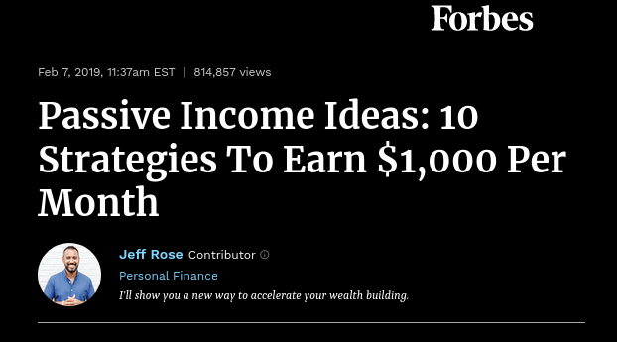

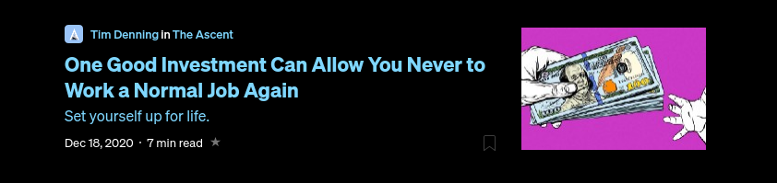

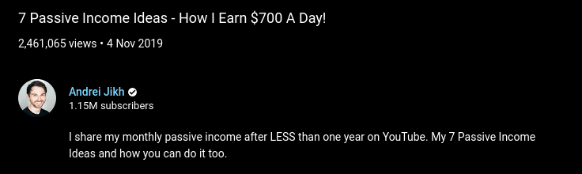
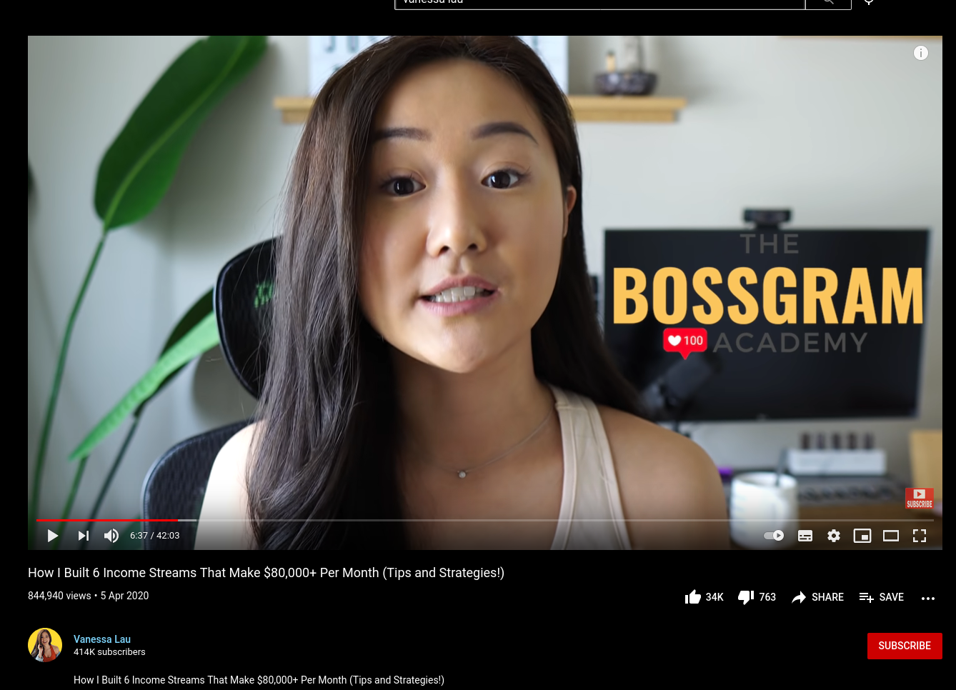
Apparently, everybody wants (you) to get rich
Source of content: medium.com, forbes.com, youtube.com, businessinsider.de
Notes:
The internet is full of more or less competent advice on how to get rich one way or another. The screenshots here are from relatively serious publications like forbes, business insider or medium. But also from YouTube.
This spawn
Source of content: Own thoughts
21

Slide 3
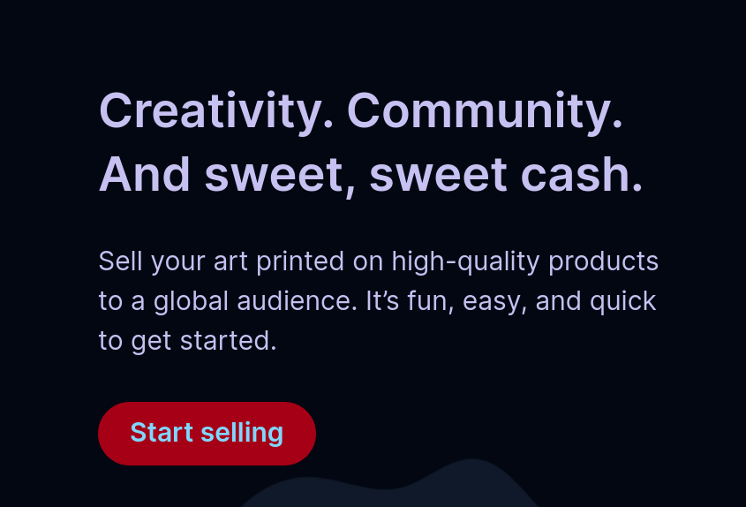
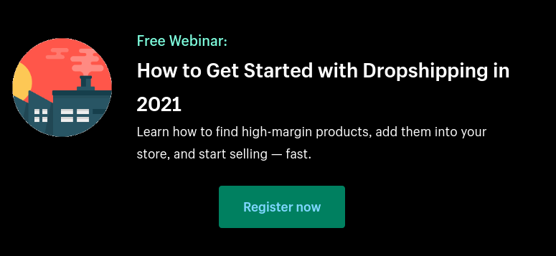

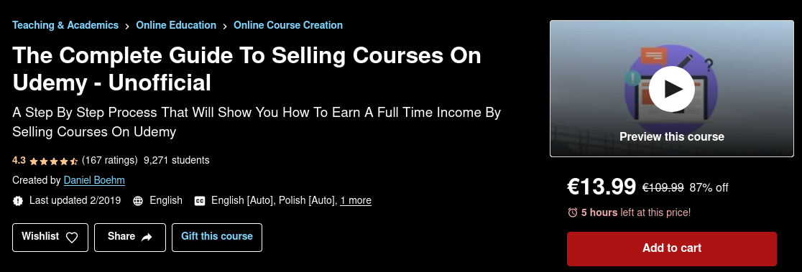
You could invest your time...
Or both, see next slide
Source of content: medium.com/earn, www.redbubble.com/about/selling, www.shopify.com/blog/dropshipping-niches, www.udemy.com/course
Notes:
There exist several to “earn money on the internet”. These mostly include blogging / writing, selling digital products like courses or niche physical products. The latter include print-on-demand shops,
art-related things or dropshipping.
Source of content: Own thoughts
21

Slide 4


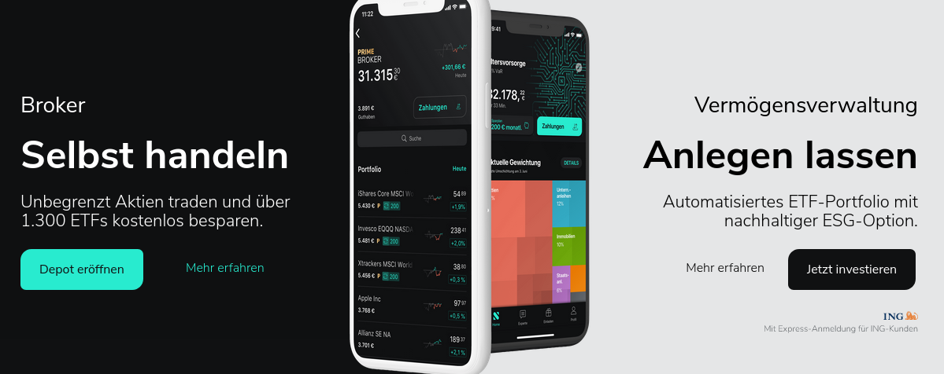
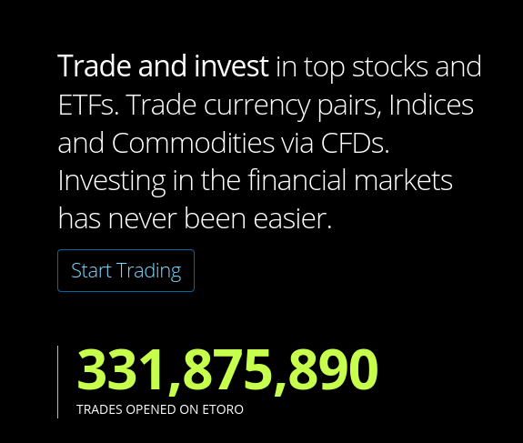
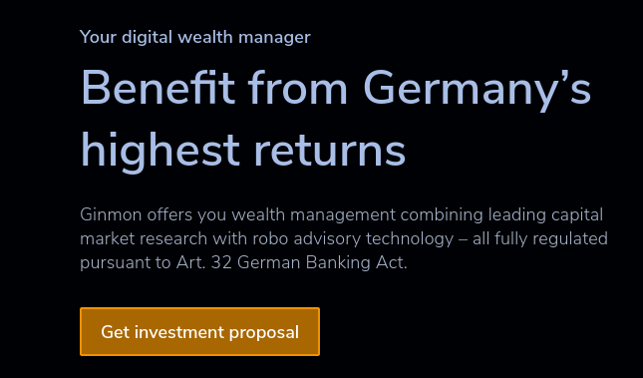

... or your money
No Free Lunch.
Source of content: robinhood.com, wealthfront.com, https://de.scalable.capital, etoro.com, ginmon.de, deutsche-bank.de
Notes:
An astonishing amount of different offerings regarding personal wealth management by robo-advisory and online brokers appeared on the market in the last few years. These screenshots show a small excerpt.
21

Slide 5
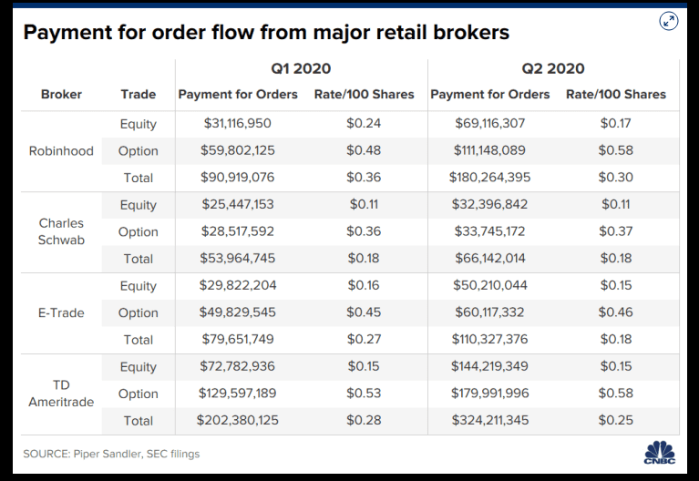
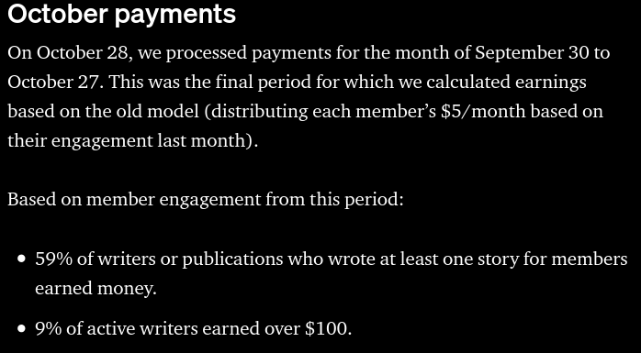
However, there is no free lunch
‘No direct commission’ does not mean ‘free’.
‘earning money’ does not mean ‘living wage’.
Source of content: https://www.cnbc.com/2020/08/13/how-robinhood-makes-money-on-customer-trades-despite-making-it-free.html https://blog.medium.com/october-update-from-the-partner-program-f6cf8216a6d8
Notes:
However, there are several caveats to all of this.
For example, most “commission-free” brokers earn a majority of their income through order-routing, receiving a commission from the order recipient. Therefore, the broker has a hidden incentive to promote products with hire routing commissions and the user probably pays for the service via increased quote prices.
In the “invest your time”-sphere of passive income, there is a huge leap between earning a bit of cash on the side and actually living off of it. Opportunity cost may to taken into account.
21

Slide 6
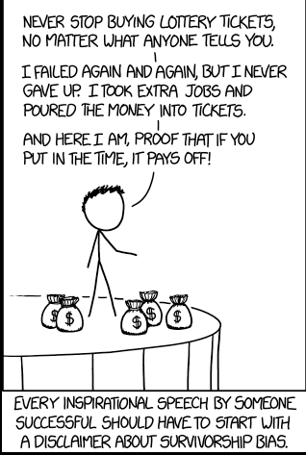
New tech, old biases
Source of content: https://xkcd.com/1827/

Slide 7

Initial Clustering
Source of image: Stux from pixabay.
Notes:
21

Slide 8
Initial clustering of Fintech Services
StashAways
Robinhood
Automated AirBnb**
ginmon
eToro
Coinbase*
Kraken*
Redbubble
Betterment
Scalable Capital
Dropshipping
Etsy
Public.com
Trade Republic
E*Trade
Yieldstreet
Medium
Estimize
WealthFront
ginmon
Fidelity
Ameritrade
Collectable
Doorvest
Portfolio Management
Market Access
e.g. Brokers
Non-stock exchange Passive Income
* Crypto currency broker **Technique, not a company name;
Source of content: Own thoughts; General internet search
Notes:
In my opinion, education is changing. While, for example, in the past, and in some cases even today, degrees are still essential, in the future, credentials will become more important than degrees. Specifically, personal recommendations can be more valuable in telling whether someone is suitable for a job than degrees obtained at a university.
Source of content: Own thoughts
21

Slide 9
Theoretical Background
Source of image: Stux from pixabay.
Notes:
21

Slide 10
Three core ideas
Invest your money
Invest your time
Combination of both
Source of content: Own thoughts; Source of image: Own illustration
Notes:
In my opinion, education is changing. While, for example, in the past, and in some cases even today, degrees are still essential, in the future, credentials will become more important than degrees. Specifically, personal recommendations can be more valuable in telling whether someone is suitable for a job than degrees obtained at a university.
Source of content: Own thoughts
21

Slide 11
Three core business models
Percentage of Capital Gains
Order Flow Routing
Commission Fees
Source of content: Own thoughts; Source of image: Own illustration
Notes:
In my opinion, education is changing. While, for example, in the past, and in some cases even today, degrees are still essential, in the future, credentials will become more important than degrees. Specifically, personal recommendations can be more valuable in telling whether someone is suitable for a job than degrees obtained at a university.
Source of content: Own thoughts
21

Slide 12
Hypotheses
Source of image: Stux from pixabay.
Notes:
21

Slide 13
Hierarchy of Hypotheses related to biases
Underestimation of exponential growth
Reduced ability to defer gratification
Overestimation of social aspects
Reduced ability to utilize structured decision making
Underestimation of compound interest
Retail Investors ignore elements of portfolio mgmt
Retail Investors over-trade
Retail Investors under-diversify
BIAS 0
BIAS 1
BIAS 2
Source of content: Own thoughts; Source of graphic: Own graphic
Notes:
In my opinion, education is changing. While, for example, in the past, and in some cases even today, degrees are still essential, in the future, credentials will become more important than degrees. Specifically, personal recommendations can be more valuable in telling whether someone is suitable for a job than degrees obtained at a university.
Source of content: Own thoughts
21

Slide 14
Bias Navigator
Source of image: Stux from pixabay.
Notes:
<number>

Slide 15
Possible biases of retail investors seeking financial independence
Source of content: Own thoughts; Source of image: Own illustration
Notes:
In my opinion, education is changing. While, for example, in the past, and in some cases even today, degrees are still essential, in the future, credentials will become more important than degrees. Specifically, personal recommendations can be more valuable in telling whether someone is suitable for a job than degrees obtained at a university.
Source of content: Own thoughts
<number>

Slide 16
Tool Selector
Source of image: Stux from pixabay.
Notes:
<number>

Slide 17
The right tool for the job
Investment
Knowledge
Current Lifestyle
Current Wealth
Dependents
Time Horizon
Individual Goals
Source of content: Own thoughts; Source of image: Own illustration
Notes:
In my opinion, education is changing. While, for example, in the past, and in some cases even today, degrees are still essential, in the future, credentials will become more important than degrees. Specifically, personal recommendations can be more valuable in telling whether someone is suitable for a job than degrees obtained at a university.
Source of content: Own thoughts
<number>

Slide 18
Bias Navigator
Source of image: Stux from pixabay.
Notes:
<number>

Slide 20
Checklist
Source of image: Stux from pixabay.
Notes:
<number>

Slide 21
Please check the following bullet points before presenting
Does every slide utilize the font type Arial?
Do I stick to the guidelines concerning font size etc. (see slide 2)?
If I use another background color (e.g. black, green, etc.), which we encourage, have I used an element on the slide for this and not changed the background in the master?
Is all information in the footer removed (e.g., date, page number, session, presenter)?
Does every slide contain information on both image and content source (i.e., each slide must name at least one source – possibly “own illustration”)?
Are all sources added to the comment section as well?
Does each slide contain several concise sentences on what you would say when explaining this slide in the comment section, i.e. the “soundtrack” of each slide?
Are all my slides visually attractive, cool and creative?
Notes:
<number>

