Slide 1
Never work again – Tools for financial freedom
Lars von Fromberg & Cornelius Koller
Notes:
<number>

Slide 2

Introduction
Source of image: Stux from pixabay.
Notes:
<number>

Slide 3
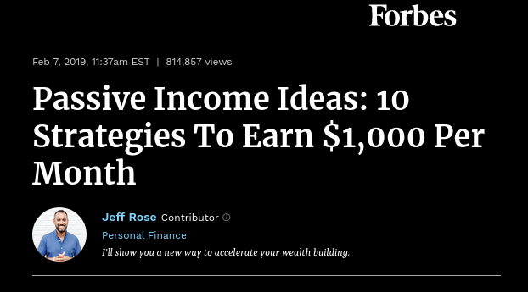
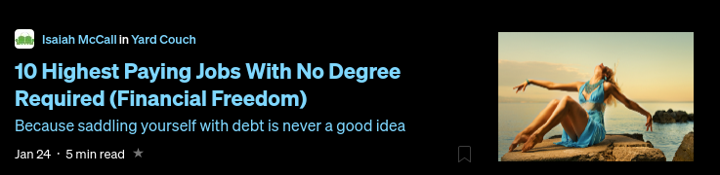
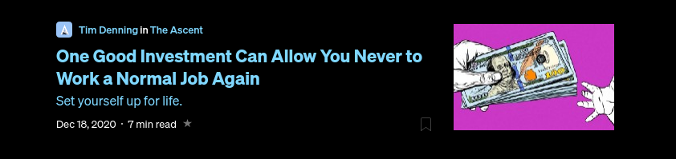

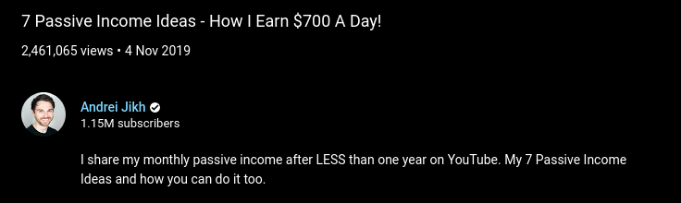
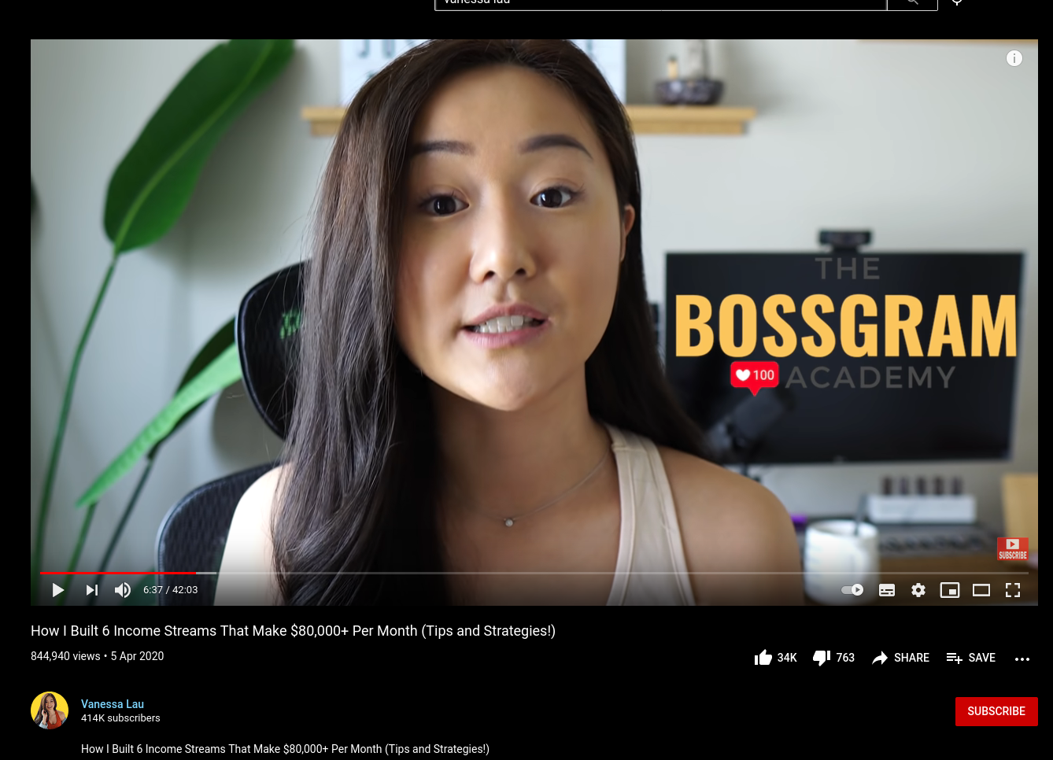
Apparently, everybody wants (you) to get rich
https://bit.ly/2LiFhcx
https://www.forbes.com/sites/jrose/2019/02/07/ passive-income-ideas-2019/
https://bit.ly/2YI89xN
https://bit.ly/2LhhHwG
https://www.youtube.com/watch?v=D0oB4aZsz6c
https://www.youtube.com/watch?v=rfb3gpNsy-4
Source of content: medium.com, forbes.com, youtube.com, businessinsider.de
Notes:
The internet is full of more or less competent advice on how to get rich one way or another. The screenshots here are from relatively serious publications like forbes, business insider or medium. But also from YouTube.
This spawns a classic signal vs. noise problem. Which techniques are actually promising and which are just part of the monetization strategy of someone else.
Source of content: Own thoughts, medium.com, youtube.com businessinsider.de, forbes.com
<number>

Slide 4
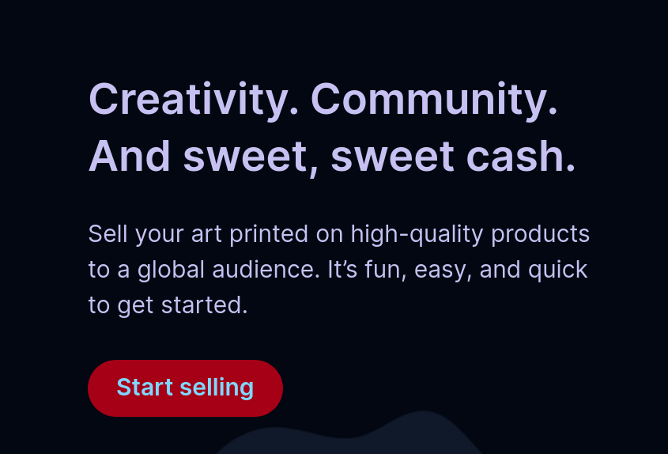
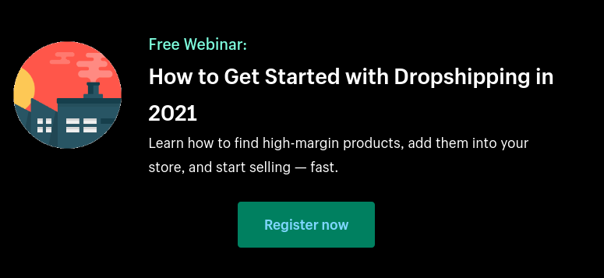
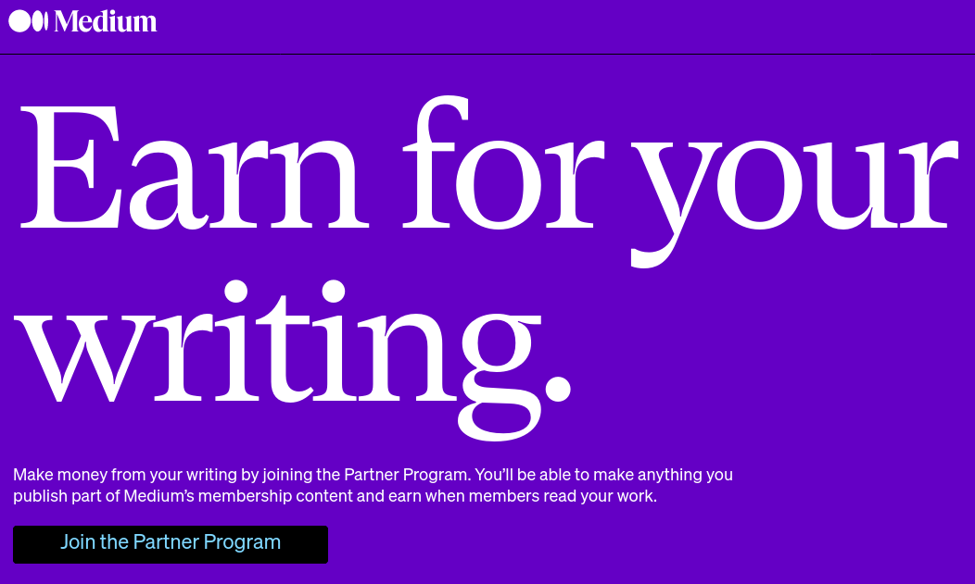
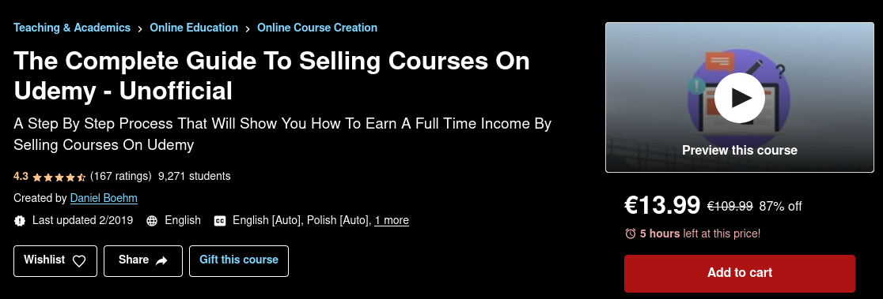
You could invest your time...
Or both, see next slide
Source of content: medium.com/earn, www.redbubble.com/about/selling, www.shopify.com/blog/dropshipping-niches, www.udemy.com/course
Notes:
There exist several to “earn money on the internet”. These mostly include blogging / writing, selling digital products like courses or niche physical products. The latter include print-on-demand shops, art-related things or dropshipping.
However, they all have in common that you primarily invest your time
Source of content: medium.com/earn www.redbubble.com/about/selling www.shopify.com/blog/dropshipping-niches, www.udemy.com/course
<number>

Slide 5
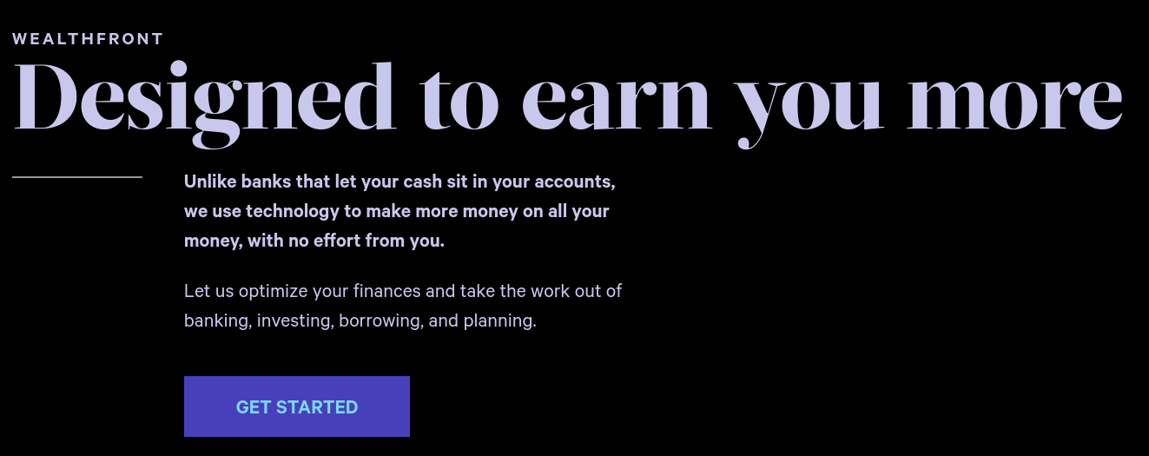
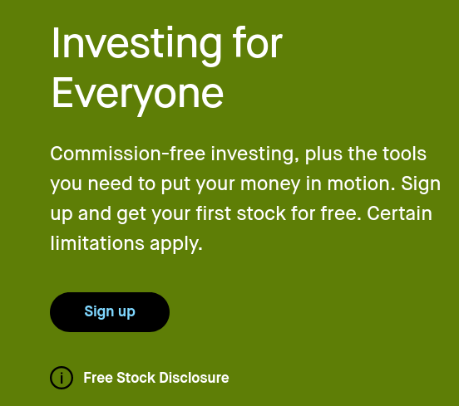
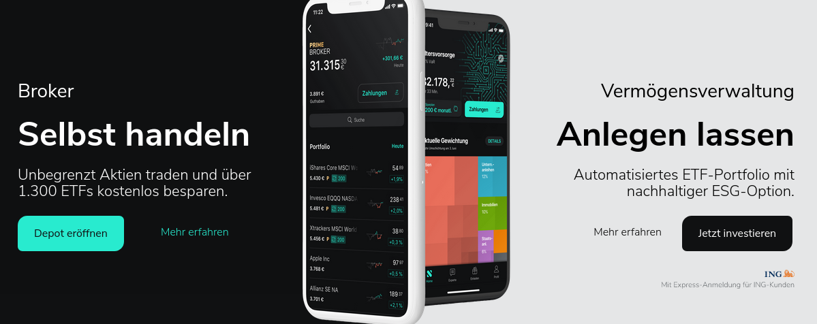
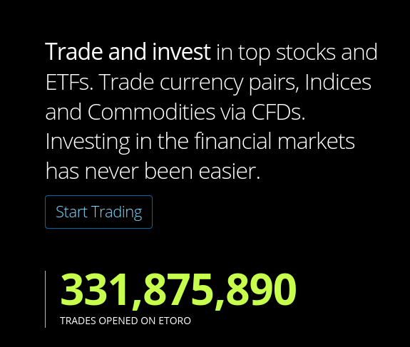
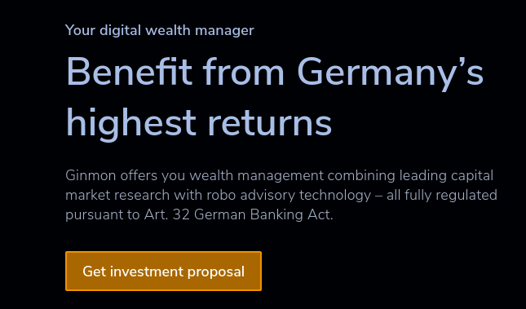

... or your money
Source of content: robinhood.com, wealthfront.com, https://de.scalable.capital, etoro.com, ginmon.de, deutsche-bank.de
Notes:
On the other side, users can just let their money work for them. An astonishing amount of different offerings regarding personal wealth management by robo-advisory and online brokers appeared on the market in the last few years. These screenshots show a small excerpt. Overall it’s safe to say that personal wealth management got significantly more attainable over the last few years.
Sources: robinhood.com, wealthfront.com, https://de.scalable.capital, etoro.com, ginmon.de, deutsche-bank.de
<number>

Slide 6
Initial clustering of Fintech Services
StashAways
Robinhood
Automated AirBnb**
ginmon
eToro
Coinbase*
Kraken*
Etsy
Redbubble
Betterment
Public.com
Scalable Capital
Dropshipping**
Trade Republic
E-Trade
Yieldstreet
Online Ads**
Medium
Estimize
WealthFront
growney
Fidelity
Ameritrade
Collectable
Doorvest
Portfolio Management
Market Access
e.g. Brokers
Non-stock exchange Passive Income
* Crypto currency broker **Technique, not a company name;
Source of content: Own thoughts and memory, General internet search
Notes:
This is the initial clustering of companies and their respective offerings and non-stock exchange techniques. Generally speaking, this illustration is not backed by academic research and should be considered an initial best guess according to self-descriptions of companies and general information on the internet.
Source of content: Own thoughts, couchbase.com, general internet search
<number>

Slide 7
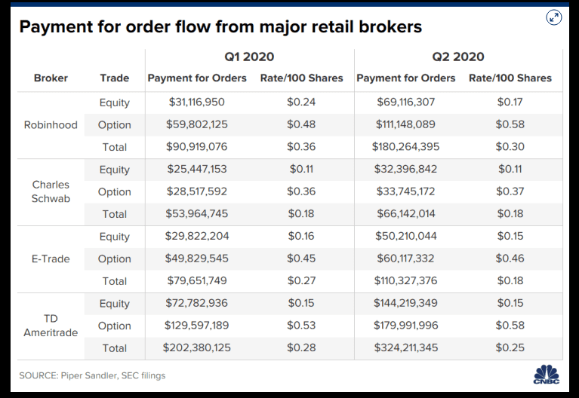
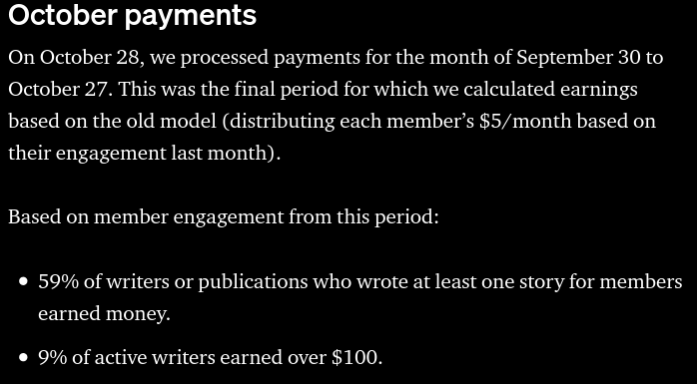
No Free Lunch
‘No direct commission’ does not mean ‘free’.
‘earning money’ does not mean ‘living wage’.
Source of content: https://www.cnbc.com/2020/08/13/how-robinhood-makes-money-on-customer-trades-despite-making-it-free.html https://blog.medium.com/october-update-from-the-partner-program-f6cf8216a6d8
Notes:
However, there are several caveats to all of this, which more or less boil down to “No Free Lunch”. Everything comes at a (hidden) cost:
For example, most “commission-free” brokers earn a majority of their income through order-routing, receiving a commission from the order recipient. Therefore, the broker has a hidden incentive to promote products with hire routing commissions and the user probably pays for the service via increased quote prices.
In the “invest your time”-sphere of passive income, there is a huge leap between earning a bit of cash on the side and actually living off of it. Opportunity cost may have to be taken into account.
Source of content: https://www.cnbc.com/2020/08/13/how-robinhood-makes-money-on-customer-trades-despite-making-it-free.html https://blog.medium.com/october-update-from-the-partner-program-f6cf8216a6d8
<number>

Slide 8
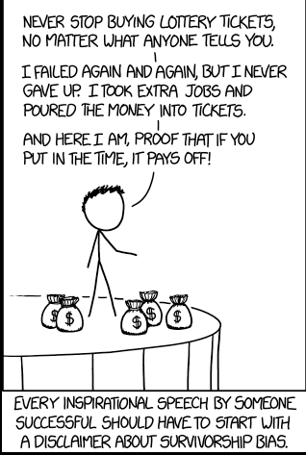
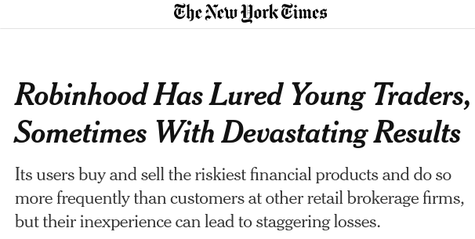
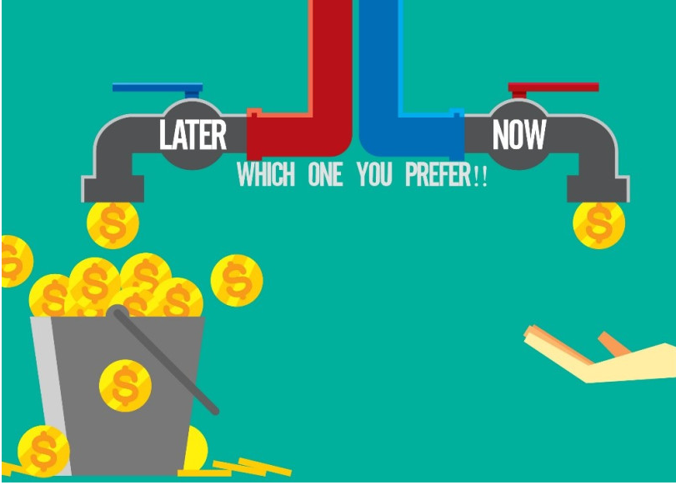
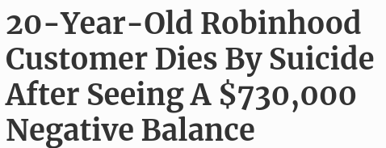
New tech, old biases
Survivorship Bias
Deferred Gratification
Media coverage of unfortunate events related to Robinhood trading
Retail Investors usually lose money in day-trading (Malinova et. Al 2013).
A study on day traders in Taiwan found that less than 1% of traders actually can reap abnormal returns in a predictive and reliable manner (Barber et al. 2014).
We assume that survivorship bias induced by influencer and social media culture may play a role
The general “instant everything” internet culture may also trickle down into investment decisions.
Source of content: Own thoughts, https://xkcd.com/1827/, https://idyahive.com/2017/07/14/delayed-gratification-path-to-riches/, https://www.nytimes.com/2020/07/08/technology/robinhood-risky-trading.html, https://www.forbes.com/sites/sergeiklebnikov/2020/06/17/20-year-old-robinhood-customer-dies-by-suicide-after-seeing-a-730000-negative-balance/ Malinova, K., Park, A. & Riordan, R. (2013) Shiftings Sands: High Frequency, Retail and Institutional Trading Profits over Time Barber. B.M., Lee, Y., Liu, Y., & Odean, T. The cross-section of speculator skill: Evidence from day trading
Notes:
There is no such thing as a perfectly rational investor. People are usually suscept to common cognitive biases. Given internet and influencer culture, we assume that survivorship bias plays an important, as those who “made it” tend to communicate their success on the internet at an above-average frequency.
Generally speaking, the statistics and prior research are not in favor of aspiring retail day traders.
Furthermore, we suspect that the instant gratification culture spawned by social media could trickle down into a given user’s investment decisions, thus inducing a bias related to deferred gratification and hyperbolic discounting.
In combination, this could have led to the events depicted on the right, which are, in the broadest sense, related to retail investors day trading without knowing what they are doing.

Slide 9
Hypotheses
Source of image: Stux from pixabay.
Notes:
<number>

Slide 10
Hierarchy of Hypotheses
Users over-trade, racking up fees
Users under-diversify, racking up uncompensated risk
Users choose inappropriate strategies for their specific situation
Users overestimate their understanding of markets / techniques
Users do not choose efficient-frontier portfolios
Users waste resources (time, money) on ultimately unsuccessful efforts
Users do not pick the right option for their specific situation
→ Tools and Techniques can not be rated in isolation → Requirement for a holistic approach to matching
Source of content: Own thoughts; Source of graphic: Own graphic
Notes:
There are several hypotheses that build on top of each other.
Fundamentally, there baseline hypotheses about user’s sub-optimal investment behaviours and views on non-financial passvive income techniques. These hypotheses stem from the aforementioned biases impacting user thoughts.
The middle layer depicts hypotheses related to more practical
research (e.g. easier to decline).
The last one is the ultimate consequence of everything above which leads us to our concrete prototype approach
Source of content: Own thoughts
<number>

Slide 11
Tool & Bias Navigator
Source of image: Stux from pixabay.
Notes:
<number>

Slide 12
The right tool for the job
Acquire Information
Generally explain cognitive biases
Weight & match biases according to user information
Recommend Tools / Techniques for a given user
Examples:
Examples:
Examples:
Examples:
Investment
Knowledge
Confirmation Bias → Are you looking for stock info that supports your guess?
”I want to get rich asap”
→ Deferred Gratification
Impatient people get no-interaction robo advisors, that force them to keep their hands off
Current Lifestyle
“I have no idea of stocks” → Dunning-Kruger effect
Current Wealth
Sunk Cost Fallacy → Are you investing further because the stock “can only go up from here”?
“Celebrity XY is so successful” → Survivorship Bias
Extremely risk-averse are recommended an ETF portfolio in order to achieve low-risk yields
“I don’t need retirement planning” → Plan continuation fallacy
Dependents
“My investment strategy doesn’t need an update” → Hot-hand fallacy
Time Horizon
Hyperbolic Discounting →Do you value cash at hand more than future opportunities?
Experienced traders may be recommended a low-fee brokerage service
Individual Goals
“I always hold” →Disposition effect
Source of content: Bias examples: own thoughts; Own illustration; Biases taken from https://en.wikipedia.org/wiki/List_of_cognitive_biases
Notes:
To determine the right tool for a given user there are four steps required in our prospect.
Firstly, we acquire user information via a questionnaire. Then, we generally explain potential biases to the user by using examples, in order to achieve a common understanding of the underlying and also to highlight that this is not a classic sales-oriented product selector.
The user is guided to the understanding that this is a different approach.
After that, we do an individual weighting / matching of the user’s answers and a database of common cognitive biases (which the aforementioned examples also stem from).
The final step combines these explanations into a concrete suitable tool recommendation.
Source of content: Own thoughts
<number>

Slide 13
The Antithesis
Source of image: Stux from pixabay.
Notes:
<number>

Slide 14
Explain Bias Exploitation
To emphasize the impact of (potential) biases, we build an inverse Tool selector which depicts the answer to “how to best exploit this user?”.
Acquire User Information
Infer potential biases
Weight potential biases
Determine the “worst” tool
Users are different, therefore it’s important to gauge which biases they may be impacted by
→ I am young, energetic and willing to take risks
User information may point to certain biases which then may point to certain investment behaviours like seeking leverage
→ I am impatient, I seek leverage to speed things up
Different biases “hit harder” depending on the business model behind an offering
→ If I profit off selling options, I have an interest to sell to people who seek leverage.
Contrary to the best tool,
There is potentially also a worst tool, that perfectly exploits the users biases
→ An impatient person may generate the most revenue if lead to very frequent trading
The core idea is to emphasize the “No Free Lunch Theorem”.
Everyone offering something has their own agenda, which may infer with a given users goals.
Source of content: Own thoughts; Own illustration
Notes:
The first recommendation step is relatively similar to common sales approaches based on product comparisons. In order to sharpen the users understanding, we also provide an antithesis e.g. the worst tool someone could opt in to. The process is generally the same, the main difference is the exploitative characteristic, preying on sub-conscious aspects of the user information and to a lesser extent on hard facts like disposable income.
It is yet to be determined whether the user questionnaire will be identical or slightly different.
Source of content: Own thoughts
<number>

Slide 15
Summary
Pro-user interpretation
Sharpen user’s understanding
Individual User
Individual Biases
Anti-user interpretation
By highlighting both sides of the coin, we can enhance the user’s understanding in a way that classic sales-oriented tool recommenders by design can not.
Source of content: Own thoughts; Own illustration
Notes:
By providing both views on the tools selection process, we can emphasize aspects like the seller’s position that traditional sales-oriented tool comparators, by design, can not deliver.
This holistic approach enables the user with unique insights and a different perspective on themselves and the market they act in.
Source of content: Own thougths

Slide 16
Notes:
<number>

Slide 17
Checklist
Source of image: Stux from pixabay.
Notes:
<number>

Slide 18
Please check the following bullet points before presenting
Does every slide utilize the font type Arial?
Do I stick to the guidelines concerning font size etc. (see slide 2)?
If I use another background color (e.g. black, green, etc.), which we encourage, have I used an element on the slide for this and not changed the background in the master?
Is all information in the footer removed (e.g., date, page number, session, presenter)?
Does every slide contain information on both image and content source (i.e., each slide must name at least one source – possibly “own illustration”)?
Are all sources added to the comment section as well?
Does each slide contain several concise sentences on what you would say when explaining this slide in the comment section, i.e. the “soundtrack” of each slide?
Are all my slides visually attractive, cool and creative?
Notes:
<number>

