Slide 1
Tri-Directional Speech
Group 3 (Aka Nerd Group)

Slide 2
What
Tri- directional speech
Allows the means of communication using only directions
Requires device and literacy

Slide 3
Who
Patients
Doctors
Nurses
First responders
Anyone

Slide 4
Tech
Database
SQLite
Device we will use
Joysticks
Game pads
WASD keys
Alphabet

Slide 5
Where
In the ambulance
In the ER
Inpatient
Outpatient

Slide 6
Why
Efficient and fast communication
Portable and easy to understand
Scenario or user story
A patient with no means of verbal communication
scenario

Slide 7
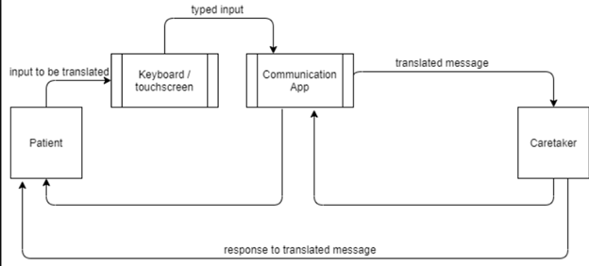
Context Diagram

Slide 8
KEY

Slide 9
Demo

Slide 10
QUESTIONS?

