Slide 1
Tri-Directional Speech
Group 3:
Marc Bauman
Kevin Coleman
Edmund Gonzales
Christian New

Slide 2
What
Tri- directional speech
Allows the means of communication using only directions
Requires device and literacy

Slide 3
Who
Patients
Doctors
Nurses
First responders
Anyone

Slide 4
Tech
Database
SQLite
Device we will use
Joysticks
Game pads
WASD keys

Slide 5
Where
In the ambulance
In the ER
Extended stays in the hospital

Slide 6
Why
Efficient and fast communication
Portable and easy to understand
A patient with no means of verbal communication

Slide 7
Medical Questions
Sample
Signs & Symptoms
Allergies
Medications
Past medical history
Last oral intake
Events leading up to
OPQRST
Onset
Provocation
Quality
Radiation
Severity
Timing

Slide 8
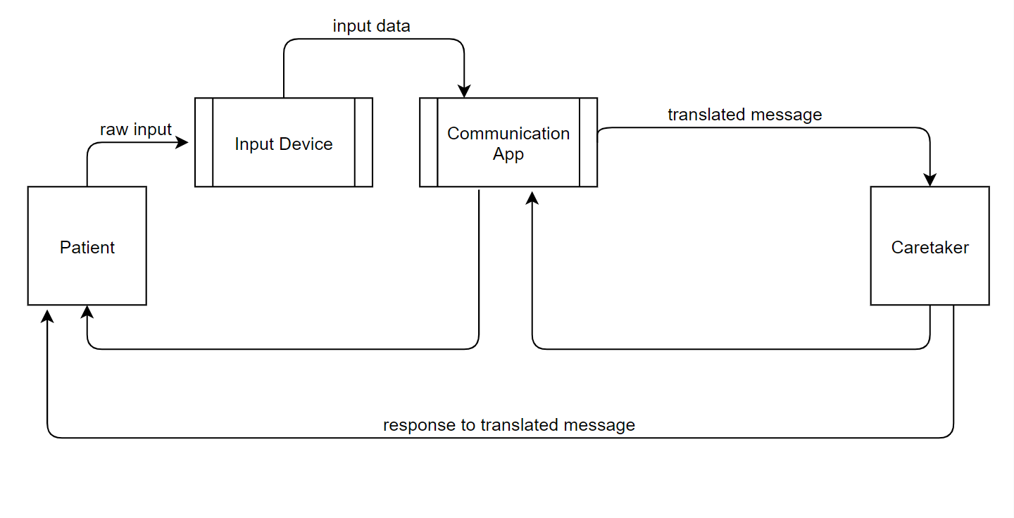
Context Diagram

Slide 9
Key

Slide 10
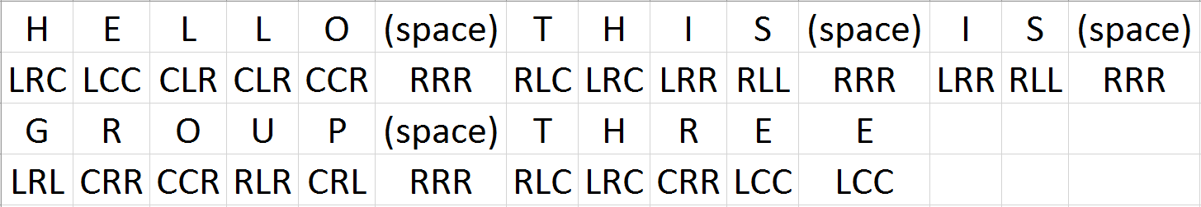
Demo
“Hello, this is Group Three!”

Slide 11

Demo

Slide 12
QUESTIONS?

Slide 13
Thank you for your time!

