Slide 1
Tri-Directional Speech
Group 3 (Aka Nerd Group)

Slide 2
What
Tri- directional speech
Allows the means of communication using only directions
Requires device and literacy

Slide 3
Tech
Database
SQLite
Device we will use
Joysticks
Game pads
WASD keys
Alphabet

Slide 4
KEY

Slide 5
Why
Efficient and fast communication
Portable and easy to understand

Slide 6
When
A patient with no means of verbal communication
scenario

Slide 7
Who
Patients
Doctors
Nurses
First responders

Slide 8
Where
In the ambulance
In the ER
In patient
Out patient

Slide 9
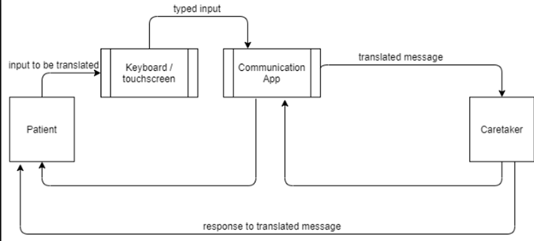
Context Diagram

Slide 10
Demo

Slide 11
QUESTIONS?

