Slide 1

ZNF768
ChIP-seq analysis
Christophe TAV, phd
Bioinformatic platform
Centre de recherche du CHU de québec – Université Laval
UPDATE
December 15th, 2025

Slide 2
E2F1 (in RAJI and U2OS cell lines)

Slide 3
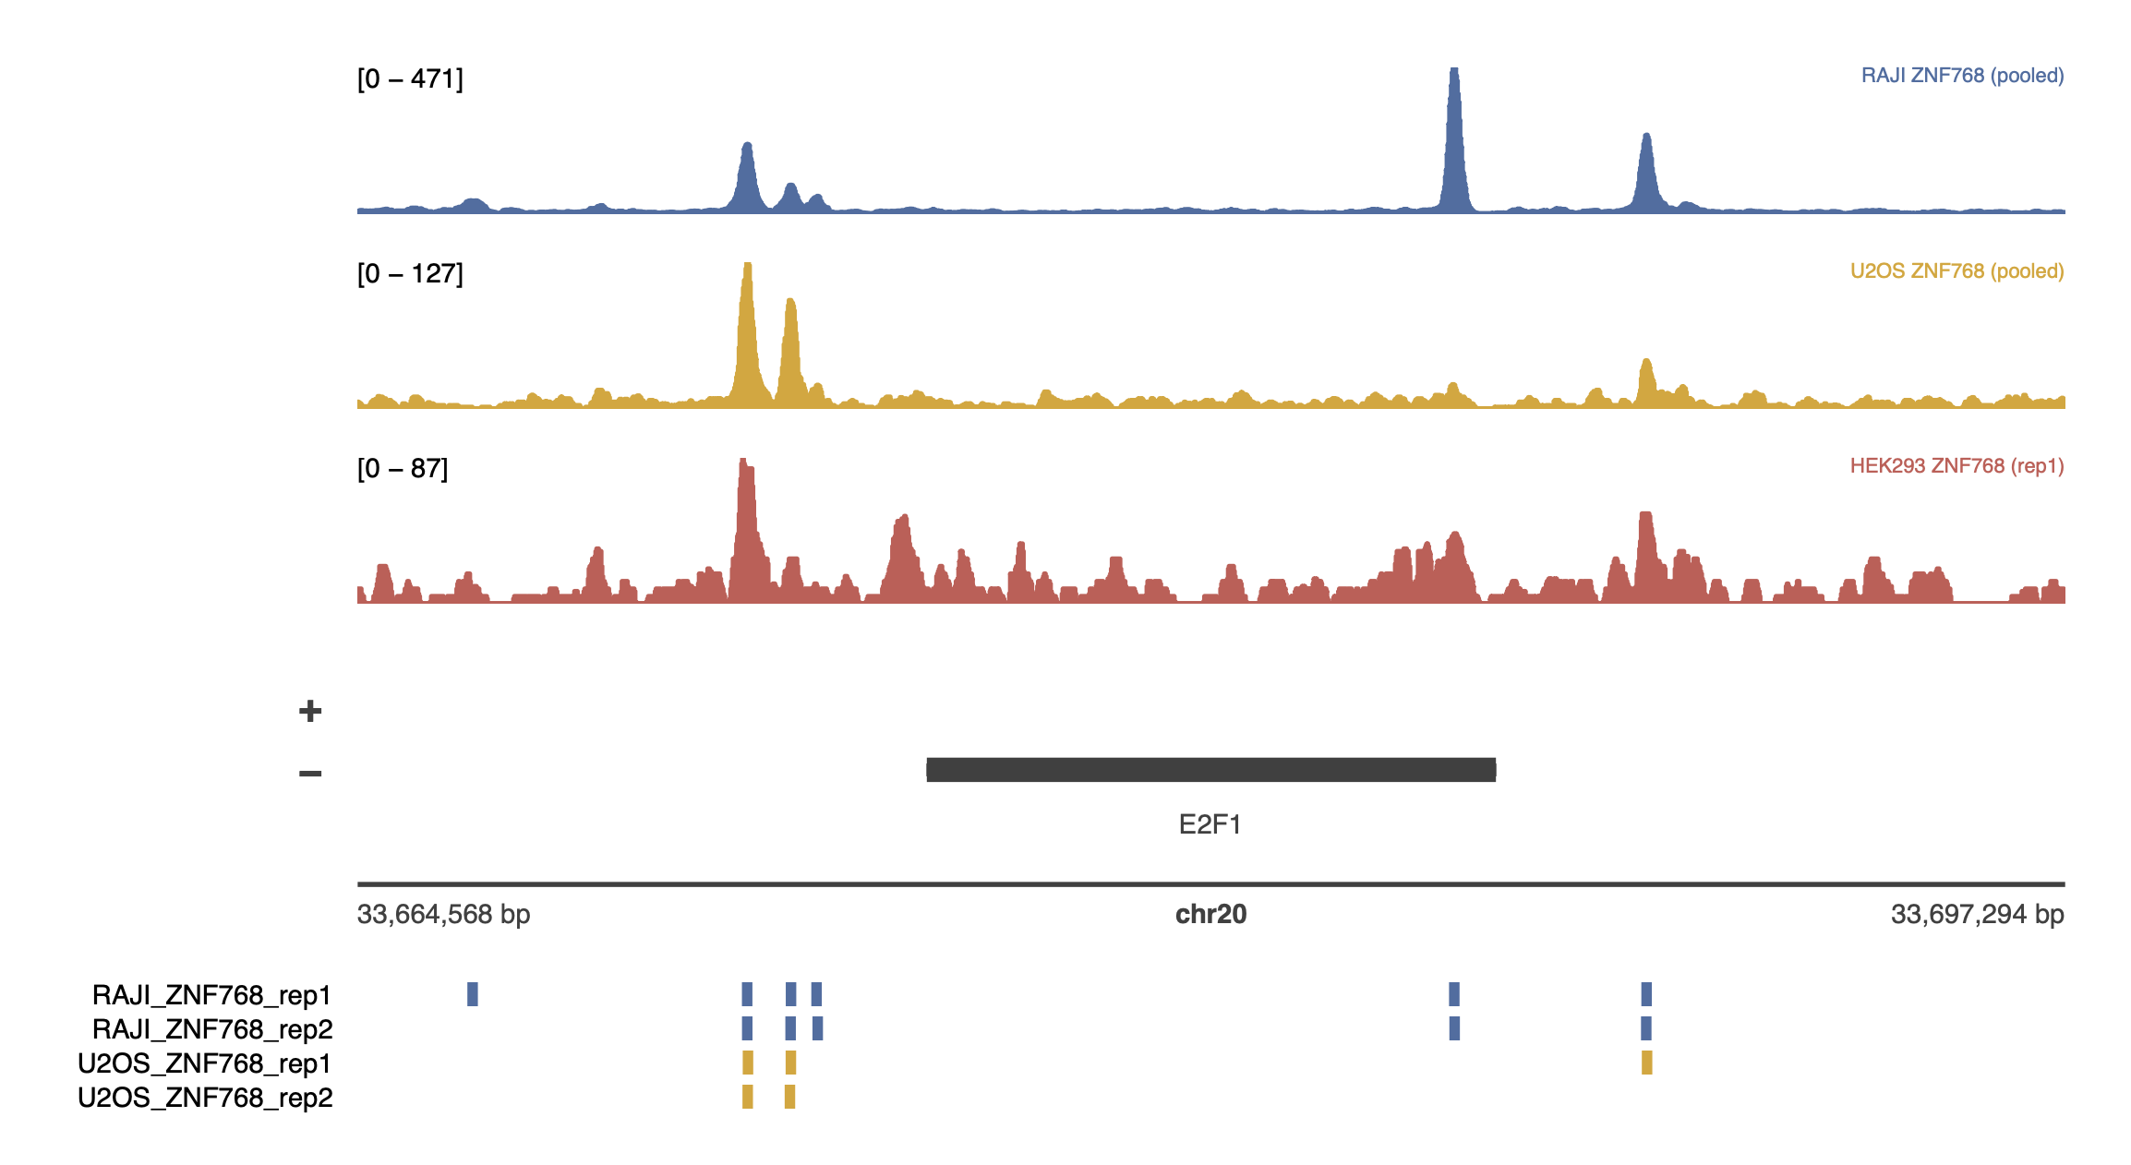
E2F1 (in RAJI, U2OS and HEK293 cell lines)
Tracks for other genes could be found here: https://github.com/ckntav/20250221_ZNF768_project/tree/main/output/analysis/tracks_plotgardener_3tracks

