Slide 1
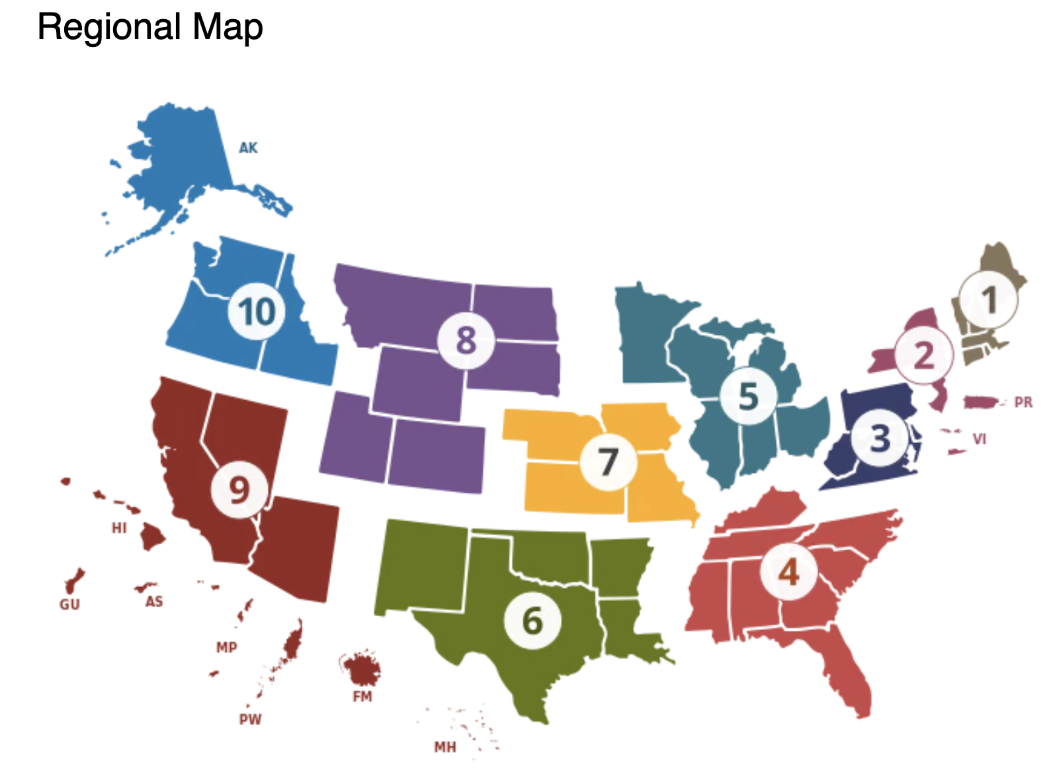
hss | color
1 | #827660
2 | #9E516C
3 | #393D69
4 | #BA514C
5 | #447586
6 | #687725
7 | #F1B142
8 | #71518C
9 | #873129
10 | #3879B0

