Slide 1
City apartment with many suburban features
Designed by: Clara Kodela
Software: Autodesk Revit 2019 Student Version.
License: MIT license.
Completed: June 15th 2019

Slide 2
This is a relatively small one-bedroom apartment with a large utility and laundry room, as well as a decent sized kitchen.
It has a balcony and a dining room as well as a living area just in front of the foyer.
It's only 500 square feet, because I wanted to see if I could implement all of the amenities of a typical suburban house into a more compact space that would allow it to be placed in a city.

Slide 3
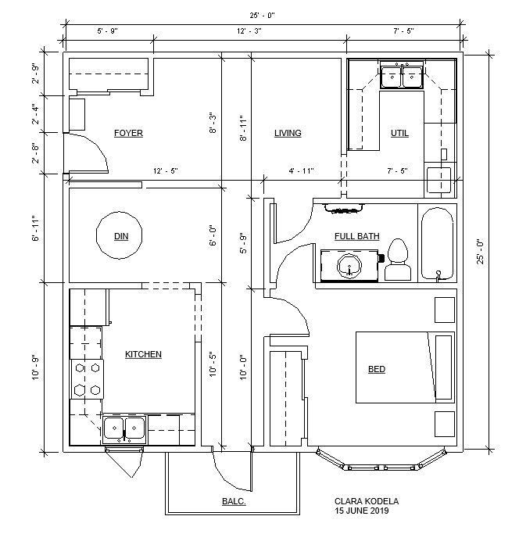
Floor Plan

Slide 4
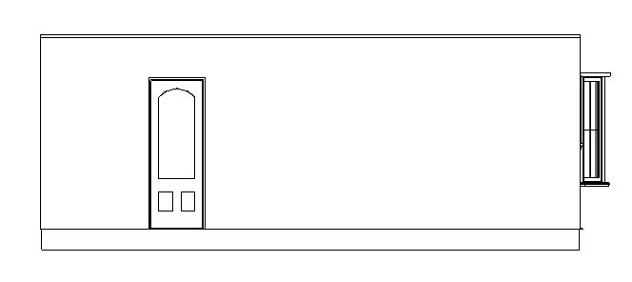
Front Elevation

Slide 5
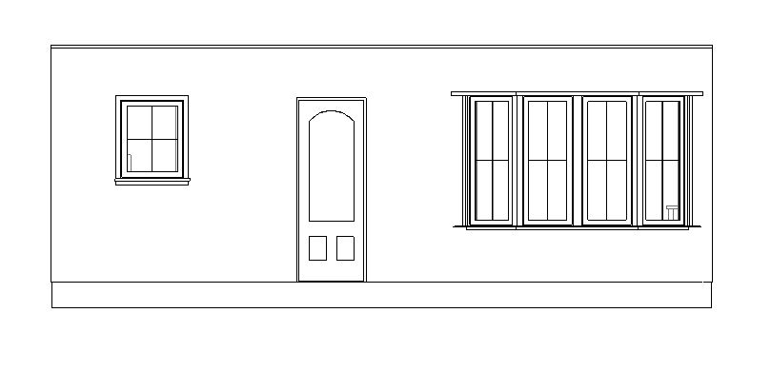
Rear Elevation

Slide 6
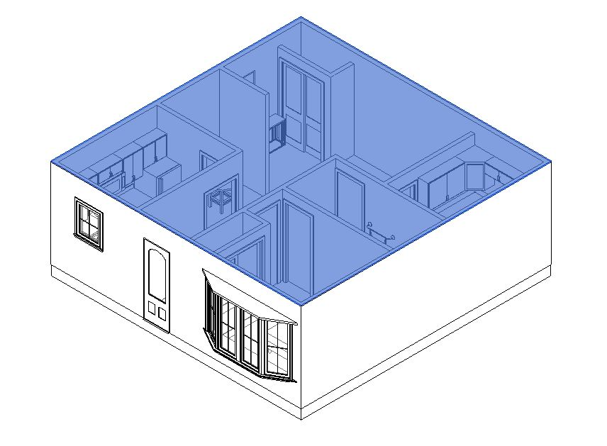
3D View

