Slide 1
CSCI 1320 Creating Modern Web Applications
Lecture 1: Course Introduction
Notes:
Jan 22, 2014

Slide 2

Problem
You have been hired to work on creating a web application for course registration, lets call it Banter.
What are the problems you would anticipate?
How would you proceed?
Notes:
After discussion – these are some of the things that will be covered in this course.

Slide 3
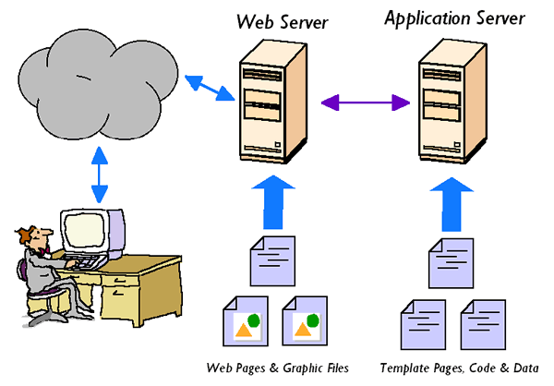
What is a Web Application
A program that the user interacts with through the Internet.
Interact via a browser
Using HTTP protocols
Where the program runs on a server
Where the program uses a database

Slide 4
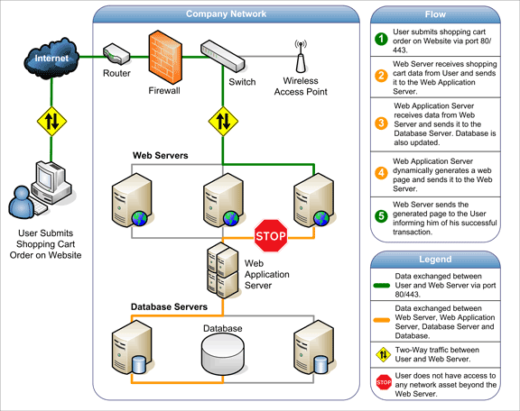
What is a Web Application
Name some web applications
Which you like to use
Which you don’t like to use
Examples
http://www.amazon.com
http://www.google.com
http://www.cs.brown.edu
http://conifer.cs.brown.edu/s6
http://eadotc.cs.brown.edu

Slide 5
Web Applications
Web Browser
Front End
HTTP
Database
Web Server
Back End
Server
Notes:
Use a web browser as the front end
Typically multiple (logical) pages
Back end server does significant processing
Database
Computation
Front and back ends interact via HTTP

Slide 6
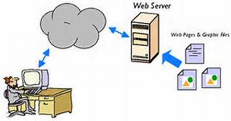
What is Not a Web Application
Static web pages
They can be part of an application however
Mobile (phone) applications
But they are very similar
In some cases they are web applications
Is SIRI a web application?
Much of what we do in this course applies to these too
Final projects may be mobile applications with a web component
Applications that use the web
My office sign uses Google calendar

Slide 7

What’s Involved in Web Apps
Requires understanding
The application, the users, and the needs of the users
Requires good design expertise
User interface design, usability, scalability, maintainability
Requires sophisticated programming skill
Handling 10,000 users; 3-5 9’s of up time; updatable
Requires programming expertise in several areas
Interactive (JavaScript, PHP, databases, …)
Large-scale server technology, distributed programming
Typically requires a development team
Programmers, designers, testers, users
Software Engineering

Slide 8

In This Course
You are going to build a real web application
For real users
In teams with mixed skills
You are going to learn the basics of web applications
Won’t become an expert in all of them
Will learn the alternatives, terminologies, etc.
Will learn enough to build your own application if desired
Will become an expert in some aspect for your project
You are going to learn to work in teams

Slide 9

CSCI1320 has Two Tracks
Concentrators Track (for concentration credit)
For CS students with programming background (CS32)
How necessary is CS32/CS33
CS32 is required for capstone credit
Emphasis on programming skills
Both in assignments and projects
Responsible for programming aspects of projects
Designers Track
For students with web design skills (html/JavaScript)
Emphasis on web design and learning how it can be used
Assignments are less programming oriented
Responsible for human-centric aspects of projects
Please email cs132headtas@cs.brown.edu

Slide 10
CS132 Has Two Tracks
Others Track
For students without significant programming experience
Who don’t know HTML/JavaScript
Who have little design experience
Notes:
Students in this track should talk to me or the TAs

Slide 11
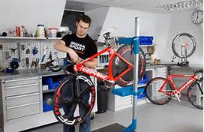
Course Mechanics
There are three parts to the course
Learning the fundamentals of web applications
Learning the basics of building web applications
Creating a web application for a client
Reflected in time commitment and grading

Slide 12

Fundamentals of Web Apps
There are lots of different web technologies
More than we can cover in one course in any depth
But a web app expert should know of them all
What they are, what they are good for, how they work, …
You need to know what to use
You need to be able to talk to clients and others
There are lots of things to consider in designing and building a web application
Security, human factors, universal access, …
You need to understand and deal with these

Slide 13

Fundamentals of Web Apps
Covered in lectures & labs
I’ll try to make this accessible to both tracks
Questions and comments are encouraged
PLEASE
Labs are interactive classes (held in the Sun Lab)
Checked w/ labs (10%) & final (15%)
All should be relatively easy if you come to class
Considering an optional midterm just before break
Final is on 5/14
Participation (3%)
Feedback on other’s projects and presentations

Slide 14
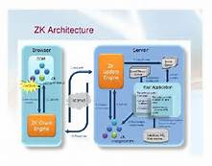
Basics of Building Web Apps
Understand a specific set of technologies
HTML/CSS
JavaScript
Node.JS (PHP) / SQL
Client-Server interaction (AJAX)
These will be covered by homework assignments
Each about one week long
Separate assignments for the two tracks
Count for 36% of your final grade

Slide 15

Web Application Project
We have gathered a suite of projects from real clients
Mix of commercial, non-profit, local
Based on your preferences we will assign teams
Four people, mixed backgrounds, apt for project
Teams should meet weekly with sponsor & mentor TA
Keep them happy
You will have opportunities to present your project
Counts as 36% of your grade
Grading based on project itself, presentations, sponsor feedback

Slide 16
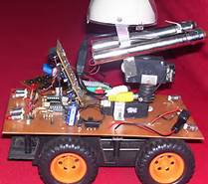
Student Projects
This year we are going to allow a limited number of student projects
If you have a web applications you really want to create
Proposer will act as project mentor
These need to be well-defined and scoped
If anyone is interested in doing one of these
We need a detailed proposal for it by Friday
Talk to the TAs for advice and suggestions

Slide 17
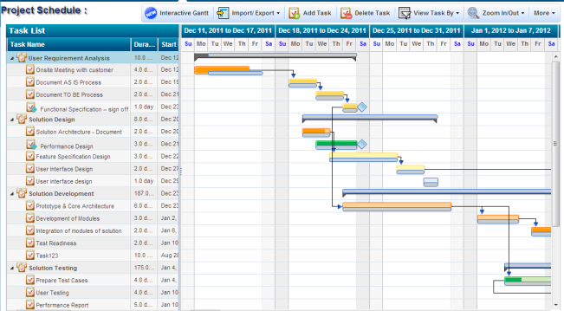
Project Schedule I
1/27: Project preferences out; due 1/31
2/03: Final project teams announced
2/21: Project specifications hand in
2/26: Potential user feedback reports hand in
2/28, 3/3: Project Elevator Talks
3/7: Initial project design presentation to TA
3/17: Project design hand in
3/17, 3/19: Project Poster Fair

Slide 18
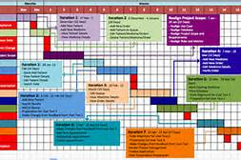
Project Schedule II
4/11: Initial prototype up and running
4/14-4/21: Project presentations
4/17: Prototype feedback from client
5/5: Final project presentations (whole day)
5/7: Final project hand-in
5/7-5/12: TA meeting with project team

Slide 19

Collaboration Policy
Please pick one up, read and sign, hand in
You won’t be assigned to a project unless you do
We expect you to do your own work
Not copy from others
Not copy from the web
We will detect cheating
Several students got directed NCs for the course in the past

Slide 20

Intellectual Property (IP)
You own your code (Brown’s policy)
Since you are working with others, they have rights
Non-exclusive perpetual right to the code and its use
Complete rights to any images, etc. they provide
You should negotiate/agree with sponsor on final rights
They might want code open sourced
They might want exclusive rights
Do this early in the process
Some projects are constrained
Take this into account in choosing projects

Slide 21

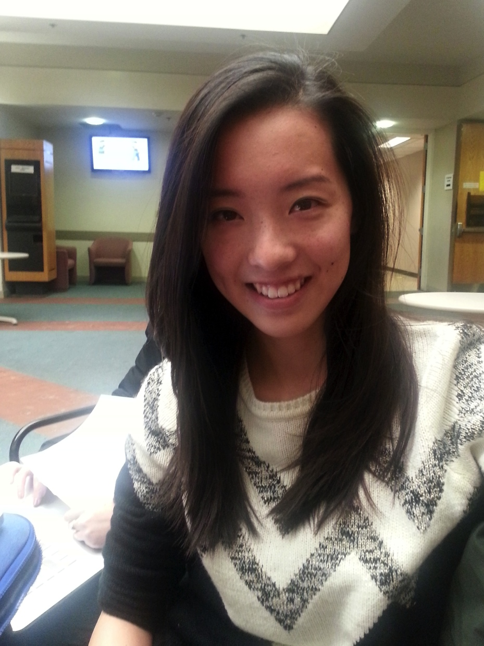


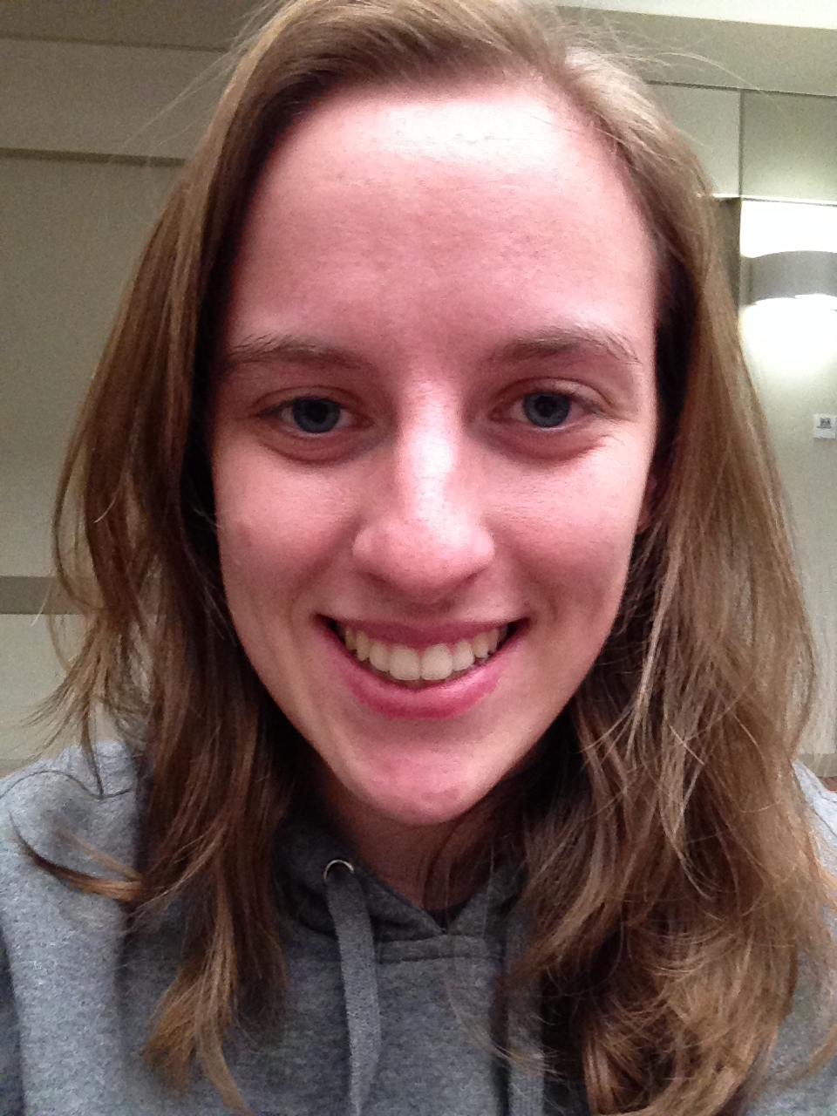
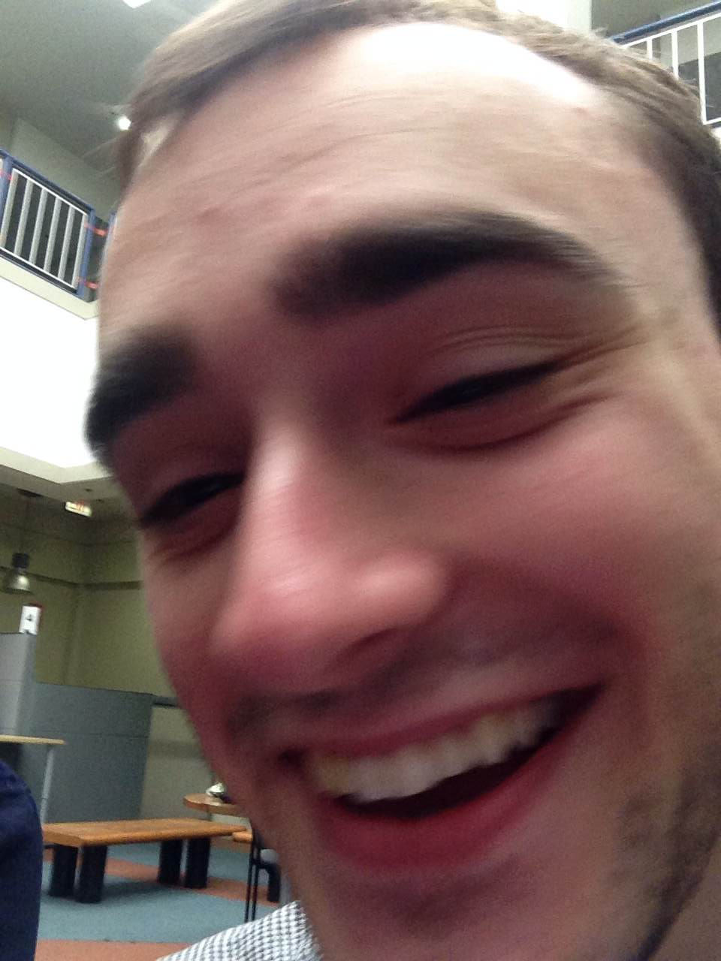


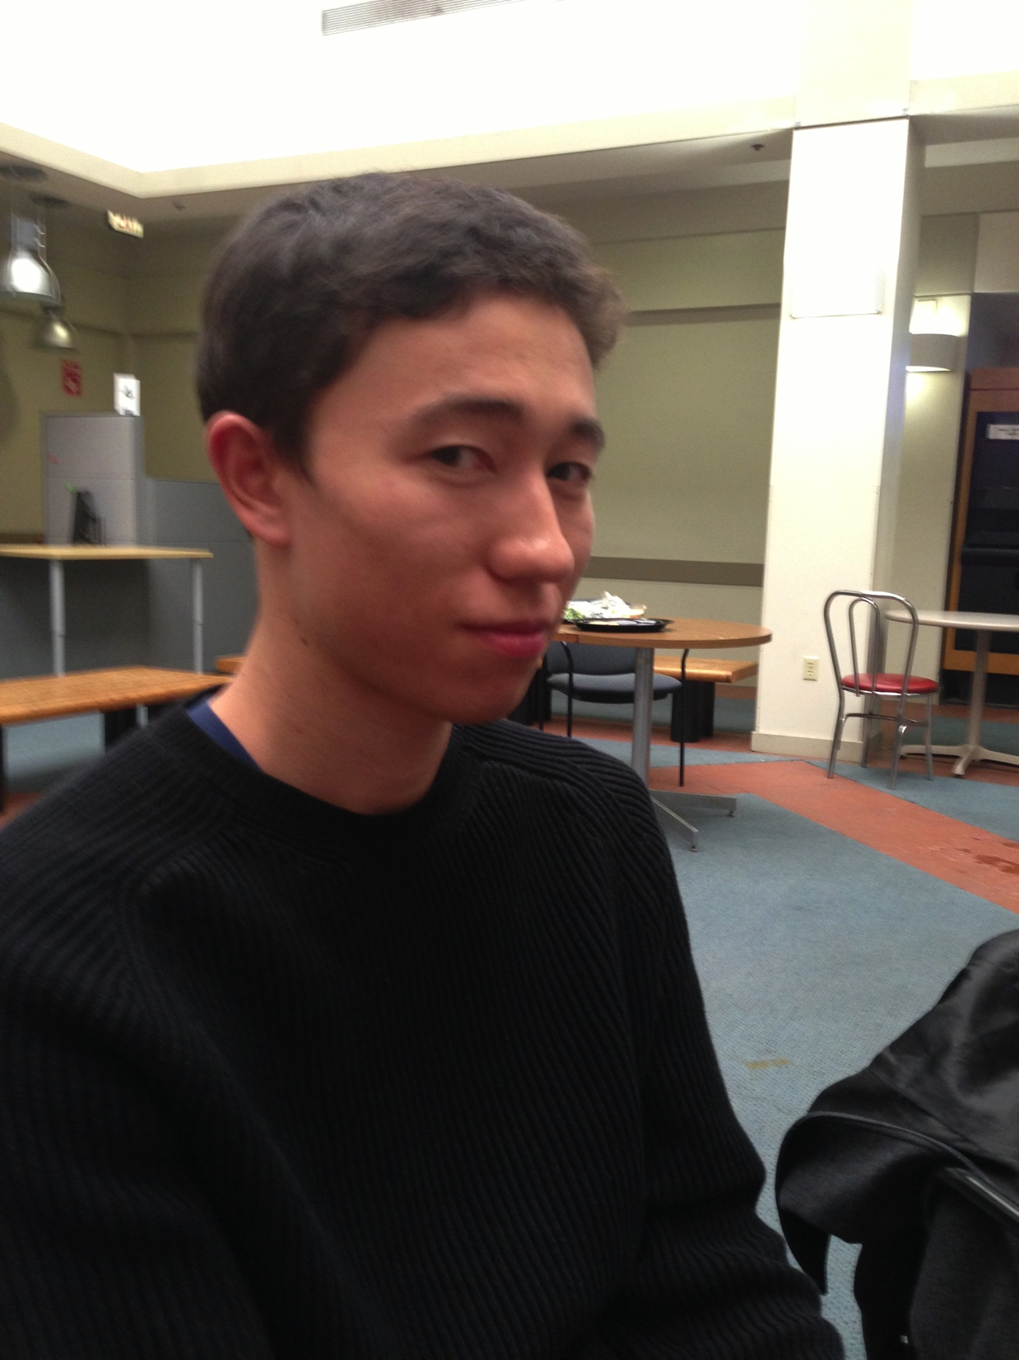
Course Staff
Professor (spr@cs.brown.edu)
HEAD TA (cs132headtas@cs.brown.edu)
Katherine Ng (kwng@cs.brown.edu)
TAs (cs132tas@cs.brown.edu)
Alec Lee (al63@cs.brown.edu)
Allison Hojsak (ahojsak@cs.brown.edu)
Bryce Aebi (baebicakez@cs.brown.edu)
Hyoju Lim (hl65@cs.brown.edu)
Jackson Owens (jbowens@cs.brown.edu)
Linh Pham (lhpham@cs.brown.edu)
Max Lesser (malesser@cs.brown.edu)
Miraj Shah (mgs3@cs.brown.edu)

Slide 22

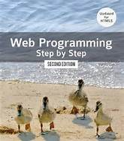

Course Text Books
Krug: Don’t Make Me Think
Good introduction to HCI issues
Stepp: Web Programming Step by Step
For those with little programming background
Second edition covers HTML5
Andersson: Software Engineering for Internet Applications
For those with CS background
Available electronically for free
All optional (there for reference and assistance)
Other material available on the web

Slide 23
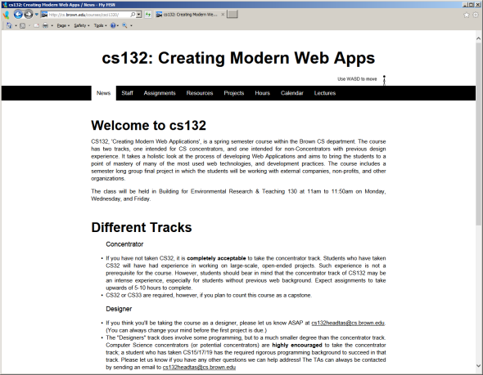
Course Web Site
http://www.cs.brown.edu/courses/csci1320
Reference Materials
Links to that other material, cherry picked for you
Calendar
Keeping up to Date

Slide 24

Questions regarding the Course

Slide 25

What Makes a Web App Different
Why do we have a course like CS132?
Why isn’t CS32 sufficient
Can anyone write a web application?
What is a “web designer”?
Architecture and Expectations
Web architectures are different
Users and clients have different expectations

Slide 26
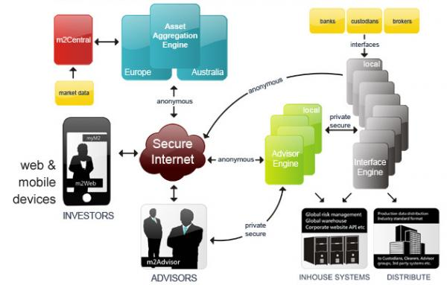
Elements of Web Applications
The importance of Human-Centric Computing
Distributed Programming
Security and Privacy
Scalability
Evolution
Software Engineering

Slide 27

Human-Centric Computing
User interface design
Ease of use
Looking good
Accessibility and internationalization
This makes or breaks a web application

Slide 28
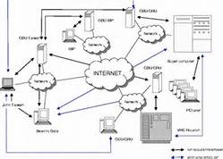
Distributed Computing
Web applications are inherently distributed
They use facilities outside of programmer’s control
They are written in a multitude of languages
Communication is asynchronous
Frameworks try to make this simpler
Nothing is standard

Slide 29

Security and Privacy
Are major concerns
In the press daily
Your application is exposed to the world
All types of attacks are possible
Same interface used by multiple users at once
Multiple applications might run on same server
Private data needs to be secure
Especially sensitive data (e.g. credit cards)
Applications often have real-world implications ($$$)
Liability issues arise

Slide 30

Scalability
How many users do you expect to have
After you’ve been slash-dotted
On Black Monday
Handling 1000 users at once is hard
Handling 10,000 requires a different approach
Handling 1,000,000 requires rethinking the application

Slide 31
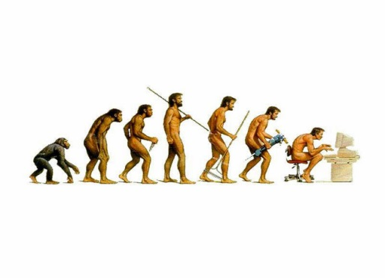
Evolution
Web apps need to change
The look gets stale after a year or two
New functionality desired
Users expect new features, new look and feel
Need to keep up with competition
Different form factors and capabilities
Different browsers
ipad, iphone and other devices

Slide 32


Software Engineering
Different programming languages and models
How to work in teams
How to work with clients
How to work with deadlines
How to organize a large project
How to plan for evolution
How to plan for problems

Slide 33
Next Time
The Browser, HTML, CSS, and the web front end

