Slide 1
CSCI 1320 Creating Modern Web Applications
Lecture 2: The Browser and HTML
Notes:
Jan 24, 2014
Need to be better prepared for using dreamweaver at the end.

Slide 2
Student Projects
Requirements

Slide 3

The Browser
What Browser do you use
Why
Is one browser better than another?
What does it do for you?
Magically makes pages appear
Allows interaction
Supports the user experience
Notes:
How many use each

Slide 4
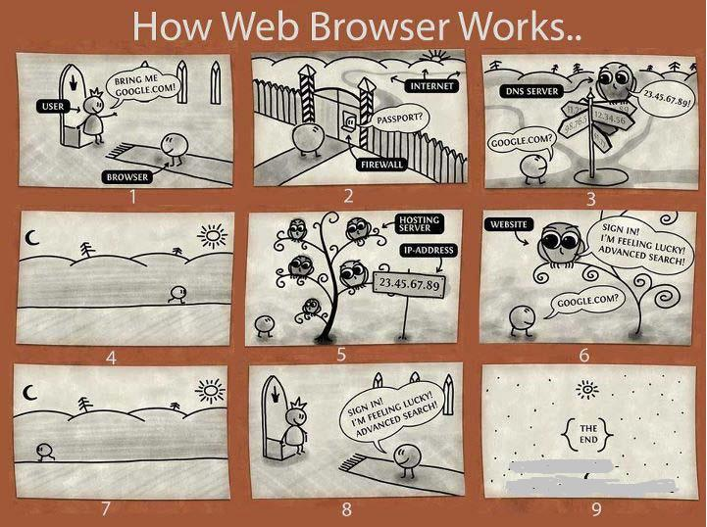
What Does the Browser Do
You are a browser
Someone gives you http://www.cs.brown.edu
What do you do?
Notes:
List of things that need to be done

Slide 5
Web Applications
Web Browser
Front End
HTTP
Database
Web Server
Back End
Server
Notes:
Use a web browser as the front end
Typically multiple (logical) pages
Back end server does significant processing
Database
Computation
Front and back ends interact via HTTP

Slide 6
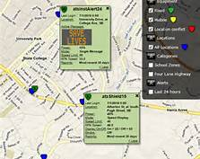
Using the Browser is Helpful
Makes it easy to create sophisticated interfaces
Including images, videos, dynamics
Color, typography, accessibility, ..
Adapts to different size windows
Works on different platforms
Powerful declarative syntax for user interfaces
Easy prototyping of user interfaces
Much less code to write

Slide 7
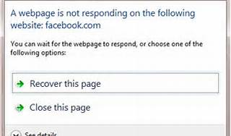
Why the Browser is Restrictive
Using a browser as a front end is limiting
Limits the user interface
Limits the user experience
Limits application control of the interface
Other limitations include
Limited communications capabilities
Limited access to the user machine
Separates the UI from the application
Limited display capabilities
You need to understand the limitations

Slide 8
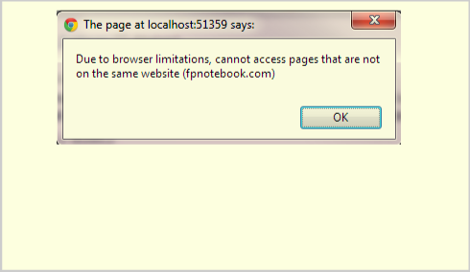
Front End Code Restrictions
Who can the front end code talk to and see
Any program/file on the user’s machine or network
This is a security/privacy problem
Requires explicit user approval; Discouraged by today’s browsers
Best not to assume this
Restricted local storage (cookies, html5 storage)
The web server
Actually any socket on the machine serving the pages
Firewalls might limit access to specific ports
Generally only the web server and its components
Talking to the server uses a limited set of protocols
URLs, HTTP

Slide 9
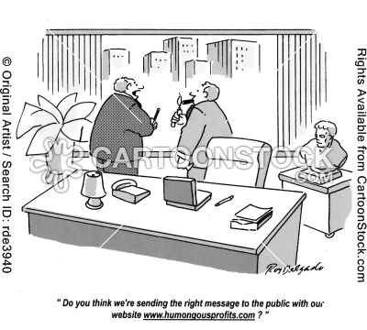
Uniform Resource Locators (URL)
HTTP: //www.cs.brown.edu :80/people/spr
#reference
?name=value&name1=value1 …
Examples
Wikipedia (http://en.wikipedia.org/wiki/Uniform_resource_locator)
Ohloh (http://code.ohloh.net/search?s=roman%20numerals&browser=Default )
Notes:
Protocol / host / port / file

Slide 10
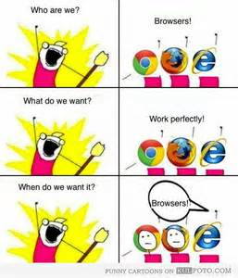
What the Browser Does
Given a URL from the user or a program
Finds the proper server (based on host)
Opens a socket to port 80 (or other specified port)
Sends a request on that socket (based on protocol)
Server then finds the corresponding data
Generally the file referred to; Might be dynamically computed
Server sends back the result
Browser reads the response
Builds an internal data structure from the response (DOM)
Displays the corresponding data structure (magic)
Replaces the current page with the new one

Slide 11
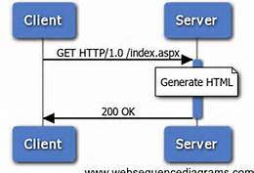
Simple HTTP Request
GET /people/spr HTTP/1.1<crlf>
Host: www.cs.brown.edu:80<crlf>
<crlf>
Notes:
Host is mandatory, other fields are optional.

Slide 12
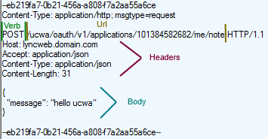
HTTP Protocol: Requests
Basic Forms are GET and POST
GET: effectively header only
POST: provides content
GET <suburl> HTTP/1.1
Header fields
name: value
Describe
Who is sending the request
Type of data passed and expected (e.g. text/html, text/xml)
Length of data; Cookies; Caching information
Content
Blank line (CRLF) and then actual data
Notes:
Summarizing a 175 page specification document

Slide 13
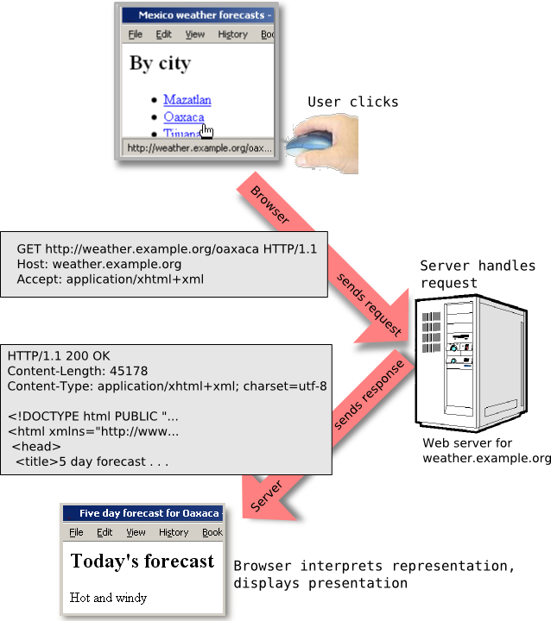
Simple HTTP Response
HTTP/1.1 200 OK<crlf>
Date: Fri, 27 Jan 2012 10:25:23 EDT<crlf>
Content-Type: text/html<crlf>
Content-Length: 234<crlf>
<crlf>
<html><head> ….

Slide 14

HTTP Protocol: Responses
HTTP/1.1 <status> <description>
1xx: OK / continue
2xx: Success in various ways
3xx: Redirection
4xx: Client error
5xx: Server error
Header fields
Content-type, Content-length
Date and other optional information

Slide 15

HTTP is Stateless
Each request is independent of other requests
From the same user or other users
From the same web page or other pages
Each request can be treated the same at the server
Why?
Fits browser model of multiple windows, back/forward, …
Don’t have to worry about state, errors, crashes, etc.
What’s wrong with this?
We’ll get back to this later in the course

Slide 16
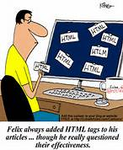
HTML
Need a way of describing what to display
Work with all browsers (browser-independent)
Window size and shape independent
User-creatable
History
SGML: type-setting markup language (EBT)
Basis for HTML and XML
Used for manuals off-line and on-line
HTML = { HTML4 , XHTML , HTML5 }

Slide 17
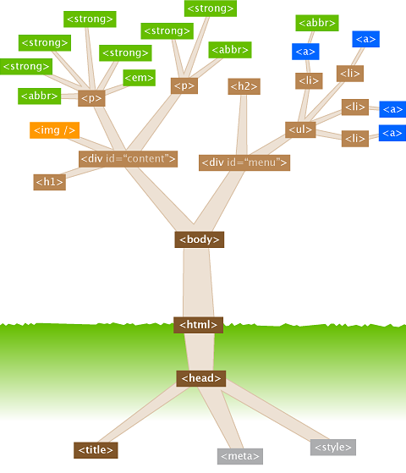
HTML Structure
HTML is a tree structure
Internal nodes represent structure
Leaf nodes represent content
Specified textually as a tree
<node>
<subnode field=‘value’>
Text in a leaf node
<leafnode />
</subnode>
</node>
Maintained internally as a tree (DOM)
Nodes have names, attributes
Text may appear at leaves

Slide 18

HTML Components
Header: basic information about the page
Styles (CSS): information on how to display
Can be in separate files
Monday + Lab Wednesday
Scripts (JavaScript)
Dynamic interactivity
Can be in separate files
Next Friday + Lab following week
Body: the data to display
Description of what should be presented on the page
Semi-structured text

Slide 19
Simple HTML Example
<!DOCTYPE html>
<html>
<head>
<meta charset="utf-8" />
<title>Page title. Shown in tabs.</title>
</head>
<body>
<h1>Simple Page!</h1>
<p>
This is a totally <em>bare-bones</em> page.
</p>
</body>
</html>
Notes:
Show the resultant page (in dreamweaver?)
-So what are we stringing it on top of?
-Here’s a valid HTML5 document.
-discuss:
->doctype comp. html4
->head
->body
-> charset
Add a div

Slide 20
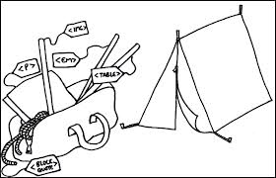
Basic HTML Body Components
Text
Descriptions of how to display text
<EM>text</EM>, <span class=‘emph’>text</span>
Managed by CSS
Text organization
Headers, paragraphs, blocks
Page layout and organization
Div, List, Table, Frame
Interactive regions
Forms: text fields, buttons, …
Canvas (HTML5), SVG regions

Slide 21
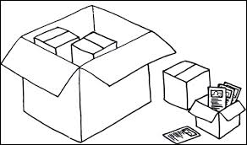
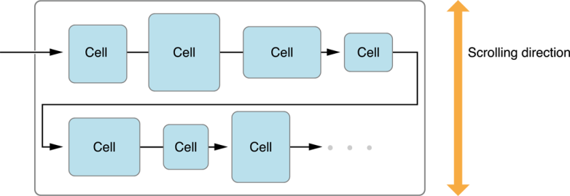
HTML Block Elements
h1, h2, h3, h4, h5, h6 (header)
p (paragraph)
ul, ol, li (unordered list, ordered list, list item)
div (logical division)
HTML5 div specialization (such as ‘header’, ‘footer’, ‘section’, and ‘article’)
img (image)
Notes:
Discuss inline-block.
And that’s basically everything that they’ll need to know.

Slide 22
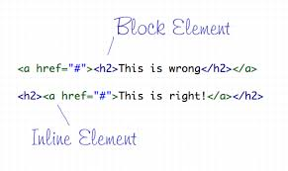
HTML Inline Elements
Tag:
Usage:
<a href=“http://google.com”>Google</a>
<strong>Usually Bold</strong>
<em>Usually italicized</em>
Text which is <span>logically divisible</span>
<img src=“image.png” alt=“description” />
a
strong
em
span
img
Notes:
What are inline elements?
Discuss:
-closing tags
Attributes.
Alt for accessibility

Slide 23
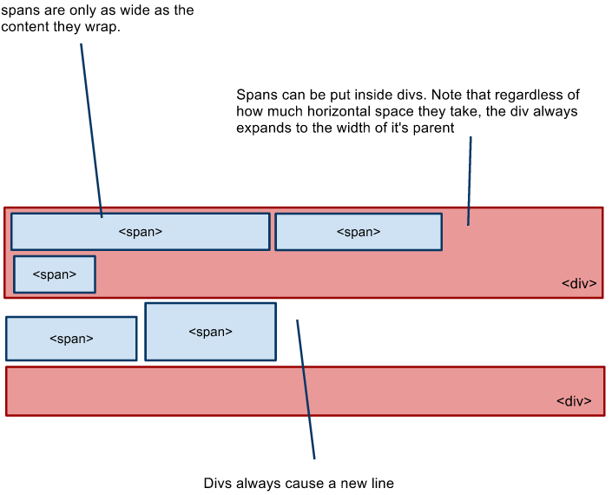
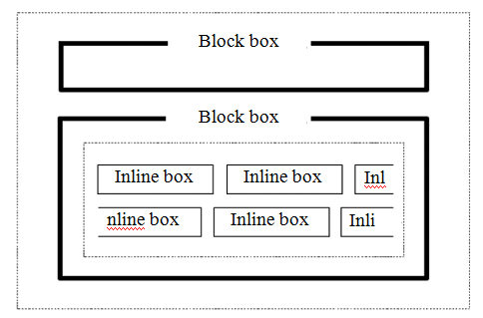
HTML Flow and Layout

Slide 24

CSS: Style versus Content
Basic Syntax
Selectors {
Property : value;
Property : value;
}
Including inline
<style> .... </style>
Including via links
<link rel=‘stylesheet’ href=“path.css” type=‘text/css’ />
Tricky Parts: selectors, property names, property values
Code Bubbles Before and After
Http://www.cs.brown.edu/people/spr/codebubbles
Http://www.cs.brown.edu/people/spr/codebubbles/indexold.html

Slide 25
HTML Examples
(Using Dreamweaver)
Basic Page
Displaying text
Using CSS and styles
Notes:
Show a more complex page in dreamweaver

Slide 26
Next Time
Monday: CSS in detail
Wednesday: HTML/CSS Lab

