Slide 1
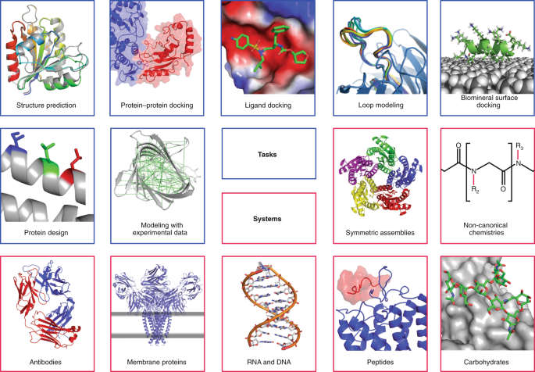

Rosetta
The Rosetta software suite for macromolecular modeling and has many applications.
Leman et al. 2020 Nature Methods

Slide 2
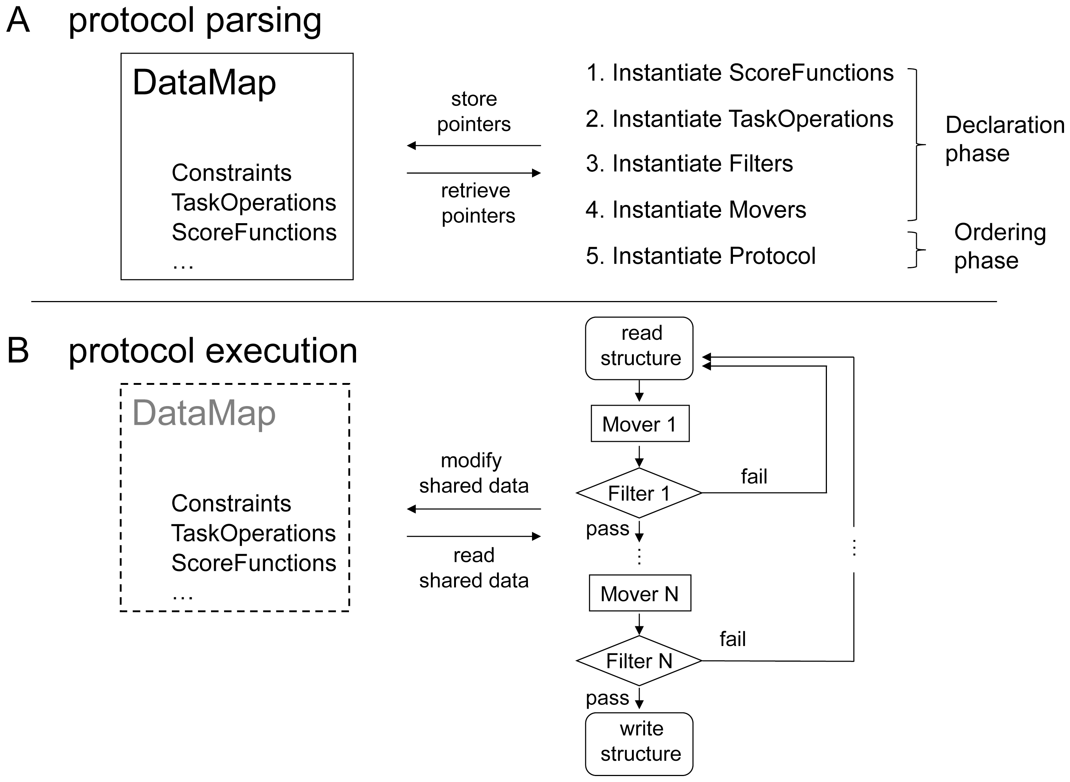
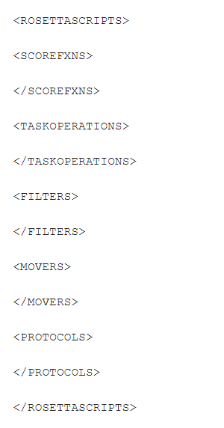
RosettaScripts
RosettaScripts is an XML-like language for specifying modeling tasks in the Rosetta framework.
RosettaScripts allows fast testing and deployment of complex protocols without need for modifying or recompiling the underlying C++ code.
RosettaScripts are built in XML-like blocks, where each block can carry different pieces of data.
Protocols can be dovetailed to generate complex trajectories.
At the most general level, a script consists of a declaration phase and an ordering phase – it reads like a recipe starting with an ingredient list and finishing with a sequence of steps.
Fleishman et al. 2011 PLOS ONE

Slide 3
RosettaScripts
At the most general level, a script consists of a declaration phase and an ordering phase – it reads like a recipe starting with an ingredient list and finishing with a sequence of steps.
In the declaration phase, the user declares a set of
ScoreFunctions (objects to evaluate the energy of a structure)
TaskOperations (objects to control how Rosetta's side-chain placement routines, “the packer,” should operate)
Filters (objects to evaluate a structure)
Movers (objects to modify a structure)
Fleishman et al. 2011 PLOS ONE

Slide 4
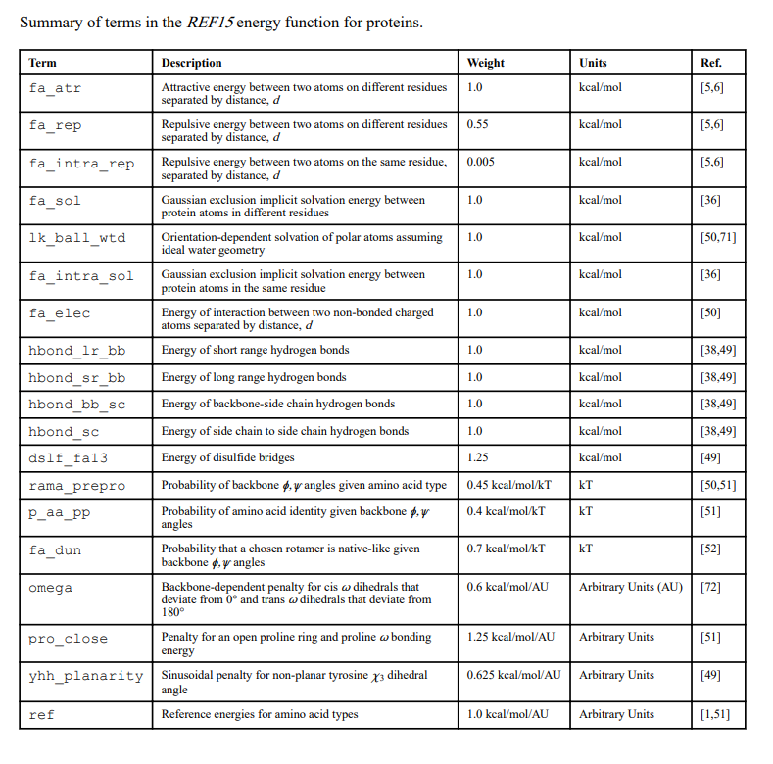
Scoring – ref2015 energy function
In Rosetta, the energy of a biomolecule is calculated by scoring it.
Rosetta has an optimized energy function or score function called ref2015 for calculating the energy of all atomic interactions in a globular protein made of L-amino acids.
You can create a custom score function to suit your requirements.
Alford et al. 2017 J Chem Theory Comput.

Slide 5
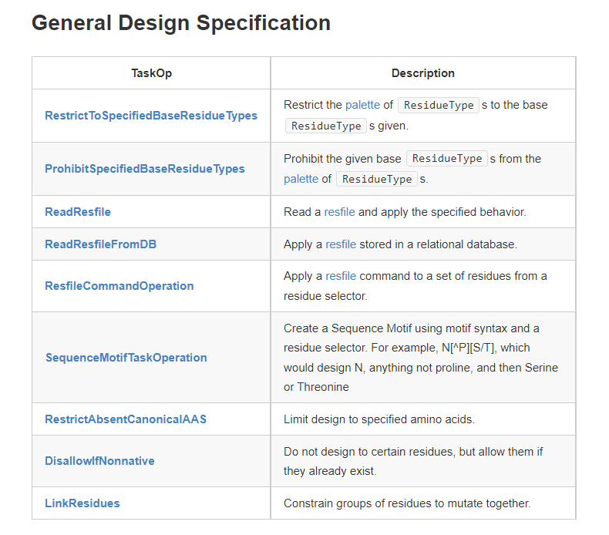
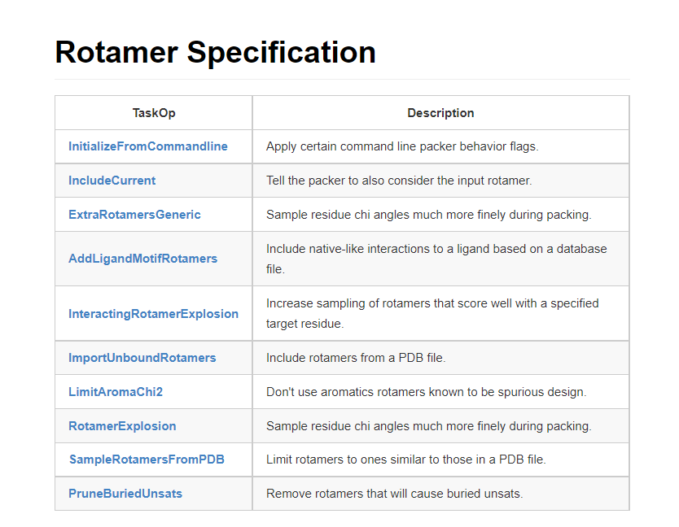
Task Operations
Task Operations control how Rosetta's side-chain placement routines, “the packer,” should operate.
The packer is Rosetta’s rapid Metropolis-Monte Carlo simulated annealing engine which essentially searches for low-energy combinations of side-chain conformations.
Task Operations define the residue conformations and identities used in the search.
https://www.rosettacommons.org/

Slide 6
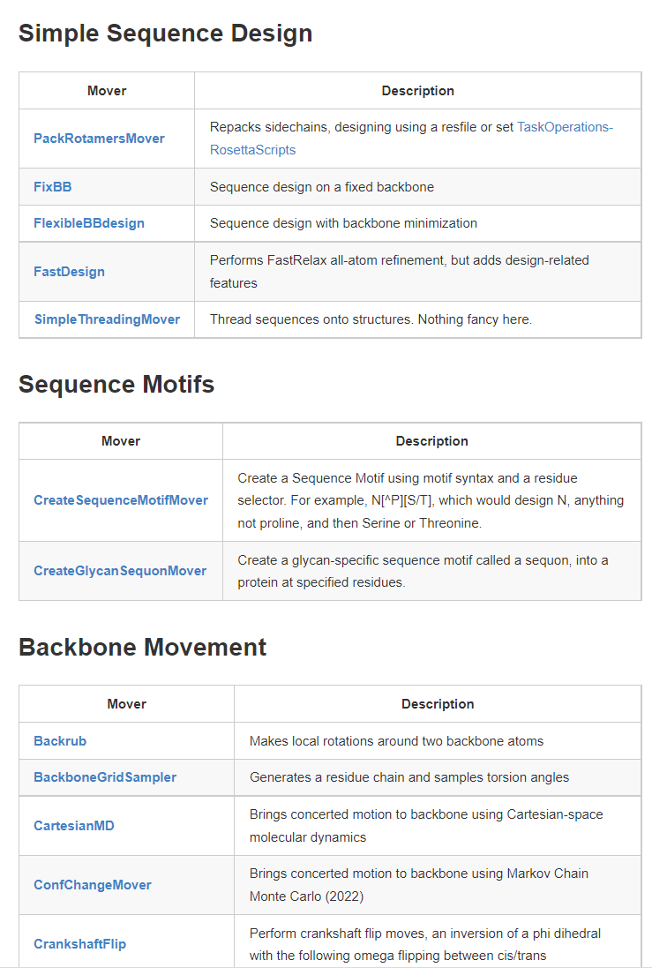
Movers
Movers are used to modify a structure.
The vast majority of Rosetta routines for modifying the structure of a protein are wrapped within Movers , from the simplest steps, such as minimizing, to more complicated protocols such as rigid-body docking.
Complex protocols are often implemented as Movers built from a series of simpler Movers.
https://www.rosettacommons.org/

Slide 7
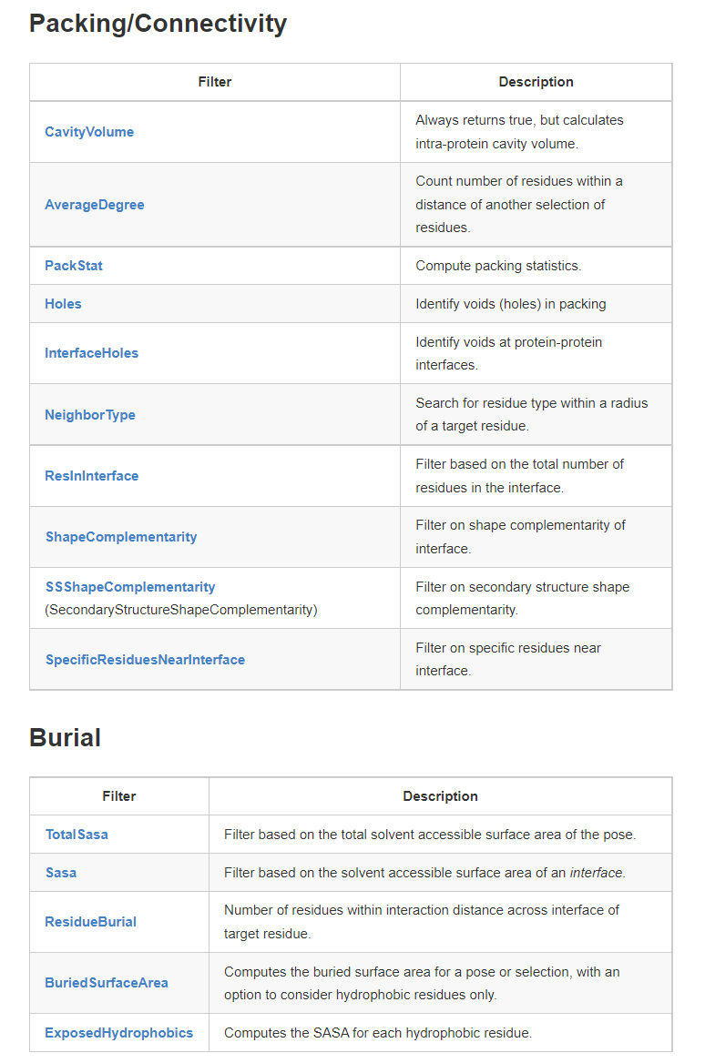
Filters
Filters are used to evaluate a structure.
Filter objects evaluate a Pose in their “apply” function and return a boolean describing whether or not the structure passed the filter.
Filters are useful in aborting trajectories that are headed towards uninteresting regions of conformation and sequence space.
https://www.rosettacommons.org/

Slide 8
Protocols
The Protocols, or ordering phase, section defines the order of Movers and Filters to be executed for each trajectory.
Protocol execution is as follows
Step 1 is the reading in of a structure.
Steps 2 through n describe how Rosetta should modify that structure. If a filter is applied at step i, and the structure fails the filter, then execution returns to step 1 for another attempt.
Finally, if a structure passes all filters, it is returned for output to disk.
Fleishman et al. 2011 PLOS ONE

Slide 9
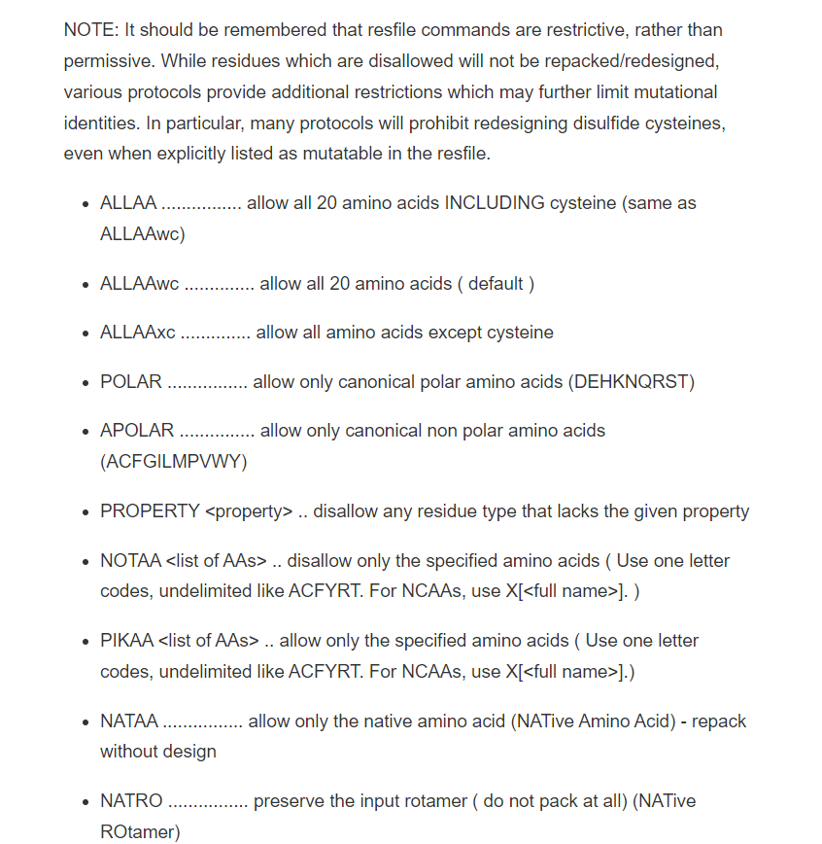
Resfile
NATRO
ALLAAxc
USE_INPUT_SC
start
1 - 166 A NATRO
200 - 219 B ALLAAxc
240 - 256 B NOTAA CP
200 B PIKAA Q
240 B PIKAA RKDESTNQAVH
https://www.rosettacommons.org/

Slide 10
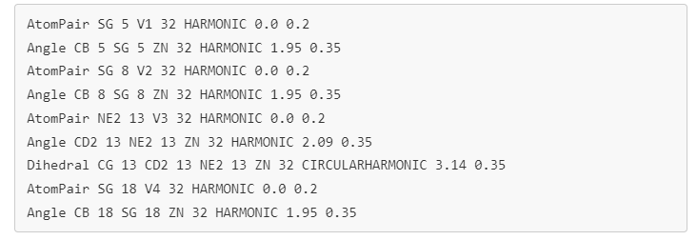
Constraints file
Constraints are used to score geometric and other features of the structure.
Each constraint consists of two parts: A) what's being measured B) how that measured value is transformed into a scoring bonus/penalty.
#Q235 to Q93 in il6
AtomPair CA 235B CA 93A HARMONIC 9.5 0.2
AtomPair OE1 235B NE2 93A HARMONIC 2.8 0.2
#Q235 to Y13 in il6
AtomPair CA 235B CA 13A HARMONIC 7.5 0.2
AtomPair NE2 235B OH 13A HARMONIC 4.9 0.2
https://www.rosettacommons.org/

Slide 11
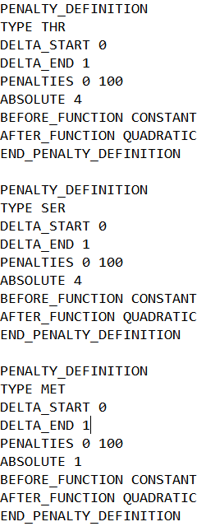
Composition file
This scoring term is intended for use during design, to penalize deviations from a desired residue type composition.
For example, a user could specify that the protein was to have no more than 5% alanines, no more than 4 serines and at least 4 prolines.
The basic idea is that the algorithm does the following:
Goes through and counts the number of residues of the types that it is supposed to count in the regions of the pose that have been selected for counting.
Calculates the difference between the desired number and the observed number.
Imposes a penalty, based on a lookup table, as a function of that difference.
https://www.rosettacommons.org/

Slide 12
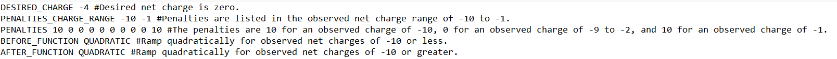
Netcharge file
This scoring term is intended for use during design, to penalize deviations from a desired net charge in a pose or region.
Rule of thumb:
Charge = (number of residues) X 0.003 + (number of loops) X (-1)
https://www.rosettacommons.org/

Slide 13
Job file
Jobs, or Rosetta runs, are run on Wynton.
The job file lists the per-job settings and XML files used.
How to submit a job to Wynton:
When in your folder, type the following: qsub jobfilename.job (where jobfilename is the name you gave you job file).
You can check the status of your jobs by typing in: qstat
To stop a job, type: qdel followed by the unique job ID Wynton gave your run

