Slide 1
visuals
File created on: 5/8/2022 10:54:26 PM

Slide 2
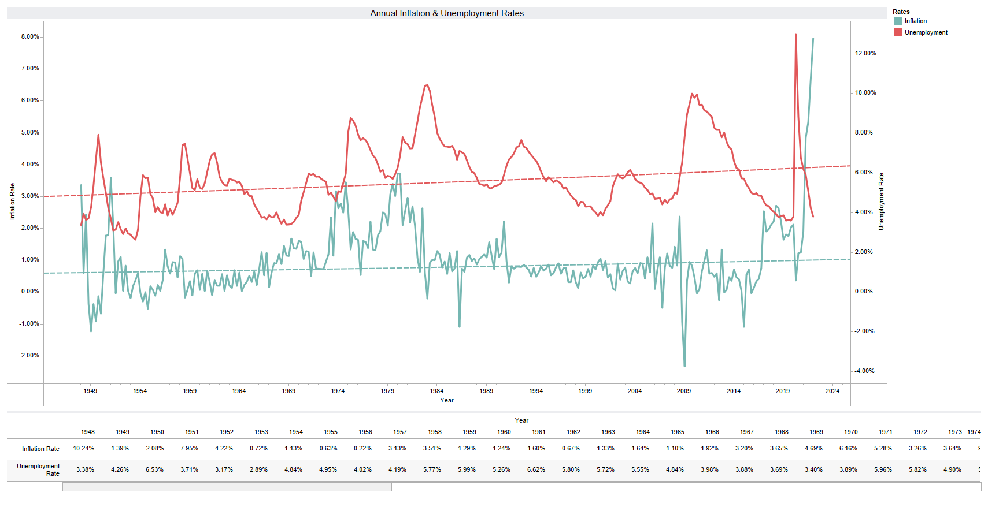

Slide 3
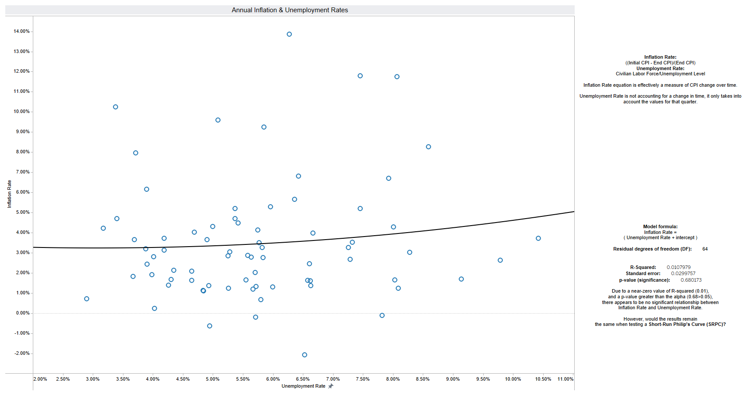

Slide 4
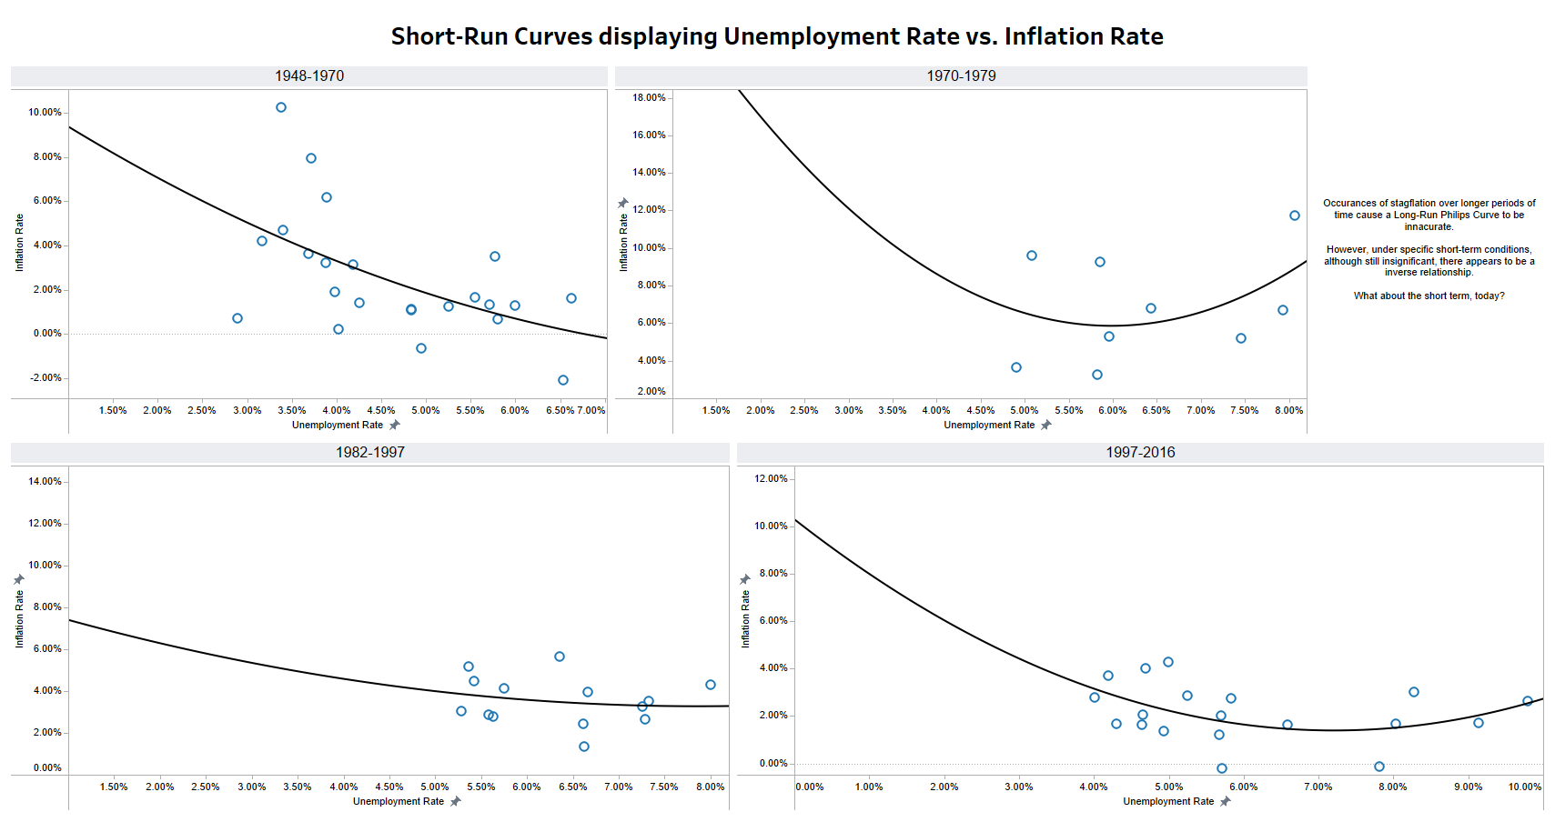

Slide 5
