Slide 1
FI Consulting Case Study
Chance Konnor

Slide 2
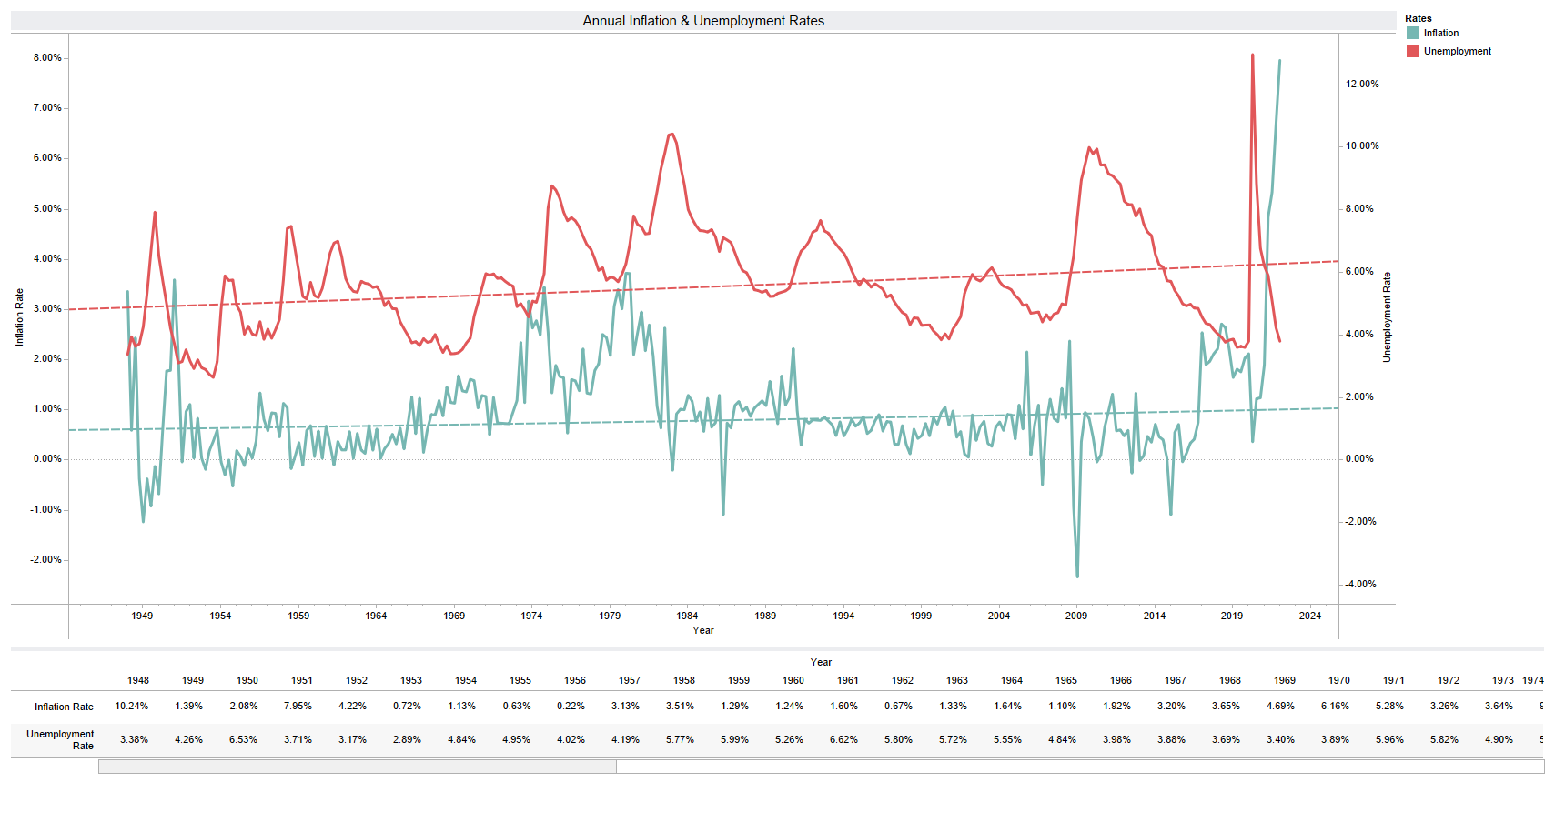

Slide 3
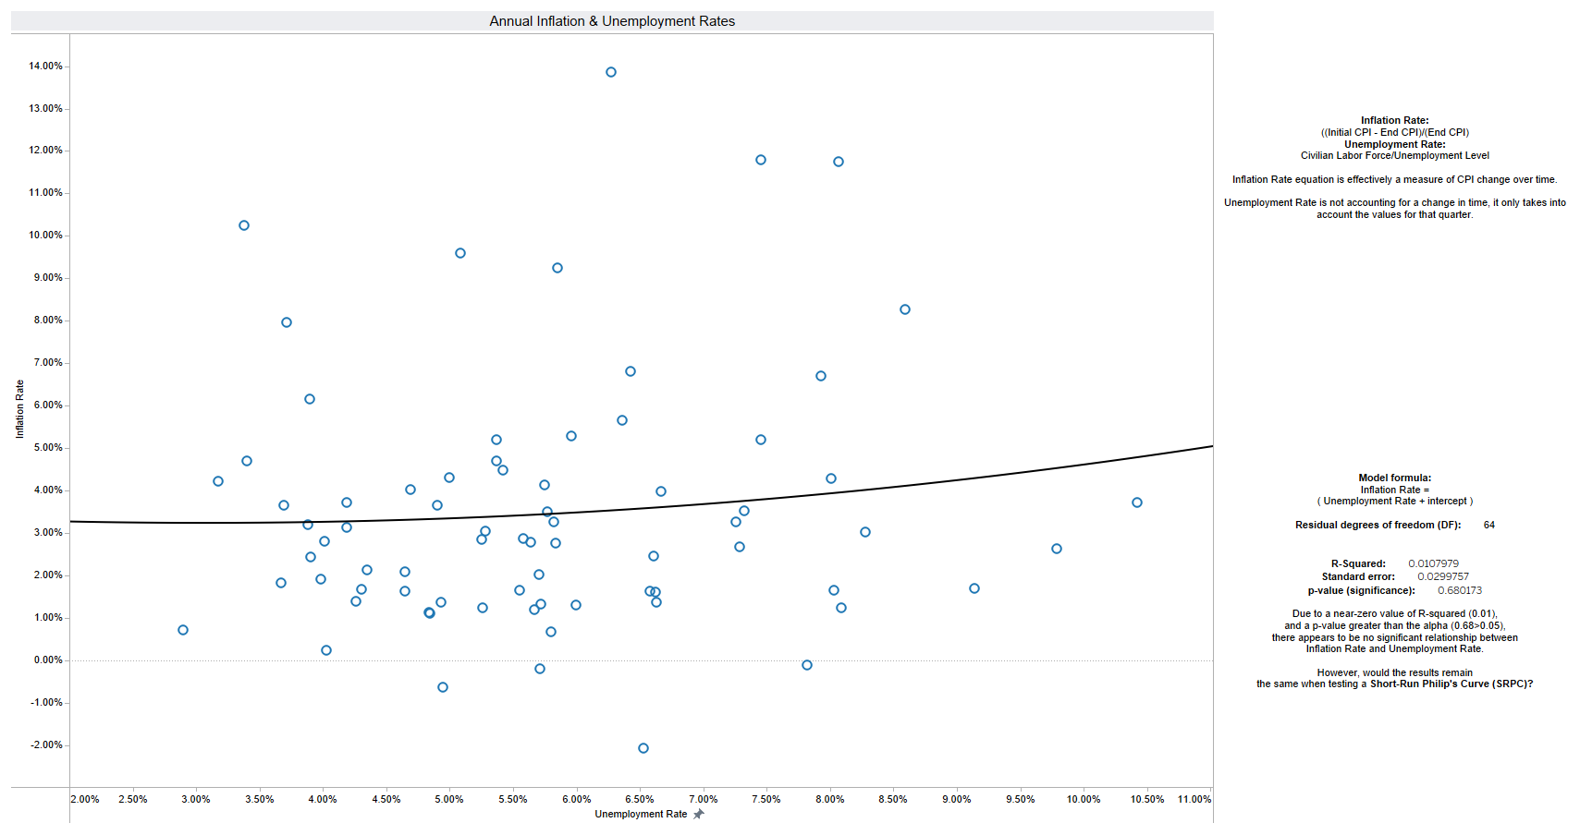

Slide 4
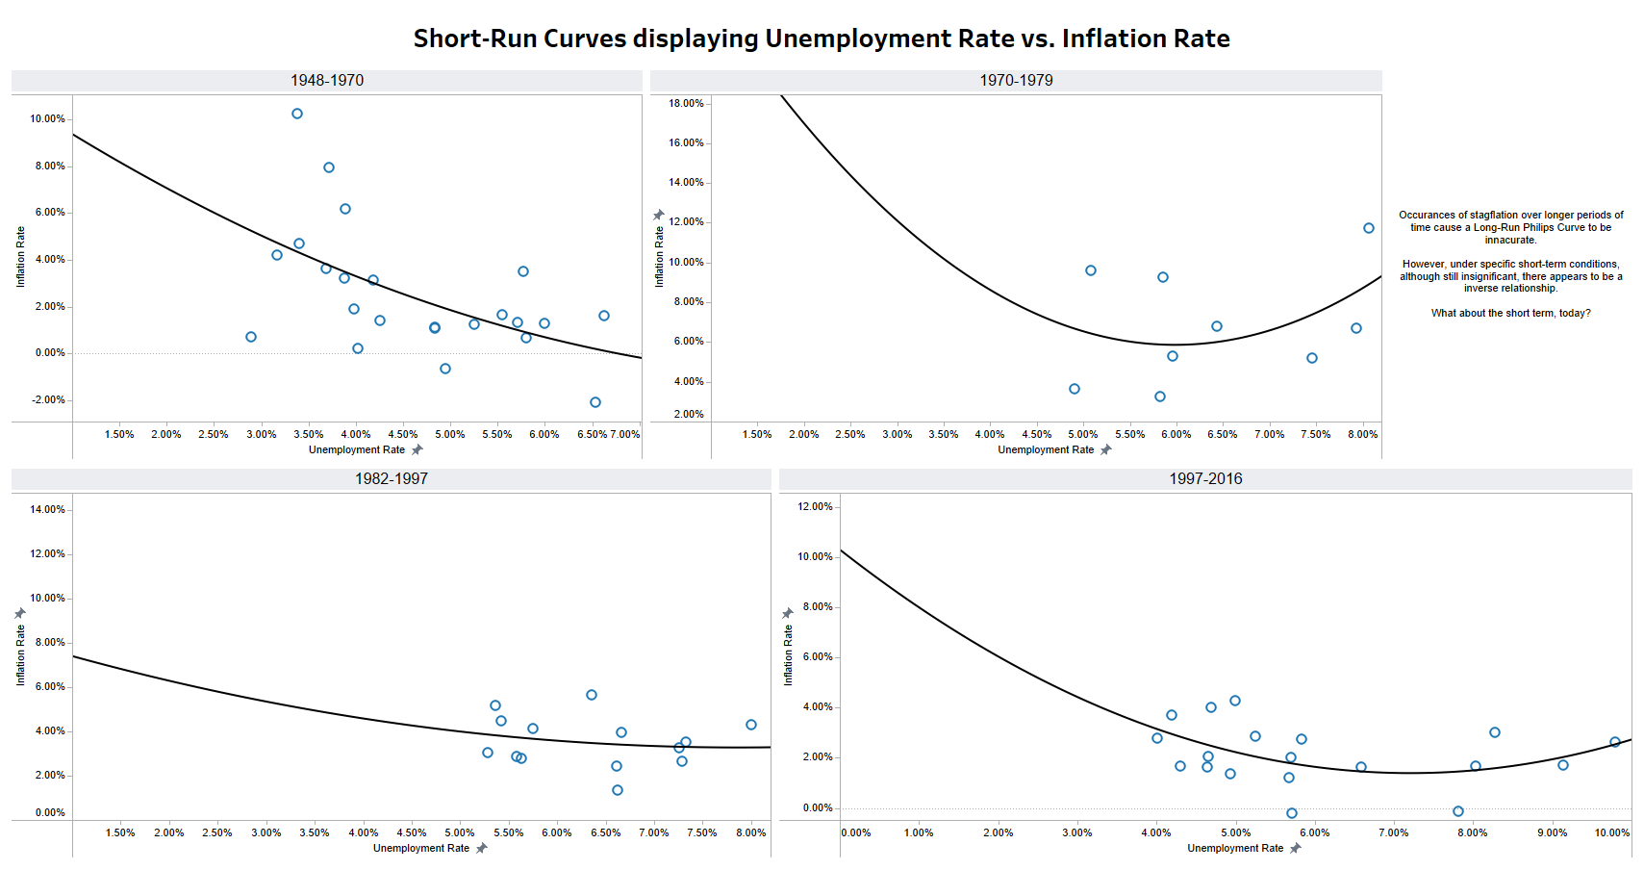

Slide 5
