Slide 1
Vectors
… backed by Radix-Balanced trees
Chaitanya Koparkar

Slide 2
It’s fast!
Op | Time complexity
lookup | O (log_{m} n)
update | O (m * log_{m} n)
cons/snoc | O (m * log_{m} n)
concat | O (n)
empty? | O(1)
toList | O(n)
fromList | O(n)
length | O(1)
Branching factor (m) = 4

Slide 3
It’s fast!
Op | Time complexity
lookup | O (log_{m} n)
update | O (m * log_{m} n)
cons/snoc | O (m * log_{m} n)
concat | O (n)
empty? | O(1)
toList | O(n)
fromList | O(n)
length | O(1)
Branching factor (m) = 4

Slide 4
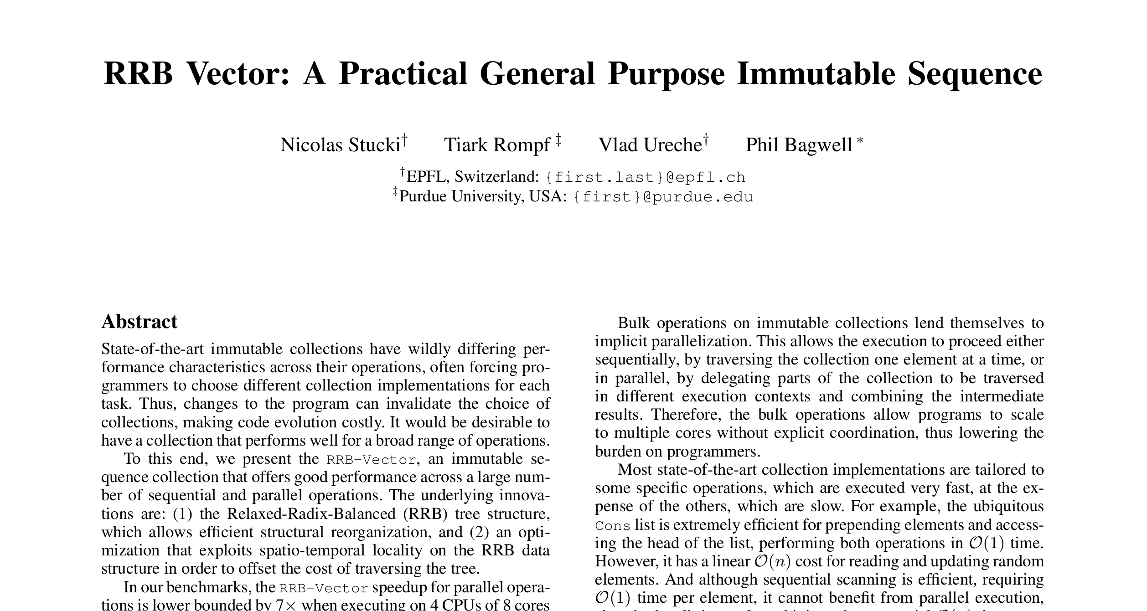

Slide 5
RB-Tree
1
Branching factor (m) = 4

Slide 6
RB-Tree
1
2
3
4
Branching factor (m) = 4

Slide 7
RB-Tree
1
Branching factor (m) = 4

Slide 8
RB-Tree
1
2
3
4
Branching factor (m) = 4

Slide 9
RB-Tree
1
2
3
4
5
6
7
8
9
10
11
12
13
14
15
Branching factor (m) = 4

Slide 10
RB-Tree
Old
New
1
2
3
4
5
6
7
8
9
10
11
12
13
14
15
13
14
15
16
Branching factor (m) = 4

Slide 11
RB-Tree
1
2
3
4
5
6
7
8
9
10
11
12
13
14
15
16
Branching factor (m) = 4

Slide 12
RB-Tree
4
8
12
16
17
Branching factor (m) = 4

Slide 13
Lookup
lookup vec 16 == 17
4
8
12
16
17
Branching factor (m) = 4

Slide 14
Lookup
lookup vec 16 == 17
Algorithm:
Convert idx to binary
4
8
12
16
17
Branching factor (m) = 4

Slide 15
Lookup
lookup vec 16 == 17
Algorithm:
16 == 10000
4
8
12
16
17
Branching factor (m) = 4

Slide 16
Lookup
lookup vec 16 == 17
Algorithm:
16 == 10000
Split it into log₂m parts
4
8
12
16
17
Branching factor (m) = 4

Slide 17
Lookup
lookup vec 16 == 17
Algorithm:
16 == 10000
01 00 00
4
8
12
16
17
Branching factor (m) = 4

Slide 18
Lookup
lookup vec 16 == 17
Algorithm:
16 == 10000
01 00 00
Each part is an index!
4
8
12
16
17
Branching factor (m) = 4

Slide 19
Lookup
lookup vec 16 == 17
Algorithm:
16 == 10000
01 00 00
Each part is an index!
4
8
12
16
17
Branching factor (m) = 4

Slide 20
Lookup
lookup vec 16 == 17
Algorithm:
16 == 10000
01 00 00
Each part is an index!
4
8
12
16
17
Branching factor (m) = 4

Slide 21
Lookup
lookup vec 16 == 17
Algorithm:
16 == 10000
01 00 00
Each part is an index!
4
8
12
16
17
Branching factor (m) = 4

Slide 22
Lookup
lookup vec 16 == 17
Algorithm:
16 == 10000
01 00 00
Each part is an index!
4
8
12
16
17
Branching factor (m) = 4

Slide 23
Lookup
lookup vec 16 == 17
Algorithm:
16 == 10000
01 00 00
Each part is an index!
4
8
12
16
17
Branching factor (m) = 4

Slide 24
Lookup
lookup vec 16 == 17
Algorithm:
16 == 10000
01 00 00
Each part is an index!
4
8
12
16
17
quot i (m ^ ht) `mod` m
Branching factor (m) = 4

Slide 25
Lookup
2
lookup vec 16 == 17
1
1
Algorithm:
16 == 10000
01 00 00
Each part is an index!
0
4
8
12
16
17
quot i (m ^ ht) `mod` m
Branching factor (m) = 4

Slide 26
Lookup
2
lookup vec 16 == 17
1
1
Algorithm:
16 == 10000
01 00 00
Each part is an index!
0
4
8
12
16
17
quot i (m ^ ht) `mod` m
Branching factor (m) = 4

Slide 27
Lookup
2
lookup vec 16 == 17
1
1
Algorithm:
16 == 10000
01 00 00
Each part is an index!
0
4
8
12
16
17
quot i (m ^ ht) `mod` m
Branching factor (m) = 4

Slide 28
RB-Tree

