Slide 1
Stress Measurements using the Picosecond Ultrasonic Method
Chris Korabik
PI: Professor Oluwaseyi Balogun
Mentors: Matt Ford, Li Zhang, Baojie Lu, Hong-Cin Liou

Slide 2


Acknowledgements
Professor O. Balogun and his research group
Special thanks to Materials Research Science and Engineering Center under NSF grant DMR #1121262
This work utilized Northwestern University Micro/Nano Fabrication Facility (NUFAB)

Slide 3
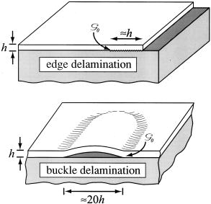
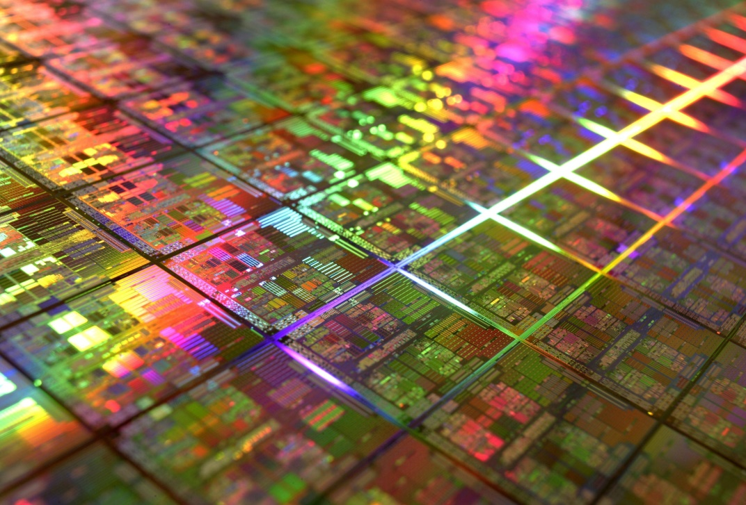
Stresses in thin films
https://techcet.com/product/silicon-wafers/
http://appliedmechanics.asmedigitalcollection.asme.org/article.aspx?articleid=1475330
Notes:
Stresses in thin films can cause them to crack or delaminate from the substrate
This can significantly hamper the performance of electronic devices
We are planning on using the picosecond ultrasonic method of measuring in order to quantify the stress exerted on a thin film
This can potentially help give rise to more future applications of this method of measurement

Slide 4
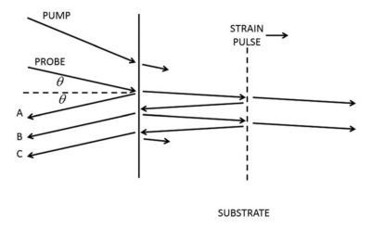
Dai et al. Journal of Applied Physics 119. 2016.
Notes:
Ultrasound is often used for nondestructive measurements on materials; piezoelectric transducers are common tools for doing this, but they are not reliable for small measurements such as those dealing with computer chips
The picosecond ultrasonic method can be used to generate and measure small acoustic waves in a thin film

Slide 5
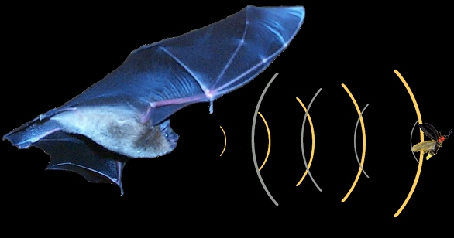
http://www.clayton.edu/faculty/sburnett/Bat-Visits/How-do-bats-navigate
Notes:
The method we use is analogous to the way bats locate their prey. Bats use echolocation to create high frequency sound pulses which bounce off of their prey; from the time it takes the sound to hit the bug and return to the bat’s ear, the bat is able to find almost exactly how far away and where the bug is. Similarly, we will use waves of light to locate how far into a sample a sound wave has traveled at a specific time.

Slide 6
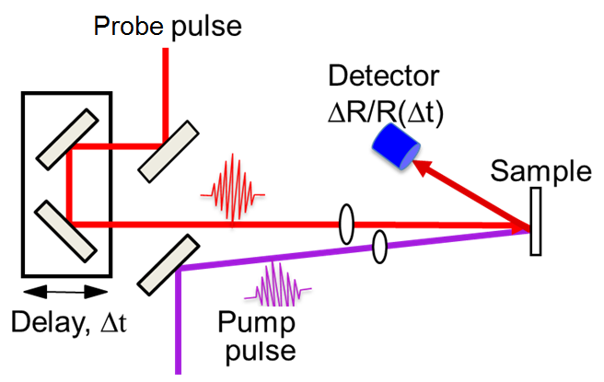
http://info.phys.tsinghua.edu.cn/zhou/ZhouLab_Research_Ultrafast%20time-resolved%20optical%20pump-probe%20technique.html
Notes:
In our experiment, we will be analyzing the stress on a thin film (100 nm) of Aluminum on a silicon wafer substrate
We will be using the pump and probe method to detect small changes in the optical properties of the film
By collecting data over various points on the wafer, we can calculate the stress over the entire film

Slide 7
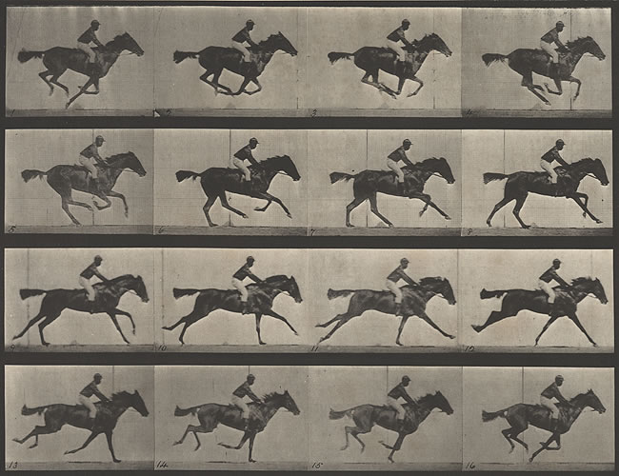
http://www.hrc.utexas.edu/exhibitions/permanent/windows/southeast/eadweard_muybridge.html

Slide 8
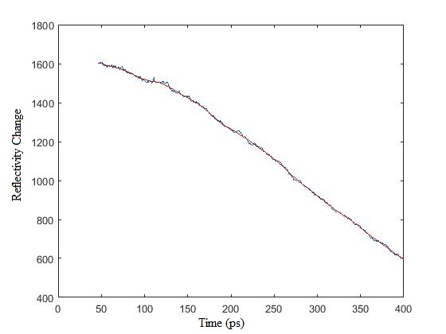
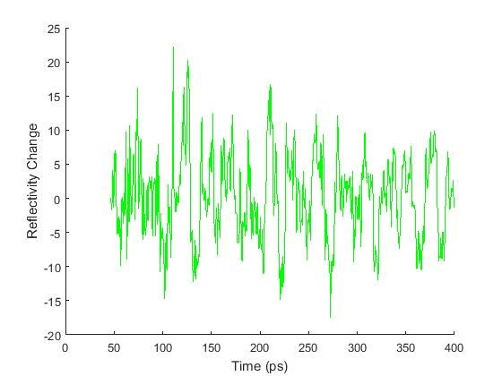
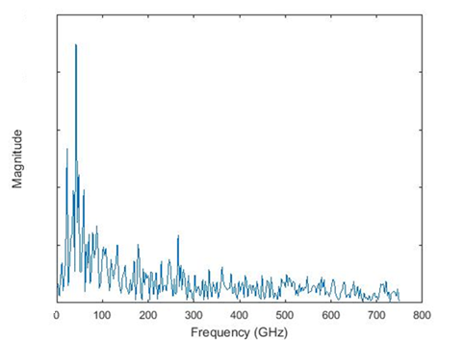
Data with weighted Average
10 nm of gold on glass
gold
glass
Data with background removed
Fourier Transform
Notes:
By collecting data on the change in reflectivity as a function of time, we can find the period τ of oscillation of the film
From the equation below, measurements of τ give the product n*v, where n is the index of refraction, v is the velocity of the sound wave,${ λ}_{0}$ is the wavelength of the pulse light in free space, and $θ$’ is the propagation direction of the probe beam when in the substrate. n and v here give us information about the stress

Slide 9
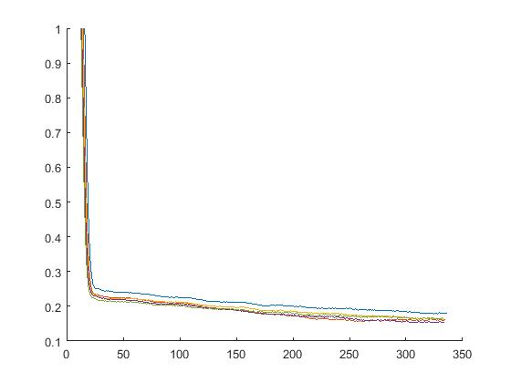



Slide 10
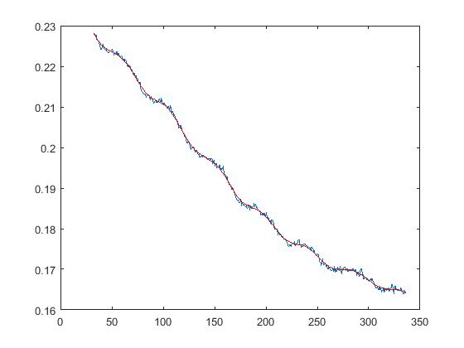
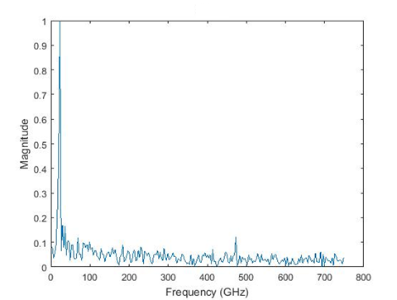
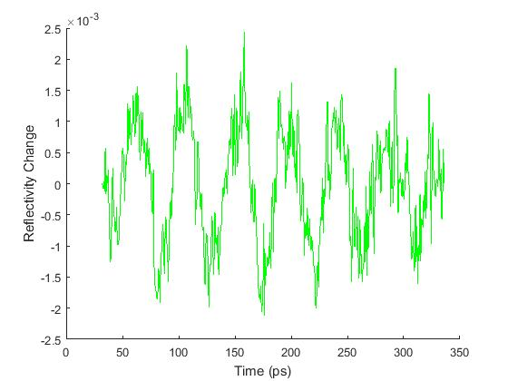
Average of 5 data sets
10 nm gold on glass with reduced noise
gold
glass
With background removed
Fourier Transform

Slide 11
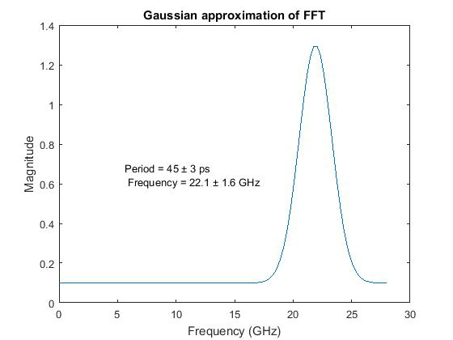

Slide 12
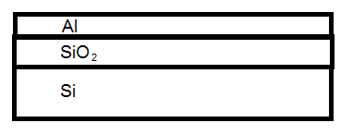
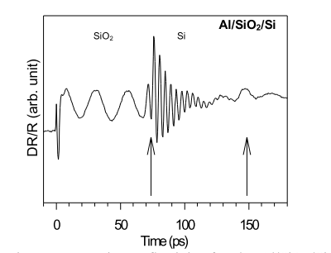

Devos et al. WCU. 2003.

Slide 13
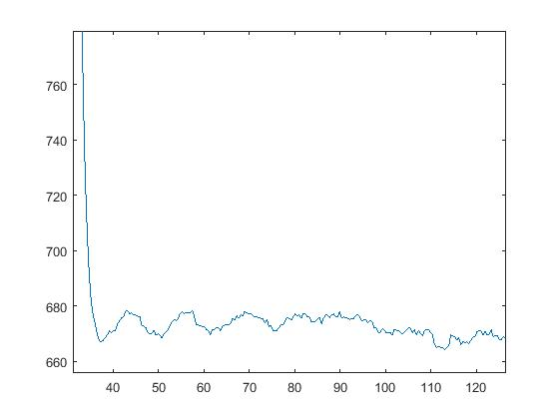
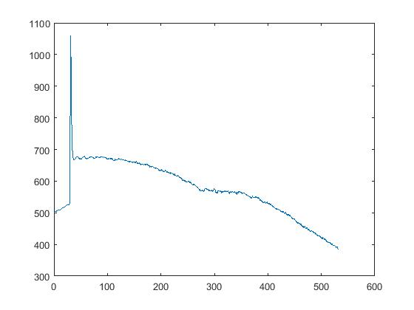
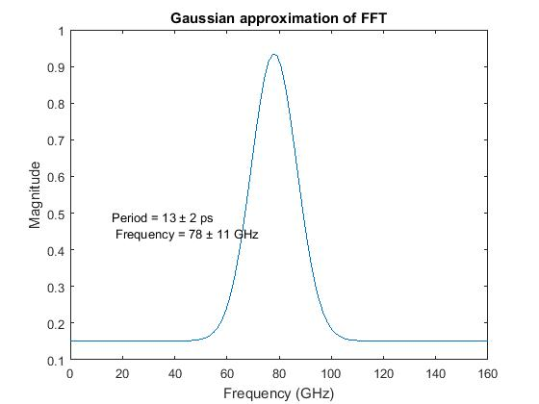
20 nm gold on glass sample
gold
glass

Slide 14
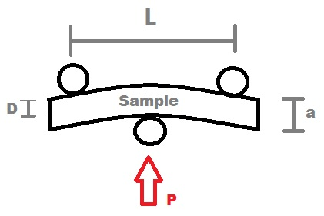
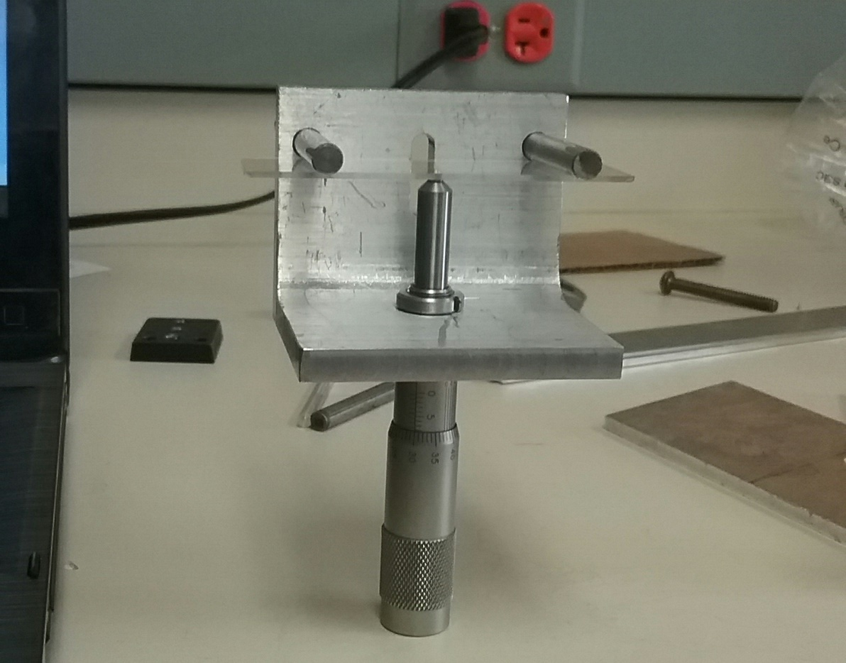



Slide 15
Conclusions
High signal-to- noise ratio is essential
3 point bend setup created
Specific stress measurements can be made
This can help optimize performance of electronic devices

Slide 16
References
Dai J, Mukundhan P, Kim C, Maris HJ. Analysis of a picosecond ultrasonic method for measurement of stress in a substrate. J Appl Phys. 2016;119(10). doi:10.1063/1.4943541.
Tauc J, Maris HJ. Picosecond Ultrasonics. IEEE J Quantum Electron. 1989;25(12):2562-2569. doi:10.1109/3.40643.
Devos, Arnaud, Renaud Cote, and Arnaud Le Louarn. 2003. “Giant Oscillations in the Picosecond Ultrasonic Response of Crystalline Silicon: Connection with the Electronic Structure.” WCU, 1197–1200.
Yu, Kuai, Tuphan Devkota, Gary Beane, Guo Ping Wang, and Gregory V Hartland. 2017. “Brillouin Oscillations from Single Au Nanoplate.” doi:10.1021/acsnano.7b02703.

