Slide 1

https://github.com/ckorakidis/ignite/tree/master/doc

Slide 2
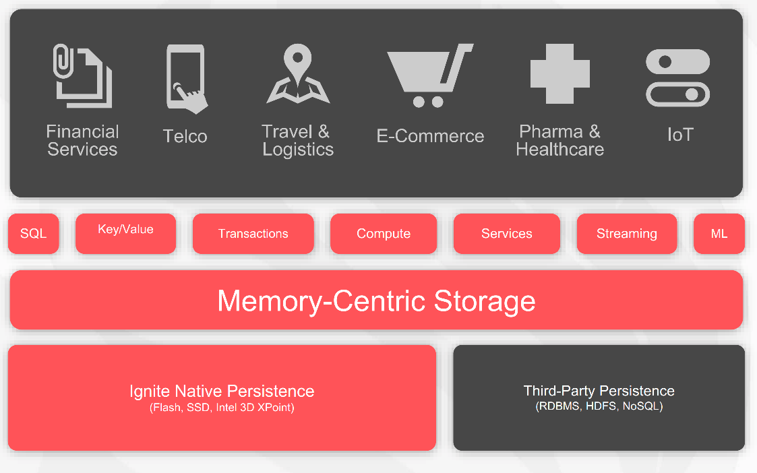
In-Memory Computing Platform

Slide 3
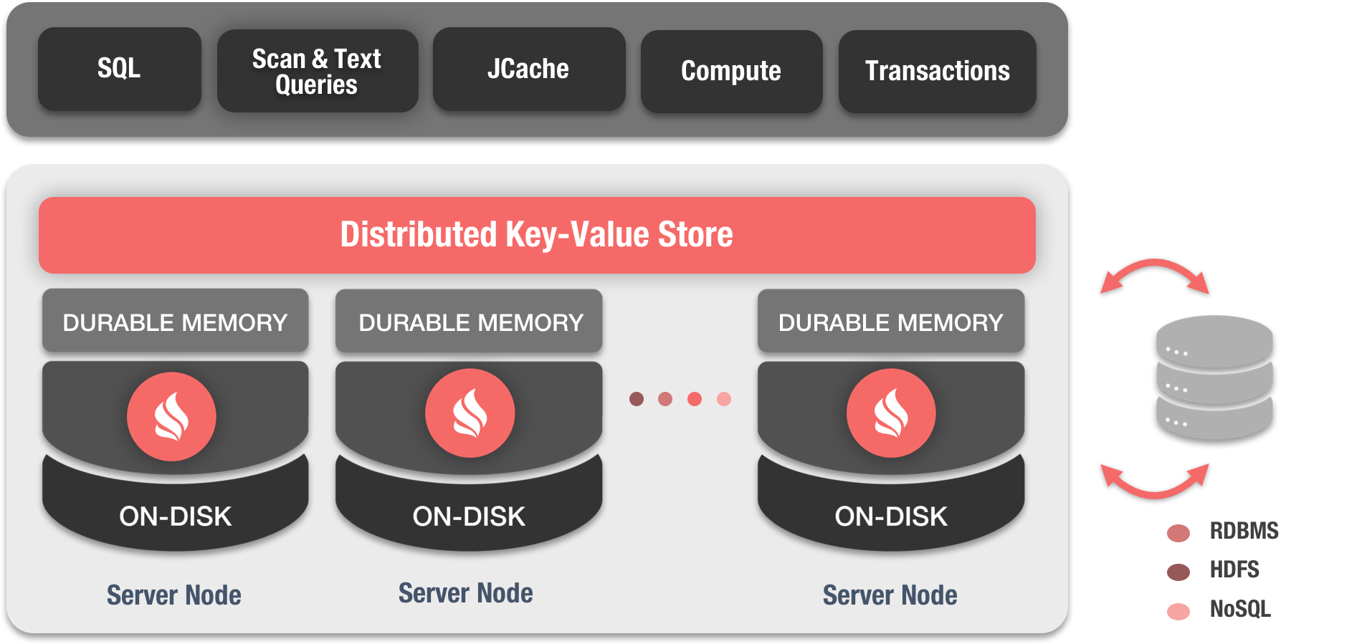
Data Grid (In-Memory distributed key-value store)

Slide 4
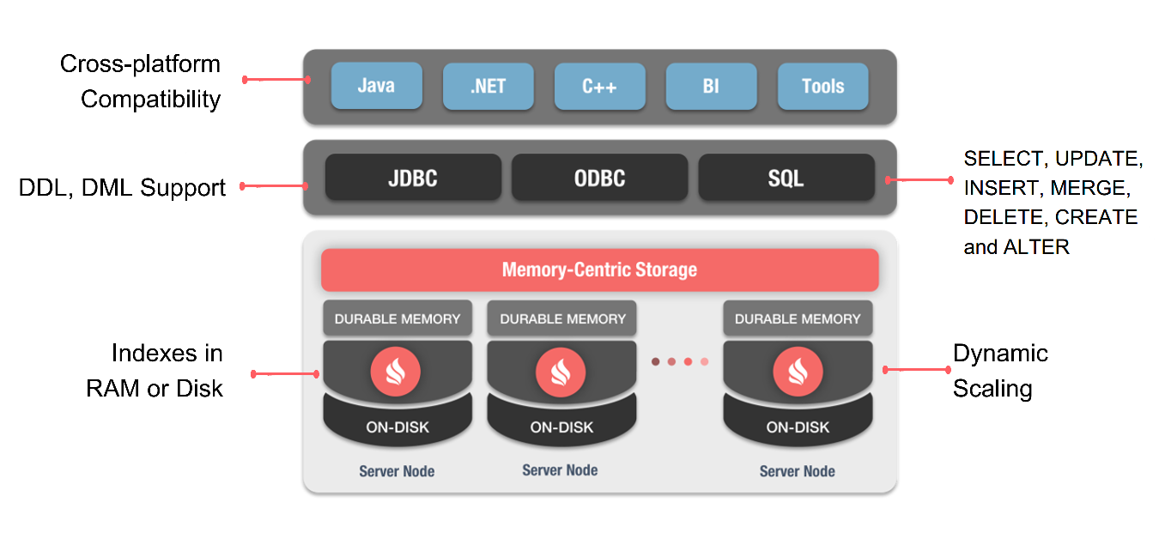
Distributed SQL

Slide 5
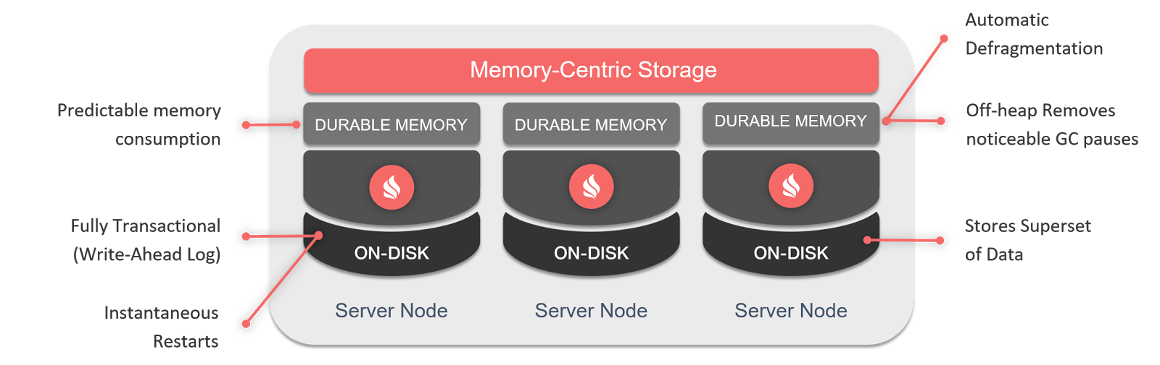
Durable Memory

Slide 6
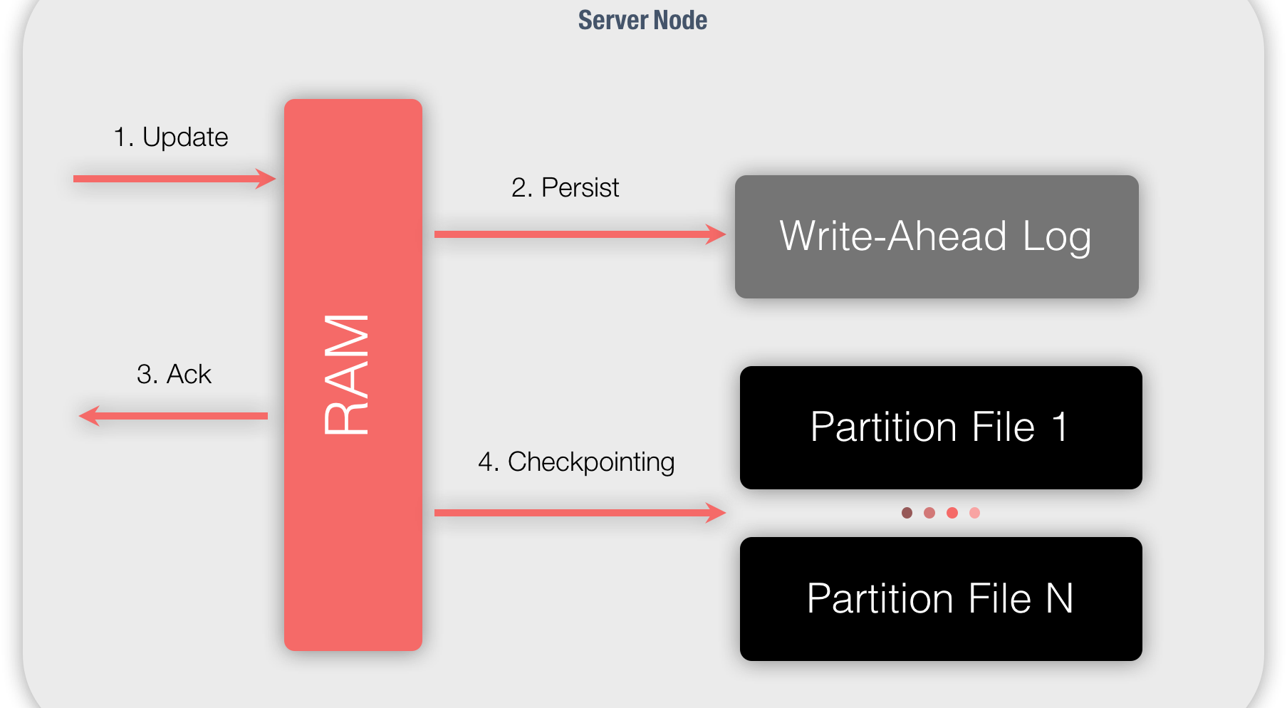
Native Persistence

Slide 7
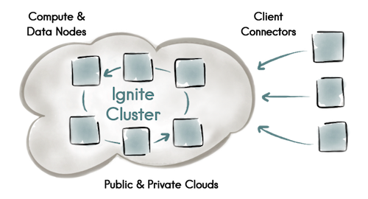
Clustering

Slide 8
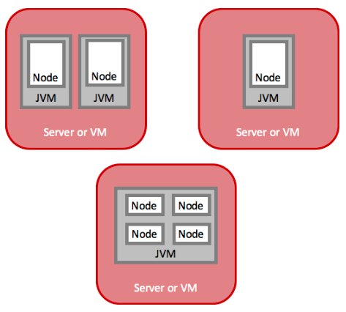
Deployment
Nodes are logical entities
Runs in a JVM process
Many nods in a single JVM process
On-Premise and Cloud
Physical server or VM
AWS, Azure, Google Compute Engine
Hybrid Cloud
Kubernetes, Mesos, YARN

Slide 9
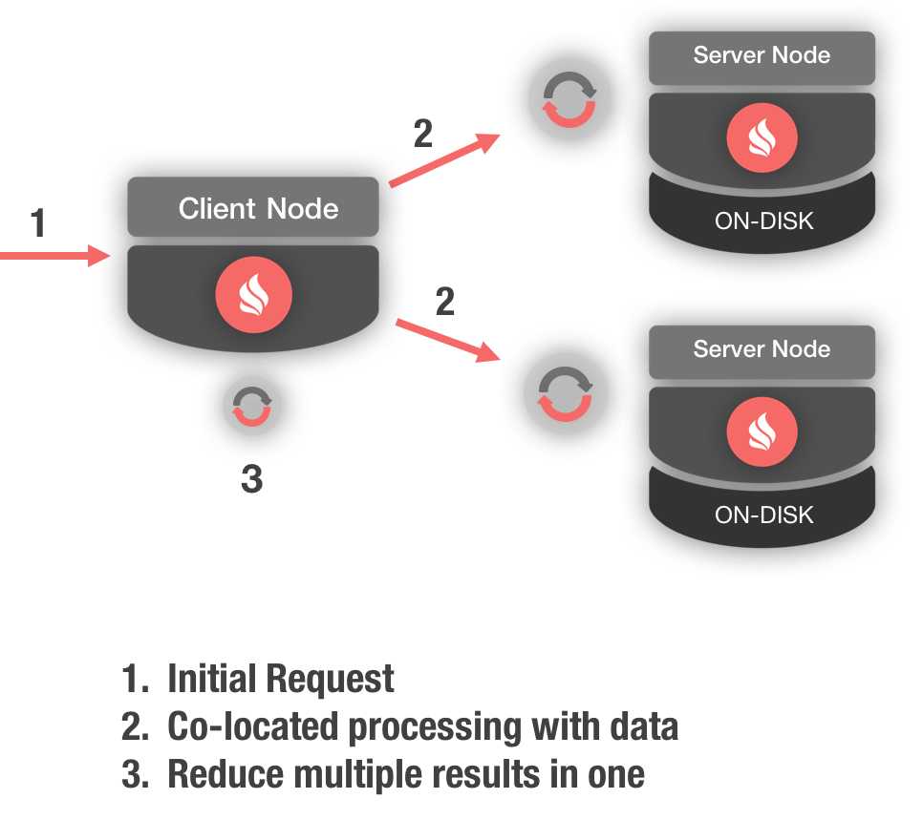
Compute Grid

Slide 10
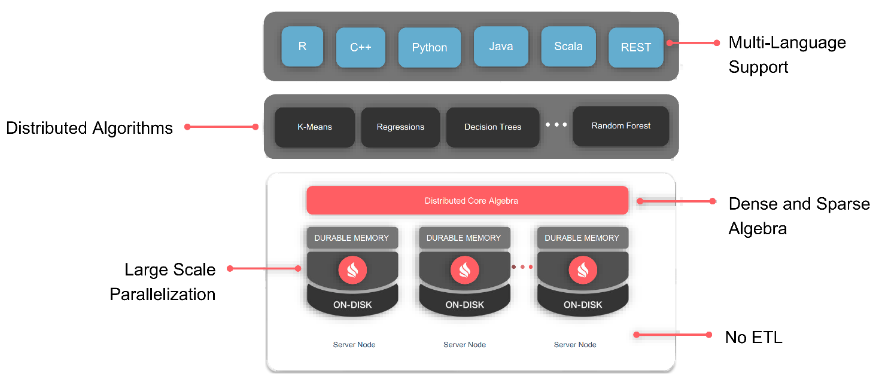
Machine Learning Grid

Slide 11
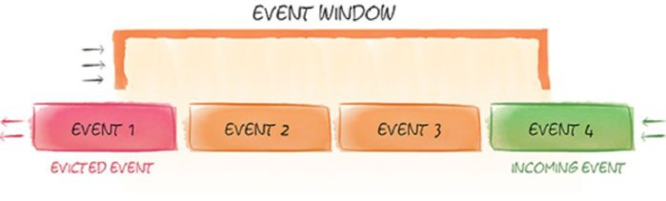
Streaming

Slide 12
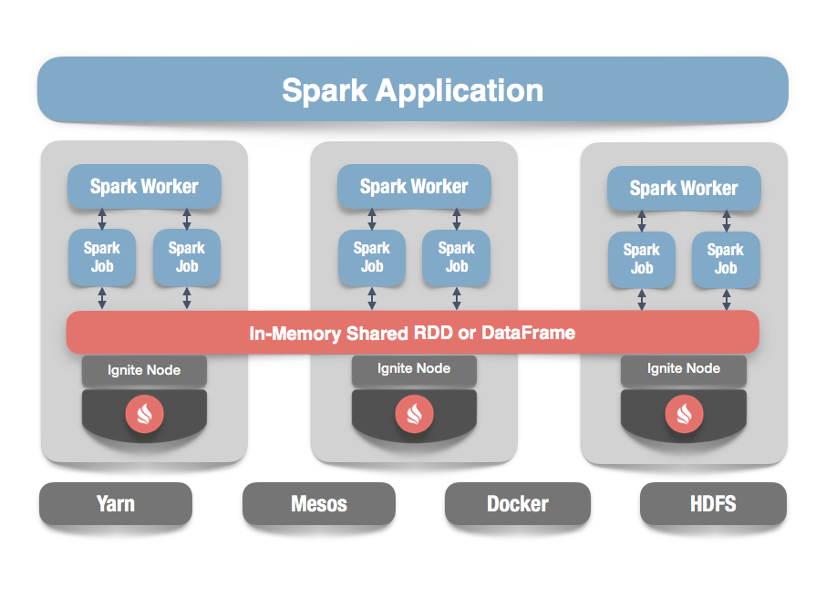
Used with Spark

Slide 13
Select * from questions limit 999

