Slide 1
CS677 Final Project
Cosmic Entity Classification
Conrad Korzon | 4/23/2024

Slide 2
Overview
Data Set: SSDS Star Classification Data Set
100,000 photometric observations of objects in space.
8 continuous numeric features used
75% Train, 25% Test
Goal: Find an effective model for classifying cosmic entities as Stars, Quasars, or Galaxies
Method: Train, Test, and Compare the following Classifiers:
K-Nearest Neighbors
Logistic Regression
Gaussian Naïve Bayes
Random Forest
Notes:
Two probabilistic classifiers, two hard voting classifiers

Slide 3
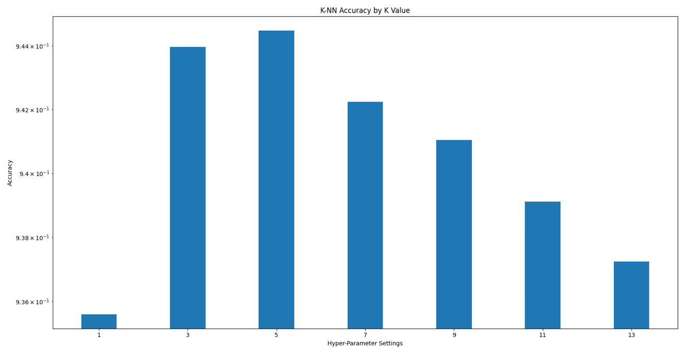
K-Nearest Neighbors
Selected K = 5 during hyperparameter tuning
Accuracy fell significantly with K >= 7

Slide 4

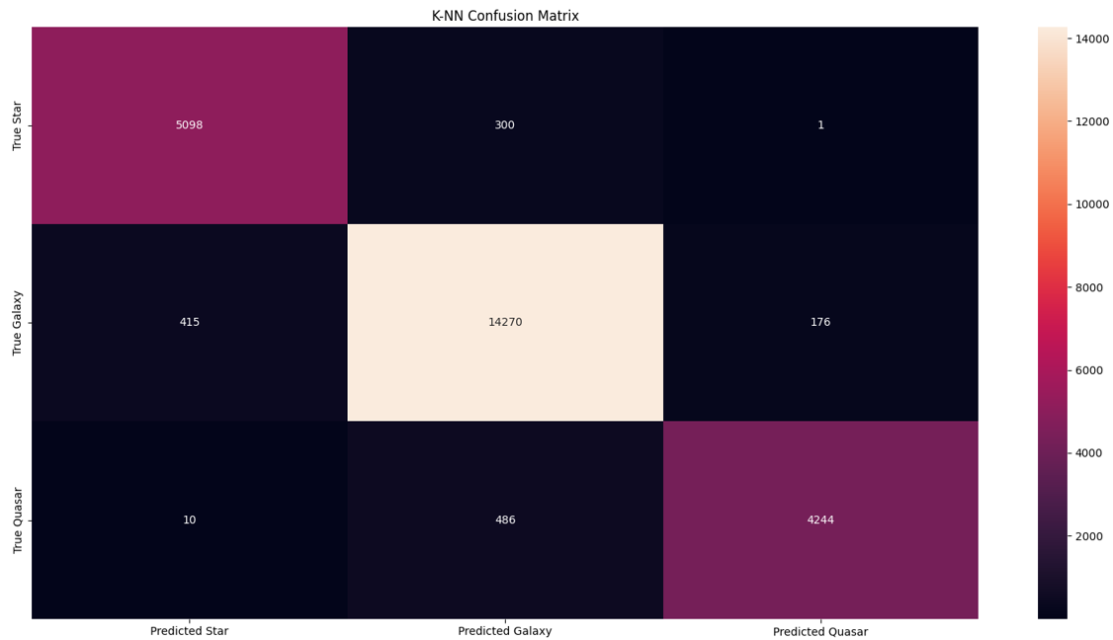



K-Nearest Neighbors
Overall accuracy = 94.45%
Performed particularly well for Stars and Galaxies
Notes:
Explain the confusion matrix

Slide 5
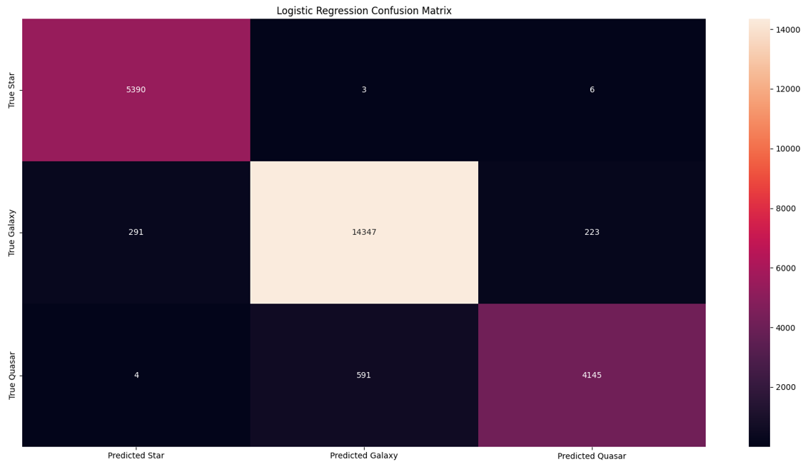
Logistic Regression
Overall accuracy = 95.53%
Performed very well; only misclassified 9 of 5,399 stars
Notes:
Explain the confusion matrix. Mention SKLearn one-vs-rest technique for multi-class prediction; picks class with highest probability

Slide 6
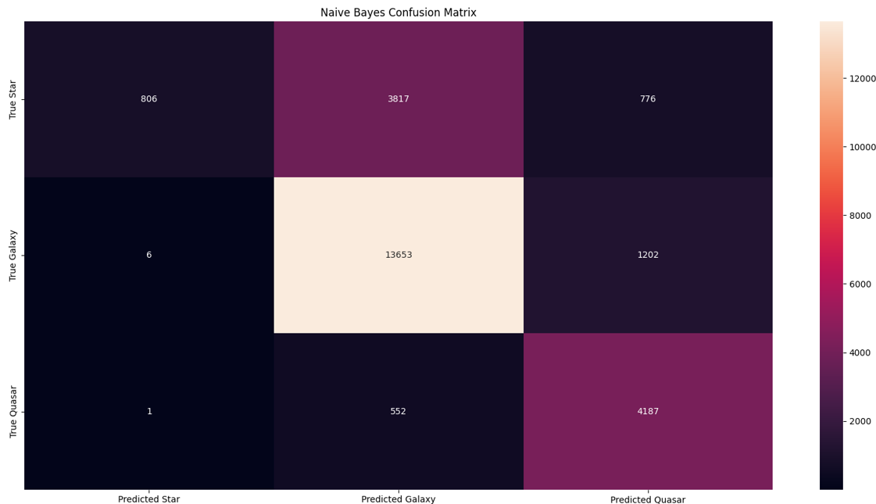
Naïve Bayes
Overall accuracy = 74.58%
Performed relatively poorly
Assumes multivariate normal distribution; may not hold true for this data.
Notes:
Confusion matrix

Slide 7
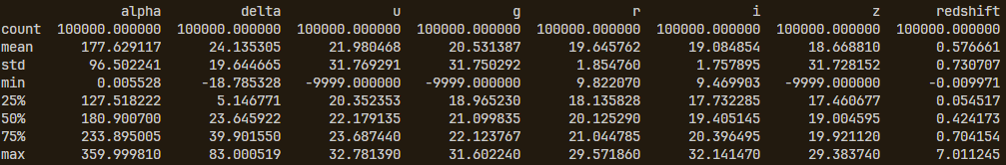
Naïve Bayes
Normal distribution assumption may not hold true for this data
Features u, g, z, and redshift all have their mean much closer to one end of their min-max range than the other.

Slide 8
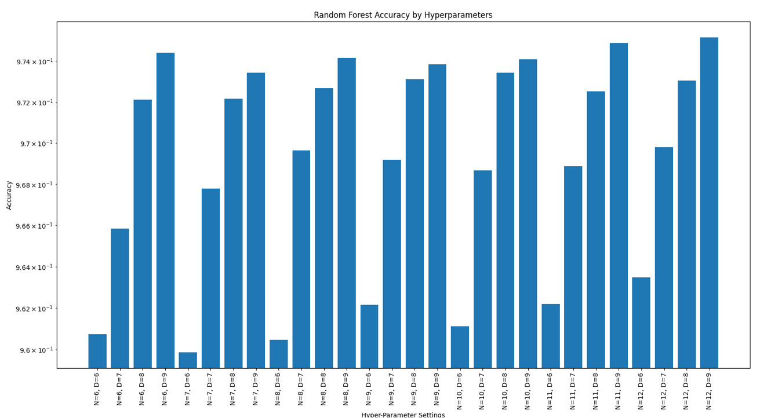
Random Forest
Selected N = 12, D = 9 during hyperparameter tuning
Much lower accuracy for low maximum depth d
Number of classifiers n had less of an effect on accuracy

Slide 9
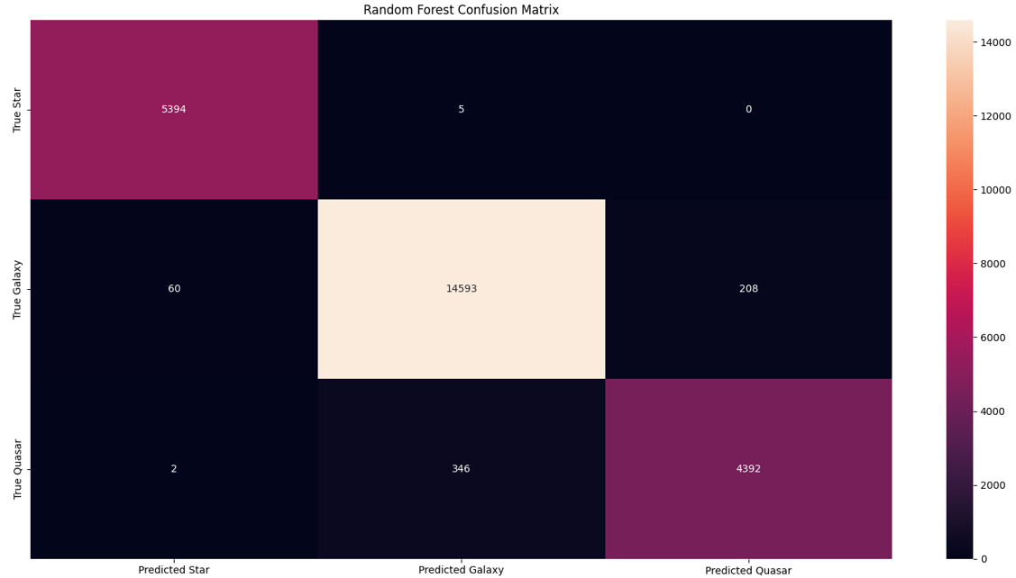
Random Forest
Overall accuracy = 97.52%
Highest accuracy of all tested classifiers
Only misclassified 5 of 5,399 Stars
Only misclassified 268 Galaxies of 14,861
Only 62 incorrect Star predictions

Slide 10
Comparisons
 | K-Nearest Neighbors (K=5) | Logistic Regression | Naïve Bayes | Random Forest (N=12, D=9)
TS | 5098 | 5390 | 806 | 5394
FS-G | 300 | 3 | 3817 | 5
FS-Q | 1 | 6 | 776 | 0
TG | 14270 | 14347 | 13653 | 14593
FG-S | 415 | 291 | 6 | 60
FG-Q | 176 | 223 | 1202 | 208
TQ | 4244 | 4145 | 4187 | 4392
FQ-S | 10 | 4 | 1 | 2
FQ-G | 486 | 591 | 552 | 346
TSR | 0.944249 | 0.998333 | 0.149287 | 0.999074
TGR | 0.960231 | 0.965413 | 0.918713 | 0.981966
TQR | 0.895359 | 0.874473 | 0.883333 | 0.926582
Accuracy | 0.94448 | 0.95528 | 0.74584 | 0.97516
Notes:
Explain row naming convention
Random forest had highest accuracy, TSR, TGR TQR
Logistic Regression had a very high TSR but suffered in TQR
K-Nearest Neighbors had a comparable TGR and Accuracy to Logistic Regression
Naïve Bayes had good TGR and TQR but terrible TSR
Top 3 models all had relatively high FG-Q and FQ-G scores, meaning the hardest part of classification may have been differentiating Galaxies and Quasars.

Slide 11
Conclusions
Ranking based on overall accuracy:
Random Forest 97.52%
Logistic Regression 95.53%
K-Nearest Neighbors 94.45%
Naïve Bayes 74.58%
Better performance for predicting Stars and Galaxies than Quasars in top 3 classifiers
Random Forest achieves best performance in all four categories (Accuracy, TSR, TGR, TQR)

Slide 12
Sources
[1] Enxing, J. (2024, March 28). MET CS 677 Module 3 Live Classrooms. Boston, MA, USA.
[2] Enxing, J. (2024, April 10). MET CS 677 Module 5 Live Classrooms. Boston, MA, USA.
[3] fedesoriano. (January 2022). Stellar Classification Dataset - SDSS17. Retrieved April 10, 2024, from https://www.kaggle.com/fedesoriano/stellar-classification-dataset-sdss17 .
[4] scikit-learn developers. (2024). LogisticRegression. scikit-learn. https://scikit-learn.org/stable/modules/generated/sklearn.linear_model.LogisticRegression.html

Slide 13
Thank You

