Slide 1
ITSC 3160 Group 8
Christian Kotas, Adam Hill, Austin Hill,
Patrick Carney, Andrew Darkwah

Slide 2
Introduction
For this project we take an existing database for a food delivery service and implement a rating system. This rating system will be implemented for both the restaurant and the delivery driver. They will get a score out of 10. There can also be many ratings for both the driver and the restaurant. When viewing a restaurant, you can see the min, max, and average ratings. Drivers will also have a view min, max, and average ratings.
https://github.com/ckotas/3160-Group-Project-Fall-2020

Slide 3
Thought Process
The goal of this project is to create a rating system for an existing restaurant and delivery service. We decided to make a rating out of 10 for both the driver and the restaurant.

Slide 4
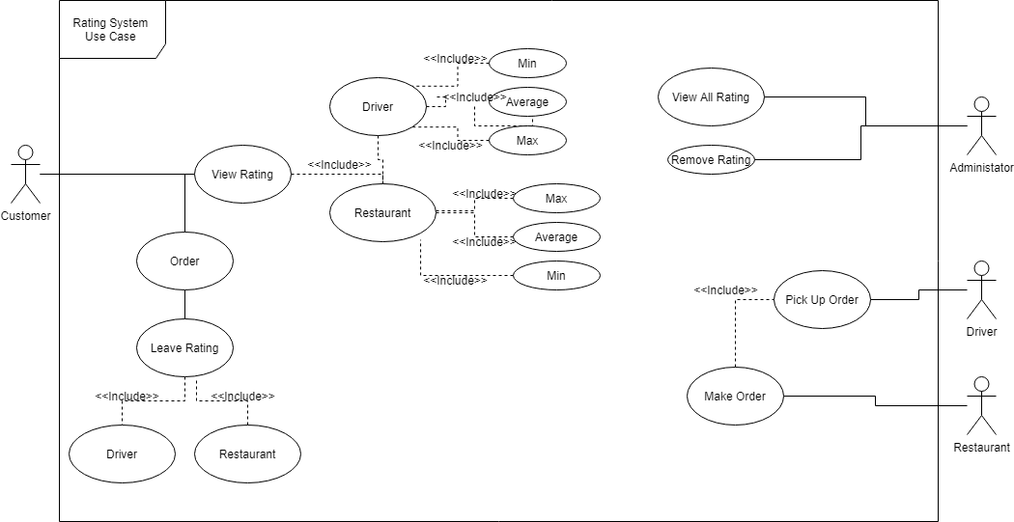
Use Case for our Restaurant

Slide 5
Business rules
The goal of this project is to implement a rating system for customers to rate the restaurant and driver.
Customers will be able to give a rating from 0-10 for the restaurant and driver.
Customer will be able to see the average rating for the restaurant and driver.
Customer will be able to see the maximum rating for the restaurant and driver.
Customer will be able to see the minimum rating for the restaurant and driver.
Administrators can see all reviews.
Administrators can remove any review.

Slide 6
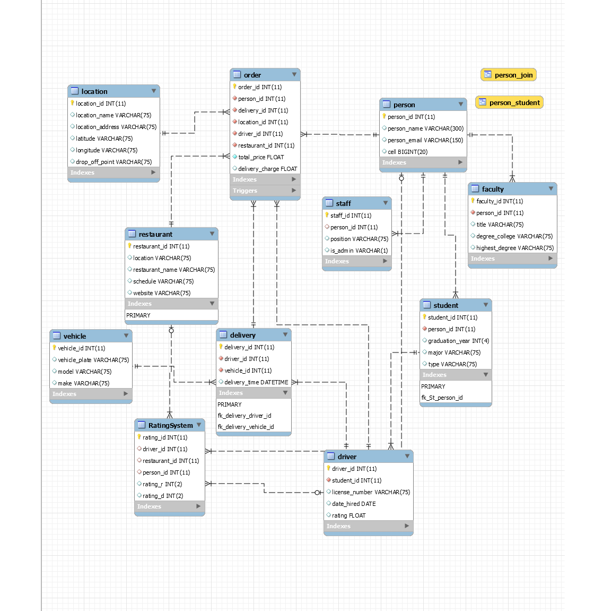
EERD

Slide 7
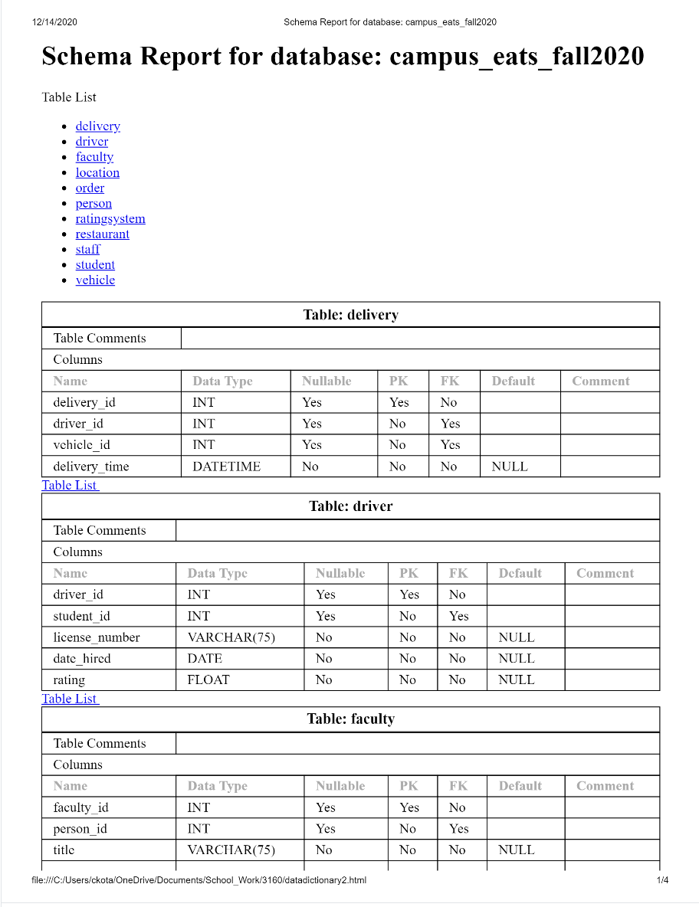
Data Dictionary
https://github.com/ckotas/3160-Group-Project-Fall-2020/blob/main/Data_Dictionary2.pdf

Slide 8
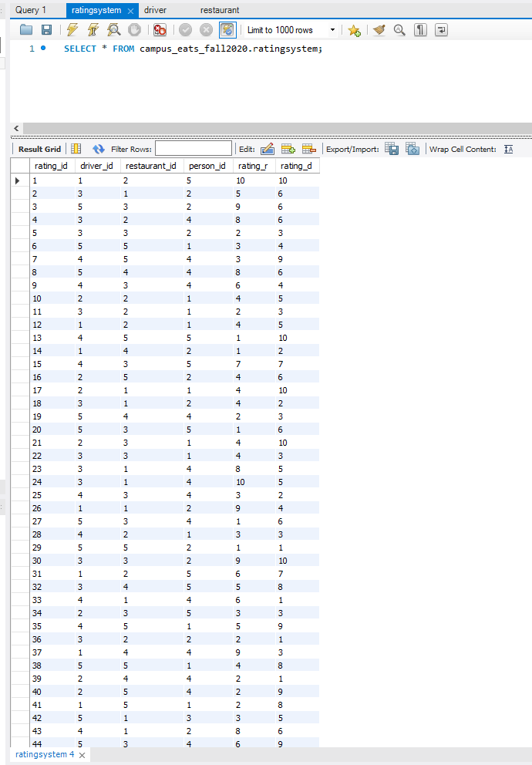
Test Data
https://github.com/ckotas/3160-Group-Project-Fall-2020/tree/main/table_select

Slide 9
SQL Dump
https://github.com/ckotas/3160-Group-Project-Fall-2020/blob/main/Dump20201214.sql

Slide 10
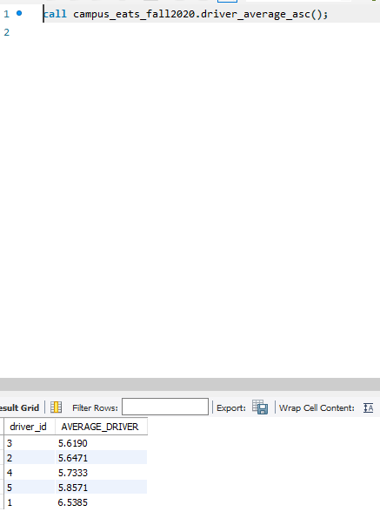
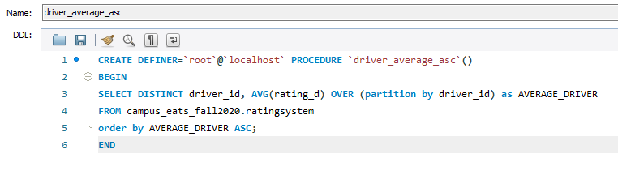
Stored Procedure
Driver Average ascending

Slide 11
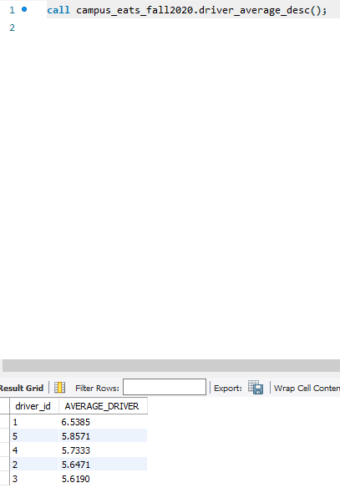
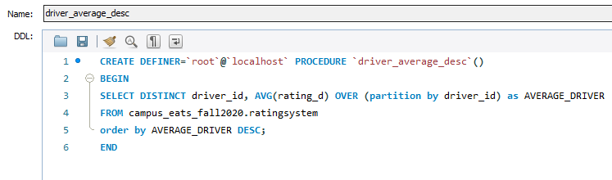
Stored Procedure
Driver Average descending

Slide 12
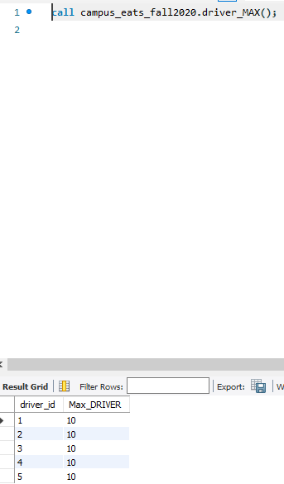
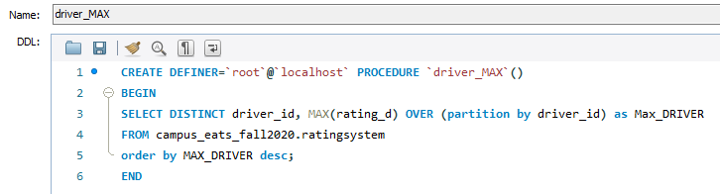
Stored Procedure
Drivers Max Rating Descending

Slide 13
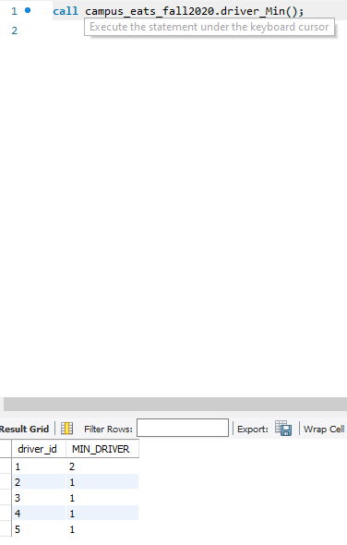
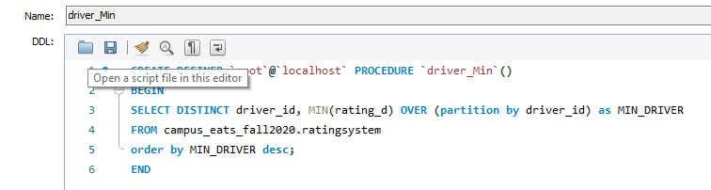
Stored Procedure
Drivers Min Rating Descending

Slide 14
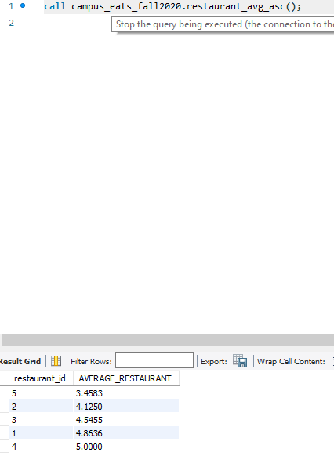
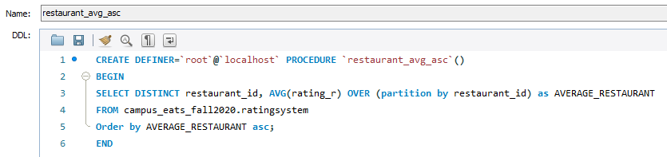
Stored Procedure
Restaurant Average Ascending Order

Slide 15
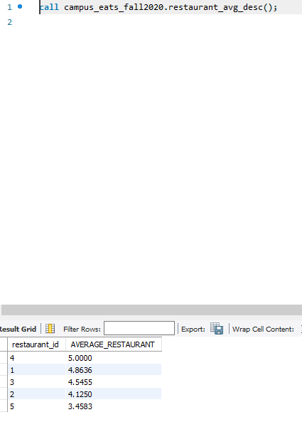
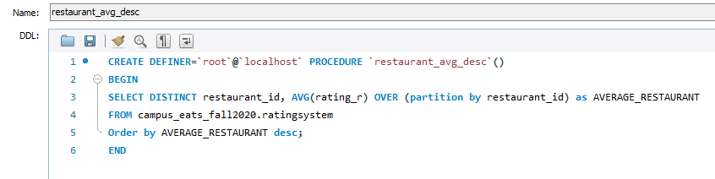
Stored Procedure
Restaurant Average Descending Order

Slide 16
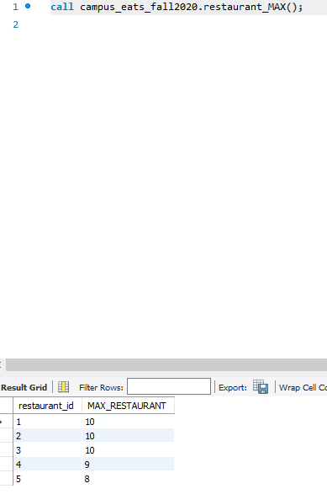
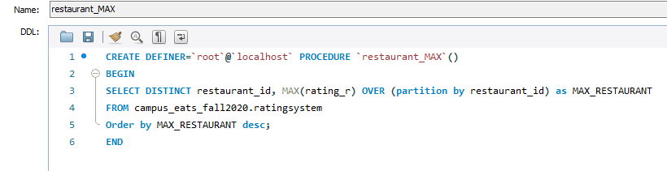
Stored Procedure
Restaurant Max Rating Descending

Slide 17
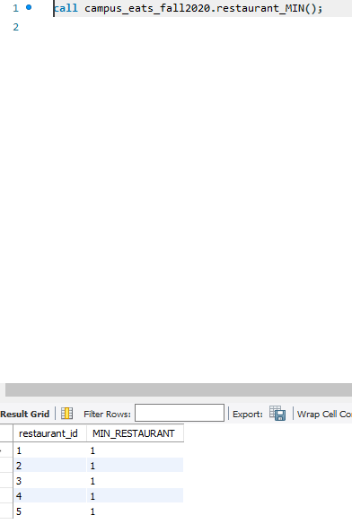
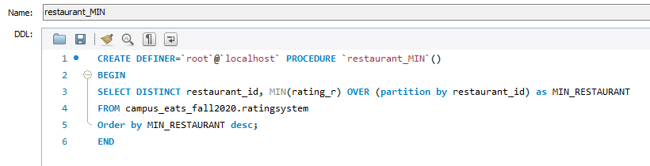
Stored Procedure
Restaurant Min Rating Descending

Slide 18
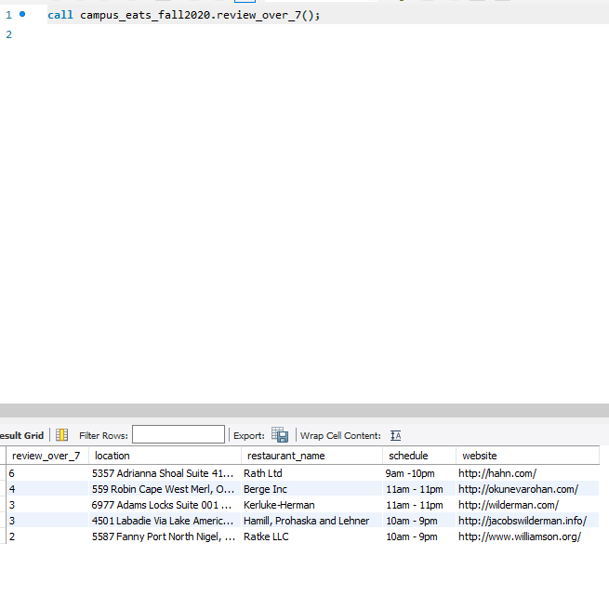
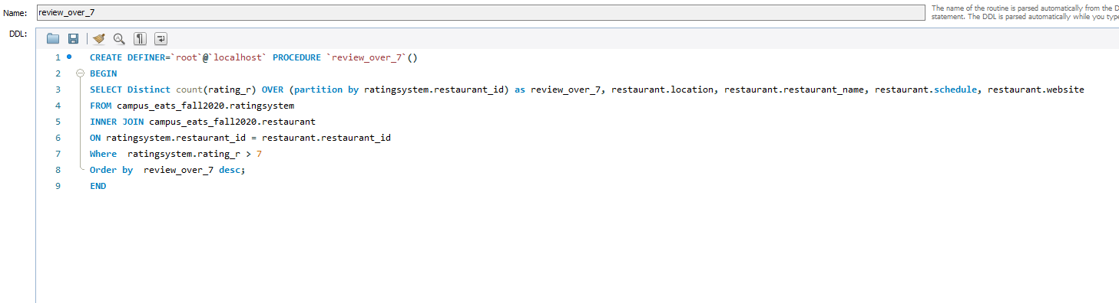
Advanced SQL Statements
Statement to get the amount of reviews for a restaurant over 7.

Slide 19
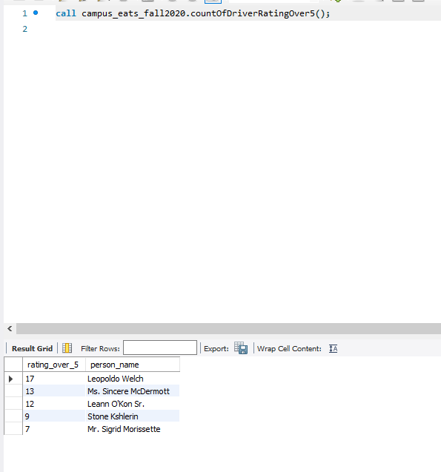
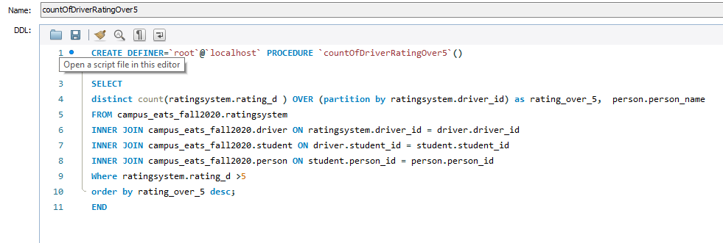
Advanced SQL Statements
Statement to get the amount of reviews for a driver over 5.

