Slide 1
EVALUATING THE RELATIONSHIP BETWEEN BMI, OBESITY AND PHYSICAL ACTIVITY LEVELS IN VARIOUS AGE AND GENDER GROUPS
Group -4
SASHI PRIYA KOKA
CHANDINI REDDY KOTHA
ANITHA PENIMETSA
AKSHAY KUMAR MAHADEVOJU
ARATI GOHIL

Slide 2
TABLE OF CONTENTS
Data Description
Data Attributes
Data Visualization
Linear Regression
Confusion Matrix
KNN & Naïve Bayes
SVM
Random Forest Graph

Slide 3
DATA DESCRIPTION
https://www.kaggle.com/datasets/mrsimple07/obesity-prediction
Source : Kaggle – Obesity Prediction data
Obesity prediction data helps to evaluate the relationship between factors like Age, Gender, Height , Weight, Physical activity level on Obesity among 1000 observations
Number of rows:1000
Number of columns: 7

Slide 4
DATA ATTRIBUTES
Age: Different age groups(years) are included
Gender: Male and Female genders are included
Height: Measured in centimeters
Weight: Measured in kilograms
BMI: Ratio of weight(kilograms) and height(meters)
Physical Activity Level: Ranging from 1 to 4 where 1 is very less physical activity and 4 being very active
Obesity category: Classified into normal weight, Overweight and Obese based on BMI.

Slide 5
FEATURE SELECTION
Age
Weight
BMI
Gender
Obesity Categories

Slide 6
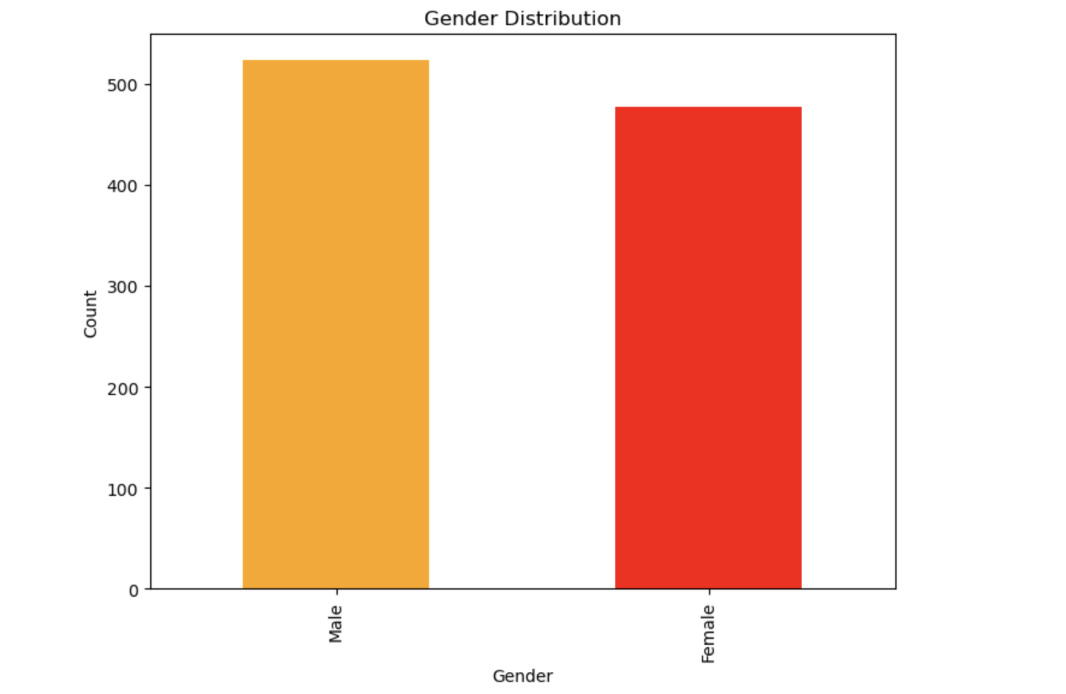
DATA VISUALIZATION
BAR CHART
Gender is a categorical variable with two categories (male, female). A bar graph would show the distribution of these categories.
The Bar chart of the Gender in Obesity data reveals that the gender "Male" are highest in number compared to that of gender "Female". No major difference can be seen, but with a slight variation, Males are highest in number than Females.

Slide 7
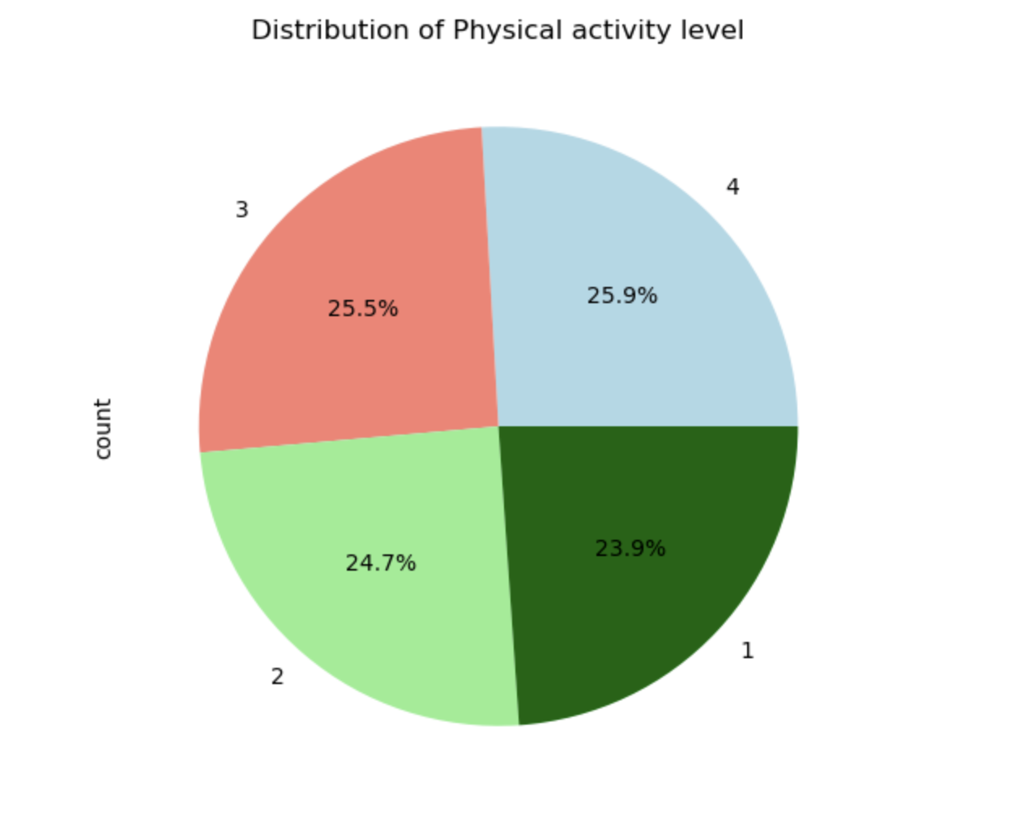
2. PIE CHART
Pie chart displays the distribution of different physical activity level (1,2,3,4) effectively visualizing the proportion or percentage of different categories in a dataset.
The pie chart of the Physical activity level of the data reveals that majority of the people have high physical activity level (4) accounting 25.9% followed by individuals accounting with slightly less physical activity (3) than 4 with 25.5%. Individuals with very less physical activity accounts for 24.7% and finally the individuals with no physical activity (1) with 23.9%.

Slide 8
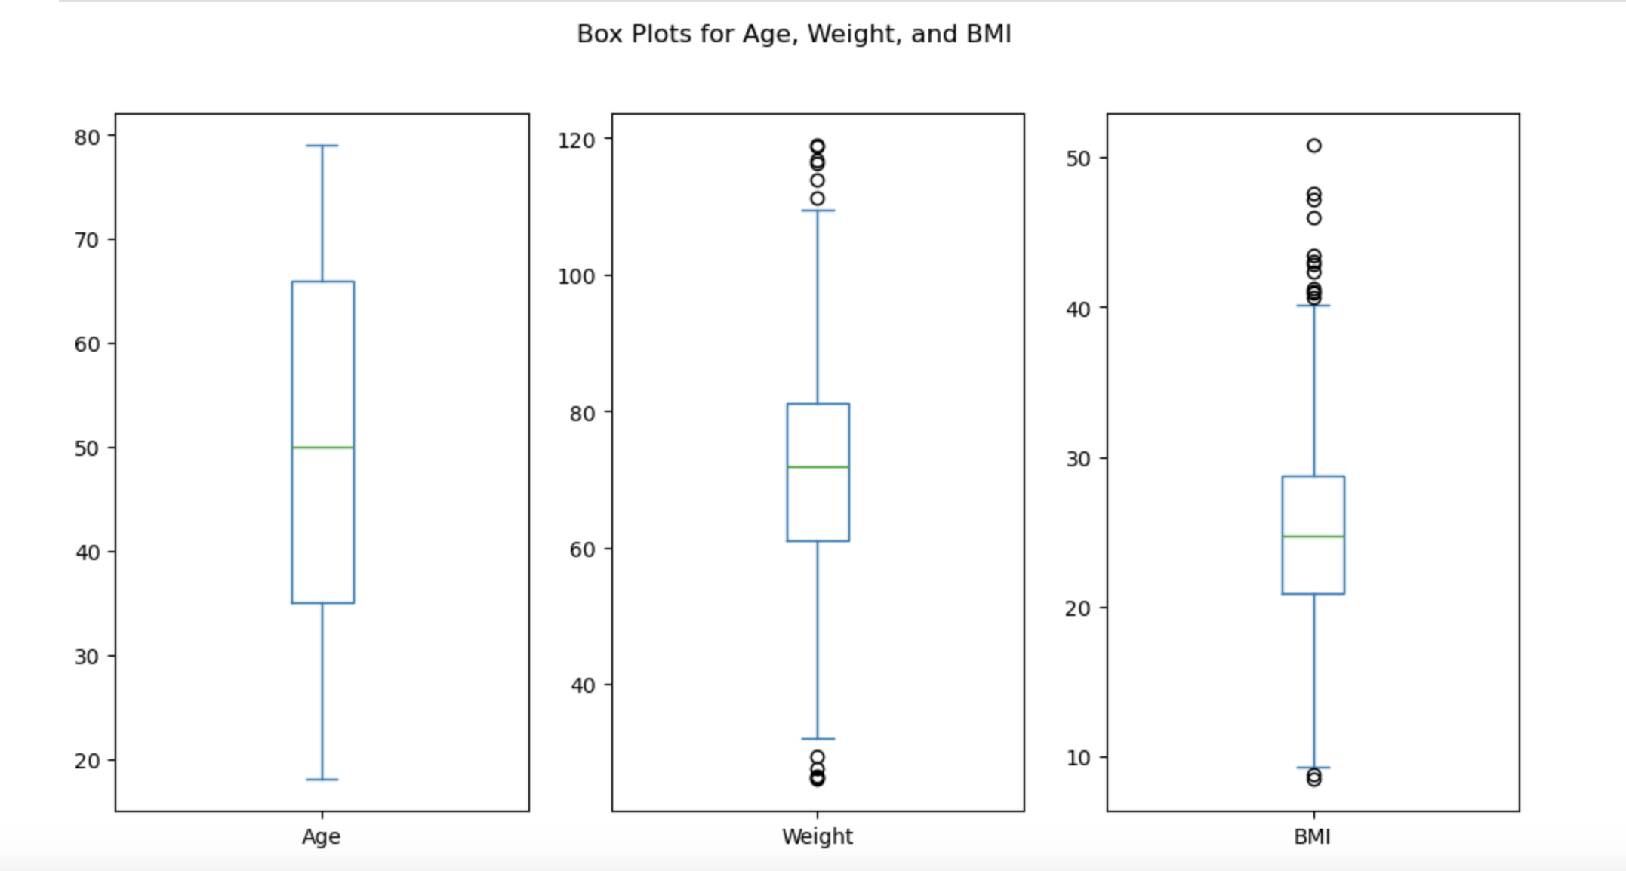
3. BOX PLOT
Age, weight, and BMI box plots provide an easy-to-read summary of the variables' ranges, core tendencies, and outlier presence. These variables are critical in understanding health patterns and demographic distribution, making them an excellent fit for box plot presentation.
a. Box plot for Age: The median age is approximately 50, with the age distribution covering a broad range. It appears that the age range is diverse, as the majority of persons are in their early 20s to late 70s or early 80s. A small number of individuals on the lower end of the sample are considered outliers, meaning they are much younger.
b. Box plot for Weight: The distribution of weights reveals a modest range from 40 to 120, with a median of about 70. Despite the presence of outliers on both extremes of the distribution, which indicate people who are either overweight or underweight than the majority of the sample, the distribution seems to be quite symmetrical.
c. Box plot for BMI: With a median BMI of about 20–30, the average person is classified as normal/overweight. The values are wide, ranging from less than 20 (underweight) to maybe more than 40–50 (obesity). There is a skew towards greater BMI due to a number of outliers on the upper end of the scale, which represent people with extremely high BMI readings.

Slide 9
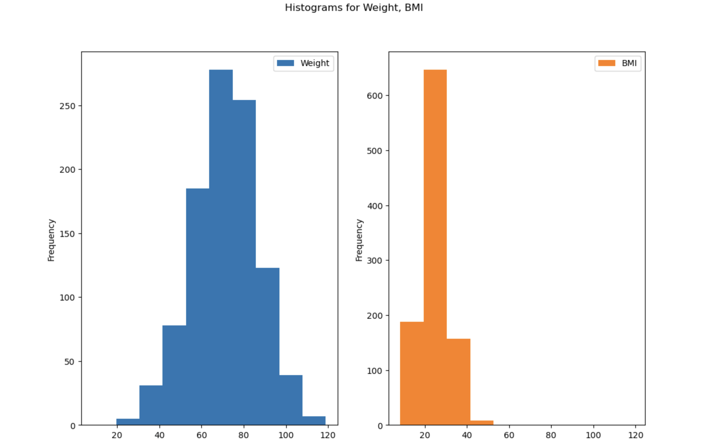
4. HISTOGRAM
a. Histogram for Weight:
Weight being a continuous variable is suitable for showing the spread of weight values.
The weight histogram displays a fairly normal distribution with a small skew to the right. This implies that the majority of the sample's members have weights that are quite close to the mean (70–80). A sufficient range of weights among the individuals in the sample is shown by the moderate data spread.
b. Histogram for BMI:
Being a numerical variable, BMI is displayed on a histogram to show the distribution of BMI across the dataset.
Majority of people have lower BMI values, while a small percentage have substantially higher values due to the histogram's significant rightward skew. Greater variability in BMI relative to weight is suggested by the distribution's wider spread, which reflects a wide range of BMI values in the sample.

Slide 10
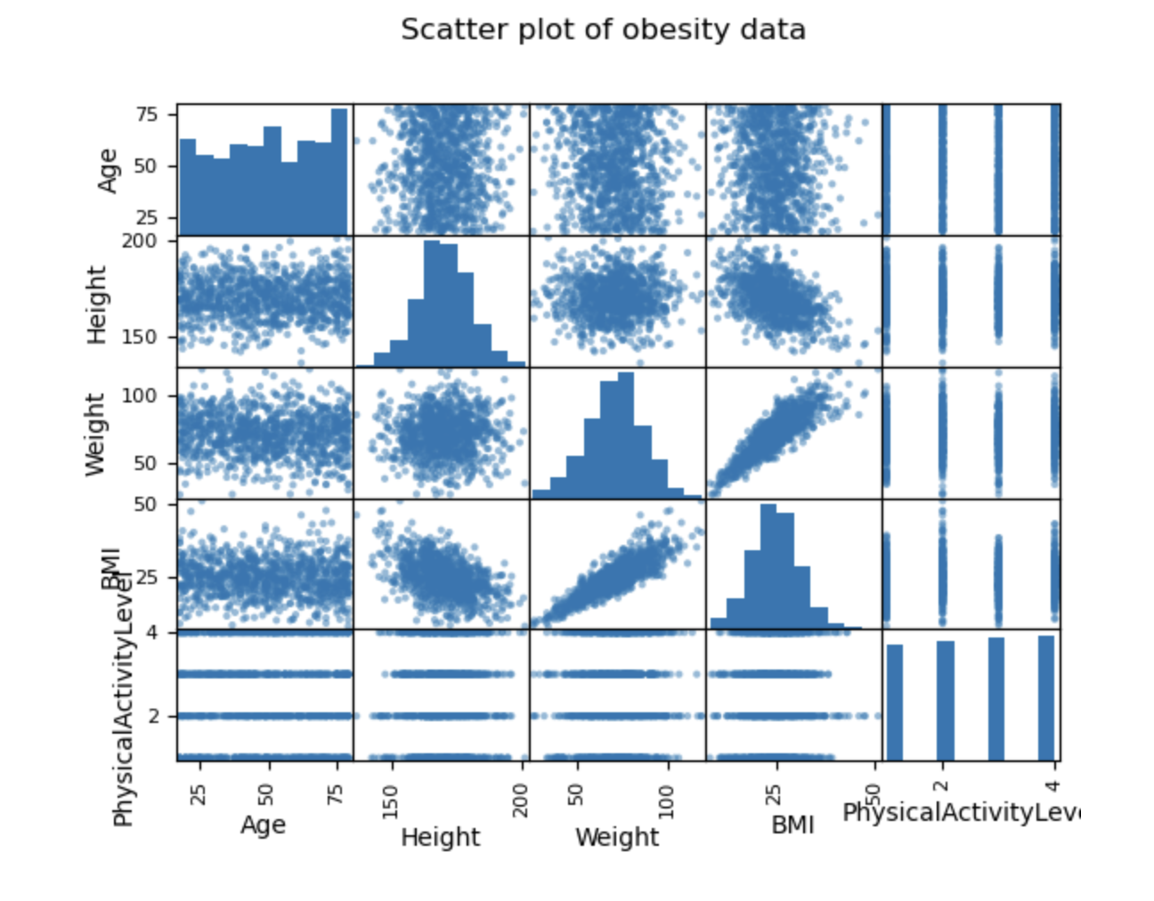
5. SCATTER PLOT:
The correlations between the different features in the obesity data are revealed by the scatter plot matrix. Although these associations are not very strong, there is a weak positive correlation between age and both weight and height, indicating that older people may be slightly taller and heavier. Age and BMI don't seem to correlate well, if at all, suggesting that factors other than age have a greater influence on BMI. As anticipated, there is a strong positive association between height and weight. There is also a moderate positive correlation between height and BMI, indicating that, although there is some fluctuation, taller people generally have higher BMIs. Given that BMI is determined by combining height and weight, the relationship between weight and BMI is the strongest. There is little to no association between physical activity level and the other variables in this dataset, which may indicate that it is not highly correlated with age, height, weight, or BMI. Overall, while height and weight are closely related, age and BMI look less connected, and physical activity level seems essentially independent of these determinants.

Slide 11
Linear Regression Equation
Linear Regression Equation: Obesity category = -2.0395 + 0.1436 * BMI
The predicted Obesity category increases by roughly 0.1436 for every unit increase in BMI, according to the linear regression equation Obesity category = -2.0395 + 0.1436 * BMI, indicating a positive association. Despite acting as a mathematical constant, the intercept (-2.0395) has no practical significance because BMI readings cannot reach zero. Overall, this model suggests that there is a correlation between greater BMI and higher categories of obesity.

Slide 12
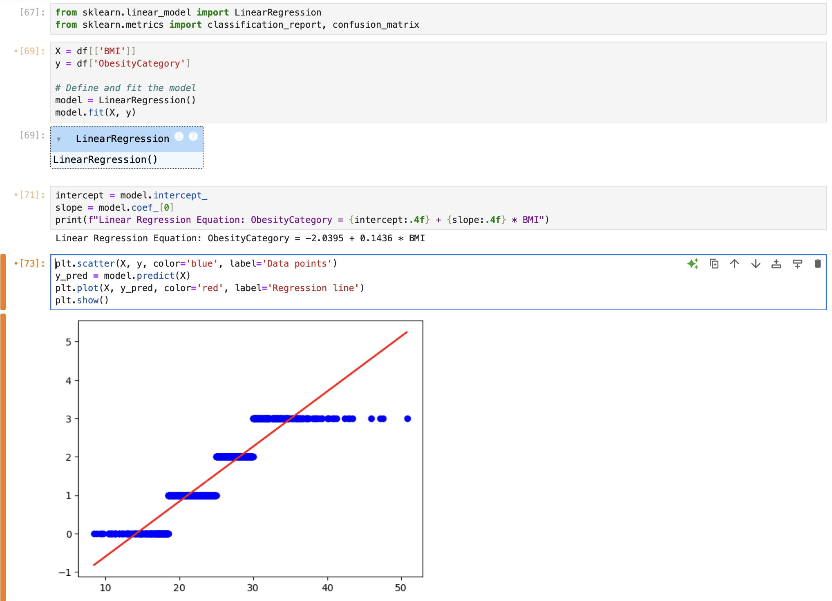
Linear Regression
The linear regression model predicted for Obesity category score increased by 0.1436 for every unit increase in BMI. Although it has no practical significance, the negative intercept (-2.0395) indicates the baseline Obesity Category when BMI is zero and aids in identifying the data's trend. The scatter plot with blue points shows the actual data, while the red line represents the fitted linear regression model, indicating the positive relationship between BMI and Obesity Category. The data points follow the regression line, suggesting that the model fits the data reasonably well.

Slide 13
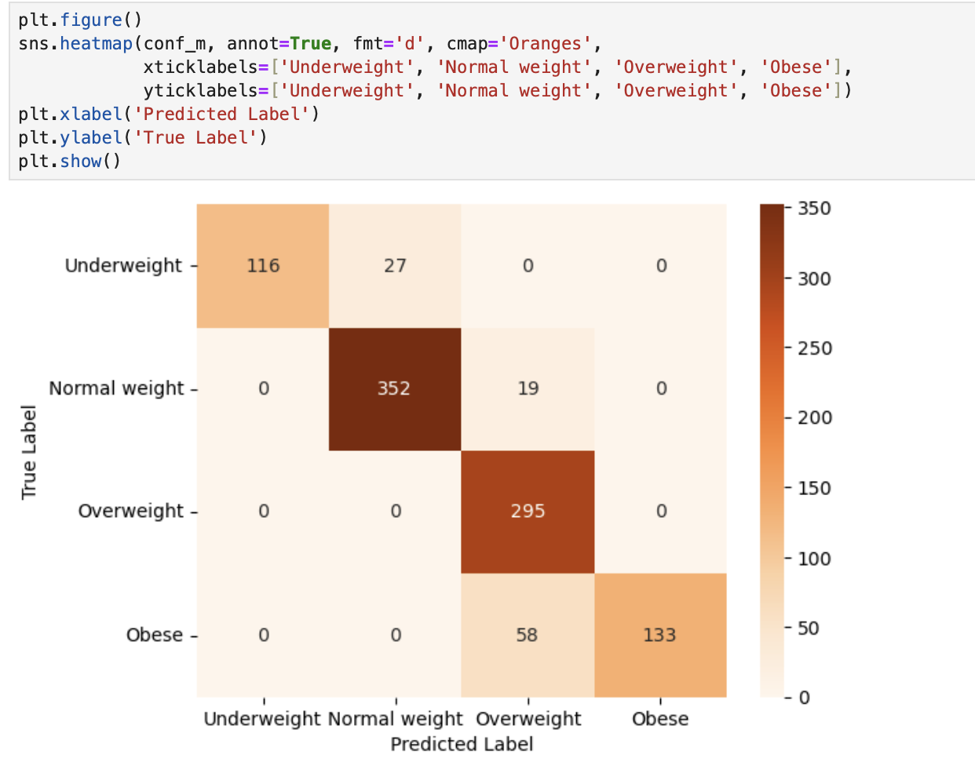
Confusion Matrix
The model's performance in four categories of obesity—underweight, normal weight, overweight, and obese is displayed in the confusion matrix. The model has a high success rate of correctly predicting normal weight and overweight (352 and 295 correct predictions, respectively). There are, however, several evident misclassifications, particularly between Obese and Overweight (58 cases) and Underweight and Normal weight (27 instances). Errors are indicated by off-diagonal values, but the diagonal values show accurate predictions.

Slide 14
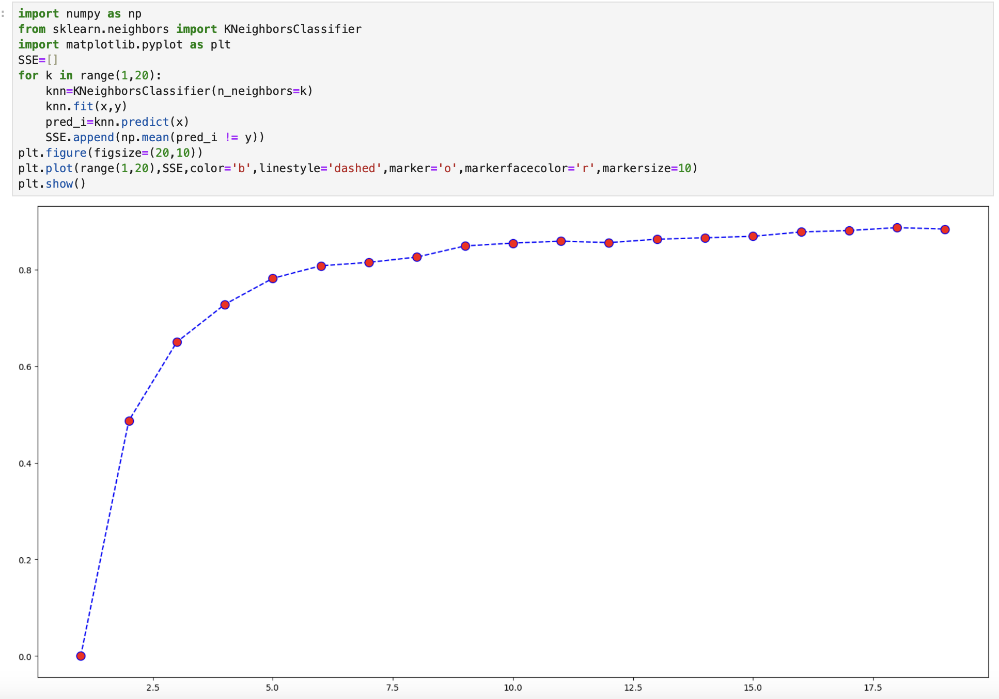
KNN

Slide 15
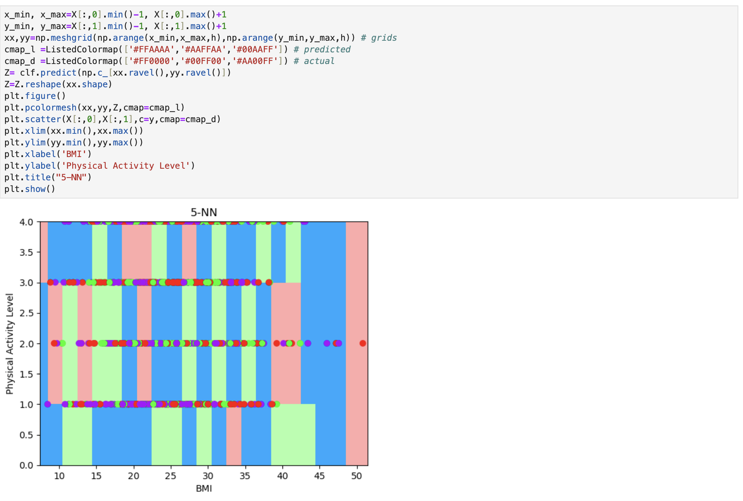

Slide 16
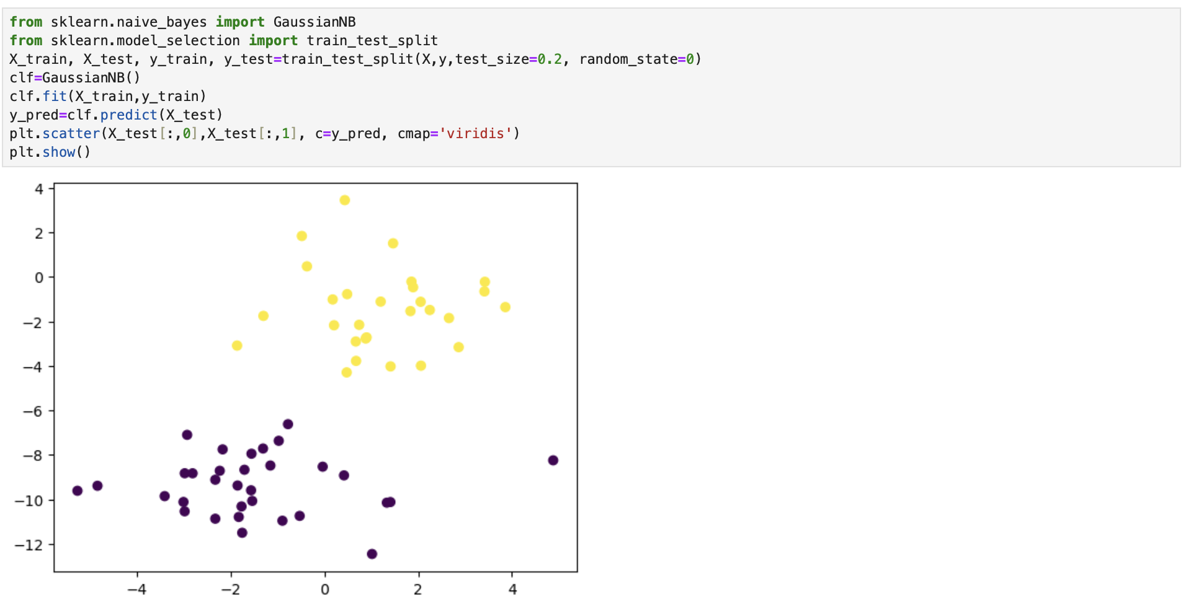
NAÏVE BAYES

Slide 18
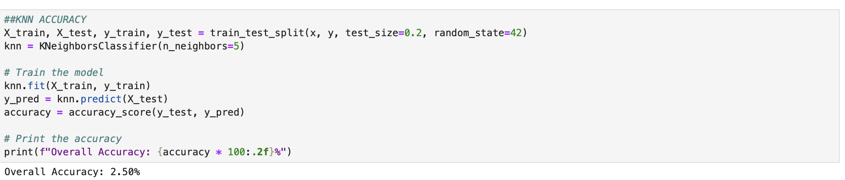
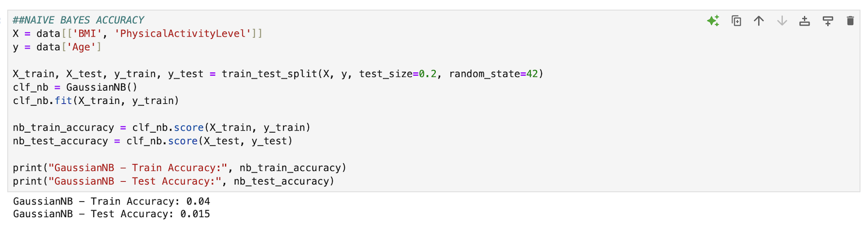
ACCURACY

Slide 19
WHICH MODEL SUITS BETTER
The accuracy of the K-Nearest Neighbors (KNN) and Naive Bayes models is only 2.50% and 1.50%, respectively, indicating their poor performance. Even while KNN performs marginally better than Naive Bayes, it is still far from becoming an effective model.

Slide 20
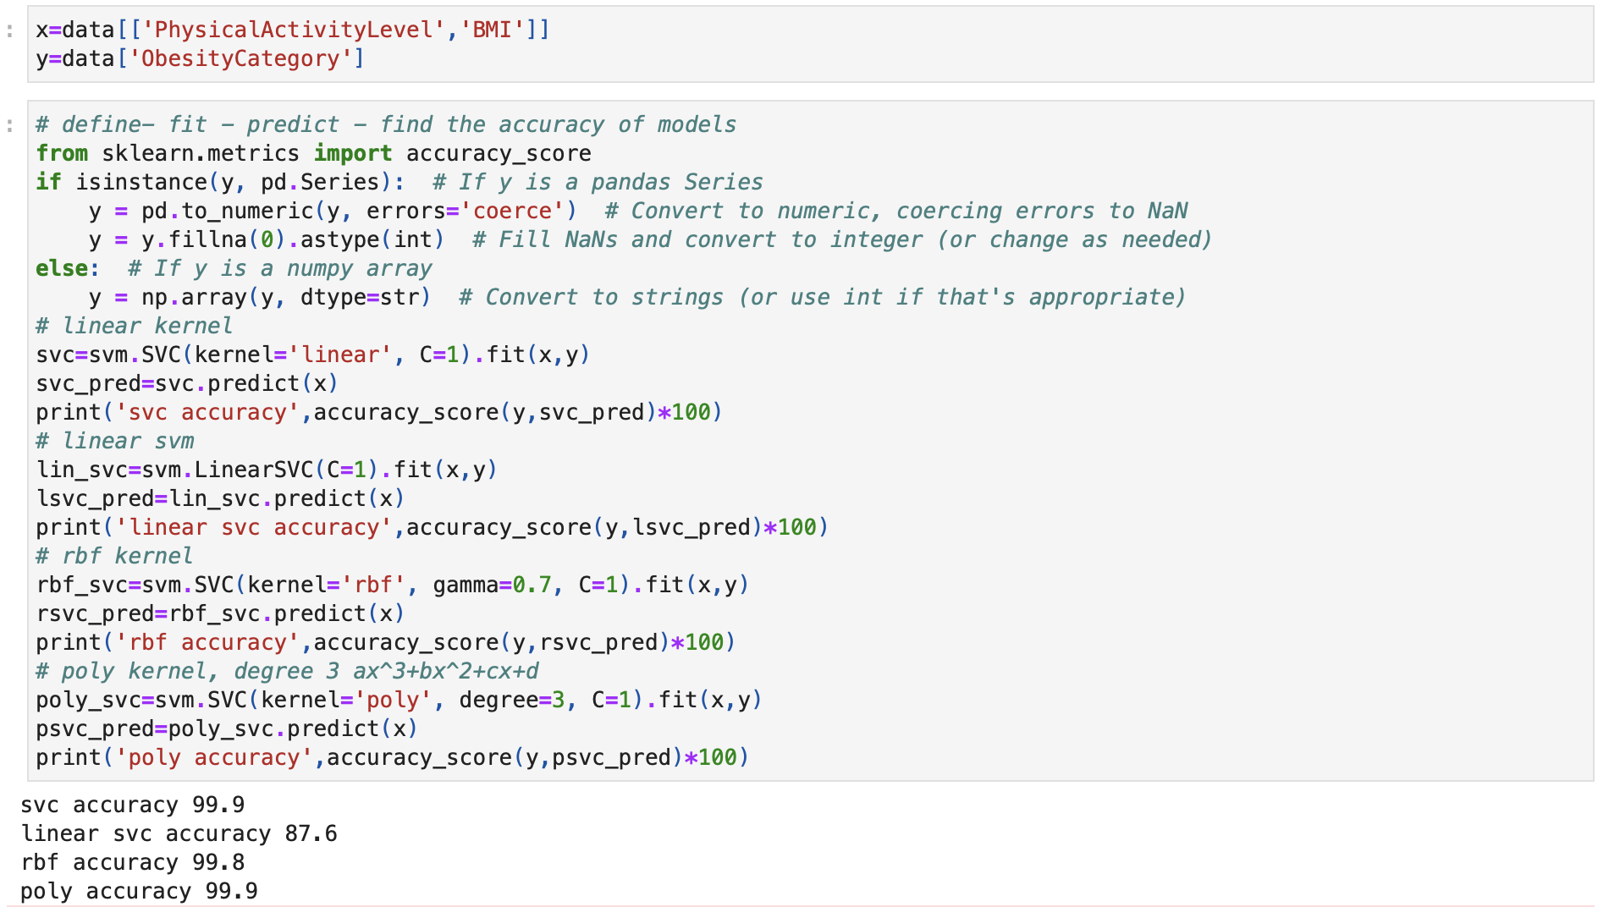
SVM

Slide 21
ACCURACY INTERPRETATION
Out of the four tested models, the SVC kernel and the polynomial kernel (poly) both attain the highest accuracy, at 99.9%. When deciding between them, it's necessary to take into consideration additional factors like the model's complexity, computational expense, and possible overfitting. Additionally, the RBF kernel performs well, achieving a 99.8% close accuracy

Slide 22
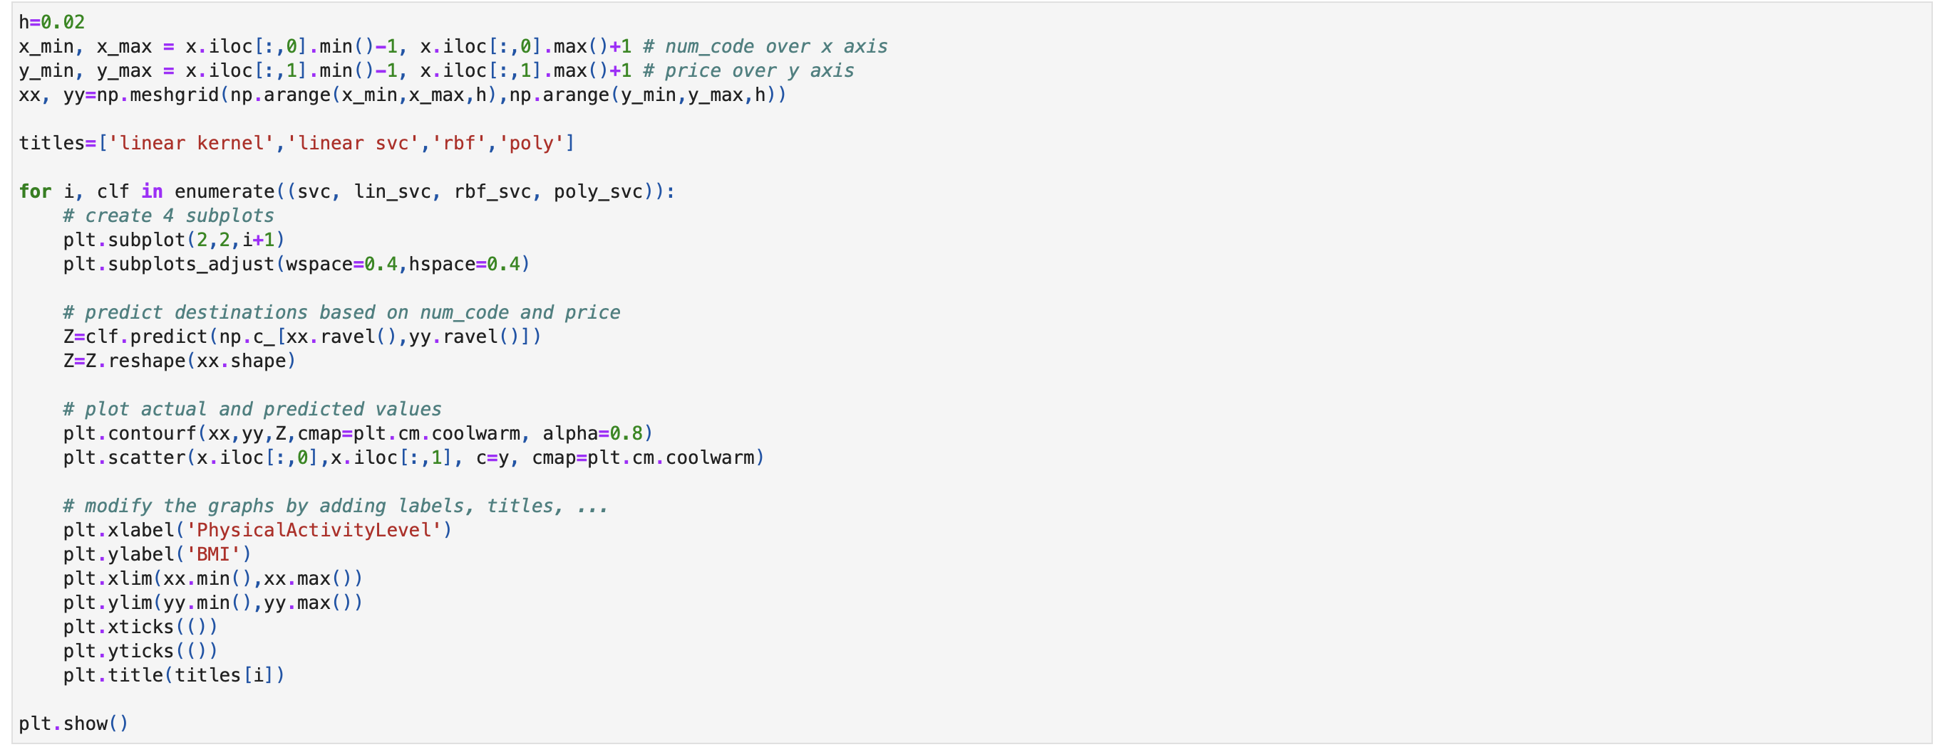

Slide 23
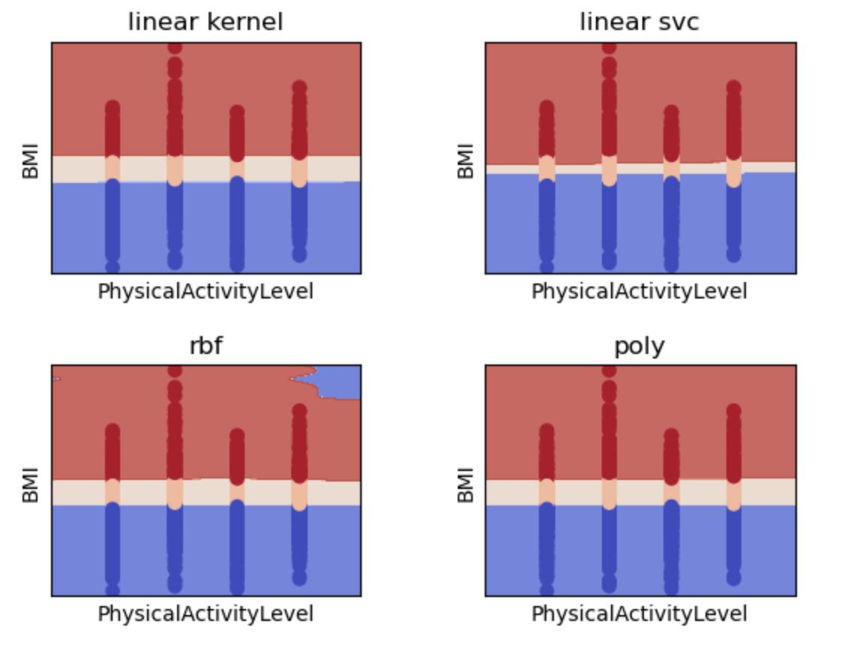

Slide 24
INTERPRETATION
As it classifies the data with more distinct boundaries and reduces misclassification between the classes (as shown by the color separation), the linear SVC kernel appears to perform better than the other kernels. Based on your features (BMI and Physical Activity Level), the regions of the linear SVC plot indicate a clearer separation between the red and blue areas, indicating that this kernel more accurately captures the decision boundary. For this dataset, the linear SVC kernel outperforms the other four kernels (linear kernel, linear SVC, RBF, and poly) in terms of classification because it separates the classes more precisely.

Slide 25
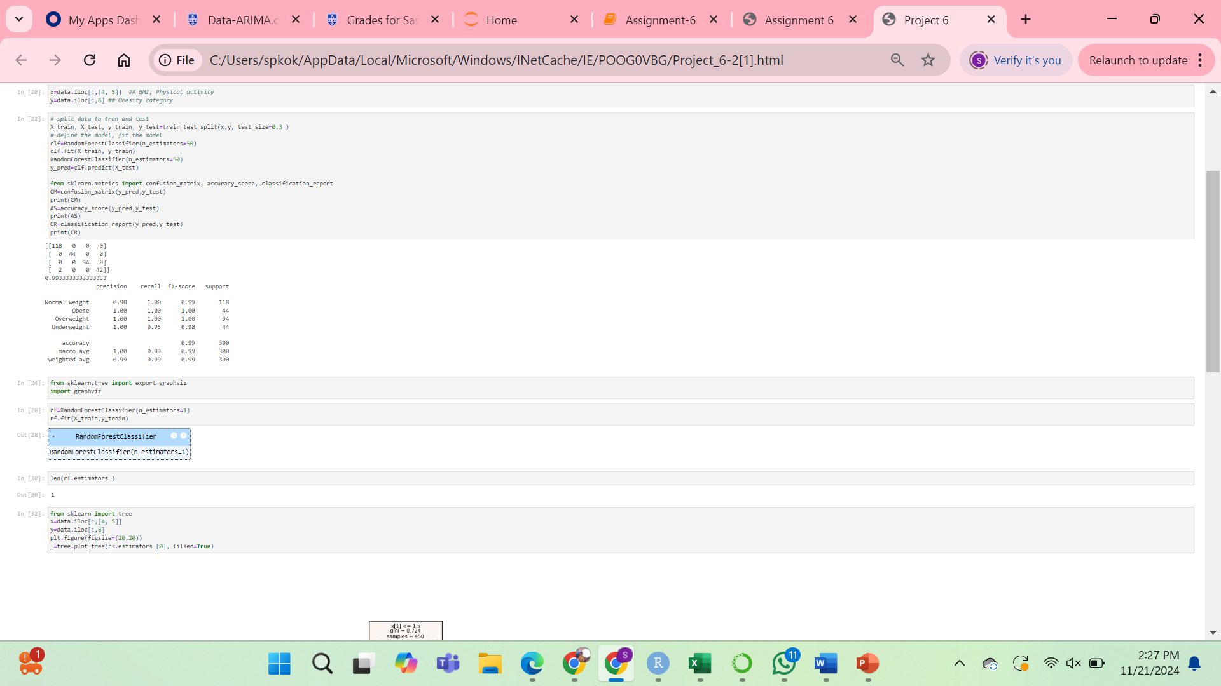
Random Forest Graph

Slide 26
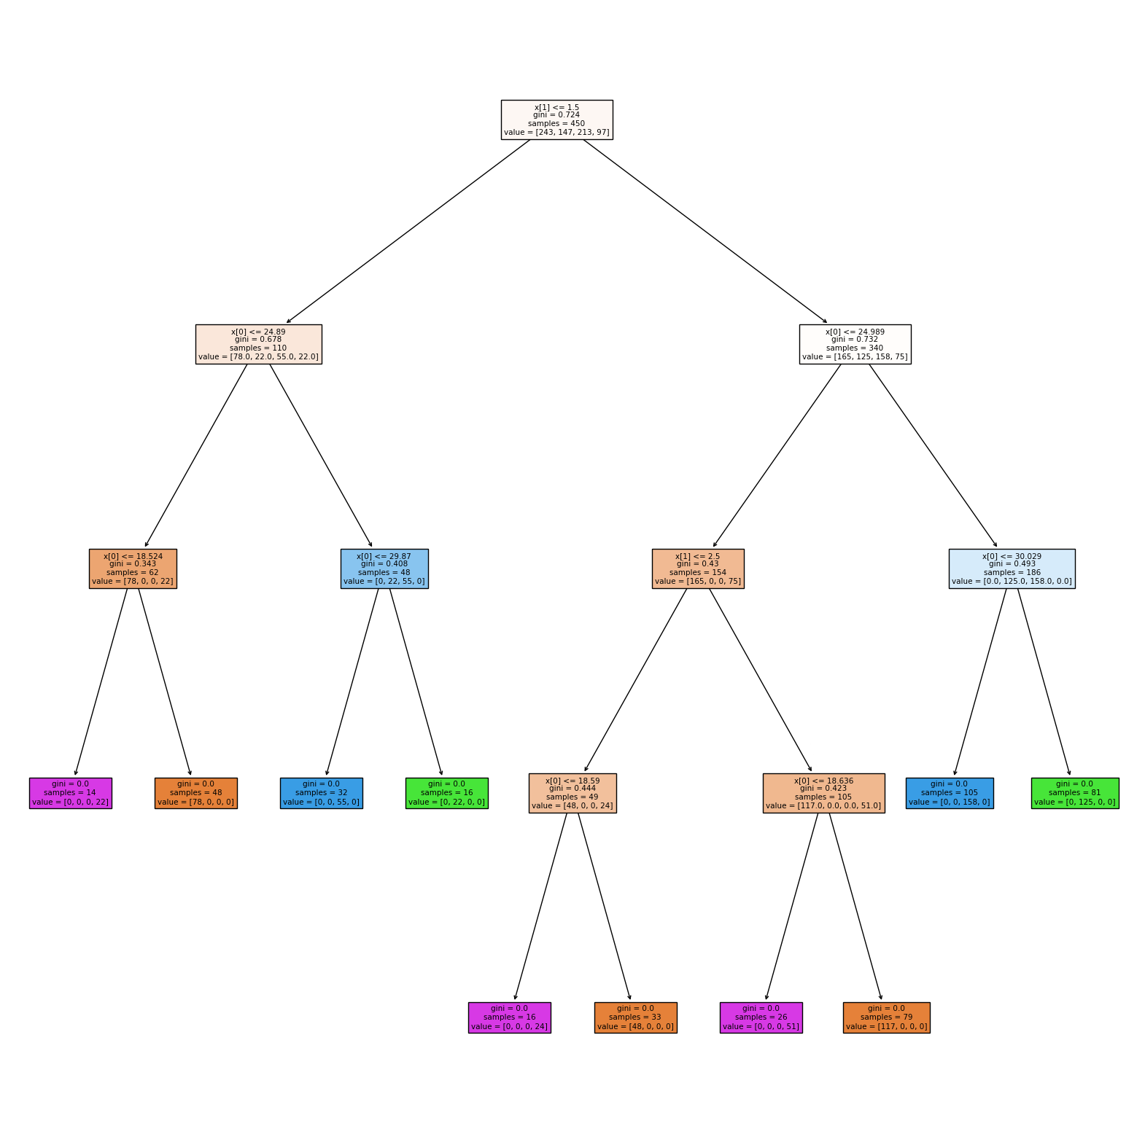

Slide 27
INTERPRETATION
The Random Forest model uses the decision tree to categorize data according to two features: x[0] and x[1]. As demonstrated by the Gini impurity, the 450 samples are separated into two branches with different levels of class distribution. By concentrating on particular groups of data, each branch further divides according to thresholds such as x[0] <= 24.89 or x[0] <= 24.989, improving the categorization process. The data is completely categorized into discrete categories when the Gini impurity reaches 0 at the leaf nodes.

