Slide 1
Ticket Hub
Chethan Kothwal
A20423243
Vismaya Veeramanju Kalyan
A20423189

Slide 2
Description
Allows users to register, create a profile and login to buy tickets for games in NBA, NFL, MLB and NHL leagues.
Tickets to each user will be displayed according to the location of the user. User can also buy tickets for games in other locations.
User can view live scores and stats for ongoing games and previous games on the website.
User can choose to see the schedule for a favourite team.
To send an email confirmation of the tickets to the customer after booking.
API used:
Sportsreference python API to get all the team names, team matches, team schedules, league schedules and locations of the game for NBA,NFL,MLB and NHL.
Data fetched from the API is stored in MySQL database. Data is then filtered according to the user needs.
Website feedback is stored in MongoDB.

Slide 3
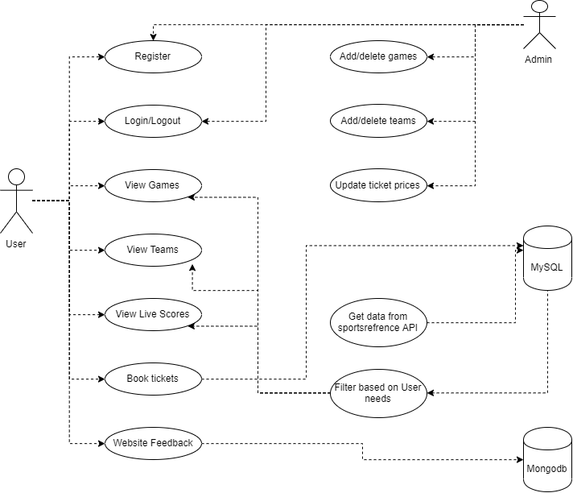

Slide 4
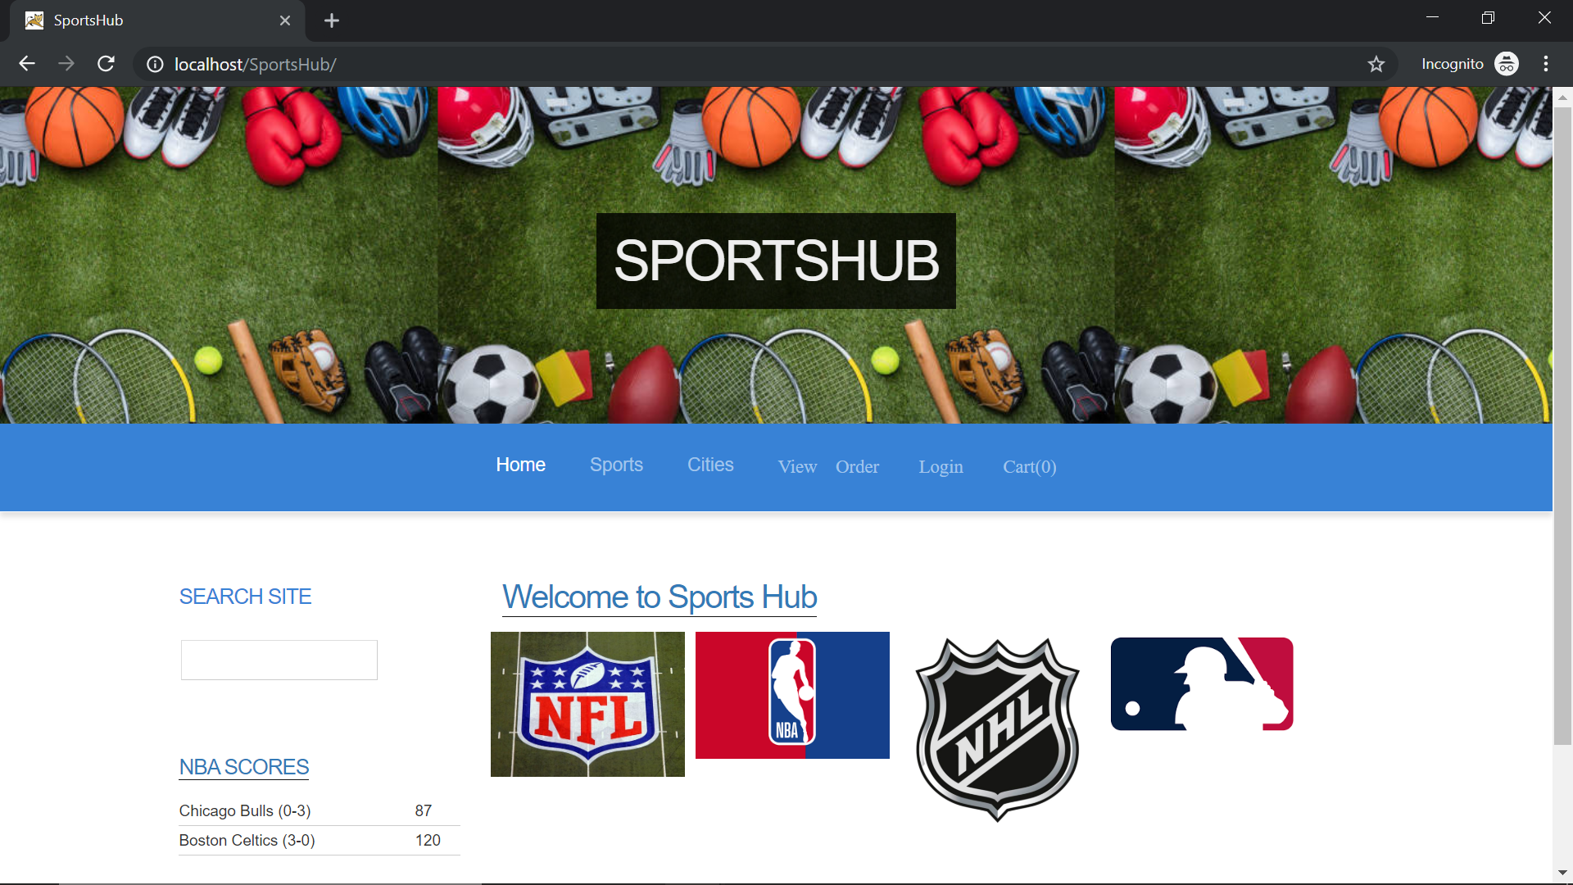

Slide 5
References
Sportsreference python API: https://sportsreference.readthedocs.io/en/latest/

