Slide 1
Ticket Hub
Chethan Kothwal
A20423243
Vismaya Veeramanju Kalyan
A20423189

Slide 2
System
User registers and creates a profile and login to buy tickets for games in NBA, NFL, NCAA and NHL leagues.
Tickets to each user will be displayed according to the sport selected by the user.
Uses a python script to fetch the data for all matches available from StubHub API
The JSON obtained is formatted and saved to SQL database
Data contains matches for all leagues and listings of tickets available for each match.
User can view the games in a particular city and of a particular team.
Email confirmation of the tickets is sent to the customer after booking.
To do:
Implement statistics charts for admin
Website feedback to be stored in MongoDB.

Slide 3
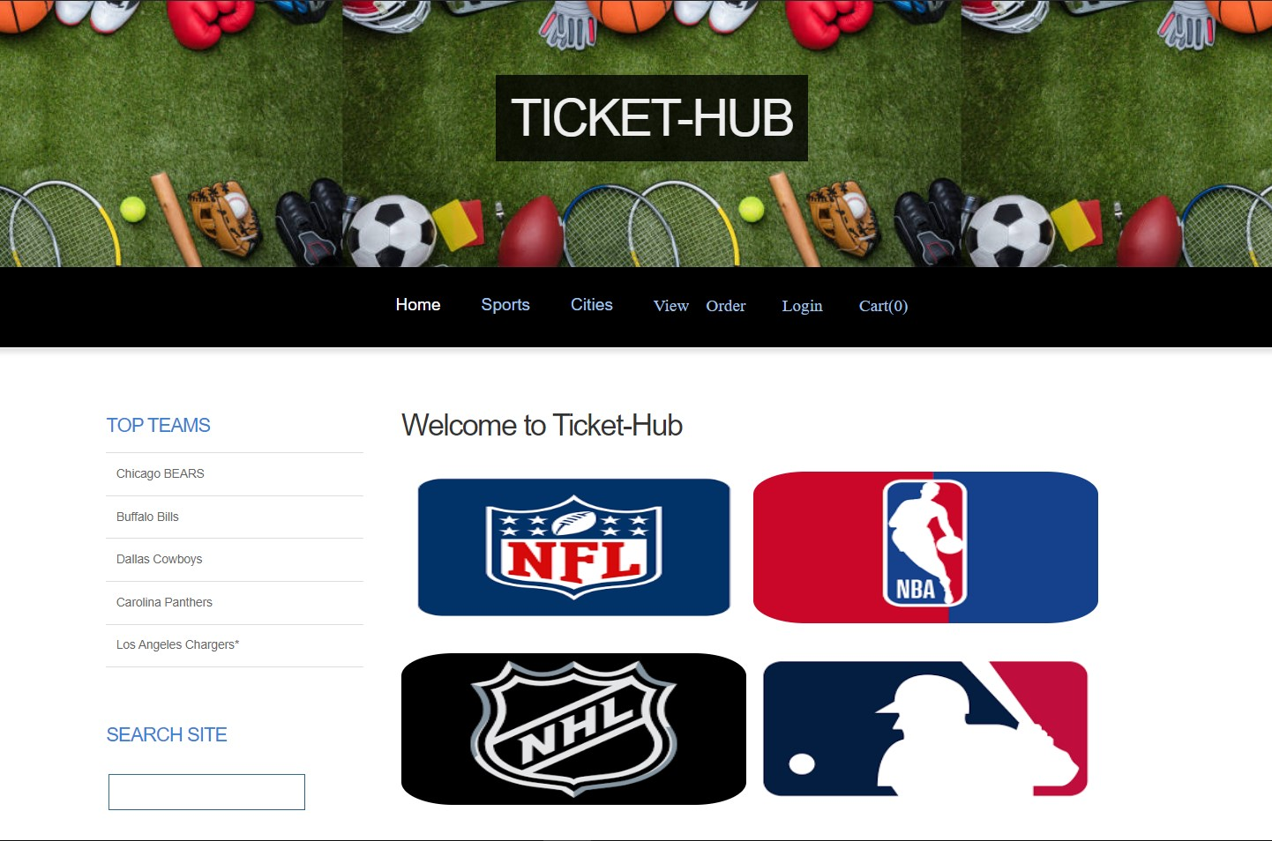

Slide 4
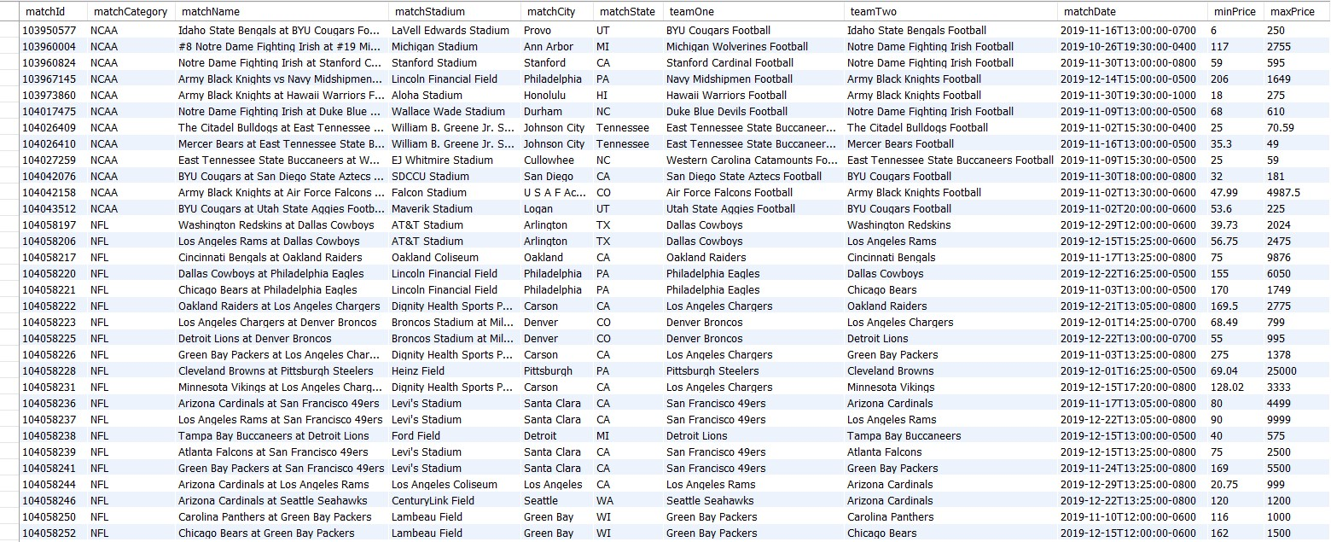

Slide 5
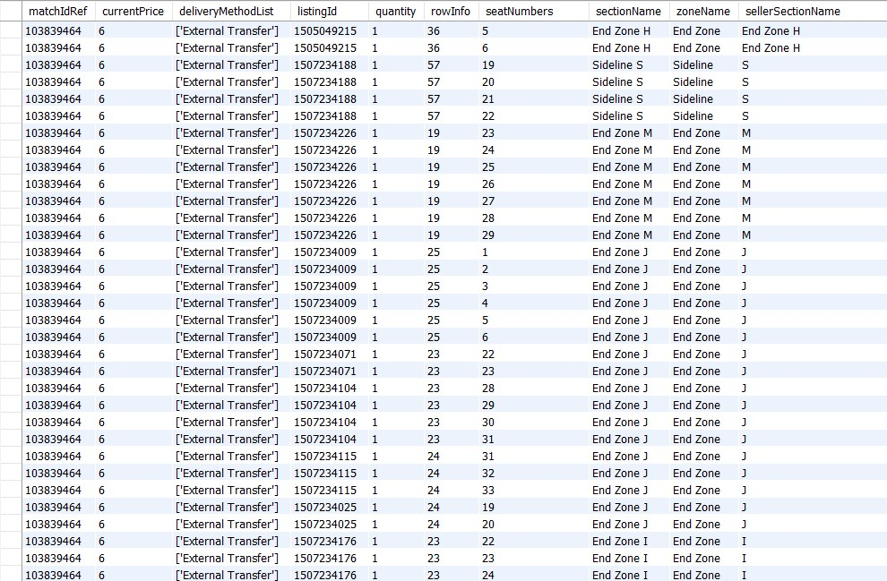

Slide 6
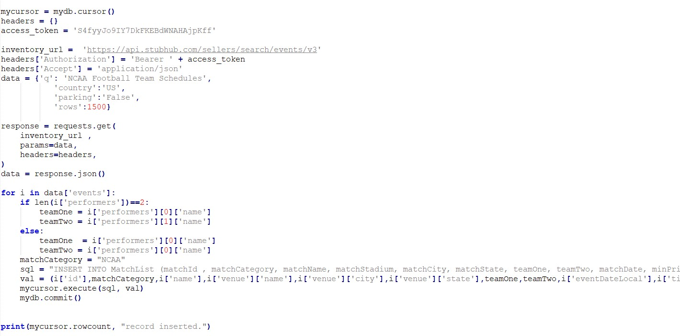
Code to get matches in a league

Slide 7
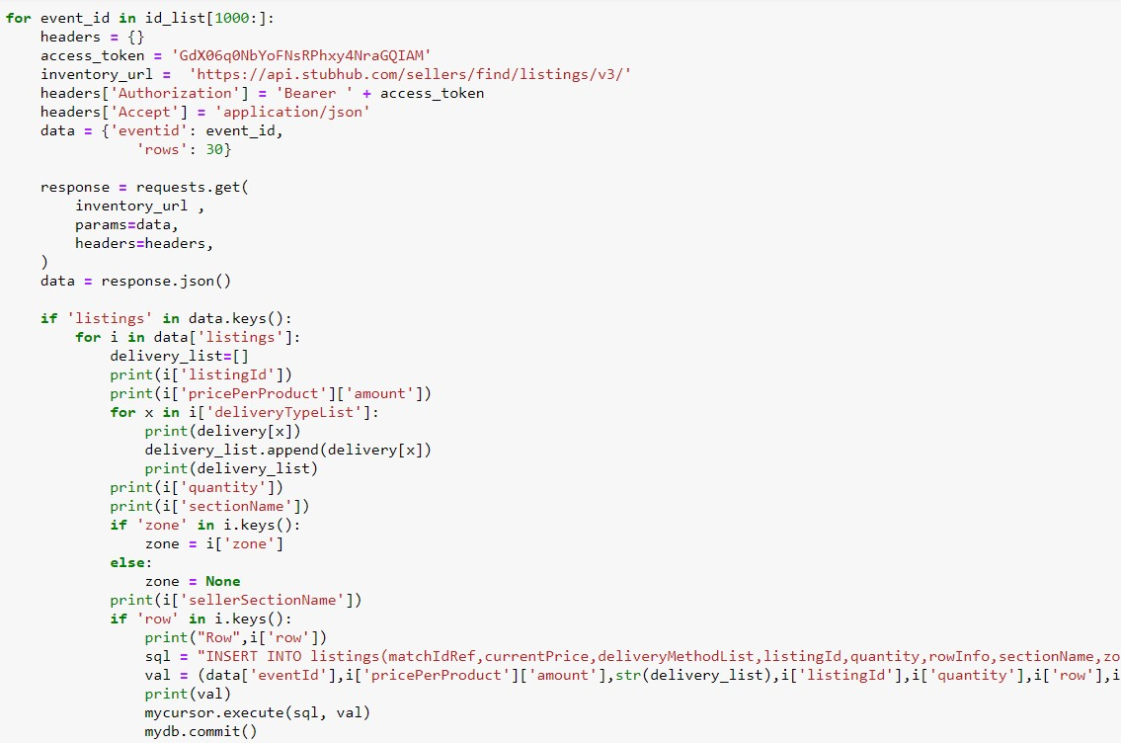
Code to get listings for each match

Slide 8
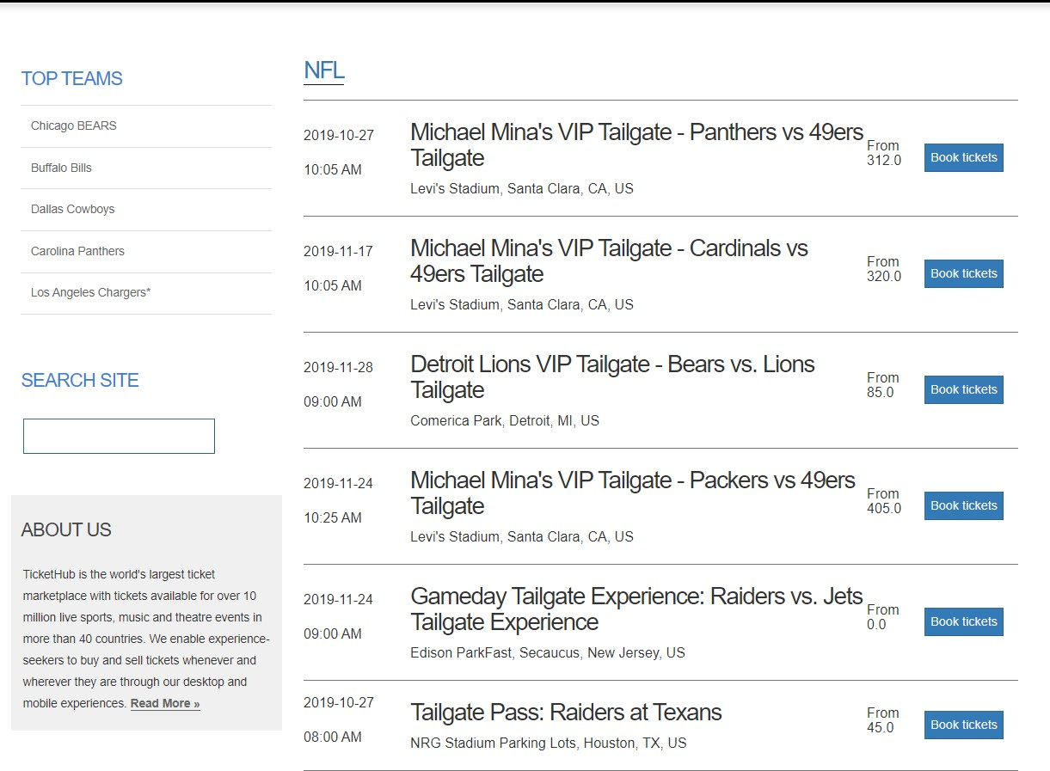

Slide 9
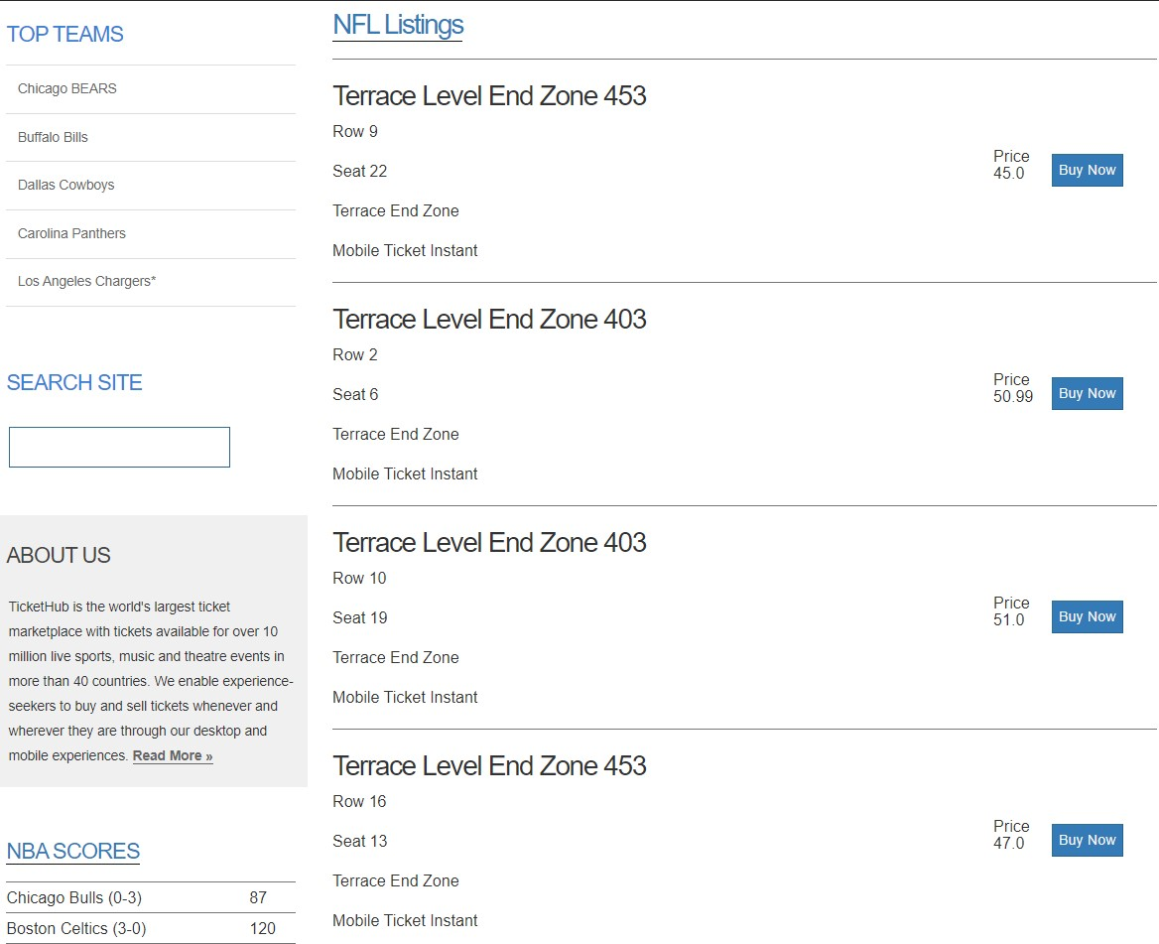

Slide 10
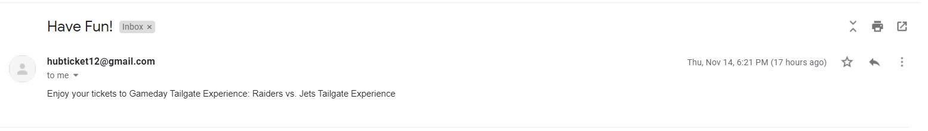
Email response to the User

Slide 11
THANK YOU

