Slide 1
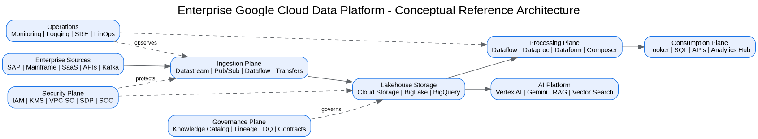
Enterprise Google Cloud Data Platform Blueprint
Executive briefing deck - implementation starter

Slide 2
Why this architecture
Modernize fragmented legacy estate
Establish governed data products
Enable analytics, AI and GenAI at scale
Reduce risk through Zero Trust and automation

Slide 3
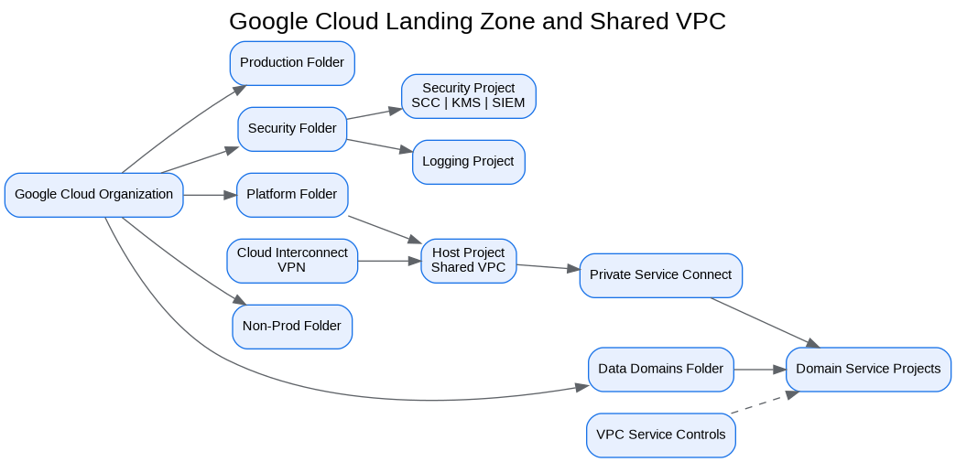
Landing zone foundation
Organization, folders and projects
Shared VPC and private connectivity
IAM, KMS, VPC SC and SCC
Central logging and monitoring

Slide 4
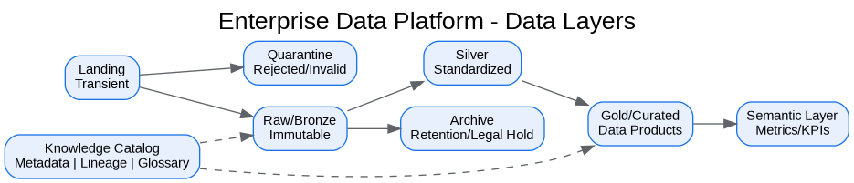
Enterprise data platform
Landing, raw, silver, gold and semantic layers
Batch, CDC, streaming and API ingestion
Knowledge Catalog governance
BigQuery and BigLake serving model

Slide 5
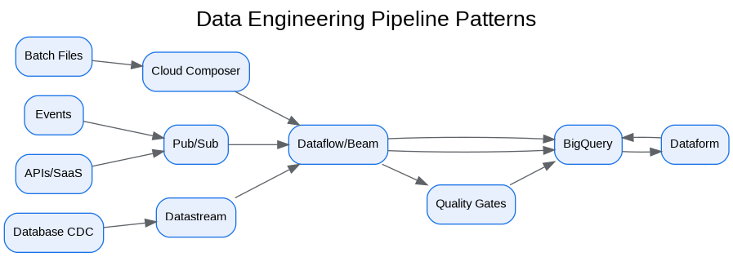
Data engineering standards
Reusable pipeline templates
Dataflow, Beam, Dataproc and Dataform
Error handling, DLQ and reconciliation
Observable SLO-driven operations

Slide 6
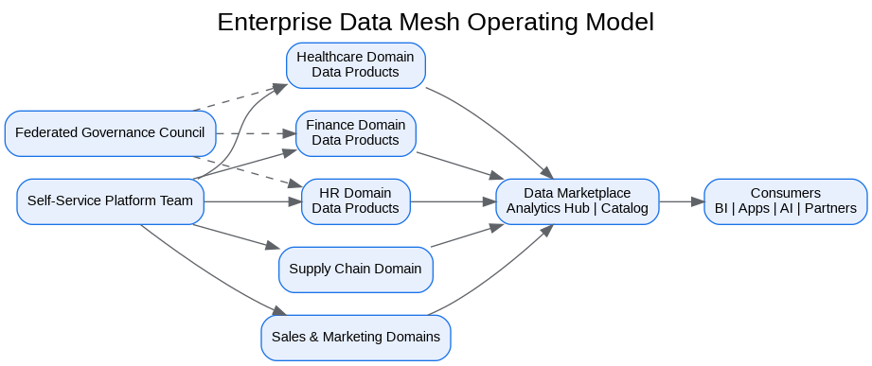
Data mesh operating model
Central self-service platform
Federated domain ownership
Certified data products
Marketplace and governed sharing

Slide 7
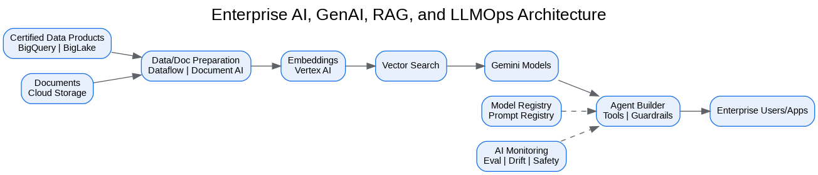
AI-ready architecture
Vertex AI, Gemini and RAG
Vector Search and grounded responses
Prompt/model governance
Sensitive-data and tool-use controls

Slide 8
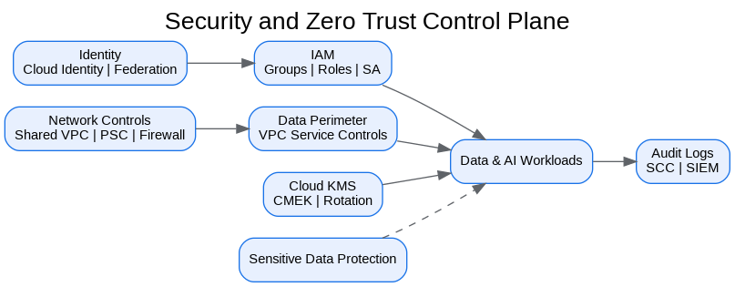
Security and Zero Trust
Identity, network, data and workload perimeters
CMEK for restricted workloads
Sensitive Data Protection and masking
Audit logging and SCC integration

Slide 9
DevSecOps and automation
Terraform golden modules
GitOps and policy-as-code
Promotion gates and approvals
Immutable artifacts and rollback

Slide 10
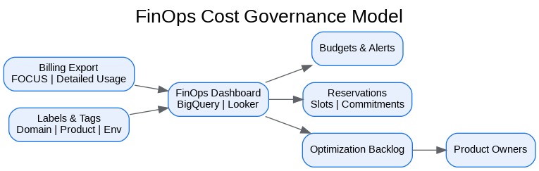
FinOps and operations
Cost allocation by domain/product
Budgets, reservations and optimization
SLIs, SLOs, runbooks and alerts
DR and production readiness

Slide 11
Recommended next actions
Confirm executive sponsor and platform product owner
Run architecture foundation workshop
Approve landing-zone MVP scope
Select first production domain
Build reference pipelines and Terraform modules
Schedule security, governance and FinOps reviews

