Slide 1
Preparing documents in R
R Markdown to create notebook, pdf and HTML documents

Slide 2
Flow of the workshop
Presentation
What is Markdown and R markdown
20-25 min
Hands-on Workshop
Creating first document using R markdown
Advantage in creating periodic report
What is not in scope of this workshop
Question
60-90 mins
Break to setup
Setting up your laptops for Workshop
20-30 min
More examples

Slide 3
Prerequisite (Important and optional)
Working knowledge of R
Understanding of Rstudio
Latex
HTML
Window or Debian based Linux system (I am not very good at working with Mac, However, if one can install all required package there no problem)

Slide 4
Software and packages
Software
R programming language
Rstudio or VS editor (You can use VS editor, its is OK, but this workshop will use Rstudio.)
Packages (R packages)
rmarkdown
knitr
kabble (help to create tables)
KabbleExtra
Tinytex (for window users, to create pdf file using Latex)
tinytex::install_tinytex(repository = “Illinois")
Tidyverse packages (ggplot2, reshape2, tidyr, etc etc)
#One can use any package in Rmarkdown

Slide 5
Markdown language
Test encoding system
With Syntax and symbols.
E.g., HTML, LATEX, XML, etc.
It is a lightweight Markup language
Developed
Jhon Gruber (John Gruber – Wikipedia)
2004
Allow to write code and text in the same document.
Open-source and can be used in a plain text editor (e.g., notepad).
Site that uses Markdown
Reddit
Github (code repository)
Stack exchange (Q AND A for codes)

Slide 6
Rmarkdown
Developed and maintained by R Studio
Can be used to integrate R, Python, SQL script
Render documents into
PDF
Word
Slides
HTML (for blogging)
Notebook format for keeping the notes.

Slide 7
Advantages
Avoid human errors; (Sorry I sent the wrong table)
Integration of other software
Create documents in multiple formats
Reproducible reports
Transparency in work
No mouse work ☺

Slide 8
Disadvantage
Syntax and symbols
Coding algorithms cannot be detected

Slide 9

Traditional uses of R in research
Equation
Additional pictures
Special symbols
Data
Graphical results
Word results
Tabular results
Documents
Publication
Notes:
Talk about human error here

Slide 10
Better way to use it.
Data
Documents
LaTex codes
Equation
Additional pictures
Special symbols
Publication

Slide 11
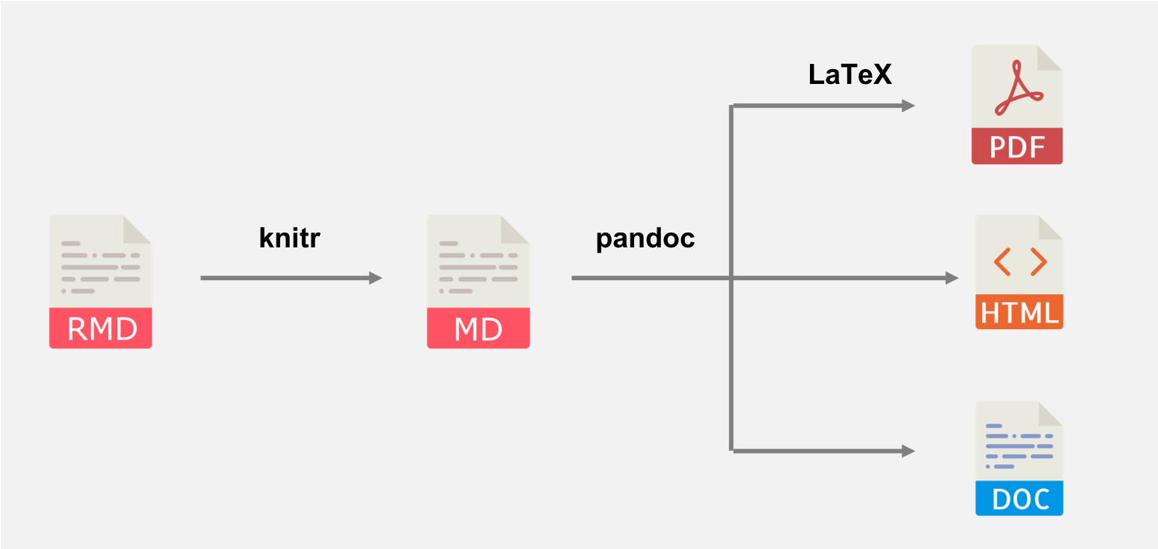

Slide 12
Setting up RStudio for markdown
Step1: Install R and Rstudio
Step2: Install packages
“rmarkdown”
“knitr”
“TinyTex for pdf”
In your Rstudio, on the menu bar,
click on the file→new file→ R markdown, to open a pop-up window
Select the option for different document types ( multiple document types can be rendered)
Click OK to start the file with .RMD ext.

Slide 13
Additional documents for help
R Markdown cheat sheet
R Markdown reference manual
Composing reproducible manuscripts using R Markdown | Labs | eLife (elifesciences.org)
R Markdown: The Definitive Guide (bookdown.org)
Many more (keeping looking)

Slide 14
Not in the scope of this workshop
Advance documents rendering
Latex codes (some examples will be provided)
Online publishing using markdown
Creating interactive documents using R markdown and shiny

Slide 15
Setup of the system for the first markdown

Slide 16
Simple document with basic ops
Heading
Bold and italics
Superscript and subscript
Including or excluding the codes and warning
Addition of images
Hyperlinks
Ordered and non-ordered bullet points

Slide 17
Second documents with pdf output
Inline text
Inline equation
Equations
Citation and citation style in R markdown
Tables and captions
Figure and captions.

