Slide 1
Review of Basic R
Chandan Kumar Pandey

Slide 2
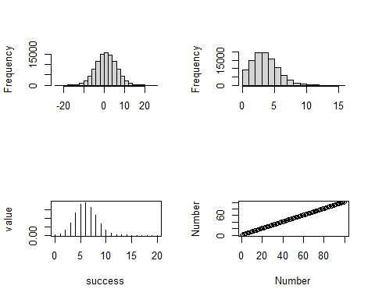
Let us Revise
Variables
Operators
Objects
Conditional statements
Loops or iteration.
Function
Bit of Ploting
What we will learn in next four days.
Day 2 {Friday}
Frequency distribution; Normal Distribution, Binomial distribution, and Poisson distribution.
Linear model and plotting the difference between groups.
Examples

Slide 3
Day3:
Linear regression models; concept
Hands-on example of linear regression with a single predictor.
Hands-on example of linear regression with multiple predictors.
Plotting the linear models

Slide 4
Day4:
Generalized linear model, concept
Hands-on example of GLM; Binomial distribution
Hands-on example of GLM; Poisson distribution

Slide 5
Day5:
Multiple Linear Regression with Interactions
Model selection using AIC

