Slide 1
Principal Component Analysis
(PCA)
Utkarsh Kulshrestha
Data Scientist - TCS
LearnBay

Slide 2
Data Reduction
summarization of data with many (p) variables by a smaller set of (k) derived (synthetic, composite) variables.
p
k
A
X
n
n

Slide 3
Principal Component Analysis
(PCA)
probably the most widely-used and well-known of the “standard” multivariate methods
invented by Pearson (1901) and Hotelling (1933)
first applied in ecology by Goodall (1954) under the name “factor analysis” (“principal factor analysis” is a synonym of PCA).

Slide 4
Principal Component Analysis
(PCA)
takes a data matrix of n objects by p variables, which may be correlated, and summarizes it by uncorrelated axes (principal components or principal axes) that are linear combinations of the original p variables
the first k components display as much as possible of the variation among objects.

Slide 5
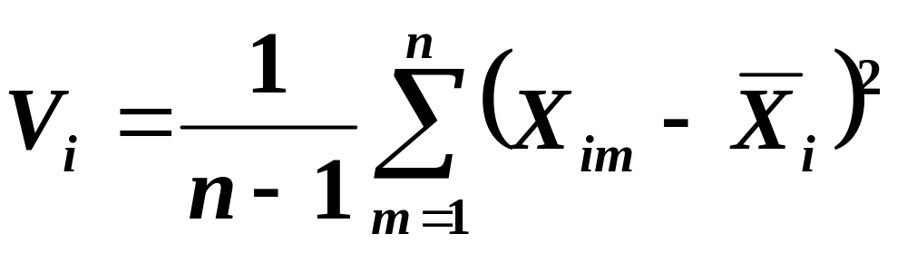
Geometric Rationale of PCA
objects are represented as a cloud of n points in a multidimensional space with an axis for each of the p variables
the centroid of the points is defined by the mean of each variable
the variance of each variable is the average squared deviation of its n values around the mean of that variable.

Slide 6
Geometric Rationale of PCA
objective of PCA is to rigidly rotate the axes of this p-dimensional space to new positions (principal axes) that have the following properties:
  ordered such that principal axis 1 has the highest variance, axis 2 has the next highest variance, .... , and axis p has the lowest variance
  covariance among each pair of the principal axes is zero (the principal axes are uncorrelated).

Slide 7
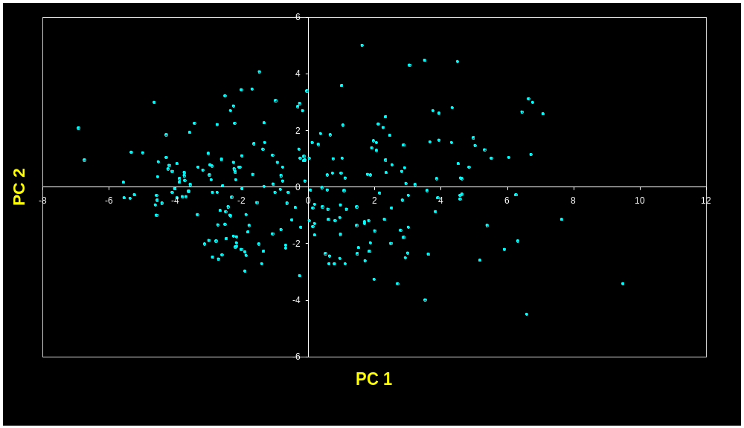
Principal Components are Computed
PC 1 has the highest possible variance (9.88)
PC 2 has a variance of 3.03
PC 1 and PC 2 have zero covariance.

Slide 8
The Dissimilarity Measure Used in PCA is Euclidean Distance
PCA uses Euclidean Distance calculated from the p variables as the measure of dissimilarity among the n objects
PCA derives the best possible k dimensional (k < p) representation of the Euclidean distances among objects.

Slide 9
Generalization to p-dimensions
In practice nobody uses PCA with only 2 variables
The algebra for finding principal axes readily generalizes to p variables
PC 1 is the direction of maximum variance in the p-dimensional cloud of points
PC 2 is in the direction of the next highest variance, subject to the constraint that it has zero covariance with PC 1.

Slide 10
Generalization to p-dimensions
PC 3 is in the direction of the next highest variance, subject to the constraint that it has zero covariance with both PC 1 and PC 2
and so on... up to PC p

Slide 11
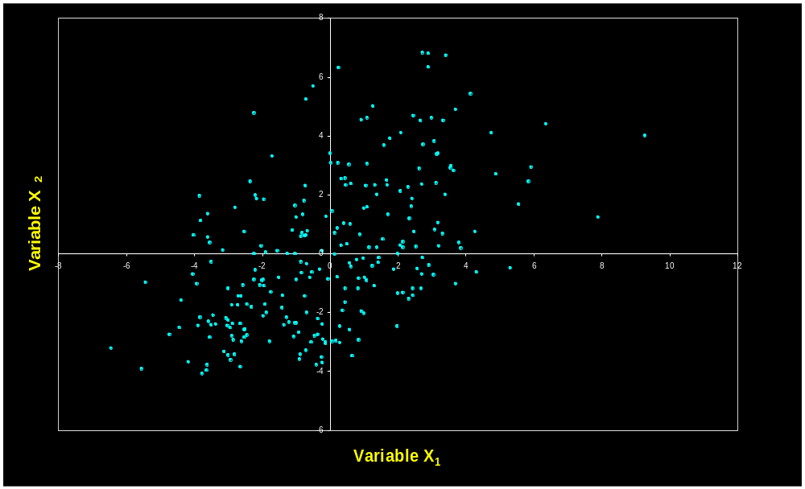
each principal axis is a linear combination of the original two variables
PC_{j} = a_{i1}Y₁ + a_{i2}Y₂ + … a_{in}Y_{n}
a_{ij}’s are the coefficients for factor i, multiplied by the measured value for variable j
PC 1
PC 2

Slide 12
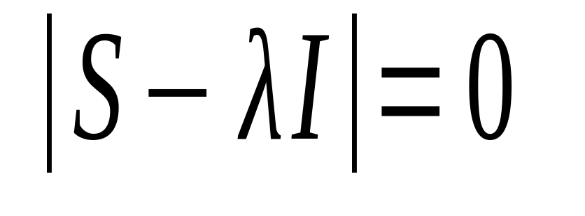
The Algebra of PCA
finding the principal axes involves eigenanalysis of the cross-products matrix (S)
the eigenvalues (latent roots) of S are solutions (λ) to the characteristic equation

Slide 13
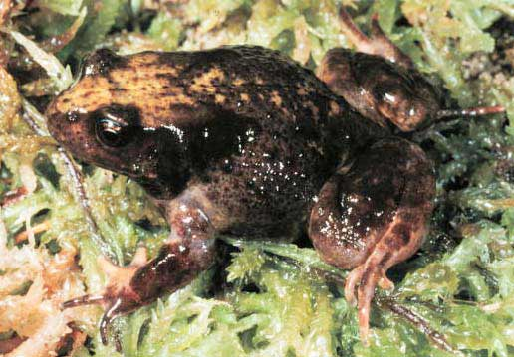
A more challenging example
data from research on habitat definition in the endangered Baw Baw frog
16 environmental and structural variables measured at each of 124 sites
correlation matrix used because variables have different units
Philoria frosti

Slide 14
Eigenvalues
Axis | Eigenvalue | % of Variance | Cumulative % of Variance
1 | 5.855 | 36.60 | 36.60
2 | 3.420 | 21.38 | 57.97
3 | 1.122 | 7.01 | 64.98
4 | 1.116 | 6.97 | 71.95
5 | 0.982 | 6.14 | 78.09
6 | 0.725 | 4.53 | 82.62
7 | 0.563 | 3.52 | 86.14
8 | 0.529 | 3.31 | 89.45
9 | 0.476 | 2.98 | 92.42
10 | 0.375 | 2.35 | 94.77

Slide 15
Interpreting Eigenvectors
 | 1 | 2 | 3
Altitude | 0.3842 | 0.0659 | -0.1177
pH | -0.1159 | 0.1696 | -0.5578
Cond | -0.2729 | -0.1200 | 0.3636
TempSurf | 0.0538 | -0.2800 | 0.2621
Relief | -0.0765 | 0.3855 | -0.1462
maxERht | 0.0248 | 0.4879 | 0.2426
avERht | 0.0599 | 0.4568 | 0.2497
%ER | 0.0789 | 0.4223 | 0.2278
%VEG | 0.3305 | -0.2087 | -0.0276
%LIT | -0.3053 | 0.1226 | 0.1145
%LOG | -0.3144 | 0.0402 | -0.1067
%W | -0.0886 | -0.0654 | -0.1171
H1Moss | 0.1364 | -0.1262 | 0.4761
DistSWH | -0.3787 | 0.0101 | 0.0042
DistSW | -0.3494 | -0.1283 | 0.1166
DistMF | 0.3899 | 0.0586 | -0.0175
correlations between variables and the principal axes are known as loadings
each element of the eigenvectors represents the contribution of a given variable to a component

Slide 16
When should PCA be used?
In community ecology, PCA is useful for summarizing variables whose relationships are approximately linear or at least monotonic
  e.g. A PCA of many soil properties might be used to extract a few components that summarize main dimensions of soil variation
PCA is generally NOT useful for ordinating community data
Why? Because relationships among species are highly nonlinear.

Slide 17

THANK YOU !!!

