Slide 1
Taxi fare prediction
Julian, Petro, Tim

Slide 2
Summary
PartData Cleaning: Recreate the test dataset
Feature creation:
Nighttrip dummy, rushhour
Average speed, duration
Not time
Clustering
Neighbourhoods
Feature Seleciton
Chi-squared test
Other metrix
Comparison with importance
Model building:
Different models per ratecodeID

Slide 3
Part 1: Data Cleaning

Slide 4
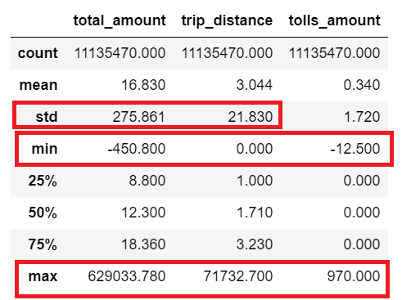
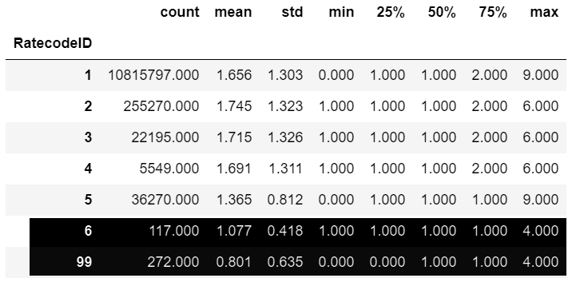
Outliers in the raw dataset
Description of passenger count per RatecodeID
RatecodeID 6 for group ride invalid

Slide 5
First steps
Initial data cleaning mainly on these features (& beyond)
Predictive power of the model good but still improvable
Solution: Data Cleaning separately per RatecodeID

Slide 6
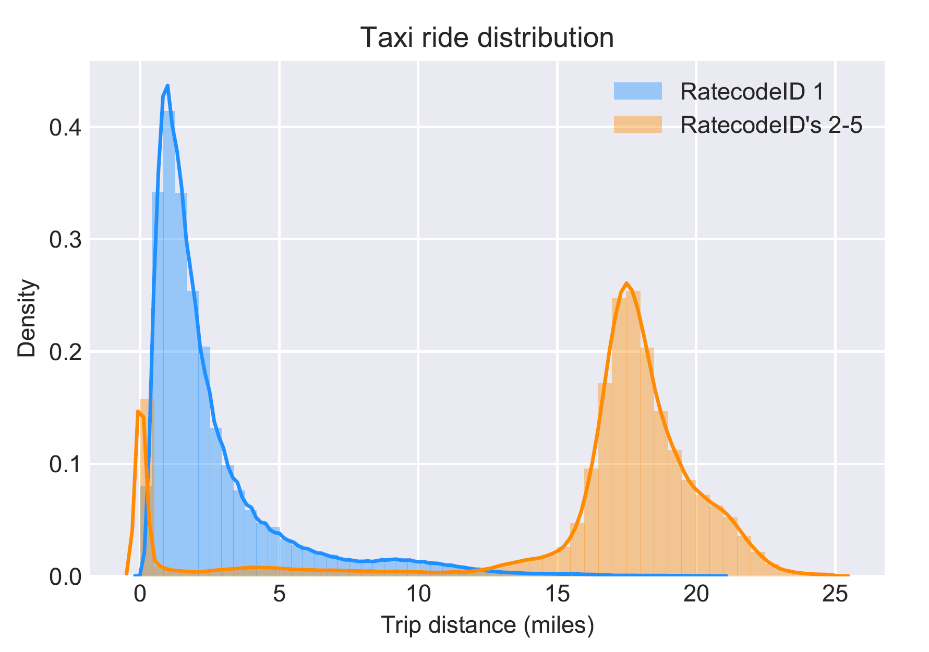
Reasoning
RatecodeID 1 (Standard rate)
Mainly short rides
RatecodeID 2-5 (Airport/Out-of- town/Negotiated)
Mainly long distances
Many „0 distance“ observations (caused by fixed rates )

Slide 7
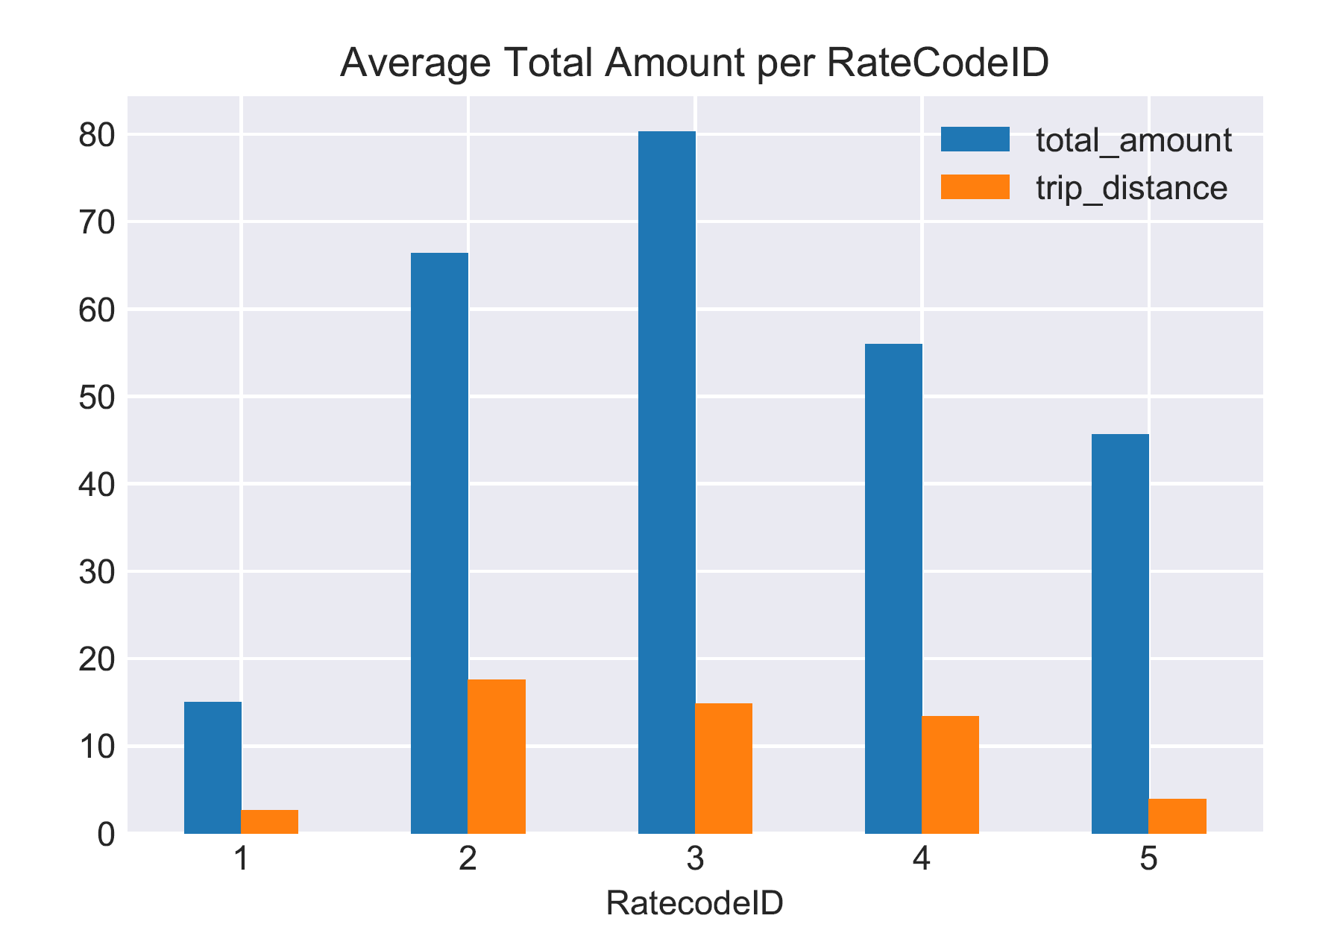
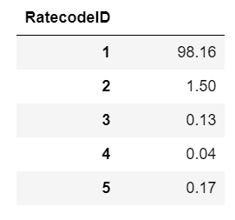
Reasoning
Portions of RatecodeID occurences
Significant differences in the average total amount
Very few, very expensive rides for RatecodeID 2-5 (long distance)
RatecodeID the most influential categorical feature

Slide 8
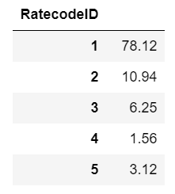
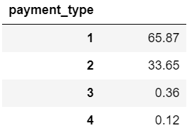
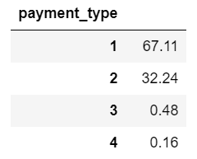
Retaining homogeneity
Distribution of categorical variables
Train
Test
Train: Almost exclusively observations for RatecodeID 1
Test: All RatecodeID‘s hold a significant portion
Train & test very similar
Caution: Do not exterminate a whole category while removing outliers!

Slide 9
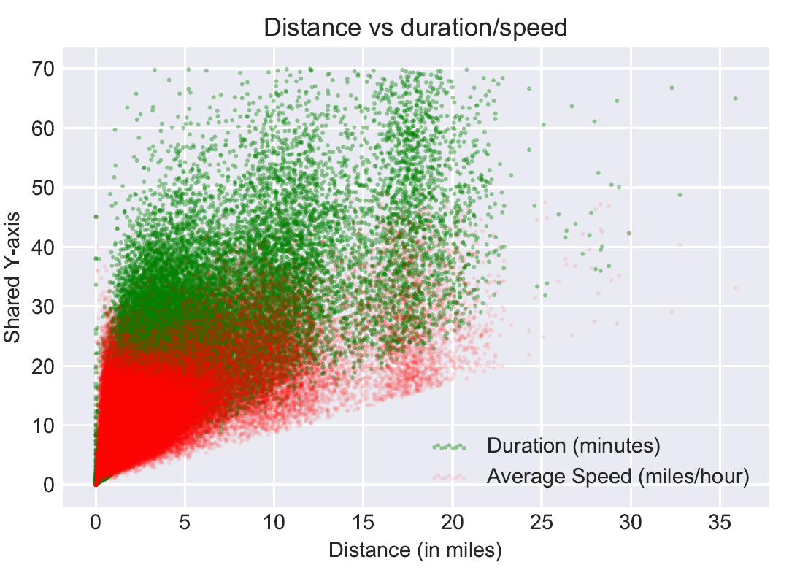
Further exploration
Positive correlation
Weird observations
Heteroscedasticity
Possible heteroscedasticity causes:
Duration dependent on traffic situation
Speed varies dependent of route (speedway/through-town)
Startpoint-Endpoint locations also important factor

Slide 10
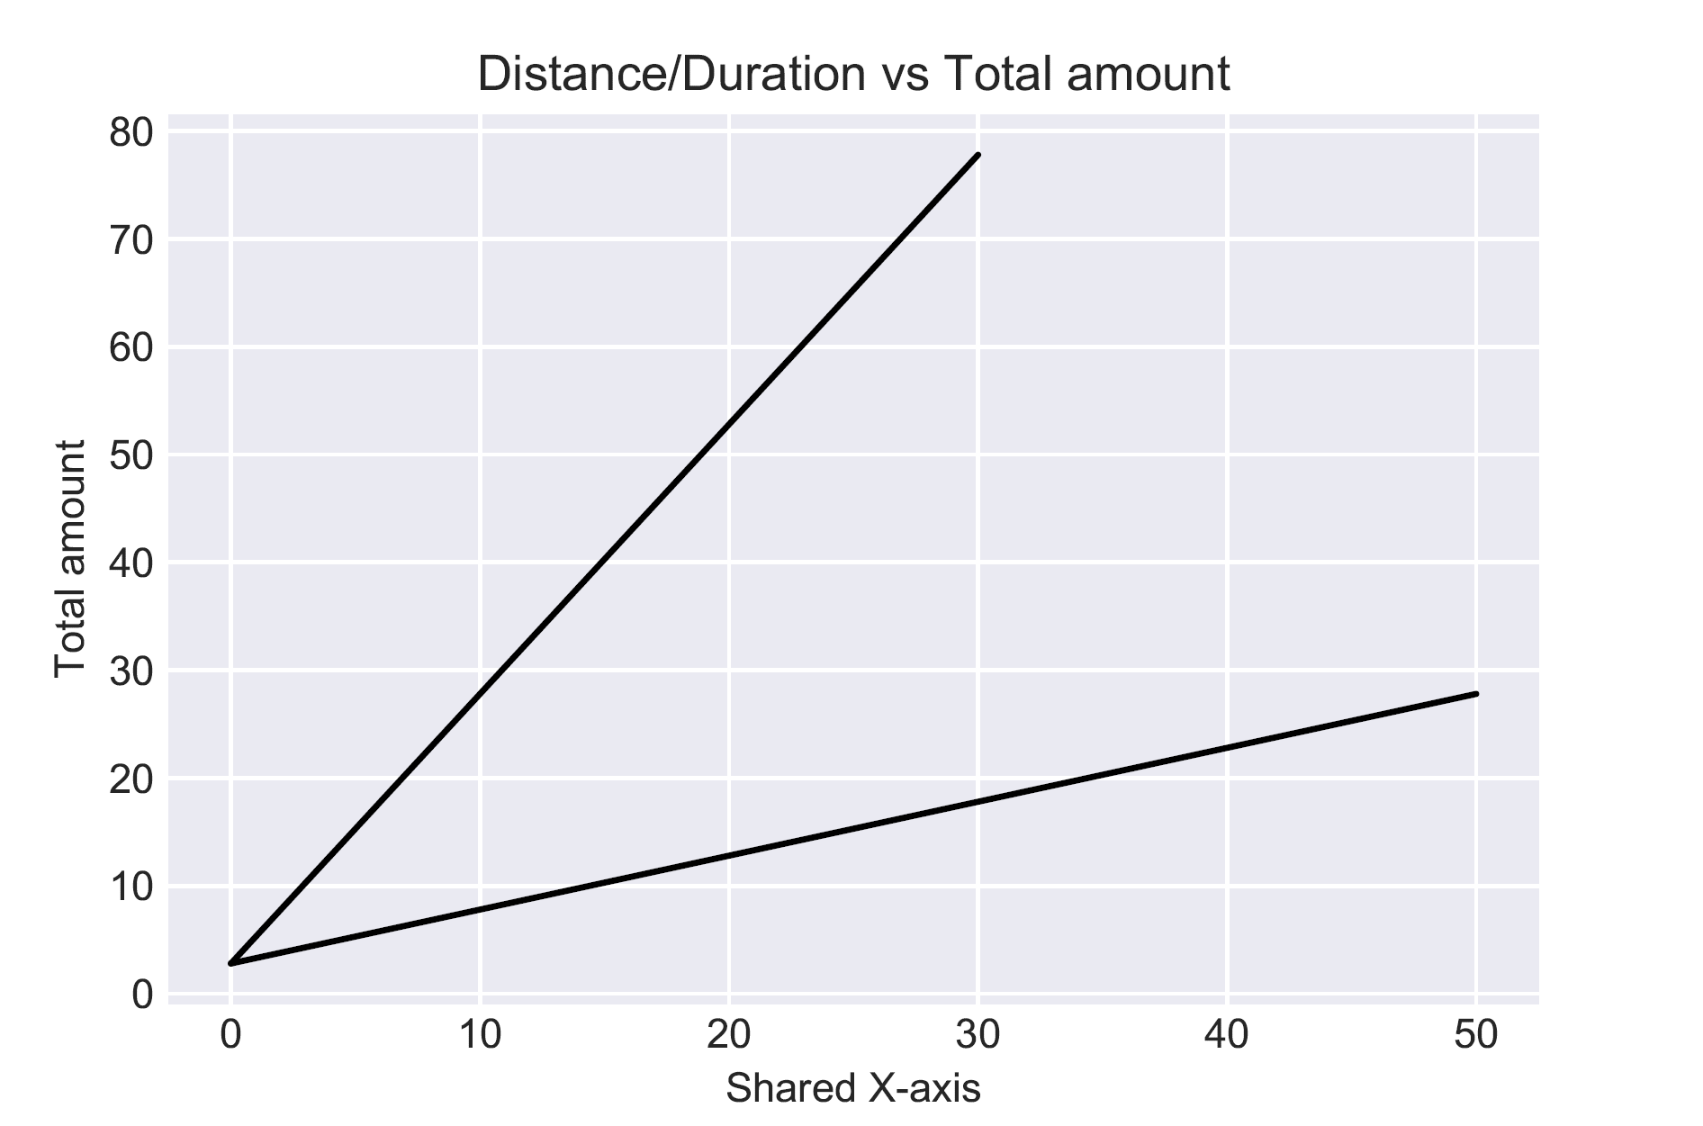
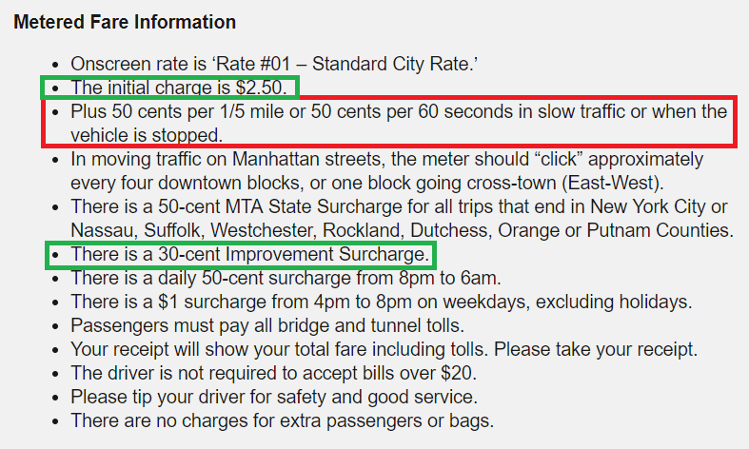

Slide 11
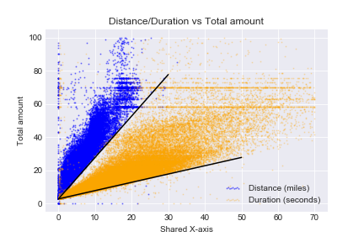
Positive correlation
Weird observations
Heteroscedasticity
Aim: Traceback variance & control it by doing feature engineering

Slide 12
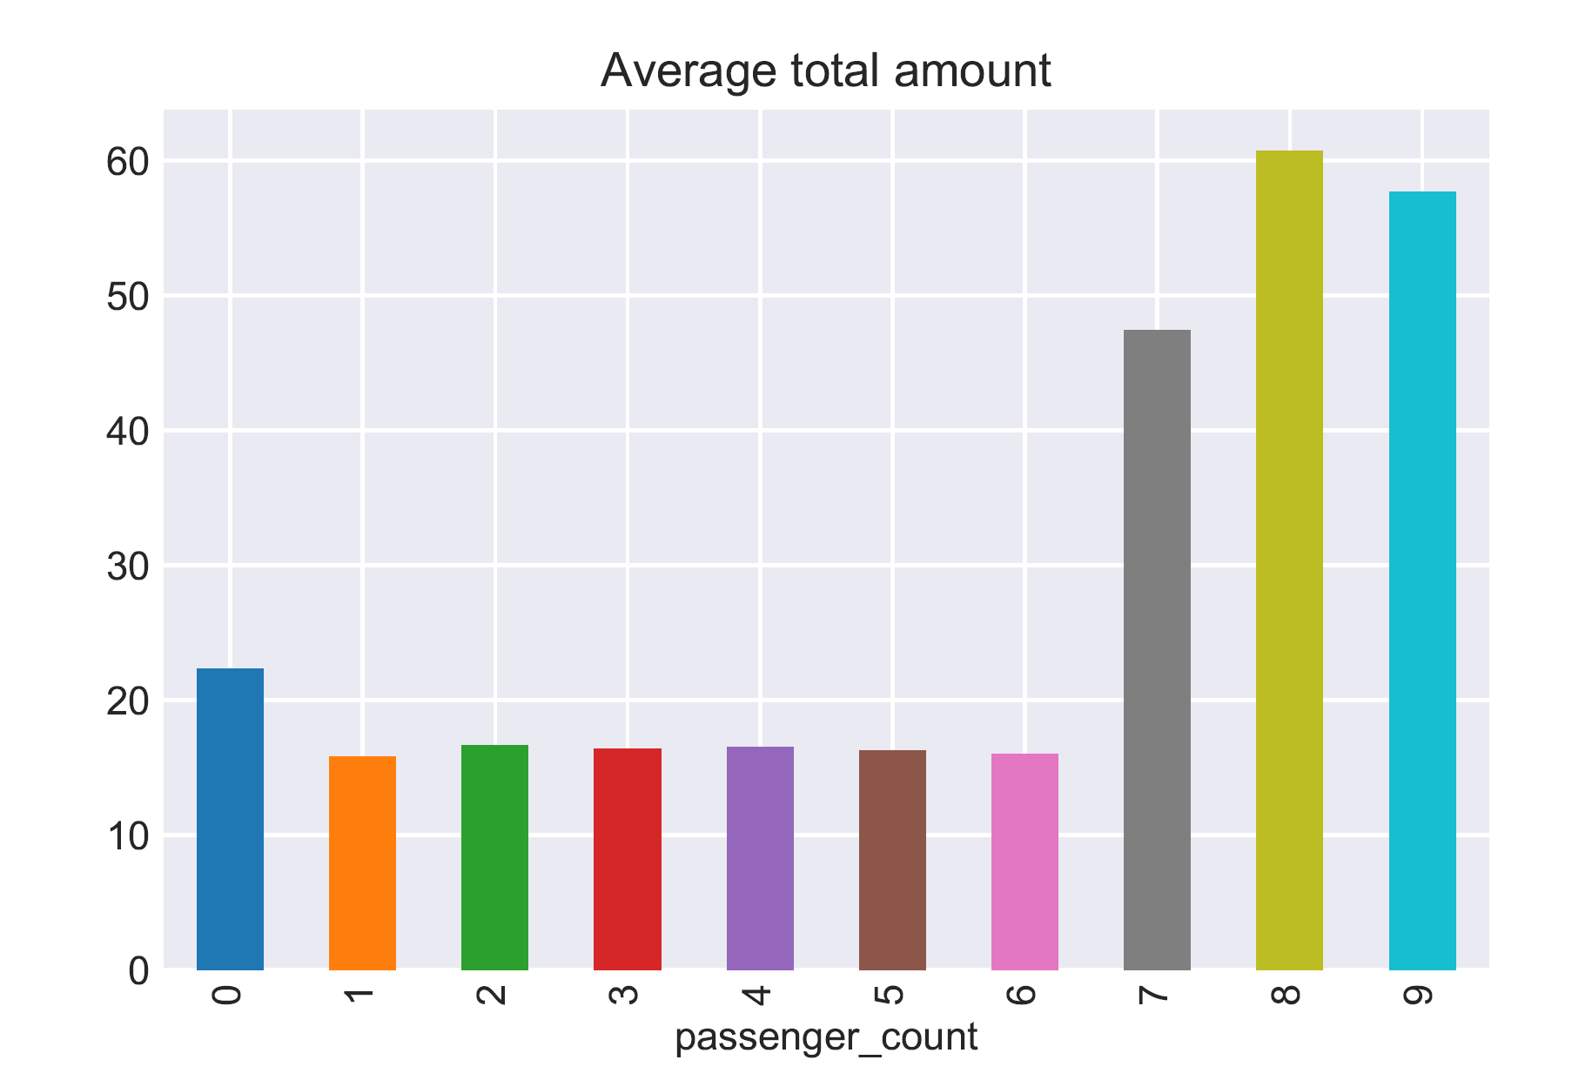
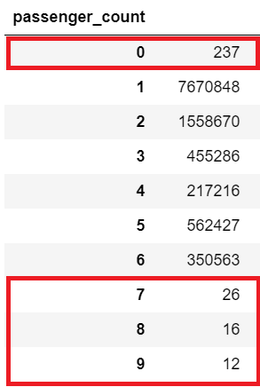
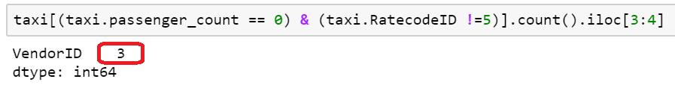
Passenger count frequency
0 passengers makes no sense
Very few rides with more than 6 passengers
These rides are very expensive on average though
When passenger count is zero, it‘s a negotiated fare

Slide 13
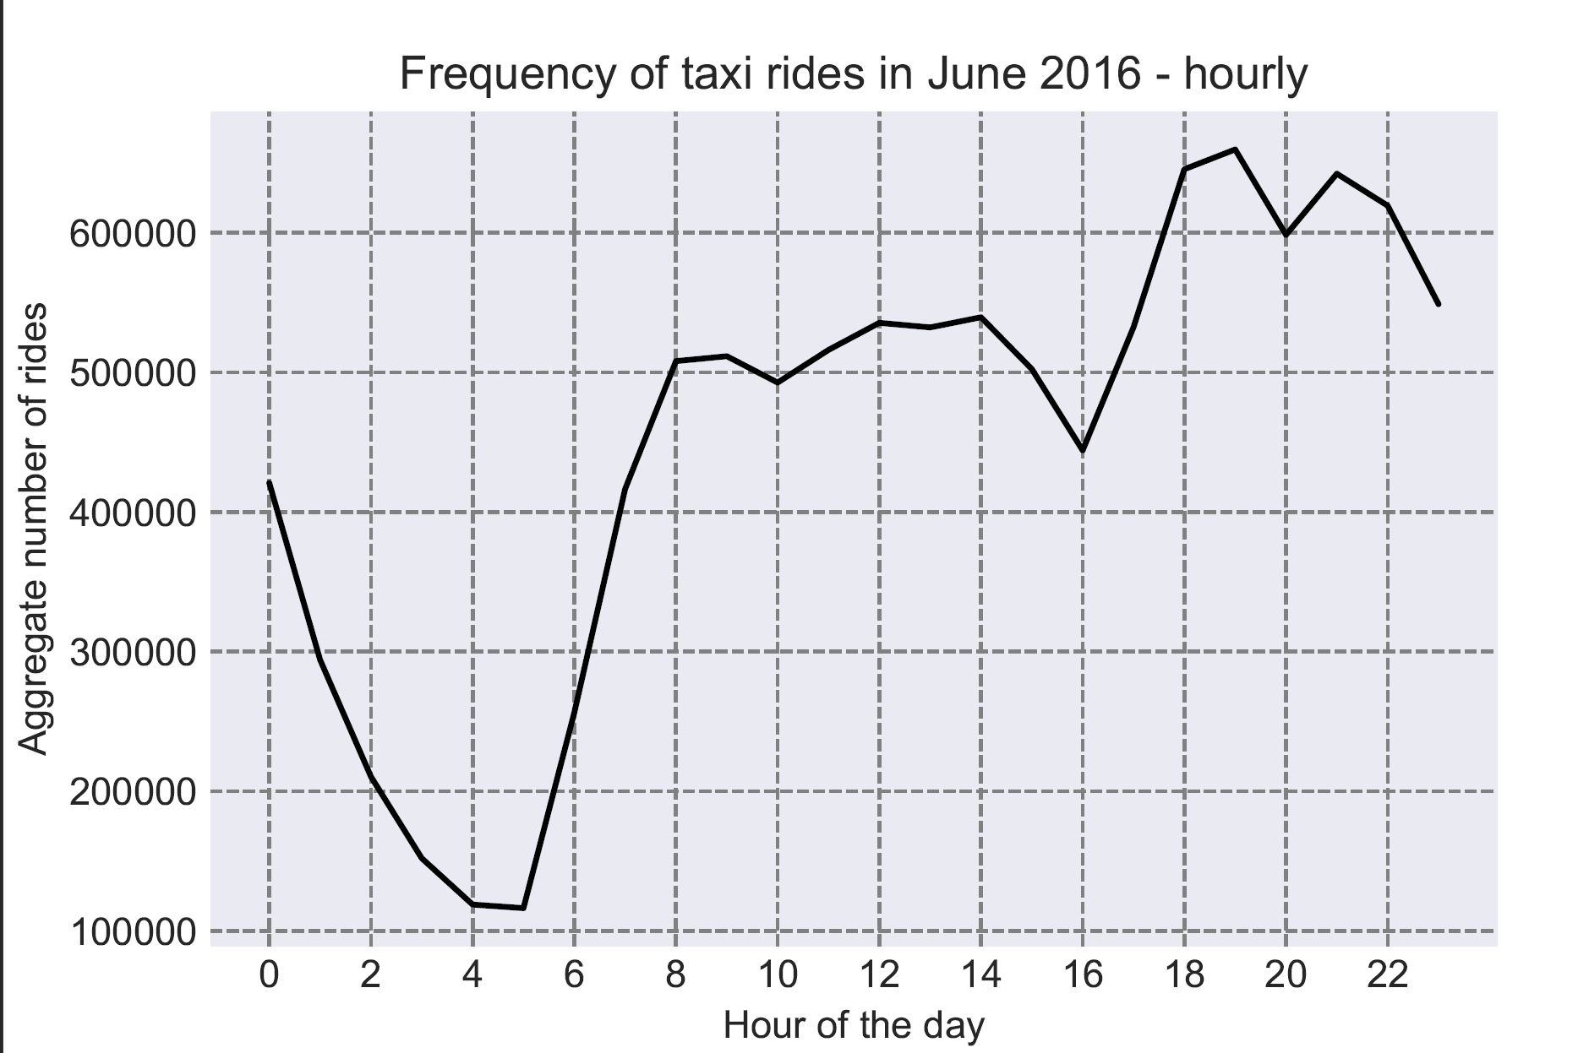
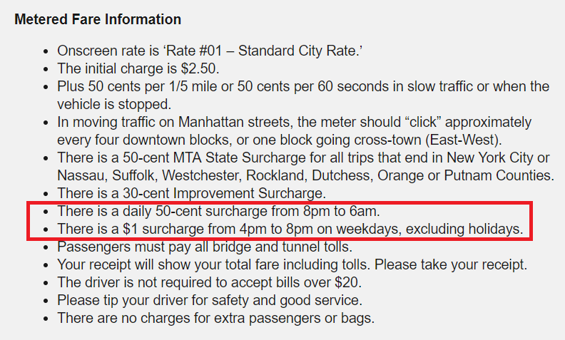
Next steps:
Night shift bonuses
Compensate income
Taxi comission takes advantage of high demand
Create dummy variables
Include in predictive model

Slide 14
Part 2: Feature engineering & Selection

Slide 15
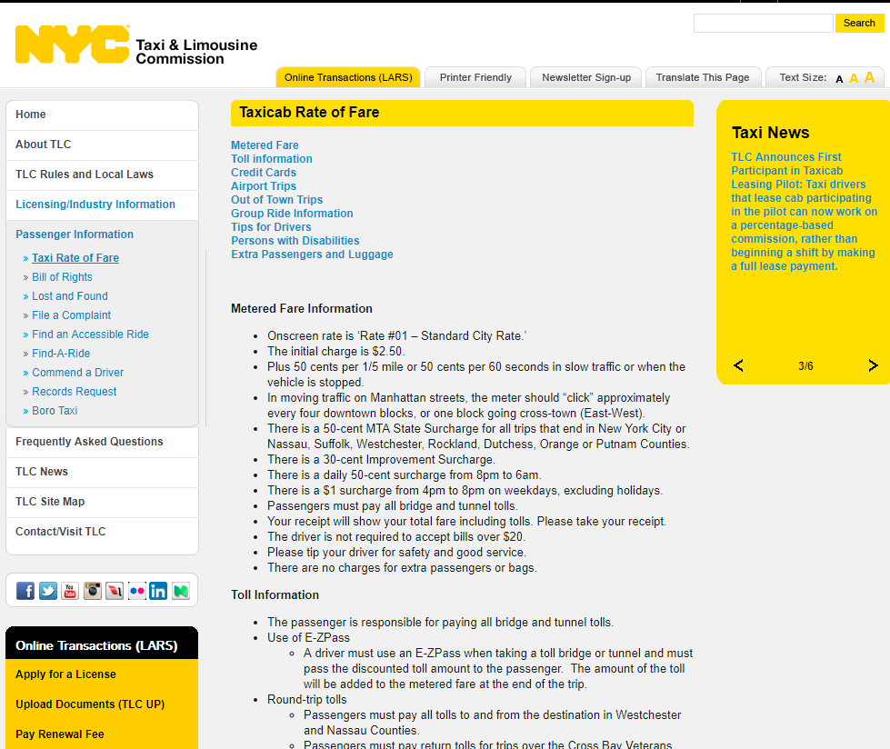
Must-haves from the Taxi commission
Price per mile or minute:
Average Speed
Trip Duration
Night-time dummy
Rush hour
Fixed trip:
Provide location in a meaningful way

Slide 16
Why not using a deterministic model?
Only for RatecodeID 1
Even there: measurement error
Missing features: “vehicle stopped”, “slow traffic”
tips
Not feasible for all other RatecodeIDs

Slide 17
Clustering of coordinates
Idea:
Find similar rides in terms of pickup and drop-off Coordinates or both.
Replace “complicate”, non-linear coordinate variables.
Method: K-means Clustering.
Example here: Pickup Points

Slide 18
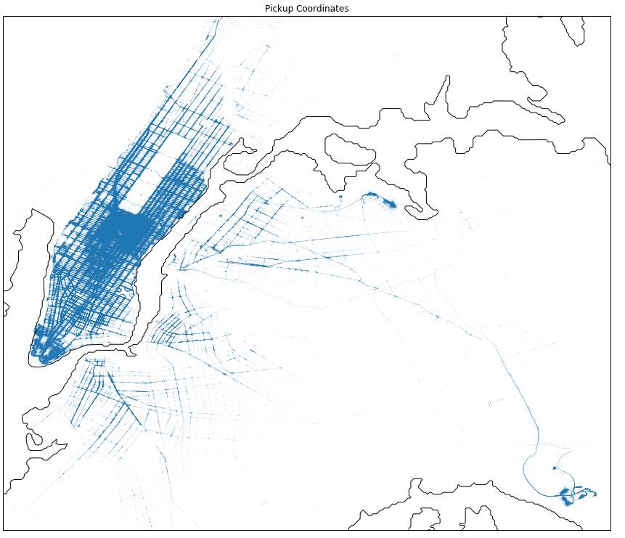
Pickup Points
Initial cleaning to get more stable clusters.

Slide 19
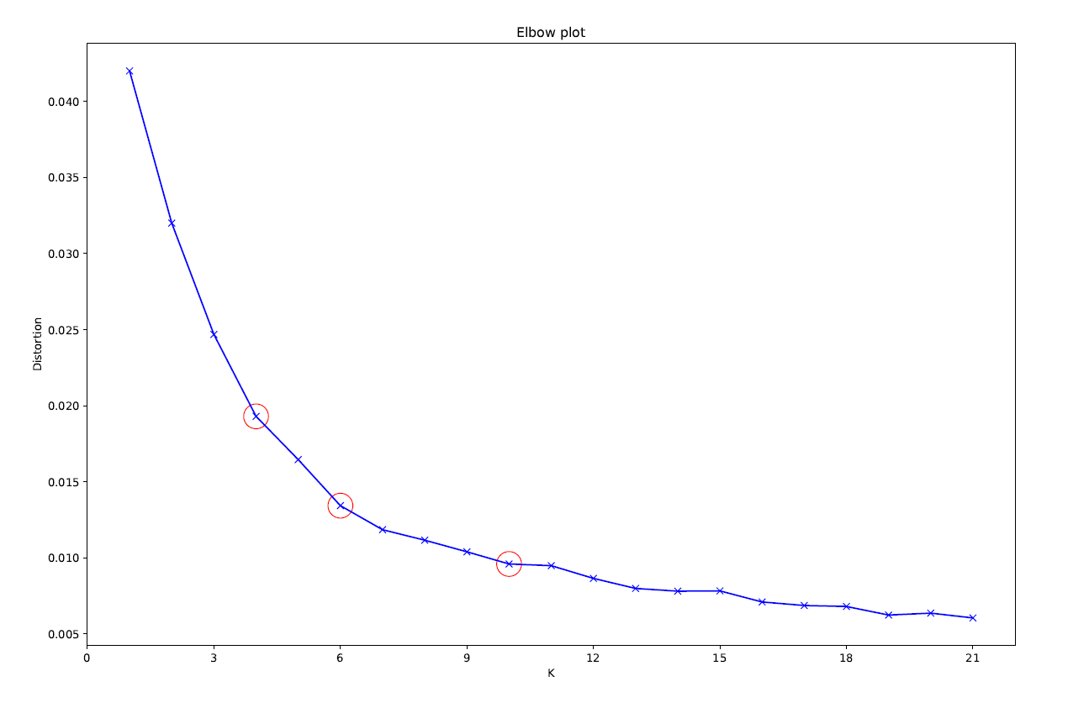
Picking K
Using the elbow plot
Possible candidates:
4, 6 and 10
Validating the pick by the stability of the estimate

Slide 20

Stability of the Cluster
Using K = 10
10 rounds of estimation
Using 250’000 data points

Slide 21
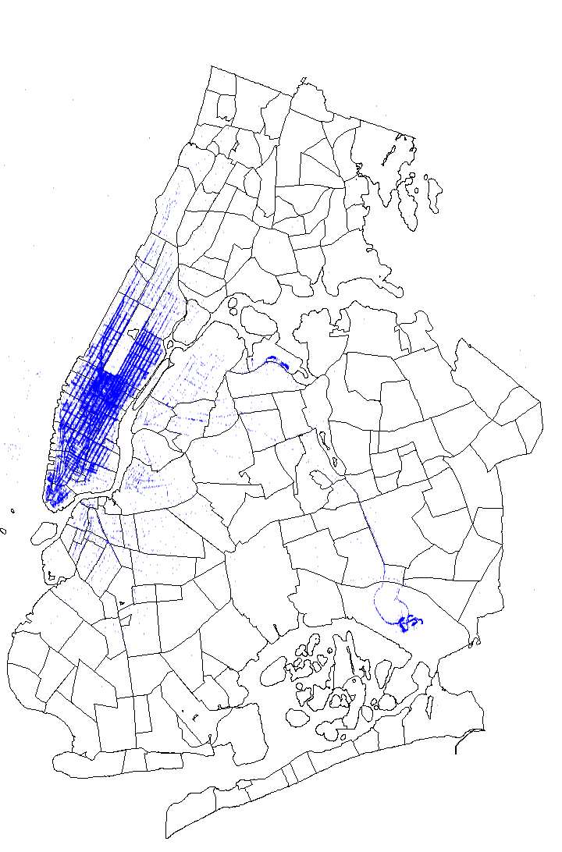
Identifying Neighborhoods
Idea:
Replace “complicate”, non-linear coordinate variables with simple dummy variables.
Method: Identifying the neighborhoods base on a grid.
The shape file is provided by Zillow
Same procedure for pickup and drop-off coordinates.

Slide 22
Adding time based features
How to include the time-based features?
So far:
Average speed
Trip duration
Night ride dummy
Rush hour
Potential variables:
Day of week?
Hour ?

Slide 23
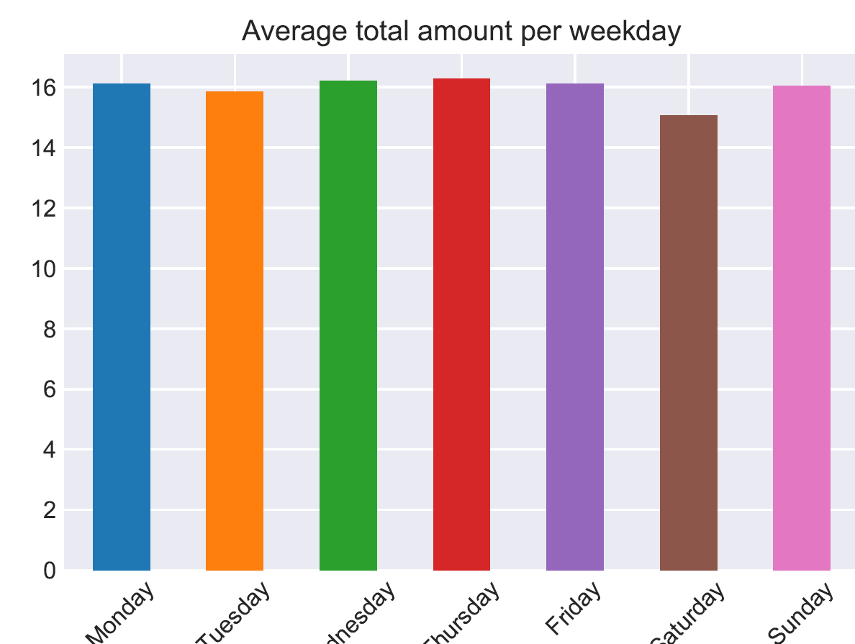
Day of week as a feature?
No indication of an effect.

Slide 24
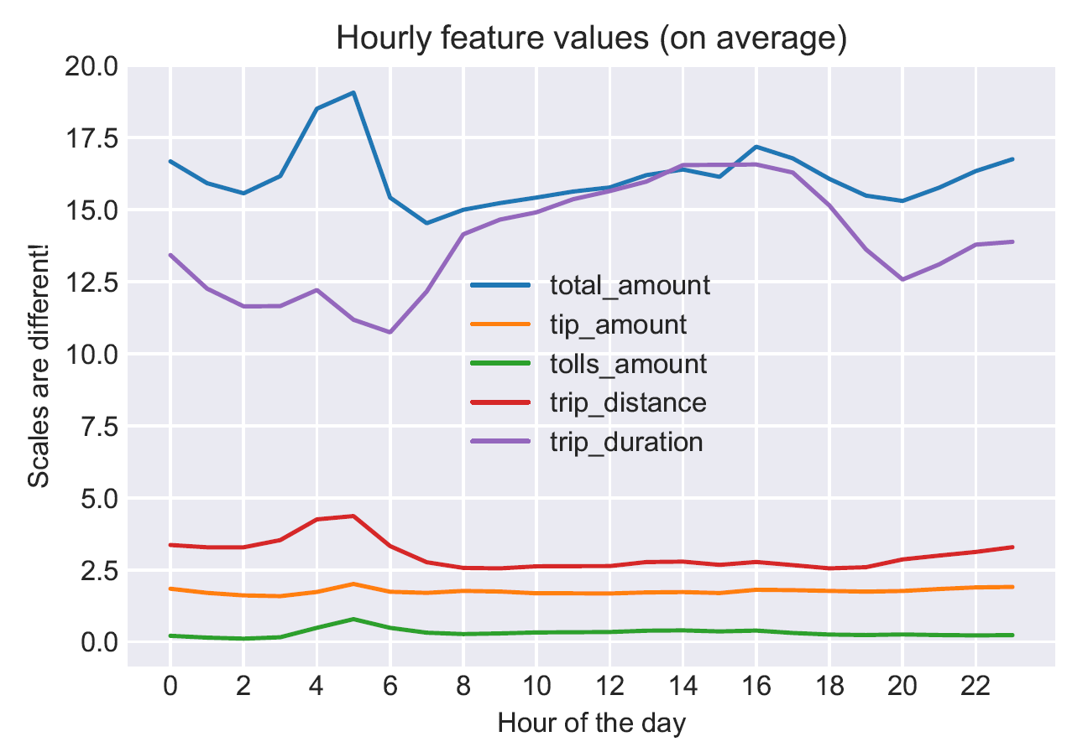
Hour as a feature?
Peak of average price at 4 pm
Yet seems to be driven by trip_distance, trip_duration …

Slide 25
Feature selection
Var | Scores
trip_distance | 13.06313204
trip_duration | 5.216370713
tolls_amount | 1.578587651
RatecodeID_1 | 0.955919964
RatecodeID_2 | 0.775490779
pickup_longitude | 0.455155918
average_speed | 0.446363094
pickup_neighborhoodJohn_F._Kennedy_International_Airport | 0.362971899
Cluster_start_1 | 0.344025217
Cluster_both_2 | 0.341242932
Cluster_both_5 | 0.248529086
dropoff_neighborhoodLa_Guardia_Airport | 0.101754595
dropoff_longitude | 0.104882837
dropoff_neighborhoodUnknown | 0.099021622
Cluster_end_2 | 0.082182622
Cluster_start_4 | 0.063394811
Cluster_both_4 | 0.058058366
pickup_latitude | 0.022143229
Cluster_end_5 | -0.00505781
Cluster_both_6 | -0.00505781
Cluster_start_10 | -0.00505781
dropoff_neighborhoodJohn_F._Kennedy_International_Airport | -0.01447606
Cluster_end_0 | -0.01876482
dropoff_neighborhoodLa_Guardia_Airport | -0.04489431
Cluster_both_3 | -0.05734436
dropoff_latitude | -0.05907032
Cluster_both_0 | -0.06381417
RatecodeID_3 | -0.07342602
Cluster_end_3 | -0.08538686
Important part of “real life” data science
Test model with vs. model vs. feature
We decided to do it based on
Univariate linear regression test (f-test)
mutual_info_regression (non-parametric)
Importance of our model
Use an observation weighted mean of the standardized metrics.

Slide 26
Part 3: Model fitting

Slide 27
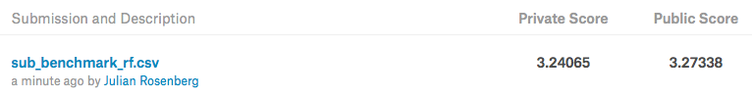
benchmark model
random forest as baseline model
xgboost/lightgbm can fit a random forest model
lightgbm :
bagging_fraction = 0.5
feature_fraction = 0.5
large num_leaves
19/20 of data as training
1/20 of data as validation
validation mae: 1.84
R packages: randomForest & ranger were not able to handle large data set

Slide 28

lightgbm model
5 separate models for RateCodeID with default parameters
without:
VendorID
store_and_fwd_flag
pickup/dropoff_datetime
improvement_surcharge
dummy encoding for:
payment_type
Cluster_start
Cluster_end
Cluster_both
pickup_neighborhood
dropoff_neighborhood

Slide 29
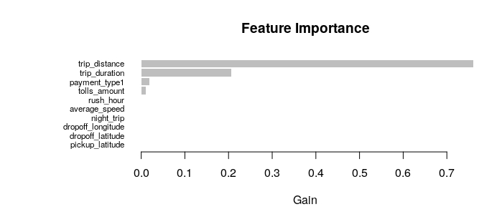
RateCodeID 1 - feature importance
validation set mae: 0.603485

Slide 30
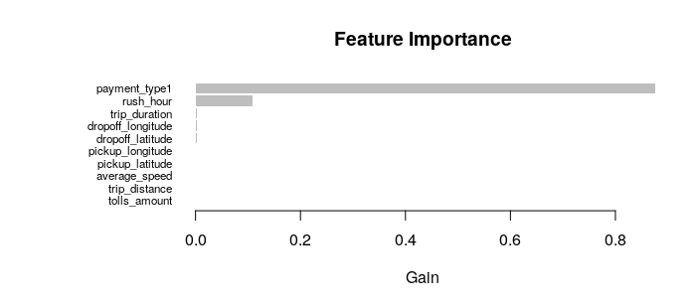
RateCodeID 2 - feature importance
validation set mae: 2.22329

Slide 31
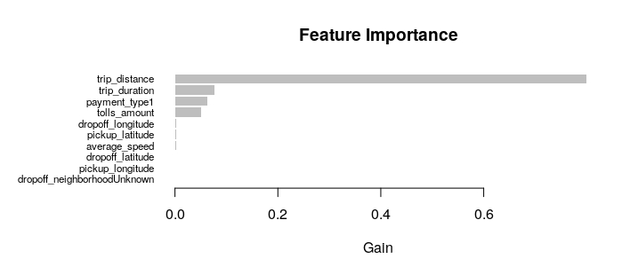
RateCodeID 3 - feature importance
validation set mae: 4.01041

Slide 32
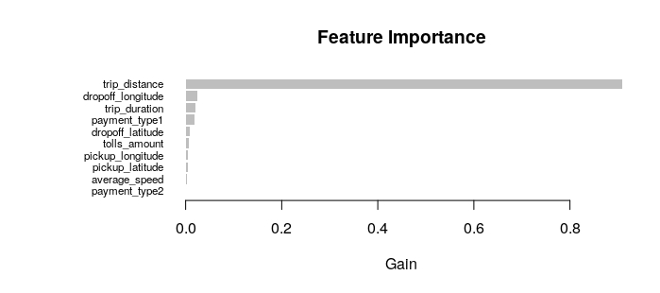
RateCodeID 4 - feature importance
validation set mae: 5.82012

Slide 33
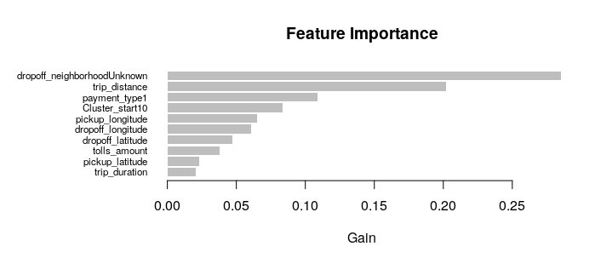
RateCodeID 5 - feature importance
validation set mae: 21.9094

Slide 34
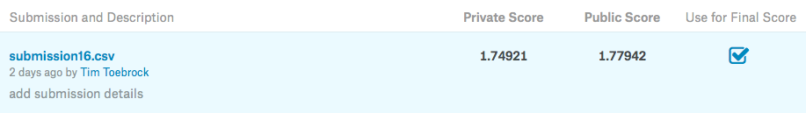
tuned xgboost model
5 separate models for RateCodeID with tuned parameters
dummy encoding only for pickup/dropoff_neighborhood
VendorID, store_and_fwd_flag and clusters included
not used as categorical, for xgboost used as numeric

Slide 35
Questions
dummy encoding for categorical variables ?
dummy variable encoding: with/without reference category?

