Slide 1
GIT HUB
WHAT is GUTHUB?
WHY we USE GITHUB?
WHEN we USE GITHUB?
HOW we USE GITHUN?

Slide 2
WHAT is GITHUB
It is a webbased platform built on Git version control systems that allows Developer ( we the sas programmer), to store,manage,and collobarate on code
From SAS point , SAS STUDIO has a separate section to connect our sas codes into this web based platform
Latest GIT version 2.51 for windows
Novorties and Roche use this platform in a different manner but the same logic(RD KIT)

Slide 3
WHY GITHUB
We use Git hub for 2 main reason one is version control and other open sources to contribute the projects current scenario R language codes are developed and shared across for easy implementation as per the CRO and Pharmaceutical clinical trials need
We has a programmer use this to get idea and draft copy of a code to start and develop as per our requirement

Slide 4
HOW to Implement
How to use GITHUB with SAS STUDIO
Create a GITHUB Profile using the link (https://github.com/) after creating an account you will have your dashboard
Then You create your own repositories(Fundamental element in which we can store and manage our code we can create multiple respositories has seen below)

Slide 5
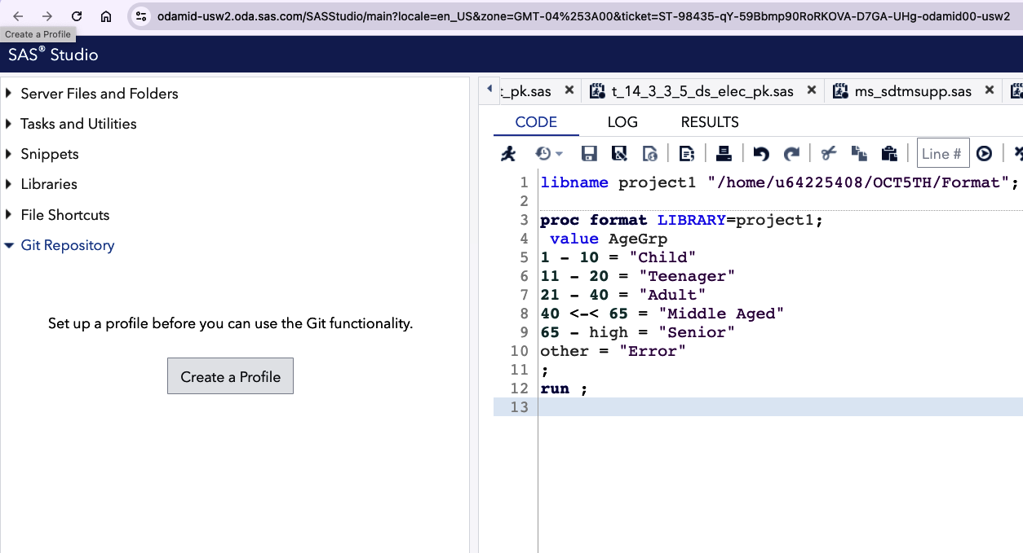
SAS STUDIO GIT REPOSITORY
SAS Studio has Git Repository tab in which we can link our git profile:
SAS older version are not compact to add GIT REPOSITORY:

Slide 6
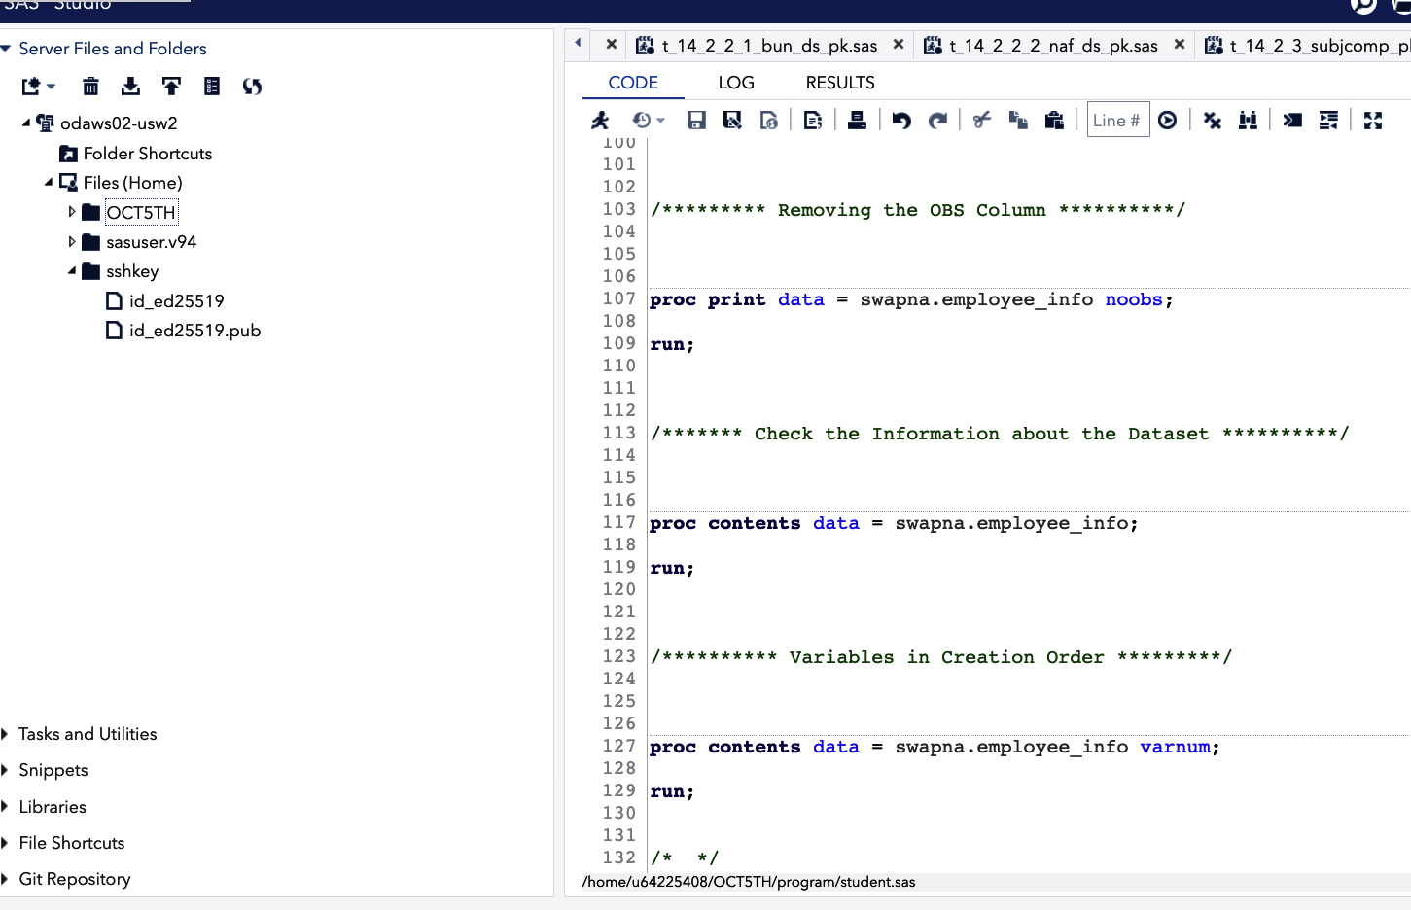
CREATION OF SSHKEY A BRIDGE FOR SAS AND GITHUB SITE
We should have a unique SSHKEY to Create our Repository :
Details about how can be found in the link at end of this session:

Slide 7
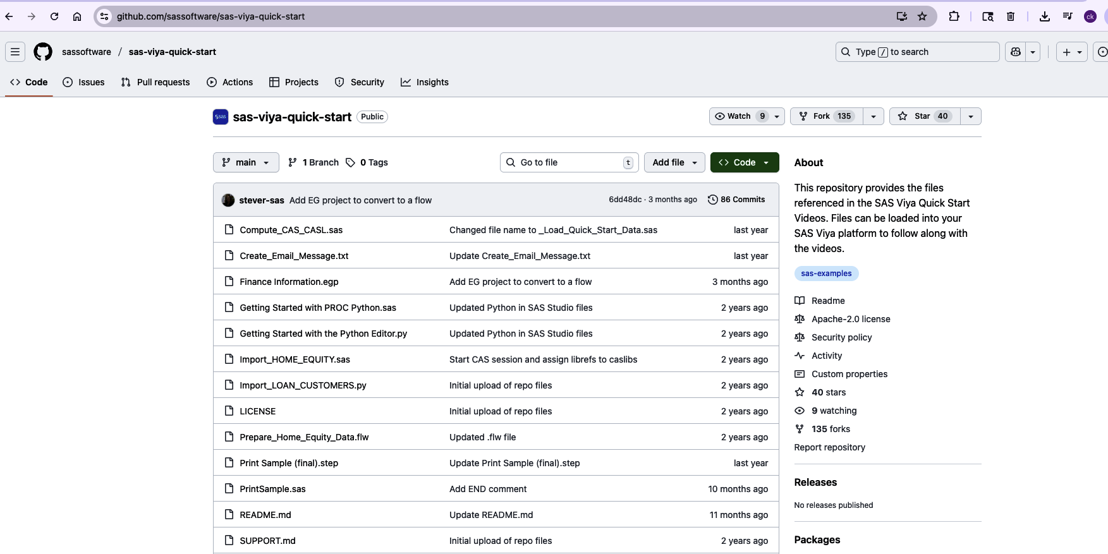
Linking GITHUB REPOSITORY TO SAS STUDIO
We can link or Fork files as per our needs provided we know the URL or Fork access
(Example: SAS-VIYA-QUICK-START):

Slide 8
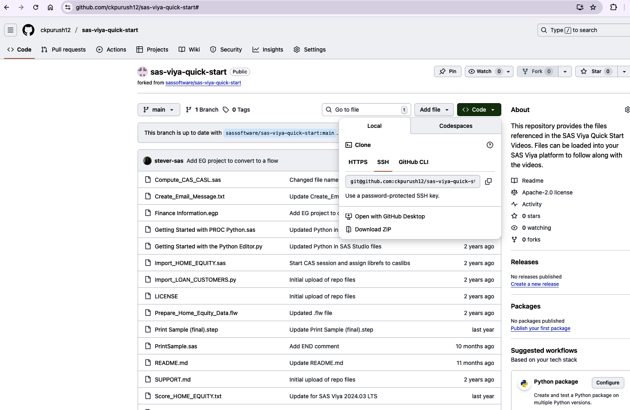
Connecting GITHUB TO SAS STUDIO
Using SSH Key for that particular Link or fork to connect to our sas studio profile:

Slide 9
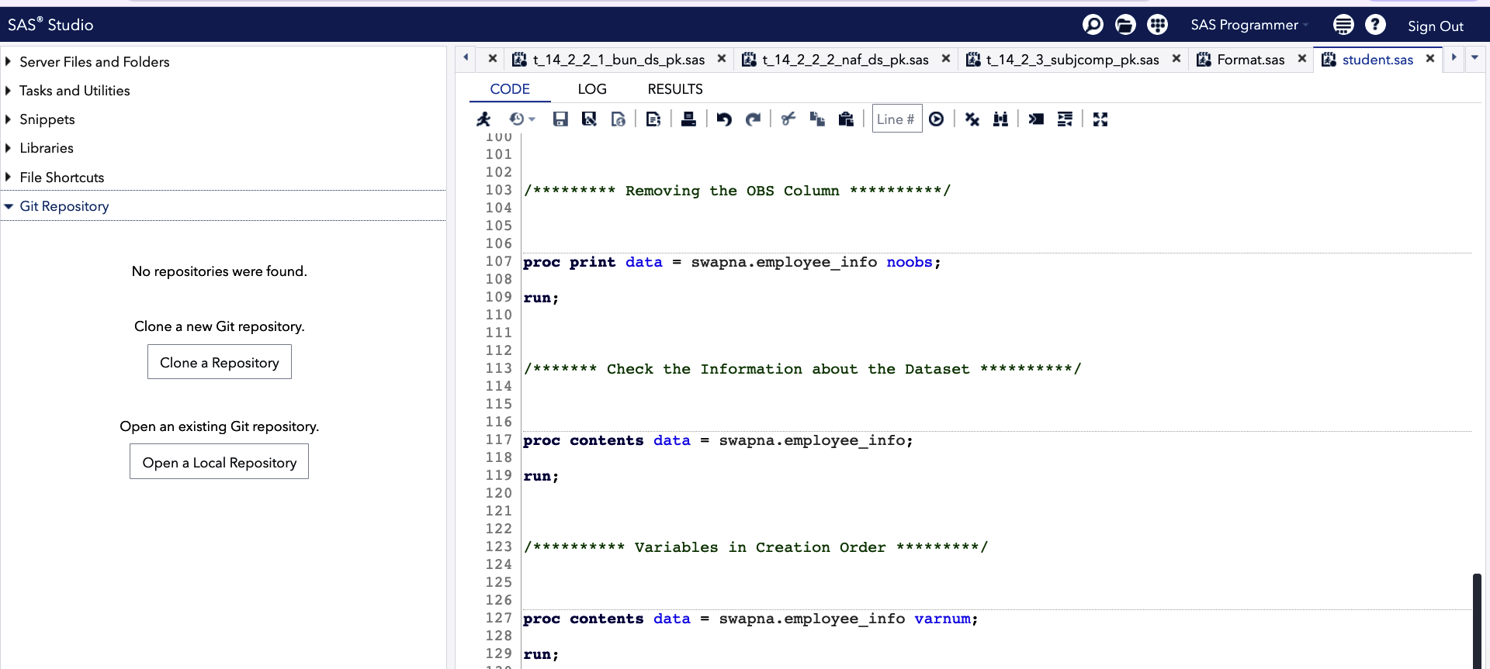
CLONE A REPOSITORY Meaning getting all github program to SAS STUDIO
Clone meaning taking a copy or replica of files,data, output ect from one source to another:
We can Clone has many Repository as we want provided we have access to the source:

Slide 10
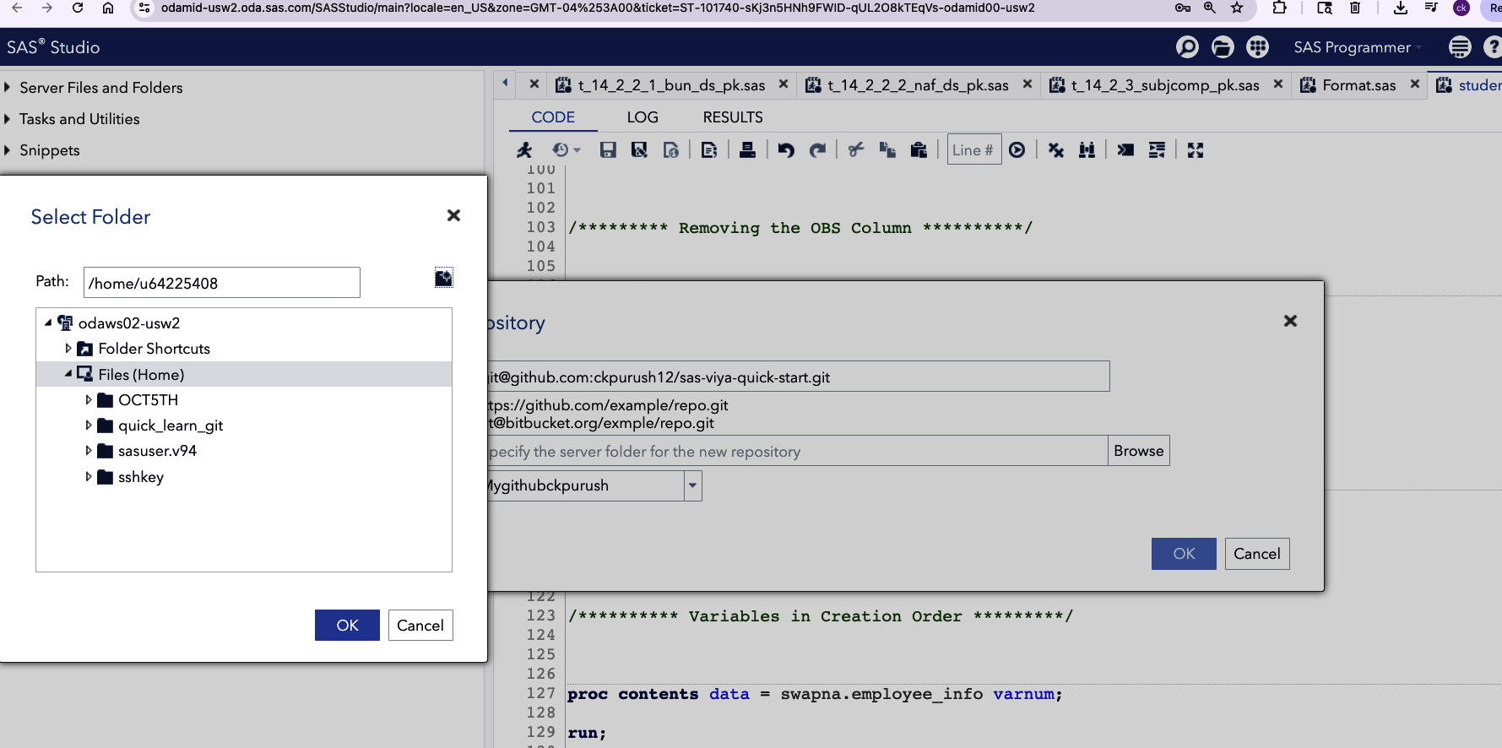
CONTINUED
Set up of colne is continued below details are explained in the video file at end of this session:

Slide 11
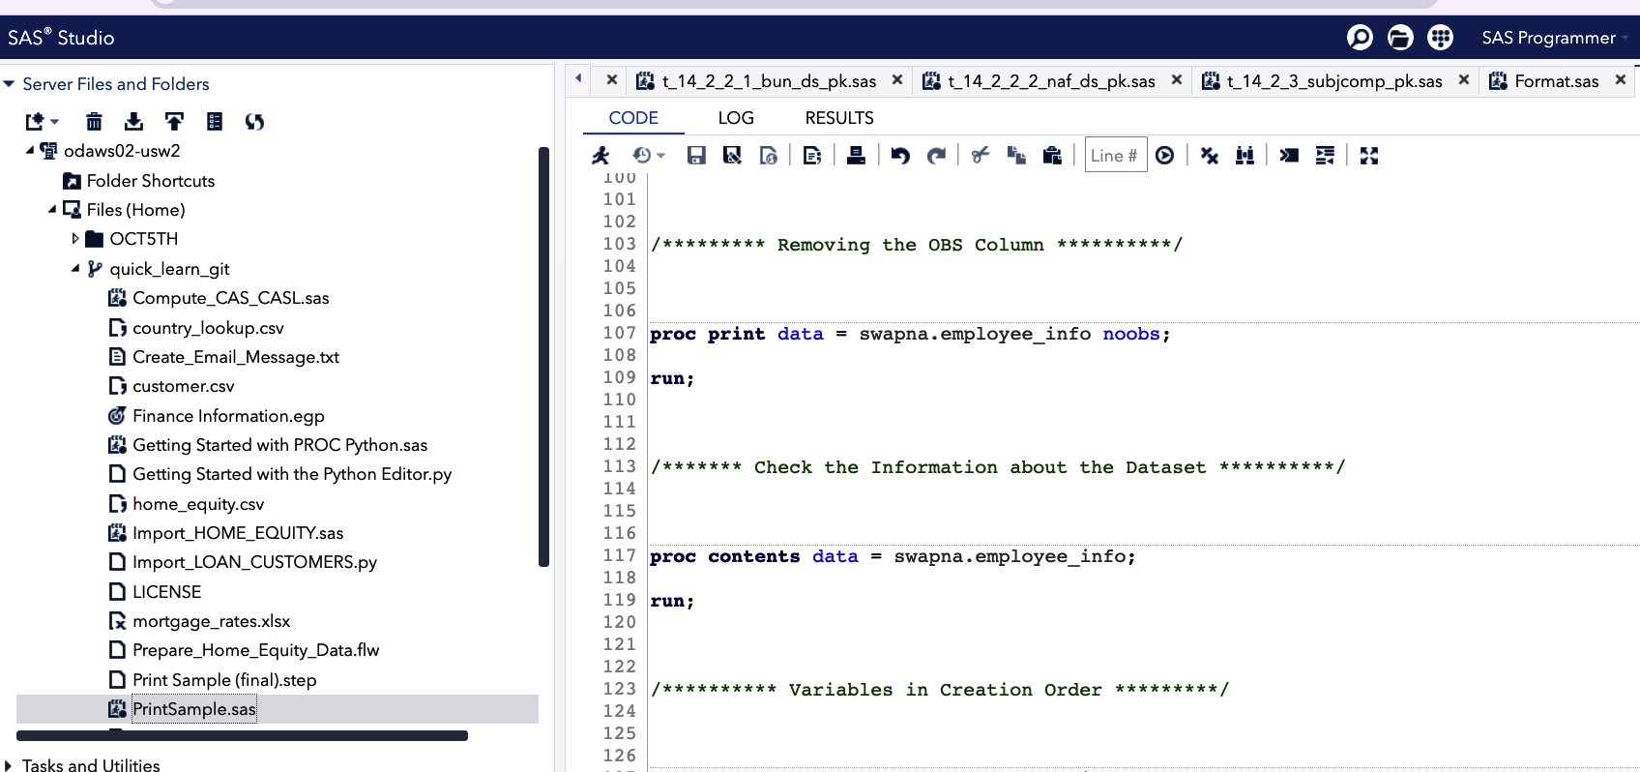
Github repository (programs ) copied or colned over
Output of the colned session can be seen below which we use and modify:

Slide 12
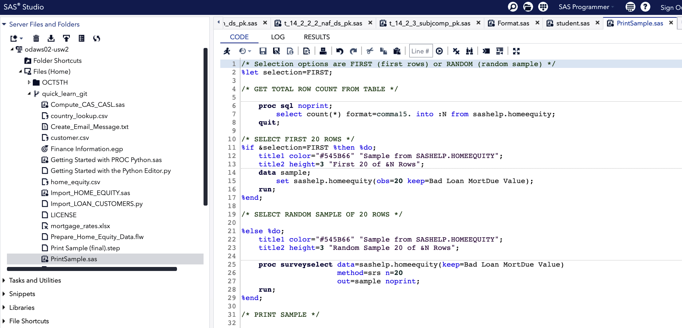
PRINT.SAS PROGRAM IS BEEN UPDATED ON SAS STUDIO
PRINT.SAS program initially we have sashelp.HOMEEQUITY dataset :
Keep= (Var1,Var2….) variables are the initially output requirement for this program:

Slide 13
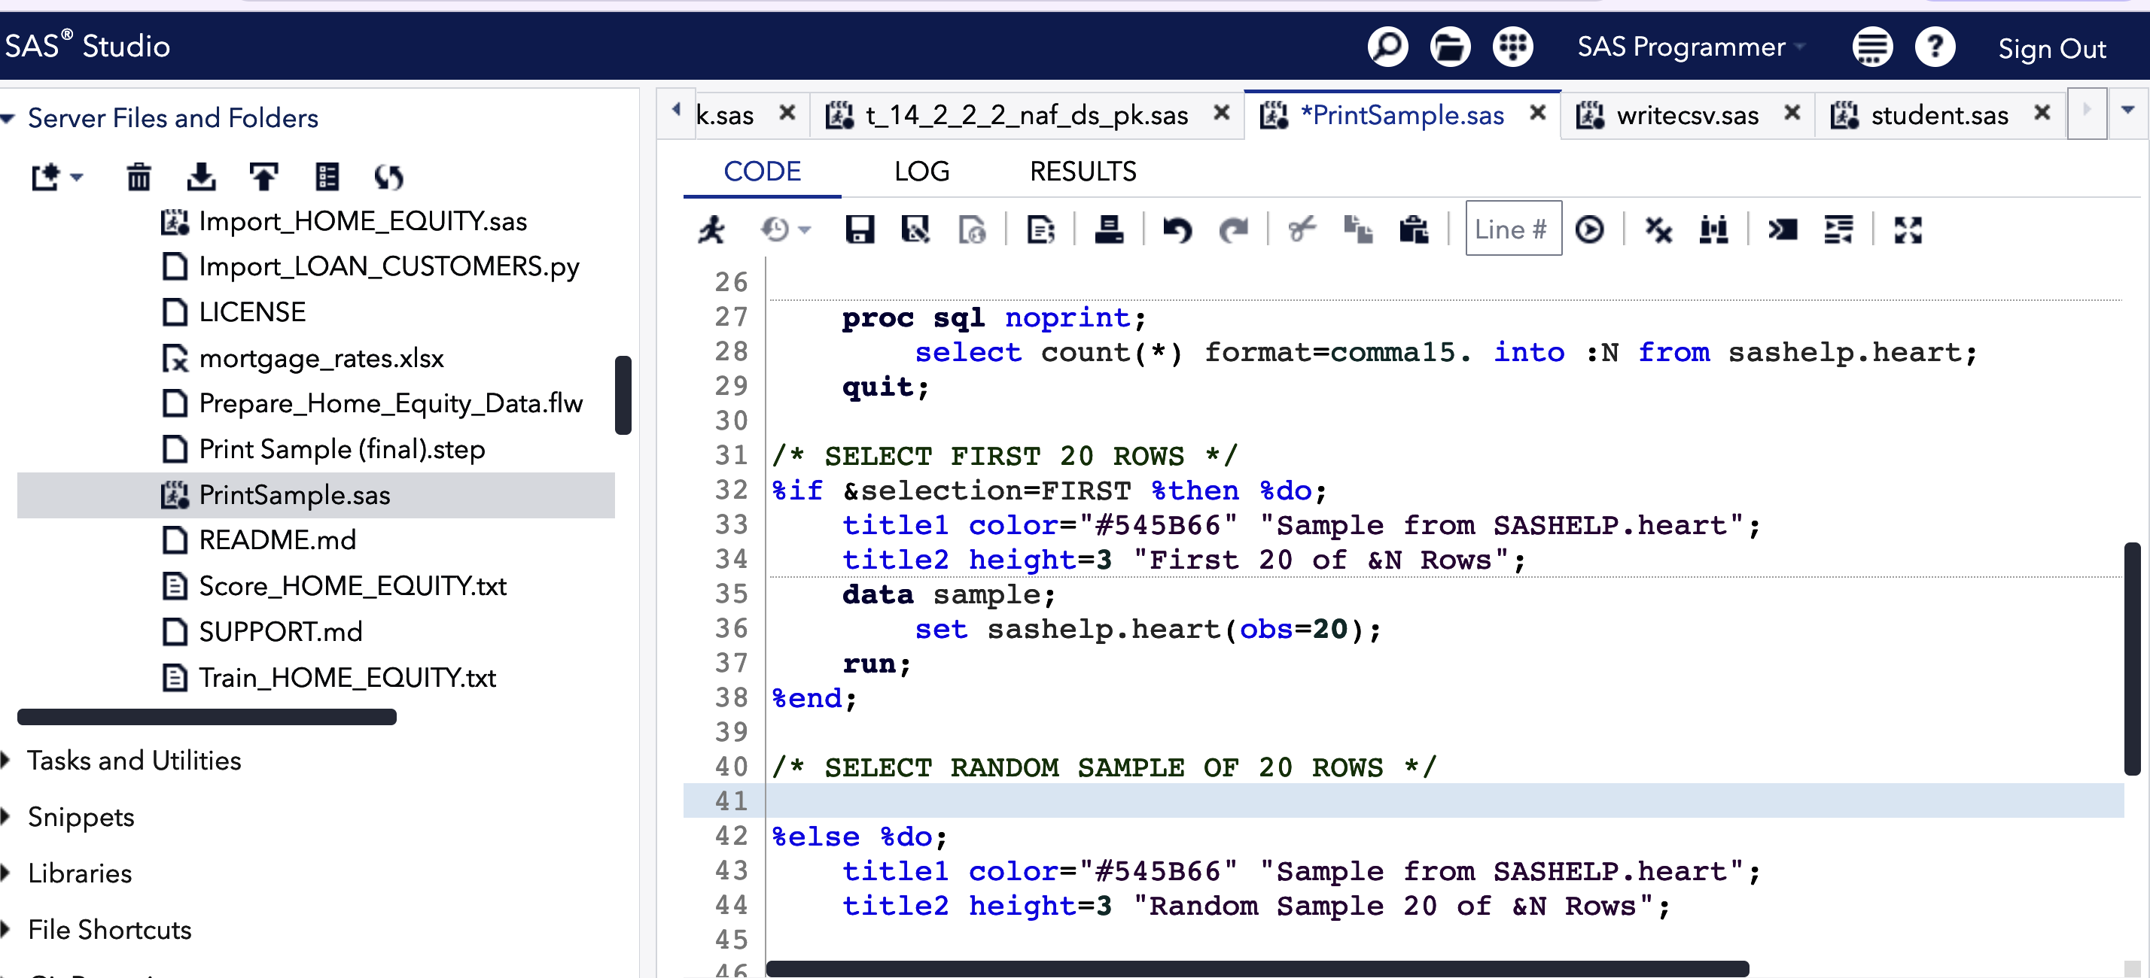
PRINT.SAS program updated on sas studio
Updates are made to SASHELP. And keep statement note there is no header in this program:

Slide 14
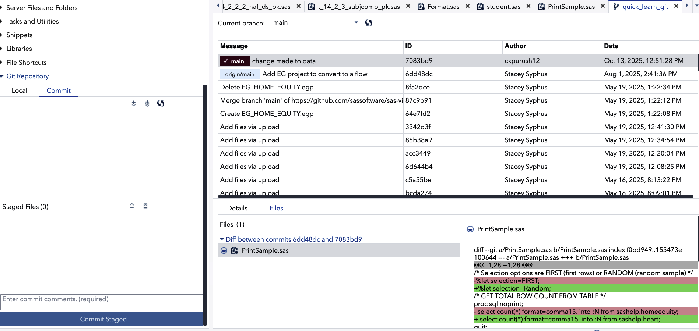
COMMIT
After making the changes to the program once we commit the program , the file display as below:
RED highlighted shows the pervious steps in program:
Green highlighted shows the current steps added to program:

Slide 15
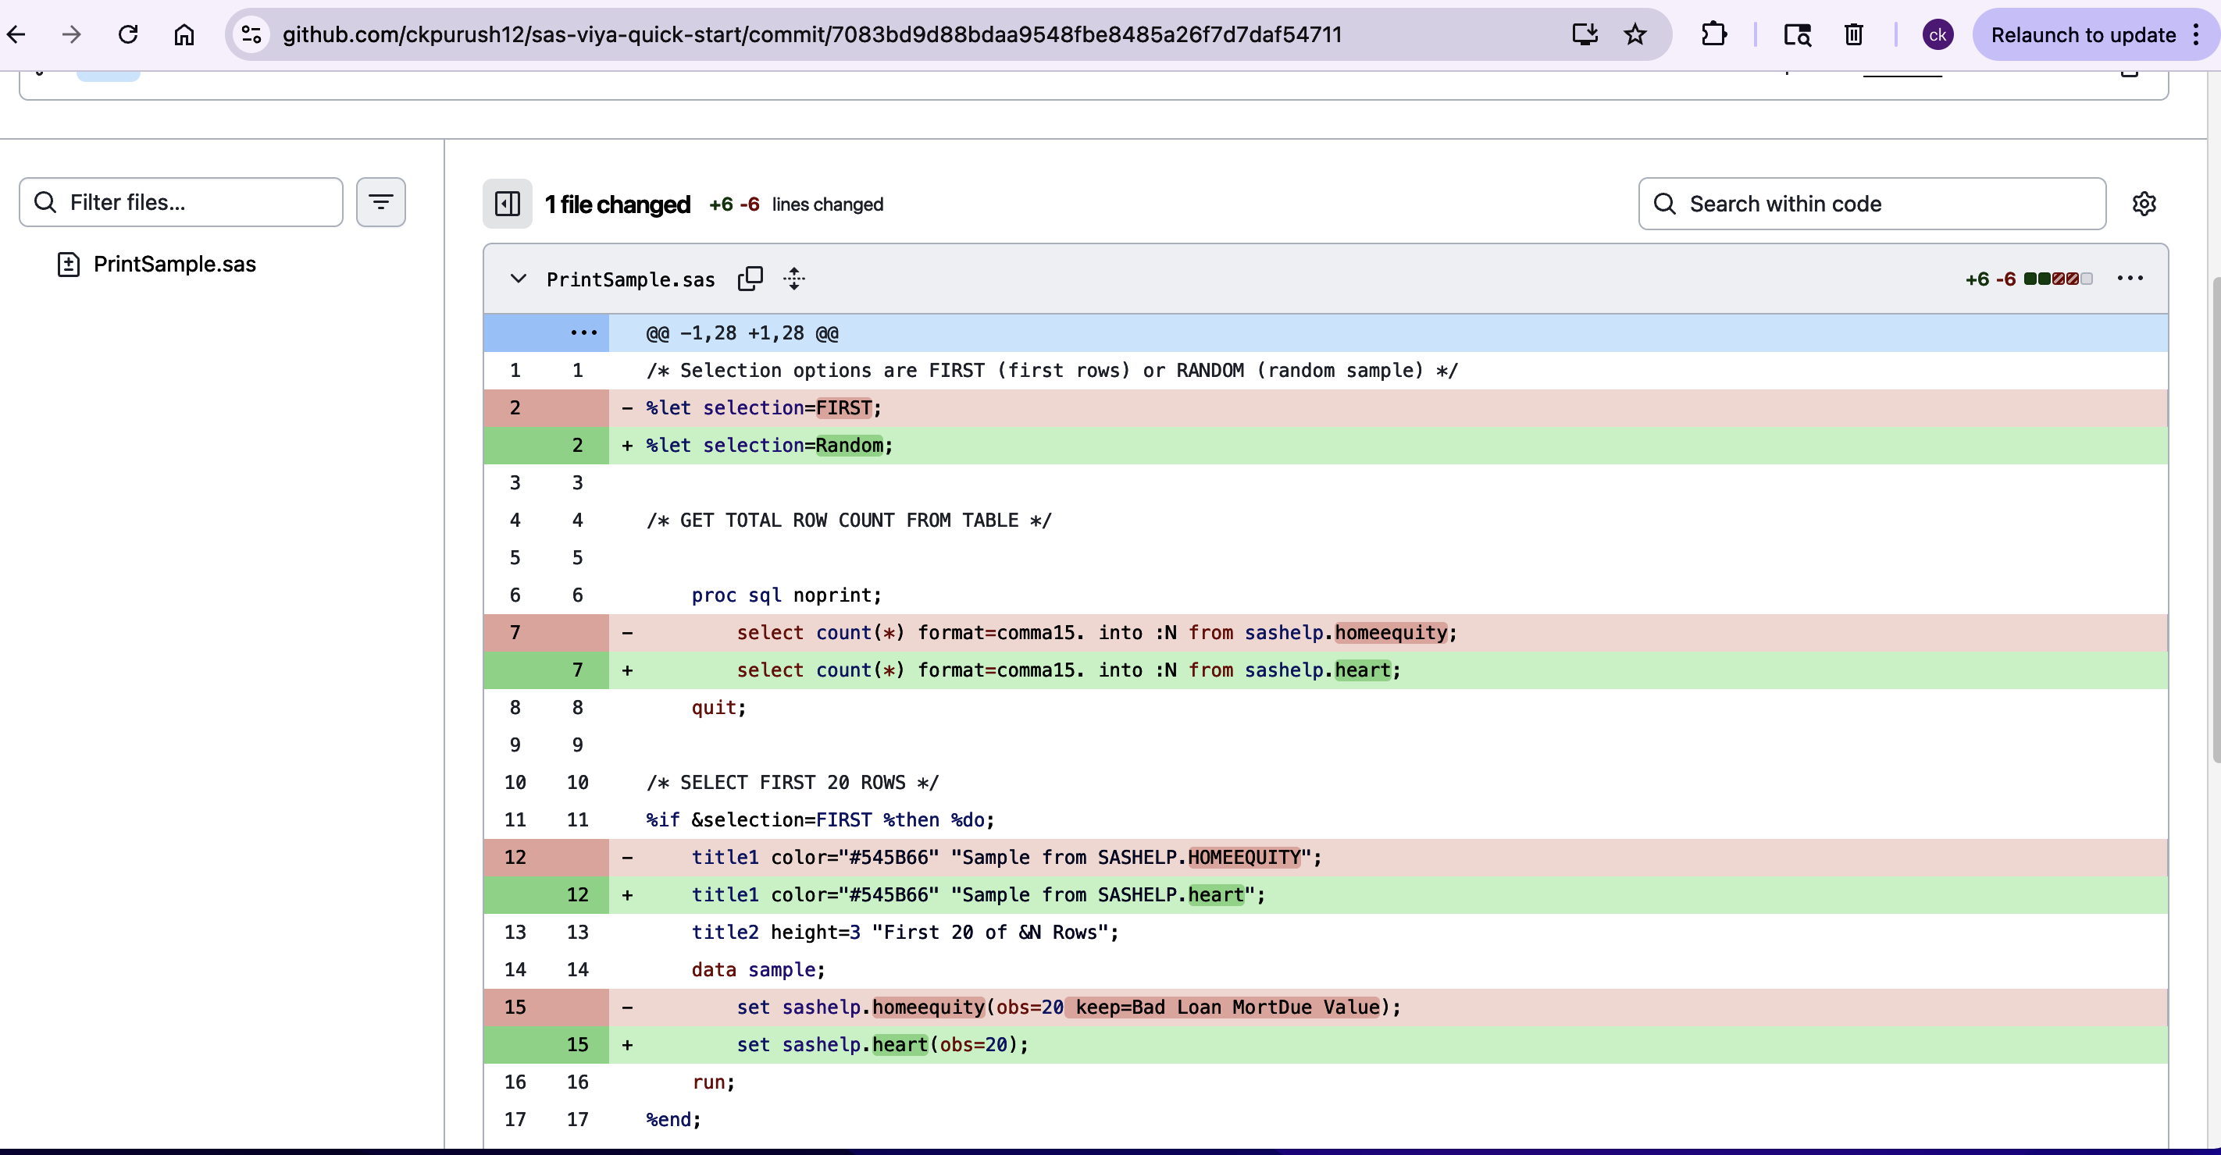
Continued:
On GITHUB side we can see the changes made to the code and after commit, Refresh the github page to see the changes

Slide 16
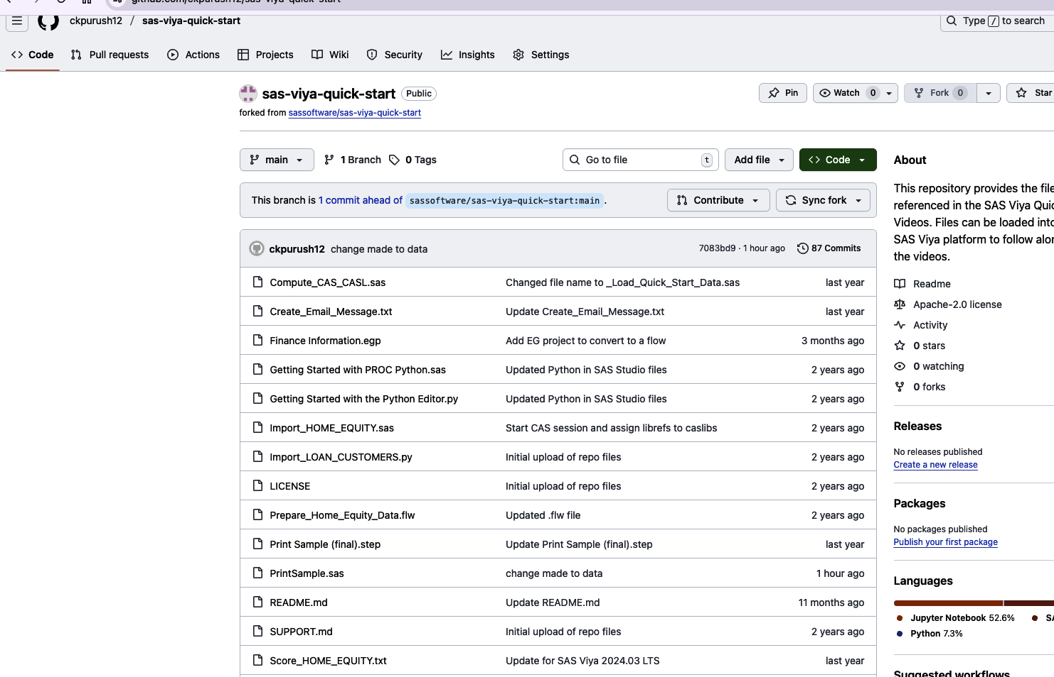
SEE THE CHANGES IN GIT HUB SINCE IT IS BRIDGED USING SSHKEY
Once we commit the changes in SAS studio, your Github Fork Session gets updated :

Slide 17
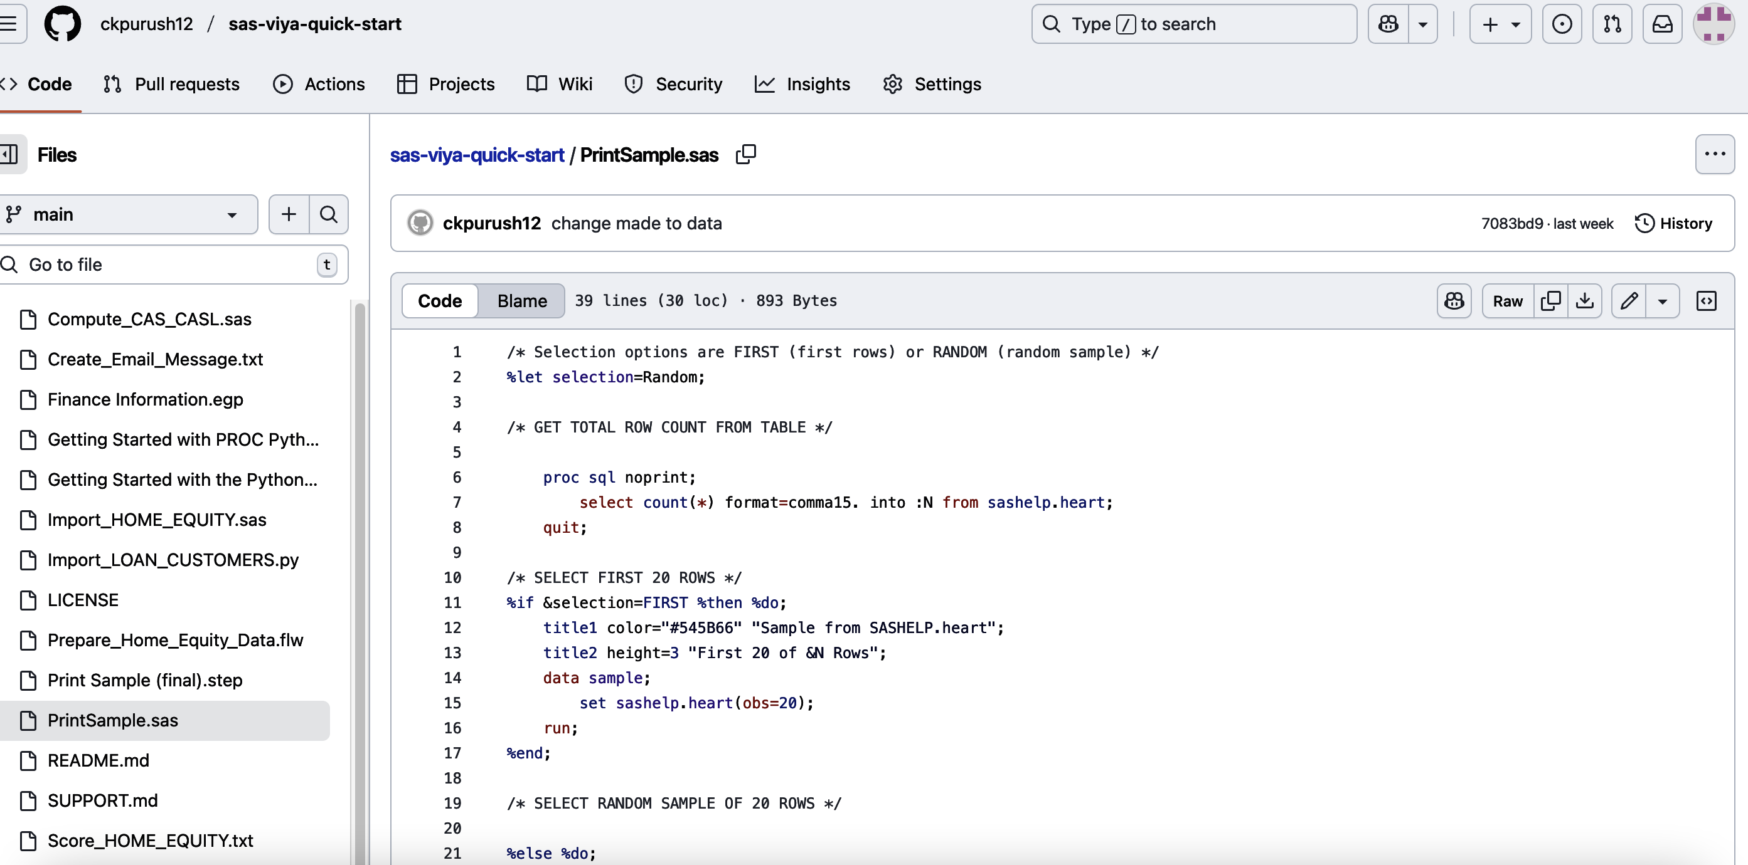
Version control :Main Purpose of GITHub
We can see the Version History in GITHUB under history tab:Navigate to your repository on GitHub. You will see a "Commits" link or tab, usually near the file list. Clicking this will display a chronological list of all commits, showing the commit message, author, and timestamp for each change. You can click on individual commits to see the specific changes (diffs) made in that commit.

Slide 18
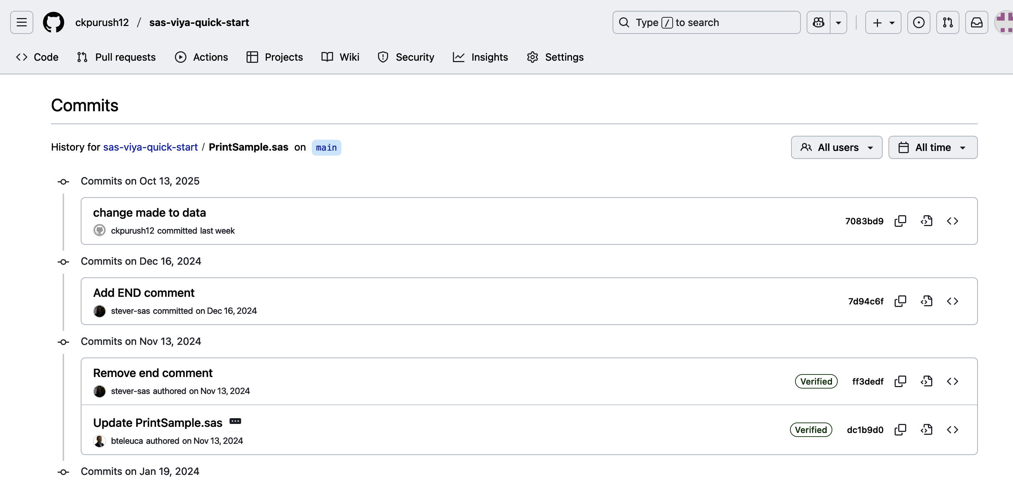
Continued

Slide 19
SAS code to GITHUB
The sas code which are programmed by you in SAS studio can be move to GITHUB.
Follow the slide 5 to 10 FOR step by step process
First process/procedure :Github profile, create repository in Github
Second process/Procedure: Clone the github repository to sas studio
Third process/Procedure: Build your own code , with data steps and proc steps and upload that to Github by commit in sas studio
Follow the video from the references section for more details

Slide 20
References:
https://www.youtube.com/watch?app=desktop&v=sRmmht9nksY
https://documentation.sas.com/doc/en/egug/8.3/p078cl08fol7hkn11a8nf1f9izq7.htm
https://www.lexjansen.com/phuse/2019/ct/CT11.pdf

