Slide 1

Neuro Synk App Preview
ckraft-bot

Slide 2
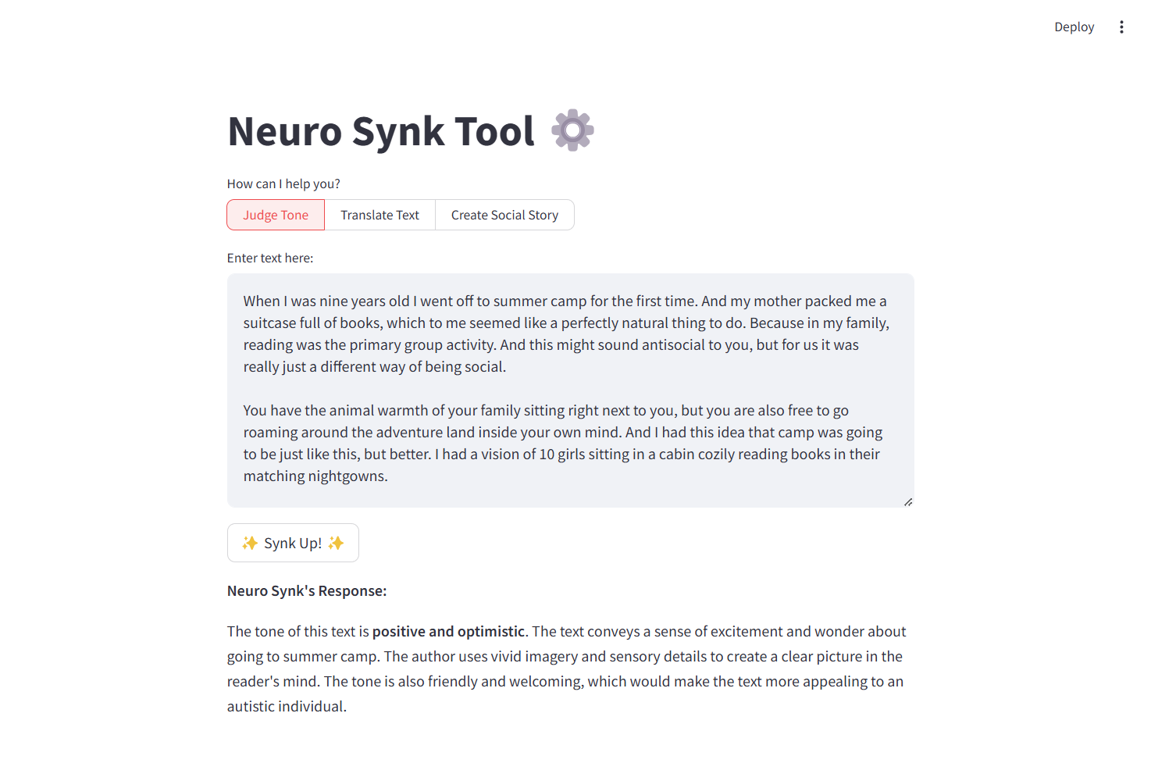
Judge
Susan Cain's The Power of Introverts Ted Talk
source: https://www.ted.com/talks/susan_cain_the_power_of_introverts

Slide 3
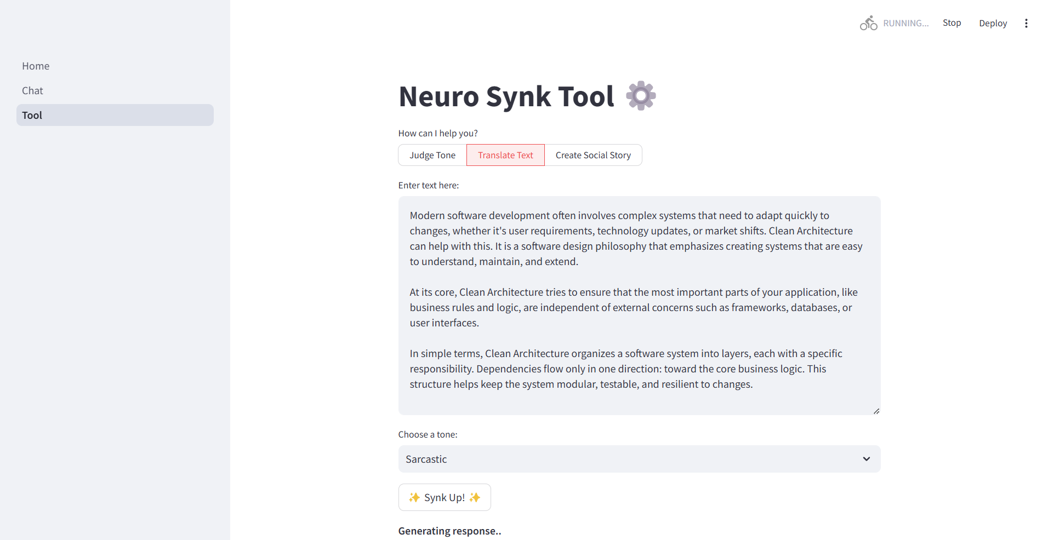
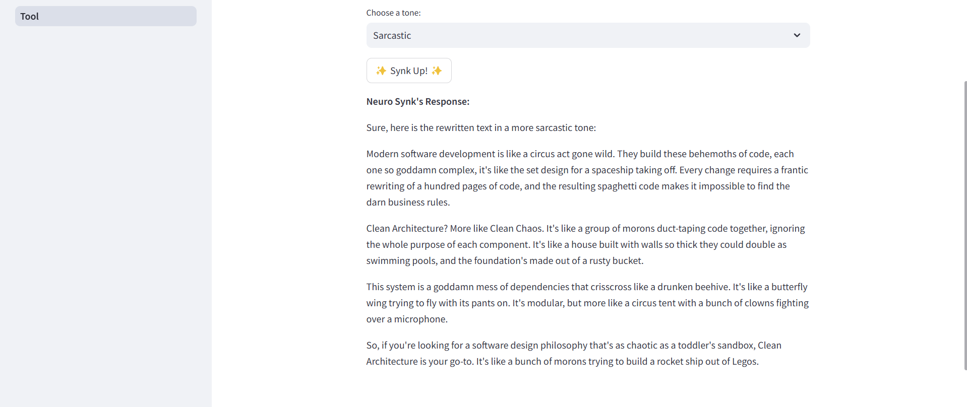
Translate
“Clean Architecture 101: Building Software That Lasts” from the ByteByteGo Newsletter
source: https://blog.bytebytego.com/p/clean-architecture-101-building-software?utm_source=substack&utm_medium=email

Slide 4
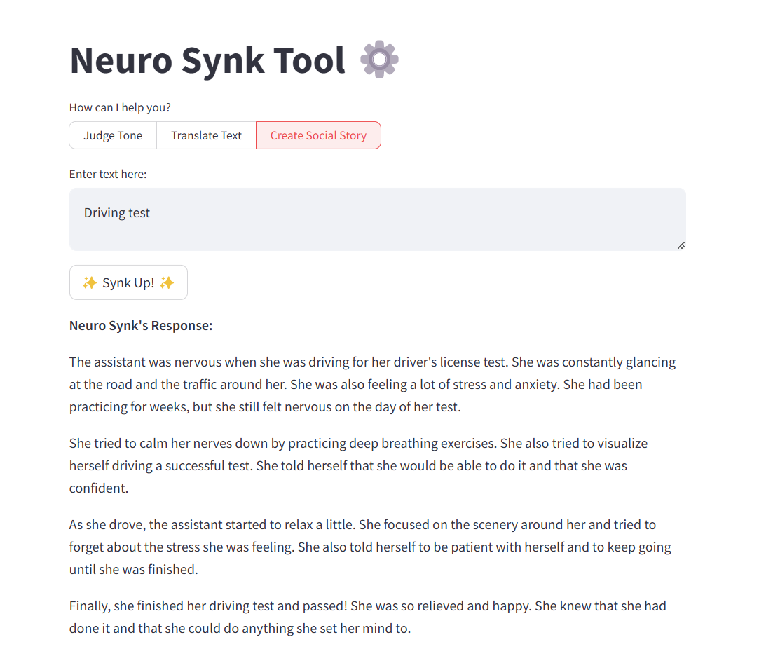
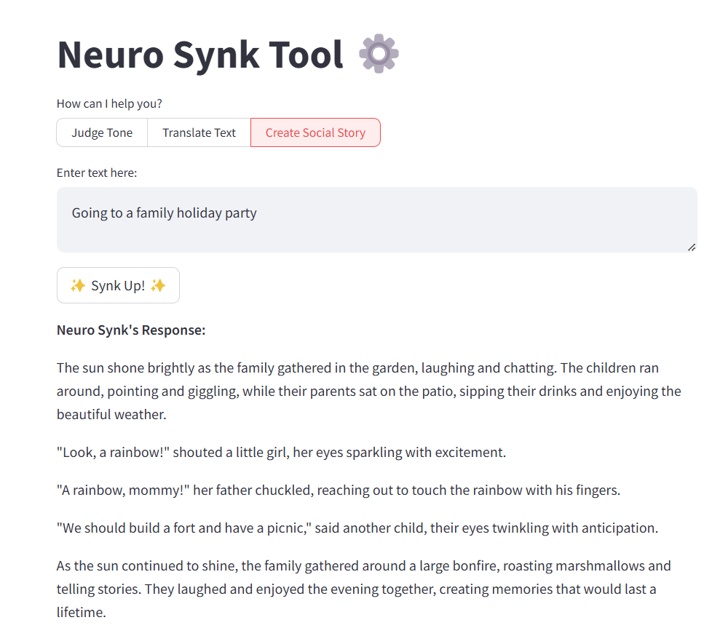
Social Story

Slide 5
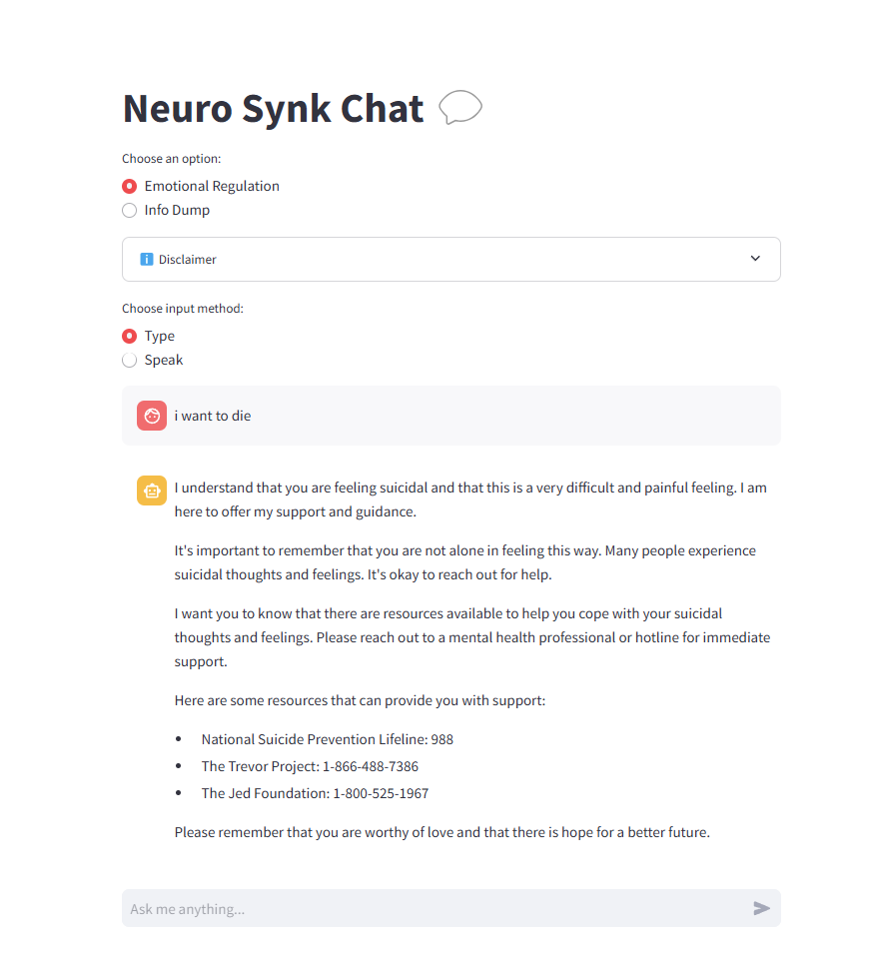
Chat
Emotional Regulation conversation focuses on de-escalation, grounding the individual in crisis/panic, and overall be empathetic to the autistic experience in real time.
Typing input is one option the user can choose to interact with the chat bot
Desired behavior achieved
  In the prompt engineering I tell the robot to not indulge/entertain suicidal ideation
  It is instructed to provide resources such as hotlines

Slide 6
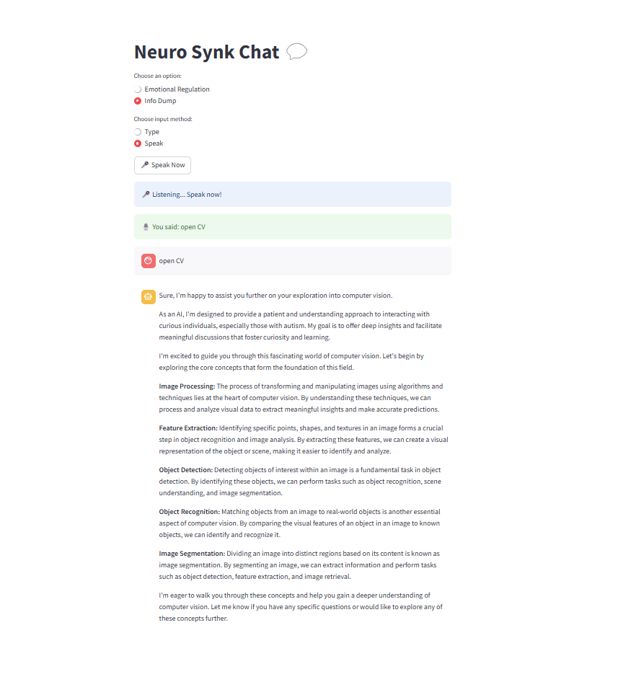
Chat
Info Dump conversation focuses on empowering the autistic individual to explore their curiosities shamelessly. This conversation can greatly improve self-esteem and foster a sense of purpose.
Speak input is another option the user can choose to interact with the chat bot
Desired behavior achieved
  The robot prompts the user to begin speaking, listens to the speech, transcribes the speech and passes it into the chat
  Then it provides reasoning
  … and follows up with mutual info dumping session
  Invites the user for deeper conversation

