Slide 1
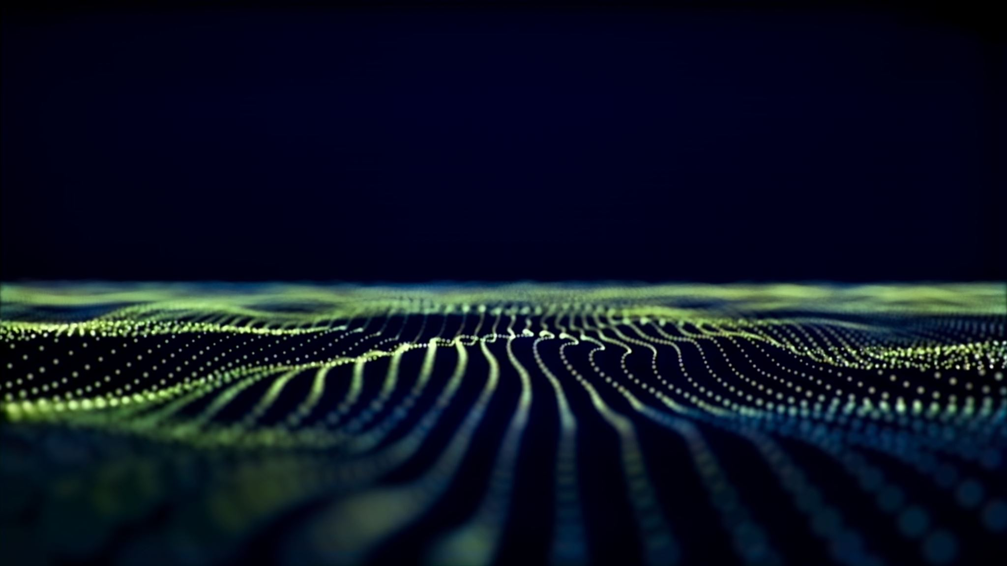
Neuro Synk App Preview
ckraft-bot

Slide 2
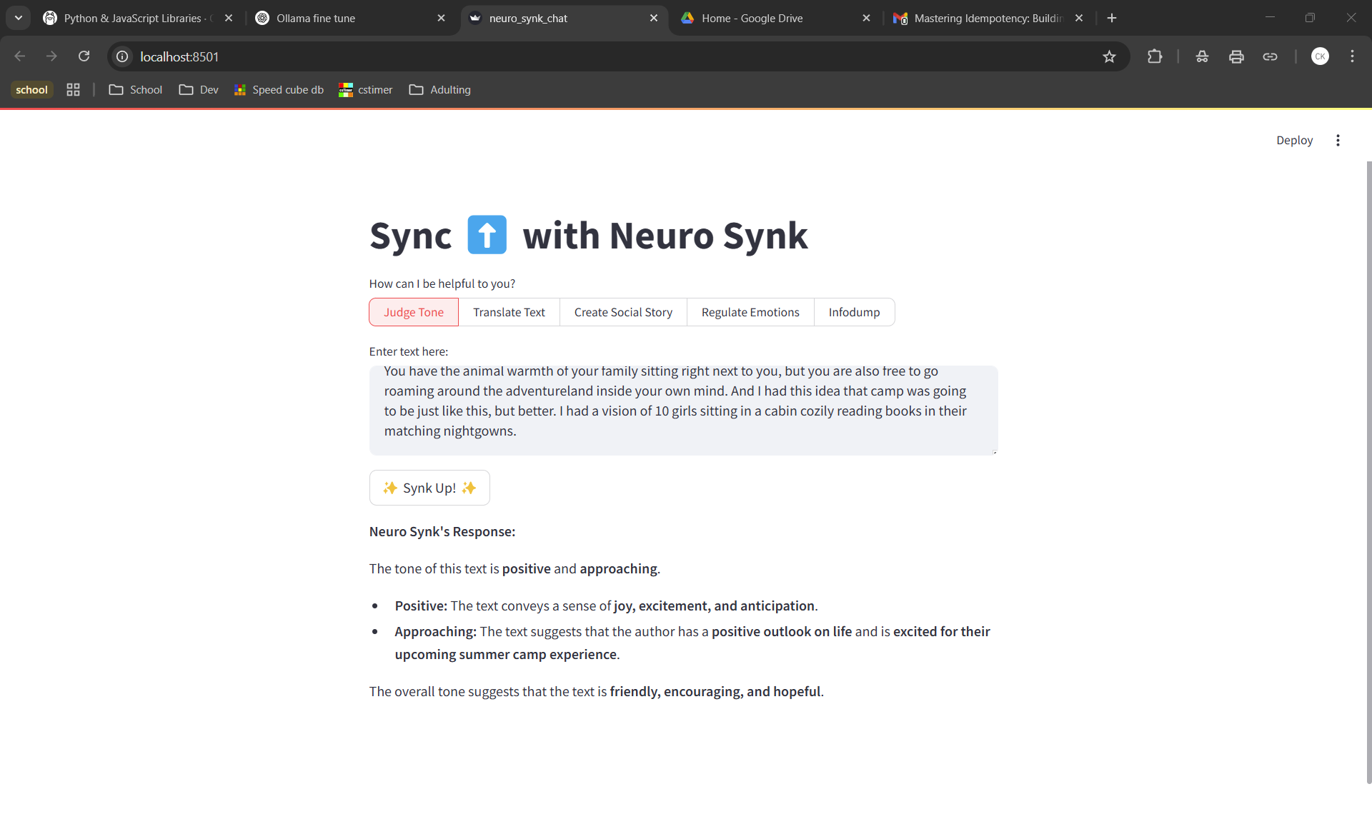
Susuan Cain's The Power of Introverts Ted Talk
source: https://www.ted.com/talks/susan_cain_the_power_of_introverts
Regulate Emotions and Infodump are not included anymore

Slide 3
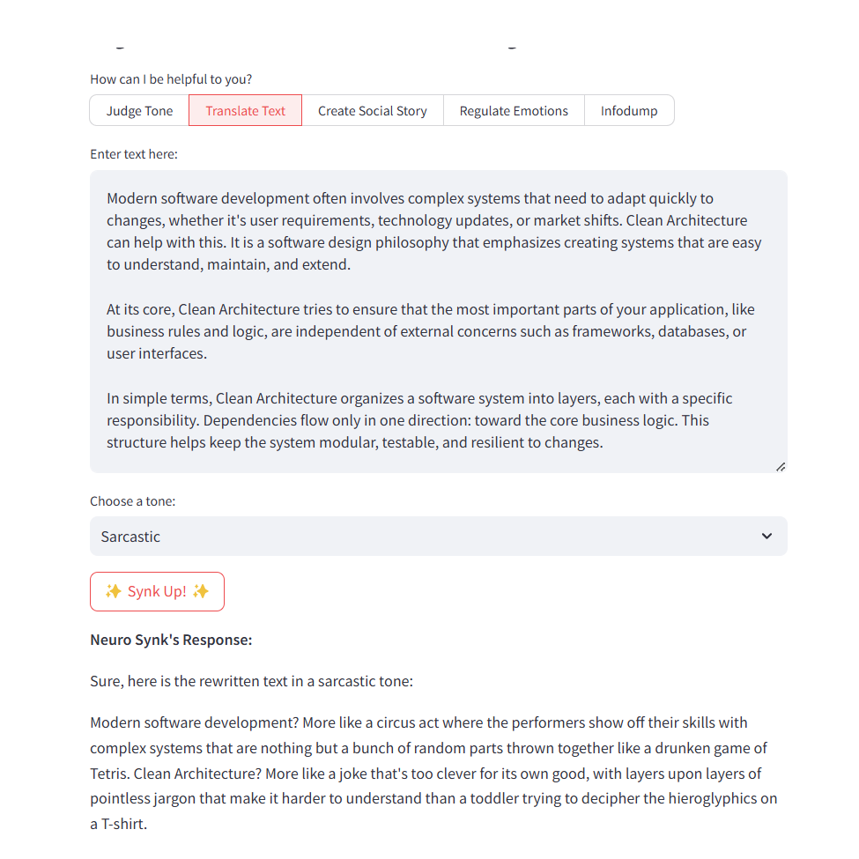
“Clean Architecture 101: Building Software That Lasts” from the ByteByteGo Newsletter
source: https://blog.bytebytego.com/p/clean-architecture-101-building-software?utm_source=substack&utm_medium=email
Regulate Emotions and Infodump are not included anymore

Slide 4
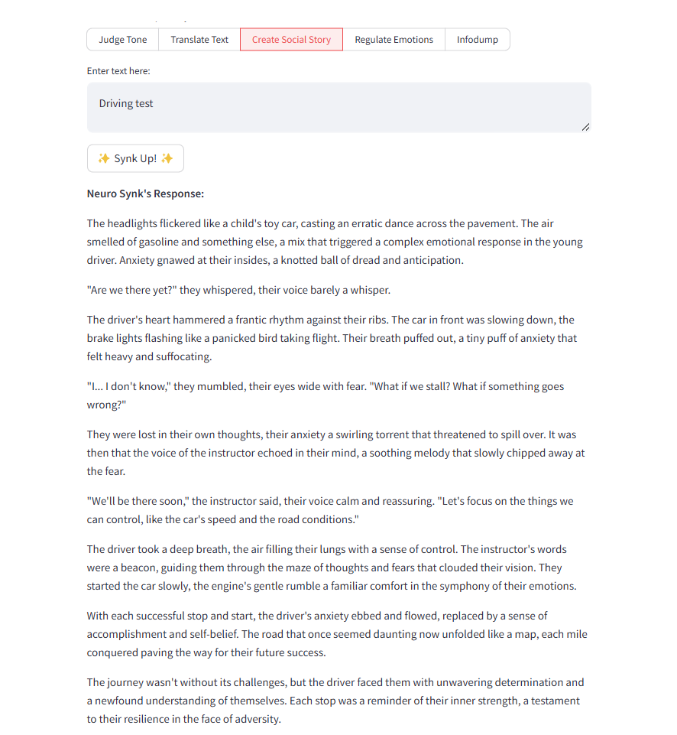
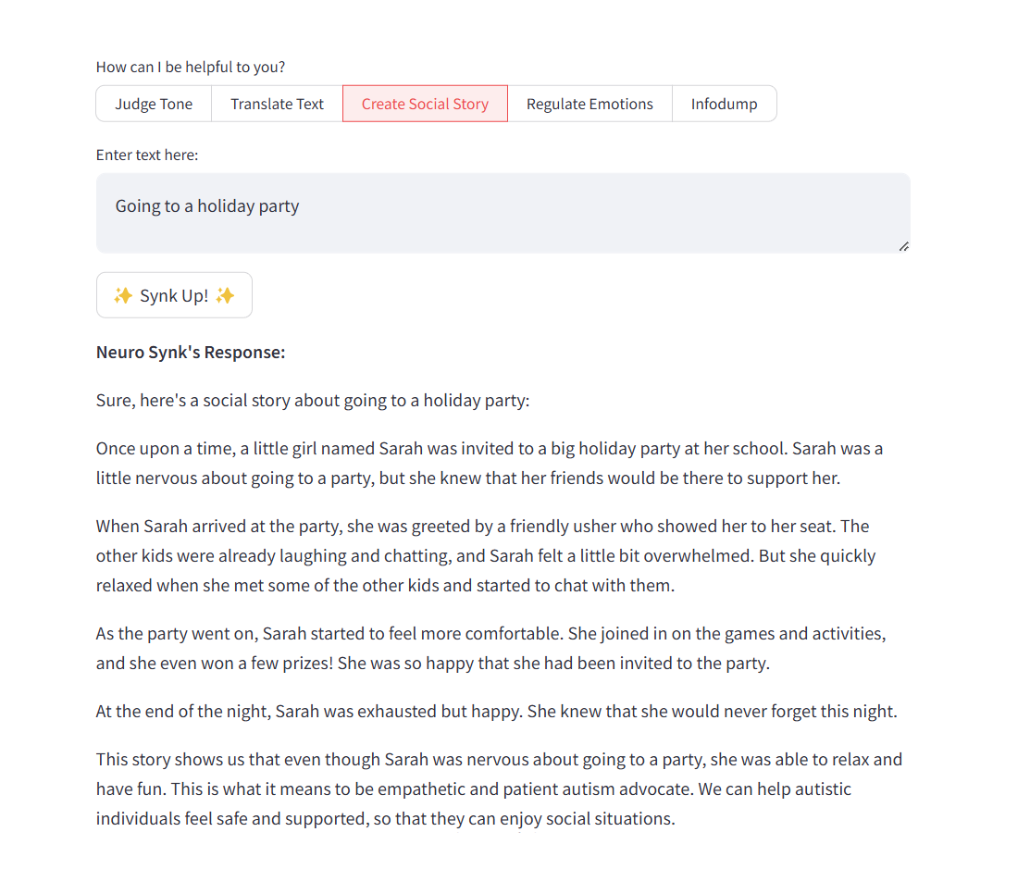
Regulate Emotions and Infodump are not included anymore

