Slide 1
First Wave
MTurk scramblings and reconstructions

Slide 2
target
scrambled
produced
“ABcDE”
“EBcDA”
“ABEcD”
High pmi
Low pmi
Managed to reconstruct
How scrambled?
How difficult to process?
#words splitting up bigrams
Edit dist
#func / #content
Prop matching bigrams
Time taken to reconstruct
Edit dist
Prop matching bigrams
How accurate the reconstruction?
Edit dist
Time
Longest common substring
#reunited bigrams

Slide 3
Example:
Target:
the blast shattered the windows of the villa and other neighbouring homes
Scrambled:
neighbouring windows shattered the other the homes the and villa blast of
Produced:
the blast shattered the windows of the villa and other neighbouring homes
#words splitting up bigrams = (blast,shattered) -> 7 total, 3 content
Edit dist (char) = (target,scrambled) -> 55 , (scrambled,produced) -> 55
(target, produced) -> 0
#func / #content = 5/7
Prop matching bigrams = (1 matching bigram over 5 total) 1/5
Avg increase in distance = (blast - shattered) -> 2, (shattered - windows) -> 0, (windows - villa) -> 2, (villa - neighbouring) -> 3, (neighbouring - homes) -> 3 → 10/5 => 2
Time taken = 117637 ms

Slide 4
Conclusions:
These numbers need to be situated within probability distributions where possible, to understand whether they are large, small, etc.
So we know the edit dist is lower than average, the average dist moved is small, and there are only a few words splitting up bigrams, thus the sentence should be easy to reconstruct.
We must determine if it was “easy” to reconstruct, which we can do, for instance, based on time. The trial took 117,000 milliseconds, which is far longer than the peak for time taken within sentences that correctly reproduced the original. Perhaps there is something interesting to explore here.
Finally, we want to make predictions based on the features. To that end, we can do the following:
a). Linear regression to predict time taken
b). Bayesian classifier to determine if sentence is likely to be reconstructed
c). PCA on the feature set to determine how much of the data they explain

Slide 5
How Scrambled
On the degree to which target sentences were scrambled

Slide 6
A more in-depth example
In the following slide we look at an example sentence, namely sentence 58. Its permutations are the following, with the target (i) and the scrambled (ii):
south africa has openly expressed willingness to establish diplomatic ties with china
willingness expressed ties south africa diplomatic china with to establish has openly
south africa has openly expressed willingness to establish diplomatic ties with china
willingness expressed ties south africa diplomatic china with to establish has openly
south africa has openly expressed willingness to establish diplomatic ties with china
willingness expressed ties south africa diplomatic china with to establish has openly
south africa has openly expressed willingness to establish diplomatic ties with china
willingness expressed ties south africa diplomatic china with to establish has openly

Slide 7
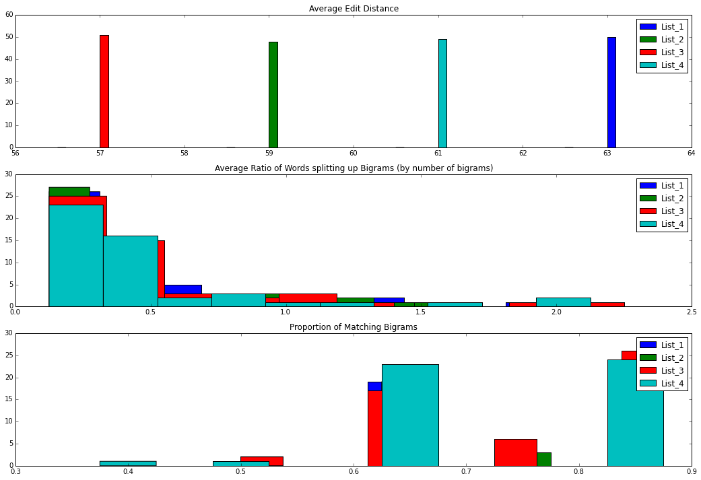

Slide 8
We can interpret the previous graphs as follows:
The 4 variations differ by a fixed number of characters by the traditional edit distance metric. Naively, this should suggest that sentences with larger edit distances should be more difficult to construct. However, a character-based edit distance doesn’t take into account sentence structure, such as dependencies, which might preserve semantic coherence over distances
To recall, the average distance metric is the sum of the number of words intervening between all possible bigrams in a sentence (in the produced version), divided by the total number of bigrams. Sentence 58 and its variations cluster around .2 to .5, while sentence 13 (shown in the next slide) has a much wider variance.
The proportion of matching bigrams is the number of bigrams that were reconstructed in the produced version divided by the number of bigrams. Sentence 58 variations have higher proportions of matching bigrams than sentnce 13.

Slide 9
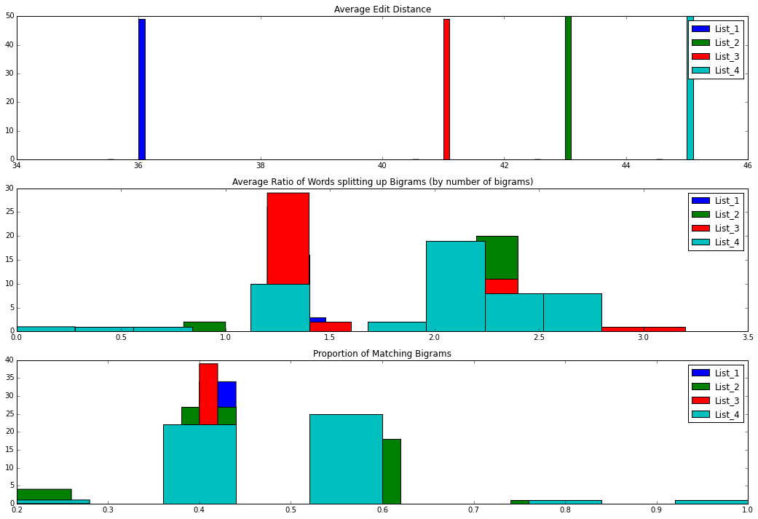

Slide 10
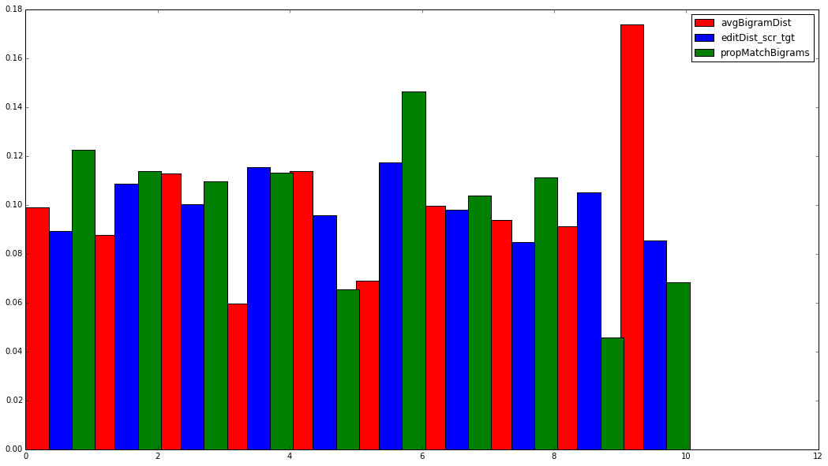
Overall Statistics (at a glance, pt.1)
We can group the dataset by sentence number to get 150 chunks, with their 4 variations, and run an aggregate measure over those “subchunks,” such as the mean. This averages the three metrics we used in the past slides over all 150 base sentences. We can then investigate, say, the first ten sentences. These numbers are normalized by their respective totals.

Slide 11
Overall Statistics (at a glance, pt.2)
We can also look at the overall distributions for the three metrics over all the 150 base sentences. This tells us how complex a scrambled sentence is on average compared to all the other base sentences.
The distributions themselves bear out interesting shapes, and so should provide a lot of information going forward!

Slide 12
