Slide 1


Computer Security: Principles and Practice
Fifth Edition
Chapter 18
Security Auditing
Copyright © 2024, 2018, 2015 Pearson Education, Inc. All Rights Reserved
Notes:
If this PowerPoint presentation contains mathematical equations, you may need to check that your computer has the following installed:
1) MathType Plugin
2) Math Player (free versions available)
3) NVDA Reader (free versions available)
Security auditing is a form of auditing that focuses on the security of an organization’s information system (I T) assets. This function is a key element in computer security. Security auditing can:
• Provide a level of assurance concerning the proper operation of the computer with respect to security.
• Generate data that can be used in after-the-fact analysis of an attack, whether successful or unsuccessful.
• Provide a means of assessing inadequacies in the security service.
• Provide data that can be used to define anomalous behavior.
• Maintain a record useful in computer forensics.

Slide 2
Table 18.1
Security Audit Terminology (R F C 2828)
Security Audit An independent review and examination of a system’s records and activities to determine the adequacy of system controls, ensure compliance with established security policy and procedures, detect breaches in security services, and recommend any changes that are indicated for countermeasures.
The basic audit objective is to establish accountability for system entities that initiate or participate in security-relevant events and actions. Thus, means are needed to generate and record a security audit trail and to review and analyze the audit trail to discover and investigate attacks and security compromises.
Security Audit Trail A chronological record of system activities that is sufficient to enable the reconstruction and examination of the sequence of environments and activities surrounding or leading to an operation, procedure, or event in a security-relevant transaction from inception to final results.
Some refer to an audit log as the record produced by a particular system, and a trail as an entire history of an event, possibly from several logs.
SJW
Notes:
Two key concepts are Security audits and Security audit trails defined in Table 18.1.
The process of generating audit information yields data that may be useful in real time for intrusion detection; this aspect is discussed in Chapter 8. In the present chapter, our concern is with the collection, storage, and analysis of data related to IT security. We begin with an overall look at the security auditing architecture and how this relates to the companion activity of intrusion detection. Next, we discuss the various aspects of audit trails, also known as audit logs. We then discuss the analysis of audit data.

Slide 3
Event Detection
A security audit is a review of system records to:
Determine if the configuration is adequately secure
Confirm that existing policies are being followed
Detect any previously undetected breaches
Recommend changes/improvements
Based on an audit trail: chronological record of available events and data woven together from multiple sources
Clocks need to be synched (NTP over UDP)
Also provides a baseline
Events are found via instrumentation or logging
Adapted from: http://people.duke.edu/~tkb13/courses/ece590-sec-2019fa/slides/16-phys-org-audit-legal-ethical.pdf
SJW
Notes:
Clocks can be synched using Network Time Protocol (NTP).
A Appropriate hooks must be available in the
application and system software to enable event detection . Monitoring software
needs to be added to the system and to appropriate places to capture relevant activity.
Next an event recording function is needed, which includes the need to provide
for a secure storage resistant to tampering or deletion. Event and audit trail analysis
software, tools, and interfaces may be used to analyze collected data as well as for
investigating data trends and anomalies.
There is an additional requirement for the security of the auditing function .
Not just the audit trail, but all of the auditing software and intermediate storage must
be protected from bypass or tampering. Finally, the auditing system should have a
minimal effect on functionality .

Slide 4
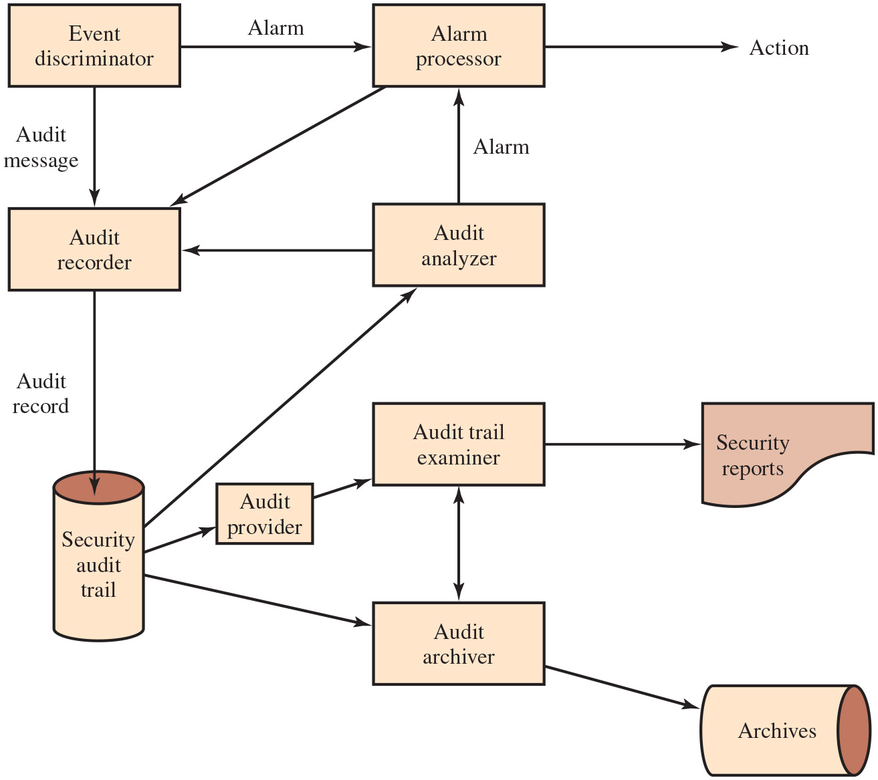
Figure 18.1
Security Audit and Alarms Model (X.816)
(for some events)
Searches for patterns
App or user analysis
UI
See next slide
https://www.itu.int/rec/T-REC-X.816-199511-I/en
SJW
Notes:
We begin our discussion of security auditing by looking at the elements that make up a security audit architecture. First, we examine a model that shows security auditing in its broader context. Then, we look at a functional breakdown of security auditing.
I T U-T Recommendation X.816 develops a model that shows the elements of the security auditing function and their relationship to security alarms. Figure 18.1 depicts the model. The key elements are as follows:
• Event discriminator: This is logic embedded into the software of the system that monitors system activity and detects security-related events that it has been configured to detect.
• Audit recorder: For each detected event, the event discriminator transmits the information to an audit recorder. The model depicts this transmission as being in the form of a message. The audit could also be done by recording the event in a shared memory area.
• Alarm processor: Some of the events detected by the event discriminator are defined to be alarm events. For such events an alarm is issued to an alarm processor. The alarm processor takes some action based on the alarm. This action is itself an auditable event and so is transmitted to the audit
recorder.
• Security audit trail: The audit recorder creates a formatted record of each event and stores it in the security audit trail.
• Audit analyzer: The security audit trail is available to the audit analyzer, which, based on a pattern of activity, may define a new auditable event that is sent to the audit recorder and may generate an alarm.
• Audit archiver: This is a software module that periodically extracts records from the audit trail to create a permanent archive of auditable events.
• Archives: The audit archives are a permanent store of security-related events on this system.
• Audit provider: The audit provider is an application and/or user interface to the audit trail.
• Audit trail examiner: The audit trail examiner is an application or user who examines the audit trail and the audit archives for historical trends, computer forensic purposes, and other analysis.
• Security reports: The audit trail examiner prepares human-readable security reports.
This model illustrates the relationship between audit functions and alarm functions. The audit function builds up a record of events that are defined by the security administrator to be security related. Some of these events may in fact be security violations or suspected security violations. Such events feed into an intrusion detection or firewall function by means of alarms. Long Description:
The block diagram consists of ten blocks labeled event discriminator, audit recorder, security audit trail, audit provider, alarm processor, audit analyzer, audit trail examiner, audit archiver, security reports, and archives. The blocks labeled security audit trail and archives are cylindrical in shape. The upper portion of the security reports block is rectangular and the lower portion is a wavy shape. All the remaining blocks are rectangular in shape. The event discriminator block is connected to the audit recorder block using an arrow labeled audit message. The event discriminator block is connected to the alarm processor block using an arrow labeled alarm. The audit recorder block is connected to the security audit trail block using an arrow labeled audit record. The alarm processor block is connected to the audit recorder block using an arrow. An arrow labeled action is drawn outward from the alarm processor block. The audit analyzer block is connected to the alarm processor block using an arrow labeled alarm. The audit analyzer block is connected to the audit recorder block using an arrow. The security audit trail block is connected to the audit analyzer block using an arrow. The security audit trail block is connected to the audit provider block using an arrow. The audit provider block is connected to the audit trail examiner block using an arrow. The audit trail examiner block is connected to the security reports block using an arrow. The audit archiver block is connected to the archives block using an arrow. The blocks audit trail examiner and audit archiver are connected using a double-sided arrow.

Slide 5
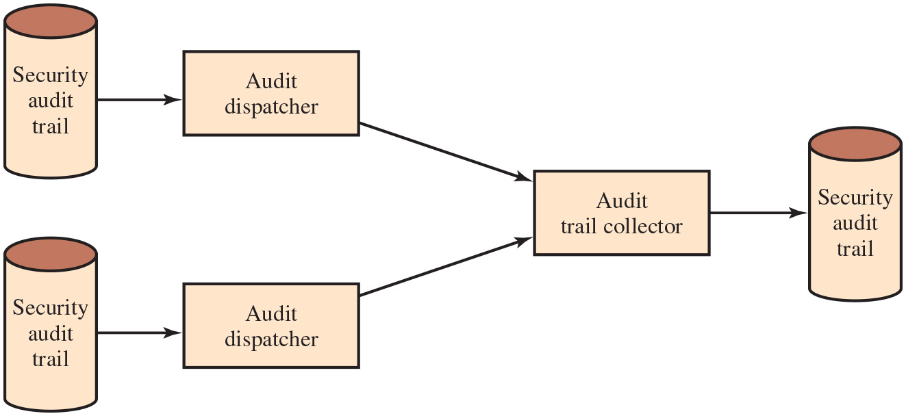
Figure 18.2
Distributed Audit Trail Model (X.816)
Combined audit trail
Transfers parts, or the whole, of a distributed security audit trail
See previous slide
SJW
Notes:
As was the case with intrusion detection, a distributed auditing function in which a centralized repository is created can be useful for distributed systems.
Two additional logical components are needed for a distributed auditing service (Figure 18.2):
• Audit trail collector: A module on a centralized system that collects audit trail records from other systems and creates a combined audit trail.
• Audit dispatcher: A module that transmits the audit trail records from its local system to the centralized audit trail collector.
Long Description:
The diagram consists of six blocks: three cylinder-shaped blocks labeled security audit trail, two audit dispatcher blocks, and an audit trail collector block. The first security audit trail block is connected to the first audit dispatcher block. The second security audit trail block is connected to the second audit dispatcher block. The two audit dispatcher blocks are connected to the audit trail collector block, which is connected to the third security audit trail block.

Slide 6
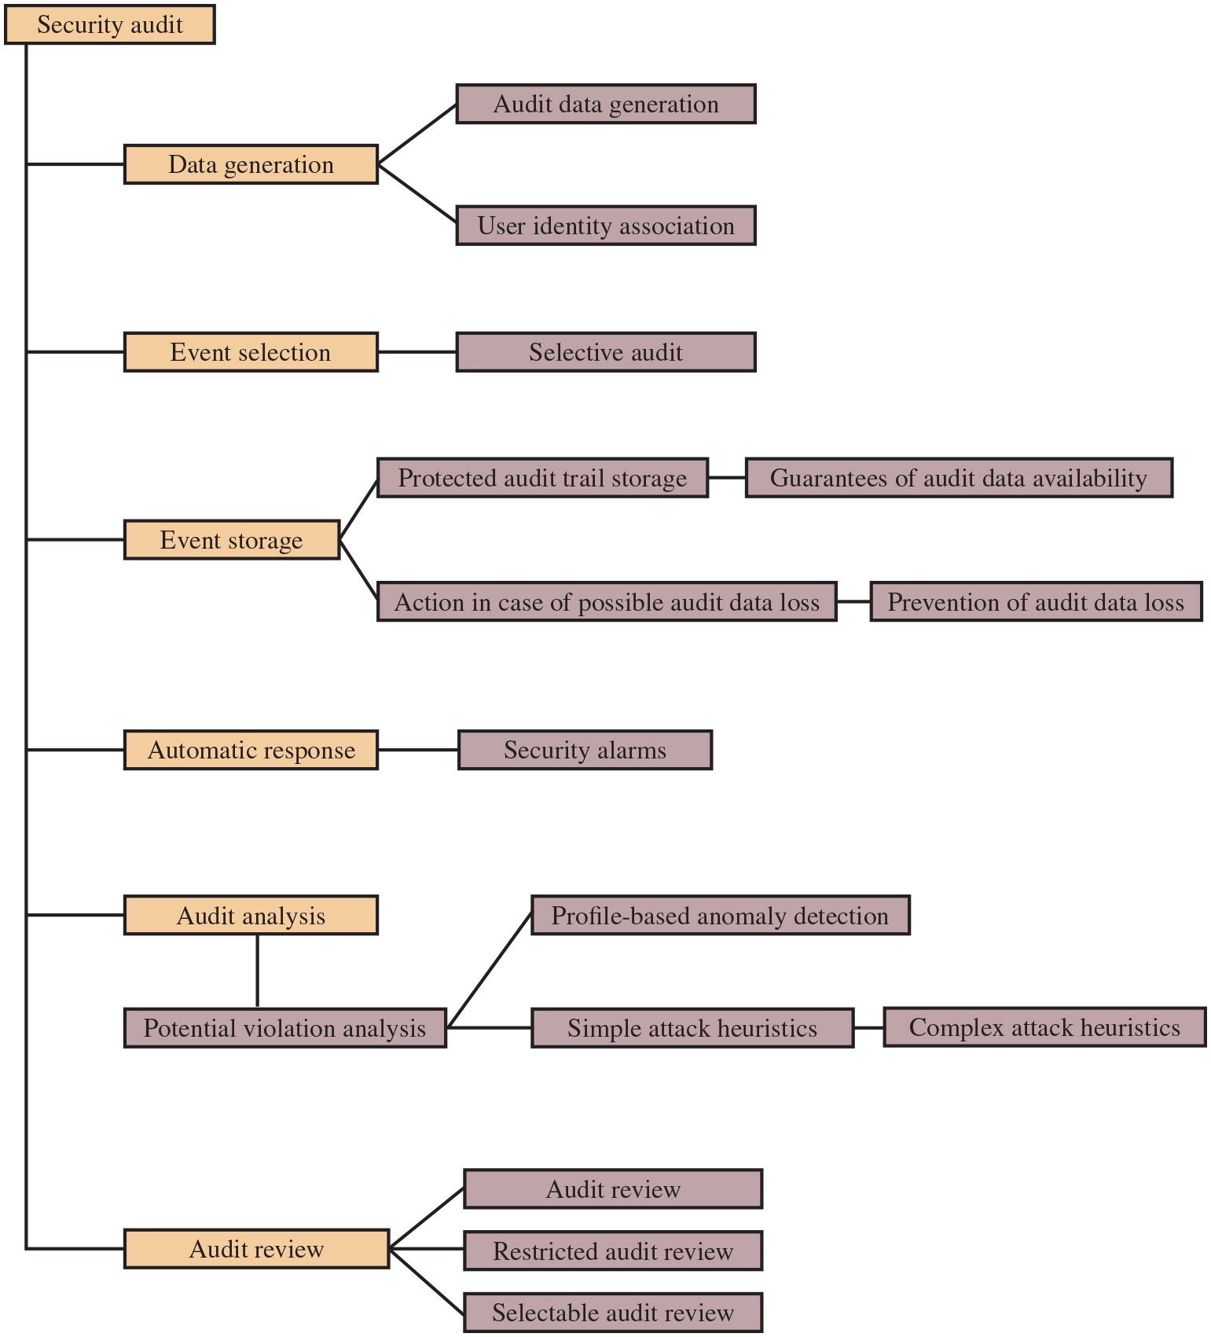
Figure 18.3
Common Criteria Security Audit Class Decomposition
Automated analysis (anomaly detection and heuristics
SJW
Notes:
It is useful to look at another breakdown of the security auditing function developed as part of the Common Criteria specification [C C P S 12a] that we introduced in Section 12.9. Figure 18.3 shows a breakdown of security auditing into six major areas, each of which has one or more specific functions:
• Data generation: Identifies the level of auditing, enumerates the types of auditable events, and identifies the minimum set of audit-related information provided. This function must also deal with the conflict between security and privacy and specify for which events the identity of the user associated with an action is included in the data generated as a result of an event.
• Event selection: Inclusion or exclusion of events from the auditable set. This allows the system to be configured at different levels of granularity to avoid the creation of an unwieldy audit trail.
• Event storage: Creation and maintenance of the secure audit trail. The storage function includes measures to provide availability and to prevent loss of data from the audit trail.
• Automatic response: Defines reactions taken following detection of events that are indicative of a potential security violation.
• Audit analysis: Provided via automated mechanisms to analyze system activity and audit data in search of security violations. This component identifies the set of auditable events whose occurrence or accumulated occurrence indicates a potential security violation. For such events, an analysis is done to determine if a security violation has occurred; this analysis uses anomaly detection and attack heuristics.
• Audit review: As available to authorized users to assist in audit data review. The audit review component may include a selectable review function that provides the ability to perform searches based on a single criterion or multiple criteria with logical (i.e., and/or) relations, sort audit data, and filter audit data before audit data are reviewed. Audit review may be restricted to authorized users. Long Description:
The diagram starts from the block security audit, which is connected to six blocks labeled data generation, event selection, event storage, automatic response, audit analysis, and audit review. These blocks are shaded in orange and the remaining blocks are shaded in purple. The data generation block is connected to the two blocks labeled audit data generation and user identity association. The event selection block is connected to the block labeled selective audit. The event storage block is connected to the two blocks labeled protected audit trail storage and action in case of possible audit data loss. The protected audit trail storage block is connected to the guarantees of audit data availability block. The action in case of possible audit data loss block is connected to the prevention of audit data loss block. The automatic response block is connected to the security alarms block. The audit analysis block is connected to the potential violation analysis block, which is connected to the two blocks labeled profile-based anomaly detection and simple attack heuristics. The simple attack heuristics block is connected to the block labeled complex attack heuristics. The audit review block is connected to the three blocks labeled audit review, restricted audit review, and selectable audit review.

Slide 7
Event Definition
Must define the set of events that are subject to audit
Common criteria suggests:
Introduction of objects
Deletion of objects
Distribution or revocation of access rights or capabilities
Changes to subject or object security attributes
Policy checks performed by the security software
Use of access rights to bypass a policy check
Use of identification and authentication functions
Security-related actions taken by an operator/user
Import/export of data from/to removable media
Notes:
Reviewing the functionality suggested by Figures 18.1 and 18.3, we can develop a set of requirements for security auditing. The first requirement is event definition. The security administrator must define the set of events that are subject to audit. We go into more detail in the next section, but we include here a list suggested in [C C P S 12a]:
• Introduction of objects within the security-related portion of the software into a subject’s address space
• Deletion of objects
• Distribution or revocation of access rights or capabilities
• Changes to subject or object security attributes
• Policy checks performed by the security software as a result of a request by a subject
• The use of access rights to bypass a policy check
• Use of identification and authentication functions
• Security-related actions taken by an operator and/or authorized user (e.g., suppression of a protection mechanism)
• Import/export of data from/to removable media (e.g., printed output, magnetic or optical disks, portable U S B storage devices)

Slide 8
Event Detection
Appropriate hooks (next slide) must be available in the application and system software to enable event detection
Monitoring software needs to be added to the system and to appropriate places to capture relevant activity
An event recording function is needed, which includes the need to provide for a secure storage resistant to tampering or deletion
Event and audit trail analysis software, tools, and interfaces may be used to analyze collected data as well as for investigating data trends and anomalies
There is an additional requirement for the security of the auditing function
Auditing system should have a minimal effect on functionality
SJW
Notes:
A second requirement is that the appropriate hooks must be available in the application and system software to enable event detection. Monitoring software needs to be added to the system and to appropriate places to capture relevant activity. Next, an event recording function is needed, which includes the need to provide for a secure storage resistant to tampering or deletion. Event and audit trail analysis software, tools, and interfaces may be used to analyze collected data as well as for investigating data trends and anomalies.
There is an additional requirement for the security of the auditing function. Not just the audit trail, but all of the auditing software and intermediate storage must be protected from bypass or tampering. Finally, the auditing system should have a minimal effect on functionality.

Slide 9
How Hook is Used
Code
…
…
Exit to hook
…
…
...
Exit to hook
…
...
Create audit record…
Return
Return (no record needed)
SJW

Slide 10
Implementation Guidelines
Agree on audit requirements with appropriate management
Scope of technical audit tests should be agreed and controlled
Audit tests should be limited to read-only access to software and data
Access other than read-only should only be allowed for isolated copies of system files
Requirements for special or additional processing should be identified and agreed
Audit tests that could affect system availability should be run outside business hours
All access should be monitored and logged to produce a reference trail
From Code of Practice for Information Security Management (ISO 27002)
SJW
Notes:
I S O 27002 (Code of Practice for Information Security Management, October 2013) provides a useful set of guidelines for information systems audit considerations:
1. Audit requirements for access to systems and data should be agreed with appropriate management.
2. The scope of technical audit tests should be agreed and controlled.
3. Audit tests should be limited to read-only access to software and data.
4. Access other than read-only should only be allowed for isolated copies of system files, which should be erased when the audit is completed, or given appropriate protection if there is an obligation to keep such files under audit documentation requirements.
5. Requirements for special or additional processing should be identified and agreed.
6. Audit tests that could affect system availability should be run outside business hours.
7. All access should be monitored and logged to produce a reference trail.

Slide 11
What to Collect
Events related to the use of the auditing software
Events related to the security mechanisms on the system
Events that are collected for use by the various security detection and prevention mechanisms
Events related to system management and operation
Operating system access
Application access for selected applications
Remote access
Why is this donkey here?
SJW
Notes:
The choice of data to collect is determined by a number of requirements. One issue is the amount of data to collect, which is determined by the range of areas of interest and the granularity of data collection. There is a trade-off here between quantity and efficiency. The more data are collected the greater the performance penalty on the system. Larger amounts of data may also unnecessarily burden the various algorithms used to examine and analyze the data. Further, the presence of large amounts of data creates a temptation to generate security reports excessive in number or length.
With these cautions in mind, the first order of business in security audit trail design is the selection of data items to capture. These may include
• Events related to the use of the auditing software (i.e., all the components of Figure 18.1)
• Events related to the security mechanisms on the system
• Any events that are collected for use by the various security detection and prevention mechanisms. These include items relevant to intrusion detection and items related to firewall operation
• Events related to system management and operation
• Operating system access (e.g., via system calls such as those listed in Table 8.2)
• Application access for selected applications
• Remote access

Slide 12
Table 18.2 (1 of 2)
Auditable Items Suggested in ITU-T X.816
Security-related events related to a specific connection
Connection requests
Connection confirmed
Disconnection requests
Disconnection confirmed
Statistics appertaining to the connection
Security-related events related to the use of security services
Security service requests
Security mechanisms usage
Security alarms
Security-related events related to management
Management operations
Management notifications
The list of auditable events should include at least
Deny access
Authenticate
Change attribute
Create object
Delete object
Modify object
Use privilege
Notes:
One example is a suggested list of auditable items in X.816, shown in Table 18.2. The standard points out that both normal and abnormal conditions may need to be audited; for instance, each connection request, such as a T C P connection request, may be a subject for a security audit trail record, whether the request was abnormal and irrespective of whether the request was accepted. This is an important point. Data collection for auditing goes beyond the need to generate security alarms or to provide input to a firewall module. Data representing behavior that does not trigger an alarm can be used to identify normal versus abnormal usage patterns and, thus, serve as input to intrusion detection analysis. Also, in the event of an attack, an analysis of all the activity on a system may be needed to diagnose the attack and arrive at suitable countermeasures for the future.

Slide 13
Table 18.2 (2 of 2)
Auditable Items Suggested in X.816
In terms of the individual security services, the following security-related events are important
Authentication: verify success
Authentication: verify fail
Access control: decide access success
Access control: decide access fail
Nonrepudiation: nonrepudiable origination of message
Nonrepudiation: nonrepudiable receipt of message
Nonrepudiation: unsuccessful repudiation of event
Nonrepudiation: successful repudiation of event
Integrity: use of shield
Integrity: use of unshield
Integrity: validate success
Integrity: validate fail
Confidentiality: use of hide
Confidentiality: use of reveal
Audit: select event for auditing
Audit: deselect event for auditing
Audit: change audit event selection criteria

Slide 14
Table 18.3
Monitoring Areas Suggested in I S O 27002
a) user I D s
b) system activities
c) dates, times, and details of key events, for example, log-on and log-off
d) device identity or location if possible and system identifier
e) records of successful and rejected system access attempts
f) records of successful and rejected data and other resource access attempts
g) changes to system configuration
h) use of privileges
i) use of system utilities and applications
j) files accessed and the kind of access
k) network addressees and protocols
l) alarms raised by the access control system
m) activation and de-activation of protection systems, such as anti-virus systems and intrusion detection systems
n) records of transactions executed by users in applications
Notes:
Another useful list of auditable events (Table 18.3) is contained in I S O 27002. As with X.816, the I S O standard details both authorized and unauthorized events, as well as events affecting the security functions of the system.
As the security administrator designs an audit data collection policy, it is useful to organize the audit trail into categories for purposes of choosing data items to collect. In what follows, we look at useful categories for audit trail design.

Slide 15
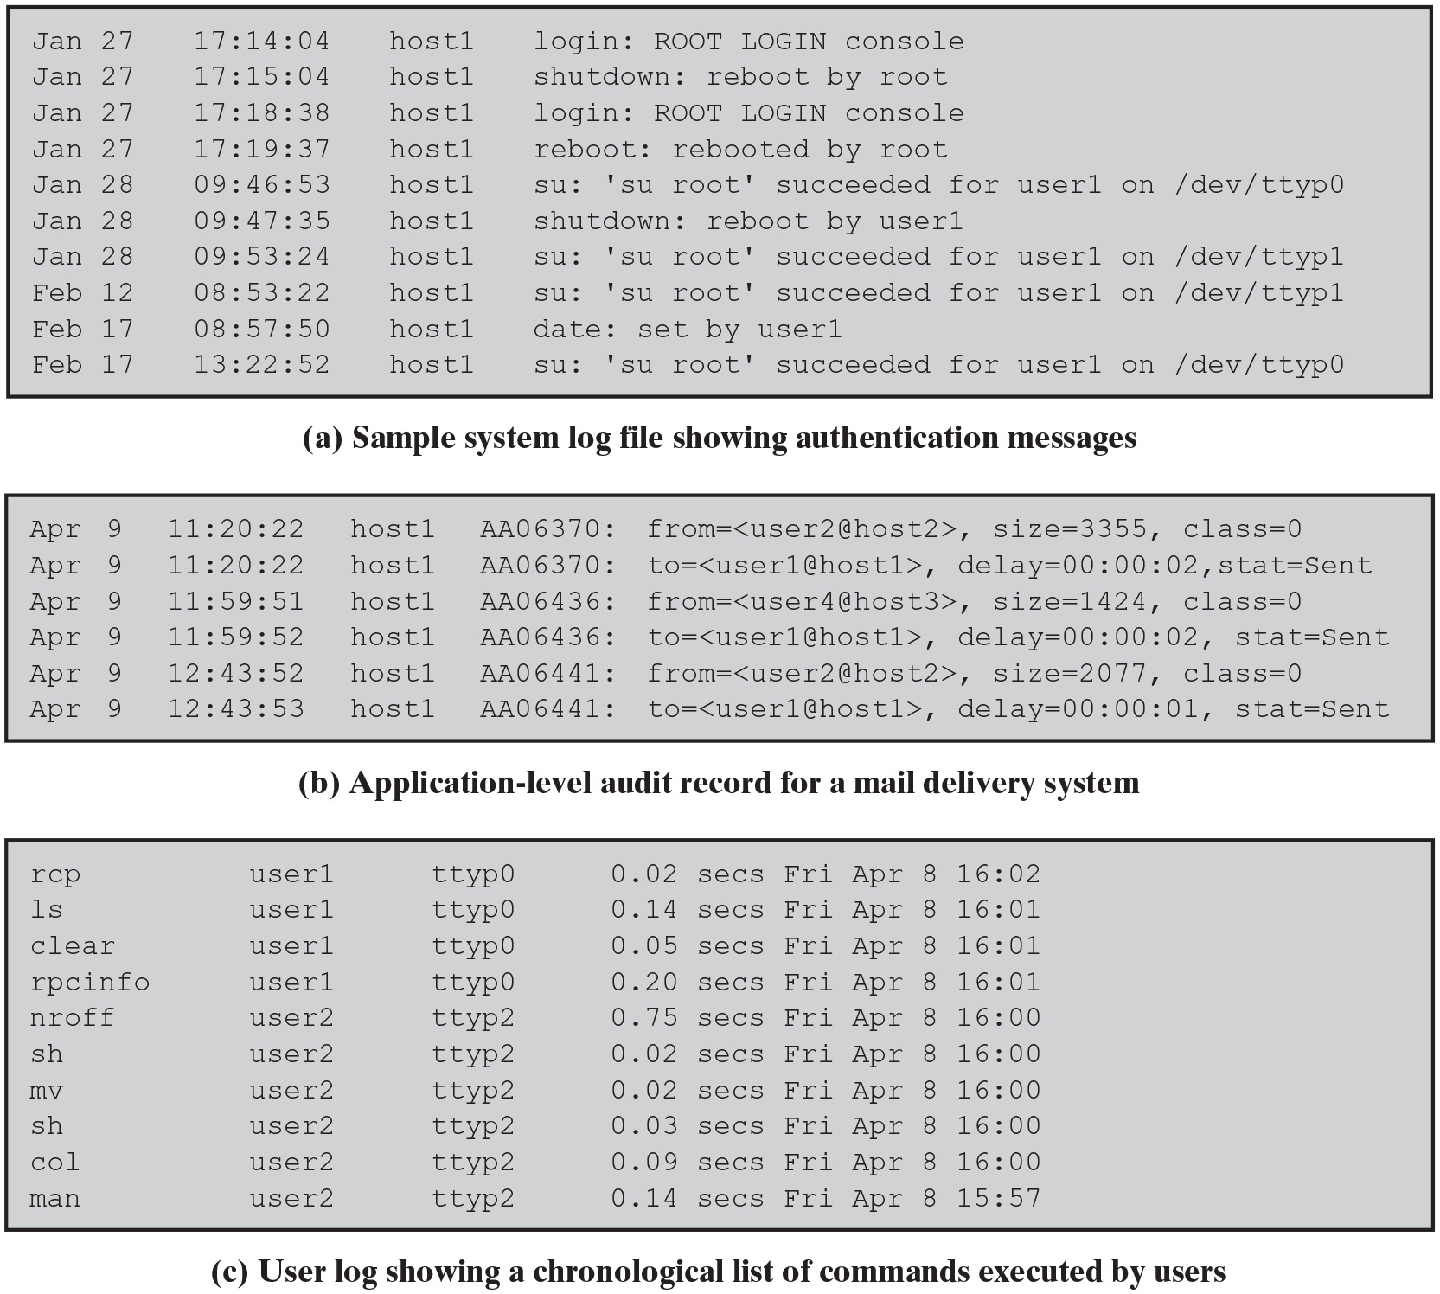
Figure 18.4
Examples of Audit Trails
Figure 18.4a is an example of a system-level audit trail on a UNIX system
su executes commands with privileges of another user
Figure 18.4b is an example of an application-level audit trail for a mail delivery system
Figure 18.4c is an example of a user-level audit trail on a UNIX system
SJW
Notes:
System-level audit trails are generally used to monitor and optimize system performance but can serve a security audit function as well. The system enforces certain aspects of security policy, such as access to the system itself. A system-level audit trail should capture data, such as login attempts, both successful and unsuccessful, devices used, and OS functions performed. Other system-level functions may be of interest for auditing, such as system operation and network performance indicators.
Figure 18.4a, from N I S T S P 800-12 (An Introduction to Computer Security: The N I S T Handbook, October 1995), is an example of a system-level audit trail on a UNIX system. The shutdown command terminates all processes and takes the system down to single-user mode. The su command creates a UNIX shell.
Application-level audit trails may be used to detect security violations within an application or to detect flaws in the application’s interaction with the system. For critical applications, or those that deal with sensitive data, an application-level audit trail can provide the desired level of detail to assess security threats and impacts. For example, for an e-mail application, an audit trail can record sender and receiver, message size, and types of attachments. An audit trail for a database interaction using S Q L (Structured Query Language) queries can record the user, type of transaction, and even individual tables, rows, columns, or data items accessed.
Figure 18.4b is an example of an application-level audit trail for a mail delivery system.
A user-level audit trail traces the activity of individual users over time. It can be used to hold a user accountable for their actions. Such audit trails are also useful as input to an analysis program that attempts to define normal versus anomalous behavior.
A user-level audit trail can record user interactions with the system, such as commands issued, identification and authentication attempts, and files and resources accessed. The audit trail can also capture the user’s use of applications.
Figure 18.4c is an example of a user-level audit trail on a UNIX system. Long Description:
(a) Sample system log file showing authentication messages
The table consists of 4 columns and 10 rows. The row entries are as follows. Row 1: Column 1: Jan 27. Column 2: 17:14:04. Column 3: host1. Column 4: login: ROOT LOGIN console. Row 2: Column 1: Jan 27. Column 2: 17:15:04. Column 3: host1. Column 4: shutdown: reboot by root. Row 3: Column 1: Jan 27. Column 2: 17:18:38. Column 3: host1. Column 4: login: ROOT LOGIN console. Row 4: Column 1: Jan 27. Column 2: 17:19:37. Column 3: host1. Column 4: reboot: rebooted by root. Row 5: Column 1: Jan 28. Column 2: 09:46:53. Column 3: host1. Column 4: su: 'su root' succeeded for user1 on slash dev slash ttyp0. Row 6: Column 1: Jan 28. Column 2: 09:47:35. Column 3: host1. Column 4: shutdown: reboot by user1. Row 7: Column 1: Jan 28. Column 2: 09:53:24. Column 3: host1. Column 4: su: 'su root' succeeded for user1 on slash dev slash ttypl. Row 8: Column 1: Feb 12. Column 2: 08:53:22. Column 3: host1. Column 4: su: 'su root' succeeded for user1 on slash dev slash ttypl. Row 9: Column 1: Feb 17. Column 2: 08:57:50. Column 3: host1. Column 4: date: set by user1. Row 10: Column 1: Feb 17. Column 2: 13:22:52. Column 3: host1. Column 4: su: 'su root' succeeded for user1 on slash dev slash ttyp0.
(b) Application-level audit record for a mail delivery system
The table consists of 4 columns and 6 rows. Row 1: Column 1: Apr 9. Column 2: 11:20:22. Column 3: host1. Column 4: AA06370: from equals OpenAngleBracket user2 at the rate host2 CloseAngleBracket, size equals 3355, class equals 0. Row 2: Column 1: Apr 9. Column 2: 11:20:22. Column 3: host1. Column 4: AA06370: to equals OpenAngleBracket user1 at the rate host1 CloseAngleBracket, delay equals 00:00:02, stat equals Sent. Row 3: Column 1: Apr 9. Column 2: 11:59:51. Column 3: host1. Column 4: AA06436: from equals OpenAngleBracket user4 at the rate host3 CloseAngleBracket, size equals 1424, class equals 0. Row 4: Column 1: Apr 9. Column 2: 11:59:52. Column 3: host1. Column 4: AA06436: to equals OpenAngleBracket user1 at the rate host1 CloseAngleBracket, delay equals 00:00:02, stat equals Sent. Row 5: Column 1: Apr 9. Column 2: 12:43:52. Column 3: host1. Column 4: AA06441: from equals OpenAngleBracket user2 at the rate host2 CloseAngleBracket, size equals 2077, class equals 0. Row 6: Column 1: Apr 9. Column 2: 12:43:53. Column 3: host1. Column 4: AA06441: to equals OpenAngleBracket user1 at the rate host1 CloseAngleBracket, delay equals 00:00:01, stat equals Sent.
(c) User log showing a chronological list of commands executed by users
The table consists of 4 columns and 10 rows. Row 1: Column 1: rcp. Column 2: user1. Column 3: ttyp0. Column 4: 0.02 secs Fri Apr 8 16:02. Row 2: Column 1: ls. Column 2: user1. Column 3: ttyp0. Column 4: 0.14 secs Fri Apr 8 16:01. Row 3: Column 1: clear. Column 2: user1. Column 3: ttyp0. Column 4: 0.05 secs Fri Apr 8 16:01. Row 4: Column 1: rpcinfo. Column 2: user1. Column 3: ttyp0. Column 4: 0.20 secs Fri Apr 8 16:01. Row 5: Column 1: nroff. Column 2: user2. Column 3: ttyp2. Column 4: 0.75 secs Fri Apr 8 16:00. Row 6: Column 1: sh. Column 2: user2. Column 3: ttyp2. Column 4: 0.02 secs Fri Apr 8 16:00. Row 7: Column 1: mv. Column 2: user2. Column 3: ttyp2. Column 4: 0.02 secs Fri Apr 8 16:00. Row 8: Column 1: sh. Column 2: user2. Column 3: ttyp2. Column 4: 0.03 secs Fri Apr 8 16:00. Row 9: Column 1: col. Column 2: user2. Column 3: ttyp2. Column 4: 0.09 secs Fri Apr 8 16:00. Row 10: Column 1: man. Column 2: user2. Column 3: ttyp2. Column 4: 0.14 secs Fri Apr 8 15:57.

Slide 16
Physical Access Audit Trails
Generated by equipment that controls physical access
Card-key systems, alarm systems
Sent to central host for analysis and storage
Data of interest:
Date/time/location/user of access attempt
Both valid and invalid access attempts
Attempts to add/modify/delete physical access privileges
May send violation messages to personnel
Notes:
Audit trails can be generated by equipment that controls physical access and then transmitted to a central host for subsequent storage and analysis. Examples are card-key systems and alarm systems. N I S T S P 800-12 lists the following as examples of the type of data of interest:
• The date and time the access was attempted or made should be logged, as should the gate or door through which the access was attempted or made, and the individual (or user I D) making the attempt to access the gate or door.
• Invalid attempts should be monitored and logged by non-computer audit trails just as they are for computer system audit trails. Management should be made aware if someone attempts to gain access during unauthorized hours.
• Logged information should also include attempts to add, modify, or delete physical access privileges (e.g., granting a new employee access to the building or granting transferred employees access to their new office [and, of course, deleting their old access, as applicable]).
• As with system and application audit trails, auditing of non-computer functions can be implemented to send messages to security personnel indicating valid or invalid attempts to gain access to controlled spaces. In order not to desensitize a guard or monitor, all access should not result in messages being sent to a screen. Only exceptions, such as failed access attempts, should be highlighted to those monitoring access.

Slide 17
Protecting Audit Trail Data
Read/write file on host
Easy, least resource intensive, instant access
Vulnerable to attack by intruder
Write-once/read-many device (CD-ROM or DVD-ROM)
More secure but less convenient
Need steady supply of recordable media
Access may be delayed and not available immediately
Write-only device
Provides paper trail
Impractical for capturing detailed audit data on large or networked systems
Useful when a permanent, immediately available log is required
Must protect both integrity and confidentiality
Encryption, digital signatures, access controls
SJW
Notes:
R F C 2196 (Site Security Handbook, 1997) lists three alternatives for storing audit records:
• Read/write file on a host
• Write-once/read-many device (e.g., C D-ROM or D V D-ROM)
• Write-only device (e.g., a line printer)
File system logging is relatively easy to configure and is the least resource intensive. Records can be accessed instantly, which is useful for countering an
ongoing attack. However, this approach is highly vulnerable. If an attacker gains privileged access to a system, then the audit trail is vulnerable to modification or deletion.
A D V D-ROM or similar storage method is far more secure but less convenient. A steady supply of recordable media is needed. Access may be delayed and not available immediately.
Printed logs do provide a paper trail, but are impractical for capturing detailed audit data on large systems or networked systems. R F C 2196 suggests that the paper log can be useful when a permanent, immediately available log is required even with a system crash.
Protection of the audit trail involves both integrity and confidentiality. Integrity is particularly important because an intruder may attempt to remove evidence of the intrusion by altering the audit trail. For file system logging, perhaps the best way to ensure integrity is the digital signature. Write-once devices, such as D V D-ROM or paper, automatically provide integrity. Strong access control is another measure to provide integrity.
Confidentiality is important if the audit trail contains user information that is sensitive and should not be disclosed to all users, such as information about changes in a salary or pay-grade status. Strong access control helps in this regard. An effective measure is symmetric encryption (e.g., using A E S [Advanced Encryption Standard] or triple D E S [Data Encryption Standard]). The secret key must be protected and only available to the audit trail software and subsequent audit analysis software.
Note that integrity and confidentiality measures protect audit trail data not only in local storage but also during transmission to a central repository.

Slide 18
Implementing Logging
Foundation of security auditing facility is the initial capture of the audit data
Software must include hooks (capture points) that trigger data collection and storage as preselected events occur
Dependent on the nature of the software
Varies depending on operating system and applications involved
Notes:
The foundation of a security auditing facility is the initial capture of the audit data. This requires that the software include hooks, or capture points, that trigger the collection and storage of data as preselected events occur. Such an audit collection or logging function is dependent on the nature of the software and will vary depending on the underlying operating system and the applications involved. In this section, we look at approaches to implementing the logging function for system-level and user-level audit trails on the one hand and application-level audit trails on the other.

Slide 19
Windows Event Log
Event is an entity that describes some interesting occurrence
Contains:
A numeric identification code
A set of attributes
Optional user-supplied data
Three types of event logs:
System: system related apps and drivers
Application: user-level apps
Security: Windows Local Security Authority (L S )A)
Events can be forwarded by third-party products which support syslog
SJW
Notes:
An event in Windows Event Log is an entity that describes some interesting occurrence in a computer system. Events contain a numeric identification code, a set of attributes (task, opcode, level, version, and keywords), and optional user-supplied data. Windows is equipped with three types of event logs:
• System event log: Used by applications running under system service accounts (installed system services), drivers, or a component or application that has events that relate to the health of the computer system.
• Application event log: Events for all user-level applications. This log is not secured, and it is open to any applications. Applications that log extensive information should define an application-specific log.
• Security event log: The Windows Audit Log. This event log is for exclusive use of the Windows Local Security Authority. User events may appear as audits if supported by the underlying application.

Slide 20
Table 18.4 (1 of 2)
Schema: the structure or organization of data
Windows Event Schema Elements
Property values of an event that contains binary data | The LevelName Windows software trace pre-processor (W P P) debug tracing field used in debug events in debug channels
Binary data supplied by Windows Event Log | Level that will be rendered for an event
Channel into which the rendered event is published | Level of severity for an event
Complex data for a parameter supplied by the event provider | FormattedString W P P debug tracing field used in debug events in debug channels
ComponentName W P P debug tracing field used in debug events | Event message rendered for an event
Computer that the event occurred on | Opcode that will be rendered for an event
Two 128-bit values that can be used to find related events | The activity or a point within an activity that the application was performing when it raised the event
Name of the event data item that caused an error when the event data was processed | Elements that define an instrumentation event
Data that makes up one part of the complex data type supplied by the event provider | Information about the event provider that published the event
Data for a parameter supplied by the event provider | Event publisher that published the rendered event
Property values of Windows software trace preprocessor (W P P) events | Information that will be rendered for an event
SJW
Notes:
For all of the event logs, or audit trails, event information can be stored in an X M L format. Table 18.4 lists the items of information stored for each event.

Slide 21
Table 18.4 (2 of 2)
Windows Event Schema Elements
Error code that was raised when there was an error processing event data | The user security identifier
A structured piece of information that describes some interesting occurrence in the system | SequenceNum W P P debug tracing field used in debug events in debug channels
Event identification number | SubComponentName W P P debug tracing field used in debug events in debug channels
Information about the process and thread in which the event occurred | Information automatically populated by the system when the event is raised or when it is saved into the log file
Binary event data for the event that caused an error when the event data was processed | Task that will be rendered for an event
Information about the process and thread the event occurred in | Task with a symbolic value
FileLine W P P debug tracing field used in debug events in debug channels | Information about the time the event occurred
FlagsName W P P debug tracing field used in debug events in debug channels | Provider-defined portion that may consist of any valid X M L content that communicates event information
KernelTime W P P debug tracing field used in debug events in debug channels | UserTime W P P debug tracing field used in debug events in debug channels
Keywords that will be rendered for an event | Event version
Keywords used by the event | Blank

Slide 22
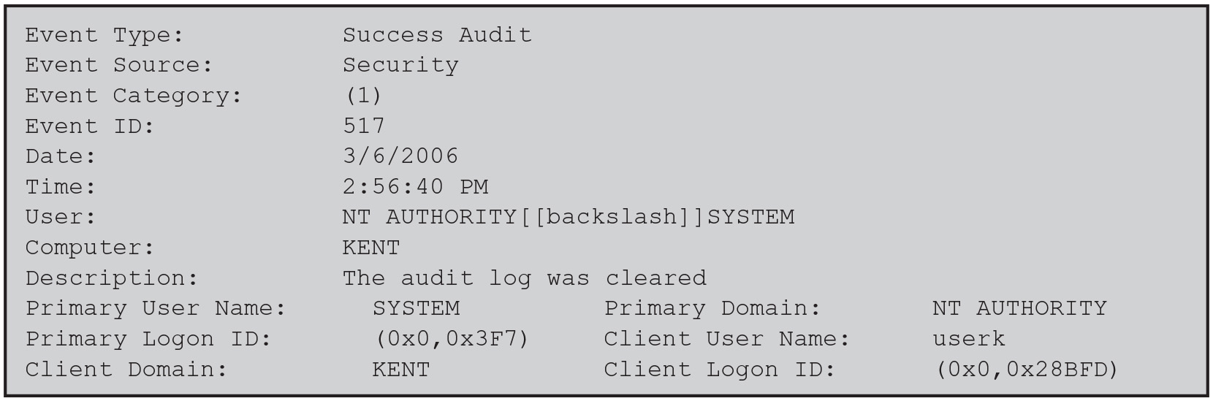
Figure 18.5
Windows System Log Entry Example
SJW
Notes:
Figure 18.5 is an example of data exported from a Windows system event log. Long Description:
Event Type colon Success Audit
Event Source colon Security
Event Category colon OpenParenthesis 1 CloseParenthesis
Event ID colon 517
Date colon 3 forward slash 6 forward slash 2006
Time colon 2 colon 56 colon 40 P M
User colon NT AUTHORITY OpenSquareBracket OpenSquareBracket backslash CloseSquareBracket CloseSquareBracket SYSTEM
Computer colon KENT
Description colon The audit log was cleared
Primary User Name colon SYSTEM
Primary Domain colon NT AUTHORITY
Primary Logon ID colon OpenParenthesis 0x0, 0x3F7 CloseParenthesis
Client User Name colon userk
Client Domain colon KENT
Client Logon I D colon OpenParenthesis 0x0, 0x28BFD CloseParenthesis

Slide 23

Windows Event Categories
Account logon events
Process tracking
Account management
Privilege use
Active Directory
service access
Policy changes
Object access (file and registry objects)
Logon events
SJW
Notes:
Windows allows the system user to enable auditing in nine categories:
• Account logon events: User authentication activity from the perspective of the system that validated the attempt. Examples: authentication granted;
authentication ticket request failed; account mapped for logon; account could not be mapped for logon. Individual actions in this category are not particularly instructive, but large numbers of failures may indicate scanning activity, brute-force attacks on individual accounts, or the propagation of automated exploits.
• Account management: Administrative activity related to the creation, management, and deletion of individual accounts and user groups. Examples:
user account created; change password attempt; user account deleted; security enabled global group member added; domain policy changed.
• Directory service access: User-level access to any Active Directory object that has a System Access Control List defined. An S A C L creates a set of users and user groups for which granular auditing is required.
• Logon events: User authentication activity, either to a local machine or over a network from the system that originated the activity. Examples: successful user logon; logon failure, unknown username, or bad password; logon failure because account is disabled; logon failure because account has expired; logon failure, user not allowed to logon at this computer; user logoff; logon failure, account locked out.
• Object access: User-level access to file system and registry objects that have System Access Control Lists defined. Provides a relatively easy way to track read access as well as changes to sensitive files integrated with the operating system. Examples: object open; object deleted.
• Policy changes: Administrative changes to the access policies, audit configuration, and other system-level settings. Examples: user right assigned; new
trusted domain; audit policy changed.
• Privilege use: Windows incorporates the concept of a user right, granular permission to perform a particular task. If you enable privilege use auditing, you record all instances of users exercising their access to particular system functions (creating objects, debugging executable code, or backing up the system). Examples: specified privileges were added to a user’s access token (during logon); a user attempted to perform a privileged system service operation.
• Process tracking: Generates detailed audit information when processes start and finish, programs are activated, or objects are accessed indirectly.
Examples: new process was created; process exited; auditable data was protected; auditable data was unprotected; user attempted to install a
service.
• System events: Records information on events that affect the availability and integrity of the system, including boot messages and the system shutdown message. Examples: system is starting; Windows is shutting down; resource exhaustion in the logging subsystem; some audits lost; audit log cleared.

Slide 24
UNIX Syslog
UNIX's general-purpose logging mechanism
Found on all UNIX/Linux variants, most network equipment and some devices such as printers
Elements:
syslog()
A P I referenced by several standard system utilities and available to application programs
logger
Command used to add single-line entries to the system log
/etc/syslog.conf
Configuration file used to control the logging and routing of system log events
syslogd
Daemon (service on Windows) to receive/route log events
Notes:
Syslog is UNIX’s general-purpose logging mechanism found on all UNIX variants and Linux. It consists of the following elements:
• syslog(): An application program interface (A P I) referenced by several standard system utilities and available to application programs
• logger: A UNIX command used to add single-line entries to the system log
• /etc/syslog.conf: The configuration file used to control the logging and routing of system log events
• syslogd: The system daemon used to receive and route system log events from syslog() calls and logger commands.
Different UNIX implementations will have different variants of the syslog facility, and there are no uniform system log formats across systems. Here, we provide a brief overview of some syslog-related functions and look at the syslog protocol.

Slide 25
Syslog Service
Basic service provides:
A means of capturing relevant events
A storage facility
A protocol for transmitting syslog messages from other machines to a central machine that acts as a syslog server
Extra add-on features may include:
Robust filtering
Log analysis
Event response
Alternative message formats
Log file encryption
Database storage
Rate limiting
Notes:
The basic service offered by UNIX syslog is a means of capturing relevant events, a storage facility, and a protocol for transmitting syslog messages from other machines to a central machine that acts as a syslog server. In addition to these basic functions, other services are available, often as third-party packages and, in some cases, as built-in modules. N I S T S P 800-92 (Guide to Computer Security Log Management, September 2006) lists the following as being the most common extra features:
• Robust filtering: Original syslog implementations allowed messages to be handled differently based on their facility and priority only; no finer-grained
filtering was permitted. Some current syslog implementations offer more robust filtering capabilities, such as handling messages differently based
on the host or program that generated a message or a regular expression matching content in the body of a message. Some implementations also
allow multiple filters to be applied to a single message, which provides more complex filtering capabilities.
• Log analysis: Originally, syslog servers did not perform any analysis of log data; they simply provided a framework for log data to be recorded and transmitted. Administrators could use separate add-on programs for analyzing syslog data. Some syslog implementations now have limited log analysis capabilities built-in, such as the ability to correlate multiple log entries.
• Event response: Some syslog implementations can initiate actions when certain events are detected. Examples of actions include sending S N M P traps, alerting administrators through pages or e-mails, and launching a separate program or script. It is also possible to create a new syslog message that indicates that a certain event was detected.
• Alternative message formats: Some syslog implementations can accept data in non-syslog formats, such as S N M P traps. This can be helpful for getting security event data from hosts that do not support syslog and cannot be modified to do so.
• Log file encryption: Some syslog implementations can be configured to encrypt rotated log files automatically, protecting their confidentiality. This can also be accomplished through the use of O S or third-party encryption programs.
• Database storage for logs: Some implementations can store log entries in both traditional syslog files and a database. Having the log entries in a database format can be very helpful for subsequent log analysis.
• Rate limiting: Some implementations can limit the number of syslog messages or T C P connections from a particular source during a certain period of time. This is useful in preventing a denial of service for the syslog server and the loss of syslog messages from other sources. Because this technique is designed to cause the loss of messages from a source that is overwhelming the syslog server, it can cause some log data to be lost during an adverse event that generates an unusually large number of messages.

Slide 26
Syslog Protocol
A transport allowing hosts to send I P event notification messages to syslog servers on UDP or TCP port 514
Provides a very general message format allowing processes and applications to use suitable conventions for their logged events
Transport layer sends the message over a network
Application layer enables messages to be routed, interpreted, and stored
The content layer is the actual data contained within the message, which contains several standardized informational elements, including facility codes and severity levels
Messages in the B S D syslog format consist of:
P R I - facilities/severity code
Header – timestamp and hostname/I P address
Msg - program name and content
SJW
Notes:
The syslog protocol provides a transport to allow a machine to send event notification messages across IP networks to event message collectors—also
known as syslog servers. Within a system, we can view the process of capturing and recording events in terms of various applications and system facilities sending messages to syslogd for storage in the system log. Because each process, application, and UNIX O S implementation may have different formatting conventions for logged events, the syslog protocol provides only a very general message format for transmission between systems. A common version of the syslog protocol was originally developed on the University of California Berkeley Software Distribution (B S D) UNIX/T C P/I P system implementations. This version is documented in R F C 3164, (The B S D Syslog Protocol, 2001). Subsequently, I E T F issued R F C 5424, (The Syslog Protocol 2009), which is intended to be an Internet standard and differs in some details from the BSD version. In what follows, we describe the B S D version.
Messages in the B S D syslog format consist of three parts:
• P R I: Consists of a code that represents the Facilities and Severity values of the message, described subsequently.
• Header: Contains a timestamp and an indication of the hostname or I P address of the device.
• Msg: Consists of two fields: The TAG field is the name of the program or process that generated the message; the CONTENT contains the details of the message. The Msg part has traditionally been a free-form message of printable characters that gives some detailed information of the event.

Slide 27
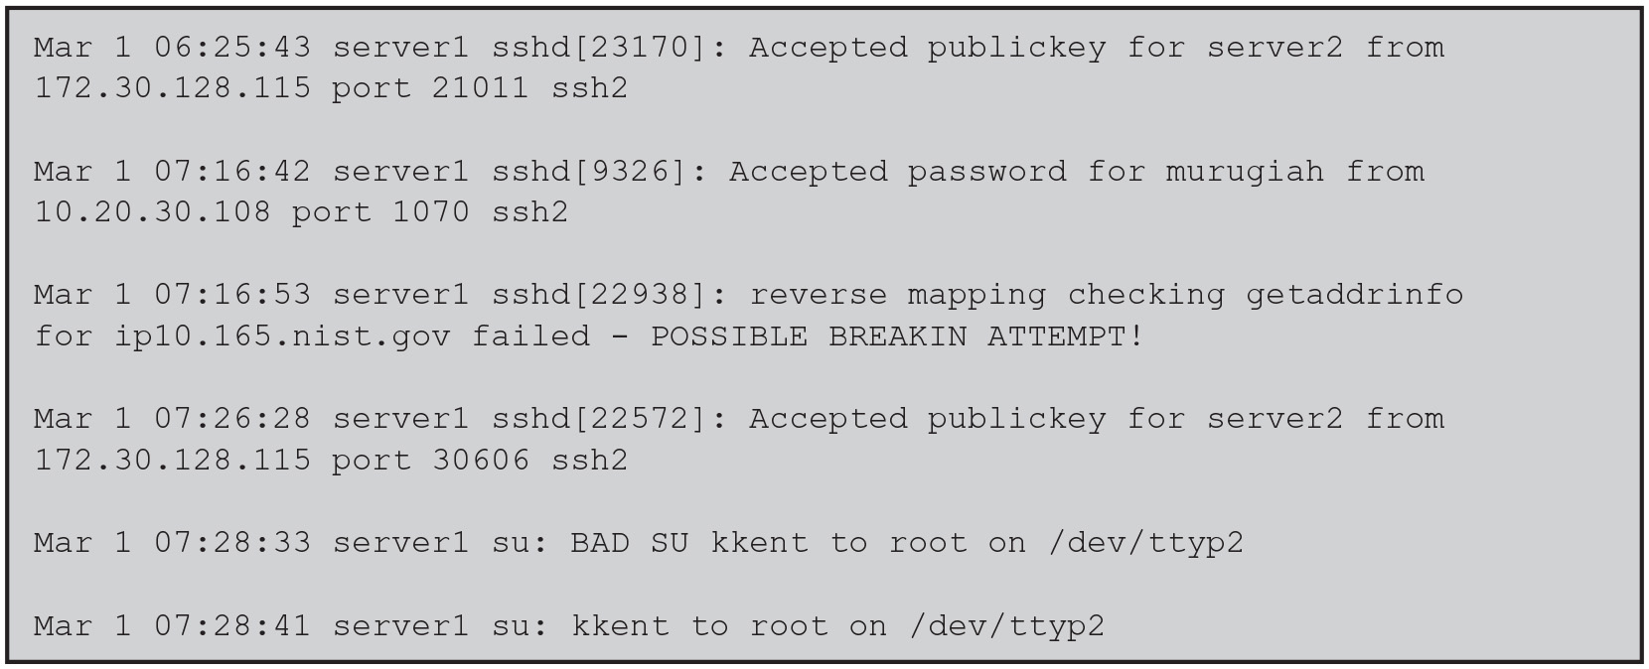
Figure 18.6
Examples of Syslog Messages
(host name to address mapping)
A DNS reverse lookup, also known as reverse DNS lookup or rDNS, is a DNS query that maps an IP address to a corresponding domain name. It can be used to verify the authenticity of the sending server's IP address or to convert an IP addresses into more human-readable domain names
SJW
Notes:
Figure 18.6 shows several examples of syslog messages, excluding the P R I part. Long Description:
Line 1: Mar 1 06 colon 25 colon 43 server1 sshd OpenSquareBracket 23170 CloseSquareBracket colon Accepted publickey for server2 from 172 dot 30 dot 128 dot 115 port 21011 ssh2
Line 2: Blank
Line 3: Mar 1 07 colon 16 colon 42 server1 sshd OpenSquareBracket 9326 CloseSquareBracket colon Accepted password for murugiah from 10 dot 20 dot 30 dot 108 port 1070 ssh2
Line 4: Blank
Line 5: Mar 1 07 colon 16 colon 53 server1 sshd OpenSquareBracket 22938 CloseSquareBracket colon reverse mapping checking getaddrinfo for ip10 dot 165 dot nist dot gov failed hyphen POSSIBLE BREAKIN ATTEMPT exclamation mark
Line 6: Blank
Line 7: Mar 1 07 colon 26 colon 28 server1 sshd OpenSquareBracket 22572 CloseSquareBracket colon Accepted publickey for server2 from 172 dot 30 dot 128 dot 115 port 30606 ssh2
Line 8: Blank
Line 9: Mar 1 07 colon 28 colon 33 server1 su colon BAD SU kkent to root on forward slash dev forward slash ttyp2
Line 10: Blank
Line 11: Mar 1 07 colon 28 colon 41 server1 su colon kkent to root on forward slash dev forward slash ttyp2

Slide 28
Table 18.5 (1 of 2)
UNIX Syslog Facilities and Severity Levels
(a) Syslog Facilities (software component generating the event)
Facility | Message Description (generated by)
kern | System kernel
user | User process
mail | e-mail system
daemon | System daemon, such as f t p d
auth | Authorization programs login, s u, and getty
Syslogd | Messages generated internally by syslogd
l p r | Printing system
news | UseNet News system
u u c p | U U C P subsystem
clock | Clock daemon
f t p | F T P daemon
n t p | N T P subsystem
log audit | Reserved for system use
log alert | Reserved for system use
Local use 0–7 | Up to 8 locally defined categories
SJW
Notes:
All messages sent to syslogd have a facility and a severity (Table 18.5).
The facility identifies the application or system component that generates the message. The severity, or message level, indicates the relative severity of the message and can be used for some rudimentary filtering.

Slide 29
Table 18.5 (2 of 2)
UNIX Syslog Facilities and Severity Levels
(b) Syslog Severity Levels
Severity | Description
emerg | Most severe messages, such as immediate system shutdown
alert | System conditions requiring immediate attention
crit | Critical system conditions, such as failing hardware or software
err | Other system errors; recoverable
warning | Warning messages; recoverable
notice | Unusual situation that merits investigation; a significant event that is typically part of normal day-to-day operation
info | Informational messages
debug | Messages for debugging purposes
The IBM mainframe has severities such as “catastrophic error” and “disastrous error” – really scarry!
SJW

Slide 30
Logging at Application Level
Privileged applications present security issues
May not be captured by system/user-level audit data
Constitute a large percentage of reported vulnerabilities (SolarWinds – a supply chain attack)
Vulnerabilities exploited:
Lack of dynamic checks on input data
Errors in application logic
May be necessary to capture behavior of application beyond its access to system services and file systems
Two approaches to collecting audit data:
Interposable libraries
Dynamic binary rewriting
SJW
Notes:
Applications, especially those with a certain level of privilege, present security problems that may not be captured by system-level or user-level auditing data. Application-level vulnerabilities constitute a large percentage of reported vulnerabilities on security mailing lists. One type of vulnerability that can be exploited is the all-too-frequent lack of dynamic checks on input data, which make possible buffer overflow (see Chapter 10). Other vulnerabilities exploit errors in application logic. For example, a privileged application may be designed to read and print a specific file. An error in the application might allow an attacker to exploit an unexpected interaction with the shell environment to force the application to read and print a different file, which would result in a security compromise.
Auditing at the system level does not provide the level of detail to catch application logic error behavior. Further, intrusion detection systems look for attack signatures or anomalous behavior that would fail to appear with attacks based on application logic errors. For both detection and auditing purposes, it may be necessary to capture in detail the behavior of an application, beyond its access to system services and file systems. The information needed to detect application-level attacks may be missing or too difficult to extract from the low-level information included in system call traces and in the audit records produced by the operating system.
In the remainder of this section, we examine two approaches to collecting audit data from applications: interposable libraries and dynamic binary rewriting.

Slide 31
Interposable Libraries
Allows the generation of audit data without needing to recompile either the system libraries or the application
Audit data can be generated without changing the system’s shared libraries or needing access to the source code for the executable
Exploits the use of dynamic libraries in UNIX
Statically linked libraries
A separate copy of the linked library function is loaded into the program’s virtual memory
Statically linked shared libraries
Referenced shared object is incorporated into the target executable at link time by the link loader
Each object is assigned a fixed virtual address
Link loader connects external referenced objects by assigning their virtual addresses when the executable is created
Dynamically linked shared libraries
The linking to shared library routines is deferred until load time
If changes are made to the library prior to load time any program that references the library is unaffected
Notes:
A technique described in [K U P E 99] and [K U P E 04] provides for application-level auditing by creating new procedures that intercept calls to shared library functions in order to instrument the activity. Interposition allows the generation of audit data without needing to recompile either the system libraries or the application of interest. Thus, audit data can be generated without changing the system’s shared libraries or needing access to the source code for the executable on which the interposition is to be performed. This approach can be used on any UNIX or Linux variant and on some other operating systems.
The technique exploits the use of dynamic libraries in UNIX. Before examining the technique, we provide a brief background on shared libraries.
The O S includes hundreds of C library functions in archive libraries. Each library consists of a set of variables and functions that are compiled and linked together. The linking function resolves all memory references to data and program code within the library, generating logical, or relative, addresses.
A function can be linked into an executable program on demand at compilation. If a function is not part of the program code, the link loader searches a list of libraries and links the desired object into the target executable. On loading, a separate copy of the linked library function is loaded into the program’s virtual memory. This scheme is referred to as statically linked libraries.
A more flexible scheme, first introduced with UNIX System V Release 3, is the use of statically linked shared libraries. As with statically linked libraries, the referenced shared object is incorporated into the target executable at link time by the link loader. However, each object in a statically linked shared library is assigned a fixed virtual address. The link loader connects external referenced objects to their definition in the library by assigning their virtual addresses when the executable is created. Thus, only a single copy of each library function exists. Further, the function can be modified and remains in its fixed virtual address. Only the object needs to be recompiled, not the executable programs that reference it. However, the modification generally must be minor; the changes must be made in such a way that the start address and the address of any variables, constants, or program labels in the code are not changed.
UNIX System V Release 4 introduced the concept of dynamically linked shared libraries. With dynamically linked libraries, the linking to shared library
routines is deferred until load time. At this time, the desired library contents are mapped into the process’s virtual address space. Thus, if changes are made to the library prior to load time, any program that references the library is unaffected.
For both statically and dynamically linked shared libraries, the memory pages of the shared pages must be marked read-only. The system uses a copy-on-write scheme if a program performs a memory update on a shared page. The system assigns a copy of the page to the process, which it can modify without affecting other users of the page.

Slide 32
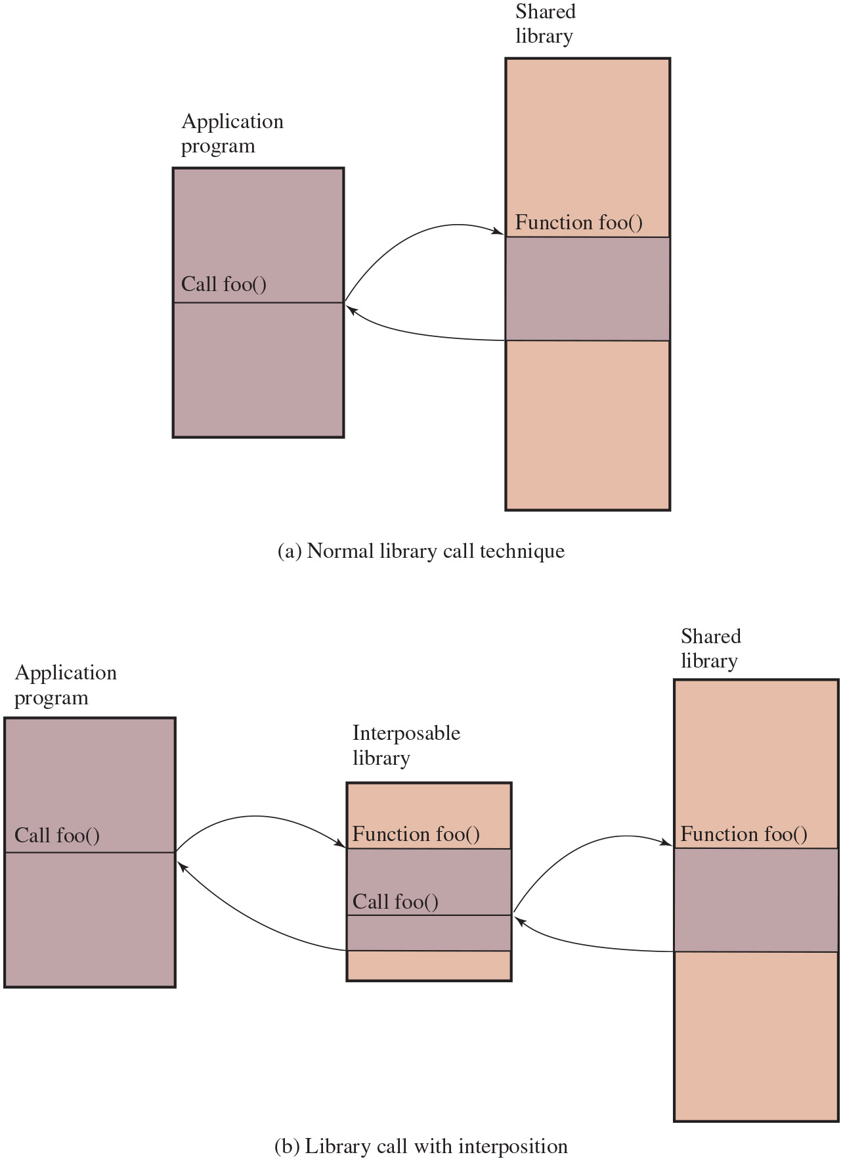
Figure 18.7
The Use of an Interposable Library
Notes:
Figure 18.7a indicates the normal mode of operation when a program invokes a routine in dynamically linked shared libraries. At load time, the reference to routine foo in the program is resolved to the virtual memory address of the start of the foo in the shared library.
With library interpolation, a special interposable library is constructed so, at load time, the program links to the interposable library instead of the shared library. For each function in the shared library for which auditing is to be invoked, the interposable library contains a function with the same name. If the desired function is not contained in the interposed library, the loader continues its search in the shared library and links directly with the target function.
The interposed module can perform any auditing-related function, such as recording the fact of the call, the parameters passed and returned, the return address in the calling program, and so forth. Typically, the interposed module will call the actual shared function (Figure 18.7b) so that the application’s behavior is not altered, just instrumented.
This technique allows the interception of certain function calls and the storage of state between such calls without requiring the recompilation of the calling program or shared objects.
Diagram a, indicates the normal mode of operation when a program invokes a routine in dynamically linked shared libraries. The call function f o o in the application program with two sections links to the shared library with three sections, first section labeled, function f o o. Diagram b, indicates the library call with interposition. A interposable library is constructed. The program links to the interposable library instead of the shared library. The interposable library contains a function with the same name. If the desired function is not contained in the interposed library, the loader continues its search in the shared library and links directly with the target function.
Long Description:
(a) Normal library call technique: The figure consists of two vertical blocks labeled application program and shared library. The application program block has two rows, the first row is labeled Call foo OpenParenthesis CloseParenthesis. The shared library block has three rows, the first row is labeled Function foo OpenParenthesis CloseParenthesis. An arrow from the division of two rows in the application program block is connected to the division of the first and second rows of the shared library block. The division of the second and third rows of the shared library block is connected to the division of two rows in the application program block.
(b) Library call with interposition: The figure consists of three vertical blocks labeled application program, interposable library, and shared library. The application program block has two rows, the first row is labeled Call foo OpenParenthesis CloseParenthesis. The interposable library block has four rows, the first row is labeled Function foo OpenParenthesis CloseParenthesis, and the second row is labeled Call foo OpenParenthesis CloseParenthesis. The shared library block has three rows, the first row is labeled Function foo OpenParenthesis CloseParenthesis. An arrow from the division of two rows in the application program block is connected to the division of the first and second rows of the interposable library block. The division of the third and fourth rows of the interposable library block is connected to the division of two rows in the application program block. An arrow from the division of the second and third rows of the interposable library block is connected to the division of the first and second rows of the shared library block. An arrow from the division of the second and third rows of the shared library block is connected to the division of the second and third rows of the interposable library block.

Slide 33
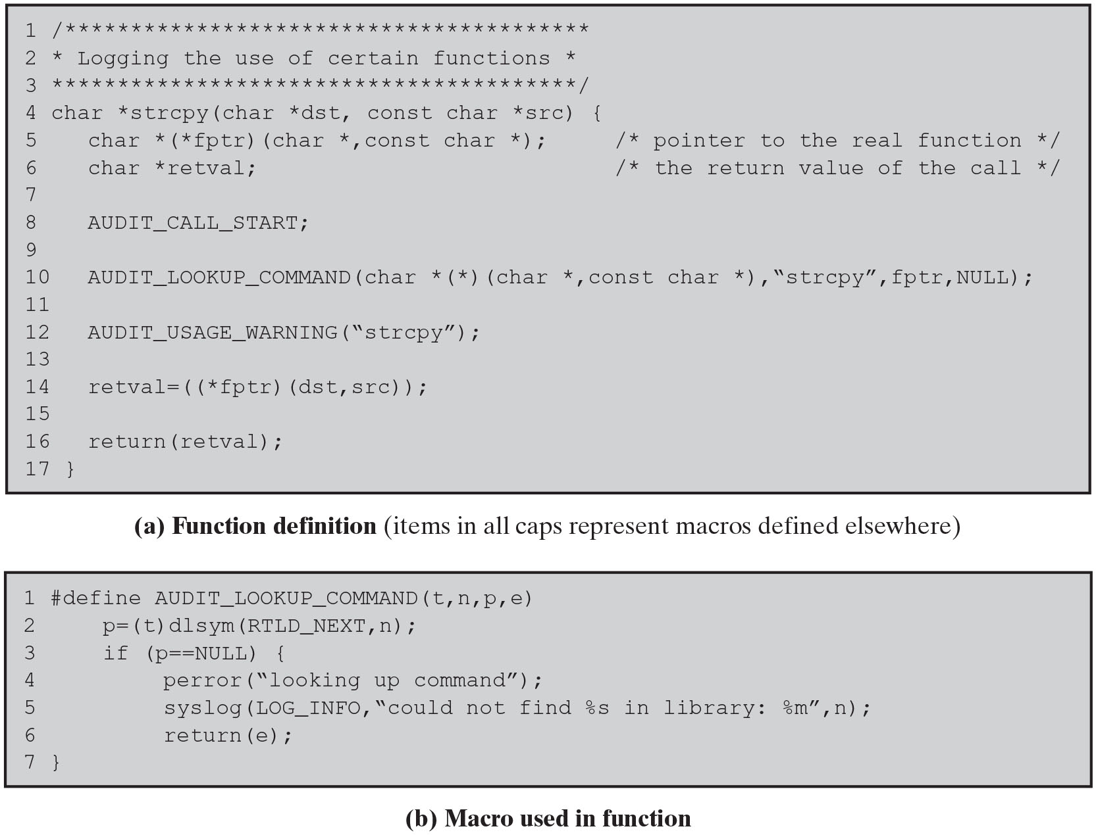
Figure 18.8
Example of Function in the Interposed Library
Notes:
[K U P E 99] gives an example of an interposable library function written in C (Figure 18.8). The function can be described as follows:
1. AUDIT_CALL_START (line 8) is placed at the beginning of every interposed function. This makes it easy to insert arbitrary initialization code into each function.
2. AUDIT_LOOKUP_COMMAND (line 10 in Figure 18.8a, detail in Figure 18.8b) performs the lookup of the pointer to the next definition of the function in the shared libraries using the dlsym(3x) command. The special flag R T L D_NEXT (Figure 18.8b, line 2) indicates that the next reference along the library search path used by the run-time loader will be returned. The function pointer is stored in fptr if a reference is found, or the error value is returned to the calling program.
3. Line 12 contains the commands that are executed before the function is called.
4. In this case, the interposed function executes the original function call and returns the value to the user (line 14). Other possible actions include the examination, recording, or transformation of the arguments; the prevention of the actual execution of the library call; and the examination, recording, or transformation of the return value.
5. Additional code could be inserted before the result is returned (line 16), but this example has none inserted. Long Description:
Line 1: forward slash asterisk asterisk asterisk asterisk asterisk asterisk asterisk asterisk asterisk asterisk asterisk asterisk asterisk asterisk asterisk asterisk asterisk asterisk asterisk asterisk asterisk asterisk asterisk asterisk asterisk asterisk asterisk asterisk asterisk asterisk asterisk asterisk asterisk asterisk asterisk asterisk asterisk asterisk asterisk asterisk
Line 2: asterisk Logging the use of certain functions asterisk
Line 3: asterisk asterisk asterisk asterisk asterisk asterisk asterisk asterisk asterisk asterisk asterisk asterisk asterisk asterisk asterisk asterisk asterisk asterisk asterisk asterisk asterisk asterisk asterisk asterisk asterisk asterisk asterisk asterisk asterisk asterisk asterisk asterisk asterisk asterisk asterisk asterisk asterisk asterisk asterisk asterisk forward slash
Line 4: char asterisk strcpy OpenParenthesis char asterisk dst, const char asterisk src CloseParenthesis OpenCurlyBracket
Line 5: Indentation level 1, char asterisk OpenParenthesis asterisk fptr CloseParenthesis OpenParenthesis char asterisk, const char asterisk CloseParenthesis semicolon forward slash asterisk pointer to the real function asterisk forward slash
Line 6: Indentation level 1, char asterisk retval semicolon forward slash asterisk the return value of the call asterisk forward slash
Line 7: Blank
Line 8: Indentation level 1, AUDIT underscore CALL underscore START semicolon
Line 9: Blank
Line 10: Indentation level 1, AUDIT underscore LOOKUP underscore, COMMAND OpenParenthesis char asterisk OpenParenthesis asterisk CloseParenthesis OpenParenthesis char asterisk, const char asterisk CloseParenthesis, double quotes strcpy double quotes, f p t r, NULL CloseParenthesis semicolon
Line 11: Blank
Line 12: Indentation level 1, AUDIT underscore USAGE underscore WARNING OpenParenthesis double quotes strcpy double quotes CloseParenthesis semicolon
Line 13: Blank
Line 14: Indentation level 1, retval equals OpenParenthesis OpenParenthesis asterisk fptr CloseParenthesis OpenParenthesis dst, src CloseParenthesis CloseParenthesis semicolon
Line 15: Blank
Line 16: Indentation level 1, return OpenParenthesis retval CloseParenthesis semicolon
Line 17: CloseCurlyBracket
(a) Function definition OpenParenthesis items in all caps represent macros defined elsewhere CloseParenthesis
(b) Macro used in function
Line 1: hash define AUDIT underscore LOOKUP underscore COMMAND OpenParenthesis t, n, p, e CloseParenthesis
Line 2: Indentation level 1, p equals OpenParenthesis t CloseParenthesis dlsym OpenParenthesis R T L D underscore NEXT, n CloseParenthesis semicolon
Line 3: Indentation level 1, if OpenParenthesis p equals equals NULL CloseParenthesis OpenCurlyBracket
Line 4: Indentation level 2, perror OpenParenthesis double quotes looking up command double quotes CloseParenthesis semicolon
Line 5: Indentation level 2, syslog OpenParenthesis LOG underscore INFO, double quotes could not find modulus s in library colon modulus m double quotes, n CloseParenthesis semicolon
Line 6: Indentation level 2, return OpenParenthesis e CloseParenthesis semicolon
Line 7: CloseCurlyBracket

Slide 34
Dynamic Binary Rewriting
Can be used with both statically and dynamically linked programs
Postcompilation technique that directly changes the binary code of executables
Change is made at load time and modifies only the memory image of a program
Does not require recompilation of the application binary
Implemented on Linux using two modules:
Loadable kernel module
Monitoring daemon
Loadable modules
Can be automatically loaded and unloaded on demand
Notes:
The interposition technique is designed to work with dynamically linked shared libraries. It cannot intercept function calls of statically linked programs unless all programs in the system are re-linked at the time that the audit library is introduced. [Z H O U 04] describes a technique, referred to as dynamic binary rewriting, that can be used with both statically and dynamically linked programs.
Dynamic binary rewriting is a postcompilation technique that directly changes the binary code of executables. The change is made at load time and modifies only the memory image of a program, not the binary program file on secondary storage. As with the interposition technique, dynamic binary rewriting does not require recompilation of the application binary. Audit module selection is postponed until the application is invoked, allowing for flexible selection of the auditing configuration.
The technique is implemented on Linux using two modules: a loadable kernel module and a monitoring daemon. Linux is structured as a collection of modules, a number of which can be automatically loaded and unloaded on demand. These relatively independent blocks are referred to as loadable modules [G O Y E 99]. In essence, a module is an object file whose code can be linked to and unlinked from the kernel at run time. Typically, a module implements some specific function, such as a file system, a device driver, or some other feature of the kernel’s upper layer. A module does not execute as its own process or thread, although it can create kernel threads for various purposes as necessary. Rather, a module is executed in kernel mode on behalf of the current process.

Slide 35
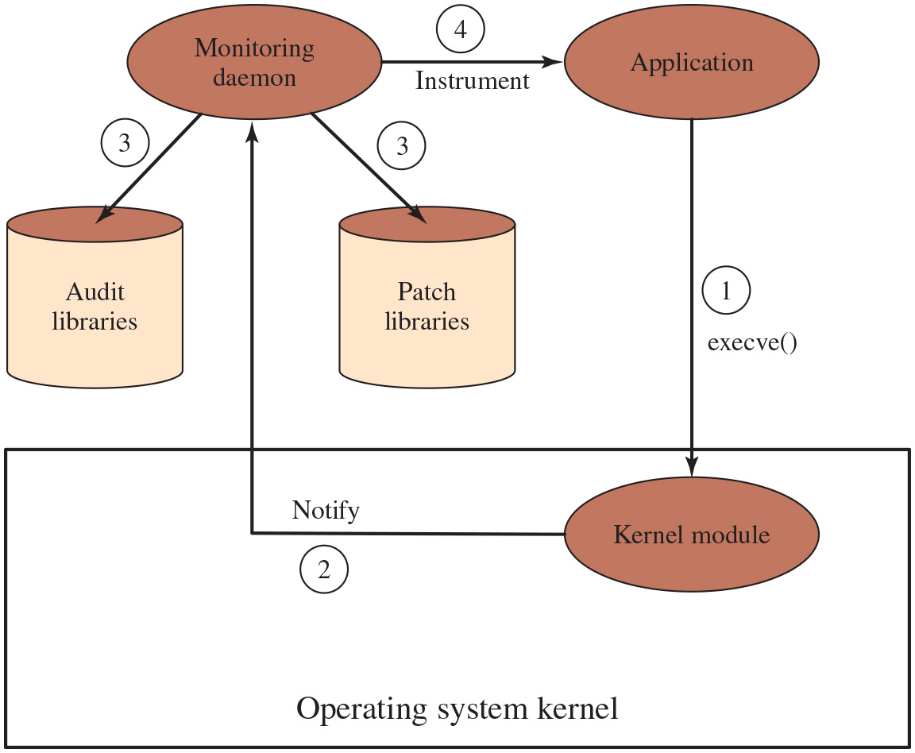
Figure 18.9
Run-Time Environment for Application Auditing
Notes:
Figure 18.9 shows the structure of this approach. The kernel module ensures non-bypassable instrumentation by intercepting the execve() system call. The execve() function loads a new executable into a new process address space and begins executing it. By intercepting this call, the kernel module stops the application before its first instruction is executed and can insert the audit routines into the application before its execution starts.
The actual instrumentation of an application is performed by the monitoring daemon, which is a privileged user-space process. The daemon manages two repositories: a patch repository and an audit repository. The patch repository contains the code for instrumenting the monitored applications. The audit repository contains the auditing code to be inserted into an application. The code in both the audit and the patch repositories is in the form of dynamic libraries. By using dynamic libraries, it is possible to update the code in the libraries while the daemon is still running. In addition, multiple versions of the libraries can exist at the same time.
The sequence of events is as follows:
1. A monitored application is invoked by the execve() system call.
2. The kernel module intercepts the call, stops the application, and sets the process’s parent to the monitoring daemon. Then the kernel module notifies the user-space daemon that a monitored application has started.
3. The monitoring daemon locates the patch and audit library functions appropriate for this application. The daemon loads the audit library functions into the application’s address space and inserts audit function calls at certain points in the application’s code.
4. Once the application has been instrumented, the daemon enables the application to begin execution.
A special language was developed to simplify the process of creating audit and patch code. In essence, patches can be inserted at any point of function call to a shared library routine. The patch can invoke audit routines and also invoke the shared library routine, in a manner logically similar to the interposition technique described earlier. The sequence is as follows. 1. A monitored application is invoked by the e x e c v e left parenthesis right parenthesis system call. 2. The kernel module notifies the monitoring daemon. 3. The monitoring daemon locates the patch and audit library functions. 4. Once the application has been instrumented, the daemon enables the application to begin execution.
Long Description:
The figure consists of three oval-shaped blocks labeled monitoring daemon, application, and Kernel module and two cylinder-shaped blocks labeled audit libraries and patch libraries. The monitoring daemon block is connected to the blocks labeled audit libraries, patch libraries, and application using the arrows labeled 3, 3, and 4 instrument. The application block is connected to the Kernel module block using an arrow labeled 1 execve open parenthesis close parenthesis. The Kernel module is connected to the monitoring daemon using an arrow labeled 2 notify. The Kernel module is shown inside a rectangle labeled operating system kernel.

Slide 36
Audit Trail Analysis (1 of 2)
Analysis programs and procedures vary widely
Must understand context of log entries
Relevant information may reside in other entries in the same logs, other logs, and non-log sources
Possibility of unreliable entries (false positives from security package)
Audit file formats contain mix of plain text and codes
Must decipher manually/automatically
Ideally, regularly review entries to gain understanding of baseline
SJW
Notes:
Programs and procedures for audit trail analysis vary widely, depending on the system configuration, the areas of most concern, the software available, the security policy of the organization, and the behavior patterns of legitimate users and intruders. This section provides some observations concerning audit trail analysis.
To perform useful audit analysis, the analyst or security administrator needs an understanding of the information available and how it can be used. N I S T S P 800-92 offers some useful advice in this regard, which we summarize in this subsection.
The security administrator (or other individual reviewing and analyzing logs) needs to understand the context surrounding individual log entries. Relevant information may reside in other entries in the same log, entries in other logs, and nonlog sources such as configuration management entries. The administrator should understand the potential for unreliable entries, such as from a security package that is known to generate frequent false positives when looking for malicious activity.
Most audit file formats contain a mixture of plain language plus cryptic messages or codes that are meaningful to the software vendor but not necessarily to the administrator. The administrator must make the effort to decipher as much as possible the information contained in the log entries. In some cases, log analysis software performs a data reduction task that reduces the burden on the administrator. Still, the administrator should have a reasonable understanding of the raw data that feeds into analysis and review software in order to be able to assess the utility of these packages.
The most effective way to gain a solid understanding of log data is to review and analyze portions of it regularly (e.g., every day). The goal is to eventually gain an understanding of the baseline of typical log entries, likely encompassing the vast majority of log entries on the system.
To perform effective reviews and analysis, administrators should have solid understanding of each of the following from training or hands-on experience:
• The organization’s policies regarding acceptable use, so that administrators can recognize violations of the policies.
• The security software used by their hosts, including the types of security related events that each program can detect and the general detection profile of each program (e.g., known false positives).
• The operating systems and major applications (e.g., e-mail, Web) used by their hosts, particularly each O S’s and major application’s security and logging capabilities and characteristics.
• The characteristics of common attack techniques, especially how the use of these techniques might be recorded on each system.
• The software needed to perform analysis, such as log viewers, log reduction scripts, and database query tools.

Slide 37

Audit Trail Analysis (2 of 2)
Recent incidents have underscored how important it is for organizations to generate, safeguard, and retain logs of their system and network events, both to improve incident detection and to aid in incident response and recovery activities.
SJW
Notes:
Programs and procedures for audit trail analysis vary widely, depending on the system configuration, the areas of most concern, the software available, the security policy of the organization, and the behavior patterns of legitimate users and intruders. This section provides some observations concerning audit trail analysis.
To perform useful audit analysis, the analyst or security administrator needs an understanding of the information available and how it can be used. N I S T S P 800-92 offers some useful advice in this regard, which we summarize in this subsection.
The security administrator (or other individual reviewing and analyzing logs) needs to understand the context surrounding individual log entries. Relevant information may reside in other entries in the same log, entries in other logs, and nonlog sources such as configuration management entries. The administrator should understand the potential for unreliable entries, such as from a security package that is known to generate frequent false positives when looking for malicious activity.
Most audit file formats contain a mixture of plain language plus cryptic messages or codes that are meaningful to the software vendor but not necessarily to the administrator. The administrator must make the effort to decipher as much as possible the information contained in the log entries. In some cases, log analysis software performs a data reduction task that reduces the burden on the administrator. Still, the administrator should have a reasonable understanding of the raw data that feeds into analysis and review software in order to be able to assess the utility of these packages.
The most effective way to gain a solid understanding of log data is to review and analyze portions of it regularly (e.g., every day). The goal is to eventually gain an understanding of the baseline of typical log entries, likely encompassing the vast majority of log entries on the system.
To perform effective reviews and analysis, administrators should have solid understanding of each of the following from training or hands-on experience:
• The organization’s policies regarding acceptable use, so that administrators can recognize violations of the policies.
• The security software used by their hosts, including the types of security related events that each program can detect and the general detection profile of each program (e.g., known false positives).
• The operating systems and major applications (e.g., e-mail, Web) used by their hosts, particularly each O S’s and major application’s security and logging capabilities and characteristics.
• The characteristics of common attack techniques, especially how the use of these techniques might be recorded on each system.
• The software needed to perform analysis, such as log viewers, log reduction scripts, and database query tools.

Slide 38
Types of Audit Trail Analysis
Audit trails can be used in multiple ways
This depends in part on when done
Possibilities include:
Audit trail review after an event
Triggered by event to diagnose cause and remediate
Focuses on the audit trail entries that are relevant to the specific event
Periodic review of audit trail data
Review bulk data to identify problems and behavior
Real-time audit analysis
Part of an intrusion detection function
Notes:
Audit trails can be used in multiple ways. The type of analysis depends, at least in part, on when the analysis is to be done. The possibilities include the following:
• Audit trail review after an event: This type of review is triggered by an observed event, such as a known system or application software problem, a known violation of existing security policy by a user, or some unexplained system or user problem. The review can gather information to elaborate on what is known about the event, to diagnose the cause or the problem, and to suggest remedial action and future countermeasures. This type of review focuses on the audit trail entries that are relevant to the specific event.
• Periodic review of audit trail data: This type of review looks at all of the audit trail data, or at defined subsets of the data and has many possible objectives. Examples of objectives include looking for events or patterns that suggest a security problem, developing a profile of normal behavior and searching for anomalous behavior, and developing profiles by individual user to maintain a permanent record by user.
• Real-time audit analysis: Audit analysis tools can also be used in a real-time or near-real-time fashion. Real-time analysis is part of the intrusion detection function.

Slide 39
Audit Review
Audit review capability provides administrator with information from selected audit records
Actions of one or more users
Actions on a specific object or resource
All or a specified set of audited exceptions
Actions on a specific system/security attribute
May be filtered by time/source/frequency
Used to provide system activity baseline
Level of security related activity
Notes:
Distinct from an analysis of audit trail data using data reduction and analysis tools is the concept of audit review. An audit review capability enables an administrator to read information from selected audit records. The Common Criteria specification [C C P S 12a] calls for a capability that allows prestorage or poststorage audit selection and includes the ability to selectively review the following:
• The actions of one or more users (e.g., identification, authentication, system entry, and access control actions)
• The actions performed on a specific object or system resource
• All or a specified set of audited exceptions
• Actions associated with a specific system or security attribute
Audit review can be focused on records that match certain attributes, such as user or user group, time window, type of record, and so forth.
One automated tool that can be useful in audit review is a prioritization of audit records based on input from the administrator. Records can be prioritized based on a combination of factors. Examples include the following:
• Entry type (e.g., message code 103, message class CRITICAL)
• Newness of the entry type (i.e., has this type of entry appeared in the logs before?)
• Log source
• Source or destination I P address (e.g., source address on a blacklist, destination address of a critical system, previous events involving a particular
I P address)
• Time of day or day of the week (e.g., an entry might be acceptable during certain times but not permitted during others)
• Frequency of the entry (e.g., x times in y seconds)
There may be a number of possible purposes for this type of audit review. Audit review can enable an administrator to get a feel for the current operation of the system and the profile of the users and applications on the system, the level of attack activity, and other usage and security-related events. Audit review can be used to gain an understanding after the fact of an attack incident and the system’s response to it, leading to changes in software and procedures.

Slide 40
Approaches to Data Analysis
Basic alerting
Indicate interesting type of event has occurred
Baselining
Define normal versus unusual events/patterns
Compare with new data to detect changes
Thresholding is the identification of data that exceed a particular baseline value
Windowing
Detection of events within a given set of parameters
Correlation
Seeks relationships among events
Notes:
The spectrum of approaches and algorithms used for audit data analysis is far too broad to be treated effectively here. Instead, we give a feeling for some of the major approaches, based on the discussion in [S I N G 04].
The simplest form of an analysis is for the software to give an indication that a particular interesting event has occurred. If the indication is given in real time, it can serve as part of an intrusion detection system. For events that may not rise to the level of triggering an intrusion alert, an after-the-fact indication of suspicious activity can lead to further analysis.
Baselining is the process of defining normal versus unusual events and patterns. The process involves measuring a set of known data to compute a range of normal values. These baseline values can then be compared to new data to detect unusual shifts. Examples of activity to baseline include the following:
• Amount of network traffic per protocol: total H T T P, e-mail, F T P, and so on.
• Logins/logouts
• Accesses of admin accounts
• Dynamic Host Configuration Protocol (D H C P) address management, D N S requests
• Total amount of log data per hour/day
• Number of processes running at any time
For example, a large increase in F T P traffic could indicate that your F T P server has been compromised and is being used maliciously by an outsider.
Once baselines are established, analysis against the baselines is possible. One approach, discussed frequently in this text, is anomaly detection. An example of a simple approach to anomaly detection is the freeware Never Before Seen (N B S) Anomaly Detection Driver. The tool implements a very fast database lookup of strings and tells you whether a given string is in the database (i.e., has already been seen).
Consider the following example involving D H C P. D H C P is used for easy T C P/I P configuration of hosts within a network. Upon an operation system start-up, the client host sends a configuration request that is detected by the D H C P server. The D H C P server selects appropriate configuration parameters (I P address with appropriate subnet mask and other optional parameters, such as IP address of the default gateway, addresses of D N S servers, domain name, etc.) for the client stations. The D H C P server assigns clients I P addresses within a predefined scope for a certain period (lease time). If an I P address is to be kept, the client must request an extension on the period of time before the lease expires. If the client has not required an extension on the lease time, the I P address is considered free and can be assigned to another client. This is performed automatically and transparently. With N B S, it is easy to monitor the organization’s networks for new medium access control/IP (M A C/I P) combinations being leased by D H C P servers. The administrator immediately learns of new M A C s and new I P addresses being leased that are not normally leased. This may or may not have security implications. N B S can also scan for malformed records, novel client queries, and a wide range of other patterns.
Another form of baseline analysis is thresholding. Thresholding is the identification of data that exceed a particular baseline value. Simple thresholding is used to identify events, such as refused connections, that happen more than a certain number of times. Thresholding can focus on other parameters, such as the frequency of events rather than the simple number of events.
Windowing is detection of events within a given set of parameters, such as within a given time period or outside a given time period—for example, baselining the time of day each user logs in and flagging logins that fall outside that range.
Another type of analysis is correlation, which seeks for relationships among events. A simple instance of correlation is, given the presence of one particular log message, to alert on the presence of a second particular message. For instance, if Snort (see Section 8.9) reports a buffer overflow attempt from a remote host, a reasonable attempt at correlation would grab any messages that contain the remote host’s I P address. Or the administrator might want to note any switch user (su) on an account that was logged into from a never-seen-before remote host.

Slide 41
Integrated Approaches
Volume of audit data means manual analysis and baselining is impractical
Need a Security Information and Event Management (SIEM) system
A centralized logging and analysis package
Agentless or agent-based
Normalizes a variety of log formats
Analyzes combined data
Correlates events among the log entries
Identifies and prioritizes significant events
Can initiate responses
SJW
Notes:
[KELL06] is a report by an information security officer at a government agency on her
attempts to get a handle on the vast amount of security audit data generated by her
agency’s networks, servers, and hosts. The systems are configured to generate audit
data, including security-related audit data, for management, auditors, and attorneys.
So much data is generated that it makes it difficult for the security officer to extract
timely and useful information. She needs to get and analyze security-related data
from hosts, servers, routers, intrusion detection systems, firewalls, and a multitude of
other security tools. The load is so great that one large server is dedicated solely to
housing security analysis software and audit files.
The problem came to a head when the security officer realized that it had
become impossible to perform one of the basic tasks of security audit analysis:
baselining. The security officer needs to be able to characterize normal activity
and thresholds so that the system will generate alerts when anomalies or malicious
patterns are detected. Because of the volume of data, a human-generated or
even human-assisted baseline generation was impractical. And with the broad mix
of audit data sources and formats, there seemed to be no obvious way to develop
automated baseline generation.
The type of product that can address these issues has been referred to
as a security information management (SIM) system or a security information
and event management (SIEM) system. As these products move into the third
and fourth generations, a number of other names have proliferated, with none
commonly accepted across product lines. Before looking at the specific solution
adopted by this security officer, we provide a brief general overview of SIEM
systems.

Slide 42
S I E M Systems
Software is a centralized logging software package similar to, but much more complex than, syslog
Provide a centralized, uniform audit trail storage facility and a suite of audit data analysis programs
There are two general configuration approaches:
Agentless
S I E M server receives data from the individual log generating hosts without needing to have any special software installed on those hosts
Agent-based
An agent program is installed on the log generating host to perform event filtering and aggregation and log normalization for a particular type of log, then transmit the normalized log data to a S I E M server, usually on a real-time or near-real-time basis for analysis and storage
Notes:
S I E M software is a centralized logging software package similar to, but much more complex than, syslog. S I E M systems provide a centralized, uniform audit trail storage facility and a suite of audit data analysis programs. N I S T S P 800-92 discusses log management and S I E M systems. It notes there are two general configuration approaches with many products offering a combination of the two:
•Agentless: The S I E M server receives data from the individual log generating hosts without needing to have any special software installed on those hosts. Some servers pull logs from the hosts, which is usually done by having the server authenticate to each host and retrieve its logs regularly. In other cases, the hosts push their logs to the server, which usually involves each host authenticating to the server and transferring its logs regularly. The S I E M server then performs event filtering and aggregation and log normalization and analysis on the collected logs.
• Agent-based: An agent program is installed on the log generating host to perform event filtering and aggregation and log normalization for a particular type of log, then transmit the normalized log data to an S I E M server, usually on a real-time or near-real-time basis for analysis and storage. If a host has multiple types of logs of interest, then it might be necessary to install multiple agents. Some S I E M products also offer agents for generic formats, such as syslog and S N M P. A generic agent is used primarily to get log data from a source for which a format-specific agent and an agentless method are not available. Some products also allow administrators to create custom agents to handle unsupported log sources.

Slide 43
S I E M Software
S I E M software is able to recognize a variety of log formats, including those from a variety of O S s, security software, application servers, and even physical security control devices, such as badge readers
Software normalizes these various log entries, so the same format is used for the same data item in all entries
Software can delete fields in log entries that are not needed for the security function and log entries that are not relevant
S I E M server analyzes the combined data from the multiple log sources, correlates events among the log entries, identifies and prioritizes significant events, and initiates responses to events if desired
Notes:
S I E M software is able to recognize a variety of log formats, including those from a variety of O S s, security software (e.g., I D S s and firewalls), application servers (e.g., Web servers, e-mail servers), and even physical security control devices, such as badge readers. The S I E M software normalizes these various log entries, so the same format is used for the same data item (e.g., I P address) in all entries. The software can delete fields in log entries that are not needed for the security function and log entries that are not relevant, greatly reducing the amount of data in the central log. The S I E M server analyzes the combined data from the multiple log sources, correlates events among the log entries, identifies and prioritizes significant events, and initiates responses to events if desired. S I E M products usually include several features to help users, such as the following:
• Graphical user interfaces (G U I s) that are specifically designed to assist analysts in identifying potential problems and reviewing all available data related to each problem.
• A security knowledge base, with information on known vulnerabilities, the likely meaning of certain log messages, and other technical data; log analysts can often customize the knowledge base as needed.
• Incident tracking and reporting capabilities, sometimes with robust workflow features.
• Asset information storage and correlation (e.g., giving higher priority to an attack that targets a vulnerable O S or a more important host).
Well-implemented S I E M systems can form a critical component in an organization’s security infrastructure. However many organizations fail to appropriately plan, install, and manage such systems. [H A D S 10] notes that an appropriate process includes defining threats, documenting responses and configuring standard reports to meet audit and compliance requirements. Appendices in this paper provide examples of each of these that can be adapted and extended for a given organization. All of these can be done as part of a wider I T security risk assessment process that we discussed in Chapters 14 and 15. This paper also lists a number of vendors of S I E M products.

Slide 44
Knowledge Base
SIEM aggregates and analyzes log data from various sources, while threat intelligence platforms (TIPs) provide insights into emerging threats and attack patterns. By combining these, organizations can improve their ability to detect, investigate, and respond to threats more effectively.
Example: MITRE ATT&CK® (Adversarial Tactics, Techniques, and Common Knowledge (ATT&CK)
A curated knowledge base of adversary tactics and techniques based on real-world observations and a model of cyber adversary behavior, reflecting the various phases of an adversary's attack lifecycle and the platforms they are known to target
The knowledge base is a foundation for the development of specific threat models and methodologies
SJW
Notes:
SIEM software is a centralized logging software package similar to, but much
more complex than, syslog. SIEM systems provide a centralized, uniform audit
trail storage facility and a suite of audit data analysis programs. There are two
general configuration approaches, with many products offering a combination of
the two:
• Agentless : The SIEM server receives data from the individual log generating
hosts without needing to have any special software installed on those hosts.
Some servers pull logs from the hosts, which is usually done by having the server
authenticate to each host and retrieve its logs regularly. In other cases, the hosts
push their logs to the server, which usually involves each host authenticating
to the server and transferring its logs regularly. The SIEM server then performs
event filtering and aggregation and log normalization and analysis on the
collected logs.
• Agent-based : An agent program is installed on the log generating host to
perform event filtering and aggregation and log normalization for a particular
type of log, and then transmit the normalized log data to an SIEM server,
usually on a real-time or near-real-time basis for analysis and storage. If a
host has multiple types of logs of interest, then it might be necessary to install
multiple agents. Some SIEM products also offer agents for generic formats
such as syslog and SNMP. A generic agent is used primarily to get log data
from a source for which a format-specific agent and an agentless method
are not available. Some products also allow administrators to create custom
agents to handle unsupported log sources.

Slide 45
Summary
Security auditing architecture
Security audit and alarms model
Security auditing functions
Requirements
Implementation guidelines
Security audit trail
What to collect
Protecting audit trail data
Security information and event management
S I E M systems
Implementing the logging function
Logging at the system level
Logging at the application level
Interposable libraries
Dynamic binary rewriting
Audit trail analysis
Preparation
Timing
Audit review
Approaches to data analysis
Notes:
Chapter 18 summary.

Slide 46

Copyright
This work is protected by United States copyright laws and is provided solely for the use of instructors in teaching their courses and assessing student learning. Dissemination or sale of any part of this work (including on the World Wide Web) will destroy the integrity of the work and is not permitted. The work and materials from it should never be made available to students except by instructors using the accompanying text in their classes. All recipients of this work are expected to abide by these restrictions and to honor the intended pedagogical purposes and the needs of other instructors who rely on these materials.

