Slide 1
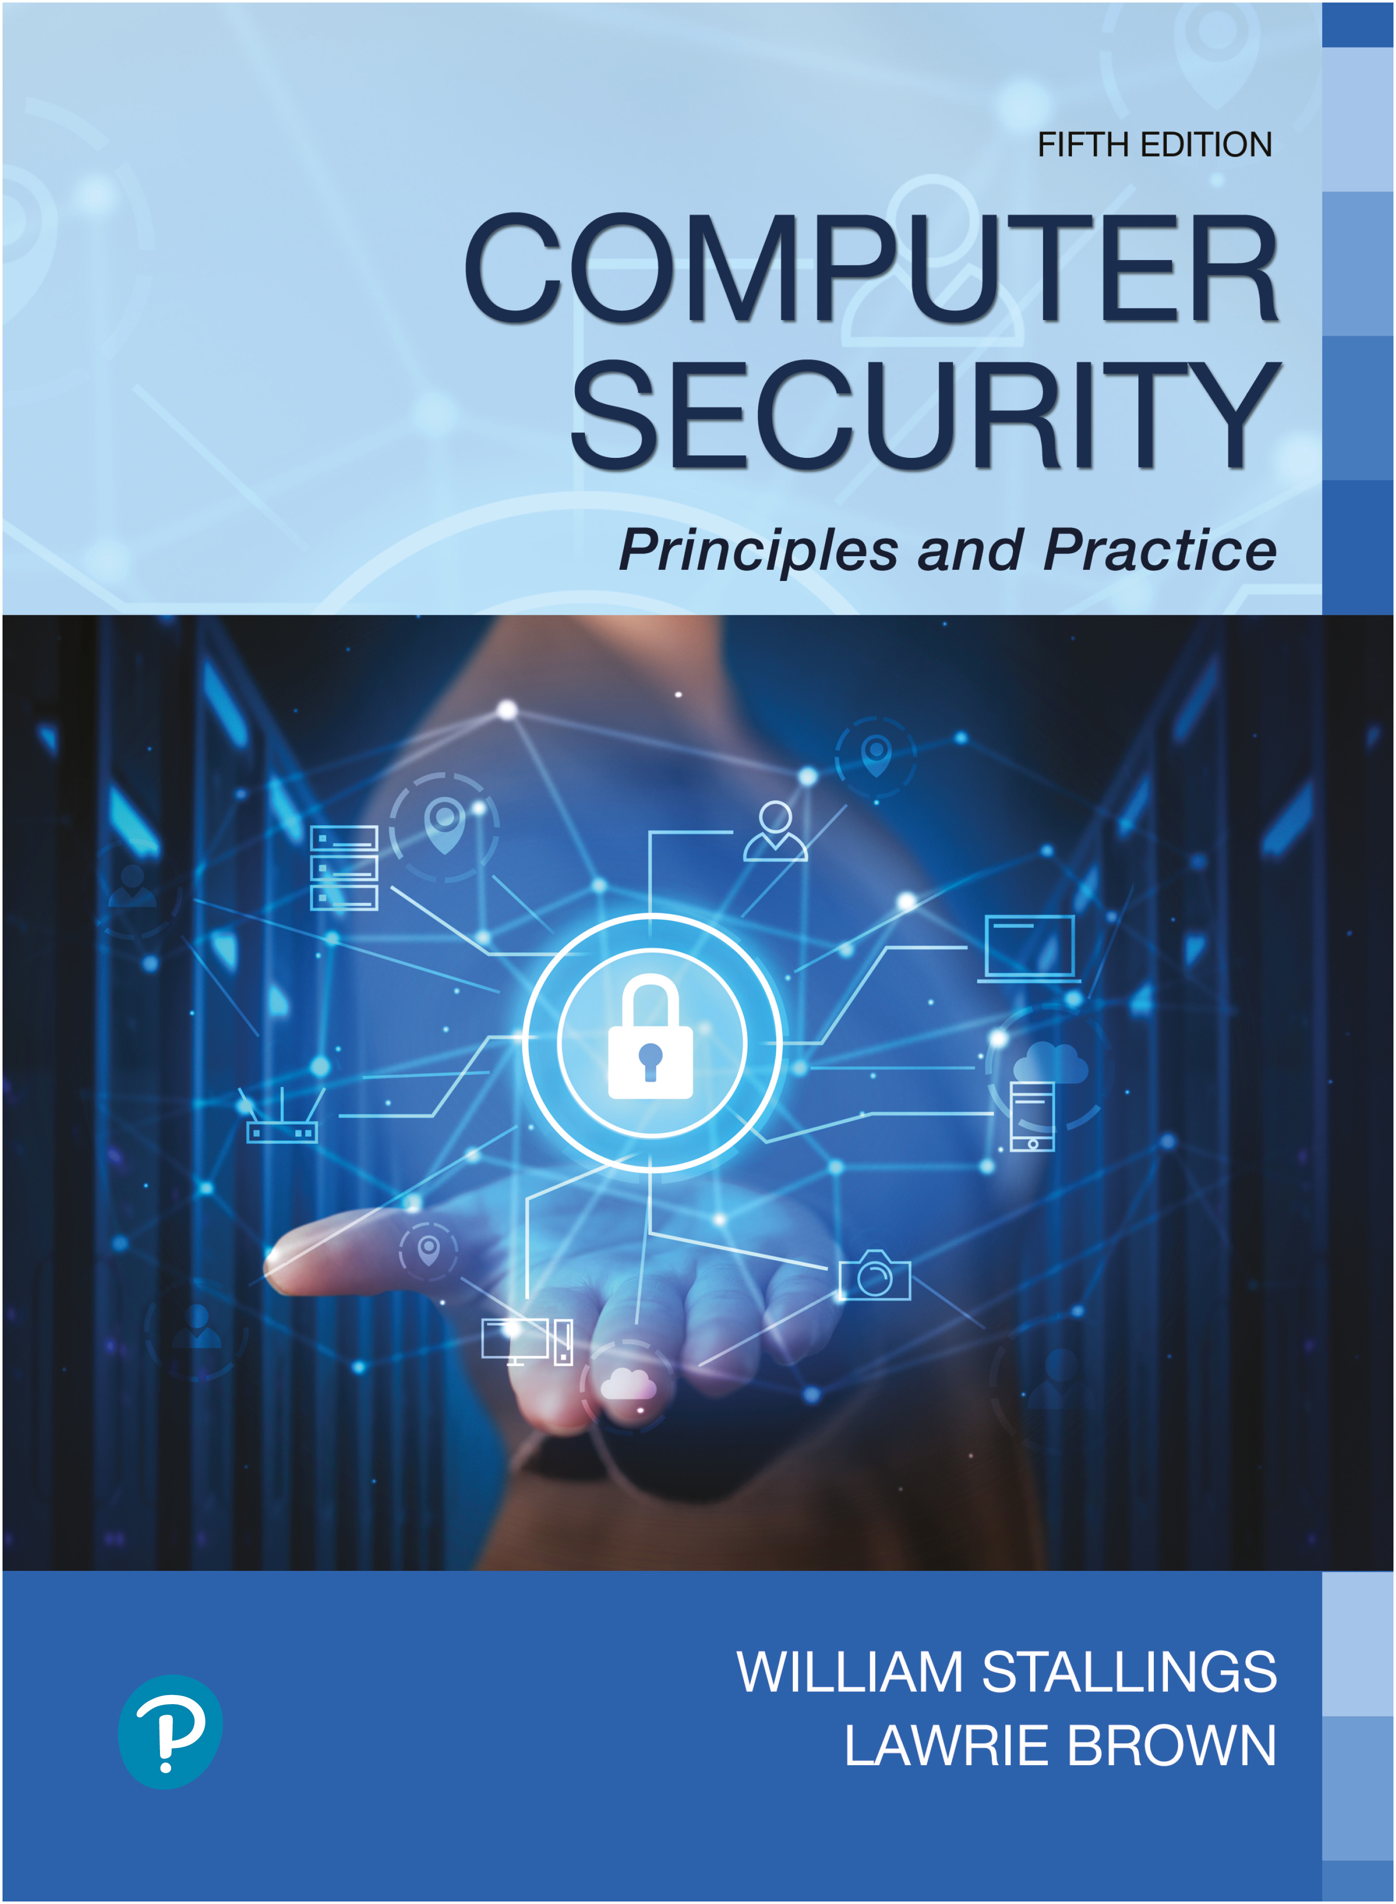

Computer Security: Principles and Practice
Fifth Edition
Chapter 15
I T Security Controls, Plans, and Procedures
Copyright © 2024, 2018, 2015 Pearson Education, Inc. All Rights Reserved
Notes:
If this PowerPoint presentation contains mathematical equations, you may need to check that your computer has the following installed:
1) MathType Plugin
2) Math Player (free versions available)
3) NVDA Reader (free versions available)
In Chapter 14, we introduced IT security management as a formal process to ensure that critical assets are sufficiently protected in a cost-effective manner. We then discussed the critical risk assessment process. This chapter continues the examination of IT security management. We survey the range of management, operational, and technical controls or safeguards available that can be used to improve security of IT systems and processes. We then explore the content of the security plans that detail the implementation process. These plans must then be implemented with training to ensure that all personnel know their responsibilities and monitoring to ensure compliance. Finally, to ensure that a suitable level of security is maintained, management must follow up the implementation with an evaluation of the effectiveness of the security controls and an iteration of the entire IT security management process.

Slide 2
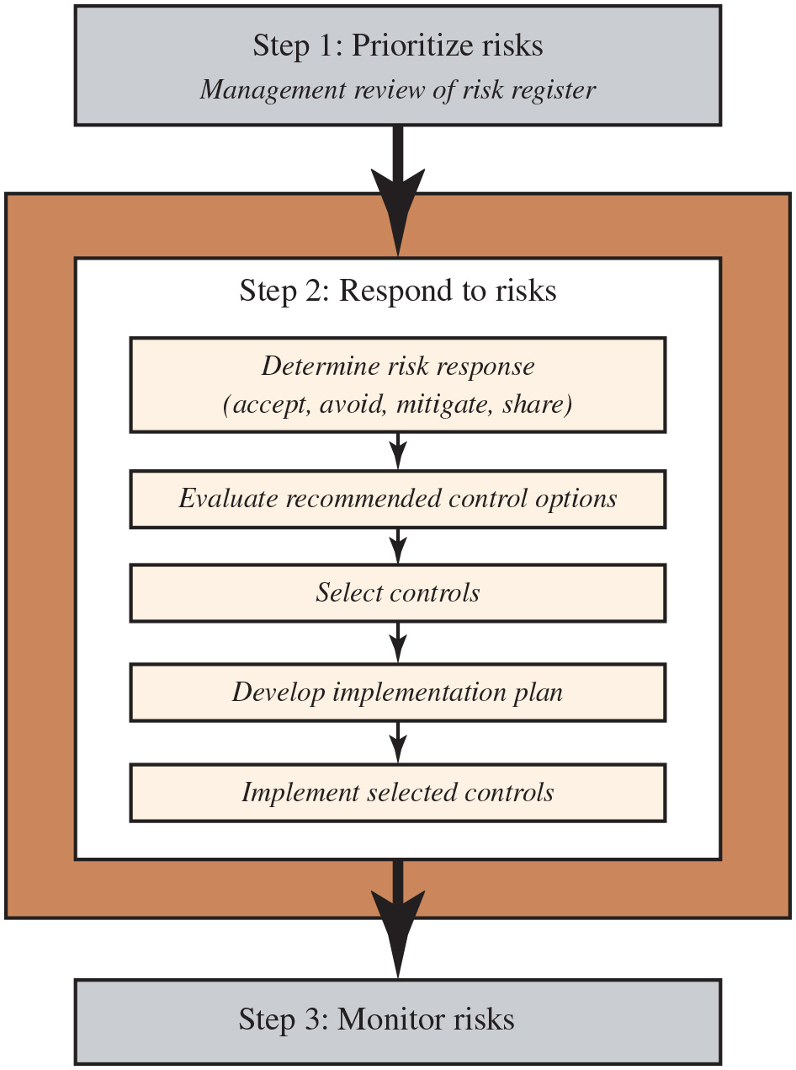
Figure 15.1
I T Security Management Controls and Implementation
"Security is a process, not a product."
- Bruce Schneier
This chapter
SJW
Notes:
We introduced the I T security management process in Chapter 14, illustrated by Figure 14.1. Chapter 14 focused on the earlier stages of this process. In this chapter, we focus on the latter stages, which include selecting controls, developing an implementation plan, and the follow-up monitoring of the plan’s implementation. We broadly follow the guidance provided in N I S T S P 800-39 (Managing Information Security Risk: Organization, Mission, and Information System View, March 2011), which was developed by N I S T in 2011 as the flagship document for providing guidance for an integrated, organization-wide program for managing information security risk in response to F I S M A. A broad summary of these steps is given in Figure 15.1. We will discuss each of these in turn.
The illustration involves the steps as follows.
Step 1. Prioritize risks, Management review of risk register.
Step 2. Respond to risks. Step 2 involves the following.
• Determine risk response, accept, avoid, mitigate, share
• Evaluate recommended control options
• Select controls
• Develop implementation plan
• Implement selected controls
Step 3. Monitor risks. Arrows extend from one step to the other.
Long Description:
The block diagram has three steps. Step 1: Prioritize risks. Management review of risk register. Step 2: Respond to risks. Step 3: Monitor risks. Step 1 is connected to Step 2 and Step 2 is connected to Step 3. Steps 1 and 3 are shown in rectangular blocks. Step 2 is shown inside a rectangular frame, and consists of five rectangular blocks connected using downward arrows. The rectangular blocks are given as follows. Determine risk response (accept, avoid, mitigate, share), evaluate recommended control options, select controls, develop implementation plan, and implement selected controls.

Slide 3
Security Control
Control is defined as:
“An action, device, procedure, or other measure that reduces risk by eliminating or preventing a security violation, minimizing the harm it can cause, or discovering and reporting it to enable corrective action.”
Notes:
A risk assessment on an organization’s I T systems identifies areas needing treatment. The next step, as shown in Figure 14.1 on risk analysis options, is to select suitable controls to use in this treatment. An I T security control, safeguard, or countermeasure (the terms are used interchangeably) helps to reduce risks. We use the following definition:
“An action, device, procedure, or other measure that reduces risk by eliminating or preventing a security violation, minimizing the harm it can cause, or discovering and reporting it to enable corrective action.”

Slide 4
Control Classifications
Management controls
Focus on security policies, planning, guidelines, and standards that influence the selection of operational and technical controls to reduce the risk of loss and to protect the organization’s mission
These controls refer to issues that management needs to address
Operational controls
Address the correct implementation and use of security policies and standards, ensuring consistency in security operations and correcting identified operational deficiencies
These controls relate to mechanisms and procedures that are primarily implemented by people rather than systems
They are used to improve the security of a system or group of systems
Technical controls
Involve the correct use of hardware and software security capabilities in systems
These range from simple to complex measures that work together to secure critical and sensitive data, information, and I T systems functions
Control classes frequently overlap
SJW
Notes:
Some controls address multiple risks at the same time, and selecting such controls can be very cost effective. Controls can be classified as belonging to one of the following classes (although some controls include features from several of these):
• Management controls: Focus on security policies, planning, guidelines, and standards that influence the selection of operational and technical controls to reduce the risk of loss and to protect the organization’s mission. These controls refer to issues that management needs to address. We discuss a number of these in the previous and this chapter.
• Operational controls: Address the correct implementation and use of security policies and standards, ensuring consistency in security operations and correcting identified operational deficiencies. These controls relate to mechanisms and procedures that are primarily implemented by people rather than systems. They are used to improve the security of a system or group of systems. We will discuss some of these in Chapters 16 and 17.
• Technical controls: Involve the correct use of hardware and software security capabilities in systems. These range from simple to complex measures that work together to secure critical and sensitive data, information, and I T systems functions.

Slide 5
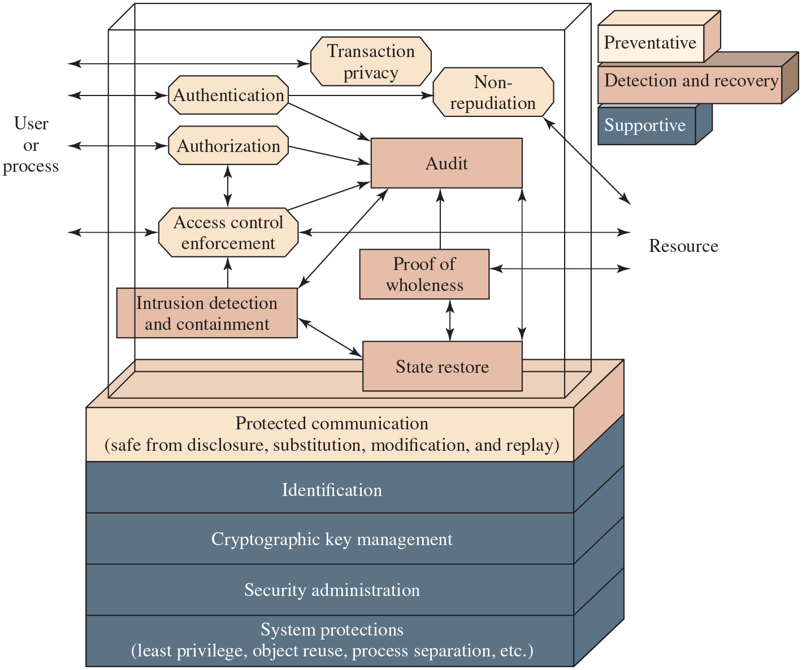
Figure 15.2
Technical Security Controls
Covered in Parts One and Two of text; source: NIST 800-33
SJW
Notes:
Figure 15.2 illustrates some typical technical control measures. Parts One and Two in this text discussed aspects of such measures.
The illustration has two frames. In the first frame, double headed arrows extend between the user or process and the blocks, Authentication, Authorization, Access control enforcement, and Transaction privacy. The authentication block communicates to the resource through the non repudiation block. Arrow extends from Authentication, Authorization, and Access control enforcement to the Audit block. Double headed arrows extend between Authorization and Access control enforcement. Double headed arrows extend between the three blocks, Audit, State restore, and Intrusion detection and containment. An arrow extends from the intrusion detection and containment to the access control enforcement. Double headed arrows extend between Proof of wholeness and state restore. An arrow extends from proof of wholeness to audit. The blocks classified under Prevent are as follows. Authentication, Authorization, Transaction Privacy, Non repudiation, and Access control enforcement. The blocks classified under detect recover are as follows. Audit, Intrusion detection and containment, Proof of wholeness, State restore. The second frame has stacked layers as follows.
• Protected communication, safe from disclosure, substitution, modification, and replay.
• Identification
• Cryptographic key management
• Security administration
• System protections, least privilege, object reuse, process separation, et cetera.
In the second frame, the layers except the protected communication layer come under support, while the protected communication comes under prevent.
Long Description: Back The diagram represents support activities as a stack, with the following support activities layered from bottom to top in the stack. system protections such as least privilege, object reuse and process separation, security administration, cryptographic key management, identification, and protected communication, which involves ensuring the content is safe from disclosure, substitution, modification, and replay. In the space above these layers, security functions involve the interactions of prevention and detection and recovery activities. For example, in the area of detection and recovery, intrusion detection and containment interacts with auditing and state restoration, and auditing and state restoration interact with proof of wholeness. On the other hand, the prevention activity, access control enforcement interacts with intrusion detection and containments, as well as prevention activity, authorization, which is also informed by the user or external process. And, together access control enforcement, authorization, and prevention activity, authentication, inform auditing. Back

Slide 6


Control Classes
Each of the control classes may include the following:
Preventative controls
Focus on preventing security breaches from occurring by inhibiting attempts to violate security policies or exploit a vulnerability
Detection and recovery controls
Focus on the response to a security breach by warning of violations or attempted violations of security policies or the identified exploit of a vulnerability and by providing means to restore the resulting lost computing resources
Supportive controls
Pervasive, generic, underlying technical I T security capabilities that are interrelated with and used by many other controls
SJW
Notes:
In turn, each of these control classes may include the following:
• Supportive controls: Pervasive, generic, underlying technical I T security capabilities that are interrelated with and used by many other controls.
• Preventative controls: Focus on preventing security breaches from occurring by inhibiting attempts to violate security policies or exploit a vulnerability.
• Detection and recovery controls: Focus on the response to a security breach by warning of violations or attempted violations of security policies or the identified exploit of a vulnerability and by providing means to restore the resulting lost computing resources.
The technical control measures shown in Figure 15.2 include examples of each of these types of controls.

Slide 7
Table 15.1 (1 of 2)
N I S T S P 800-53 Security and Privacy Control Families
Class | Control Family
Management | Assessment, Authorization, and Monitoring
Management | Personally Identifiable Information Processing and Transparency
Management | Planning
Management | Program Management
Management | Risk Assessment
Management | Supply Chain Risk Management
Management | System and Services Acquisition
Operational | Awareness and Training
Operational | Configuration Management
Operational | Contingency Planning
Operational | Incident Response
SJW
Notes:
Lists of controls are provided in a number of national and international standards, including I S O 27002 (Code of practice for information security management, 2013), I S O 13335 (Management of information and communications technology security, 2004), F I P S 200 (Minimum Security Requirements for Federal Information and Information Systems, March 2006) and N I S T S P 800-53 (Recommended Security Controls for Federal Information Systems, September 2020). There is broad agreement among these and other standards as to the types of controls that should be used and the detailed lists of typical controls. Indeed many of the standards cross-reference each other, indicating their agreement on these lists. I S O 27002 is generally regarded as the primary list of controls and is cited by most other standards. Table 15.1 (adapted from Table 1 in N I S T S P 800-53) is a typical list of families of controls within each of the classes.

Slide 8
Table 15.1 (2 of 2)
N I S T S P 800-53 Security and Privacy Control Families
Class | Control Family
Operational | Maintenance
Operational | Media Protection
Operational | Personnel Security
Operational | Physical and Environmental Protection
Operational | System and Information Integrity
Technical | Access Control
Technical | Audit and Accountability
Technical | Identification and Authentication
Technical | System and Communications Protection
SJW

Slide 9
Table 15.2 (1 of 2)
I S O/I E C 27002 Security Controls
Control Category | Objective
Security Policies | To provide management direction and support for information security in accordance with business requirements and relevant laws and regulations.
Organization of Information Security | To establish a management framework to initiate and control the implementation and operation of information security within the organization; to ensure the security of teleworking and use of mobile devices.
Human Resource Security | To ensure that employees and contractors understand their responsibilities and are suitable for the roles for which they are considered; to ensure that employees and contractors are aware of and fulfill their information security responsibilities; to protect the organization’s interests as part of the process of changing or terminating employment.
Asset Management | To identify organizational assets and define appropriate protection responsibilities; to ensure that information receives an appropriate level of protection in accordance with its importance to the organization; to prevent unauthorized disclosure, modification, removal or destruction of information stored on media.
Access Control | To limit access to information and information processing facilities; to ensure authorized user access and to prevent unauthorized access to systems and services; to make users accountable for safeguarding their authentication information; to prevent unauthorized access to systems and applications.
Cryptography | To ensure proper and effective use of cryptography to protect the confidentiality, authenticity and/or integrity of information.
Physical and Environmental Security | To prevent unauthorized physical access, damage, and interference to the organization’s information and information processing facilities; to prevent loss, damage, theft or compromise of assets and interruption to the organization’s operations.
SJW
Notes:
Compare this with the list in Table 15.2, which details the categories of controls given in I S O 27002, and with Table 1.4, which lists controls from F I P S 200, noting the high degree of overlap. Within each of these control classes, there is a long list of specific controls that may be chosen.

Slide 10
Table 15.2 (2 of 2)
I S O/I E C 27002 Security Controls
Control Category | Objective
Operations Security | To ensure correct and secure operations of information processing facilities; to ensure that information and information processing facilities are protected against malware; to protect against loss of data; to record events and generate evidence; to ensure the integrity of operational systems; to prevent exploitation of technical vulnerabilities; to minimize the impact of audit activities on operational systems.
Communications Security | To ensure the protection of information in networks and its supporting information processing facilities; to maintain the security of information transferred within an organization and with an external entity.
System Acquisition, Development, and Maintenance | To ensure that information security is an integral part of information systems across the entire lifecycle, including the requirements for information systems which provide services over public networks; to ensure that information security is designed and implemented within the development lifecycle of information systems; to ensure the protection of data used for testing.
Supplier Relationships | To ensure protection of the organization’s assets that are accessible by suppliers; to maintain an agreed level of information security and service delivery in line with supplier agreements.
Information Security Incident Management | To ensure a consistent and effective approach to the management of information security incidents, including communication on security events and weaknesses.
Information Security Continuity | To embed I T continuity in the organization’s business continuity management systems; to ensure availability of information processing facilities.
Compliance | To avoid breaches of legal, statutory, regulatory, or contractual obligations related to information security and of any security requirements; to ensure that information security is implemented and operated in accordance with the organizational policies and procedures.
SJW

Slide 11
Table 15.3 (1 of 10)
Controls selected based on organization’s overall risk profile, resources and capabilities
Detailed N I S T S P 800-53 Security Controls
Access Control
Access Control Policy and Procedures, Account Management, Access Enforcement, Information Flow Enforcement, Separation of Duties, Least Privilege, Unsuccessful Login Attempts, System Use Notification,
Previous Logon Notification, Concurrent Session Control, Device Lock, Session Termination, Permitted Actions without Identification or Authentication, Security and Privacy Attributes, Remote Access, Wireless Access, Access Control for Mobile Devices, Use of External Systems, Information Sharing, Publicly Accessible Content, Data Mining Protection, Access Control Decisions, Reference Monitor
Awareness and Training
Awareness and Training Policy and Procedures, Literacy Training and Awareness, Role-Based Training, Training Records, Training Feedback
SJW
Notes:
Table 15.3 (adapted from the table in Appendix C of N I S T SP 800-53) itemizes the full list of controls detailed in this standard.
To attain an acceptable level of security, some combination of these controls should be chosen. If the baseline approach is being used, an appropriate baseline set of controls is typically specified in a relevant industry or government standard. A selection should be made that is appropriate to the organization’s overall risk profile, resources, and capabilities. These should then be implemented across all the I T systems for the organization, with adjustments in scope to address broad requirements of specific systems.

Slide 12
Table 15.3 (2 of 10)
Detailed N I S T S P 800-53 Security Controls
Audit and Accountability
Audit and Accountability Policy and Procedures, Event Logging, Content of Audit Records, Audit Log Storage Capacity, Response to Audit Logging Process Failures, Audit Record Review Analysis and Reporting, Audit Record Reduction and Report Generation, Time Stamps, Protection of Audit Information, Nonrepudiation, Audit Record Retention, Audit Record Generation, Monitoring for Information Disclosure, Session Audit, Cross-Organizational Auditing
Assessment, Authorization, and Monitoring
Assessment Authorization and Monitoring Policies and Procedures, Control Assessments, Information Exchange, Plan of Action and Milestones, Authorization, Continuous Monitoring, Penetration Testing, Internal System Connections
Configuration Management
Configuration Management Policy and Procedures, Baseline Configuration, Configuration Change Control, Impact Analysis, Access Restrictions for Change, Configuration Settings, Least Functionality, System Component Inventory, Configuration Management Plan, Software Usage Restrictions, User-Installed Software, Information Location, Data Action Mapping, Signed Components
SJW

Slide 13
Table 15.3 (3 of 10)
Detailed N I S T S P 800-53 Security Controls
Contingency Planning
Contingency Planning Policy and Procedures, Contingency Plan, Contingency Training, Contingency Plan Testing, Alternate Storage Site, Alternate Processing Site, Telecommunications Services, System Backup, System Recovery and Reconstitution, Alternate Communications Protocols, Safe Mode, Alternative Security Mechanisms
Identification and Authentication
Identification and Authentication Policy and Procedures, Identification and Authentication (Organizational Users), Device Identification and Authentication, Identifier Management, Authenticator Management, Authentication Feedback, Cryptographic Module Authentication, Identification and Authentication (Nonorganizational Users), Service Identification and Authentication, Adaptive Authentication, Re-authentication, Identity Proofing
SJW

Slide 14
Table 15.3 (4 of 10)
Detailed N I S T S P 800-53 Security Controls
Incident Response
Incident Response Policy and Procedures, Incident Response Training, Incident Response Testing, Incident Handling, Incident Monitoring, Incident Reporting, Incident Response Assistance, Incident Response Plan, Information Spillage Response
Maintenance
Maintenance Policy and Procedures, Controlled Maintenance, Maintenance Tools, Nonlocal Maintenance, Maintenance Personnel, Timely Maintenance, Field Maintenance
Media Protection
Media Protection Policy and Procedures, Media Access, Media Marking, Media Storage, Media Transport, Media Sanitization, Media Use, Media Downgrading
SJW

Slide 15
Table 15.3 (5 of 10)
Detailed N I S T S P 800-53 Security Controls
Physical and Environmental Protection
Physical and Environmental Protection Policy and Procedures, Physical Access Authorizations, Physical Access Control, Access Control for Transmission, Access Control for Output Devices, Monitoring Physical Access, Visitor Access Records, Power Equipment and Cabling, Emergency Shutoff, Emergency Power, Emergency Lighting, Fire Protection, Environmental Controls, Water Damage Protection, Delivery and Removal, Alternate Work Site, Location of System Components, Information Leakage, Asset Monitoring and Tracking, Electromagnetic Pulse Protection, Component Marking, Facility Location
Planning
Planning Policy and Procedures, System Security and Privacy Plans, Rules of Behavior, Security Concept of Operations, Security and Privacy Architectures, Central Management, Baseline Selection, Baseline Tailoring
SJW
Notes:
N I S T S P 800-18 (Guide for Developing Security Plans for Federal Information Systems, February 2006) suggests that adjustments may be needed for considerations related to the following:
• Technology: Some controls are only applicable to specific technologies, and hence these controls are only needed if the system includes those technologies. Examples of these include wireless networks and the use of cryptography. Some may only be appropriate if the system supports the technology they require— for example, readers for access tokens. If these technologies are not supported on a system, then alternate controls, including administrative procedures or physical access controls, may be used instead.
• Common controls: The entire organization may be managed centrally and may not be the responsibility of the managers of a specific system. Control changes would need to be agreed to and managed centrally.
• Public access systems: Some systems, such as an organization’s public Web server, are designed for access by the general public. Some controls, such as those relating to personnel security, identification, and authentication, would not apply to access via the public interface. They would apply to administrative control of such systems. The scope of application of such controls must be specified carefully.
• Infrastructure controls: Physical access or environmental controls are only relevant to areas housing the relevant equipment.
• Scalability issues: Controls may vary in size and complexity in relation to the organization employing them. For example, a contingency plan for systems critical to a large organization would be much larger and more detailed than that for a small business.
• Risk assessment: Controls may be adjusted according to the results of specific risk assessment of systems in an organization, as we now consider.
If some form of informal or formal risk assessment process is being used, then it provides guidance on specific risks to an organization’s I T systems that need to be addressed. Such guidance will typically be some selection of operational or technical controls that together can reduce the likelihood of the identified risk occurring, the consequences if it does, or both, to an acceptable level. The controls may be in addition to those controls already selected in the baseline or may simply be a more detailed and careful specification and use of the already selected controls.
The process illustrated in Figure 15.1 indicates that a recommended list of controls should be made to address each risk needing treatment. The recommended controls need to be compatible with the organization’s systems and policies, and their selection may also be guided by legal requirements. The resulting list of controls should include details of the feasibility and effectiveness of each control. The feasibility addresses factors such as technical compatibility with and operational impact on existing systems and users’ likely acceptance of the control. The effectiveness equates the cost of implementation against the reduction in level of risk achieved by implementing the control.

Slide 16
Table 15.3 (6 of 10)
Detailed N I S T S P 800-53 Security Controls
Program Management
Information Security Program Plan, Information Security Program Leadership Role, Information Security and Privacy Resources, Plan of Action and Milestones Process, System Inventory, Measures of Performance, Enterprise Architecture, Critical Infrastructure Plan, Risk Management Strategy, Authorization Process, Mission and Business Process Definition, Insider Threat Program, Security and Privacy Workforce, Testing Training and Monitoring, Security and Privacy Groups and Associations, Threat Awareness Program, Protecting Controlled Unclassified Information on External Systems, Privacy Program Plan, Privacy Program Leadership Role, Dissemination of Privacy Program Information, Accounting of Disclosures, Personally Identifiable Information Quality Management, Data Governance Body, Data Integrity Board, Minimization of Personally Identifiable Information Used in Testing Training and Research, Complaint Management, Privacy Reporting, Risk Framing, Risk Management Program Leadership Roles, Supply Chain Risk Management Strategy, Continuous Monitoring Strategy, Purposing
SJW

Slide 17
Table 15.3 (7 of 10)
Detailed N I S T S P 800-53 Security Controls
Personnel Security
Personnel Security Policy and Procedures, Position Risk Designation, Personnel Screening, Personnel Termination, Personnel Transfer, Access Agreements, External Personnel Security, Personnel Sanctions, Position Descriptions
Personally Identifiable Information Processing and Transparency
Personally Identifiable Information Processing and Transparency Policy and Procedures, Authority to Process Personally Identifiable Information, Personally Identifiable Information Processing Purposes, Consent, Privacy Notice, System of Records Notice, Specific Categories of Personally Identifiable Information, Computer Matching Requirements
SJW

Slide 18
Table 15.3 (8 of 10)
Detailed N I S T S P 800-53 Security Controls
Risk Assessment
Risk Assessment Policy and Procedures, Security Categorization, Risk Assessment, Vulnerability Monitoring and Scanning, Technical Surveillance Countermeasures Survey, Risk Response, Privacy Impact Assessments, Criticality Analysis, Threat Hunting
System and Services Acquisition
System and Services Acquisition Policy and Procedures, Allocation of Resources, System Development Life Cycle, Acquisition Process, System Documentation, Security and Privacy Engineering Principles, External System Services, Developer Configuration Management, Developer Testing and Evaluation, Development Process Standards and Tools, Developer-Provided Training, Developer Security and Privacy Architecture and Design, Customized Development of Critical Components, Developer Screening, Unsupported System Components, Specialization
SJW

Slide 19
Table 15.3 (9 of 10)
Detailed N I S T S P 800-53 Security Controls
System and Communications Protection
System and Communications Protection Policy and Procedures, Separation of System and User Functionality, Security Function Isolation, Information in Shared System Resources, Denial of Service Protection, Resource Availability, Boundary Protection, Transmission Confidentiality and Integrity, Network Disconnect, Trusted Path, Cryptographic Key Establishment and Management, Cryptographic Protection, Collaborative Computing Devices and Applications, Transmission of Security and Privacy Attributes, Public Key Infrastructure Certificates, Mobile Code, Secure Name/Address Resolution Service (Authoritative Source), Secure Name/Address Resolution Service (Recursive or Caching Resolver), Architecture and Provisioning for Name/Address Resolution Service, Session Authenticity, Fail in Known State, Thin Nodes, Decoys, Platform-Independent Applications, Protection of Information at Rest, Heterogeneity, Concealment and Misdirection, Covert Channel Analysis, System Partitioning, Non-modifiable Executable Programs, External Malicious Code Identification, Distributed Processing and Storage, Out-of-Band Channels, Operations Security, Process Isolation, Wireless Link Protection, Port and I/O Device Access, Sensor Capability and Data, Usage Restrictions, Detonation Chambers, System Time Synchronization, Cross Domain Policy Enforcement, Alternate Communications Paths, Sensor Relocation, Hardware-Enforced Separation and Policy Enforcement, Software-Enforced Separation and Policy Enforcement, Hardware- Based Protection
SJW

Slide 20
Table 15.3 (10 of 10)
Detailed N I S T S P 800-53 Security Controls
System and Information Integrity
System and Information Integrity Policy and Procedures, Flaw Remediation, Malicious Code Protection, System Monitoring, Security Alerts Advisories and Directives, Security and Privacy Functionality Verification, Software Firmware and Information Integrity, Spam Protection, Information Input Validation, Error Handling, Information Management and Retention, Predictable Failure Prevention, Non-Persistence, Information Output Filtering, Memory Protection, Fail-Safe Procedures, Personally Identifiable Information Quality Operations, De-Identification, Tainting, Information Refresh, Information Diversity, Information Fragmentation
Supply Chain Risk Management
Supply Chain Risk Management Policy and Procedures, Supply Chain Risk Management Plan, Supply Chain Controls and Processes, Provenance, Acquisition Strategies Tools and Methods, Supplier Assessments and Reviews, Supply Chain Operations Security, Notification Agreements, Tamper Resistance and Detection, Inspection of Systems or Components, Component Authenticity, Component Disposal
SJW

Slide 21
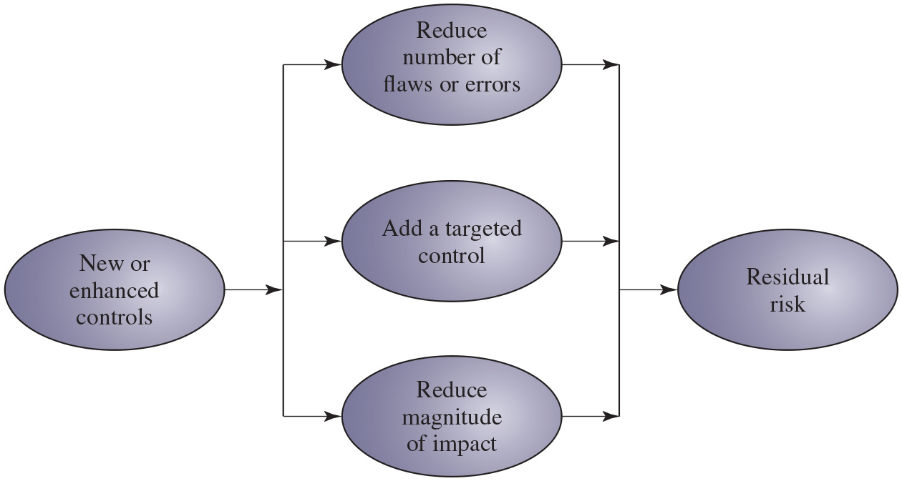
Figure 15.3
Residual Risk
Secondary risk: "those risks that arise as a direct outcome of implementing a risk response“ Source: PMBOK Guide
Not all recommended controls will be implemented
(vulnerabilities)
SJW
Notes:
The reduction in level of risk that results from implementing a new or enhanced control results from the reduction in threat likelihood or consequence that the control provides, as shown in Figure 15.3. The reduction in likelihood may result either by reducing the vulnerabilities (flaws or weaknesses) in the system or by reducing the capability and motivation of the threat source. The reduction in consequence occurs by reducing the magnitude of the adverse impact of the threat occurring in the organization.
Long Description:
The block diagram consists of five oval-shaped blocks labeled new or enhanced controls, reduce the number of flaws or errors, add a targeted control, and reduce the magnitude of impact, and residual risk. An arrow from the new or enhanced controls block branches into three arrows toward the blocks to reduce the number of flaws or errors, add a targeted control, and reduce the magnitude of impact. Three arrows from these blocks point to a single arrow toward the block residual risk.

Slide 22
Cost-Benefit Analysis
Should be conducted by management to identify controls that provide the greatest benefit to the organization given the available resources
May be qualitative or quantitative
Must show cost justified by reduction in risk
Should contrast the impact of implementing a control or not, and an estimation of cost
Management chooses selection of controls
Considers if it reduces risk too much or not enough, is too costly or appropriate
Fundamentally a business decision
Recommended controls → Cost-benefit analysis → Selected controls
SJW
Notes:
The organization will likely not have the resources to implement all the recommended controls. Therefore, management should conduct a cost-benefit analysis to identify those controls that are most appropriate and provide the greatest benefit to the organization given the available resources. This analysis may be qualitative or quantitative and must demonstrate that the cost of implementing a given control is justified by the reduction in level of risk to assets that it provides. It should include details of the impact of implementing the new or enhanced control, the impact of not implementing it, and the estimated costs of implementation. The analysis must then assess the implementation costs and benefits against system and data criticality to determine the importance of choosing this control.
Management must then determine which selection of controls provides an acceptable resulting level of risk to the organization’s systems. This selection will consider factors such as the following:
• If the control would reduce risk more than needed, then a less expensive alternative could be used.
• If the control would cost more than the risk reduction provided, then an alternative should be used.
• If a control does not reduce the risk sufficiently, then either more or different controls should be used.
• If the control provides sufficient risk reduction and is the most cost effective, then use it.
It is often the case that the cost of implementing a control is more tangible and easily specified than the cost of not implementing it. Management must make a business decision regarding these ill-defined costs in choosing the final selection of controls and resulting residual risk.

Slide 23
I T Security Plan
Provides details of:
What will be done
What resources are needed
Who is responsible
Goal is to detail the actions needed to improve the identified deficiencies in the risk profile
See next slide
Should include
Risks, recommended controls, action priority
Selected controls, resources needed
Responsible personnel, implementation dates
Maintenance requirements
Risks are asset/threat/vulnerability combinations
SJW
Notes:
After a range of possible controls have been identified and management has selected some to implement, an I T security plan should then be created, as indicated in Figures 14.1 and 15.1. This is a document that provides details as to what will be done, what resources are needed, and who will be responsible. The goal is to detail the actions needed to improve the identified deficiencies in the organization’s risk profile in a timely manner. N I S T S P 800-30 (Risk Management Guide for Information Technology Systems, September 2012) suggests that this plan should include details of:
• Risks (asset/threat/vulnerability combinations)
• Recommended controls (from the risk assessment)
• Action priority for each risk
• Selected controls (on the basis of the cost-benefit analysis)
• Required resources for implementing the selected controls
• Responsible personnel
• Target start and end dates for implementation
• Maintenance requirements and other comments

Slide 24
Table 15.4
Implementation Plan (references Table 14.5 Risk Register
Risk (Asset/Threat) | Hacker attack on Internet router
Level of Risk | High
Recommended Controls | Disable external telnet access Use detailed auditing of privileged command use Set policy for strong admin passwords Set backup strategy for router configuration file Set change control policy for the router configuration
Priority | High
Selected Controls | Implement all recommended controls Update related procedures with training for affected staff
Required Resources | 3 days I T net admin time to change and verify router configuration, write policies 1 day of training for network administration staff
Responsible Persons | John Doe, Lead Network System Administrator, Corporate I T Support Team
Start to End Date | February 6, 2017, to February 9, 2017
Other Comments | Need periodic test and review of configuration and policy use
SJW
Notes:
These details are summarized in an implementation plan table, such as that shown in Table 15.4. This illustrates an example implementation plan for the example risk identified and shown in Table 14.5. The suggested controls are specific examples of remote access, auditable event, user identification, system backup, and configuration change controls applied to the identified threatened asset. All of them are chosen because they are neither costly nor difficult to implement. They do require some changes to procedures. The relevant network administration staff must be notified of these changes. Staff members may also require training on the correct implementation of the new procedures and their rights and responsibilities.

Slide 25
Security Plan Implementation
I T security plan documents:
What needs to be done for each selected control
Personnel responsible
Resources and time frame
Identified personnel:
Implement new or enhanced controls
May need system configuration changes, upgrades or new system installation
May also involve development of new or extended procedures
Need to be encouraged and monitored by management
When implementation is completed, management authorizes the system for operational use
The “do” stage of the cyclic implementation model in Chapter 14
Implementation includes associated specific training and general security awareness programs – see Chapter17
SJW
Notes:
The next phase in the I T security management process, as indicated in Figure 14.1, is to manage the implementation of the controls detailed in the I T security plan. This comprises the do stage of the cyclic implementation model discussed in Chapter 14. The implementation phase comprises not only the direct implementation of the controls as detailed in the security plan, but also the associated specific training and general security awareness programs for the organization.
The I T security plan documents what needs to be done for each selected control, along with the personnel responsible and the resources and time frame to be used. The identified personnel then undertake the tasks needed to implement the new or enhanced controls, be they technical, managerial, or operational. This may involve some combination of system configuration changes, upgrades, or new system installation. It may also involve the development of new or extended procedures to document practices needed to achieve the desired security goals. Note that even technical controls typically require associated operational procedures to ensure their correct use. The use of these procedures needs to be encouraged and monitored by management.
The implementation process should be monitored to ensure its correctness. This is typically performed by the organizational security officer, who checks that:
• The implementation costs and resources used stay within identified bounds.
• The controls are correctly implemented as specified in the plan so that the identified reduction in risk level is achieved.
• The controls are operated and administered as needed.
When the implementation is successfully completed, management needs to authorize the system for operational use. This may be a purely informal process within the organization. Alternatively, especially in government organizations, this may be part of a formal process resulting in accreditation of the system as meeting required standards. This is usually associated with the installation, certification, and use of a trusted computing system, as we mentioned in Chapter 12. In these cases an external accrediting body will verify the documented evidence of the correct design and implementation of the system.

Slide 26
Implementation Follow-Up
Security management is a cyclic process
Constantly repeated to respond to changes in the I T systems and the risk environment
Need to monitor implemented controls
Evaluate changes for security implications
Otherwise increase chance of security breach
Includes a number of aspects
Maintenance of security controls
Security compliance checking
Change and configuration management
Incident handling
Notes:
The I T security management process does not end with the implementation of controls and the training of personnel. As we noted in Chapter 14, it is a cyclic process, constantly repeated to respond to changes in the I T systems and the risk environment. The various controls implemented should be monitored to ensure their continued effectiveness. Any proposed changes to systems should be checked for security implications and the risk profile of the affected system reviewed if necessary. Unfortunately, this aspect of I T security management often receives the least attention and in many cases is added as an afterthought, if at all. Failure to monitor the controls can greatly increase the likelihood that a security failure will occur. This follow-up stage of the management process includes a number of aspects:
• Maintenance of security controls
• Security compliance checking
• Change and configuration management
• Incident handling
Any of these aspects might indicate that changes are needed to the previous stages in the I T security management process. An obvious example is that if a breach should occur, such as a virus infection of desktop systems, then changes may be needed to the risk assessment, to the controls chosen, or to the details of their implementation. This can trigger a review of earlier stages in the process.

Slide 27
Maintenance
Need continued maintenance and monitoring of implemented controls to ensure continued correct functioning and appropriateness
Goal is to ensure controls perform as intended
Tasks
Periodic review of controls
Upgrade of controls to meet new requirements
System changes do not impact controls
Address new threats or vulnerabilities
Notes:
The first aspect concerns the continued maintenance and monitoring of the implemented controls to ensure their continued correct functioning and appropriateness. It is important that someone has responsibility for this maintenance process, which is generally coordinated by the organization’s security officer.
The maintenance tasks include ensuring that:
• Controls are periodically reviewed to verify that they still function as intended.
• Controls are upgraded when new requirements are discovered.
• Changes to systems do not adversely affect the controls.
• New threats or vulnerabilities have not become known.
This review includes regular analysis of log files to ensure that various system components are functioning as expected and to determine a baseline of activity against which abnormal events can be compared when handling incidents. We discuss security auditing further in Chapter 18.
The goal of maintenance is to ensure that the controls continue to perform as intended and, hence, that the organization’s risk exposure remains as chosen. Failure to maintain controls could lead to a security breach with a potentially significant impact on the organization.

Slide 28
Security Compliance
Audit process to review security processes
Goal is to verify compliance with security plan
Use internal or external personnel
Usually based on use of checklists which verify:
Suitable policies and plans were created
Suitable selection of controls were chosen
That they are maintained and used correctly
Includes “pen”etration testing and “red teams”
Conducted on implementation and periodically
Often as part of wider general audit
SJW
Notes:
Security compliance checking is an audit process to review the organization’s security processes. The goal is to verify compliance with the security plan. The audit may be conducted using either internal or external personnel. It is generally based on the use of checklists, which verify that suitable policies and plans have been created, that suitable controls were chosen, and that the controls are maintained and used correctly.
This audit process should be conducted on new I T systems and services once they are implemented and on existing systems periodically, often as part of a wider, general audit of the organization or whenever changes are made to the organization’s security policy.

Slide 29
Change and Configuration Management (1 of 2)
Change management is the process to review proposed changes to systems
Evaluate the impact
Important component of general systems administration process
Test patches to make sure they do not adversely affect other applications
May be informal or formal
Configuration management is specifically concerned with keeping track of the configuration of each system in use and the changes made to them
Keep lists of hardware and software versions installed on each system to help restore them following a failure
Know what patches or upgrades might be relevant
Also part of general systems administration process
Notes:
Change management is the process used to review proposed changes to systems for implications on the organization’s systems and use. Changes to existing systems can occur for a number of reasons, such as the following:
• Users reporting problems or desired enhancements
• Identification of new threats or vulnerabilities
• Vendor notification of patches or upgrades to hardware or software
• Technology advances
• Implementation of new I T features or services, which require changing existing systems
• Identification of new tasks, which require changing existing systems
The impact of any proposed change on the organization’s systems should be evaluated. This includes not only security-related aspects, but wider operational issues as well. Thus change management is an important component of the general systems administration process. Because changes can affect security, this general process overlaps I T security management and must interact with it.
An important example is the constant flow of patches addressing bugs and security failings in common operating systems and applications. If the organization is running systems of any complexity with a range of applications, then patches should ideally be tested to ensure that they don’t adversely affect other applications. This can be a time-consuming process that may require considerable administration resources and could leave the organization exposed to a new vulnerability for a period. Otherwise, the patches or upgrades can be applied without testing, which may result in other failures in the systems and the loss of functionality but will also improve system security due to faster patching. Management needs to decide whether availability or security has higher priority in such cases.
Ideally, most proposed changes should act to improve the security profile of a system. However, it is possible that for imperative business reasons a change is proposed that reduces the security of a system. In cases like this, it is important that the reasons for the change, its consequences on the security profile for the organization, and management authorization of it be documented. The benefits to the organization would need to be traded off against the increased risk level.
The change management process may be informal or formal, depending on the size of the organization and its overall I T management processes. In a formal process, any proposed change should be documented and tested before implementation. As part of this process, any related documentation, including relevant security documentation and procedures, should be updated to reflect the change.
Configuration management is concerned with specifically keeping track of the configuration of each system in use and the changes made to each. This includes lists of the hardware and software versions installed on each system. This information is needed to help restore systems following a failure (whether security related or not) and to know what patches or upgrades might be relevant to particular systems. Again, this is a general systems administration process with security implications and requires interaction with I T security management.

Slide 30

Change and Configuration Management (2 of 2)
Regression testing: a type of software testing to confirm that a recent program or code change has not adversely affected existing features
Need to standby after implementation in case of problems
Rising Sun Flag
SJW
Notes:
Change management is the process used to review proposed changes to systems for implications on the organization’s systems and use. Changes to existing systems can occur for a number of reasons, such as the following:
• Users reporting problems or desired enhancements
• Identification of new threats or vulnerabilities
• Vendor notification of patches or upgrades to hardware or software
• Technology advances
• Implementation of new I T features or services, which require changing existing systems
• Identification of new tasks, which require changing existing systems
The impact of any proposed change on the organization’s systems should be evaluated. This includes not only security-related aspects, but wider operational issues as well. Thus change management is an important component of the general systems administration process. Because changes can affect security, this general process overlaps I T security management and must interact with it.
An important example is the constant flow of patches addressing bugs and security failings in common operating systems and applications. If the organization is running systems of any complexity with a range of applications, then patches should ideally be tested to ensure that they don’t adversely affect other applications. This can be a time-consuming process that may require considerable administration resources and could leave the organization exposed to a new vulnerability for a period. Otherwise, the patches or upgrades can be applied without testing, which may result in other failures in the systems and the loss of functionality but will also improve system security due to faster patching. Management needs to decide whether availability or security has higher priority in such cases.
Ideally, most proposed changes should act to improve the security profile of a system. However, it is possible that for imperative business reasons a change is proposed that reduces the security of a system. In cases like this, it is important that the reasons for the change, its consequences on the security profile for the organization, and management authorization of it be documented. The benefits to the organization would need to be traded off against the increased risk level.
The change management process may be informal or formal, depending on the size of the organization and its overall I T management processes. In a formal process, any proposed change should be documented and tested before implementation. As part of this process, any related documentation, including relevant security documentation and procedures, should be updated to reflect the change.
Configuration management is concerned with specifically keeping track of the configuration of each system in use and the changes made to each. This includes lists of the hardware and software versions installed on each system. This information is needed to help restore systems following a failure (whether security related or not) and to know what patches or upgrades might be relevant to particular systems. Again, this is a general systems administration process with security implications and requires interaction with I T security management.

Slide 31
The 7 R’s of Change Management
The REASON behind the change?
RISKS involved in the requested change?
RESOURCES required to deliver the change?
Who RAISED the change request?
Value of RETURN to justify the change?
Who is RESPONSIBLE for creating, testing, and implementing (or backing out) the change?
RELATIONSHIP between suggested change and other changes?
Recovery (8!) from the change?
- A change request may raise skepticism leading to FUD:
Fear, Uncertainty and Doubt – EPO episode
- Freeze on changes - Tokyo videoconference episode
SJW
Notes:
Mention elbow on EPO switch (reputation and resulting FUD); installation of plexiglass door (continuous improvement).

Slide 32
Case Study: Silver Star Mines
Given risk assessment, the next stage is to identify possible controls
Based on assessment it is clear many categories are not in use
General issue of systems not being patched or upgraded
Need contingency plans
S C A D A: add intrusion detection system
Info integrity: better centralize storage
Email: provide backup system
Notes:
Consider the case study introduced in Chapter 14, which involves the operations of a fictional company, Silver Star Mines. Given the outcome of the risk assessment for this company, the next stage in the security management process is to identify possible controls. From the information provided during this assessment, clearly a number of the possible controls listed in Table 15.3 are not being used. A comment repeated many times was that many of the systems in use had not been regularly upgraded, and part of the reason for the identified risks was the potential for system compromise using a known but unpatched vulnerability. That clearly suggests that attention needs to be given to controls relating to the regular, systematic maintenance of operating systems and applications software on server and client systems. Such controls include
• Configuration management policy and procedures
• Baseline configuration
• System maintenance policy and procedures
• Periodic maintenance
• Flaw remediation
• Malicious code protection
• Spam and spyware protection
Given that potential incidents are possible, attention should also be given to developing contingency plans to detect and respond to such incidents and to enable speedy restoration of system function. Attention should be paid to controls such as
• Audit monitoring, analysis, and reporting
• Audit reduction and report generation
• Contingency planning policy and procedures
• Incident response policy and procedures
• Information system backup
• Information system recovery and reconstitution
These controls are generally applicable to all the identified risks and constitute good general systems administration practice. Hence, their cost effectiveness is high because they provide an improved level of security across multiple identified risks.
Now consider the specific risk items. The top-priority risk relates to the reliability and integrity of the Supervisory Control and Data Acquisition (S C A D A) nodes and network. These were identified as being at risk because many of these systems are running older releases of operating systems with known insecurities. Further, these systems cannot be patched or upgraded because the key applications they run have not been updated or validated to run on newer O/S versions. Given these limitations on the ability to reduce the vulnerability of individual nodes, attention should be paid to the firewall and application proxy servers that isolate the S C A D A nodes and network from the wider corporate network. These systems can be regularly maintained and managed according to the generally applied list of controls we identified. Further, because the traffic to and from the S C A D A network is highly structured and predictable, it should be possible to implement an intrusion detection system with much greater reliability than applies to general-use corporate networks. This system should be able to identify attack traffic, as it is very different from normal traffic flows. Such a system might involve a more detailed, automated analysis of the audit records generated on the existing firewall and proxy server systems. More likely, it could be an independent system connected to and monitoring the traffic through these systems. The system could be further extended to include an automated response capability, which could automatically sever the network connection if an attack is identified. This approach recognizes that the network connection is not needed for the correct operation of the S C A D A nodes. Indeed, they were designed to operate without such a network connection, which is much of the reason for their insecurity. All that would be lost is the improved overall monitoring and management of the S C A D A nodes. With this functionality, the likelihood of a successful attack, already regarded as very unlikely, can be further reduced.
The second priority risk relates to the integrity of stored information. Clearly all the general controls help ameliorate this risk. More specifically, much of the problem relates to the large number of documents scattered over a large number of systems with inconsistent management. This risk would be easier to manage if all documents identified as critical to the operation of the company were stored on a smaller pool of application and file servers. These could be managed appropriately using the generally applicable controls. This suggests that an audit of critical documents is needed to identify who is responsible for them and where they are currently located. Then policies are needed that specify that critical documents should be created and stored only on approved central servers. Existing documents should be transferred to these servers. Appropriate education and training of all affected users is needed to help ensure that these policies are followed.
The next three risks relate to the availability or integrity of the key Financial, Procurement, and Maintenance/Production systems. The generally applicable controls we identified should adequately address these risks once the controls are applied to all relevant servers.
The final risk relates to the availability, integrity, and confidentiality of e-mail. As was noted in the risk assessment, this is primarily the responsibility of the parent company’s I T group that manages the external mail gateway. There is a limited amount that can be done on the local site. The use of the generally applicable controls, particularly those relating to malicious code protection and spam and spyware protection on client systems, will assist in reducing this risk. In addition, as part of the contingency planning and incident response policies and procedures, consideration could be given to a backup e-mail system. For security this system would use client systems isolated from the company intranet and connected to an external local network service provider. This connection would be used to provide limited e-mail capabilities for critical messages should the main company intranet e-mail system be compromised.

Slide 33
Table 15.5
Silver Star Mines: Implementation Plan
Risk (Asset/Threat) | Level of Risk | Recommended Controls | Priority | Selected Controls
All risks (generally applicable) | Blank | Configuration and periodic maintenance policy for servers Malicious code (S P A M, spyware) prevention Audit monitoring, analysis, reduction, and reporting on servers Contingency planning and incident response policies and procedures System backup and recovery Procedures | 1 | 1. 2. 3. 4. 5.
Reliability and integrity of S C A D A nodes and network | High | Intrusion detection and response system | 2 | 1.
Integrity of stored file and database information | Extreme | Audit of critical documents Document creation and storage policy User security education and Training | 3 | 1. 2. 3.
Availability and integrity of Financial, Procurement, and Maintenance/ Production Systems | High | Blank | Blank | (general controls)
Availability, integrity, and confidentiality of e-mail | High | Contingency planning—backup e-mail service | 4 | 1.
Notes:
This analysis of possible controls is summarized in Table 15.5, which lists the controls identified and the priorities for their implementation. This table must be extended to include details of the resources required, responsible personnel, time frame, and any other comments. This plan would then be implemented, with suitable monitoring of its progress. Its successful implementation leads then to longer term follow-up, which should ensure that the new policies continue to be applied appropriately and that regular reviews of the company’s security profile occur. In time this should lead to a new cycle of risk assessment, plan development, and follow-up.

Slide 34
Summary
I T security management implementation
Security controls or safeguards
I T security plan
Implementation of controls
Implementation of security plan
Security awareness and training
Monitoring risks
Maintenance
Security compliance
Change and configuration management
Incident handling
Case study: Silver Star Mines
Notes:
Chapter 15 summary.

Slide 35

Copyright
This work is protected by United States copyright laws and is provided solely for the use of instructors in teaching their courses and assessing student learning. Dissemination or sale of any part of this work (including on the World Wide Web) will destroy the integrity of the work and is not permitted. The work and materials from it should never be made available to students except by instructors using the accompanying text in their classes. All recipients of this work are expected to abide by these restrictions and to honor the intended pedagogical purposes and the needs of other instructors who rely on these materials.

