Slide 1
AWS TRAINING
BY :
KSHITIJ CHAUHAN
EMAIL: KSHITIJ.CHAUHAN@GIRIKON.COM

Slide 2
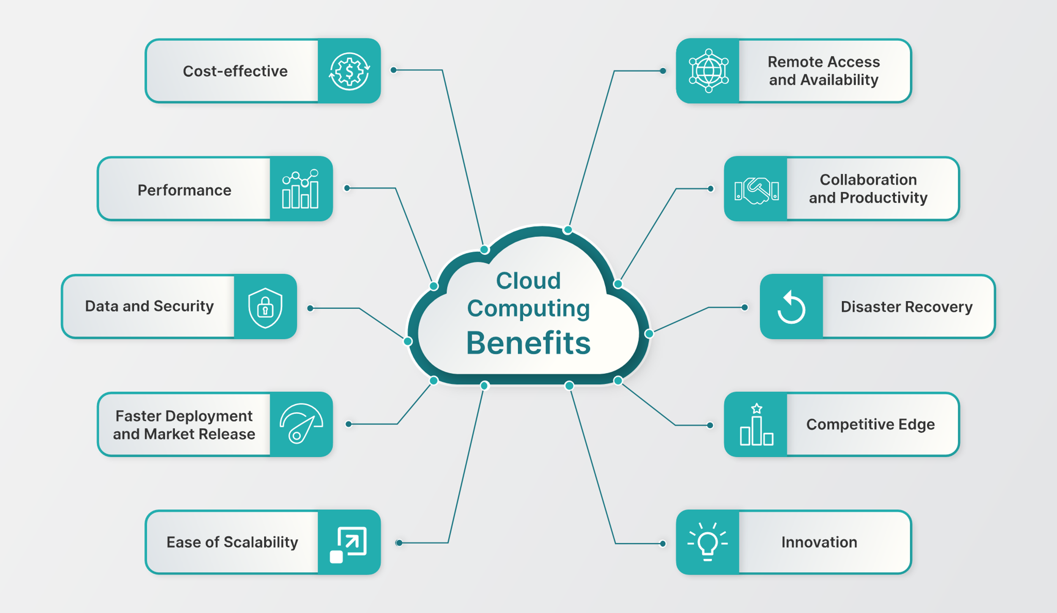
Let’s Understand Cloud

Slide 3
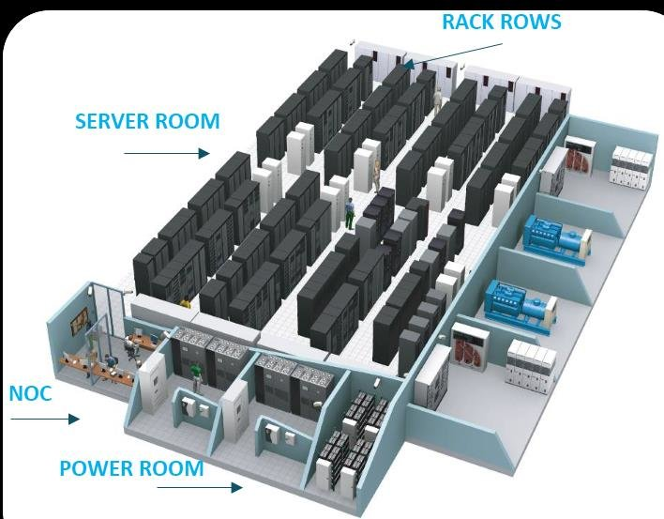
Why need of cloud is felt!!!

Slide 4
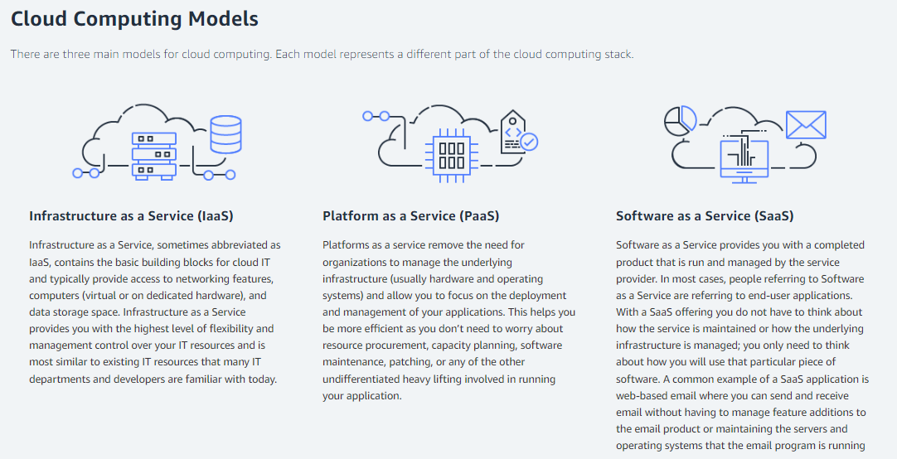

Slide 5
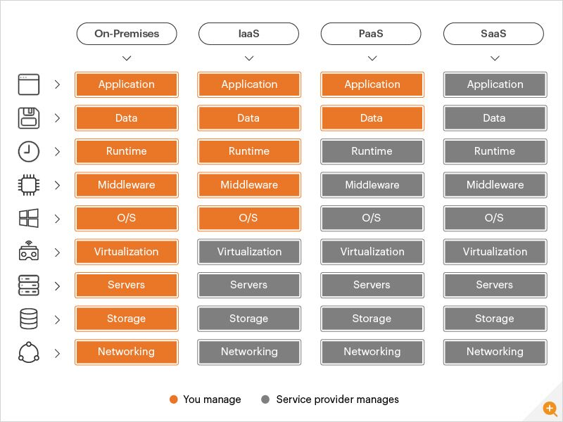
AWS Implementing the Cloud Models

Slide 6
Little History about AWS cloud
It was launched in 2002 internally at amazon.
In 2003 they expanded their infrastructure as their core strength.
In 2004 , Launched first public offering service SQS .
In 2006, Re-launched publicly with SQS , S3 & EC2.
In 2007, Went for global and launched in Europe.
Since the, They are growing their infra and offerings as a service for different domains.

Slide 7
Getting Started…..
AWS (Amazon Web Services) is the oldest player in the cloud market, comparatively has a bigger community support and user base as compared to other top contenders in cloud market like Microsoft Azure and Google cloud . Therefore, AWS has more high-profile and well-known customers like Netflix, Airbnb, Unilever, BMW, Samsung, MI, Zynga, etc.
AWS has revolutionized IT over time by offering 200+ services in different domains.
Some of the AWS provided offering in cloud models are :
-> Infrastructure as a Service
-> Platform as a Service
-> Software as a Service
-> Database as a Service
-> Function as a Service
-> Software as a Service

Slide 8
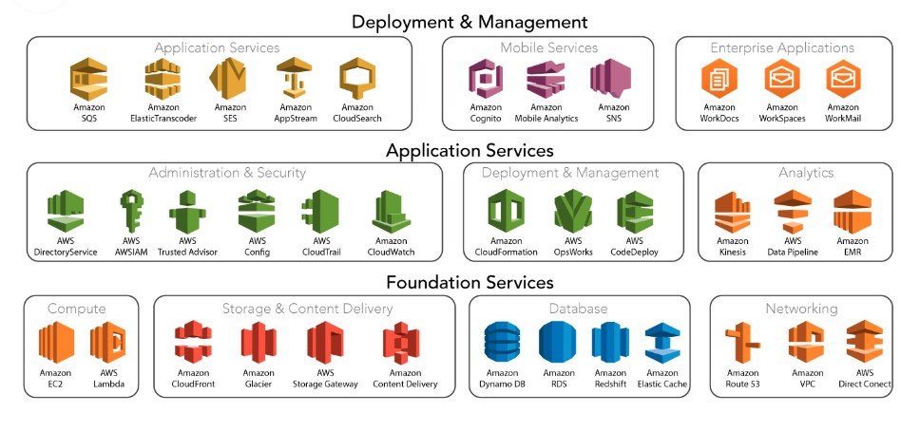
AWS Services Overview

Slide 9
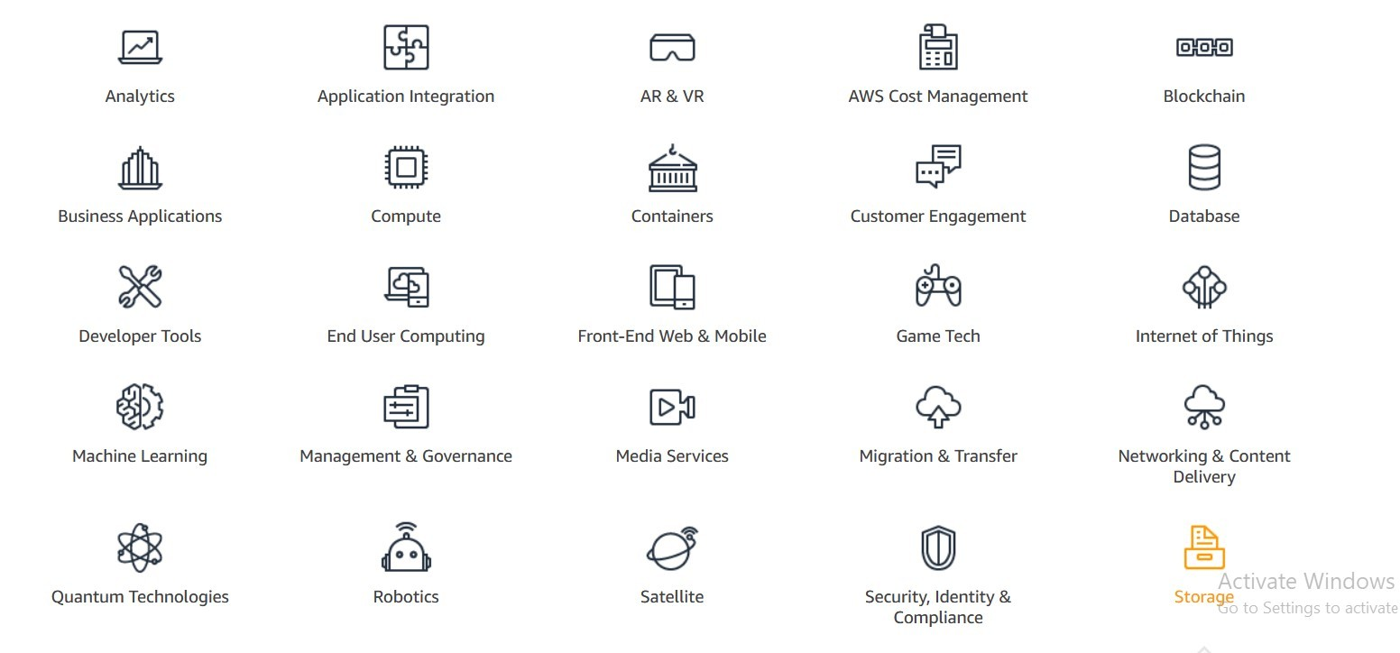
AWS Services Domains

Slide 10
AWS Big Clients
According to Intricately, the top ten AWS users based on EC2 monthly spend are:
Netflix: $19 million
Twitch: $15 million
LinkedIn: $13 million
Facebook: $11 million
Turner Broadcasting: $10 million
BBC: $9 million
Baidu: $9 million
ESPN: $8 million
Adobe: $8 million
Twitter: $7 million

Slide 11
AWS Carrer Path
AWS certifications typically followed a progression from foundational to associate to professional levels. The typical path for AWS certification was as follows:
AWS Certified Cloud Practitioner: This was the foundational-level certification designed for individuals who wanted to gain a broad understanding of AWS services.
AWS Certified Solutions Architect - Associate: focuse on designing scalable and highly available systems on AWS. It was recommended to have some hands-on experience with AWS services before attempting this certification.
AWS Certified Developer - Associate: This associate-level certification was oriented towards developers who work with AWS services.
AWS Certified SysOps Administrator - Associate: Individuals who wanted to focus on system operations and administration tasks in AWS environments.
AWS Certified Solutions Architect - Professional: This was a professional-level certification that built upon the knowledge tested in the associate-level Solutions Architect exam. It required a deeper understanding of AWS services and more hands-on experience.
AWS Certified DevOps Engineer - Professional: This professional-level certification was for individuals who specialized in implementing and managing continuous delivery systems and methodologies on AWS. It also built upon the knowledge from the associate-level certifications.

Slide 12
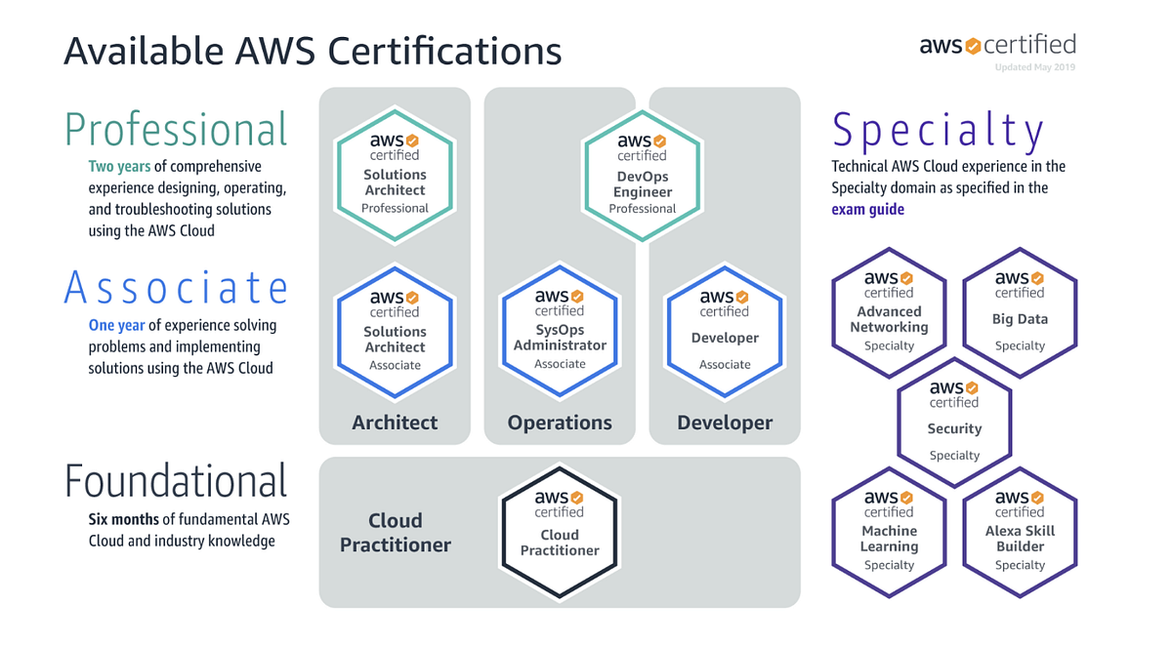

Slide 13
AWS Global Infrastructure
AWS infrastructure can be viewed as:
AWS Regions: Launched in 32 regions each with multiple Availability Zones (AZs).
Each Region is connected with a private network of AWS ensuring security and connectivity between them.
2. AWS Availability zones : 102 Availability Zones with each region containing 3 to 6 each isolated from each other but linked with a high bandwidth and ultra low latency network.
3. AWS Data centers : A region is cluster of data center.
4. AWS Edge Locations/ 550+ Points of Presence and 13 Regional Edge Caches: Content is delivered to end user with lowest latency possible.
Map View: https://aws.amazon.com/about-aws/global-infrastructure/regions_az/

Slide 14
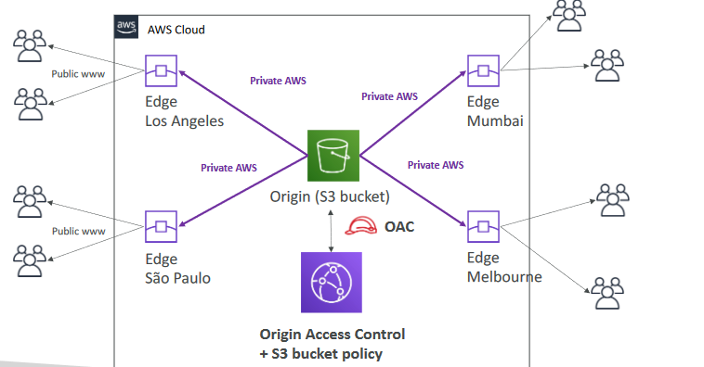
Edge Location Architecture

Slide 15
How to choose AWS Region
1. Compliance : Sometimes gov want data or application to be local within the country so launch in that region only where that compliance is applicable to.
2. Proximity: Deploy your application close to user to reduce latency.
3. Available Services: Your service should be available in your region.
https://aws.amazon.com/about-aws/global-infrastructure/regional-product-services/?p=ngi&loc=4
We can check whether a service is available in your region or not.
4. Pricing
https://aws.amazon.com/free/?nc2=h_ql_pr_ft&all-free-tier.sort-by=item.additionalFields.SortRank&all-free-tier.sort-order=asc&awsf.Free%20Tier%20Types=*all&awsf.Free%20Tier%20Categories=*all

