Slide 1
DA 204o: Data Science in Practice Course Project Presentation Predicting Employee Attrition Using Machine Learning
Chandan Kumar Singh, IISC, chandansingh@iisc.ac.in
Monika Tyagi, IISC, monikatyagi@iisc.ac.in
Mukesh Kumar Yadav, IISC, mukeshyadav@iisc.ac.in
Rishabh Mehrotra, IISC, rishabhmehro@iisc.ac.in

Slide 2

Problem Statement
The goal is to predict employee attrition, which is a critical issue for fast-growing organizations. Attrition, caused by resignation leads to economic and operational challenges, including recruitment and training costs. Using a predictive model, HR teams can take proactive steps to minimize turnover and improve workforce stability.
Key Idea :
Manual methods to predict attrition are time-consuming and lack accuracy .
Use machine learning models to analyze employee data and predict attrition.
Identifying employees likely to leave can help organizations take proactive measures.

Slide 3
Different Model and their f1- Score
Dummy Model
0.0%
Only predicts true class .Accuracy 72.4%
Logistic Regression 52.81%
Logistic Regression 56.5%
Logistic Regression 60.81%
Used features with high correlation only
Naïve Bayes
58%
Decision Tree
81.6 %
Random Forest 96.9%
Not used StandardScaler
Used StandardScaler
Not used any categorical variable
Used all columns

Slide 4
Can this help further improvement ? If one model is highly accurate, assembling with other model is unlikely to improve the overall accuracy.
Voting Classifier with F1 Score 93%
Soft Voting
DecissionTree Model with F1 Score 81 %
Random Forest with F1 Score 97 %
Voting Classifier with F1 Score 88%
Soft Voting
Logistic Model with F1 Score 60 %
Random Forest with F1 Score 97 %

Slide 5
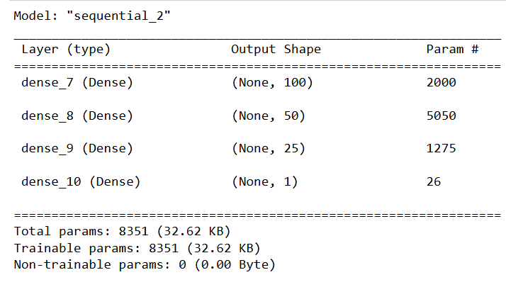
Can we improve using neural network ?
f1 score 91% in single try .
Accuracy reduces when we add more layer and number of neurons in each layer ( f1 reduces to 61% also )
Random forest is still best for our problem .
Even though using sigmoid at the output layer this will not give 0 and 1 directly .
Use (y_nn_pred > 0.6).astype(int) to get binary prediction .

Slide 6
Conclusion
HyperParameter tunning is important to improve the model . We have done GridSearchCv to do tunning of our model as our data was not that big .
Random forest : max_depth=16, n_estimators=162
Decision Tree : 'max_depth': 22, 'min_samples_leaf': 5, 'min_samples_split': 10
Exploring advanced techniques like ensemble models or deep learning could enhance predictive performance .
Feature selection based on correlation also helped us here .

Slide 7
Questions ?
Thank You !!

