Slide 1

DA 204o: Data Science in Practice Course Project Presentation Predicting Employee Attrition Using Machine Learning
Chandan Kumar Singh, IISC, chandansingh@iisc.ac.in
Monika Tyagi, IISC, monikatyagi@iisc.ac.in
Mukesh Kumar Yadav, IISC, mukeshyadav@iisc.ac.in
Rishabh Mehrotra, IISC, rishabhmehro@iisc.ac.in

Slide 2

Abstract
Employee attrition increases recruitment costs and disrupts organizational workflows. This presentation explores machine learning models for attrition prediction, using techniques to address class imbalance, feature selection, and hyperparameter tuning.

Slide 3

Problem Statement
The goal is to predict employee attrition, which is a critical issue for fast-growing organizations. Attrition, caused by resignation leads to economic and operational challenges, including recruitment and training costs. Using a predictive model, HR teams can take proactive steps to minimize turnover and improve workforce stability.
Key Idea :
Manual methods to predict attrition are time-consuming and lack accuracy .
Use machine learning models to analyze employee data and predict attrition.
Identifying employees likely to leave can help organizations take proactive measures.

Slide 4
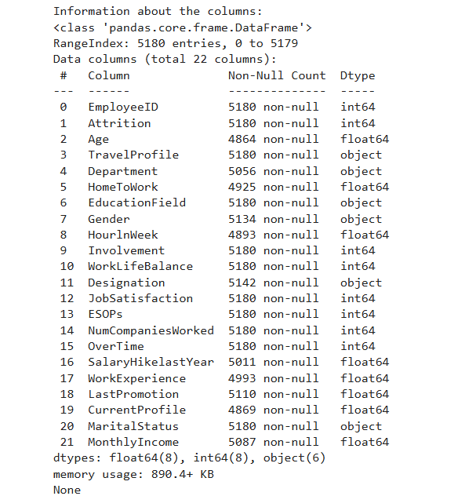
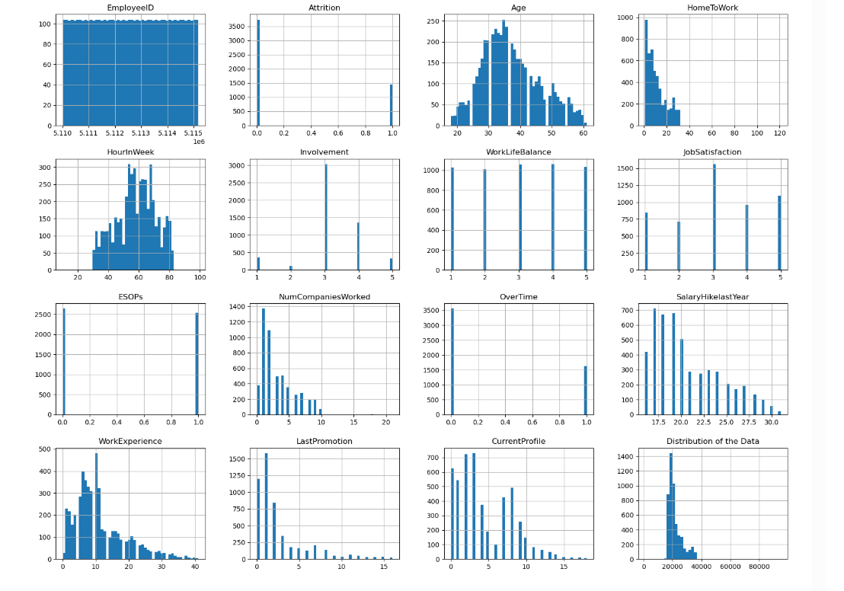
Know the Data

Slide 5
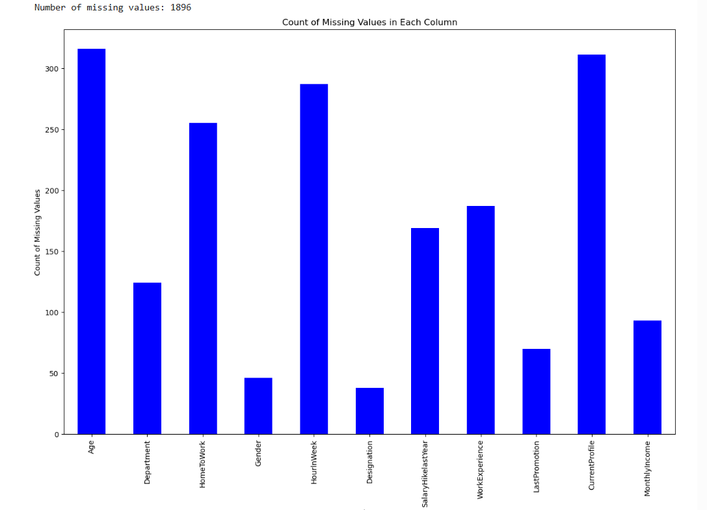
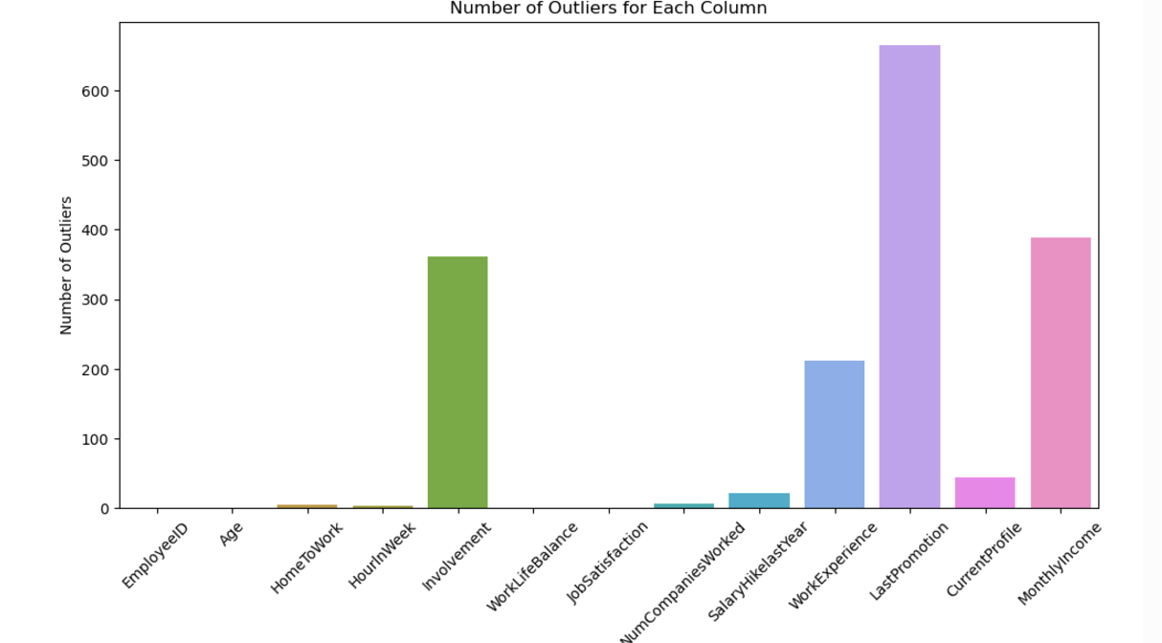
Handle outliers and Missing Values

Slide 6
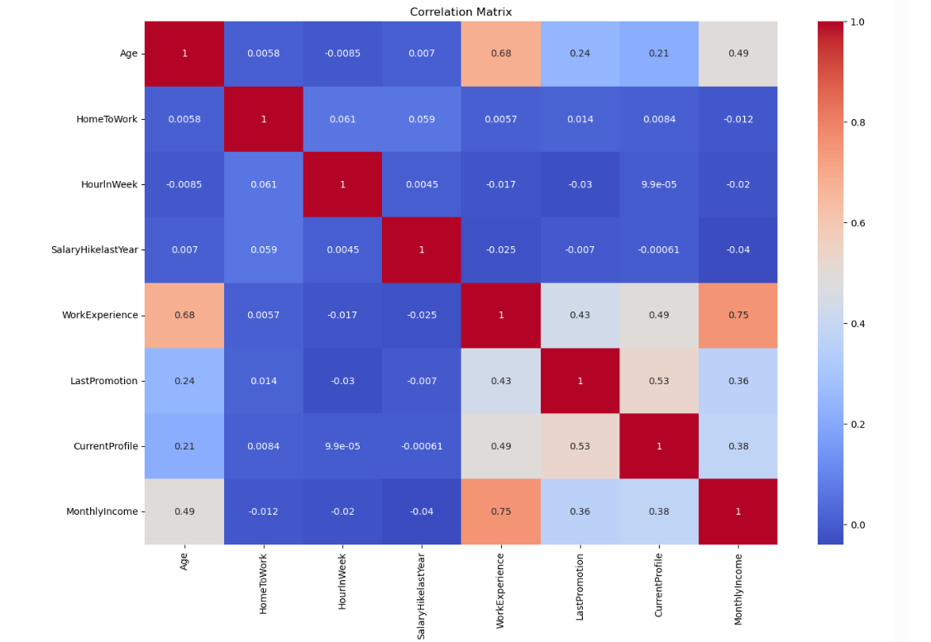
Correlation

Slide 7
Hyperparameter Tunning
We have done GridSearchCv to do tunning of our model as our data was not that big .
Random forest : max_depth=16, n_estimators=162
Decision Tree : 'max_depth': 22, 'min_samples_leaf': 5, 'min_samples_split': 10

Slide 8
Different Model and their f1- Score
Dummy Model
0.0%
Only predicts true class .Accuracy 72.4%
Logistic Regression 52.81%
Logistic Regression 56.5%
Logistic Regression 60.81%
Used StandardScaler
Naïve Bayes
58%
Decision Tree
81.6 %
Random Forest 96.9%
Not used StandardScaler
Used StandardScaler
Used categorical variable as well
Used numerical columns
Used features with high correlation only

Slide 9
Can this help further improvement ? If one model is highly accurate, assembling with other model is unlikely to improve the overall accuracy.
Voting Classifier with F1 Score 93%
Soft Voting
Decision Tree Model with F1 Score 81 %
Random Forest with F1 Score 97 %
Voting Classifier with F1 Score 88%
Soft Voting
Naïve Bayes with F1 Score 58 %
Random Forest with F1 Score 97 %

Slide 10
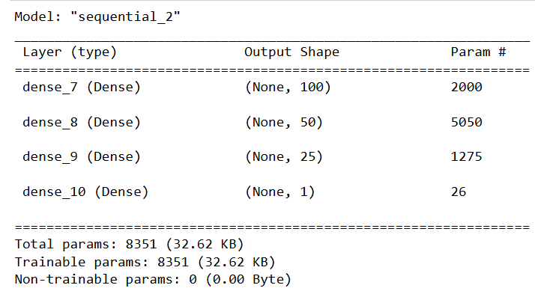
Can we improve using neural network ?
f1 score 91% in single try .
Accuracy reduces when we add more layer and number of neurons in each layer ( f1 reduces to 61% also )
Random forest is still best for our problem.
Even though using sigmoid at the output layer this will not give 0 and 1 directly .
Use (y_pred > 0.6).astype(int) to get binary prediction .

Slide 11
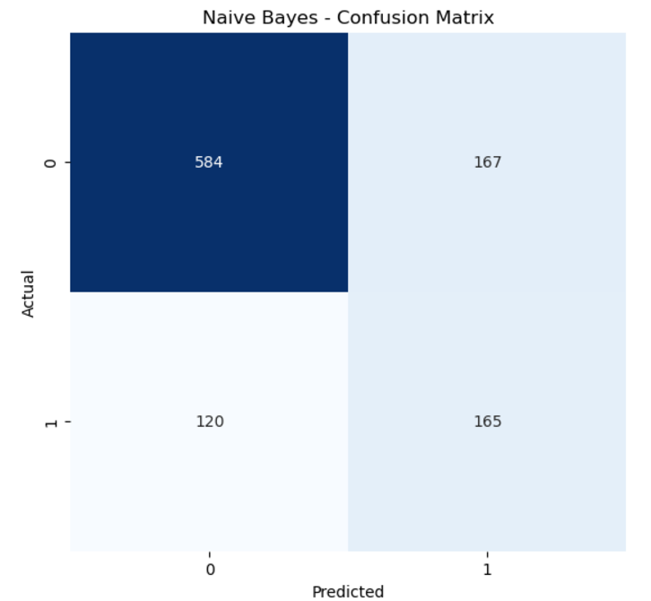
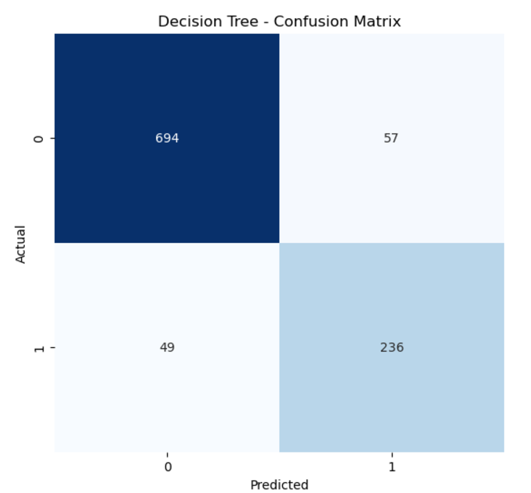
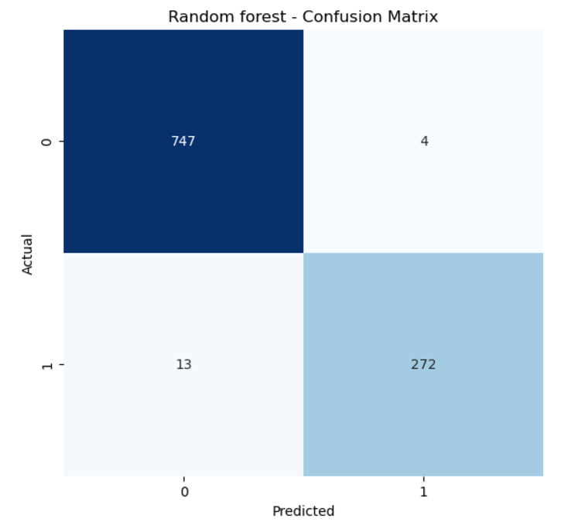

Slide 12

Deployment Summary for Employee Attrition Web Application
Current State:
Local deployment for Front-End (FE) and Back-End (BE) services.
Accessible via tunneling tools for testing and development.
Future Plan:
Cloud Deployment:
Target platforms: AWS, Azure, or Google Cloud.
Goals: High availability, scalability, and secure access.

Slide 13
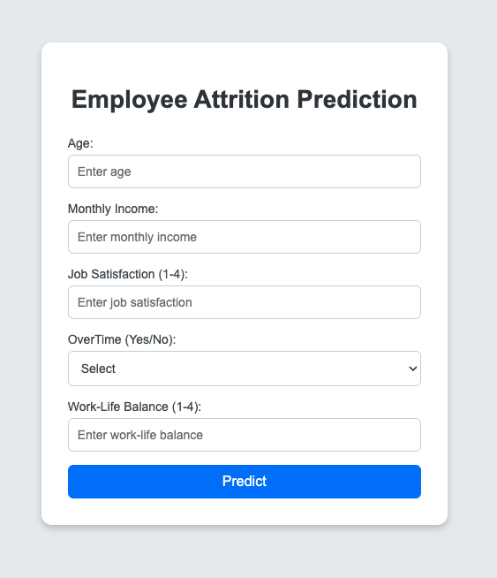

Slide 14
Conclusion
Feature selection based on correlation also helped us here .
Data Cleaning also helps improve the model .
Hyper Parameter tunning is important to improve the model .
Exploring advanced techniques like ensemble models or deep learning could enhance predictive performance but not always not to jump directly on them .

Slide 15
Data Science Canvas |  |  | Project: | Employee-Attrition-Prediction
 |  |  | Team: | Chandan, Monika, Mukesh and Rishabh
Problem Statement |  |  |  | Execution & Evaluation |  | Data Collection & Preparation
Business Case & Value Added The business case involves predicting employee attrition to enable proactive retention strategies. This adds value by reducing recruitment costs, improving workforce stability, and increasing employee satisfaction. | Model Selection Analysis methods include Random Forest (for feature importance and accuracy), Decision Tree (for interpretability), and Naive Bayes (as a baseline). Random Forest has shown the highest accuracy in the current setup. | Model Requirements The model requires clean, balanced data with imputation for missing values. Features must be encoded for categorical variables, and proper hyperparameter tuning is essential for generalization. | Skills Skills required include data preprocessing, feature engineering, machine learning model training, and performance evaluation. Familiarity with Python and scikit-learn is essential. | Model Evaluation Key metrics include accuracy, F1-score, and confusion matrix to evaluate the model. Regular quality checks and periodic retraining with updated data ensure reliability. Real-time monitoring is unnecessary unless the system goes live. | Data Storytelling Results must be communicated through visuals like bar charts for feature importance and confusion matrices for accuracy. Tailor the story to HR professionals by focusing on actionable insights, like high-risk employees or factors influencing attrition. | Data Selection & Cleansing Relevant data includes job satisfaction, work-life balance, salary, and demographic information. Missing values in Age, Department, and Monthly Income need imputation. Outliers in numeric columns, like Home To Work, require handling. | Data Collection Additional data, such as employee feedback surveys or external market trends, can be collected through surveys or web scraping. This data should align with current features and be normalized.
Data Landscape The dataset includes 22 features such as demographics, job satisfaction, work-life balance, and income. It is sufficient for initial analysis. Additional data, like employee feedback or external market factors, could enhance the model. |  | Software & Libraries Python is used with libraries like pandas, NumPy, scikit-learn (for modelling), matplotlib, and seaborn (for visualization). These are standard tools for predictive modelling. |  |  |  | Data Integration Data from various sources, such as internal HR systems and surveys, should be integrated into a unified format (e.g., CSV or a relational database) for analysis. | Explorative Data Analysis Are there outliers or structures to be considered? Creation of descriptive key figures for the first assessment of the data.
Adopted from: https://github.com/tomalytics/datasciencecanvas

Slide 16
Questions ?
Thank You !!

