Slide 1

Grid optimization with weather
DA 231o Data Engineering at Scale Course Project Presentation
Chandan Kumar Singh, IISC, chandansingh@iisc.ac.in
Monika Tyagi, IISC, monikatyagi@iisc.ac.in
Mukesh Kumar Yadav, IISC, mukeshyadav@iisc.ac.in
Rishabh Mehrotra, IISC, rishabhmehro@iisc.ac.in

Slide 2
Problem Definition
The project aims to optimize the energy grid by forecasting electricity demand using historical weather data and power consumption patterns. Accurate forecasting enables better grid management, reduces energy waste, and balances demand-supply distribution.

Slide 3
Data Collection and Challenges
Data Source: Open Weather provides different APIs to pull weather data. Attempted to collect bulk weather data from OpenWeatherMap API using Python for the past 45 years.
Challenges:
Data retrieved contained only a few unique timestamps due to subscription limitations.
Unable to find real weather data through alternative sources.
Solution:
Created a Python utility to generate 2GB of synthetic data, simulating the typical response from OpenWeatherMap API.

Slide 4

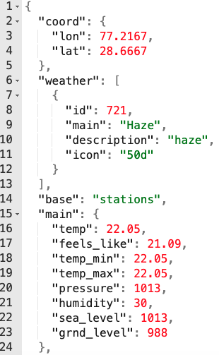
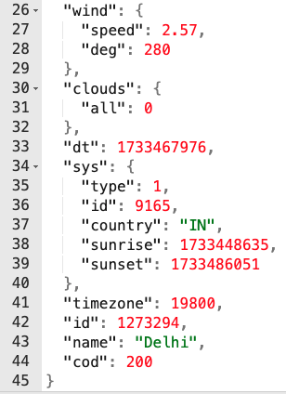
OpenWeatheMap API used to get weather data
Request:
Response:

Slide 5
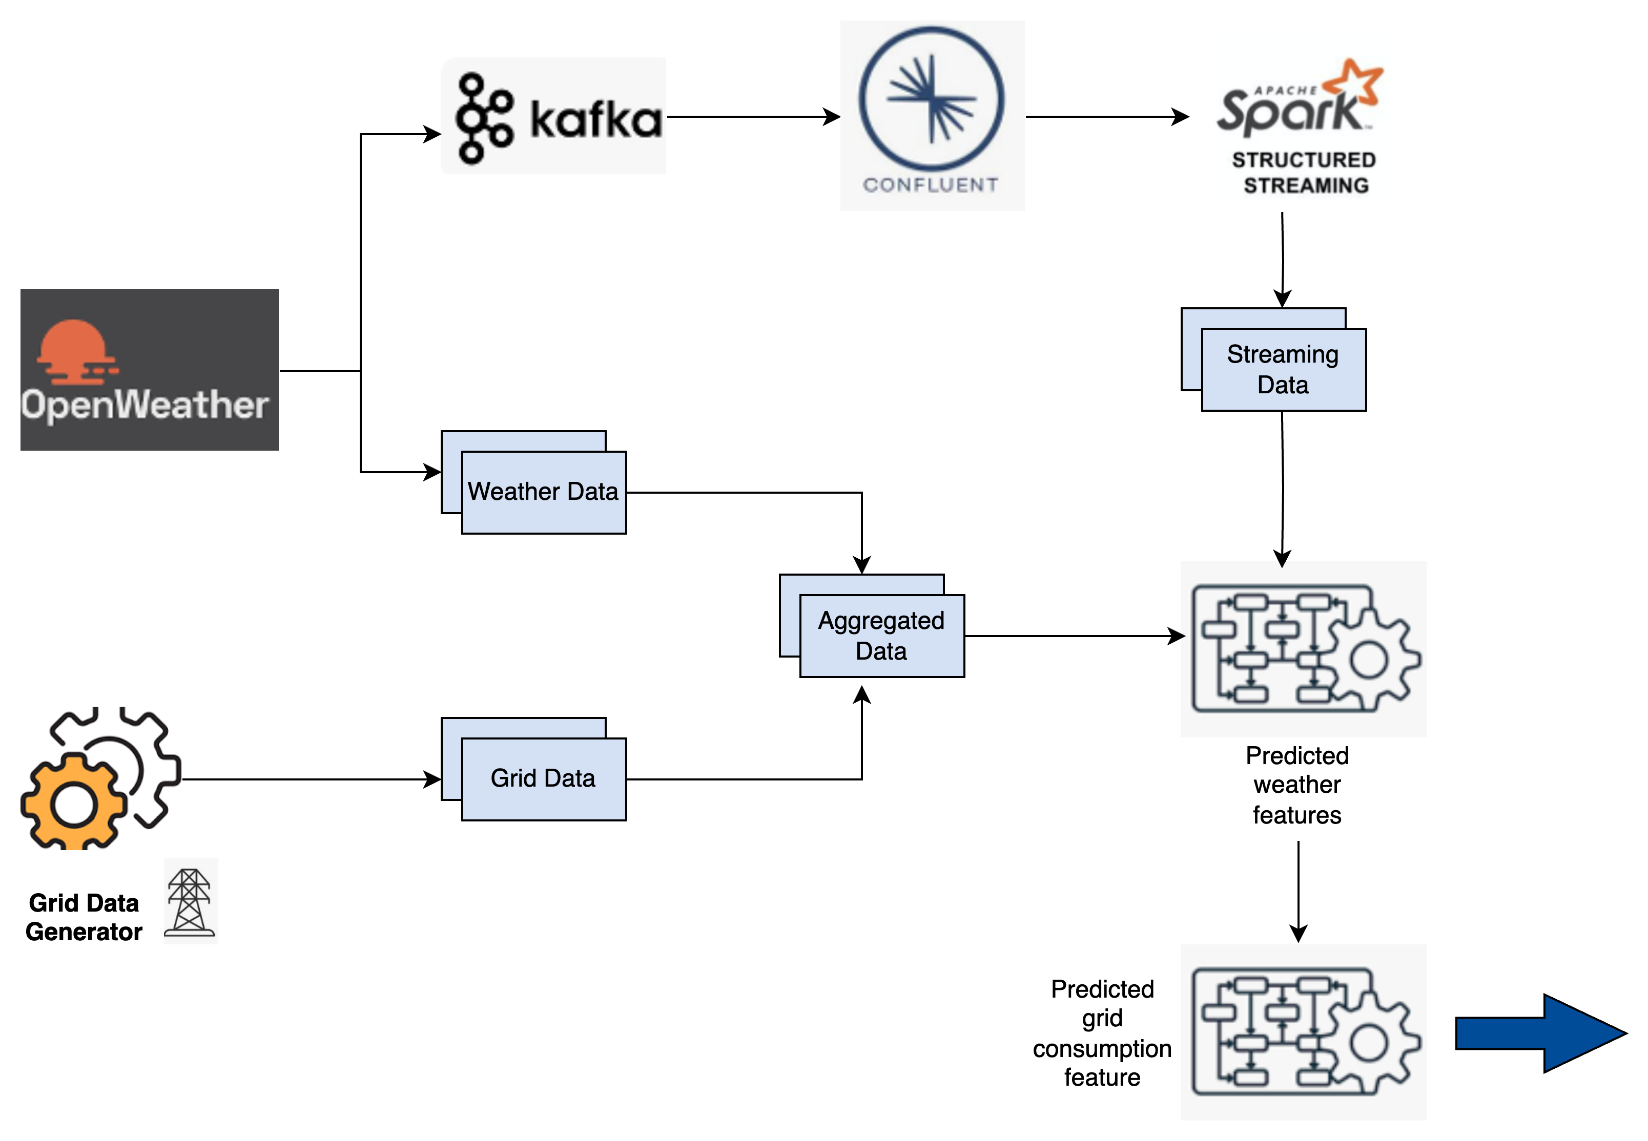

Slide 6
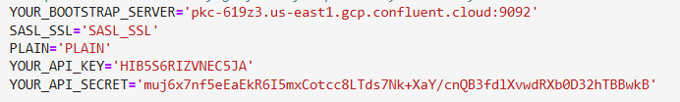
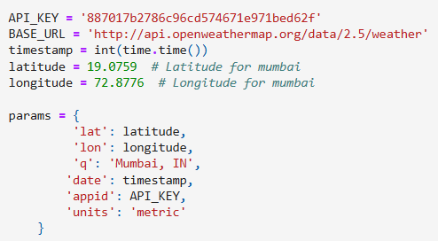

Kafka to load data to Topic
Git Code Repo :Link
hit openweater API each timestamp with below parameter :
Kafka Config :
from confluent_kafka import Producer
Producer send data to topic- ‘weather_0’
Create topics state wise . ( help scale)

Slide 7
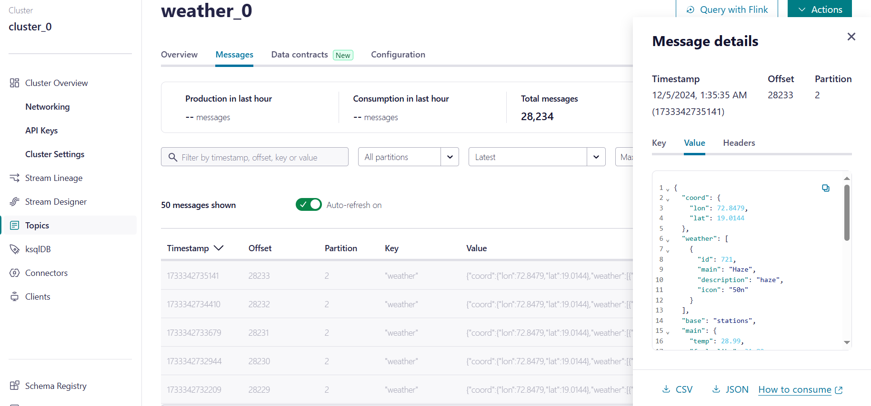
It Actually start sending data to weather_0

Slide 8
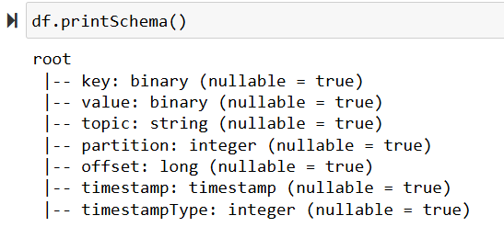
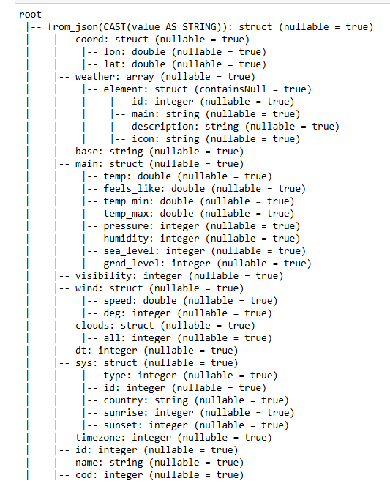
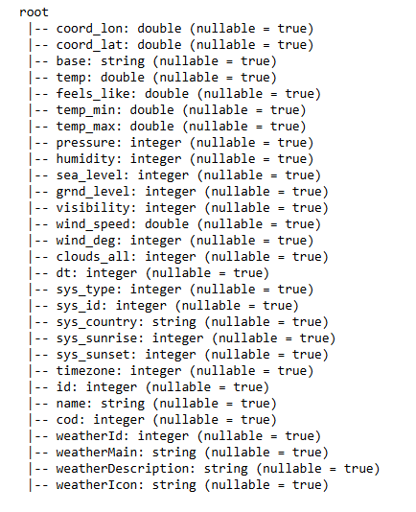
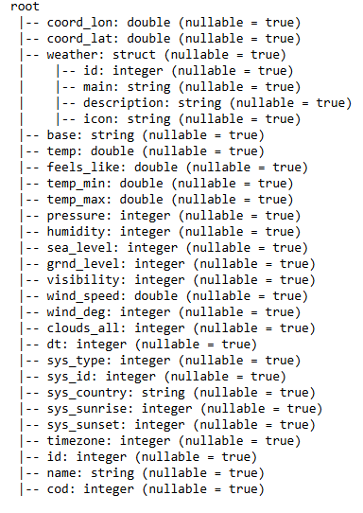

Slide 9
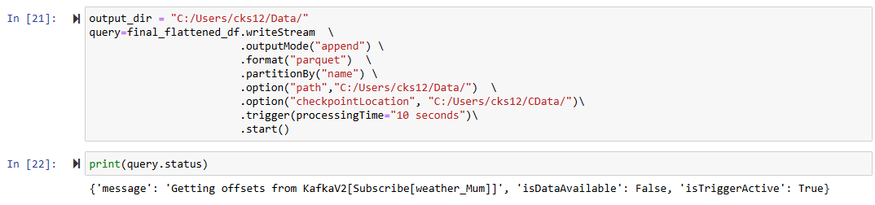
Read data from topic using spark streaming
While reading using format parquet ( help scale)
Also partition by city name ( help scale)
Git Code Repo :Link

Slide 10
Problem faced
Solution to the Problem
Failed to create new KafkaAdminClient
getting error -Py4JJavaError: An error occurred while calling o39.load.
Main Data was stored only in value .
While creating spark session set jar config("spark.jars.packages", "org.apache.spark:spark-sql-kafka-0-10_2.12:3.2.0,org.apache.kafka:kafka-clients:3.5.2") \
Also pass right Kafka bootstrap.servers and kafka topic while spark.readStream
Cast value to string and then use from_jsom to take Json data and use explode to flatten the json

Slide 11





Grid Data Weather Data
Missing Values
Missing Values Check: We analysed both datasets (electricity and weather) to ensure data completeness.
Observation: No missing values were found in any columns, indicating that both datasets are complete and ready for further preprocessing.
Significance: Accurate data is critical for reliable forecasting models, and this step validates the integrity of our datasets.

Slide 12
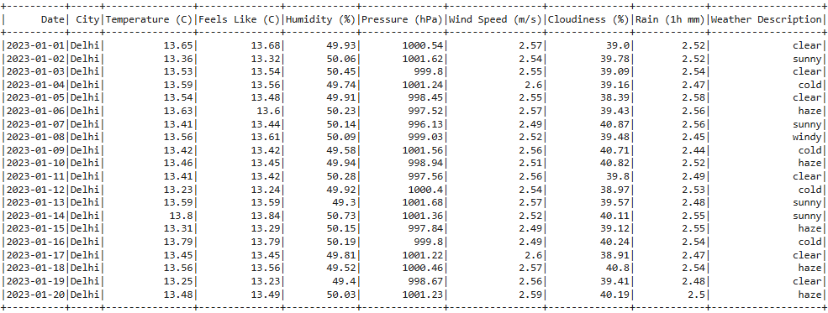
Aggregation Approach
1. Numerical Feature Aggregation:
Calculated the average for all numerical features (e.g., Temperature, Humidity).
2. Categorical Feature Aggregation:
Applied mode operation to find the most frequent value for categorical features (e.g., Weather Description).
Result: Transformed minute-wise data into a single record for each day, simplifying the dataset.

Slide 13
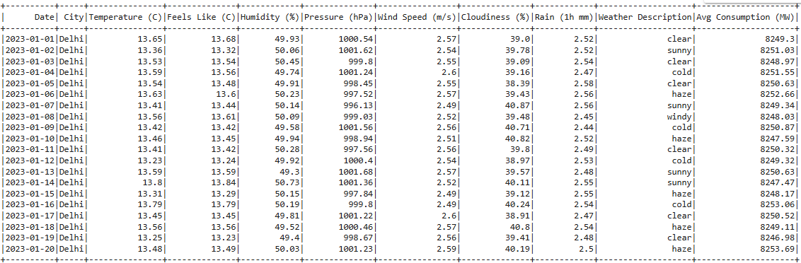
Merging Approach
1. Merging Data Frames:
Merged weather and electricity datasets based on the 'Date' column.
2. Cleaning the Data:
Removed one redundant 'City' column to avoid duplication
Result: Combined dataset ready for further analysis.

Slide 14
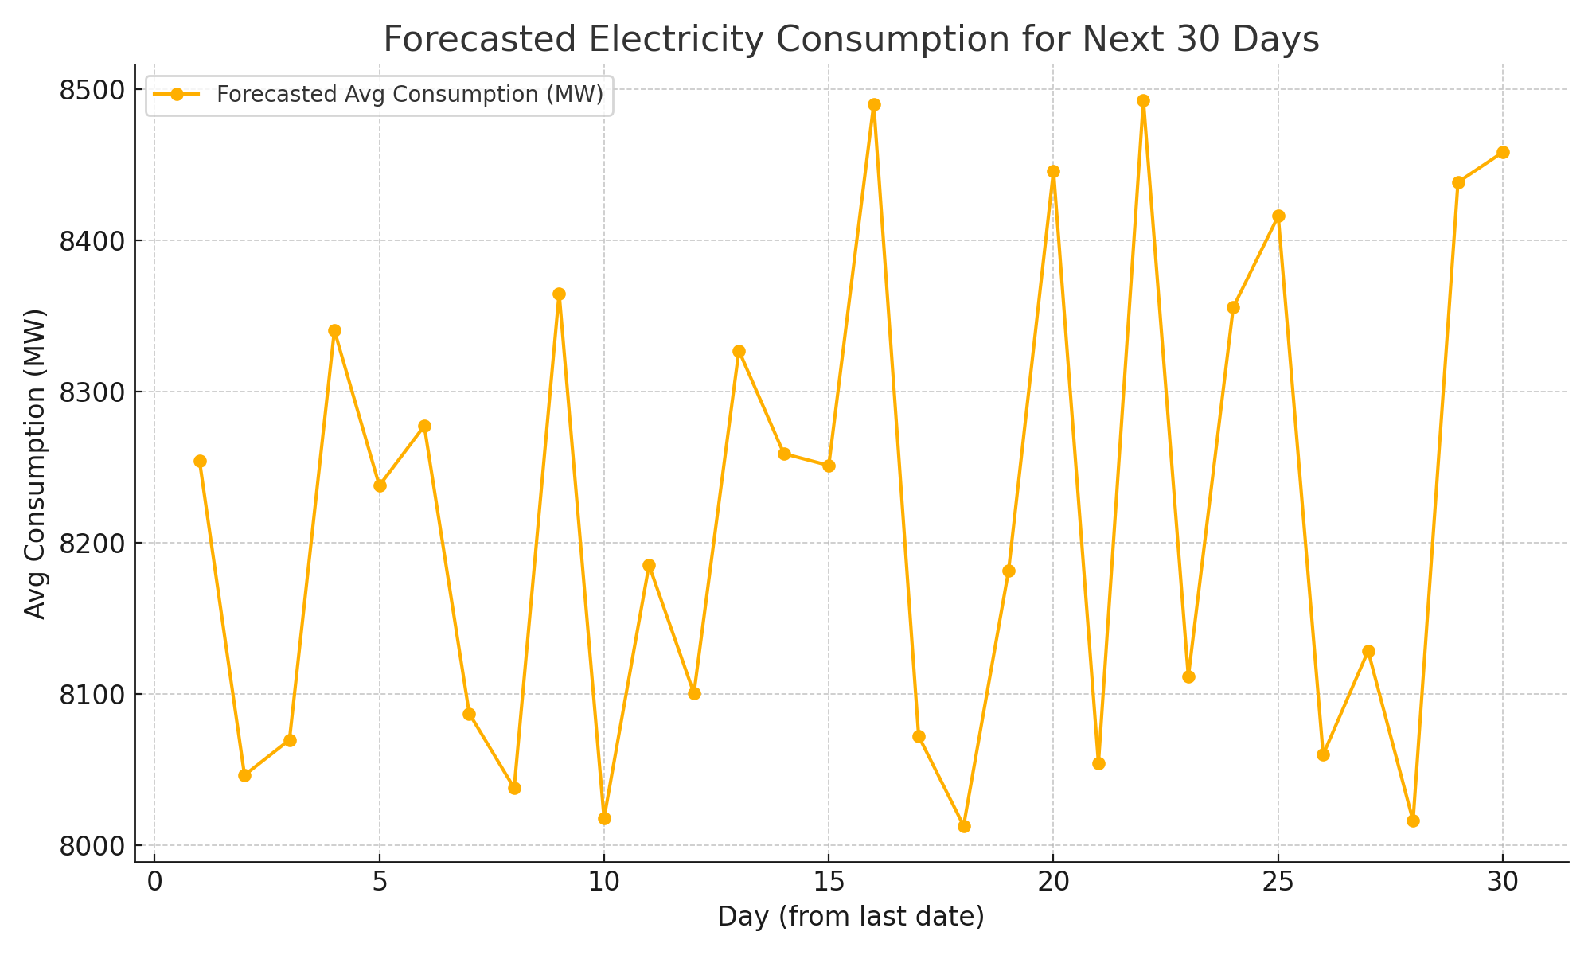
Forecasting Model Overview
1. Historical Data Preparation:
Data includes features like Temperature, Humidity, Wind Speed, and Consumption.
Target variable: Avg Consumption (MW).
2. Model Training:
Split historical data into Train (80%) and Test (20%).
Trained Gradient Boosted Tree (GBT) Regressor.
3. Forecasting:
Generated future dates and derived features (e.g., Year, Month).
Predicted Avg Consumption for the next 30 days using trained model.

Slide 15
LSTM time series Model
Git Code Repo: Link
Used tensorFlow as spark doesn’t have LSTM avlb in it’s ml library, Future scope to try running same code using tensorFlowonspark as that is available to handle scale.
Convert spark dataframe to panda for making date as index as didn’t find anything in spark for the same.
Used TimeseriesGenerator to get data which we can input to model with multivariant analysis of temp and grid.

Slide 16

1
2
3
1
2
3
4
n

Slide 17
1
2
3
P
1
2
3
n

Slide 18
1
2
3
P
P
1
2
3
n-1
n
Replace P with Original Data coming from spark stream

Slide 19
Deployment Summary for Grid Consumption Prediction Web Application
Current State:
Local deployment for Web application services.
Accessible via tunneling tools for testing and development.
Future Plan:
Cloud Deployment:
Target platforms: AWS, Azure, or Google Cloud.
Goals: High availability, scalability, and secure access.

Slide 20
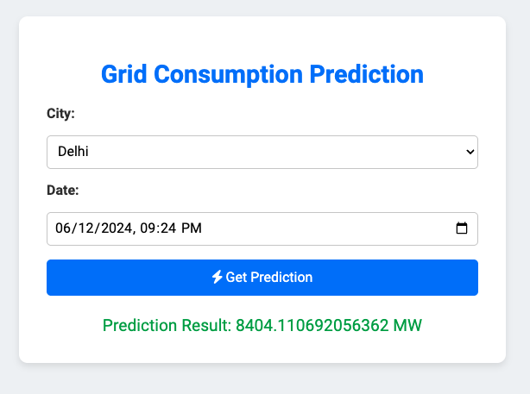

Slide 21

Demo

Slide 22
Conclusion
The integration of weather forecasting and big data analytics for energy grid optimization shows promise in addressing current energy management challenges by providing reliable, scalable, and efficient energy demand forecasts.

Slide 23

Questions ?
Thank You !!

