Slide 1
Separate Compilation of Hierarchical Real-Time Programs into Linear-Bounded Embedded Machine Code
Daniel IERCAN
“Politehnica” University of Timisoara
Arkadeb GHOSAL, UC Berkeley
Christoph KIRSCH, University of Salzburg
Thomas HENZINGER, EPFL
Alberto SANGIOVANNI-VINCENTELLI, UC Berkeley
APGES – October 4th, 2007, Salzburg

Slide 2
Introduction
Linear-bounded target code as parallelism and hierarchy of real-time program are increased
Modular compiling algorithm
Notes:
In this paper we have presented a way of compiling hierarchical real-time programs while maintaining two key features:
- linear bounded code size is as parallelism and hierarchy increases (I will explain on my next slide what I mean by this)
- the compiler algorithm is modular, which means that we can cut the input program into pieces and compile it separately

Slide 3
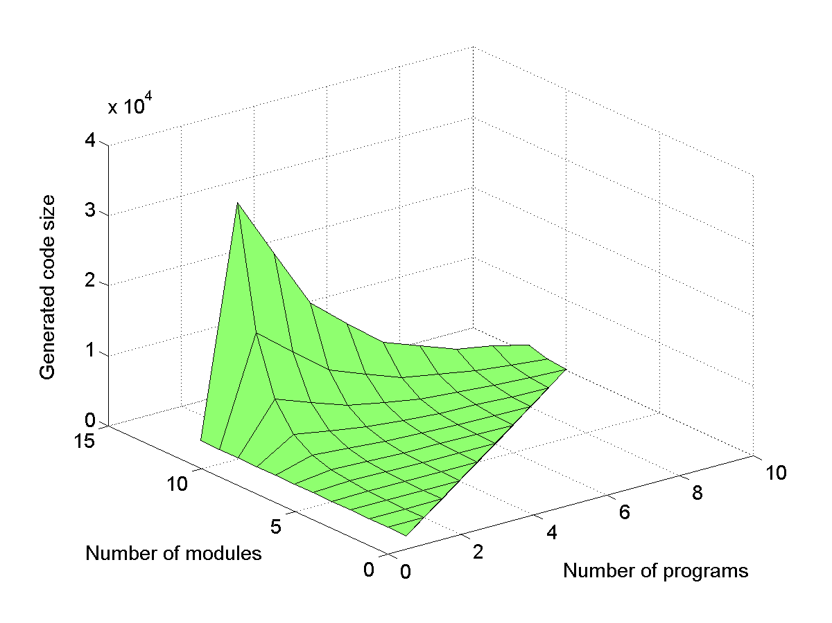
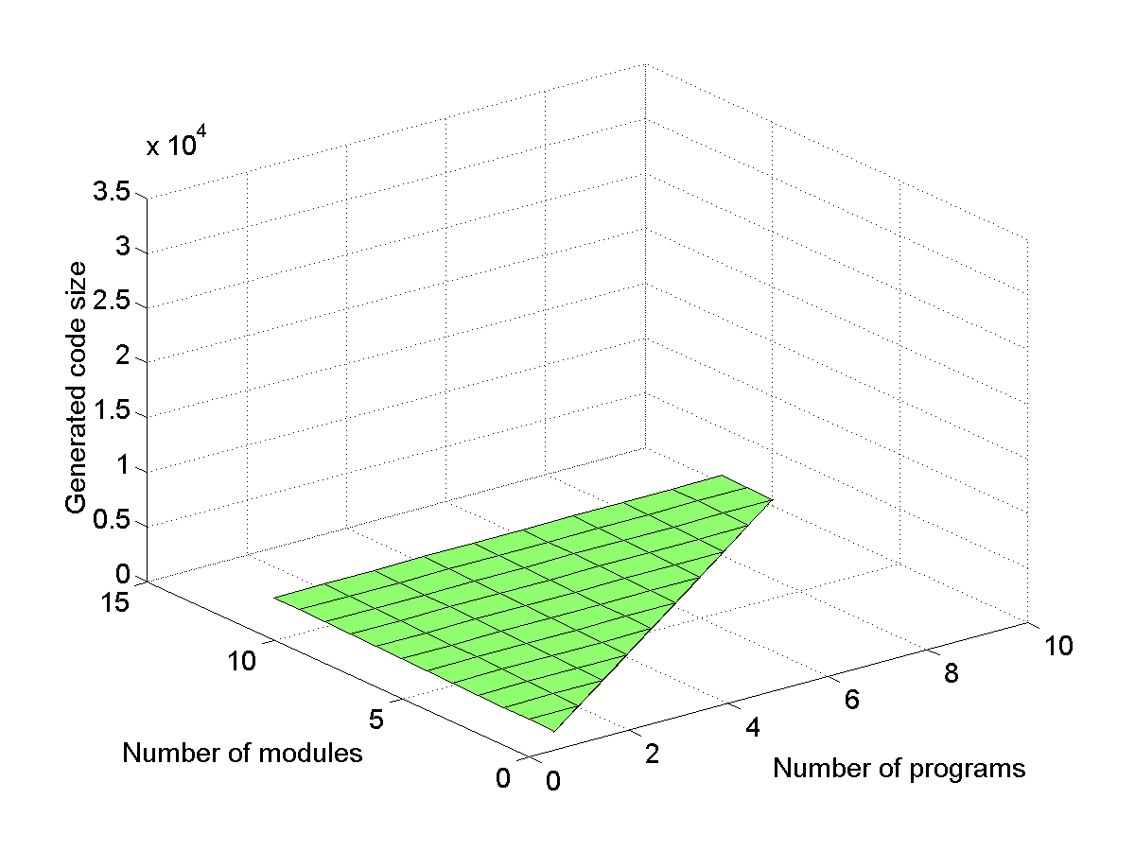
Flat vs. Hierarchical Compilation
Flat
Hierarchical
Notes:
We will see on this slide what I mean by linear bounded in size and what are the limitation of the flat compiler from this point of view
When compiling an hierarchical real-time program, there are two possible solutions:
Flattening the hierarchical program and the compile the resulting flat program
Directly compile the hierarchical program
First method has the advantage of being simpler but it also has two important disadvantages, i.e., the size of the generated code increases exponentially with the degree of parallelism, and it is impossible to design a flat modular compiler
Second method trades of runtime performance (i.e., a program which was flatten and then compile will run faster than one that was hierarchically compiled), in order to achieve separate compilation and generation of code which is linear bounded in size.
We can see on this chart what happens when a Flat Compilation technique is used.
On the X axe it is plotted the number of modules, which represents the degree of parallelism in a real-time program.
On the Y axe it is plotted the number of programs, which represents the degree of hierarchy (hierarchy means that we have means of specifying an abstract timing configuration of a real time program, which is further refined by concrete timing configurations) in a real-time program.
On the Z axe it is plotted the size of the generated code.
One can easily see that as the degree of parallelism increases linearly, the size of generated code increases exponentially, this is due to the fact that a flat compiler has to generate code for all possible combinations. On the other side if the degree of hierarchy increases linear, then the size of generated code increases laniary too.
On this chart we can see that if a Hierarchical compiler is used then the size of generated code increases laniary both if the degree of parallelism and the degree of hierarchy increase.
In the following slides I will describe how flat and hierarchical compilation works

Slide 4
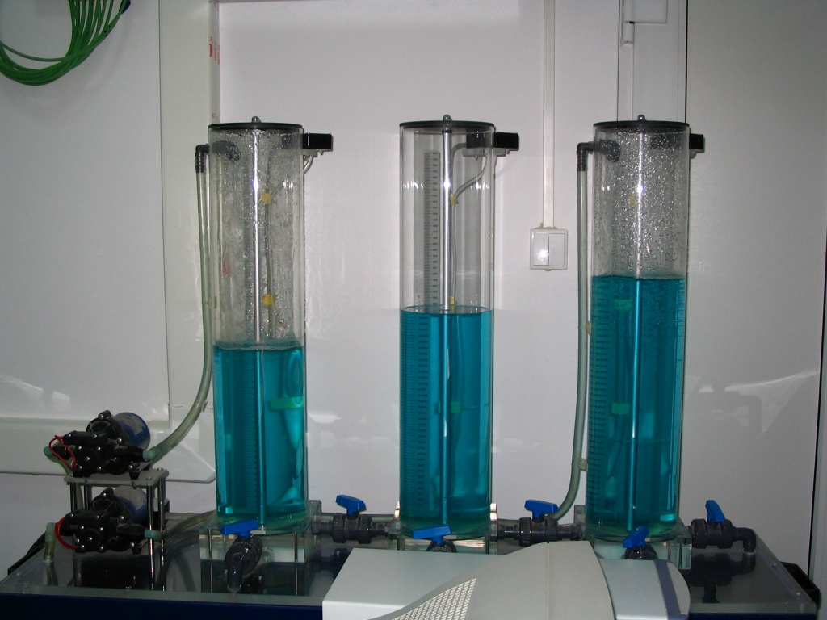
Case Study
T1
T3
T2
P1
P2
Perturbation Taps
Interconnection Taps
Notes:
As a case study we have choose the Three Tank System (further referred as 3TS). The plant consists of three interconnected tanks (T1, T2, and T3).
Tanks T1 and T2 are connected to two pumps P1 and P2 respectively.
There are two interconnection taps (between T1 and T3, and T2 and T3).
And four perturbation taps, one for each tank, except that for T2 there are two such taps.

Slide 5


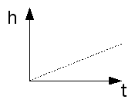
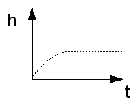

Controller Design
No Perturbation => I
No Perturbation => PT1
P controller
PI controller
T1 – P controller || T2 – P controller
T1 – P controller || T2 – PI controller
T1 – PI controller || T2 – P controller
T1 – PI controller || T2 – PI controller
Notes:
The goal of the controller is to maintain a constant level of the water in tanks T1 and T2.
In order to accomplish we have used two controllers one to control pump P1 and the other one control pump P2.
If there is no perturbation in a tank then it behaves like an integrator, thus in this situation we need a P controller
If there is perturbation in a tank then it behaves like a PT1, thus in this situation we need a PI controller
Since for the 3TS we have to control two tanks then there are four possibilities: both for T1 and T2 we use a P controller, for T1 we use a PI controller and for T2 we use a P controller ….

Slide 6
One Tank System Controller (Hierarchy)
Functionality
Flat Code
controller
Code 1a
Code 1b
0: release(P)
1: future(500, 0)
2: return
3: release(PI)
4: future(500, 3)
5: return
P
PI
Timing
Hierarchical Code
h
controller
pump
Code 2a
Code 2b
t
0: release(P)
1: future(500, 0)
2: return
3: release(PI)
4: future(500, 3)
5: return
500
Logical Execution Time = 500
Notes:
Next I will present what is the functionality and the timing of a possible implementation of a controller for One Tank System, I will also present the generated code for both the flat and hierarchical compiler.
If there where only one tank, then functionality of the real time program that implements the controller would look like:
At any time there is only one controller task, which in particular can be either the P controller or the PI controller. In this example “controller” task is an abstract tasks while the “P” and the “PI” are the concert implementations of the “controller” tasks
The timing of the program would be:
- controller task reads at the beginning of the period the height of the water in one tank and at the end of the period updates the command given to the pump.
The controller tasks has a period of 500 time units and a LET still of 500, which means that the task will be released for execution at the beginning of those 500 time units, but in realty it is not necessary to be executed right away, it just has to execute some time between reading of the height sensor and writing the pump.
On this diagrams I have not plotted P and PI tasks since the controller task acts from the timing point of view as a place holder for one of this two tasks. The controller tasks will never executes instead either P task or PI task will execute. If we limit P and PI to have a smaller WCET then the controller tasks then it is enough to check that controller tasks is schedulable on a given platform in order to say that the entire program is schedulable on that platform.
We can see now the code that would be generated if a flat compilation algorithm is used, the controller program would be flatten, thus no code will be generated for “controller” tasks, only for P and PI tasks. The code that I present here contains only the instructions that do the release and those that are needed to implement the timing, I have omitted the instruction that do the IO and these that are used for switching from one piece of code to the other, in order to make the code easy to be understood.
The RELEASE instruction, releases a task for execution.
The FUTURE instruction, places a trigger in a trigger queue, which when will get enabled will cause the code at the specified address to be executed by the virtual machine.
The return instruction places the virtual machine in a waiting state, only when a trigger gets enable the virtual machine will leave this state
In the left you can see the code generated for P task while in the right is the task generated for task PI, the execution will switch between this two pieces of code based on some conditions.
Now we can see the generated code by an hierarchical compiler. As you can see there is no difference between the falt and hierarchical compiler when only Hierarchy exists into a program, but as we can see in the next two slides this will change when there is both hierarchy and parallelism in the program.

Slide 7
Three Tanks System Controller (Parallelism)
Functionality
controller_1
controller_2
P_1
PI_1
P_2
PI_2
Timing
h_1
controller_1
pump_1
h_2
controller_2
pump_2
t
500
Logical Execution Time = 500
Notes:
Now if we come back to the Three Tanks System controller then the controller for this plat would consists of the controller that controls tank T1 running in parallel with the controller that controls tank T2.
The timing of the program consists of:
Controller task for T1 reads sensor h1 at the beginning of period and updates pump1 at the end of period
Controller task for T2 reads sensor h2 at the beginning of period and updates pump2 at the end of period
Both controller_1 and controller_2 have a LET to 500 ms, which mean that they can execute in any order in this 500 time units.
In order to see if the entire program is schedulable we just have to check if controller_1 can be run in paralel with controller_2

Slide 8
Code Generation
Flat Code
Hierarchical Code
Code 1a
Code 1b
Code 2a
Code 2b
0: release(P_1)
1: release(P_2)
2: future(500, 0)
3: return
8: release(P_1)
9: release(PI_2)
10: future(500, 8)
11: return
0: release(P_1)
1: future(500, 0)
2: return
6: release(P_2)
7: future(500, 6)
8: return
Code 1c
Code 1d
Code 2c
Code 2d
4: release(PI_1)
5: release(P_2)
6: future(500, 4)
7: return
12: release(PI_1)
13: release(PI_2)
14: future(500, 12)
15: return
3: release(PI_1)
4: future(500, 3)
5: return
9: release(PI_2)
10: future(500, 9)
11: return
T1 controller
T2 controller
Notes:
Flat compiler generates code for all possible combinations while the hierarchical compiler generates e code for a task only once and relies on runtime support to run the pieces of code in parallel.
Now if we think that for each task it is need code that does the sensors reading and actuators update we can easily see why code generated by a Flat compiler grows exponentially in size as parallelism increases, while code generated with a hierarchical compiler only growth laniary.

Slide 9
Worst Case Code Size Comparison
 | Hierarchy Level = 10 Number of Modules = 12 Number of Switches = 2 | Hierarchy Level = 8 Number of Modules = 8 Number of Switches = 3
Flat Compiler | 32777 | 43756
Hierarchical Compiler | 645 | 747
Notes:
Here you can see a comparison between the two compiler algorithm from the point of view of the generated code size worst case.
In the first situation the maximum degree of hierarchy is 10, the maximum degree of Parallelism is 12 and the number of switches possible at each level in the hierarchy is 2, while in the second case we have a maximum degree of hierarchy of 8, a maximum degree of parallelism of 8 and the number of switches at each level is 3.
We have generated all the possible programs for this configurations, we have compiled them using both the Flat and Hierarchical compiler and we have computed the maximum number of instructions that was generated.
We can see here that the size of the generated increases exponentially when a flat compiler is used, and the value of the base of the exponential function is higher as the number of switches increases.

Slide 10
Related Work
Code generation for Timed Languages
  Giotto and TDL are restricted to one level of periodic tasks
  Code generation for TM does not explicitly address the hierarchical structure
Code generation for Synchronous Languages
  Simulink-to-SCADE/Lustre-to-TTA, generates code for a target time-triggered architecture.
  Taxys generates an application specific scheduler that ensures timing commitment of tasks
Our code generation technique uses hierarchical structure and generates code for a virtual machine
Notes:
REDUCE THE AMOUNT OF TEXT (PRESENT THE NAME)
Code generation for Timed Languages
Giotto and TDL are restricted to one level of periodic tasks
TM can express hierarchy; however the code generation does not explicitly address the hierarchical structure
Code generation for Synchronous Languages
Simulink-to-SCADE/Lustre-to-TTA is a tool chain that accepts discrete time models written in Simulink, translates to Lustre models, verifies system properties (e.g. schedulability) and generates code for a target time-triggered architecture.
Taxys, a tool chain that combines Esterel and model checker Kronos, generates an application specific scheduler that ensures timing commitment of tasks
Our code generation technique differs from the above two approaches in accounting for the hierarchical structure and in generating code for a virtual machine

Slide 11
Conclusion
Compiler for hierarchical real-time program
Linear bounded code
Modular Compiler
Low runtime overhead
The full implementation and a demo video are available at:
http://htl.cs.uni-salzburg.at/HEcode
Notes:
Although you will expect to get worth runtime performance when an hierarchical compiler as compare to the flat compiler, the runtime overhead introduced by the runtime support need for the hierarchical compiler is almost insignificant as compared to that introduced be the flat generated code; all the instructions we have added in order to support hierarchical compilation are executed in constant time, except one for which the execution time is linear in times of the input program, but this is not a frequently used instruction, we need it only when a switch happens (switches do not happen to often in a real program).
In case of the Three Tanks System program the overhead is below 1% of the time for both flat and hierarchical compiler, this of course could get worth if the compiled program contains tasks with higher frequencies (for the 3TS program we had only tasks with a frequency of 2Hz).
You are welcome to visit Hierarchical E code home page

Slide 12
Thank you!!!

