Slide 1


Project Proposal
mar ur
A social platform for location-based content aggregation and discussion
Jeswin Thomas
Abhin S Babu
Chris K Thomas
Kevin Sebastian
Guide
Prof. Jayakrishna V

Slide 2
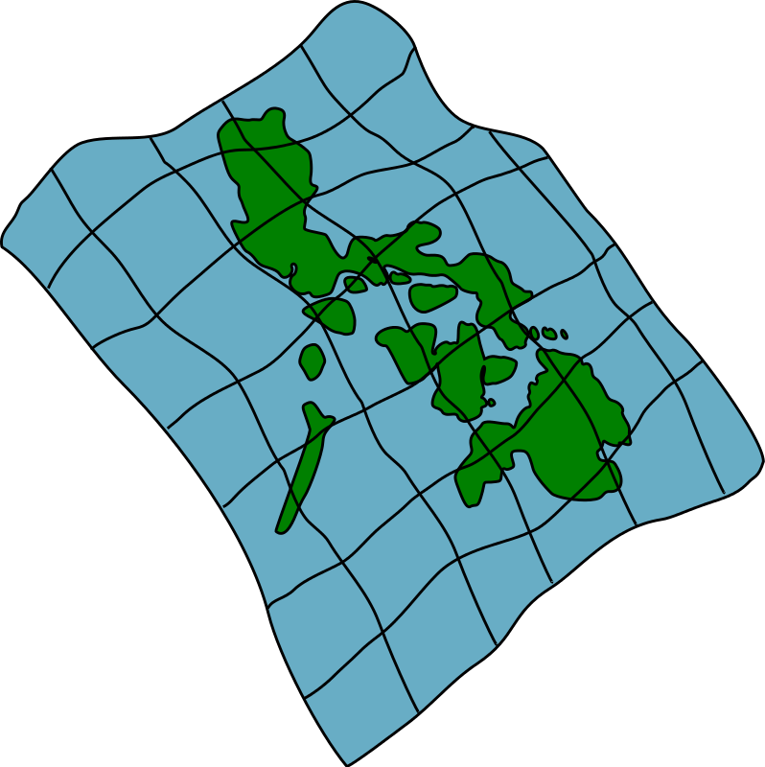
Introduction
Edgar’s Birthday Party
25/02/2020
Markers
- Mark a location
- Store some information

Slide 3
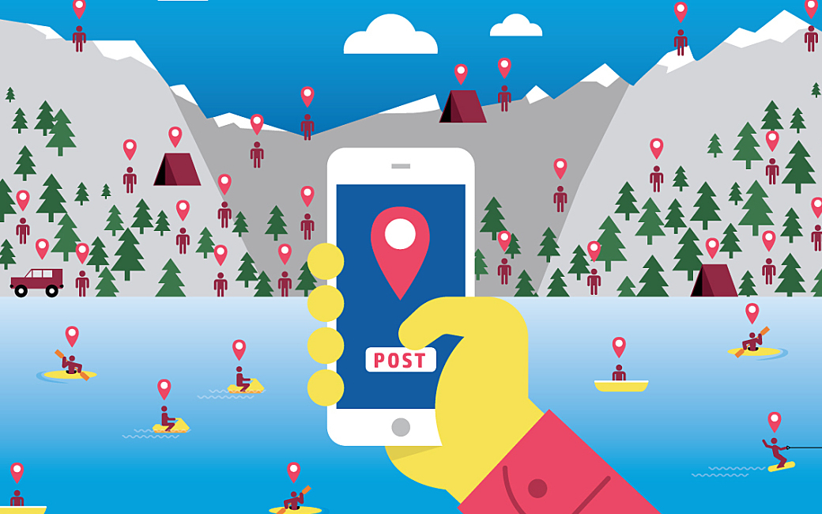
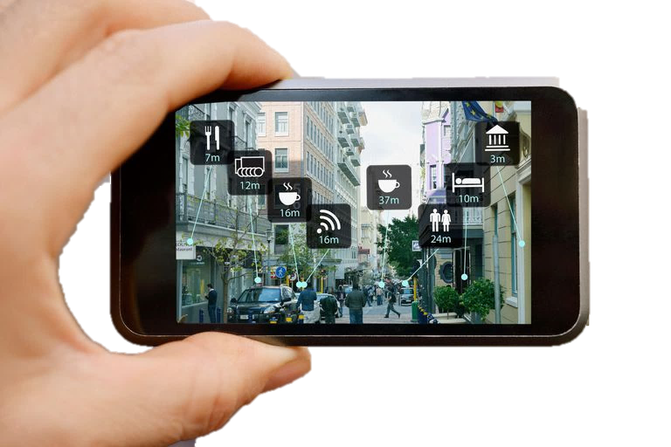


AR + Geotagging + Social Networking

Slide 4
Social Network Aspects
Social Network Features
Marqur Features
Timelines for people
Post on other’s walls
Likes & Dislikes
Comments
AR Stickers & Filters
Timelines for places
Post at a location’s wall
Upvotes & Downvotes
Discussions
AR Content Discovery

Slide 5

Basic Operation
Adding Content
Step 1: Pick a location
Step 2: Post content at location
Viewing Content
Step 1: Visit a location
Step 2: Discover content sorted by votes

Slide 6

Existing Solution
Google Maps
Key Similarities:
Location-based
User Added Content
Reviews
Key Differences:
Permanent, not Time-based
Learn about a place, not current events
No Voting-based Discovery

Slide 7
Motivations
Good source for local
news updates
Better alternative to
ads and classifieds
Discover location’s
history and culture

Slide 8
Objectives
Primary:
1) Let users post content at a specific location
2) Let users see content posted at a particular location
Secondary:
1) Let users vote/comment/report posts
2) Let users view a location's posts sorted according to votes or time
3) Let users post content on different 'channels' allowing for better
discovery
4) Let users make and view user profiles
5) Let users view posts around their current location using AR

Slide 9
Work Plan
Weeks 1-3:
Basic app that posts and fetches content stored at specific coordinates
Weeks 4-6:
Standard UI with Map view and content navigation
Weeks 7-9:
Social features and AR
Weeks 10-12:
Finalization and Deployment

Slide 10

So Far…
Implemented Marker Adding Flow
Integrated GeoFire for Location based Querying
Integrated Maps and Places API
Integrated Map Search and GPS Fetching
Initialised Firebase and Realtime Database
Added User Login/Registration
Created Basic Application and Flow
Converted Activities to Fragments and integrated with ViewPager

Slide 11
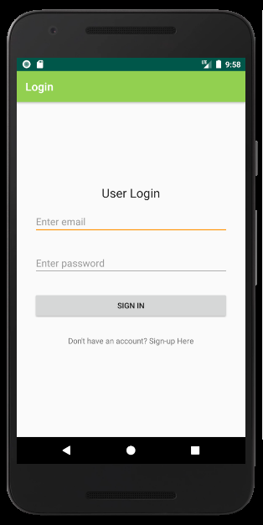
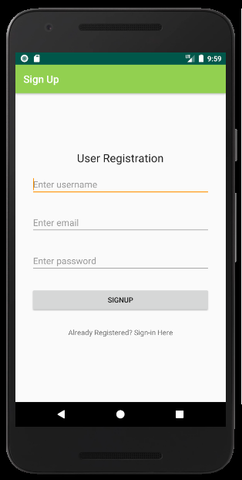
Users & Authentication

Slide 12
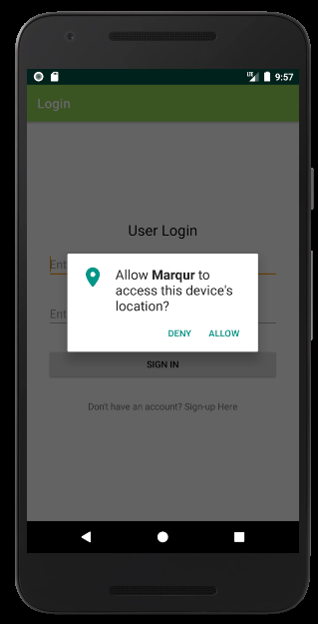
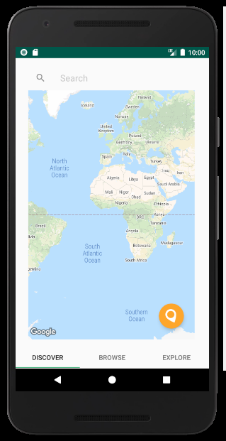
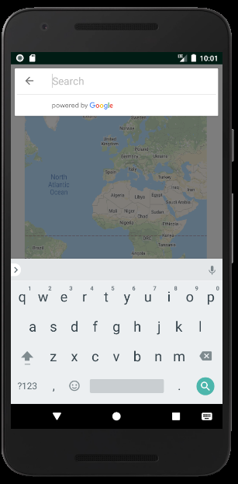
Map View

Slide 13
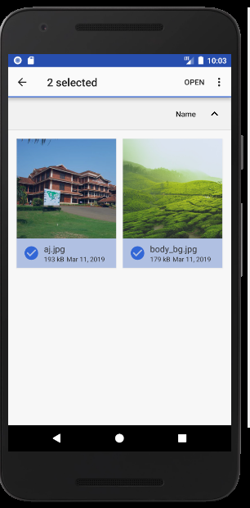
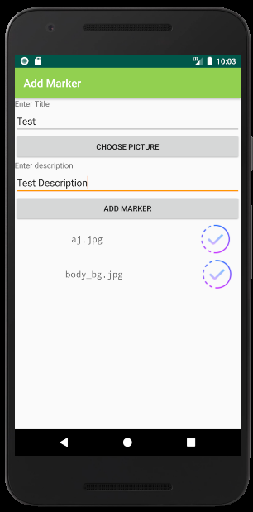
Image Picker

Slide 14
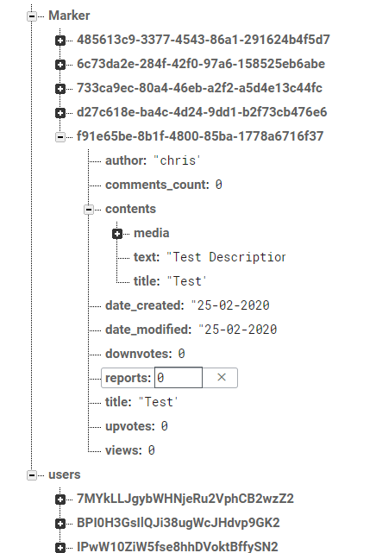

Marker Database

Slide 15
Thank You!

