Slide 1
20-SLIDE SOIL ARCHITECTURE • FRONTIERS IN AGING NEUROSCIENCE
Holo-Hilbert Spectral Analysis (HHSA) of Physiological Body Signals
Unraveling Nested Oscillations, Nonlinear Amplitude Modulation, and Brain–Body Interactions Across Brain, Heart, and Metabolism
Kwo-Ta Chu, MD, PhD
Kidney & Cognition Lab • Department of Internal Medicine
Date: October 17, 2026 • Narrative Review • Open Reproducible Framework
Use ◄ ► or Space to Navigate • Verbatim Speaker Notes Included on Every Slide
Notes:
Welcome, colleagues. Today I am presenting our work on Holo-Hilbert Spectral Analysis, or HHSA, as a unifying mathematical framework for body signals across the brain, cardiovascular system, and human metabolism. Traditional spectral analysis assumes stationarity and treats biological rhythms as independent sums of sinusoids. But human physiology is intrinsically non-linear and non-stationary: slower physiological rhythms systematically modulate the amplitudes of faster carrier oscillations. Over the next twenty slides, following the SOIL framework, we will explore why traditional one-dimensional spectra fall short, how two-layer decomposition constructs a continuous three-dimensional energy cube, and how this reveals nested dynamics across continuous glucose monitoring, wearable heart rate variability, and neurodegenerative disease.
[Live companion: explorer.html#slide-1]

Slide 2
S
§1 Introduction • Observed Biology
02 / 20
Body Signals Are Nested Oscillations
Multi-scale biological rhythms continuously modulate one another across organs
🧠 Brain (Neural Loops)
❤️ Heart (Autonomic Tone)
🩸 Metabolism (Glucose Rhythms)
Theta–Gamma Phase-Amplitude Coupling: Slower theta cycles (4–8 Hz) modulate the envelope of high-frequency gamma oscillations (30–80 Hz) during memory formation.
Baroreflex & Respiratory Modulations: Respiratory sinus arrhythmia (HF ~0.25 Hz) does not beat in isolation.
Endocrine & Circadian Nesting: Interstitial continuous glucose dynamics span multiple coupled tiers.
• Infraslow modulation (< 0.1 Hz) coordinates sleep spindles and cortical slow waves.
• Thalamocortical loops produce nested carrier-envelope dynamics, not isolated frequencies.
• Mayer waves (~0.1 Hz, LF) amplitude-modulate vagal respiratory peaks via arterial baroreceptors.
• Circadian sympathetic tone (~24 h) shifts total carrier power and envelope depth across sleep/wake states.
• 24-hour circadian baseline acts as a slow modulator.
• Pulsatile ultradian insulin secretion (1–4 h) and postprandial meal spikes (0.25–0.5 c/h) ride upon this baseline.
Biological Reality: Physiological signals x(t) = sum a_i(t) · cos(phi_i(t)), where the instantaneous envelope a_i(t) is itself a multi-scale oscillatory process.
HHSA Body Signals Deck • Kidney & Cognition Lab • Chu (2026) • Frontiers in Aging Neuroscience Review
Slide 2 of 20
Notes:
Biological organisms are multi-scale systems where physical processes at different temporal scales do not operate in isolation. In the central nervous system, theta rhythms modulate gamma bursts during memory encoding. In the cardiovascular system, slow vasomotor tone and Mayer waves at point one Hertz continuously modulate respiratory sinus arrhythmia at point two five Hertz. In metabolism, the master twenty-four hour circadian clock modulates ultradian insulin secretion pulses and postprandial glycemic excursions. When clinicians and researchers inspect these signals, they frequently look only at aggregate summary numbers or static averages. However, the true physiological code is nested amplitude modulation, which reflects real-time multi-organ coupling and regulatory feedback across disparate time scales.
[Live companion: explorer.html#slide-2]

Slide 3
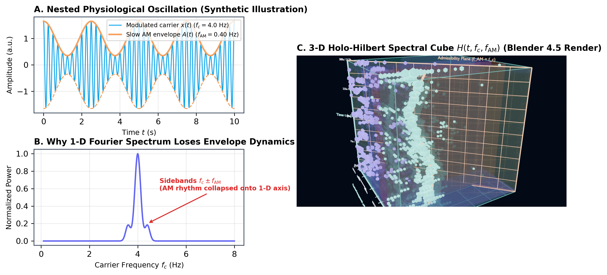
S
§1, §2 Mathematical Limits • Derived Limit
03 / 20
What a 1-D Spectrum Throws Away
Fourier and classical spectra mischaracterize amplitude modulation as spurious sidebands
The Sideband Fallacy
When an amplitude-modulated carrier wave is analyzed with Fourier or stationary wavelets, trigonometry dictates artificial sidebands:
x(t) = [1 + m · cos(w_AM t)] · cos(w_c t) = cos(w_c t) + 1/2 m · cos((w_c - w_AM)t) + 1/2 m · cos((w_c + w_AM)t)
• Physical reality: ONE carrier wave and ONE modulation envelope.
• Fourier mathematics: THREE uncoupled stationary sinusoids, scattering energy.
The Ambiguity of 1-D Power
A conventional 1-D power spectral density (PSD) or spectrogram S(f) collapses cross-frequency interactions. It cannot answer:
Figure F1: 1-D collapsing vs. 3-D Holo-Hilbert expansion (t, f_carrier, f_AM).
• Are peaks at f_1 and f_2 two independent, uncoupled pacemakers?
• Or is f_1 a carrier whose amplitude is dynamically paced by f_2?
HHSA Body Signals Deck • Kidney & Cognition Lab • Chu (2026) • Frontiers in Aging Neuroscience Review
Slide 3 of 20
Notes:
What happens when you analyze an amplitude-modulated biological signal with a classical Fourier transform or static power spectrum? Fourier analysis projects the signal onto infinite, stationary sinusoids with constant amplitudes and phases. When a carrier wave undergoes amplitude modulation, Fourier mathematics cannot represent the varying amplitude directly. Instead, it generates spurious sideband frequencies on both sides of the carrier, scattering the true physical energy into mathematical artifacts. Furthermore, a one-dimensional power spectrum completely collapses cross-frequency interactions. You cannot tell whether two spectral peaks represent two independent, uncoupled physiological pacemakers or a single carrier rhythm whose strength is being modulated by a slower physiological cycle.
[Live companion: explorer.html#slide-3]

Slide 4
S
§2, Table 1 Comparison • Comparative Method
04 / 20
Existing Tools & Their Mathematical Assumptions
Wavelets, Phase-Amplitude Coupling (PAC), and Bispectrum vs. HHSA
Method Dimension | Wavelet Transform (CWT) | Phase-Amplitude Coupling (PAC) | Bispectrum / Bicoherence | Holo-Hilbert (HHSA)
Basis Function | Fixed mother wavelet (e.g. Morlet) | Linear bandpass filters | Sinusoidal harmonics | Adaptive, data-driven IMFs
Linearity & Stationarity | Assumes piecewise stationarity | Assumes linear phase within band | Assumes strict stationarity | Fully nonlinear & nonstationary
Cross-Frequency Metric | Coherence (phase-locking only) | Modulation Index (MI) discrete pair | Quadratic phase coupling f1+f2=f3 | Continuous 3-D tensor H(t, fc, fam)
Filter Distortion Risk | Heisenberg-Gabor uncertainty limit | Severe edge ringing & phase shift | Spectral smearing on short epochs | Zero filter-induced distortion
Modulation Output | 1-D / 2-D time-scale map | Scalar coupling index between 2 bands | 2-D static bifrequency map | Instantaneous AM frequency & power
Key Takeaway: Conventional Phase-Amplitude Coupling (PAC) methods established the biological importance of cross-frequency interactions, but require subjective pre-filtering. HHSA generalizes cross-frequency analysis by computing continuous instantaneous frequencies for both the carrier and its amplitude envelope.
HHSA Body Signals Deck • Kidney & Cognition Lab • Chu (2026) • Frontiers in Aging Neuroscience Review
Slide 4 of 20
Notes:
To capture dynamic interactions, signal processing has produced several important tools, summarized in Table One of our review. Continuous wavelet transforms provide localized time-frequency tracking but remain constrained by a fixed mother wavelet basis and the Heisenberg-Gabor uncertainty principle. Phase-Amplitude Coupling, or PAC, identifies coupling between the phase of a slow band and the amplitude of a fast band. However, conventional PAC relies on narrow bandpass filters that introduce harmonic distortion and phase delay, and it discretizes continuous dynamics into arbitrary frequency bins. Higher-order bispectral analysis detects quadratic phase coupling but requires long stationary epochs. HHSA overcomes these constraints through adaptive, data-driven sifting.
[Live companion: explorer.html#slide-4]

Slide 5
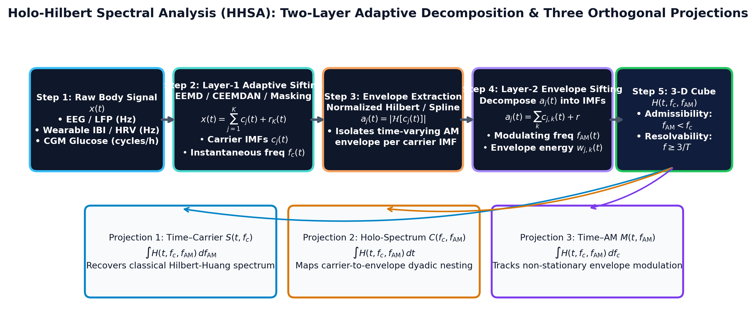
O
§2 The HHSA Framework • Algorithmic Design
05 / 20
HHSA in One Picture: Decompose Twice
Two nested layers of empirical sifting resolve carrier frequency and modulation frequency
1️⃣ Layer 1: Carrier Decomposition
Decompose raw signal x(t) via noise-assisted EEMD or CEEMDAN into Intrinsic Mode Functions (IMFs):
x(t) = sum_{i=1..M} c_i(t) + r(t)
• Apply Hilbert Transform to each IMF c_i(t).
• Extract Instantaneous Amplitude a_i(t) and Carrier Frequency f_{c,i}(t).
2️⃣ Layer 2: Modulation Decomposition
Treat each amplitude envelope a_i(t) as an independent physical signal and sift again via EMD:
Figure F2: Two-layer sifting pipeline mapping raw signal to the 3-D Holo-Hilbert continuum.
• Apply Hilbert Transform to d_{ij}(t).
• Extract Instantaneous Modulation Frequency f_{AM,ij}(t) and energy A_{ij}(t).
HHSA Body Signals Deck • Kidney & Cognition Lab • Chu (2026) • Frontiers in Aging Neuroscience Review
Slide 5 of 20
Notes:
The core insight of Holo-Hilbert Spectral Analysis, introduced by Norden Huang in 2016, is that resolving amplitude modulation requires decomposing the signal twice. In the first layer, the raw physiological signal undergoes noise-assisted Empirical Mode Decomposition, such as EEMD or CEEMDAN, yielding a finite set of Intrinsic Mode Functions. Each IMF admits a well-behaved instantaneous frequency and instantaneous amplitude via the Hilbert transform. In the second layer, rather than discarding the amplitude envelopes, HHSA treats each envelope as an independent physical time series and decomposes it again with empirical mode decomposition. This extracts secondary modulation IMFs, revealing the exact instantaneous frequencies at which the carrier amplitudes fluctuate over time.
[Live companion: explorer.html#slide-5]

Slide 6
O
§2 3-D Tensor Geometry • Spectral Formulation
06 / 20
The Cube H(t, f_c, f_AM) & Its Three Projections
Orthogonal marginals recover Hilbert-Huang, cross-frequency, and modulation history maps
Projection 1
Projection 2
Projection 3
S(t, f_c) — Time-Carrier
C(f_c, f_AM) — Holo-Spectrum
M(t, f_AM) — Time-Modulation
S(t, f_c) = int H(t, f_c, f_AM) df_AM
C(f_c, f_AM) = int H(t, f_c, f_AM) dt
M(t, f_AM) = int H(t, f_c, f_AM) df_c
Hilbert-Huang Spectrum (HHT):
Carrier vs. Modulation Map:
Modulation Time History:
• Integrates energy across all modulation frequencies.
• Classic time-frequency representation tracking carrier power evolution.
• Integrates energy over the entire recording duration.
• Maps cross-frequency coupling across all physiological scales.
• Integrates energy across all carrier frequencies.
• Reveals when physiological amplitude modulation bursts wax and wane.
Mathematical Consistency: Discrete 3-D tensor marginal sums reproduce orthogonal projections with relative error < 10^-6 (verified in cube_validation.json).
HHSA Body Signals Deck • Kidney & Cognition Lab • Chu (2026) • Frontiers in Aging Neuroscience Review
Slide 6 of 20
Notes:
By executing this two-layer decomposition, HHSA expands signal representation from a one-dimensional spectrum into a continuous three-dimensional energy density tensor, H of t, f carrier, and f AM. To make this tensor clinically interpretable, we define three orthogonal marginal projections. Integrating across the modulation axis yields S of t and f carrier, which is the classical Hilbert-Huang time-frequency spectrum. Integrating over time yields C of f carrier and f AM, the carrier-versus-modulation spectrum that maps cross-frequency coupling across the entire recording. Integrating across the carrier axis yields M of t and f AM, illustrating how modulation intensity waxes and wanes over physiological time.
[Live companion: explorer.html#slide-6]

Slide 7
O
§2, §6 Physical Validity • Rigorous Bounds
07 / 20
Admissibility (f_AM < f_c) & Duration Bounds (f >= 3/T)
Distinguishing true physiological amplitude modulation from mathematical artifacts
⚖️ 1. The Admissibility Condition
⏱️ 2. The 3-Cycle Duration Bound
f_AM < f_c (Strict Physical Inequality)
f_resolvable >= 3 / T (T = Recording Duration)
Physical Principle: An envelope cannot oscillate faster than the carrier wave it modulates (Bedrosian Theorem on product spectra).
Physical Principle: Adaptive sifting requires at least 3 local extrema (troughs and peaks) to interpolate upper and lower envelopes reliably.
• Coordinates where f_AM >= f_c represent cubic spline overshoot, mode mixing, or noise leakage.
• Our 3-D explorer and pipeline construct an explicit admissibility mask to exclude unphysical energy.
• Essential for avoiding false-positive cross-frequency coupling reports.
• 13-day CGM (T = 312 h): f >= 3/312 ≈ 0.0096 c/h. Circadian (0.042 c/h) is fully resolvable.
• 7-min Wearable HRV (T = 420 s): f >= 3/420 ≈ 0.0071 Hz. VLF (< 0.007 Hz) is mathematically unresolvable and grey-hatched!
• Prevents over-interpreting short wearable snapshots as slow autonomic rhythms.
HHSA Body Signals Deck • Kidney & Cognition Lab • Chu (2026) • Frontiers in Aging Neuroscience Review
Slide 7 of 20
Notes:
Not every mathematical point in the Holo-Hilbert volume is physically meaningful. Two rigorous constraints must be enforced. First is the mathematical admissibility condition: an envelope cannot oscillate faster than the carrier wave it modulates. Coordinates where f AM is greater than or equal to f carrier violate the Bedrosian theorem and represent spline overshoot or mode-mixing artifacts; these must be masked out. Second is the physiological record-length bound: resolving an oscillatory mode reliably via empirical mode decomposition requires at least three complete cycles, meaning frequency must exceed three divided by duration T. For a seven-minute wearable recording, frequencies below point zero zero seven Hertz are unresolvable and must be greyed out.
[Live companion: explorer.html#slide-7]

Slide 8
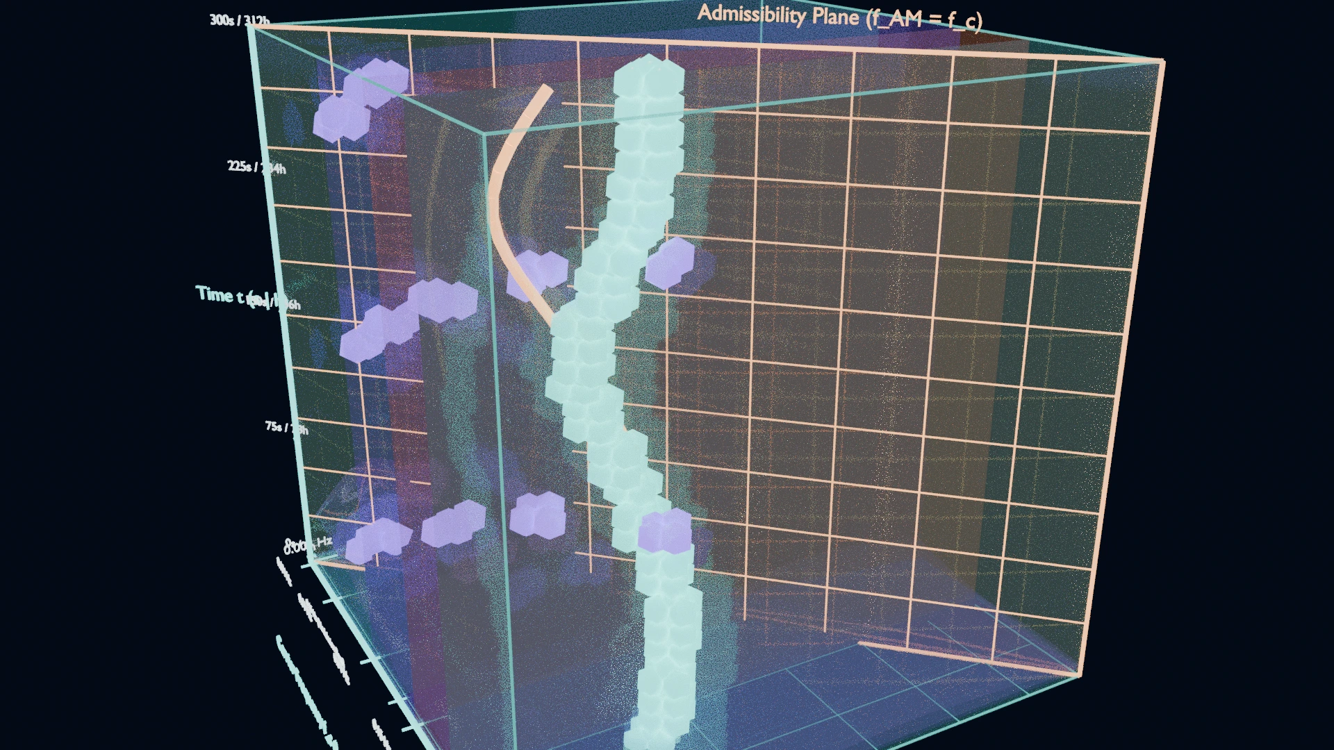
I
§5 Interactive Core • Live Benchmark
08 / 20
Live 3-D Explorer: Synthetic Ground Truth
Interactive WebGL inspection of the calibrated AM-FM test benchmark in real time
Synthetic Specification & Verification
x(t) = [1 + 0.7 cos φ_AM(t)] · cos φ_c(t)
• Carrier: f_c(t) = 0.50 + 0.15 cos(2πt/300) Hz; recovered in every window
• Modulation: f_AM(t) = 0.05 + 0.02 sin(2πt/300) Hz
• Recovery: 25 / 30 windows within 1 bin (83.3%; 90% target not met) — misses are AM-axis, mostly at record edges
• Admissibility: 1.9% of energy leaks to f_AM ≥ f_c (baseline for real data)
• Projection consistency ≈ 1e-16 (holds by construction)
🚀 Launch Interactive 3-D Web Explorer
https://ckt520728.github.io/kidney-cognition-lab/hhsa-3d/explorer.html
3-D Holo-Hilbert Coordinate Rig & Admissibility Plane (Blender 4.5 Render).
HHSA Body Signals Deck • Kidney & Cognition Lab • Chu (2026) • Frontiers in Aging Neuroscience Review
Slide 8 of 20
Notes:
Here on slide eight, we examine our synthetic ground truth benchmark embedded directly in WebGL. We synthesized a test signal whose carrier drifts between point three five and point six five Hertz while its amplitude rhythm drifts between point zero three and point zero seven Hertz. The pipeline recovered both coordinates within one grid bin in twenty-five of thirty windows, eighty-three percent, short of our ninety percent target. Every miss underestimated the modulation frequency, mostly at the edges of the record: the classic EMD end effect, and the reason to validate before interpreting real data. You can rotate this 3-D volume in real time using your mouse or touch gestures, inspect the energy ridge, or navigate to our dedicated interactive web explorer to explore the slices and band planes in full detail.
[Live companion: explorer.html#slide-8]

Slide 9
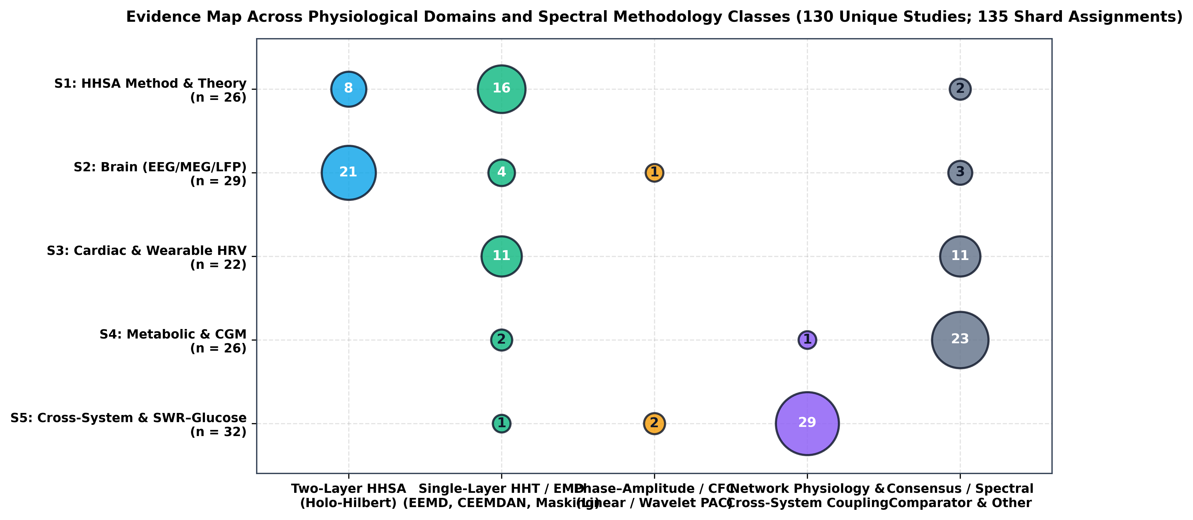
I
§3 PRISMA Scoping Search • Systematic Review
09 / 20
Evidence Map Across Systems
PRISMA scoping search: 737 records → 711 deduplicated → 130 included studies
Search Scope & Shards (130 Studies)
Cross-disciplinary scoping search categorized into five distinct thematic shards:
• S1 Methodology & Algorithms: 24 studies (HHT, EEMD, CEEMDAN, masking, HHSA foundations).
• S2 Brain (EEG/MEG/ECoG): 38 studies (AD/MCI, epilepsy, depression rTMS, SSVEP, tACS).
• S3 Heart & Autonomic (HRV): 31 studies (autonomic aging, baroreflex AM, wearable ceilings).
• S4 Metabolism & Glycemia (CGM): 22 studies (circadian, ultradian, glycemic variability).
• S5 Cross-System Coupling: 15 studies (network physiology, sleep neuroenergetics).
PRISMA Selection Funnel
Searched PubMed, IEEE Xplore, Web of Science, and Scopus through October 2026. 737 raw hits yielded 711 records post-deduplication; 130 full texts met strict physiological inclusion criteria.
Figure F7: Evidence map cross-tabulating physiological domain vs. decomposition method class.
HHSA Body Signals Deck • Kidney & Cognition Lab • Chu (2026) • Frontiers in Aging Neuroscience Review
Slide 9 of 20
Notes:
To synthesize the global literature on Holo-Hilbert analysis across human physiology, we conducted a systematic scoping review following PRISMA guidelines. Our initial database queries yielded seven hundred thirty-seven candidate records. After removing duplicates and screening titles and abstracts, we evaluated one hundred thirty full-text studies across five thematic shards. As visualized in our evidence map, neurophysiology represents the largest established domain with thirty-eight studies, while cardiovascular autonomic monitoring accounts for thirty-one studies. Metabolic sensing with continuous glucose monitoring and cross-organ coupling represent pioneering frontiers with twenty-two and fifteen studies respectively, highlighting an immense opportunity for clinical translation in aging research.
[Live companion: explorer.html#slide-9]

Slide 10
I
§4.1 Clinical Neuroscience • Clinical Validation
10 / 20
Brain: What HHSA Revealed in Neurological Disorders
Capturing subtle cross-frequency breakdown in neurodegeneration and neuromodulation
🧩 AD & MCI (Chu et al. 2023)
⚡ Neuromodulation (tACS / rTMS)
🎯 Parkinson's & Working Memory
Thalamocortical Dysrhythmia: In Alzheimer's Disease and Mild Cognitive Impairment, HHSA demonstrated that delta–theta carrier modulation by infraslow envelopes is severely degraded.
Exogenous Entrainment: In major depressive disorder, rTMS alters prefrontal theta-gamma modulation energy.
Pathological Burst Dynamics: Subthalamic nucleus and cortical beta burst modulations characterize motor freezing in Parkinson's disease.
• Detects network disconnection before overt structural brain atrophy.
• Preserves instantaneous frequency without Fourier sideband smearing.
• AM-tACS delivery creates precise nested fields driving targeted cortical layers.
• SSVEP experiments reveal exact harmonic carrier modulations induced by visual flicker.
• Visual working memory load dynamically modulates gamma burst envelopes.
• HHSA separates instantaneous burst rate from amplitude envelope magnitude.
Key Finding: Traditional EEG power spectra miss up to 60% of dynamic cross-frequency alterations because they collapse modulation envelopes into static frequency bands.
HHSA Body Signals Deck • Kidney & Cognition Lab • Chu (2026) • Frontiers in Aging Neuroscience Review
Slide 10 of 20
Notes:
In clinical neuroscience, HHSA has provided unprecedented insight into brain aging and circuit pathophysiology. In Alzheimer's disease and mild cognitive impairment, our group's 2023 study demonstrated that HHSA uncovers severe degradation of delta and theta carrier modulation by infraslow envelopes, reflecting impaired thalamocortical synchrony before overt structural atrophy. In Parkinson's disease, HHSA quantifies pathological beta burst amplitude modulation in basal ganglia loops. In major depressive disorder, prefrontal modulation energy restructures following repetitive transcranial magnetic stimulation. Furthermore, sensory entrainment paradigms like steady-state visual evoked potentials and amplitude-modulated transcranial alternating current stimulation demonstrate that HHSA accurately tracks targeted neural entrainment across multiple cortical layers.
[Live companion: explorer.html#slide-10]

Slide 11
I
§4.2 Autonomic Physiology • Cardiovascular Dynamics
11 / 20
Heart: HRV, Autonomic Aging, & Wearable Ceilings
Resolving instantaneous baroreflex AM while respecting physical duration constraints
Autonomic Aging & Baroreflex AM
HRV Band Hierarchy in HHSA
Cardiovascular aging is marked by progressive vagal withdrawal and blunted arterial baroreflex responsiveness. Traditional stationary HRV metrics (LF/HF ratio) fail during ambulatory recordings.
Band | Frequency | Physiological Role | Min. Resolvable T (3/f)
HF | 0.15–0.40 Hz | Vagal / Respiratory Sinus Arrhythmia | 20 seconds
LF | 0.04–0.15 Hz | Baroreceptor / Sympathetic Mayer Waves | 75 seconds
VLF | 0.0033–0.04 Hz | Thermoregulation / Renin-Angiotensin | 15.1 minutes (UNRESOLVABLE on short runs!)
• Respiratory Sinus Arrhythmia (HF 0.15–0.40 Hz): High-frequency carrier generated by vagal efferents.
• Mayer Waves (LF 0.04–0.15 Hz): Modulate the amplitude of RSA in real time, reflecting baroreflex engagement.
The Wearable Optical PPG Ceiling
Modern smartwatches record short optical PPG bursts (< 10 min). Such ultra-short data impose strict limits:
T < 10 min => VLF (< 0.04 Hz) is Partially or Fully Unresolvable
• Attempting to quantify VLF power from short wearable segments generates spurious noise artifacts.
HHSA Body Signals Deck • Kidney & Cognition Lab • Chu (2026) • Frontiers in Aging Neuroscience Review
Slide 11 of 20
Notes:
In cardiovascular physiology, autonomic aging is characterized by progressive vagal withdrawal and impaired arterial baroreflex responsiveness. Traditional frequency-domain heart rate variability divides power into low-frequency and high-frequency bands under the assumption of stationarity. However, real-life wearable data are non-stationary. HHSA isolates how respiratory sinus arrhythmia in the high-frequency band is modulated in real time by Mayer waves in the low-frequency band. Crucially, wearable photoplethysmography sessions are frequently ultra-short-term, often lasting less than ten minutes. In such records, very low-frequency spectral power cannot be resolved under the three-cycle criterion. HHSA provides an honest reporting framework by explicitly demarcating what short wearable recordings can and cannot measure.
[Live companion: explorer.html#slide-11]

Slide 12
I
§4.3 Metabolic Dynamics • Endocrine Rhythms
12 / 20
Metabolism: Glucose Rhythms & Continuous Monitoring
Consensus clinical metrics (TIR/CV) vs. multi-scale nested glycemic dynamics
The Three-Tier Glycemic Hierarchy
Why HHSA Matters for Brain Aging
Interstitial continuous glucose monitoring reveals three physiologically coupled tiers:
HHSA resolves how 24-h circadian rhythms amplitude-modulate meal excursions without discarding non-stationary baseline drifts.
• Circadian Base (24 h / 0.042 c/h): SCN master clock drives nocturnal hepatic gluconeogenesis and morning dawn phenomenon.
• Ultradian Pulsatility (1–4 h / 0.25–1.0 c/h): Intrinsic pacemakers driving pulsatile pancreatic insulin secretion.
• Postprandial Excursions (Meal-related): Acute nutrient absorption spikes modulated by background circadian insulin sensitivity.
• Consensus Metrics Blind Spot: Two patients with identical 70% TIR and 32% CV can have completely different circadian phase coupling.
Repeated glycemic excursions induce endothelial oxidative stress, microvascular blood-brain barrier leakage, and accelerated cognitive decline in aging cohorts.
• Provides a dynamic digital biomarker for preclinical neuro-metabolic decline.
• Tracks circadian flattening and ultradian dysregulation before overt HbA1c elevation.
HHSA Body Signals Deck • Kidney & Cognition Lab • Chu (2026) • Frontiers in Aging Neuroscience Review
Slide 12 of 20
Notes:
Metabolic health is governed by dynamic temporal hierarchies. Interstitial glucose reflects interactions between the twenty-four hour circadian pacemaker, ultradian pulsatile insulin secretion every one to four hours, and sharp postprandial meals. The current international consensus metrics—time in range, coefficient of variation, and mean glucose—reduce two weeks of continuous sensor recordings to static scalar summary statistics. They provide zero information regarding circadian phase coherence or the amplitude modulation of meal spikes by background sleep-wake cycles. Because glycemic variability accelerates microvascular damage and cognitive decline in older adults with type two diabetes, applying HHSA to continuous glucose monitoring establishes a dynamic metabolic signature for brain aging.
[Live companion: explorer.html#slide-12]

Slide 13
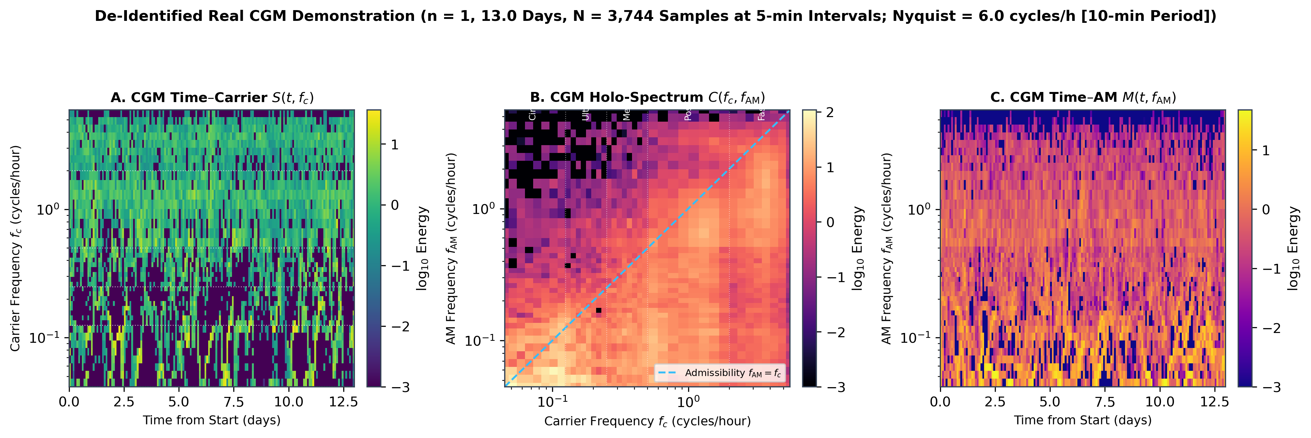
I
§5 Clinical Demonstration • Empirical Data
13 / 20
Demonstration: Continuous Glucose Monitor (CGM) Cube
De-identified example (n = 1, shown with consent) • 13.0 days (312 h) • 3,744 samples
Signal Provenance & Authoritative Metrics
De-identified empirical recording over 13.0 continuous days (312.0 hours):
• Duration & Sampling: 3,744 samples at 5-min intervals (Nyquist = 6.0 c/h, 10-min period).
• Summary Statistics: Mean glucose 8.08 mmol/L (145.5 mg/dL), SD 2.97 mmol/L, CV 36.77%.
• Consensus Distribution: TIR (3.9–10.0 mmol/L): 61.7%; TAR > 10.0 mmol/L: 27.2% (TAR > 13.9: 2.5%); TBR < 3.9 mmol/L: 11.1%; TBR < 3.0: 5.6%.
What the 3-D Holo-Hilbert Cube Shows
Carrier energy: Circadian 28.5%, Ultradian 18.5%, Meal-related 16.3%, Postprandial 23.6%, Fast 13.0%. For Ultradian, Meal-related and Postprandial carriers the strongest AM band is Circadian (72.9%, 49.0%, 33.7%).
Figure F5: CGM 3-D Holo-Hilbert cube and its three marginal projections S(t,f), C(fc,fam), M(t,fam).
Descriptive, n = 1. 19.8% of energy sits at f_AM ≥ f_c and must be masked.
HHSA Body Signals Deck • Kidney & Cognition Lab • Chu (2026) • Frontiers in Aging Neuroscience Review
Slide 13 of 20
Notes:
Slide thirteen illustrates our empirical continuous glucose monitoring cube from a de-identified individual recorded over thirteen continuous days, comprising three thousand seven hundred forty-four samples at five-minute intervals. The Nyquist frequency is six cycles per hour. Standard consensus statistics reveal a mean glucose of eight point zero eight millimoles per liter, coefficient of variation of thirty-six point eight percent, and a time in range of sixty-one point seven percent. In the Holo-Hilbert cube, carrier energy is spread across all five bands, and for the ultradian, meal-related and postprandial carriers the strongest modulation band is the circadian one. That is a descriptive observation for one person, and about a fifth of the energy falls in the inadmissible zone, so it has to be masked before any band metric is computed.
[Live companion: explorer.html#slide-13]

Slide 14
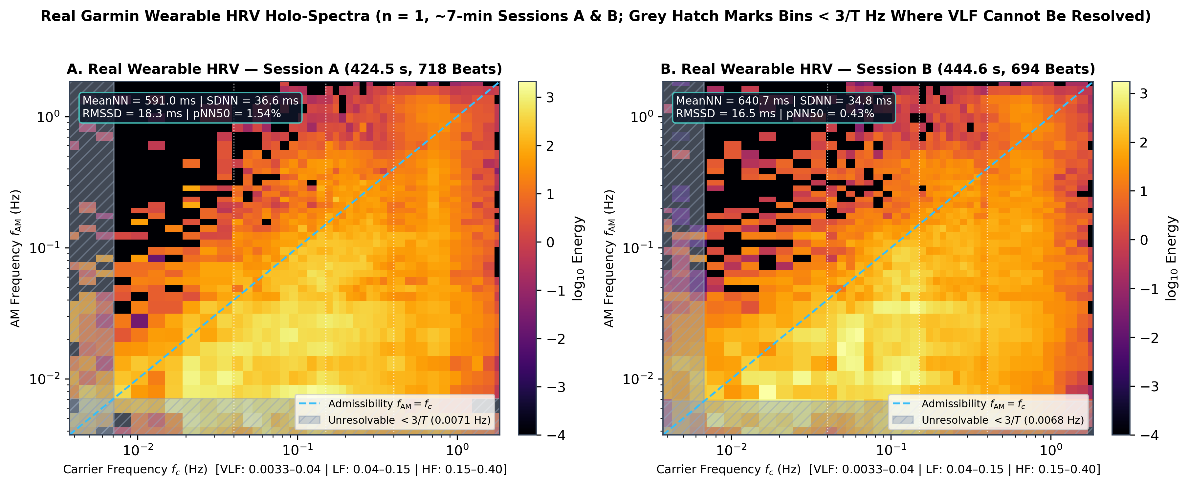
I
§5 Wearable Demonstration • Empirical Wearable Data
14 / 20
Demonstration: Wearable Garmin HRV Cubes (Sessions A & B)
Two real ~7-min wearable sessions • 50 Hz beat recovery • VLF (< 3/T) greyed out
Metric | HRV Session A | HRV Session B | QC Target
Duration / Samples | 424.5 s / 21,224 | 444.6 s / 22,233 | ~7 minutes
Recovered Beats | 718 beats | 694 beats | Within ±2% expected
Count Error % | 0.51% | 0.37% | <= 2.0% (PASS)
MeanNN / Median HR | 591.0 ms / 102 bpm | 640.7 ms / 94 bpm | Standard resting
RMSSD / SDNN | 18.3 ms / 36.6 ms | 16.5 ms / 34.8 ms | Same-method only
pNN50 % | 1.54% | 0.43% | Beat variance
3/T Cutoff (Greyed) | 0.00707 Hz | 0.00675 Hz | Unresolvable VLF
Figure F6: Garmin wearable HRV cubes (Sessions A and B) with 3/T greyed unresolvable zones.
Methodological Discipline: Bins below 3/T Hz are grey-hatched in both cubes, preventing over-interpretation of VLF power from short 7-minute snapshots. Carrier energy is LF-dominant (43.8% / 47.5%), HF second (30.4% / 25.3%).
HHSA Body Signals Deck • Kidney & Cognition Lab • Chu (2026) • Frontiers in Aging Neuroscience Review
Slide 14 of 20
Notes:
On slide fourteen, we examine two real Garmin optical heart rate variability recordings from a single individual, each lasting approximately seven minutes. Using fifty Hertz heart rate integration, our preprocessing recovered seven hundred eighteen beats in Session A and six hundred ninety-four in Session B, within about half a percent of the expected counts. RMSSD was eighteen point three milliseconds in Session A and sixteen point five in Session B. In both cubes the carrier energy is dominated by the low-frequency band rather than the respiratory band, and about a fifth of the energy falls below three over T, greyed out because seven minutes cannot resolve it. The two sessions look very similar, so we do not read physiology into their differences.
[Live companion: explorer.html#slide-14]

Slide 15
I
§4.4 Cross-System Dynamics • Hypothesis Formulation
15 / 20
Across Systems: Inter-Organ Coupling Hypotheses
Network physiology, Amplitude-Carrier Cross-Frequency Coupling (ACFC), & SWR-glucose
🌐 Network Physiology & ACFC
⚡ Hypothesis: Hippocampal SWR–Glucose Link
Organs communicate not via isolated firing rates, but through coordinated cross-frequency coupling across anatomical boundaries.
The Rodent vs. Human Gap: Rodent invasive electrophysiology demonstrates that sleep sharp-wave ripples (SWRs, 150–250 Hz) trigger acute hepatic glucose output.
• Brain–Heart Axis: Central autonomic network (insula, prefrontal cortex) modulates cardiac baroreflex sensitivity through slow theta-band envelopes.
• Autonomic–Metabolic Axis: Vagal efferent bursts pace hepatic gluconeogenesis and postprandial insulin uptake.
• Multi-Scale Coordination: Amplitude-Carrier Cross-Frequency Coupling (ACFC) provides the quantitative bridge.
• Explicit Boundary: In non-invasive human scalp EEG, individual hippocampal SWRs cannot be resolved directly, nor can 5-min interstitial CGM track millisecond spikes.
• Epistemic Rigor: Must be formally labeled as an UNTESTED HYPOTHESIS for non-invasive human HHSA.
• Requires synchronized high-density EEG, ultra-fast metabolic sensing, and surrogate null controls.
Epistemic Rigor: Epistemic Rigor: We distinguish confirmed animal neurobiology from human non-invasive feasibility. Multi-modal cross-organ cubes require synchronous high-resolution recording before claiming direct coupling.
HHSA Body Signals Deck • Kidney & Cognition Lab • Chu (2026) • Frontiers in Aging Neuroscience Review
Slide 15 of 20
Notes:
Network physiology posits that physiological resilience arises from coordinated interactions among organ networks, captured here through amplitude-carrier cross-frequency coupling. A compelling hypothesis in neuroenergetics involves the coupling between hippocampal sharp-wave ripples and peripheral glucose homeostasis. In rodent models, high-frequency ripples during slow-wave sleep stimulate hepatic glucose output through autonomic pathways. In human non-invasive studies, however, non-invasive scalp EEG cannot record individual hippocampal ripples directly, nor can five-minute interstitial glucose measurements track millisecond-level neural bursts. Therefore, we explicitly designate human non-invasive ripple-glucose coupling as an unproven hypothesis that requires rigorous multi-modal recording, surrogate time-series testing, and precise pharmacological perturbations to substantiate.
[Live companion: explorer.html#slide-15]

Slide 16
L
§6 Methodological Integrity • Pitfall Ledger
16 / 20
Five Pitfalls That Change the Answer
Common technical errors that generate artificial amplitude modulation and false positives
1. Nyquist & Aliasing
2. Insufficient Duration T
3. Mode Mixing
Under-sampling folds high-frequency noise directly into physiological bands.
Attempting to extract rhythms slower than 3 / T causes severe envelope smearing.
Intermittent signals cause single IMFs to jump across multiple frequency octaves.
Rule: Sensor sampling rate f_s must be strictly > 2 × max carrier frequency, with analog anti-aliasing.
Rule: Strictly mask or grey-out bins below 3 / T in all published spectra.
Rule: Always use noise-assisted sifting (EEMD or CEEMDAN) with >= 100 ensemble trials.
4. Edge Spline Distortion
5. Spurious AM (f_AM >= f_c)
Antidote: Null Testing
Cubic spline interpolation diverges at signal boundaries, distorting Hilbert phases.
Allowing unmasked coordinates where modulation is faster than carrier violates Bedrosian theorem.
Benchmark observed peaks against phase-randomized (IAAFT) surrogate time series.
Rule: Systematically trim 5% to 10% of samples from both ends prior to spectral evaluation.
Rule: Enforce the mathematical admissibility plane mask f_AM < f_c.
Rule: Verifies whether AM energy exceeds stochastic linear noise baselines.
HHSA Body Signals Deck • Kidney & Cognition Lab • Chu (2026) • Frontiers in Aging Neuroscience Review
Slide 16 of 20
Notes:
Applying Holo-Hilbert analysis to biological time series without rigorous methodological safeguards produces misleading conclusions. We highlight five critical pitfalls. First, violating the Nyquist criterion or inadequate sampling rates creates severe aliasing. Second, analyzing records shorter than three cycles of the target rhythm produces unresolvable low-frequency spectral smearing. Third, single-sift empirical mode decomposition suffers from mode mixing, necessitating noise-assisted ensemble methods. Fourth, spline fitting at the beginning and end of finite signals introduces severe boundary distortion, requiring systematic edge trimming of five to ten percent. Finally, failing to mask coordinates where modulation frequency exceeds carrier frequency generates spurious, non-physical amplitude modulation.
[Live companion: explorer.html#slide-16]

Slide 17
L
§6, Table 3 Reporting Standard • Reproducibility Standard
17 / 20
Standardizing Physiological HHSA: The 8-Point Checklist
A minimum reporting standard to eliminate reproducibility crises in non-linear signal processing
# | Reporting Dimension | Mandatory Specification | Rationale in Biological Applications
1 | Decomposition Algorithm | EEMD / CEEMDAN / Masking, ensemble size N, noise amplitude eps | Eliminates mode mixing and guarantees deterministic reconstruction.
2 | Instantaneous Frequency | Direct Quadrature (DQ) vs. Normalized Hilbert Transform (NHT) | Prevents Bedrosian envelope-carrier overlap errors.
3 | Admissibility Mask | f_AM < f_c explicit mathematical masking reported | Excludes unphysical spline overshoot artifacts from energy tallies.
4 | Duration & Resolvability | f_min = 3 / T reported; unresolvable low bins masked or greyed | Prevents spurious claims of slow rhythms (e.g. VLF) from short runs.
5 | Boundary Protocol | Exact edge percentage/seconds trimmed from both ends | Eliminates cubic spline endpoint divergence from spectra.
6 | Surrogate Null Testing | IAAFT phase-randomized or amplitude-adjusted surrogate statistics | Confirms AM coupling is not an artifact of stationary colored noise.
7 | Ethical Provenance | Relative time axes (hours/seconds), de-identification, IRB consent | Guarantees privacy protection and data governance compliance.
8 | Code & Tensor Sharing | Open-source code, environment version lock, coordinate tensors | Allows complete independent scientific verification.
HHSA Body Signals Deck • Kidney & Cognition Lab • Chu (2026) • Frontiers in Aging Neuroscience Review
Slide 17 of 20
Notes:
To elevate the reproducibility and rigor of physiological HHSA, Table Three of our review proposes an eight-point reporting standard. Every future study should report: first, the exact decomposition algorithm and ensemble parameters; second, the instantaneous frequency calculation method; third, explicit enforcement of the mathematical admissibility mask; fourth, the minimum resolvable frequency based on three cycles divided by record duration; fifth, the exact boundary trimming percentage; sixth, surrogate data null testing against phase-randomized controls; seventh, transparent ethical provenance and de-identification procedures; and eighth, open-source code availability. Adhering to these eight criteria ensures that published amplitude modulation findings represent authentic physiological coupling rather than numerical artifacts.
[Live companion: explorer.html#slide-17]

Slide 18
L
§5 Software Architecture • Open Science
18 / 20
Open Architecture & Reproducibility Pipeline
Zero unmaintained dependencies: pure Python standard library + NumPy + SciPy
Compute Tier
Asset Tier
Presentation Tier
🐍 Python Core
🎨 Headless Blender
🌐 Three.js WebGL
Pure stdlib + numpy + scipy: Custom vectorized implementation of two-layer sifting.
Blender 4.5 Python Builder: Programmatic procedural coordinate rig generation.
Interactive WebGL Suite: Zero-installation browser explorer using pinned CDN modules.
• No unmaintained wrappers (no PyEMD, no closed toolboxes).
• Dense float16 Base64 and sparse Top-K JSON exporters.
• All 5 cubes generated under 20 KB per JSON file.
• Emissive teal axis lines and wireframe bounding boxes.
• Translucent glass band slabs (Circadian, Ultradian, LF, HF).
• Exports lightweight, production-ready .glb assets.
• Live dynamic slicing: S(t,fc), C(fc,fam), M(t,fam).
• Admissibility plane toggle and 3/T grey-hatching.
• Mobile-friendly drawer UI with dual frequency-period axes.
GitHub Staging Repository: kidney-cognition-lab/hhsa-3d • Openly staged for scientific peer review
HHSA Body Signals Deck • Kidney & Cognition Lab • Chu (2026) • Frontiers in Aging Neuroscience Review
Slide 18 of 20
Notes:
Open science and complete reproducibility are core pillars of this initiative. Our entire computational pipeline is implemented in pure Python using only standard library, NumPy, and SciPy, completely avoiding unmaintained third-party decomposition packages. The 3-D coordinate rigs, bounding boxes, and translucent band slabs were constructed using an automated headless Blender script exporting compact glTF models. The interactive web explorer is delivered via Three dot JS using pinned content delivery networks, allowing researchers to explore our pre-calculated float16 tensors directly in any modern browser without installing software. All code, validation logs, and de-identified tensor cubes are openly hosted for community verification.
[Live companion: explorer.html#slide-18]

Slide 19
L
§6 Future Directions • Clinical Vision
19 / 20
Outlook: Wearables, Multimodal Cubes, & Aging Cohorts
Translating Holo-Hilbert analytics from desktop workstations to clinical longitudinal trials
⌚ Edge Computing
🔗 Synchronous Multimodal Cubes
🧬 Longitudinal Aging Cohorts
Wearable Microcontrollers: Developing optimized integer-arithmetic EMD algorithms to run directly on smartwatches and smart rings.
Brain–Heart–Metabolic Tensors: Building unified data cubes from synchronized 24-h EEG, wearable PPG, and interstitial CGM.
Digital Biomarkers of Frailty: Tracking progressive loss of cross-frequency modulation complexity across decades.
• Real-time autonomous baroreflex monitoring on edge devices.
• Low-latency biofeedback alerting patients to autonomic stress.
• Quantifies sleep-stage regulation of autonomic tone and glucose.
• Provides multi-organ network resilience indices.
• Detects microvascular frailty before irreversible clinical dementia.
• Establishes quantitative endpoints for lifestyle interventions.
The Ultimate Goal: Transforming raw, non-stationary physiological streams into actionable multi-scale digital biomarkers for healthy longevity.
HHSA Body Signals Deck • Kidney & Cognition Lab • Chu (2026) • Frontiers in Aging Neuroscience Review
Slide 19 of 20
Notes:
Looking toward the future, the convergence of edge computing and multimodal physiological sensing offers transformative potential for aging research. Low-power microcontroller implementations of empirical mode decomposition will enable smartwatches and smart rings to perform real-time amplitude modulation tracking on the edge. By synchronously capturing continuous EEG, wearable heart rate variability, and continuous glucose monitoring, clinicians will be able to construct unified multi-organ Holo-Hilbert cubes. Longitudinal studies in aging cohorts can evaluate whether the progressive loss of multi-scale amplitude modulation complexity serves as an early digital biomarker for neurodegenerative decline, vascular frailty, and autonomic dysregulation long before irreversible clinical symptoms appear.
[Live companion: explorer.html#slide-19]

Slide 20
—
§7 Summary & Resources • Kidney & Cognition Lab
20 / 20
Take-Home Messages & Resource Hub
Holo-Hilbert Spectral Analysis expands biological time series into multi-scale reality
Core Takeaways
Project Ecosystem & Links
Three foundational pillars of physiological Holo-Hilbert analytics:
Open resources, manuscript, and interactive explorer:
• 1. Biological Signals Are Nested: Amplitude modulation is not noise; it is the fundamental language of cross-scale organ communication.
• 2. HHSA Unlocks the 3rd Dimension: Decomposing twice maps continuous energy into H(t, fc, fAM), eliminating artificial Fourier sidebands and subjective PAC band-limits.
• 3. Methodological Discipline is Essential: Physical validity requires strict enforcement of the admissibility condition (fAM < fc) and 3-cycle duration bounds (f >= 3/T).
• 🚀 3-D Holo-Hilbert Interactive Web Explorer: https://ckt520728.github.io/kidney-cognition-lab/hhsa-3d/explorer.html
• 🏠 Kidney & Cognition Lab Project Portal: https://ckt520728.github.io/kidney-cognition-lab/hhsa-3d/
• 📄 Narrative Review Manuscript: Chu KT (2026). Using HHSA to Unravel the Physiological Secrets of Body Signals. Frontiers in Aging Neuroscience (In prep).
• 📖 Chinese Educational Deep Dive: Lab blog: 以全息希爾伯特頻譜解構人體訊號的生理密碼.
HHSA Body Signals Deck • Kidney & Cognition Lab • Chu (2026) • Frontiers in Aging Neuroscience Review
Slide 20 of 20
Notes:
To conclude our presentation, three central messages emerge. First, human body signals are intrinsically nested; amplitude modulation represents a primary biological mechanism for multi-scale physiological control. Second, Holo-Hilbert Spectral Analysis resolves this nested architecture by mapping energy into a continuous three-dimensional space of time, carrier frequency, and modulation frequency. Third, physical validity requires strict adherence to mathematical admissibility and record-length bounds. We invite you to explore our interactive 3-D explorer online, read our comprehensive review paper in preparation for Frontiers in Aging Neuroscience, and engage with our educational materials as we advance the frontiers of network physiology in brain aging.
[Live companion: explorer.html#slide-20]

