Slide 1

Engineering Statistics
Estimation &
Confidence Interval
Dr. vvn Weian Chao (趙韋安)
https://ce.nctu.edu.tw/member/teachers/23
Department of Civil Engineering, National Yang Ming Chiao Tung University, Taiwan

Slide 2

Purpose
Parameter
Estimation
參數估計

Slide 3
利用
樣本統計量
與
抽樣分配
來對母體參數進行推估

Slide 4
Purpose
Point Estimation
Confidence Level

Slide 5
估計會有誤差存在
需量化誤差
信賴區間

Slide 6
R: Useful function
“BSDA”package
z.test().-z檢定
t.test().-t檢定
prop.test().
-樣本比例檢定

Slide 7
Outline
-Point Estimation
-Large-sample Confidence Intervals for Population Mean
-Small-sample Intervals Based on a Normal Population Distribution
-Other Topic in Estimation

Slide 8
Outline
參數估計問題
n < 30
n >= 30
母體標準差未知
母體標準差已知
z distribution
樣本標準差
樣本標準差?=母體標準差
符合常態分佈
t distribution
樣本標準差
不符合
Bootstrap、Maximum likelihood method (MLE)

Slide 9

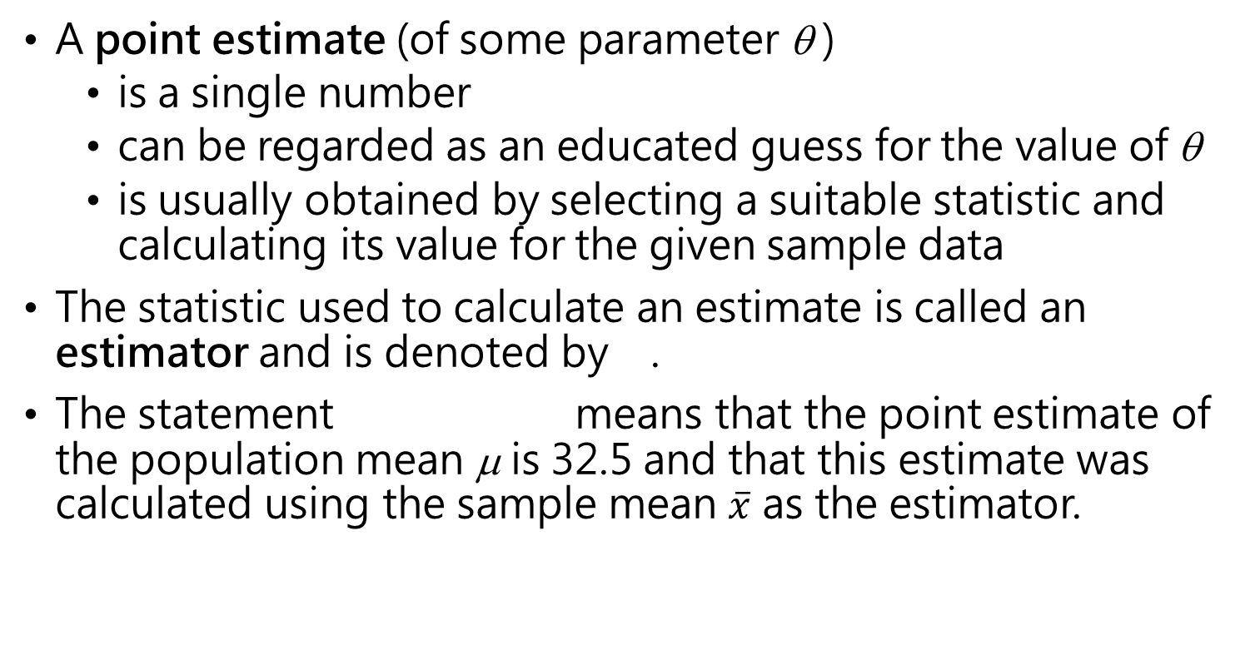
Point Estimation
估計值只是一個數值，當選擇一個樣本統計量當估計式，則以該估計值推論母體參數並做決策。
使用樣本資料透過估計式來計算未知母體參數的估計值。
A point estimate (of some parameter θ )
is a single number
can be regarded as an educated guess for the value of θ
is usually obtained by selecting a suitable statistic and calculating its value for the given sample data
The statistic used to calculate an estimate is called an estimator and is denoted by .
The statement means that the point estimate of the population mean μ is 32.5 and that this estimate was calculated using the sample mean $\overline{x}$ as the estimator.

Slide 10
Point Estimation- Properties of Estimators
好的估計式應能夠讓估計值集中在目標數值上。
不偏性、一致性、最小變異不偏性、有效性
A good estimator should be
Unbiased
Consistent
An estimator is unbiased if, in repeated random samples, the numerical values of the estimator stack up around the population parameter that we are trying to estimate.
In the case of a shot fired at a target, as long as all the shots fall in a pattern with the target value in the middle, we say that the shots are unbiased.
If the majority of the shots are centered somewhere else, then we say that they exhibit a certain amount of bias.

Slide 11
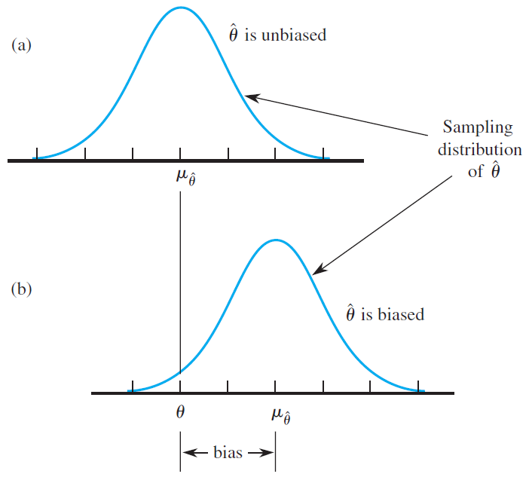
Point Estimation- Properties of Estimators

Slide 12
Point Estimation- Properties of Estimators
一致性(consistent): 當樣本數n增加，估計式分佈均值會接近於未知母體參數，且該均值對應之機率密度函數值亦要接近1。
The estimator is said to be consistent if the probability that it lies close to θ increases to 1 as the sample size increases.

Slide 13
Large-Sample Confidence Intervals for a Population Mean
區間估計-信心區間(選擇信心水準)
An interval estimate or confidence interval (CI) is the calculation and reporting of an entire interval of plausible values.
A confidence interval is always calculated by first selecting a confidence level, which is a measure of the degree of reliability of the interval.
A confidence level of 95% implies that 95% of all samples would give an interval, and only 5% of all samples would yield an erroneous interval.
Most frequently used confidence levels are 95%, 99%, and 90%.
The higher the confidence level, the more strongly we believe that the value of the parameter being estimated lies within the interval.

Slide 14
Large-Sample Confidence Intervals for a Population Mean
-信賴區間(區間估計)為進階描述點估計所無法提供有關估計母體參數的準確性部分。
-信賴區間為樣本統計量與抽樣誤差所構成的一個區間。
-信賴水準係指信賴區間包含母體參數的信心水平。通常會使用信賴水準90%、95%及99%。

Slide 15
樣本數量(n)
將是決定信賴區間範圍的重要關鍵

Slide 16
A confidence interval for μ with CL 95%
A confidence interval for a population or process mean μ is based on the following properties of the sampling distribution of :
When n is large (n≥30), the distribution is approximately normal.
We get the standardized variable z:

Slide 17
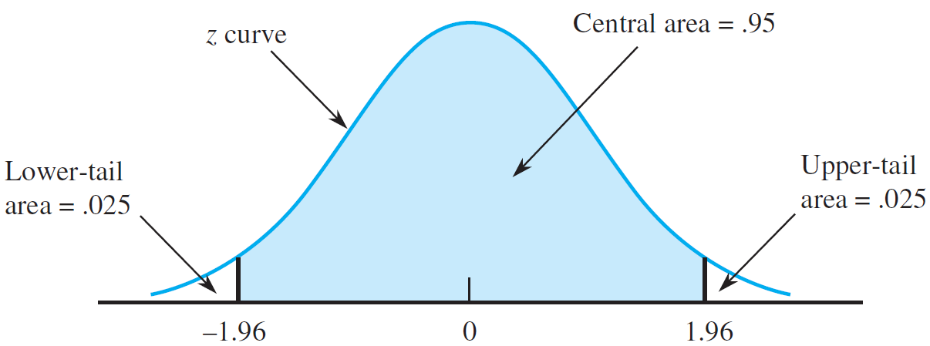
A confidence interval for μ with CL 95%
CL: 90%, 95%, 99%
z critical value (z*): 1.645, 1.96, 2.576

Slide 18
A confidence interval for μ with CL 95%
CL: 90%, 95%, 99%
z critical value (z*): 1.645, 1.96, 2.576

Slide 19
A confidence interval for μ with CL 95%
CL: 90%, 95%, 99%
z critical value (z*): 1.645, 1.96, 2.576

Slide 20
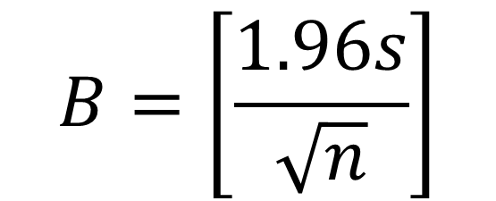
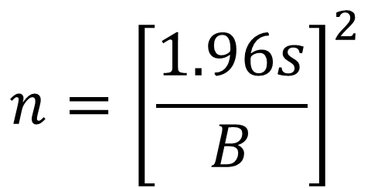
Bound on the error of estimation (B)
The half-width of the 95% CL
$$B=\left[\frac{1.96s}{\sqrt{n}}\right]$$
$$n={\left[\frac{1.96s}{B}\right]}^{2}$$
計算樣本數量時，最大的困難是n未決定時，是無法計算樣本標準差。一般有兩種方式取得:
使用母體標準差
透過樣本中最大值與最小值的差距，除以4

Slide 21
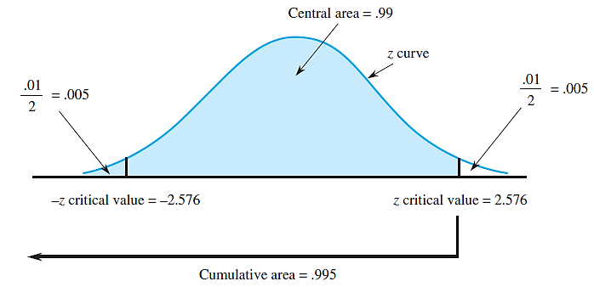
A confidence interval for μ with CL 99%
CL: 90%, 95%, 99%
z critical value (z*): 1.645, 1.96, 2.576

Slide 22
A general formula
CL: 90%, 95%, 99%
z critical value (z*): 1.645, 1.96, 2.576

Slide 23
One-sided CI (Confidence bounds)
單邊估計值區間的z critical value不同
A large-sample upper confidence bound for μ is
A large-sample lower confidence bound for μ is
The three most commonly used confidence levels, 90%, 95%, and 99%, use critical values of 1.28, 1.645, and 2.33, respectively.

Slide 24
R: Confidence Intervals
z.test().

Slide 25
TRY
it
in
R

Slide 26
R: Confidence Intervals
R_estimation_CI_a.R

Slide 27
Small-sample intervals based on a Normal population distribution
當樣本數n夠大時，則可以將母體標準差取代為樣本標準差；當樣本數n不夠大，將無法這樣處理。因此，需要新的機率密度函數來描述。
t Distributions and the One-Sample t Confidence Interval
A Prediction Interval for a Single x Value
Tolerance Intervals

Slide 28
t distributions & the one-sample t CL
When the population distribution is normal, the sampling distribution of is also normal for any sample size n.
This implies that has a standard normal distribution (the z curve).
Proposition
Let x₁, x₂, . . . , x_{n} be a random sample from a normal distribution. Then the standardized variable
The standardized variable t has a type of probability distribution called a t distribution with n − 1 degrees of freedom (df).

Slide 29
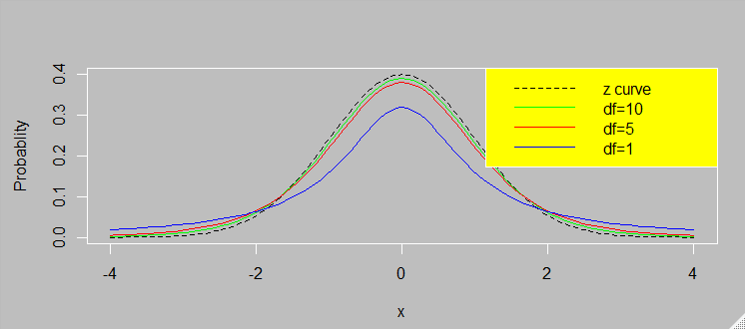
t distributions & the one-sample t CL

Slide 30
t distributions & the one-sample t CL
Properties of Distributions
Any particular t distribution is specified by the value of a parameter called the number of degrees of freedom (df). There is one distribution with 1 df, another with 2 df, yet another one with 3 df, and so on. The number of df for a t distribution can be any positive integer.
The density curve corresponding to any particular t distribution is bell-shaped and centered at 0, just like the z curve.
Any t curve is more spread out than the z curve.
As the number of df increases, the spread of the corresponding t curve decreases. Thus the most spread out of all t curves is the one with 1 df, the next most spread out is the one with 2 df, and so on.
As the number of df increases, the sequence of t curves approaches the z curve.

Slide 31
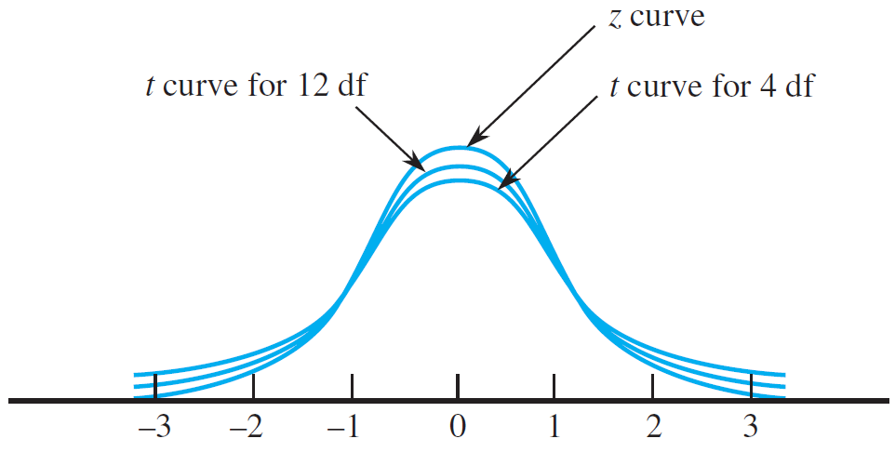
t distributions & the one-sample t CL
任何特定的t分布都是由自由度df所控制，其中df可以為任意整數。
t分布皆為鐘型分布且對稱於0點。
隨著df增加，t分布分散程度越小；且越接近z分布。

Slide 32
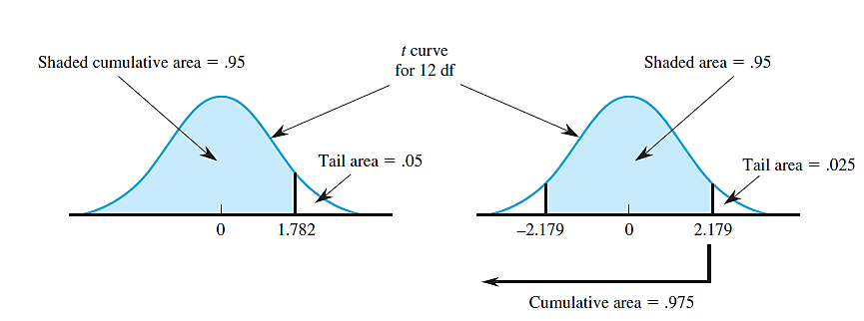
t distributions & the one-sample t CL

Slide 33
t distributions & the one-sample t CL
One-Sample t Confidence Intervals
A two-sided confidence interval for the population or process mean μ has the form
For upper confidence bound: replace “±” in the given formula by “+”
For lower confidence bound: replace “±” by “−”
For such a one-sided interval, a t critical value in the cumulative area column corresponding to the desired confidence level is used.

Slide 34
A prediction interval for a single x value
利用數據資料來預測未發生的事情，例如(1)下一個購買產品其保存期限為何? (2)下一頓晚餐的熱量是多少?
The data may wish to use it as a basis for predicting a single x value that has not yet been observed, for example, the lifetime of the next component to be purchase, the number of calories in the next frozen dinner to be consumed, and so on.

Slide 35
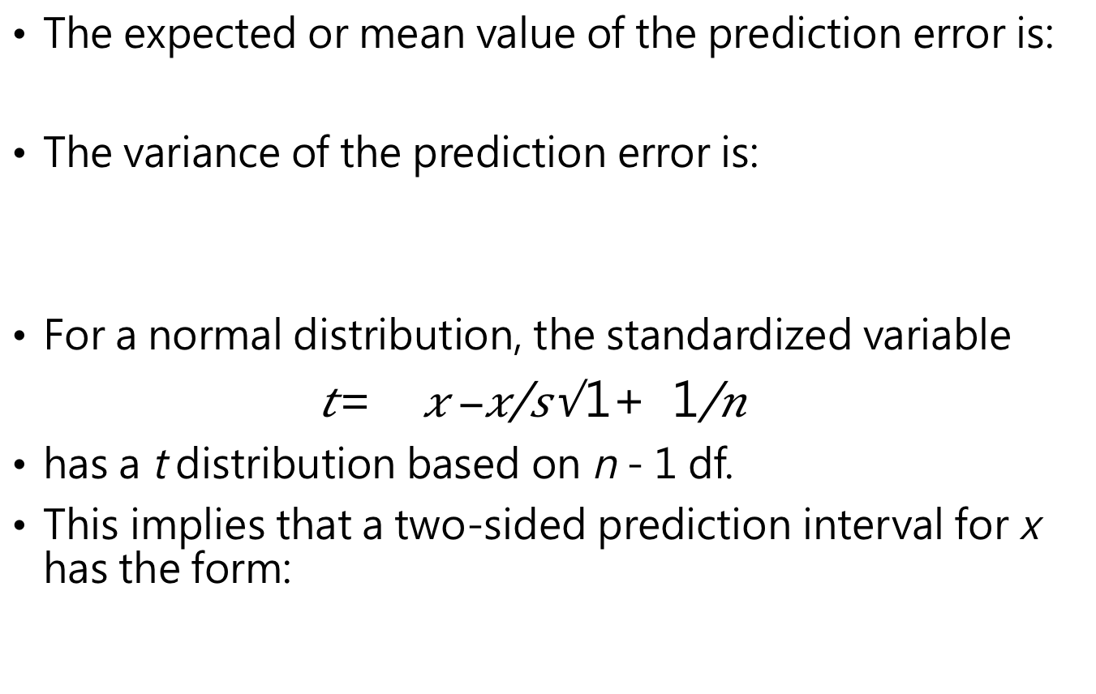
A prediction interval for a single x value
(1)假設平均值估計誤差為0
(2)樣本平均值預估範圍一定比信心水準預估的範圍大
The expected or mean value of the prediction error is:
The variance of the prediction error is:
For a normal distribution, the standardized variable
has a t distribution based on n − 1 df.
This implies that a two-sided prediction interval for x has the form:

Slide 36
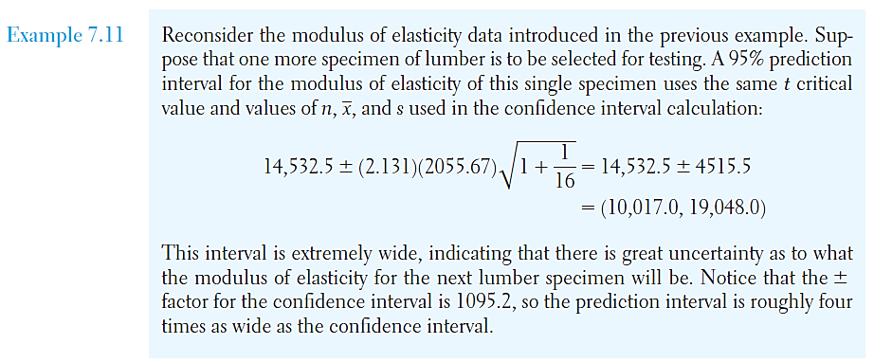
A prediction interval for a single x value
預測範圍大約是信心水準範圍的4倍

Slide 37
Tolerance intervals
容忍區間，特定信心水準%之下、樣本數n與特定%of population capture，可以查詢到tolerance critical value，即可以計算容忍區間。

Slide 38
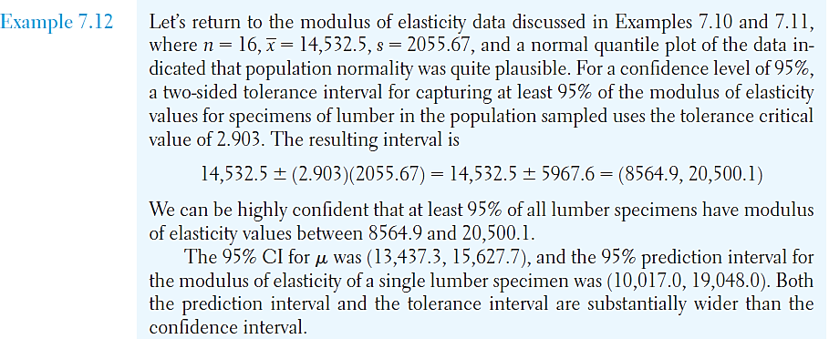
Tolerance intervals
-95% CL & 95% of population capture
容忍區間及預測區間都明顯大於信心水準區間。

Slide 39
R: Confidence Intervals
t.test().

Slide 40
TRY
it
in
R

Slide 41
R: Confidence Intervals
R_estimation_CI_a.R

Slide 42
Other topics in estimation
A Large-Sample Confidence Interval for π
Maximum Likelihood Estimation (MLE)
Bootstrap

Slide 43
A Large-Sample CI for π
樣本比例估計值
Let π denote the proportion of individuals or objects in a population or process that possess a particular characteristic
The natural statistic for estimating π is the sample proportion:
General properties of the sampling distribution of p: (樣本比例分佈之中心)
μ_{p} = π
If both nπ > 5 and n(1 − π) > 5, the sampling distribution is approximately normal

Slide 44
A Large-Sample CI for π

Slide 45
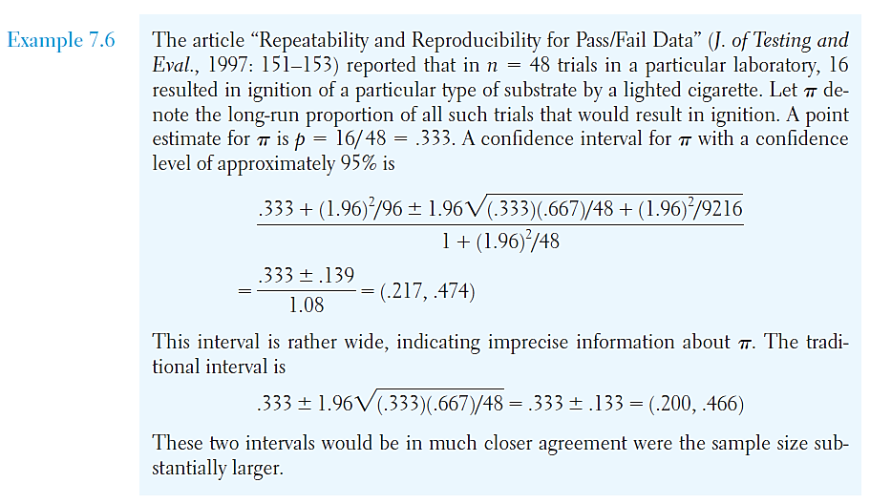
A Large-Sample CI for π
嘗試48次，成功點燃特殊材料的次數為16。因此，樣本比例p = 16/48 = 0.333。嘗試來估計母體比例，並考慮信心水準95%，則信賴區間為何?

Slide 46
A Large-Sample CI for π
-bound of the error of estimation

Slide 47
R: Confidence Intervals
prop.test().

Slide 48
TRY
it
in
R

Slide 49
R: Confidence Intervals
R_estimation_CI_b.R

Slide 50
MLE (最大似然法)
MLE可以依據最大可能原則去自動求得點估計值
Maximum likelihood estimation is a technique for automatically generating point estimators.
MLE is based on trying to find the value of an estimator that is most likely, given the particular set of sample data.
Given the data x₁, x₂, x₃, . . . , x_{n} in any random sample from a population whose distribution is described by f (x), we form the likelihood function
L(θ₁, θ₂,…, θ_{k}) = f (x₁)f (x₂)f (x₃)… f (x_{n})
The maximum likelihood estimators of the parameters θ₁, θ₂,…, θ_{k} are the particular values of θ₁, θ₂,…, θ_{k} that maximize the function L(θ₁, θ₂,…, θ_{k}).

Slide 51
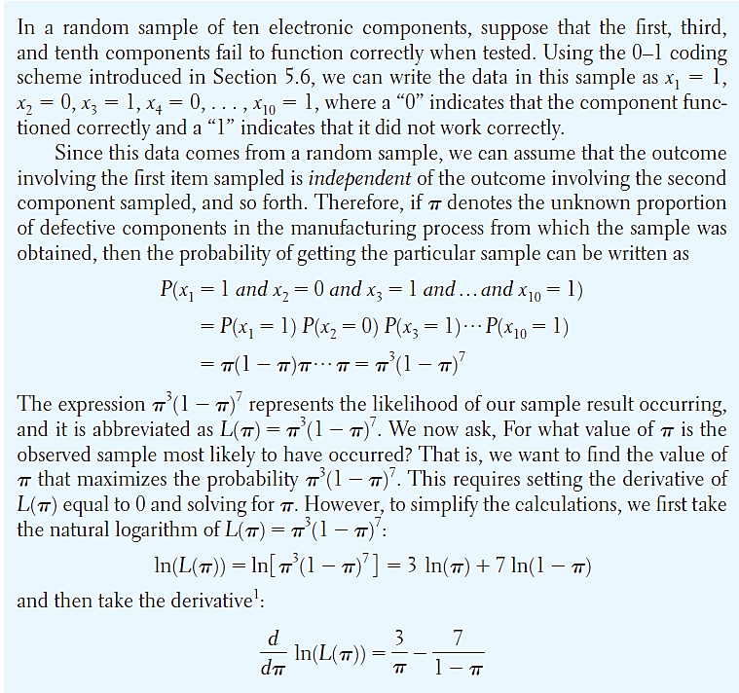
MLE (最大似然法): Example-母體比例
產品製作的過程中，若是先不知道產品有缺陷的機率π。
如何透過MLE方法去估計? 考慮抽樣10個產品其中有3個是有缺陷的問題。
π為多少才可以讓上述情況最容易發生?

Slide 52
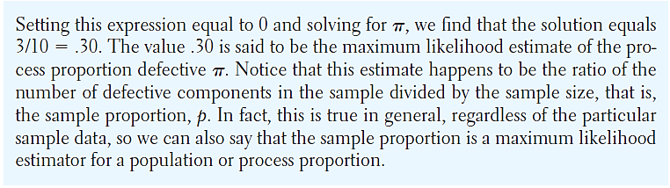
MLE (最大似然法): Example-母體比例
樣本比例可自然推估母體比例

Slide 53
MLE (最大似然法): Example-母體比例
(1)f(x)為機率密度函數，可用來定義似然函數L()
(2)若估計參數個數為一(k=1)，則需要針對L似然函數微分求導數值為0時(估計參數使得L機率最大)，其解即為估計值。若k>1，則需算偏微分。

Slide 54
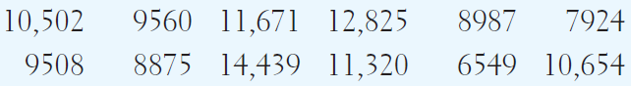
MLE (最大似然法): Example
已知12個產品(小樣本數)分別可以使用的壽命(單位小時):
壽命問題，使用指數機率密度函數，其中λ未知:
定義似然函數L:

Slide 55
MLE (最大似然法): Example
以最大似然基礎，求解λ:
產品使用壽命的指數分佈函數的λ，就是樣本平均數的倒數

Slide 56
Bootstrap confidence intervals
The bootstrap is one example of a general class of methods called resampling procedures.
Outline of the Bootstrap Method
Obtain a random sample of size n from a population or process.
Generate a random sample of size n, with replacement, from the original sample in step 1.
Calculate a statistic of interest for the sample in step 2.
Repeat steps 2 and 3 a large number of times to form the approximate sampling distribution of the statistic.

Slide 57
Bootstrap intervals for the mean
Bootstrap confidence intervals (bootstrap percentile intervals) – generated using the general format outlined previously.
A large number, B, of bootstrap samples are randomly selected and the sample mean is calculated for each sample.
A (1 – α)100% confidence interval for μ is formed by finding the upper and lower (α /2)100% percentiles of the B sample means.
The bootstrap procedure can be applied to large-sample and small-sample problems alike.
The values of B in the range of 500 to 1000 generally give good results.
Larger values of B should be used for larger confidence levels.

Slide 58
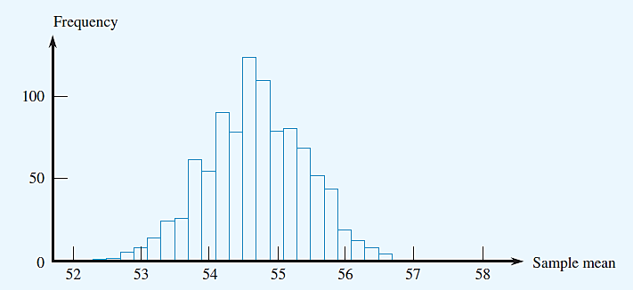
Bootstrap intervals for the mean
B=1000次的bootstrap得到樣本平均數的分布，要求95%的信心水準:
則第25與第975的平均值(53.2,56.1)即為信賴區間

Slide 59
Comments for bootstrap
某些情境下無法估計信賴區間，則可以使用bootstrap來推估
It is relatively easy to write macros in any statistical or spreadsheet software program to carry out bootstrap computations.
Bootstrap intervals generally agree fairly well with traditional confidence interval results when the assumptions necessary for the traditional interval are met.
In those cases where the assumptions are not met, bootstrap intervals offer the additional advantage of giving more realistic results than traditional confidence intervals.

Slide 60

課堂練習: 學號-姓名-ch10-estimation.R
觀念: 90%的信賴區間的90%並不代表是機率，而是信心。使用樣本平均值為中心估算的信賴區間擁有90%信心水準會包含母體平均值
請試著用R語言來設計一個迴圈來實際操作上述的觀念
(1)給定母體平均數(mu=50)與母體標準差(sigma=10)
(2)進行100次抽樣，每次抽樣樣本數是20個(x <- rnorm(20,mean,sd); 代表隨機抽樣樣本數據符合常態分佈)
(3)針對每次抽樣計算樣本平均值(mean(x))、90%信賴區間估計誤差的大小(bound on the error of estimation; 為信賴區間的一半)、信賴區間下限、信賴區間上限
(4)檢查給定母體平均值(mu=50)是否落在上述的信賴區間內，若是落在信賴區間內則繪製黑色errorbar線條，若是落在區間外則繪製紅色errorbar線條

Slide 61
R: Useful function
geom_errorbar(
aes(
ymin = x1,
ymax= x2)
).

Slide 62
課堂練習: 學號-姓名-ch10-estimation.R

