Slide 1
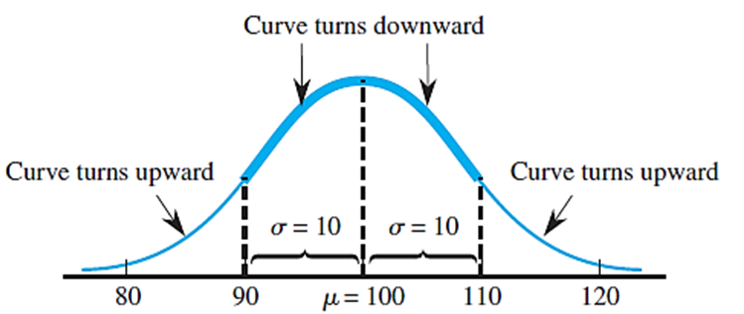
Engineering Statistics
Distribution
Dr. Vvn Weian Chao (趙韋安)
https://ce.nctu.edu.tw/member/teachers/23
Department of Civil Engineering, National Yang Ming Chiao Tung University, Taiwan

Slide 2

Distribution
Choice
of
an appropriate
distribution

Slide 3
Distribution
Decide
which family
is
reasonable

Slide 4
Distribution (統計模型)
若能決定所觀察現象的機率分布之參數，就可以了解所觀察現象的本質

Slide 5
Distribution
Continuous
Discrete

Slide 6
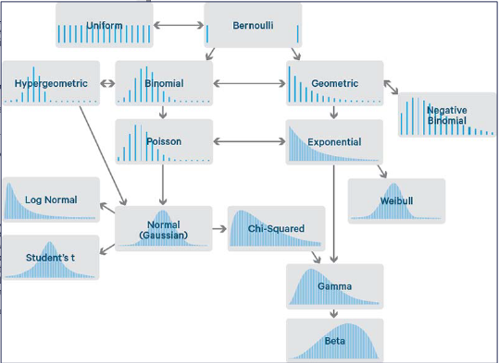
Distribution

Slide 7
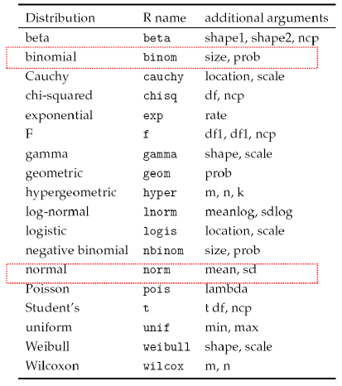
Distribution in R
normal
lognormal
exponential
weibull
poisson
gamma
chi-squared
beta

Slide 8
Normal distribution in R
dnorm() –常態機率密度函數
pnorm() –常態累積機率函數
qnorm() –常態機率函數之分位數
rnorm() –常態隨機亂數
Distribution, d
Probability, p
Quantile, q
Random, r

Slide 9
How to change
legend title for ggplot
scale_color_discrete(name =,
labels =).

Slide 10
TRY
it
in
R

Slide 11
R: Distribution
R_distribution_a.R

Slide 12
R: Distribution
Quantile Plot
An effective way to check a distributional assumption (also called a probability plot ).

Slide 13
R: Distribution
Quantile Plot
If the plot is based on the correct distribution, the points in the plot will fall close to a straight line.

Slide 14
Quantile Plot
判斷資料是否服從某機率分佈(如常態分佈)的描述性方法之一，就是畫出資料次數分佈的直方圖或莖葉圖，若資料近似服從分佈函數，則圖形的形狀與函數應該相似

Slide 15
Quantile Plot
但是，實際上更常用的是繪製樣本資料的分位數-分位數圖(Q-Q plot)，Q-Q plot是根據觀測值的實際分位數與理論分佈的分位數的符合程度繪製

Slide 16

Quantile Plots: Sample Quantiles (樣本分位數)
Definition:
Let x₍₁₎ denote the smallest sample observation, x₍₂₎ the second smallest sample observation, . . . , x_{(n)} the largest sample observation.
Take x₍₁₎ to be the (.5/n)th sample quantile, x₍₂₎ to be the (1.5/n)th sample quantile, . . . , x_{(n)} to be the [(n − .5)/n]th sample quantile.
For i = 1, . . . , n,
x_{(i)} is the [(i − .5)/n]th sample quantile.

Slide 17
A Normal Quantile Plot
Definition:
A normal quantile plot is a plot of the (z quantile, observation) pairs.
The linear relation between normal (μ, σ) quantiles and z quantiles implies that if the sample has come from a normal distribution with particular values of μ and σ, the points in the plot should fall close to a straight line with slope σ and vertical intercept μ.
Thus a plot for which the points fall close to some straight line suggests that the assumption of a normal population or process distribution is plausible.

Slide 18
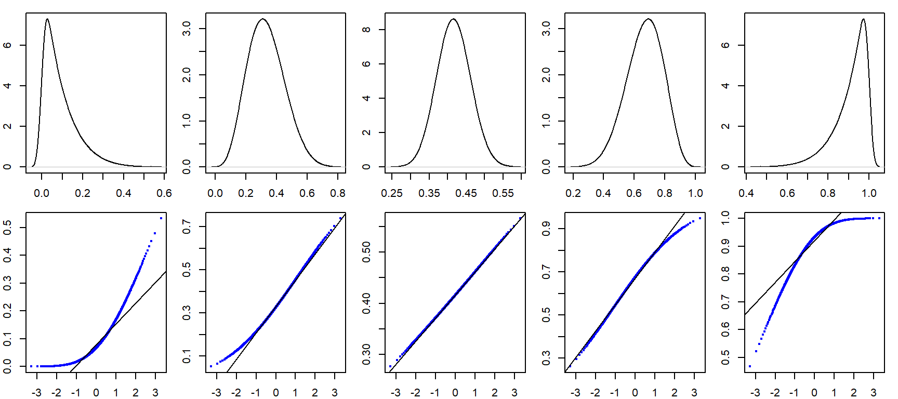
R: Distribution
QQPlot
Source :https://mgimond.github.io/ES218/Week06a.html

Slide 19
R: Distribution
QQPlot in ggplot2
stat_qq(
distribution
).
: produce quantile-quantile data points
Source :https://mgimond.github.io/ES218/Week06a.html

Slide 20
R: Distribution
QQPlot in ggplot2
stat_qq_line(
line.p =
).
: produce line
Source :https://mgimond.github.io/ES218/Week06a.html

Slide 21
TRY
it
in
R

Slide 22
R: Distribution
QQPlot in ggplot2
R_distribution_b.R

Slide 23
Continuous Distributions
Definition:
A nonnegative variable x is said to have a lognormal distribution if ln(x) has a normal distribution with parameters μ and σ.
The density function of x :

Slide 24
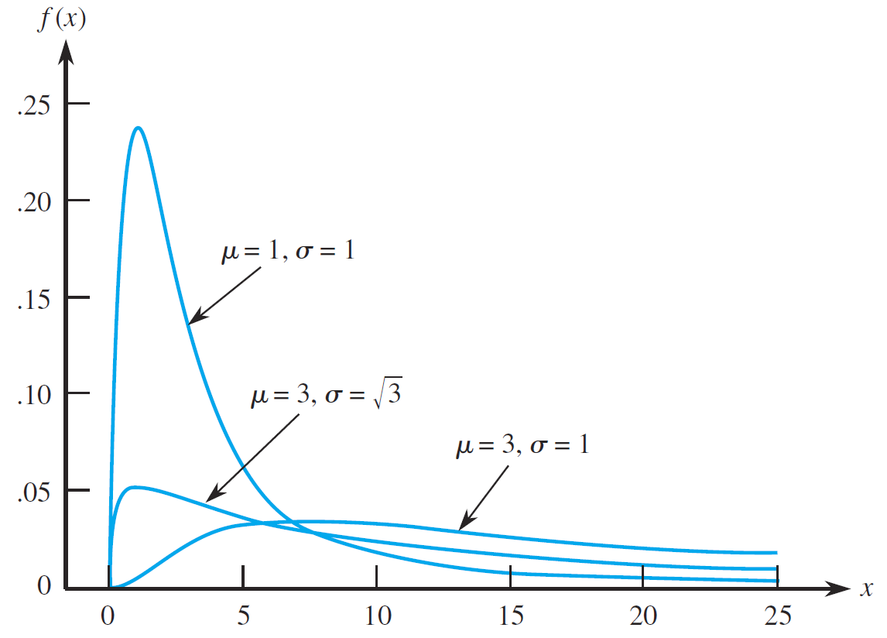
Continuous Distributions
Positively skewed
dlnorm(x, mean =, sd =)
Here:
mean = 算數平均數
sd = 標準差

Slide 25
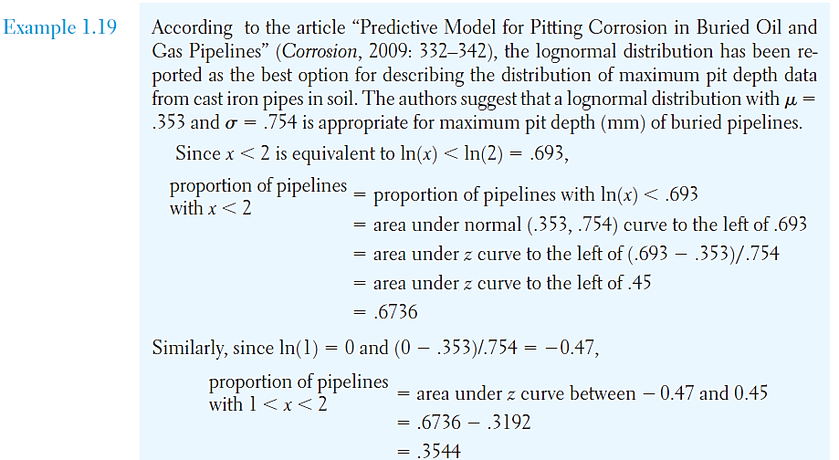
Continuous Distributions
油管最大可埋藏的深度可安全運作的機率

Slide 26
TRY
it
in
R

Slide 27
R: Distribution
Log-normal distribution
R_distribution_c.R

Slide 28
Continuous Distributions
A lognormal variable x is one for which ln(x) has a normal distribution with mean value μ. That is, μ_{ln(x)}=μ. Therefore, it might seem that μ_{x}=e^{μ}, but this not the case. It can be shown that:

Slide 29
Continuous Distributions
Definition:
A variable x is said to have an exponential distribution with parameter λ > 0 if the density function for x is

Slide 30
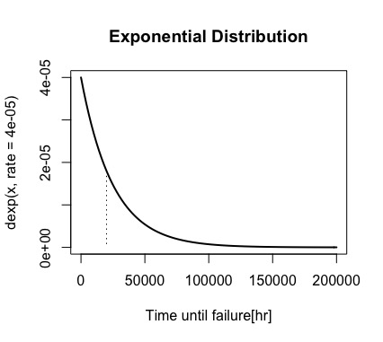
Continuous Distributions
連續函數Exponential Distribution來描述使用燃料引擎的風扇，其可正常運作的壽命。
P(x ≤ 20,000)
➔
pexp(20,000, rate = 0.00004)
= 0.5506

Slide 31
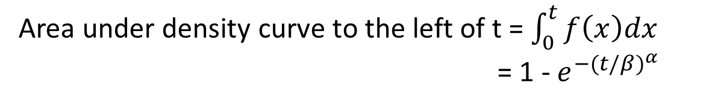
Continuous Distributions
Definition:
A variable x has a Weibull distribution with parameters α and β if the density function of x is
Area under density curve to the left of t = $\int_{0}^{t}{f\left(x\right)dx}$
= 1 - $e^{−{(t/β)}^{α} }$

Slide 32
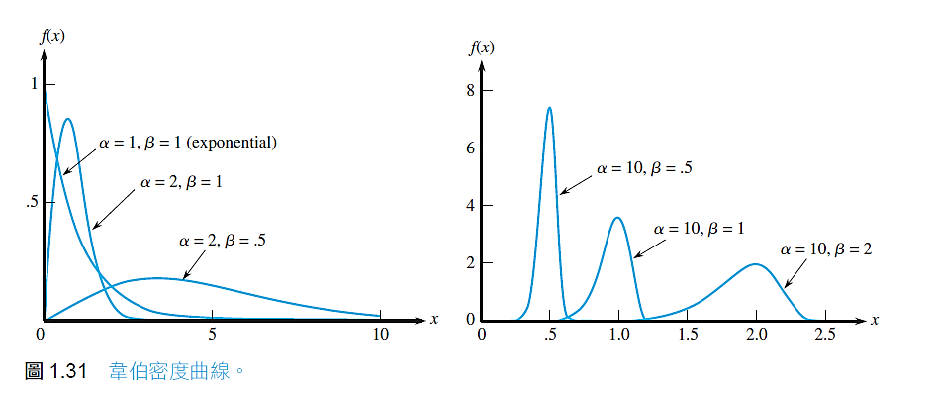
Continuous Distributions
Positively or Negative skewed
α= β = 1 for exponential distribution
dweibull(x, shape =, scale =)
Here:
shape = alpha
scale = beta

Slide 33
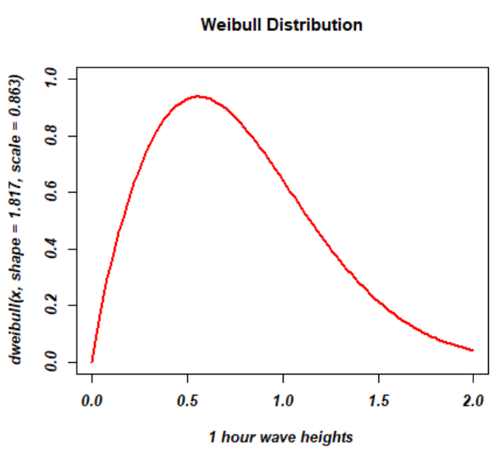
Continuous Distributions
前人研究發現離岸風機基座承受小時特定波浪高度的機率可以使用Weibull(alpha = 1.817, beta = 0.863)來描述。試著回答下列問題。
dweibull(x, shape = 1.817, scale = 0.863)

Slide 34
Discrete Distributions
(特定時間內，某情況發生的次數)
Usually used as a model for the number of times an “event” occurs during a specified time period or particular region of space
The Poisson mass function is
where the parameter λ must satisfy λ > 0.

Slide 35
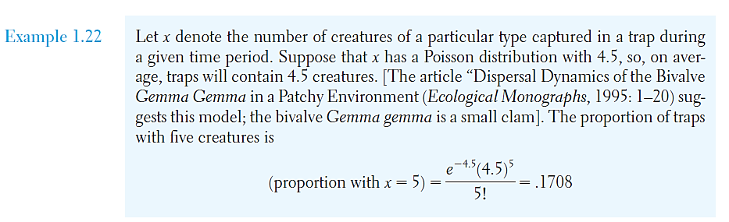
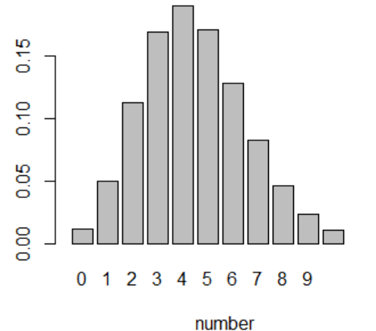
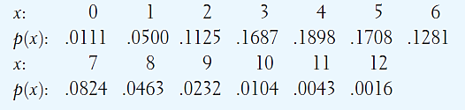
Discrete Distributions
在一定的時間內，生物被捕捉的數量數據可以使用Poisson
dpois(x = 0:10, lambda =4.5)

Slide 36
TRY
it
in
R

Slide 37
R: Distribution
Poisson distribution
R_distribution_d.R

Slide 38
Discrete Distributions
Let x be a Poisson variable with parameter λ.
The mean value of x is λ itself.
If we now let y = x – 1, the range of summation is from y = 0 to infinite

Slide 39
Discrete Distributions

Slide 40
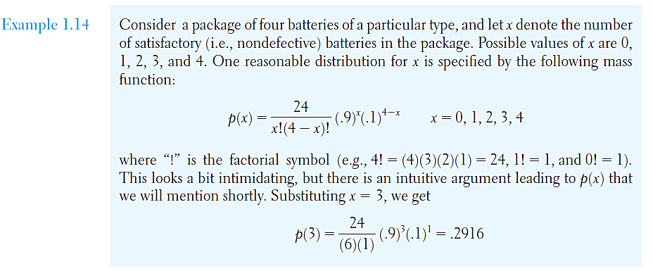
Discrete Distributions
1組4個電池，其中品質良好的數量為x的機率為p(x)
成功機率 p = 0.9 則失敗機率q = 1-p = 0.1

Slide 41
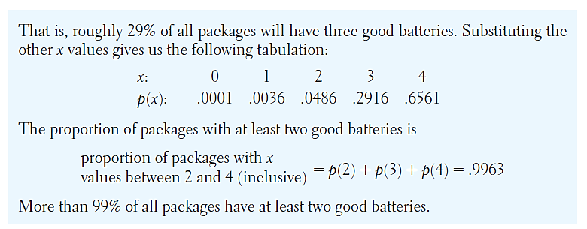
Discrete Distributions
超過0.9機率至少有兩個電池是良好的!!

Slide 42
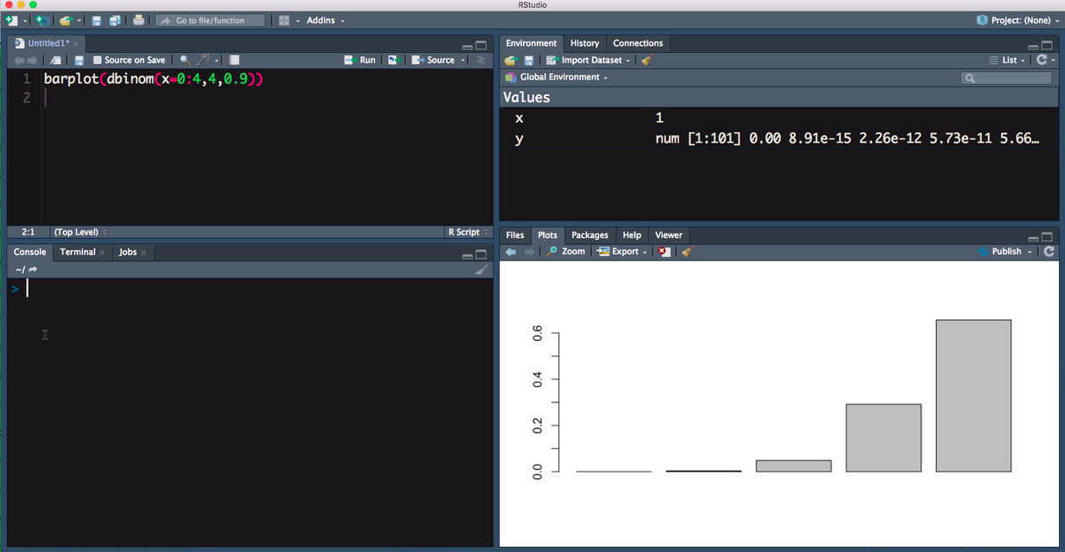
Discrete Distributions
dbinom(x,n,p)

Slide 43
Discrete Distributions
If x is a binomial variable with parameters
n = group size and π = success proportion,
then μ_{x} = nπ .

Slide 44
Discrete Distributions
When π=0.5, is maximized for σ value

Slide 45
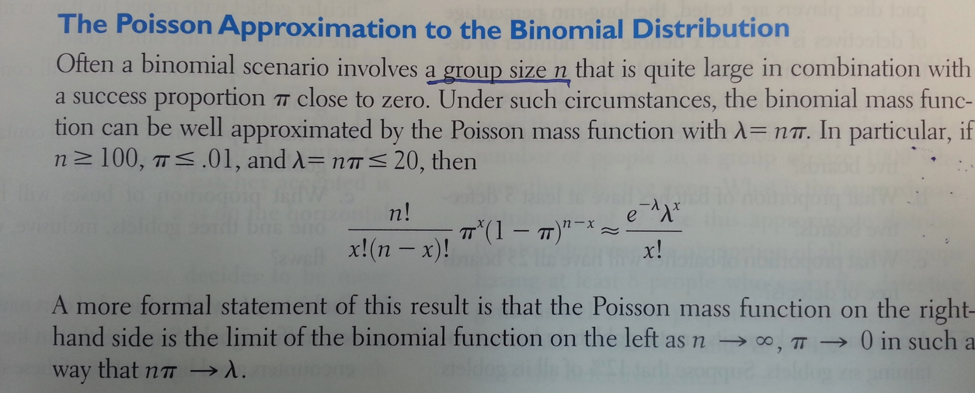
Discrete Distributions
(數量大且發生機率小)
Many applications of Poisson distribution are in fact based on an underlying binomial situation without explicitly-stated values of and n and π.

Slide 46
R: Distribution
Appropriate distribution
“MASS”

Slide 47
R: Distribution
Appropriate distribution
fitdistr(x, densfun)

Slide 48
R: Distribution
Appropriate distribution
-densfun is distribution of x
“beta”
“normal”
“chi-squared”
“exponential”
“f”
“gamma”
“lognormal”
“Poisson”
“t”
“weibull”

Slide 49
R: Distribution
Appropriate distribution
-Output value
estimate: the parameter estimates
sd: the estimated standard errors
vcov: the estimated variance-covariance matrix
loglik: the log-likelihood (數值越大代表函數擬合的程度越好)

Slide 50

distribution
fitting
process

Slide 51
Distribution
Fit your data to likely distribution
Check the fit of the data

Slide 52
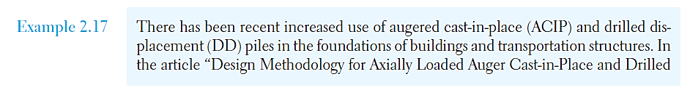
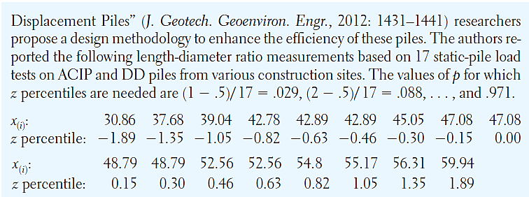
Selecting an appropriate distribution
研究員提出設計方法使得樁擁有更好的工作效率，以下為17筆現地測試之樁的長度與直徑比值資料

Slide 53
TRY
it
in
R

Slide 54
R: Distribution
fitting distribution
R_distribution_e.R

Slide 55
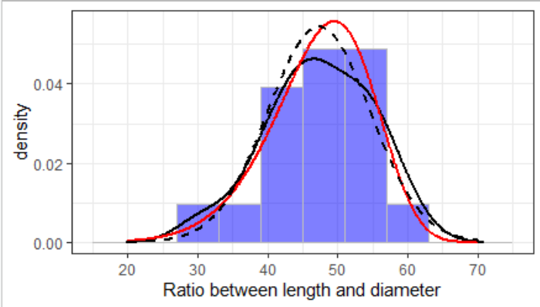
R: Distribution
fitting distribution

Slide 56
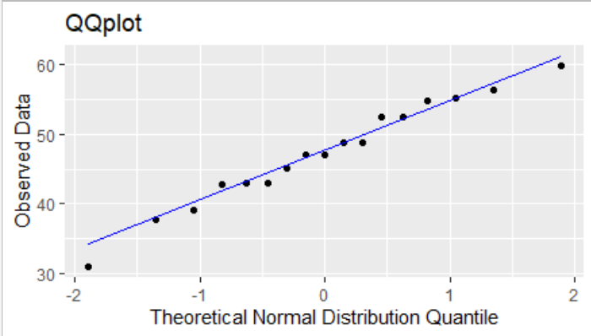
R: Distribution
fitting distribution

Slide 57
R: Distribution
fitting distribution

Slide 58

課堂練習: 學號-姓名-ch6-Distribution.R
25個圓柱狀試體的彈性模數大小數據:
37.0 37.5 38.1 40.0 40.2 40.8 41.0 42.0 43.1 43.9
44.1 44.6 45.0 46.1 47.0 50.2 55.0 56.0 57.0 58.0
62.0 64.3 68.8 70.1 74.5
單位: MPa
試著回答以下問題:
Fitting the data with “Weibull”and “Normal”distributions and then comparing them with density curve. (red line for Weibull, dashed line for Normal, solid line for density curve)
Construct a normal quantile plot(檢驗分布是否為常態分布)
Make comment on the plausibility of a normal population distribution(描述自己觀察到的結果)

Slide 59
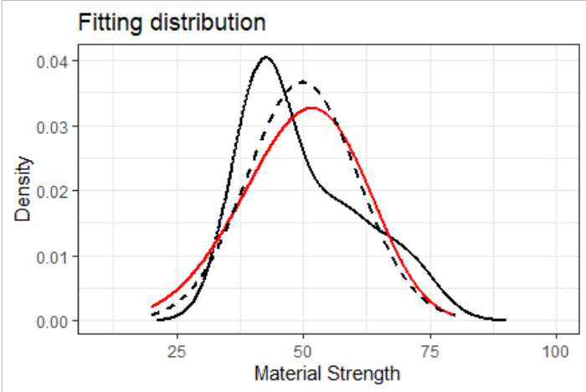
課堂練習: 學號-姓名-ch6-Distribution.R

Slide 60
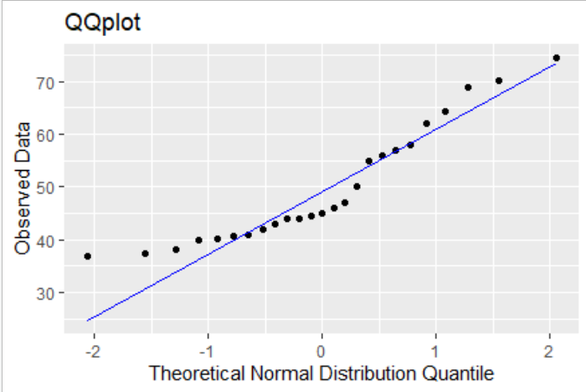
課堂練習: 學號-姓名-ch6-Distribution.R

