Slide 1
The Hadoop Eco System
Shanghai Data Science Meetup
Karthik Rajasethupathy, Christian Kuka

Slide 2
Overview
What is this talk about?
Giving an overview of the Hadoop Ecosystem and related Apache projects
Showing the architecture/functionality of some projects
Illustrating the combination of different projects based on a simple example
The intention of this talk is to give an overview of the Hadoop Ecosystem for beginners

Slide 3
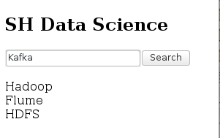
Example
During this talk we will illustrate the usage of some components of the Hadoop Ecosystem based on the following web application.
Each search request is transmitted to the web server using AJAX
→ Analyze most frequent search terms in the web form
Webserver
HTTP GET /….

Slide 4
Example
Data Storage and Communication
Apache HTTP: Provide basic website with search form
HDFS: Hadoop distributed filesystem for log data storage
Flume: Connector between Apache webserver and Hadoop Ecosystem
Kafka: Distributed messaging system
Hbase: NoSQL database for persistent storage
Data Analysis and Management
Map/Reduce: Estimate frequent search terms
Hive: Perform map/reduce jobs using SQL-based query language
Zookeeper: Centralized service for maintaining configuration information and synchronization

Slide 5
Example
Store web access logs for big data analysis
Big Data analysis
Apache Log
Persistent
Storage
Copy log files to storage
scp /var/log/apache/… log

Slide 6
HDFS
Hadoop Distributed File System
Supported operations: Write, Delete, Append, Read
No Update
Name node
Metadata
Operation
Block
Operation
Client
Read/Write
Operation
Data nodes
Data nodes
Replication
Name node: Stores all metadata
Data nodes: Stores each HDFS block in one file
Blocks: Default size 64MB
Blocks
→ http://hadoop.apache.org/

Slide 7
Example – Run HDFS
Setup Hadoop:
<property>
<name>fs.defaultFS</name>
<value>hdfs://localhost:9000</value>
</property>
<property>
<name>dfs.replication</name>
<value>1</value>
</property>
Format the filesystem
$> /usr/local/bin/hdfs namenode -format
Start HDFS
$> /usr/local/sbin/start-dfs.sh
HDFS

Slide 8
Example
Store web access logs to HDFS for big data analysis
Big Data analysis
Apache Log
HDFS
Copy log files to HDFS
scp /var/log/apache/… log
hadoop fs -copyToLocal log

Slide 9
Example
Simplify movement of web access logs to HDFS
Apache Log
HDFS
Move files to HDFS

Slide 10
Flume
Distributed service for collecting, aggregating, and moving large amounts of streaming event data.
Flume
Apache Log
Agent
HDFS
Source
Channel
Sink
→ http://flume.apache.org/

Slide 11
Example – Flume Configuration
agent.sources = mySource
agent.channels = myChannel
agent.sinks = mySink
agent.sources.mySource.type = avro
agent.sources.mySource.bind = localhost
agent.sources.mySource.port = 10000
agent.sources.mySource.channels = myChannel
agent.sinks.mySink.type = hdfs
agent.sinks.mySink.channel = myChannel
agent.sinks.mySink.hdfs.path = hdfs://localhost:9000/flume
agent.channels.myChannel.type = memory
agent.channels.myChannel.capacity = 100

Slide 12
Example – Run Flume
Start Flume
$> flume-ng agent --conf /usr/local/conf -f /usr/local/conf/flume-conf.properties -n agent
Apache Log
Flume
Agent
Apache
Flume Client
AVRO
Source
Channel
Sink

Slide 13
Example – Run Flume
Pipe HTTP log entries to Flume client
Add the following line in the Apache httpd configuration:
CustomLog “||flume-ng avro-client –conf /usr/local/conf -H localhost -p 10000" combined
Apache Log
Flume
Agent
Apache
Flume Client
AVRO
Source
Channel
Sink

Slide 14
Example
Result after a few search requests:
/tmp/hadoop-user/dfs/data/current/BP-92512059-127.0.1.1-1446363295938/current/finalized/subdir0/subdir0/blk_1073741825
SEQ^F!org.apache.hadoop.io.LongWritable"org.apache.hadoop.io.BytesWritable^@^@^@^@^@^@<BA>^Hp<A0><FD> G^_5<95>[<9C><B7>Y?<B0>^@^@^@<A5>^@^@^@^H^@^@^AP<C1><F9><C1><9C>^@^@^@<99>::1 - - [01/Nov/2015:15:36:00 +0800] "GET / HTTP/1.1" 200 792 "-" "Mozilla/5.0 (X11; Linux x86_64; rv:38.0) Gecko/20100101 Firefox/38.0 Iceweasel/38.3.0"^@^@^@<A5>^@^@^@^H^@^@^AP<C1><F9><C1><9E>^@^@^@<99>::1 - - [01/Nov/2015:15:36:09 +0800] "GET / HTTP/1.1" 200 792 "-" "Mozilla/5.0 (X11; Linux x86_64; rv:38.0) Gecko/20100101 Firefox/38.0 Iceweasel/38.3.0“
→ Sequence file with HTTP requests in HDFS

Slide 15
Example
Analyze web access log data stored on HDFS to estimate frequent search terms
Apache Log
Flume
Agent
HDFS
Analyze data
Source
Channel
Sink

Slide 16
Map/Reduce
Main execution framework for distributed parallel data processing
2 Phases:
Map: Map values to key/value pairs
Reduce: Aggregate key/value pairs
Map
Apache Log
Flume
Agent
HDFS
Reduce
Source
Channel
Sink
→ http://hadoop.apache.org/

Slide 17
Map/Reduce
What is map/reduce?
Programming paradigm for processing large data sets across multiple servers
Composed of a Map and a Reduce procedure
Scalable and fault-tolerant
Value
Map
Key | Value
Reduce
Key | Value

Slide 18
Map/Reduce – Architecture
Input Data
Input Split
Input Split
Input Format
Mapper Process
…
Mapper Process
defines
Reader
Reader
Mapper
Mapper
defines
Driver
Partition, shuffle & sort
defines
Reducer Process
Reducer Process
defines
Reducer
Reducer
Writer
Writer
Output Format
Output Data
Output Data

Slide 19
Map/Reduce – Mapper Process
Input Data
Input Split
Input Split
Mapper Process can contain 3 parts
Mapper: Map incoming key/value pairs to new key/value pairs
Combiner: Combine key/values with same key (Mini-Reducer)
Partitioner: Partition key/value pairs to reducer processes (Default: Hash partitioner)
Mapper Process
…
Mapper Process
Reader
Reader
Mapper
Mapper
Combiner
Combiner
Partitioner
Partition, shuffle & sort
Partitioner
Reducer Process
Reducer Process
Output Data
Output Data

Slide 20
Example – Perform Map-Step
public static class Map extends Mapper<LongWritable, BytesWritable, Text, IntWritable> {
public void map(LongWritable key, BytesWritable value, Context context) {
String line = new String(value.getBytes());
Text word = new Text();
word.set(line.split(" ")[6]);
context.write(word, new IntWritable(1));
}
}

Slide 21
Example – Perform Reduce-Step
public static class Reduce extends Reducer<Text, IntWritable, Text, IntWritable> {
public void reduce(Text key, Iterable<IntWritable> values, Context context) {
int sum = 0;
for (IntWritable val : values) {
sum += val.get();
}
context.write(key, new IntWritable(sum));
}
}

Slide 22
Example – Driver
public static void main(String[] args) throws Exception {
Configuration conf = new Configuration();
Job job = new Job(conf, “searchcount");
job.setOutputKeyClass(Text.class); job.setOutputValueClass(IntWritable.class);
job.setMapperClass(Map.class);
job.setReducerClass(Reduce.class);
job.setInputFormatClass(SequenceFileInputFormat.class); job.setOutputFormatClass(TextOutputFormat.class);
FileInputFormat.addInputPath(job, new Path(args[0]));
FileOutputFormat.setOutputPath(job, new Path(args[1]));
job.waitForCompletion(true);
}

Slide 23
Example – Run Map/Reduce
Start Hadoop
$> /usr/local/bin/hadoop jar hadoop-example.jar searchcount hdfs://localhost:9000/flume hdfs://localhost:9000/result
…
15/11/03 10:18:03 INFO mapred.LocalJobRunner: Waiting for map tasks
…
15/11/03 10:18:03 INFO mapred.MapTask: Processing split: hdfs://localhost:9000/flume/FlumeData.1446516967102:0+1111
…
15/11/03 10:18:03 INFO mapred.LocalJobRunner: reduce task executor complete.
…
15/11/03 10:18:04 INFO mapreduce.Job: map 100% reduce 100%
15/11/03 10:18:04 INFO mapreduce.Job: Job job_local1804904239_0001 completed successfully

Slide 24
Example
Analyze web access log data stored on HDFS using a SQL-based language
SELECT … FROM … WHERE …
Map
Apache Log
Flume
Agent
HDFS
Reduce
Source
Channel
Sink

Slide 25
Hive
Run Hive queries in HiveQL (HQL) a dialect of SQL (influenced by MySQL).
Hive takes care of converting these queries to a series jobs for execution on the hadoop cluster.
Can create:
User Defined Functions (UDF)
User Defined Aggregation Functions (UDAF)
User Defined Table Functions (UDTF)
SELECT … FROM … WHERE …
Apache Log
Flume
Agent
HDFS
Hive
Source
Channel
Sink
→ http://hive.apache.org/

Slide 26
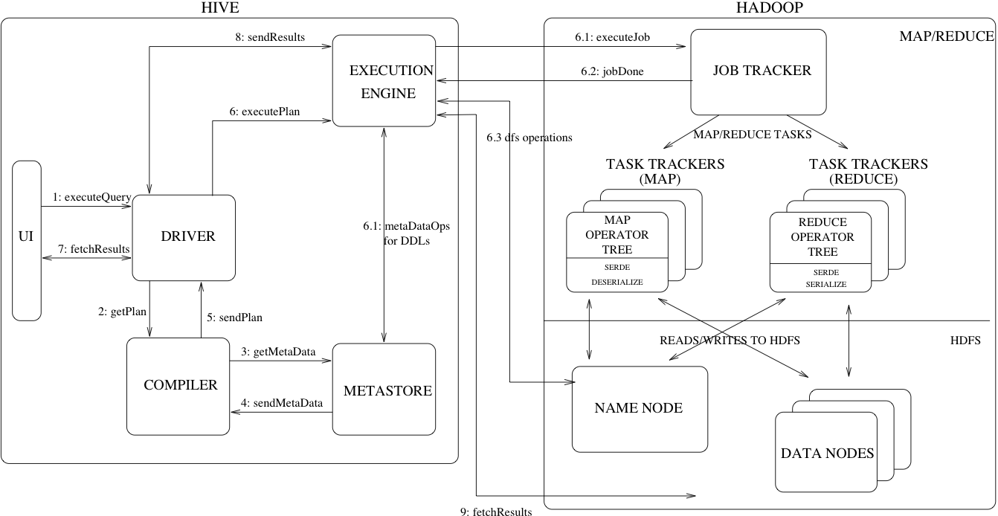
Hive - Components

Slide 27
Hive - Components
UI - submit query
Driver - recieves query
Compiler - parses and does semantic analysis of query (plans jobs)
Metastore - stores all table info and column types
Execution Engine - manages execution of jobs

Slide 28
Example – Hive Schema
CREATE EXTERNAL TABLE apache_log (
ip STRING, identd STRING, user STRING, finishtime STRING, request string, status string, size string
)
ROW FORMAT SERDE 'org.apache.hadoop.hive.serde2.dynamic_type.DynamicSerDe'
WITH SERDEPROPERTIES (
'serialization.format'='org.apache.hadoop.hive.serde2.thrift.TCTLSeparatedProtocol',
'quote.delim'='("|\\[|\\])', 'field.delim'=' ', 'serialization.null.format'='-')
STORED AS sequencefile
LOCATION 'hdfs://path/to/apache/files/';

Slide 29
Example – Hive Query
SELECT parse_url(concat("http://www.some_example.com",split(requestline,' ')[1]),'QUERY','q') AS query, count(*) AS co
FROM apache_log
GROUP BY parse_url(concat("http://www.some_example.com",split(requestline,' ')[1]),'QUERY','q');

Slide 30
Example – Run Hive
By Default, Hive sets the following values for hadoop variables:
hadoop.bin.path - $HADOOP_HOME/bin/hadoop - The location of hadoop script which is used to submit jobs to hadoop when submitting through a separate jvm.
hadoop.config.dir - $HADOOP_HOME/conf - The location of the configuration directory of the hadoop installation
Start Hadoop
Start Hive job:
$> $HIVE_HOME/bin/hive

Slide 31
Example
Store frequent search terms in a database
Apache Log
Flume
Agent
HDFS
Processing
Database
Source
Channel
Sink

Slide 32
HBase
BigTable architecture supporting loose schema
HMaster
Get Data Location
Client
Get
Data
Region server
Region server
Memstore: In-memory data cache
WAL: Write-ahead-log to record all changes
Hfile: Specialized HDFS file format
Memstore
Memstore
WAL
HFile
WAL
HFile
HDFS
→ http://hbase.apache.org/

Slide 33
HBase - Structure
Row: Uninterpreted bytes key (rows are lexicographically sorted)
Column family: Group for columns
Cell: {row, column, version} identifies exactly one cell value
{
“row”:{
“column family”: {
“t1”: “ column family:column name” “value”
“t2”: “column family:column name”: “value”
}
}
}

Slide 34
Example – With Map/Reduce
Start HBase
$> ./usr/local/bin/hbase start
Create the table
$> hbase shell
hbase (main)> create ‘SearchCount’, ‘cf’
Apache Log
Flume
Agent
HDFS
Map/Reduce
HBase
Source
Channel
Sink

Slide 35
Example – Perform Reduce-Step
public static class Reduce extends TableReducer<Text, IntWritable, ImmutableBytesWritable> {
public void reduce(Text key, Iterable<IntWritable> values, Context context) {
int sum = 0;
for (IntWritable val : values) {
sum += val.get();
}
Put put = new Put(Bytes.toBytes(key.toString()));
put.add(Bytes.toBytes("cf"), Bytes.toBytes("count"), Bytes.toBytes(sum));
context.write(null, put);
}
}

Slide 36
Example – Driver
HBase already provides a job configuration
public static void main(String[] args) throws Exception {
Job job = new Job(conf, "searchcount");
…
FileInputFormat.addInputPath(job, new Path(args[0]));
Configuration conf = HBaseConfiguration.create();
TableMapReduceUtil.initTableReducerJob("SearchCount", Reduce.class, job);
job.waitForCompletion(true);
}

Slide 37
Example – Query HBase
List tables:
hbase(main)> list
TABLE
SearchCount
=> ["SearchCount"]
Scan column:
hbase(main)> scan 'SearchCount'
ROW COLUMN+CELL
/index.html?q=HDFS column=cf:count, timestamp=1, value=\x00\x00\x00\x01
/index.html?q=Hadoop column=cf:count, timestamp=2, value=\x00\x00\x00\x04

Slide 38
HBase – With Hive
Use Hive HBase Integration to store processing result into Hbase:
CREATE TABLE result(...)
STORED BY 'org.apache.hadoop.hive.hbase.HBaseStorageHandler'
TBLPROPERTIES ('hbase.table.name' = ‘searchcount');
Apache Log
Flume
Agent
HDFS
Hive
HBase
Source
Channel
Sink

Slide 39
Example
Distribute analyzes of web access log data
Application
Messaging System
Application
Apache Log
Flume
Agent
Source
Channel
Sink
HDFS
Analyze data

Slide 40
Kafka
Kafka is a distributed, partitioned, replicated commit log service
Producer A
Kafka Cluster
Consumer A
Consumer B
Producer B
Consumer C
→ http://kafka.apache.org/

Slide 41
Kafka
Kafka is a distributed, partitioned, replicated commit log service
Partition 1
Topic
Producer A
Partition 2
Consumer A
Partition 3
Consumer B
Producer B
Consumer C

Slide 42
Kafka – Storage
Partition 1
Segment Files
topic/34477849968.kafka
Message 34477849968
Message 34477850175
.
.
Message 35551591806
Message 35551592051
Active Segment List
Deletes
34477849968 – 35551592051
35551592052 – 36625333894
.
.
.
81722490797 – 82796232651
82796232652 – 83869974631
Reads
.
.
.
Appends

Slide 43
Zookeeper
ZooKeeper is a centralized service for maintaining configuration information, naming, providing distributed synchronization, and providing group services.
Server
Server
Leader
Server
Client
Client
Client
Client
Client
→ http://zookeeper.apache.org/

Slide 44
Zookeeper - Structure
Structured like a filesystem
Each node can have a value and multiple children
Clients can register to changes on nodes
/
/app1/p1
/app1/p2
/app2
/app2/p1
/app1

Slide 45
YARN
Client
Resource Manager
Scheduler
Applications
Manager
Node Manager
Node Manager
Node Manager
Container
Container
Container
App Master
App Master
Container
Resource Manager: Overall manager
Node Manager: Per-machine framework agent
App Master: Negotiating appropriate resource containers
Container: Memory, cpu, disk, network etc.
Scheduler: Allocating resource
Applications Manager: Handling of job-submissions

Slide 46
Anything else?
What was not covered by this talk:
Spark
Cassandra
Mahout
Pig
….
→http://projects.apache.org/

