Slide 1
The Hadoop Eco System
Shanghai Data Science Meetup

Slide 2
Content
HDFS
Flume
Map/Reduce
Kafka
Hive
Hbase

Slide 3
Example
During this talk we will illustrate the usage of some components of the Hadoop Ecosystem.
Running example:
Store entered search terms
Apache HTTP: Provide basic website with search form
Flume: Connector between Apache webserver and Hadoop Ecosystem
Kafka: Transport of log data to HDFS
Analyze frequent search terms
Map/Reduce: Estimate frequent search terms

Slide 4
Key Value
Basic concept of key value

Slide 5
HDFS
Hadoop Distributed File System
Name node
Metadata
Operation
Block
Operation
Client
Read/Write
Operation
Data nodes
Data nodes
Replication
Blocks

Slide 6
Example
Store web access logs to HDFS for big data analysis
Apache Log
HDFS
Copy log files to HDFS
scp /var/log/apache/… log
hadoop fs -copyToLocal log

Slide 7
Flume
Distributed service for collecting, aggregating, and moving large amounts of streaming event data.
Apache Log
Agent
HDFS
Flume
Source
Channel
Sink
→ http://flume.apache.org/

Slide 8
Example – Flume Configuration
agent.sources = mySource
agent.channels = myChannel
agent.sinks = mySink
agent.sources.mySource.type = avro
agent.sources.mySource.bind = localhost
agent.sources.mySource.port = 10000
agent.sources.mySource.channels = myChannel
agent.sinks.mySink.type = hdfs
agent.sinks.mySink.channel = myChannel
agent.sinks.mySink.hdfs.path = hdfs://mypath/..
agent.channels.myChannel.type = memory
agent.channels.myChannel.capacity = 100

Slide 9
Example – Run Flume
Start Flume
$> flume-ng agent -c conf -f conf/flume-conf.properties
Apache Log
Agent
Flume
Apache
Flume Client
AVRO
Source
Channel
Sink

Slide 10
Example – Run Flume
Pipe HTTP log entries to Flume client
Add the following line in the Apache httpd configuration:
CustomLog "|flume-ng avro-client -H localhost -p 10000" combined
Apache Log
Agent
Flume
Apache
Flume Client
AVRO
Source
Channel
Sink

Slide 11
Map/Reduce
Main execution framework for distributed parallel data processing
2 Phases:
Map
Reduce
Map
Apache Log
Agent
HDFS
Flume
Reduce
Source
Channel
Sink

Slide 12
Map/Reduce
Value
Map
Key | Value
Reduce
Key | Value

Slide 13
Kafka
Kafka is a distributed, partitioned, replicated commit log service
Producer A
Kafka Cluster
Consumer A
Consumer B
Producer B
Consumer C
→ http://kafka.apache.org/

Slide 14
Kafka
Kafka is a distributed, partitioned, replicated commit log service
Producer A
Topic
Consumer A
Partition 1
Partition 2
Consumer B
Partition 3
Producer B
Consumer C

Slide 15
Kafka Storage
Partition 1
Segment Files
topic/34477849968.kafka
Message 34477849968
Message 34477850175
.
.
Message 35551591806
Message 35551592051
Active Segment List
Deletes
34477849968 – 35551592051
35551592052 – 36625333894
.
.
.
81722490797 – 82796232651
82796232652 – 83869974631
Reads
.
.
.
Appends

Slide 16
Hive
Run Hive queries in HiveQL (HQL) a dialect of SQL (influenced by MySQL).
Hive takes care of converting these queries to a series jobs for execution on the hadoop cluster.
Can create:
User Defined Functions (UDF)
User Defined Aggregation Functions (UDAF)
User Defined Table Functions (UDTF)

Slide 17
Hive Components
UI - submit query
Driver - recieves query
Compiler - parses and does semantic analysis of query (plans jobs)
Metastore - stores all table info and column types
Execution Engine - manages execution of jobs

Slide 18
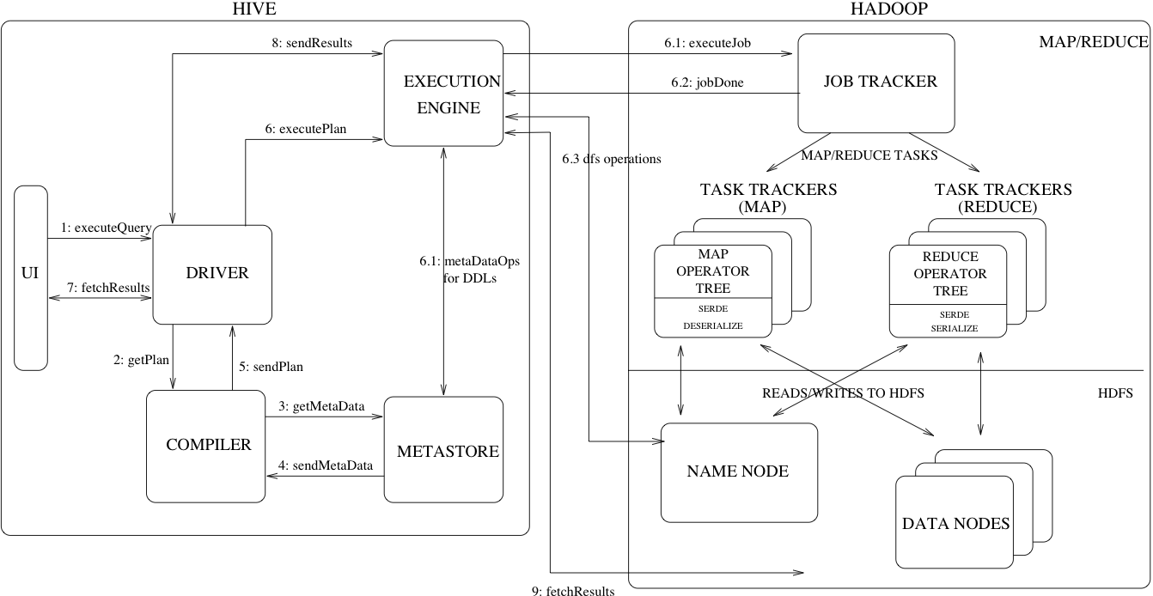
Hive

Slide 19
HBase
BigTable architecture supporting loose schema
HMaster
Get Data Location
Client
Get
Data
Region server
Region server
Memstore
Memstore
WAL
HFile
WAL
HFile
Memstore: In-memory data cache
WAL: Write-ahead-log to record all changes
Hfile: Specialized HDFS file format
HDFS

