Slide 1

GROUP 15
TELECOMMUNICATION
MANAGEMENT
SYSTEM
Team Members :
Rahul Balakrishna (002833716)
Sakshi Wadaskar (002820228)
Chinmay Kulkarni (002209448)
Anirudh Jagadish (002743405)
Vinay Sai Rajapu (002870410)

Slide 2



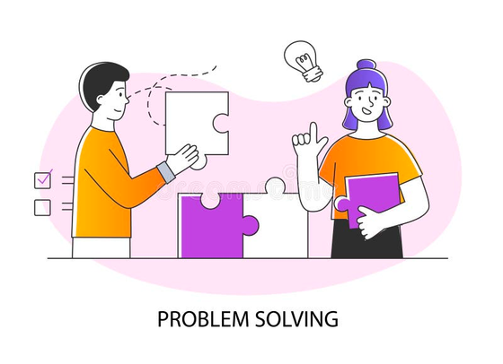
DMDD GROUP 15
OBJECTIVES
Rapid Technological Advances: Adapting to fast-changing technology within the telecommunications industry.
Escalating Data Traffic: Managing the increasing volume of data flow efficiently with the network.
Network Stability Assurance: Ensuring consistent and reliable network performance.

Slide 3

DMDD GROUP 15
GOALS
Goals 1
Goals 2
Goals 3
Goals 4
Centralized Database Access: Facilitating seamless access to diverse customer data.
Streamlined Management: Efficiently managing customer information for time savings.
Unified Telecom Services: Creating a cohesive system for all services.
Enhanced Billing Integration: Integrating billing from multiple perspectives.

Slide 4
DMDD GROUP 15
HIGH LEVEL DESIGN
1 | Database Management System (DBMS): We've selected MSSQL Database to serve as the foundation for our telecommunication management system.
2 | Database Architecture: Employing a three-tier architecture, we've meticulously separated the presentation layer, application layer, and data layer to enhance system organization and efficiency.
3. | Web Application (Frontend): Crafted an intuitive web-based user interface for seamless access and administration of the telecommunication management system. The implementation leverages Swagger UI, where we've meticulously configured APIs to adeptly manage interactions between the frontend and the database.
4. | Application Layer: Engineered a robust server-side application using JavaScript and Node.js. This layer is enriched with carefully designed RESTful APIs, ensuring smooth communication between the frontend and the application layer.

Slide 5
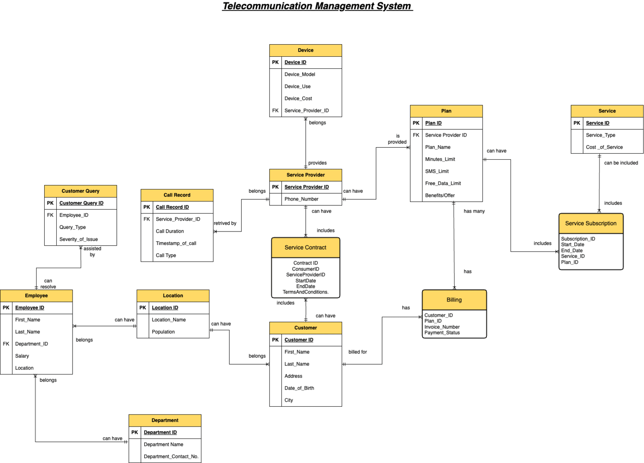
ERD - Entity Relationship Diagram
DMDD GROUP 15

Slide 6
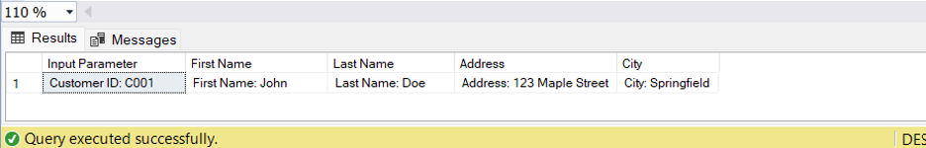
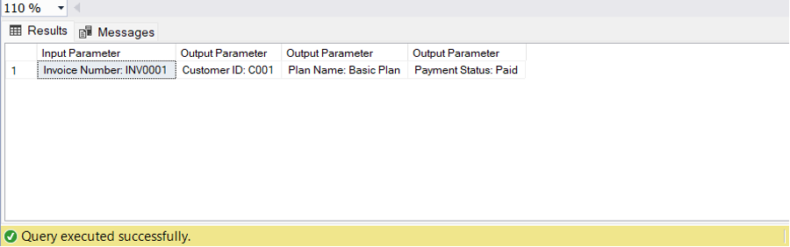
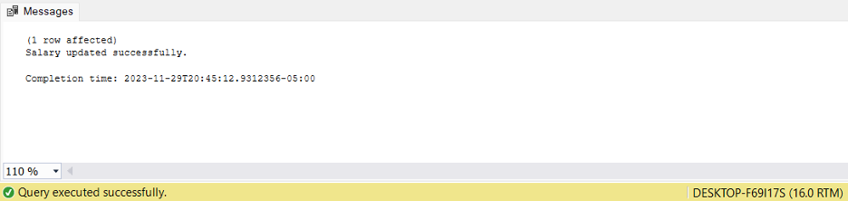
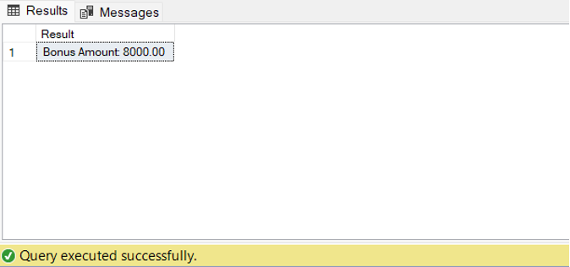
STORED PRODECURE -
DMDD GROUP 15
1. GetCustomerInfo
2. GetBillingDetails
3. UpdateEmployeeSalary
4. CalculateEmployeeBonus

Slide 7
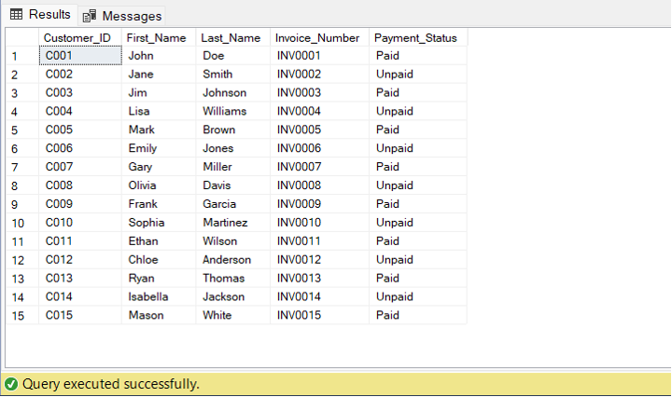
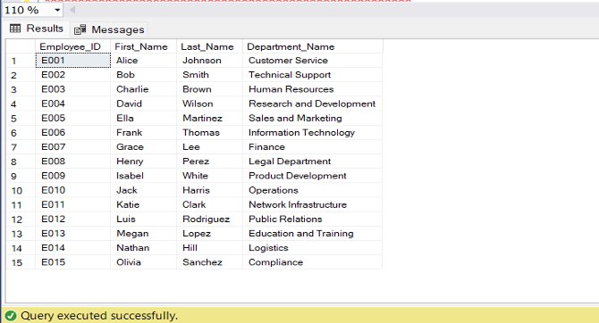
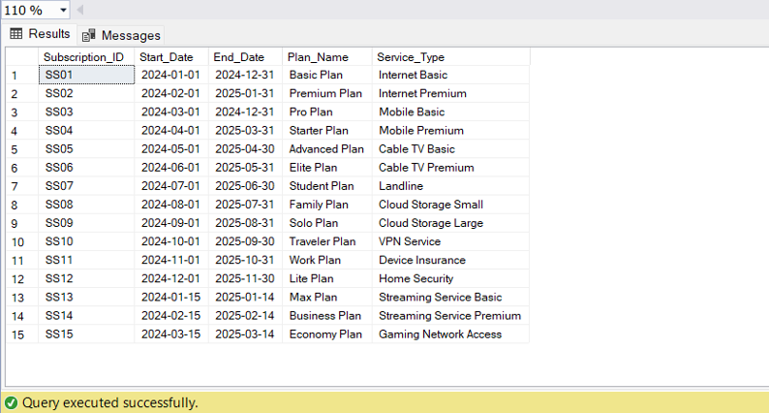
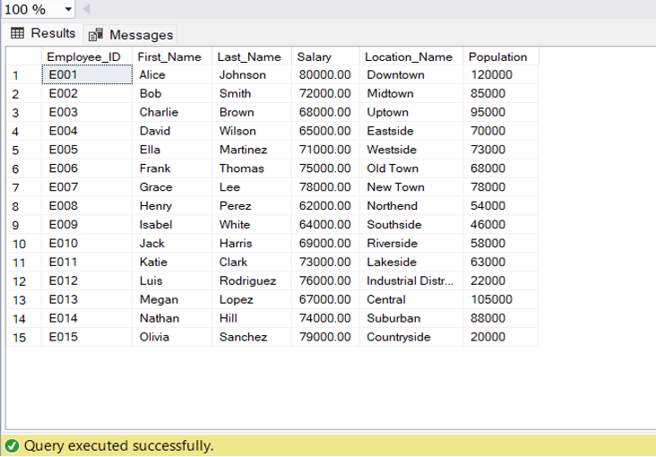
VIEWS -
DMDD GROUP 15
1. CustomerBillingView
2. EmployeeDepartmentView
3. ServiceSubscriptionDetailsView
4. EmployeeLocationView

Slide 8
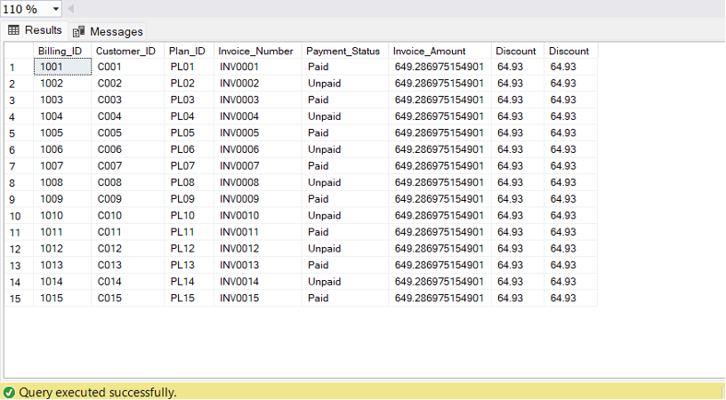
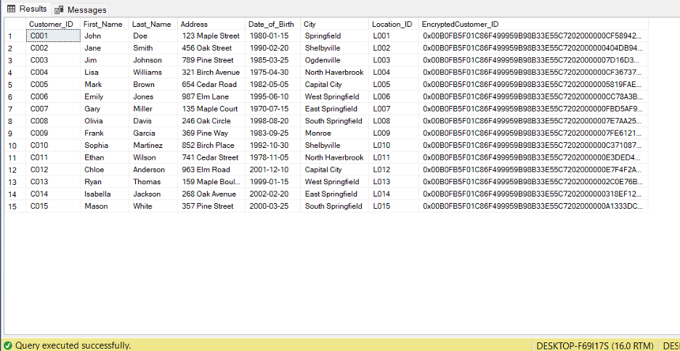
DMDD GROUP 15
User-defined function (UDF)
Column Data Encryption
dbo. CalculateDiscount
CREATE SYMMETRIC KEY Customer_IDKey
WITH ALGORITHM = AES_256
ENCRYPTION BY PASSWORD = 'DMDD123';

Slide 9
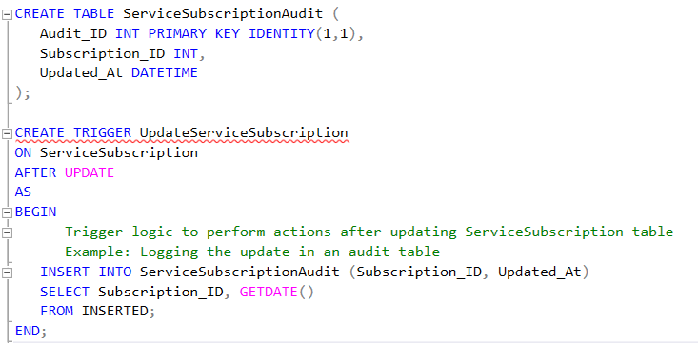
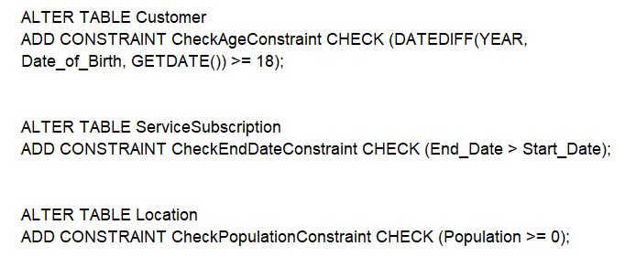
DMDD GROUP 15
TRIGGERS
CONSTRAINTS

Slide 10
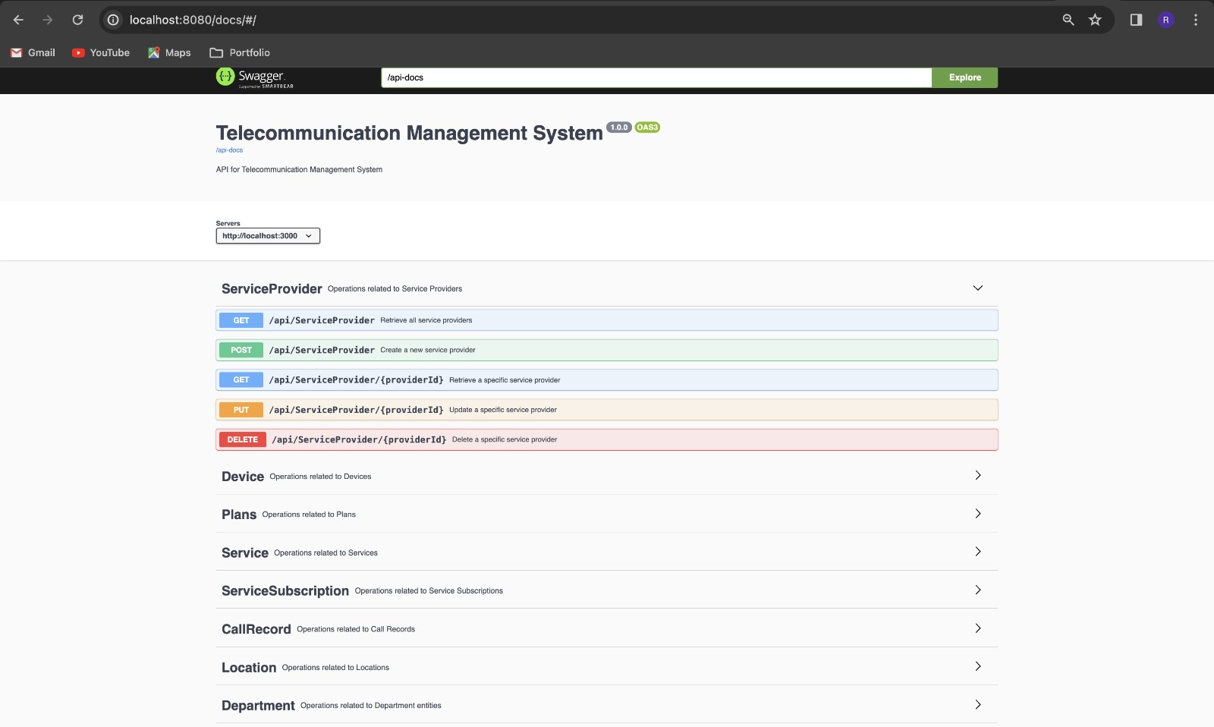
DMDD GROUP 15
GUI

Slide 11
DMDD GROUP 15
THANK YOU !!!!

