Slide 1
CISP 362 Mukarram, FALL 2017 Student: Chakra Kunda Android App Presentation
Final Class Project

Slide 2
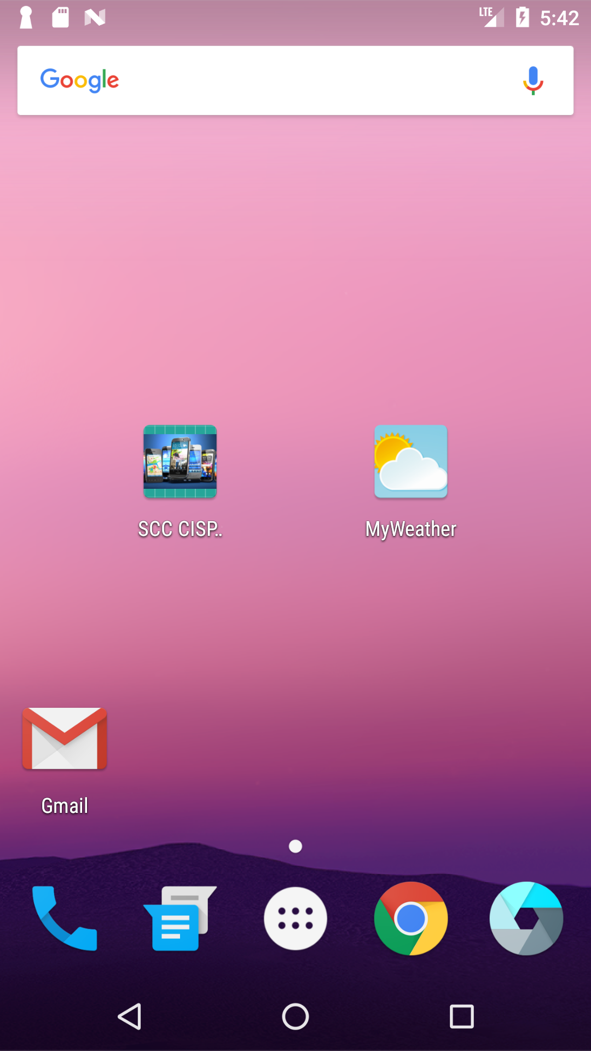
Class App: SCC CSIP.
Today we are presenting 2 apps: Class App and Personal App
Class App: SCC CISP.
This is the app that all the students in this class wrote for class project. It was built over time in pieces as we were learning mobile app programming on the Android platform
Personal App: MyWeather
This app is an individual app where we were free to come up with idea and publish it in Google Play Store

Slide 3
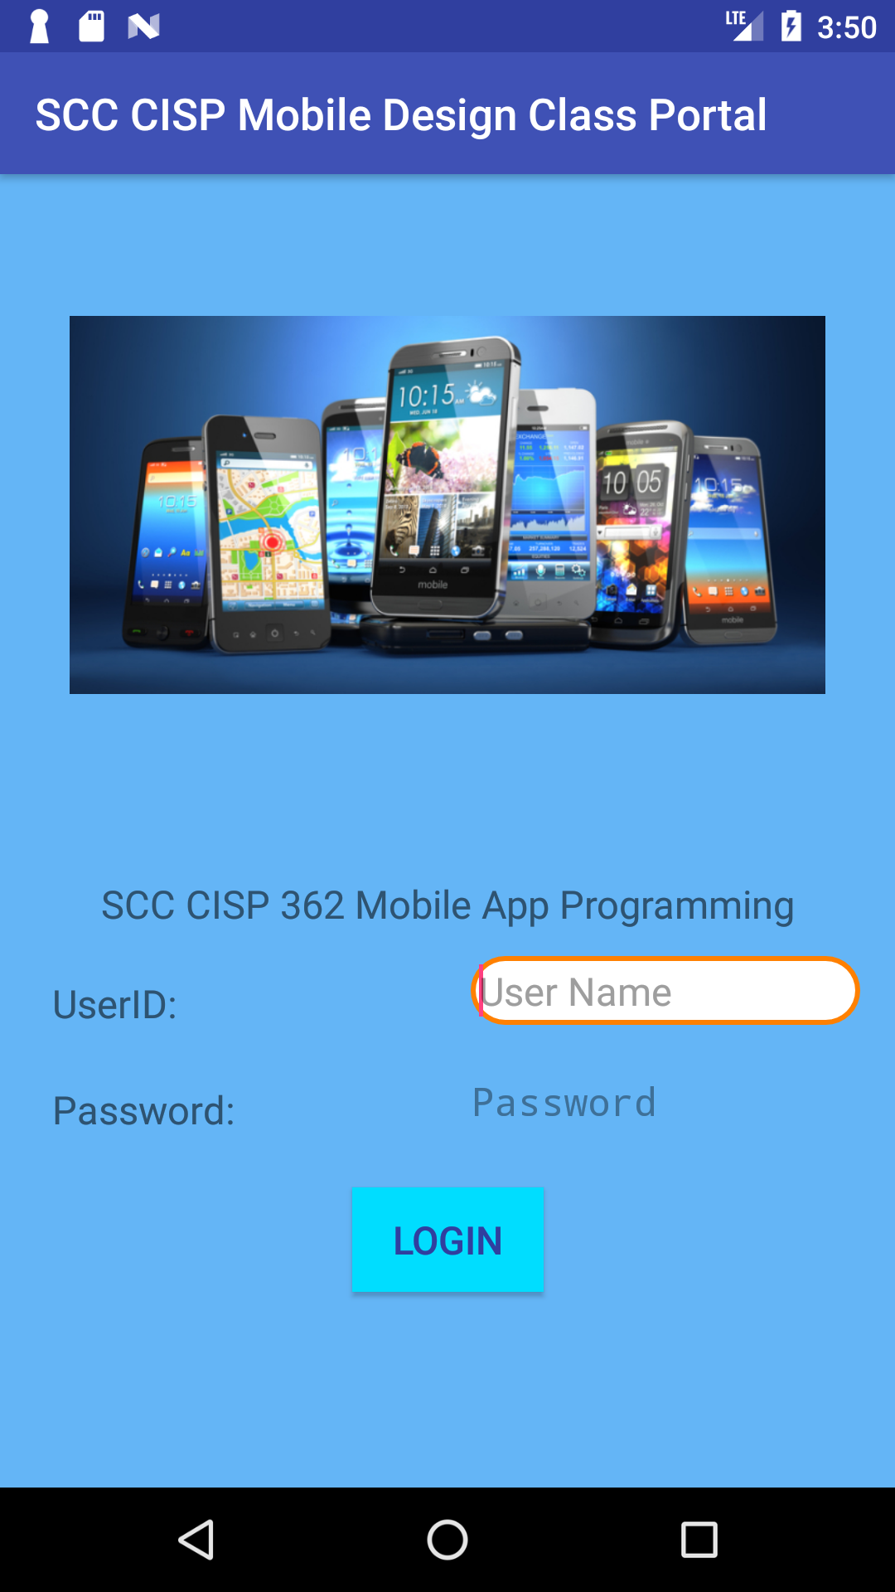
Class App: SCC CISP 362
Enter UserID
NBKAECY
Password:
tramp

Slide 4
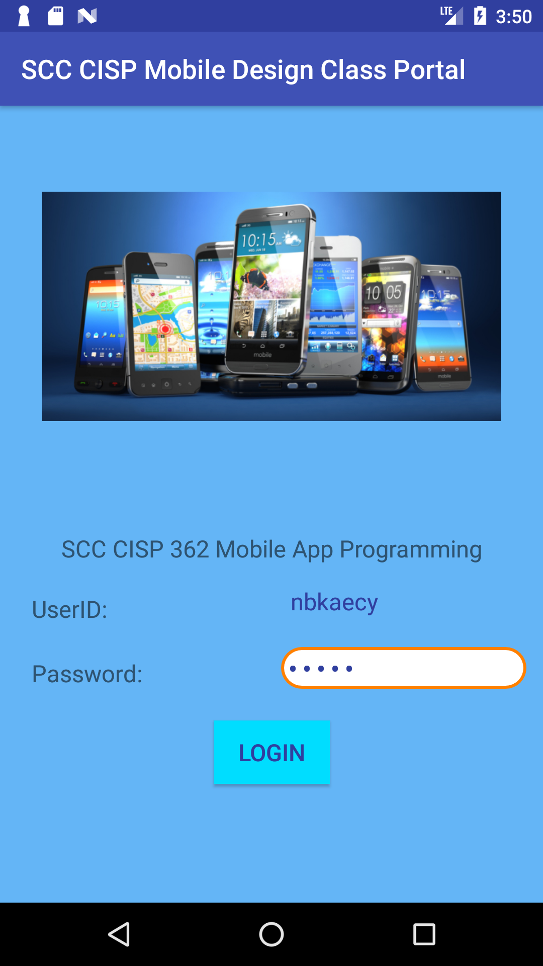
Class App: SCC CSIP.
Click LOGIN button to login and go to the next page.

Slide 5
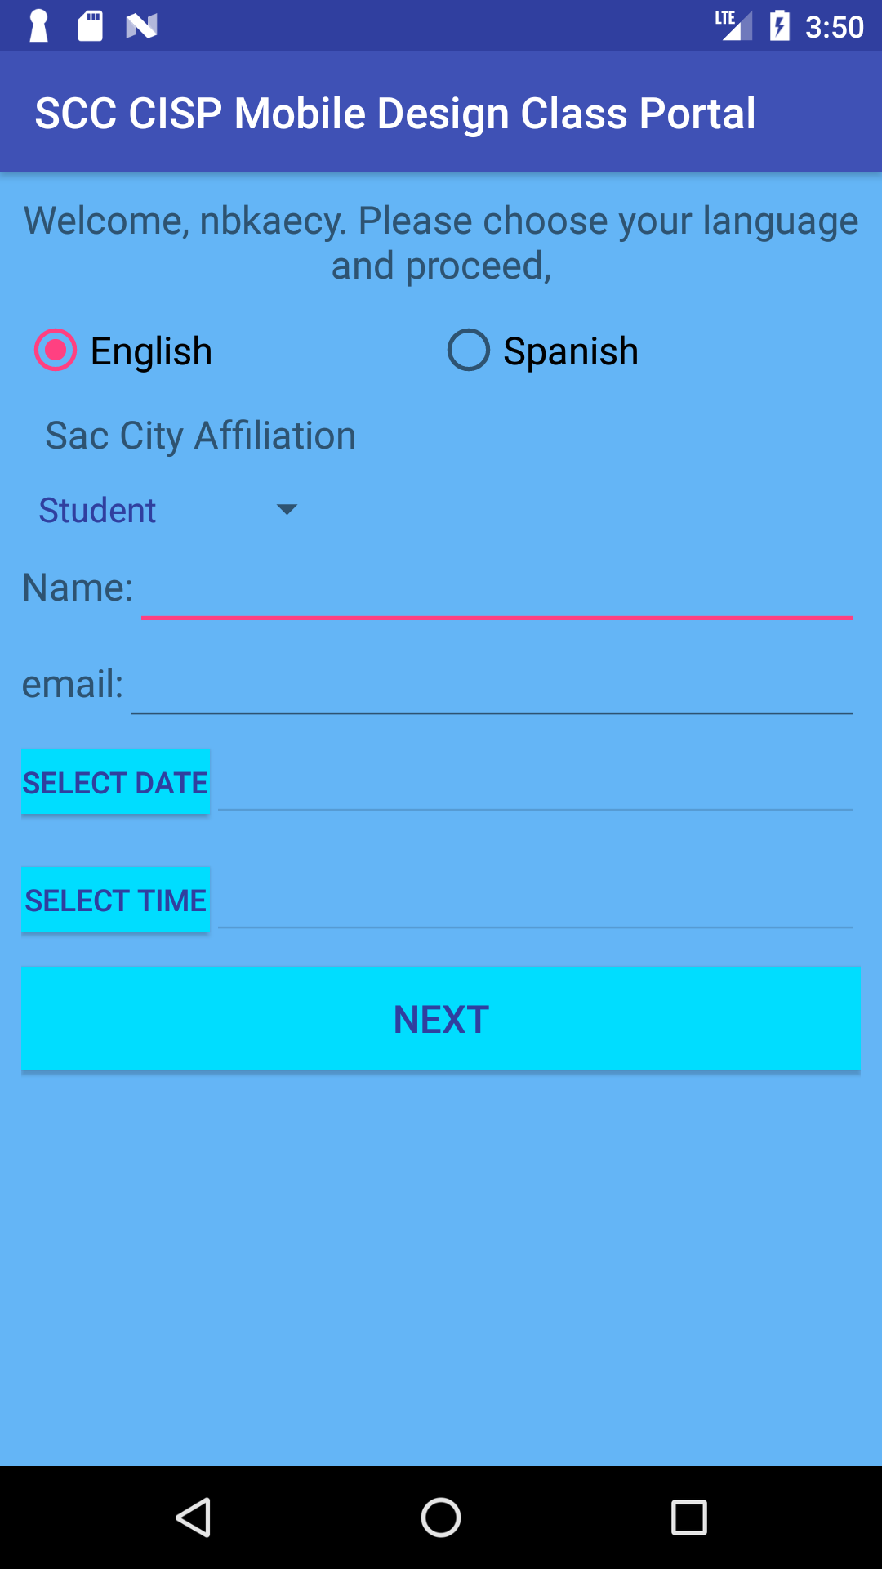
Class App: SCC CSIP.
Select your preferred language: English or Spanish
Select your affiliation to Sac City from drop down list
Enter your Name
Enter your email address
Enter a preferred date and time for a make believe appointment

Slide 6
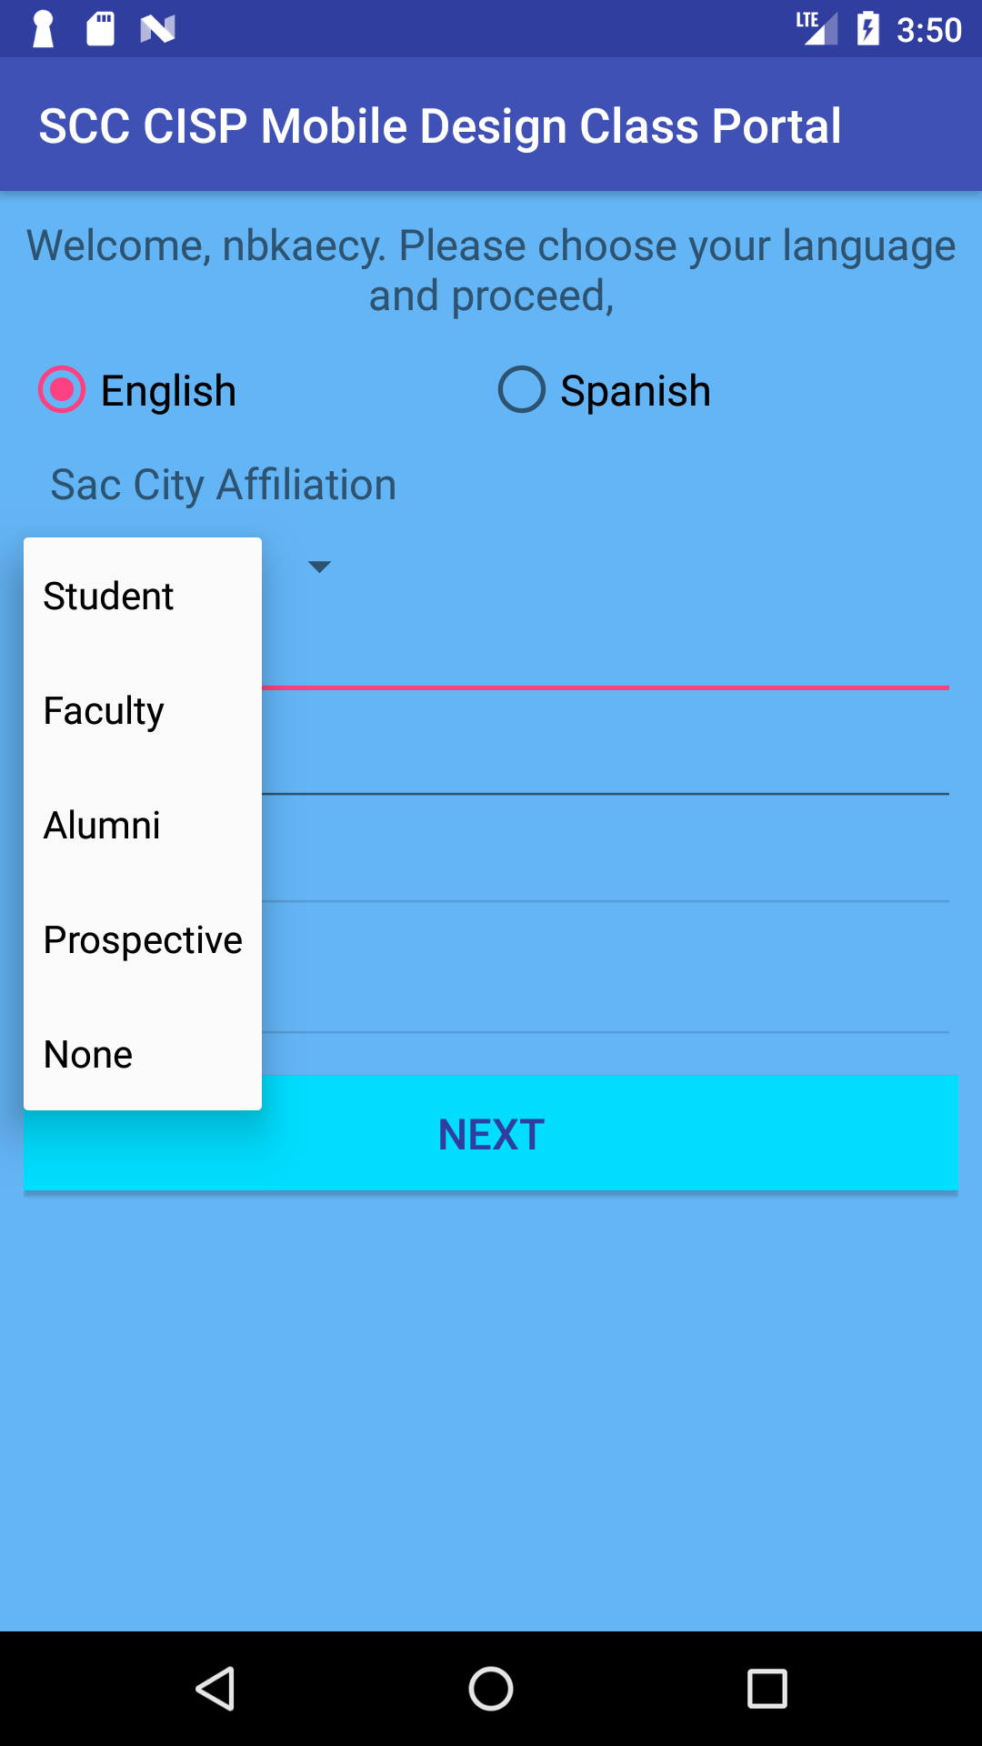
Class App: SCC CSIP.
Sac City Affiliation choices:
Student
Faculty
Alumni
Prospective
None

Slide 7
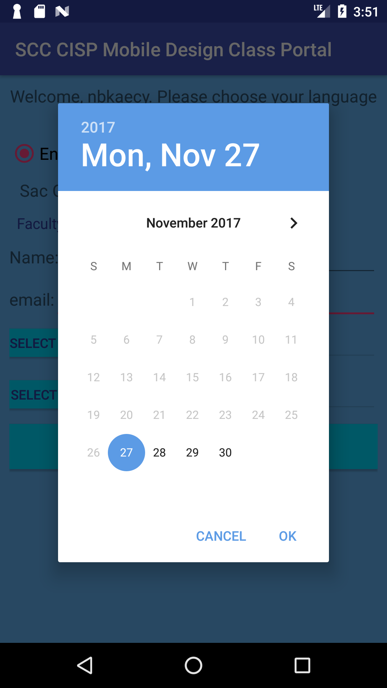
Class App: SCC CSIP.
On the Date field you can click on the ‘Select Date’ button to select date from a Calendar for your make believe appointment

Slide 8
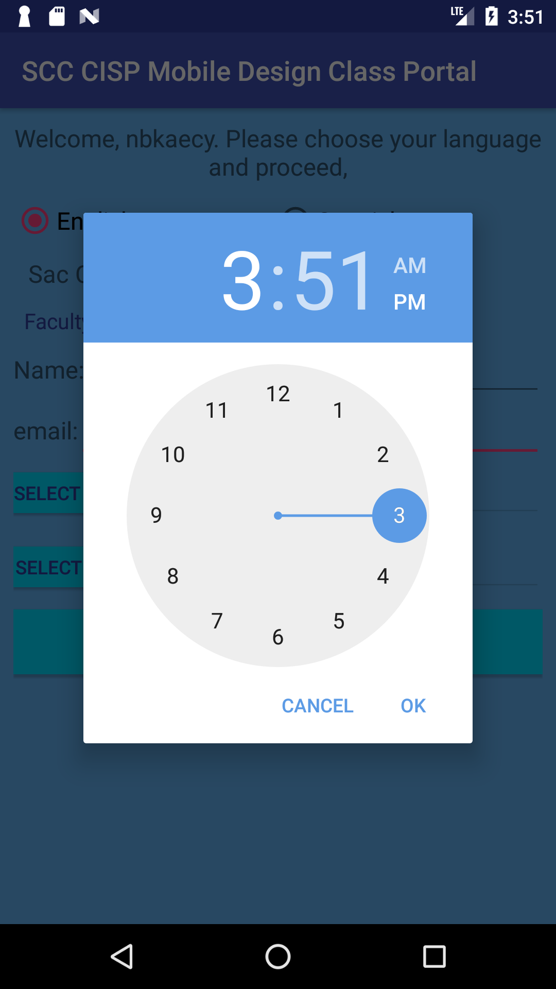
Class App: SCC CSIP.
On the Time field you can click on the ‘Select Time’ button to select time from a Clock for your make believe appointment

Slide 9
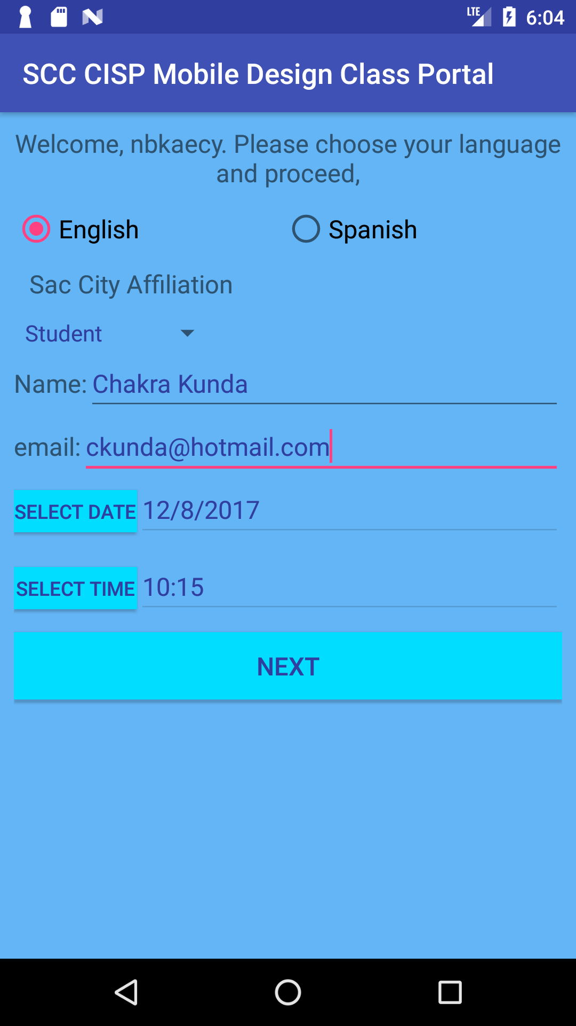
Class App: SCC CSIP.
Click on NEXT button once you entered all the information on this page

Slide 10
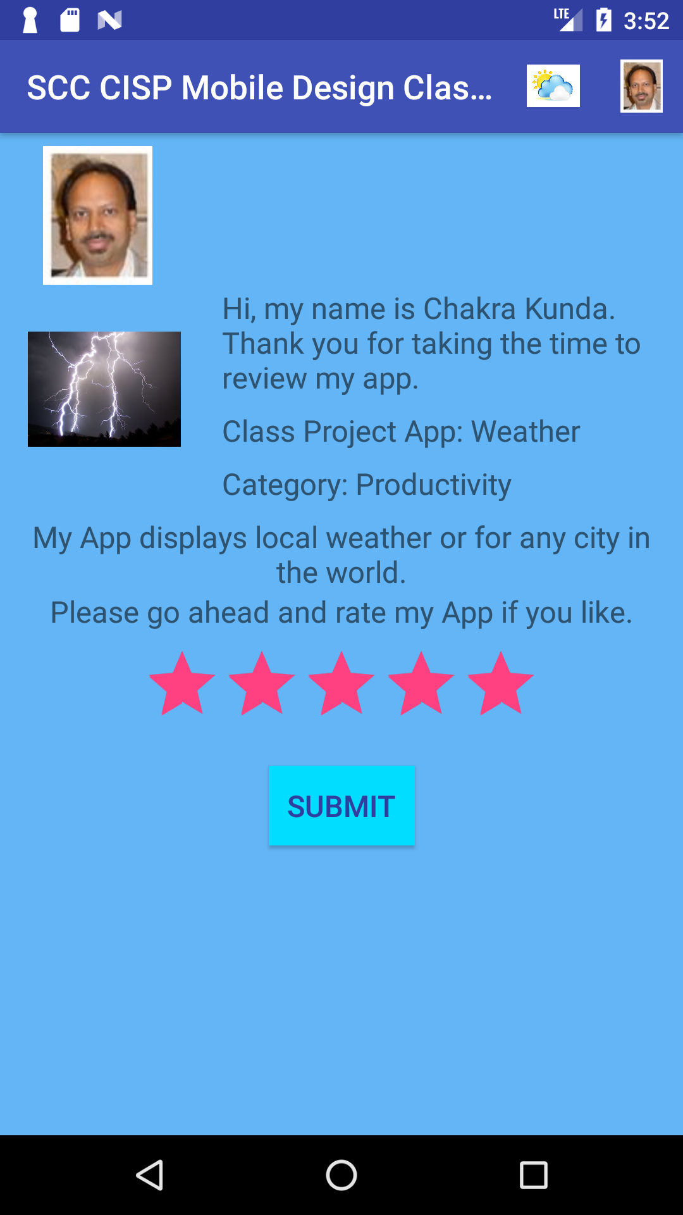
Class App: SCC CSIP.
This page displays some information about myself and my personal app.
You can also rate your experience of my app
Clicking on SUBMIT button launches the built-in GMail app where you can send an email to the email address you entered in the previous screen

Slide 11
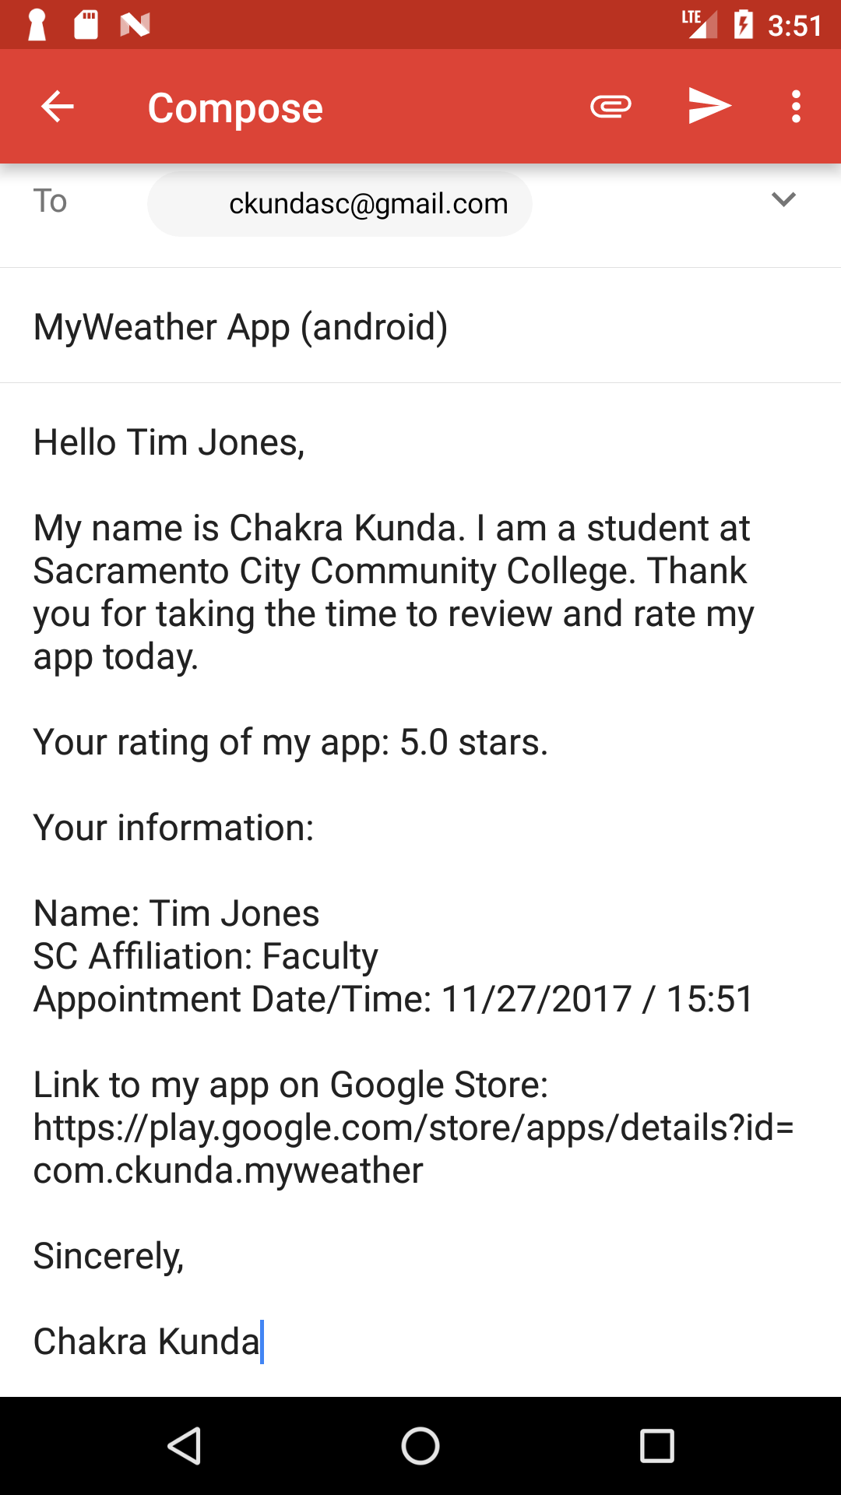
Class App: SCC CSIP.
This is Gmail App, here you can review the email that will be sent to the email address you entered earlier. You can modify the contents of the email before sending it.

Slide 12
Class App: SCC CSIP.
Back in the main page of the mobile phone, you can click on MyWeather to launch my personal app

Slide 13
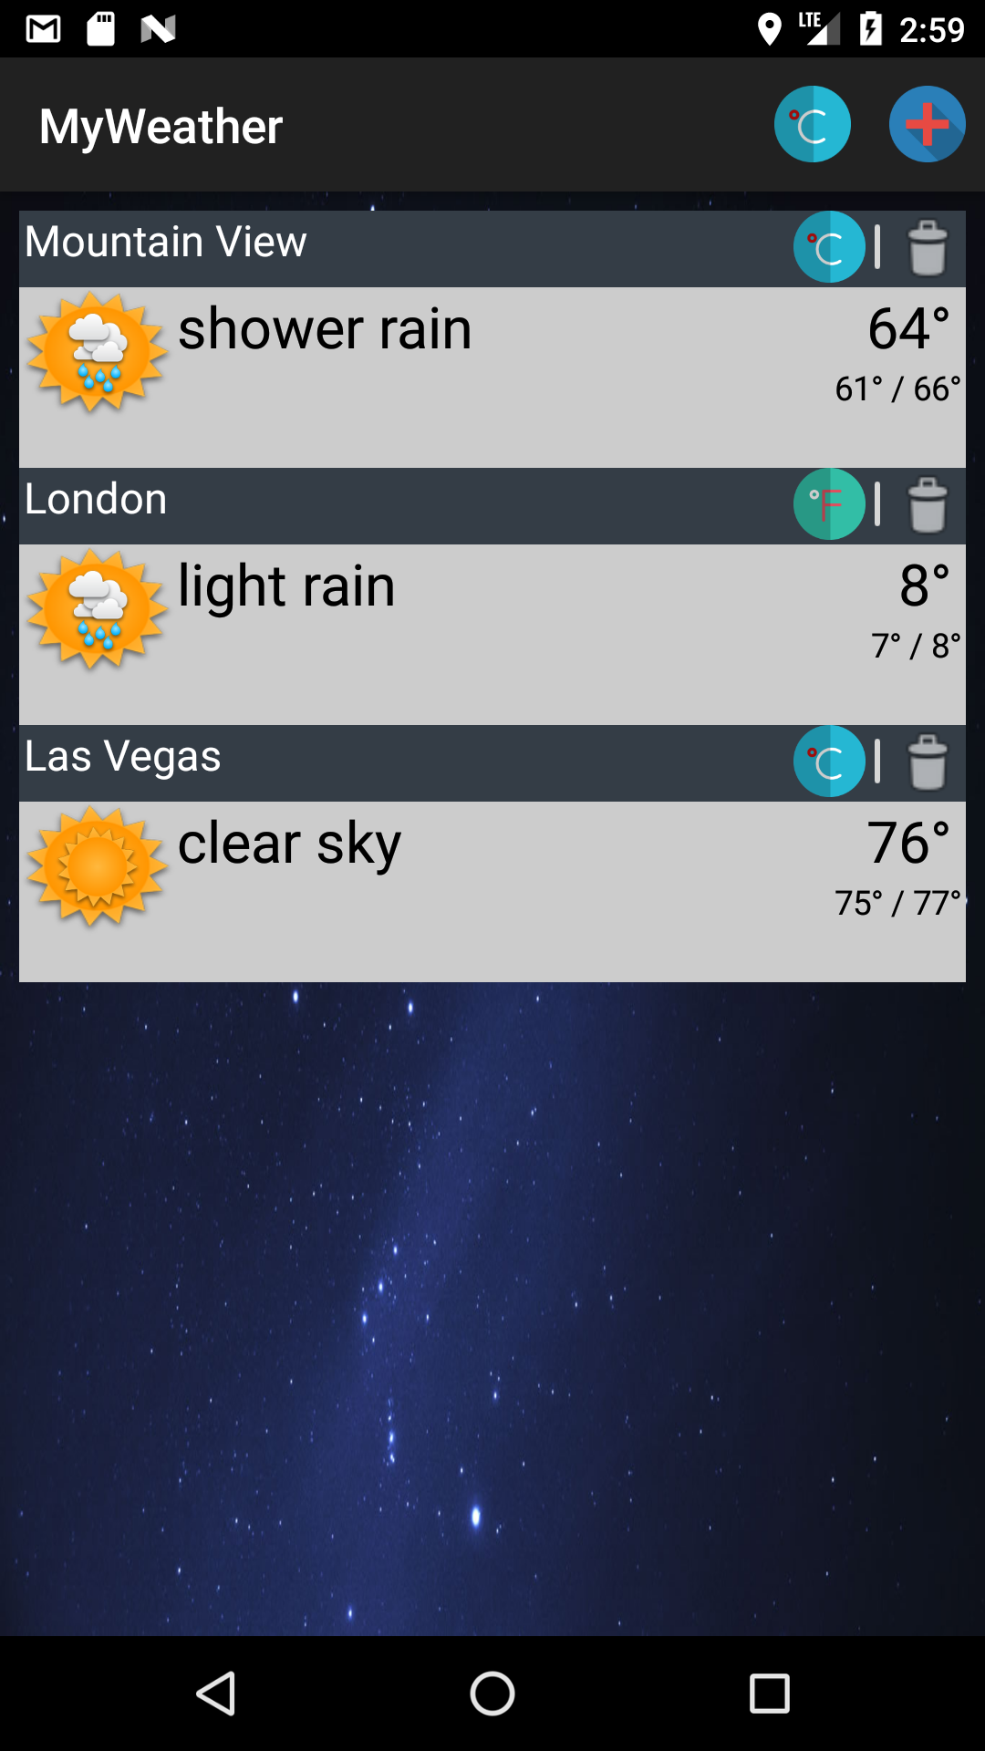
MyWeather
A light weight app that quickly displays local weather or for any city in the world. You can create a list of favorite cities.
App Features:
Displays weather for the local location.
Add/Remove cities to favorites list.
Toggle between F / C for a location or for all locations
Available on the Google Play Store

Slide 14

Thank you

