Slide 1

Predicting the effects of U.S. Meat Export Industry on the Environment
A time-series analysis of U.S Livestock and Meat Exports worldwide
Kristin Kusheva
14th Oct 2019

Slide 2
Research questions
Can we predict the amount of livestock or meat products being exported worldwide from USA over the next 3 years?
Based on what we learn, what does this prediction mean for the environment?
Given recent events such as the fires in the Amazon and more demand on land cultivation, can we find any correlation between those events and the export of meat?

Slide 3
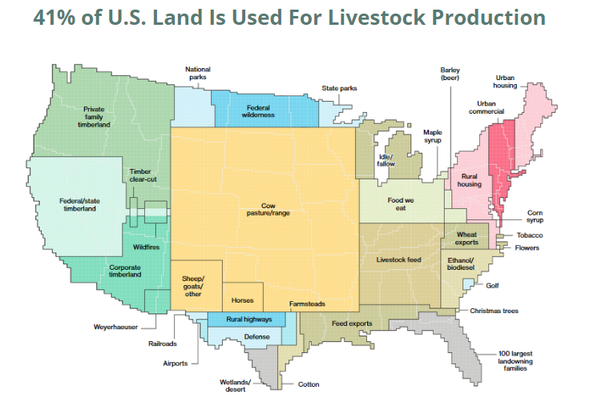
Background
Over the next 50 years, the world population is projected to increase by some 3 billion
This food insecurity and poverty is affecting one-quarter of the world's population
About time to address the issues of sustainable agricultural and rural development.

Slide 4
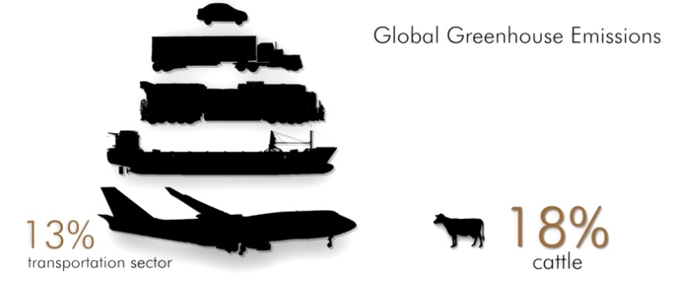
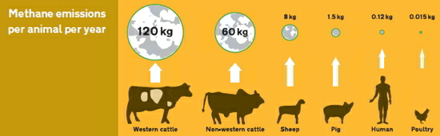
Agriculture and Climate Change
Agriculture contributes to climate change through the release of greenhouse gases into the atmosphere.
Land use changes also contributes to climate change. For example, deforestation, soil erosion or machine-intensive farming methods increase carbon concentrations in the atmosphere

Slide 5
The Data
I obtained my dataset from data.gov which is a website of the U.S. Government’s data for public use.
My features will include the amount of livestock and meat products exported from the USA to different countries from 1990 to present.

Slide 6
Techniques
I will employ machine learning NLP such as word2vec and lemmatising techniques to classify each commodity description to a more simplified commodity in order to clean the data so it will be suitable for aggregation.
1
I will use ARIMA modelling to model the number of livestock and meat products exported from the USA and project it further out. I will also use GridSearch to optimise the parameters when using the ARIMA modelling.
2
I will use neural network techniques such as LSTM to model the amount livestock and meat products exported from the USA and project it further out.
3

Slide 7
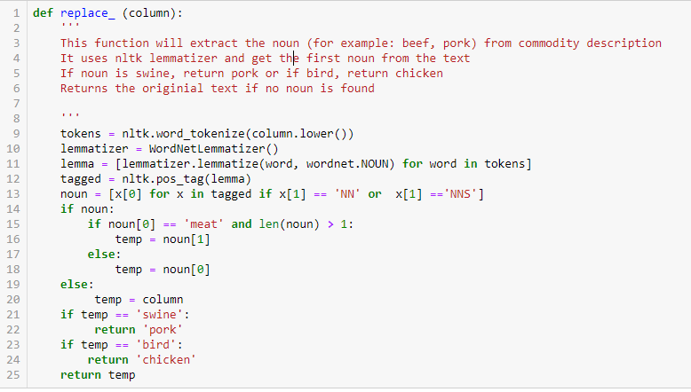

preparing the data for modelling
Example:
Cleaning the noise data by replacing them with blank
Removing duplicates
Converting the text to be lowercase
Standardising the unit of measurements for all the products to be in kilograms
Extracting the noun from the commodity description column
Applying the function to column ‘Main_Desc’:

Slide 8

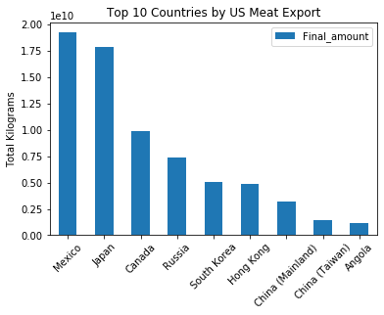
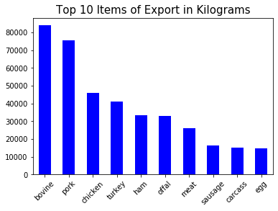
US Meat export analysis

Slide 9
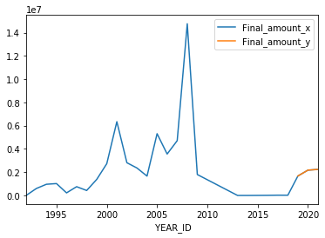
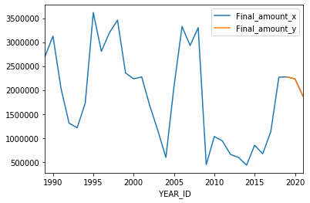
Modelling: ARIMA
Bulgaria:
AutoRegressive Integrated Moving Average
Extension of linear least squares regression
AR(p) – Lag order; number of lag terms to consider
I(d) – Degree of differencing to make stationary
MA(q) – Size of moving average window
ARIMA (p,d,q)
Brazil:

Slide 10
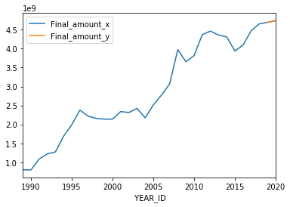
Predicting the Meat Export from the US to the World Using ARIMA in Kg

Slide 11
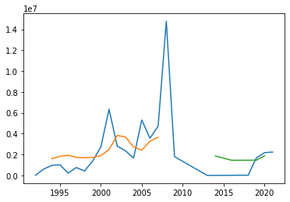
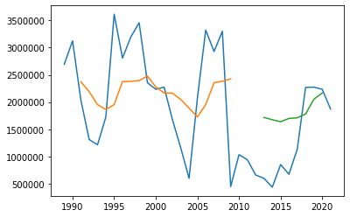
LSTM
Bulgaria:
A powerful type of neural network designed to handle sequence dependence is called recurrent neural networks. The Long Short-Term Memory network or LSTM network is a type of recurrent neural network used in deep learning because very large architectures can be successfully trained.
Brazil:

Slide 12
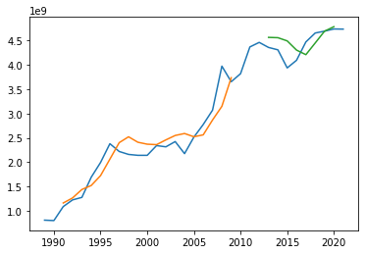
Predicting the Meat Export from the US to the World Using LSTM in Kg

Slide 13
Interpretation of the predictions
Bulgaria – the import from USA will rise during the next 3 years. We see that since 2009 there has not been any import of pork from the US. However, from 2018 till mid 2019 in total there were 23 tonnes of pork imported from the US. This might be as a result of the recent swine fever that affected the pig agriculture in many countries in the Eastern Europe.
Brazil – the import of meat will be decreasing during the next 3 years which might mean that they started producing their own meat. If this is true, Brazil needs more land in order to fulfill their demand. Amazon fires – on purpose or a convenient coincidence?
World – the export of meat is rising during the next 2 years. This is concerning because as we saw that 41% of the land in the US is used for agricultural purpose. The percentage will rise even further.

Slide 14
Conclusion
For both 2019 and 2020, the world will import a total of 9 billion kg of meat from the US – 4.69 billion in 2019 and 4.73 billion in 2020.
This is 83 million kilograms more compared to 2018.
In 2019 the meat exports from the Us will require the use of 42.2 trillion litres of water whereas in 2020 this amount it is predicted to rise even higher – 42.6 trillion litres.
This is 707 billion litres more compared to the numbers in 2018.
Over the course of the following year, the world will need 4156 km2 extra land to satisfy the customers’ demand for meat products exported from the US only. This is 4 times the size of hong kong.

Slide 15
References
https://www.bloomberg.com/graphics/2018-us-land-use/
https://www.theguardian.com/news/datablog/2013/jan/10/how-much-water-food-production-waste
https://www.arespectfullife.com/2018/08/05/41-of-u-s-land-is-used-for-livestock-production/
https://www.ncbi.nlm.nih.gov/pmc/articles/PMC5366844/
https://www.ers.usda.gov/amber-waves/2019/may/us-exports-for-most-major-meat-commodities-grew-in-2018/

Slide 16

Q&A time

Slide 17

Thank you!

