Slide 1
Assignment by CK Wee (15-May-2021)

Slide 2
Contents
Overview of modelling process
Exploratory analysis of data
Methods of outlier detection and other data cleaning steps
Model selection and validation process
Selection of accuracy metric(s) and prediction accuracy achieved
Explanation of variables that are most important to predicting dose rates
Description of how such a dosing model can be implemented, monitored and utilized
Proposal of any other methods that can be pursued

Slide 3
Overview of modelling process
Steps
Understand the situation and problem precisely.
List what are the expectations.
Design the model(s) to meet the challenges
Train or solve the model using the data
Validate and analyze the model
Prepare or integrate model for acceptance testing
Serve and support the model to production.

Slide 4
Exploratory analysis of data
Try to understand the nature of the dataset. Things to look out for in the dataset;
- Types of data (structured, unstructured or semi)
The attributes of the dataset;
Number of entries
Datatypes of the columns
Presence of null or zero values, which may indicate absent of valid data.
Distribution of the numeric data (e.g. range, mean, std deviation, min-max, 25%/50%/85% percentile)
pairwise joint distribution of the data
Presence of potential outliers or abnormal text.
If the data is time series, then we need to look at the following attributes of the dataset;
Frequency, period range
Plot the data to see visually by daily, monthly and yearly frequency
Decomposition of the dataset to see if it has trend, seasonality, other random patterns.
Validate if the frequency interval is consistent. BOM’s weather dataset are notorious for skipping this.

Slide 5
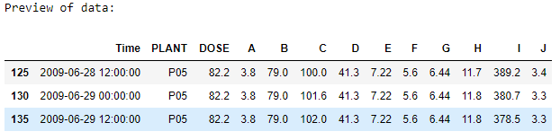
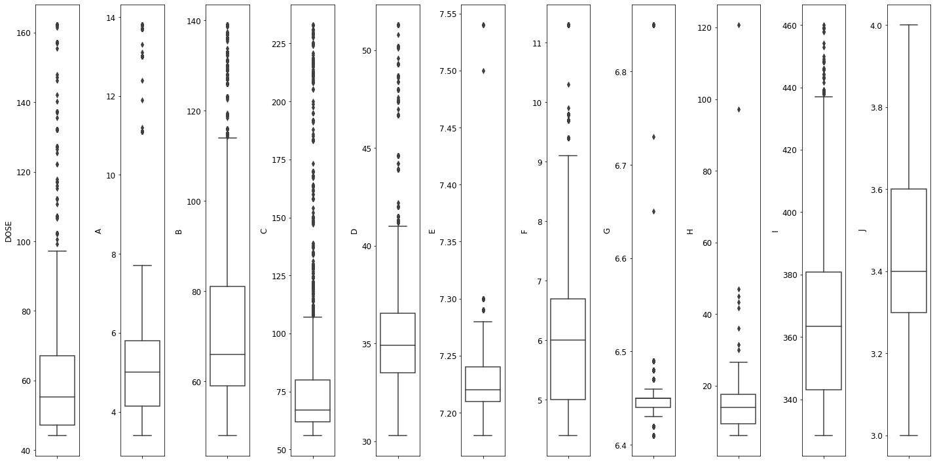
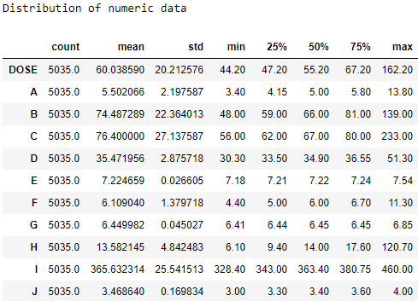
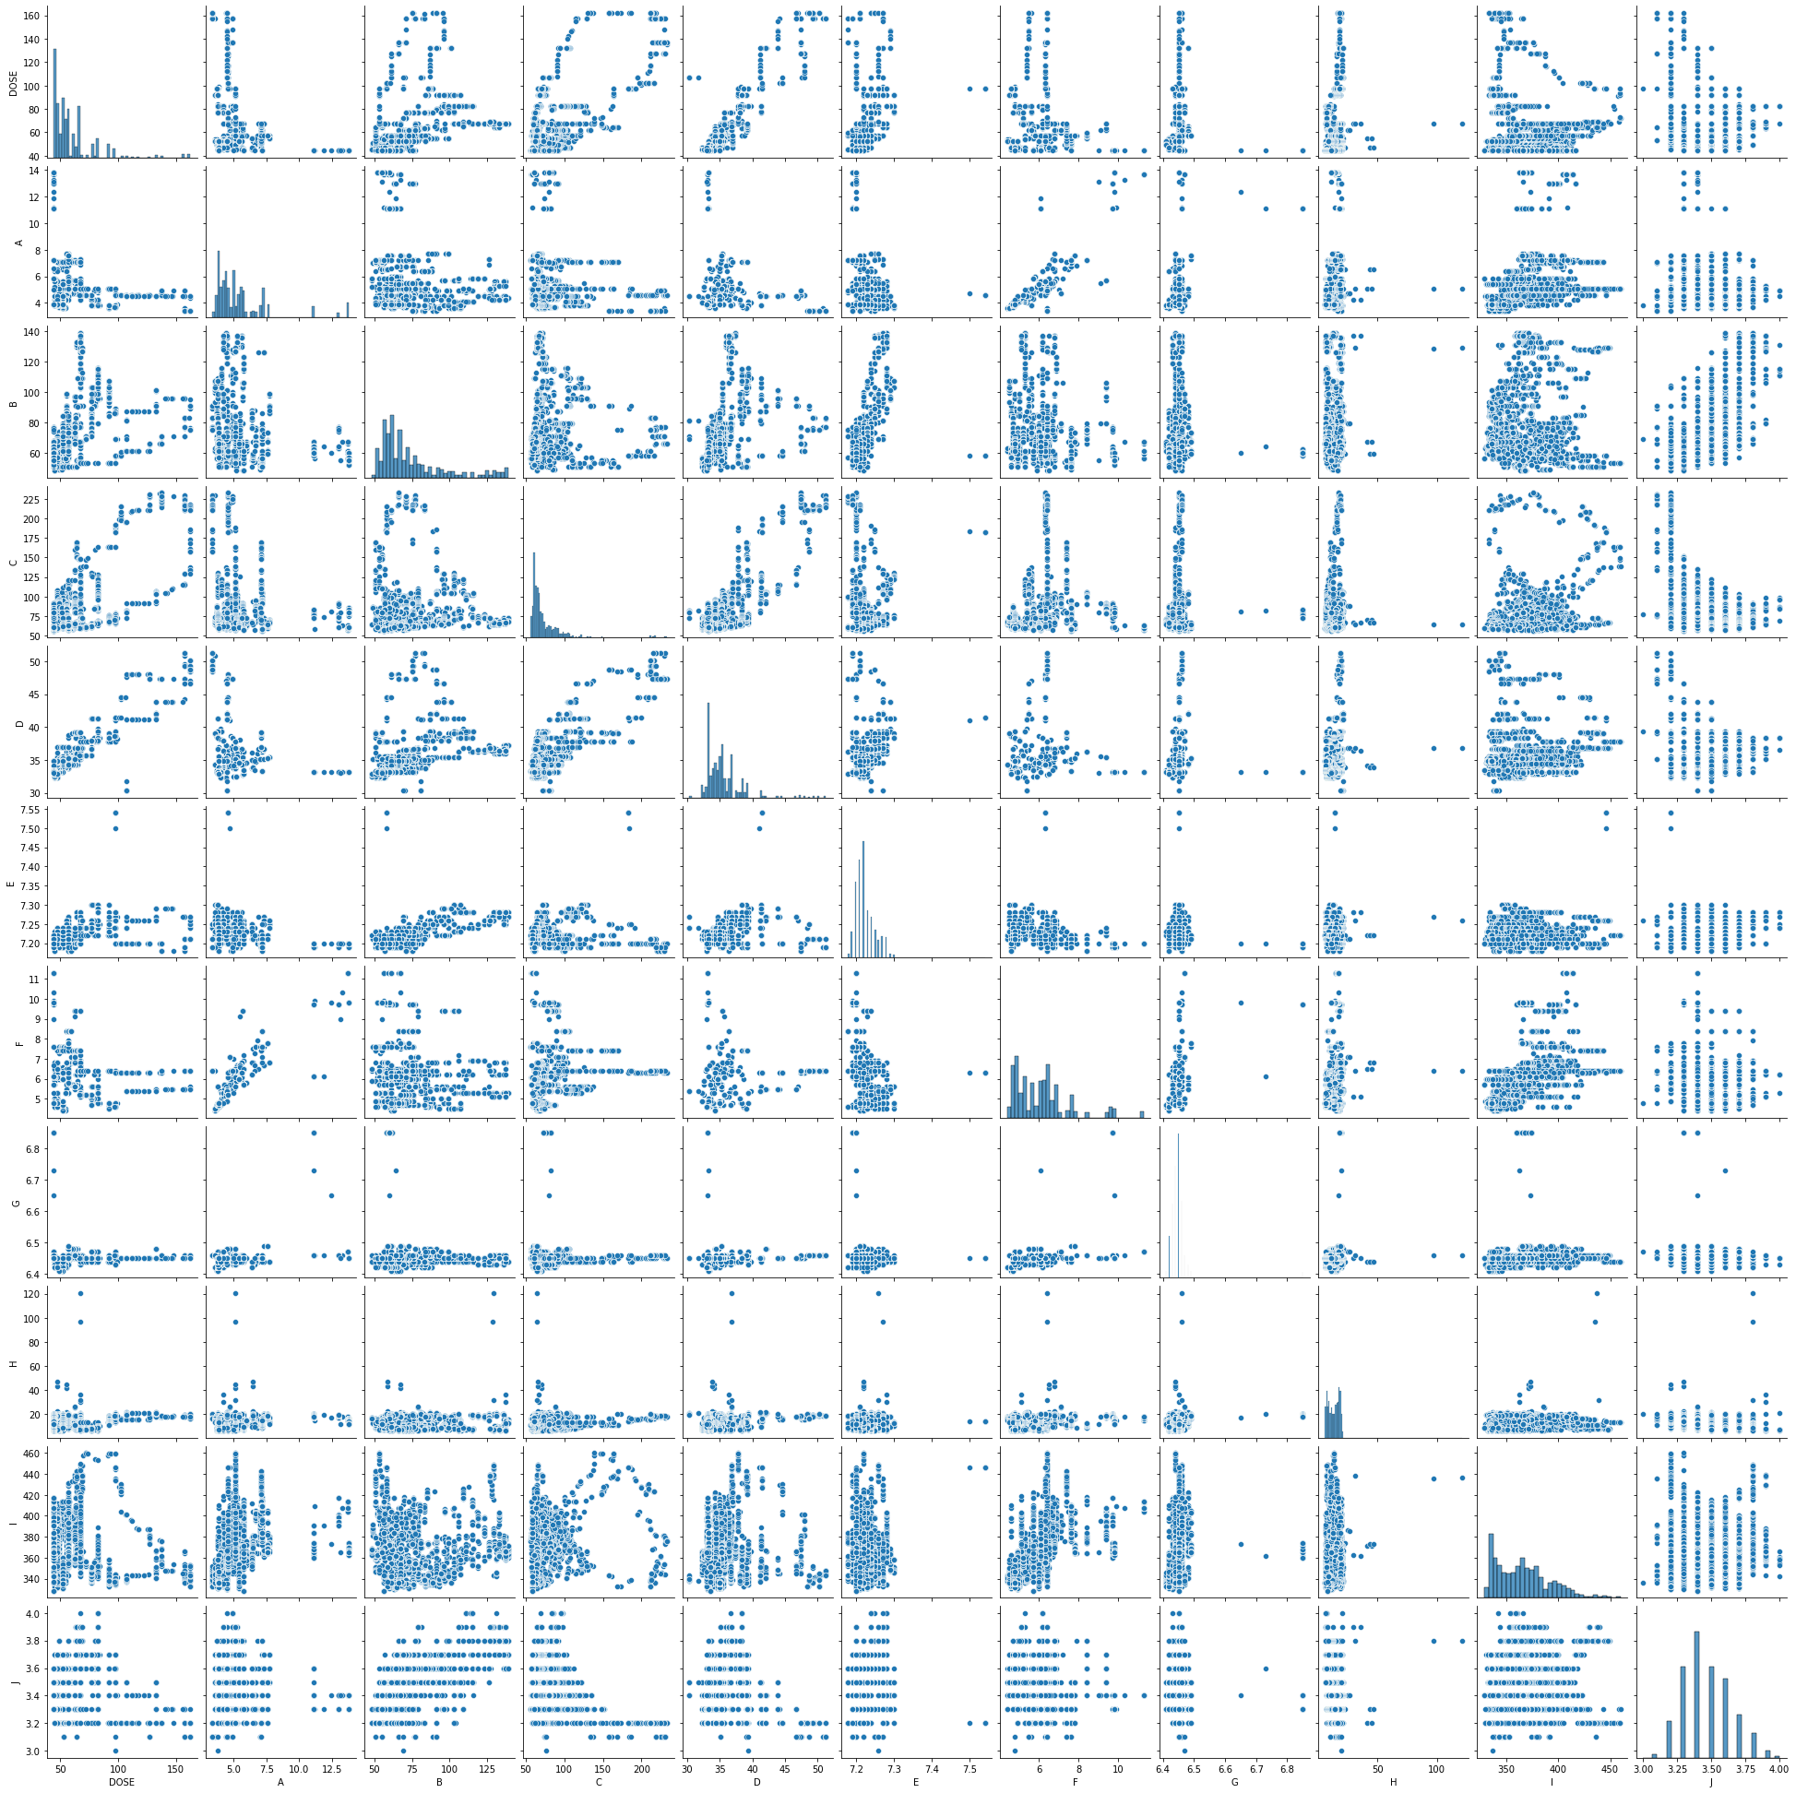
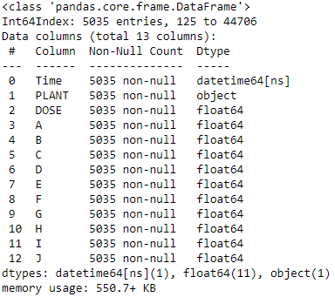
This explore the entire dataset for all the periods for station P05. Ideally, it should be limited to 1 to 2 seasons.

Slide 6
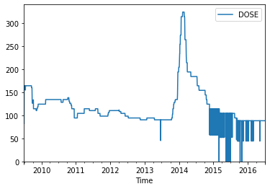
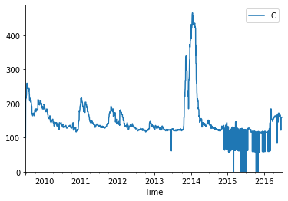
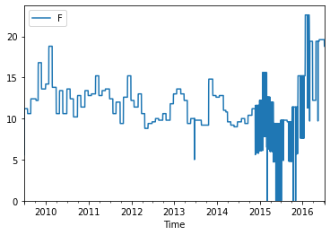
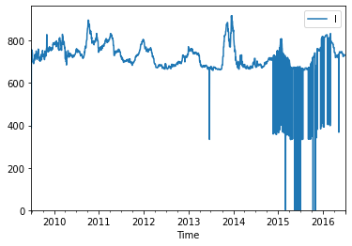
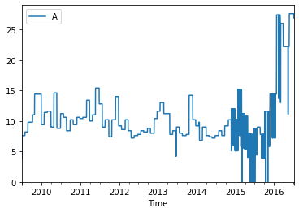
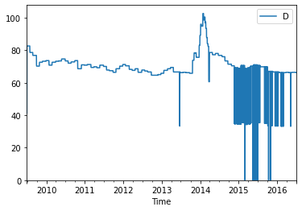
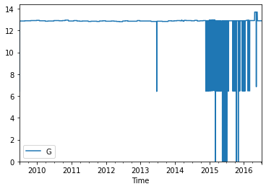
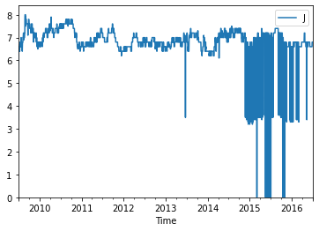
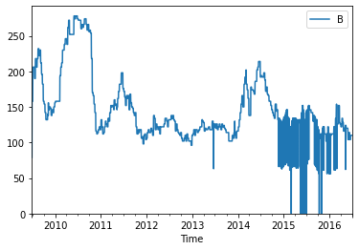

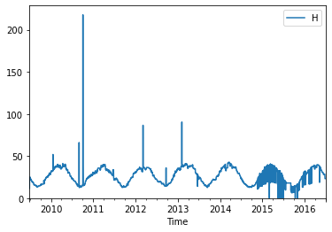
Exploratory analysis of data for P05 station (time series plot without change to interval )

Slide 7
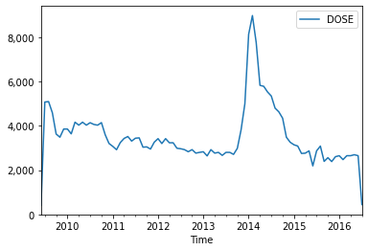
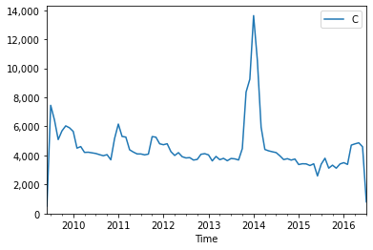
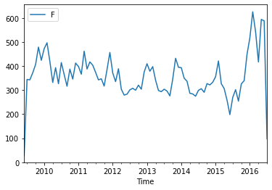
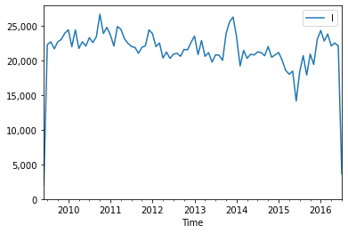
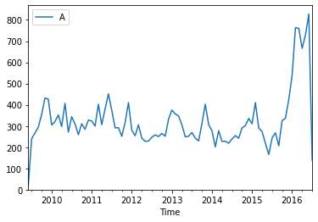
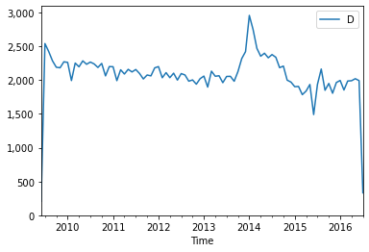
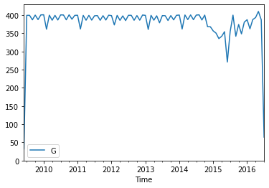
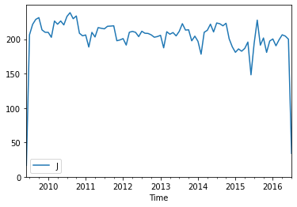
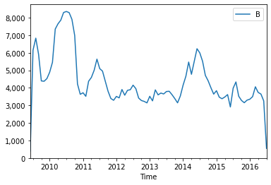
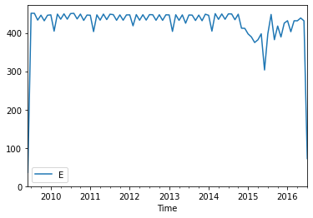
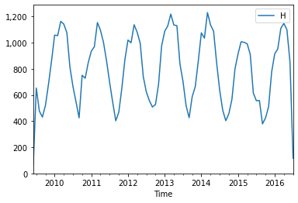
Exploratory analysis of data for P05 station (time series plot monthly)

Slide 8
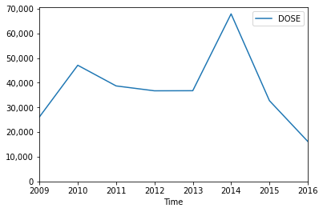
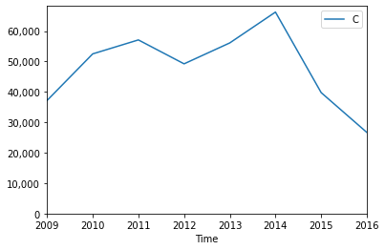
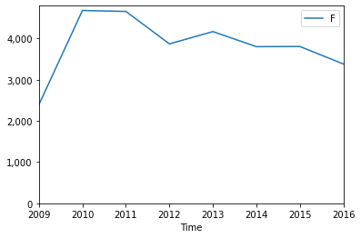
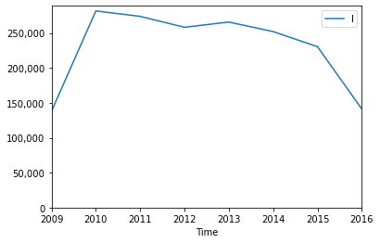
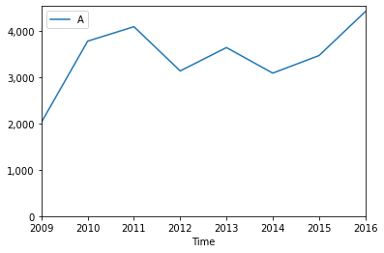
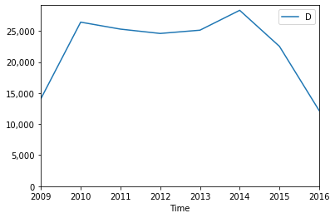
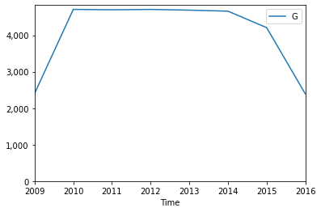
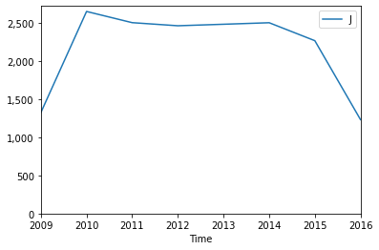
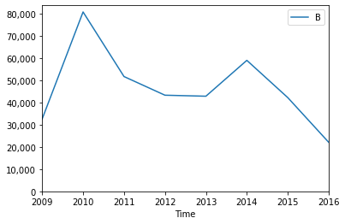
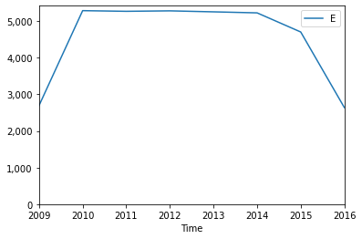
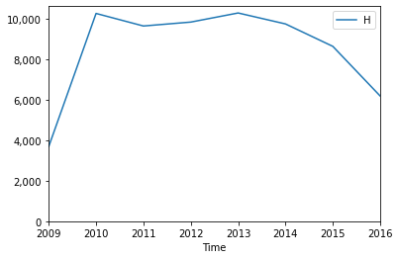
Exploratory analysis of data for P05 station (time series plot yearly).

Slide 9
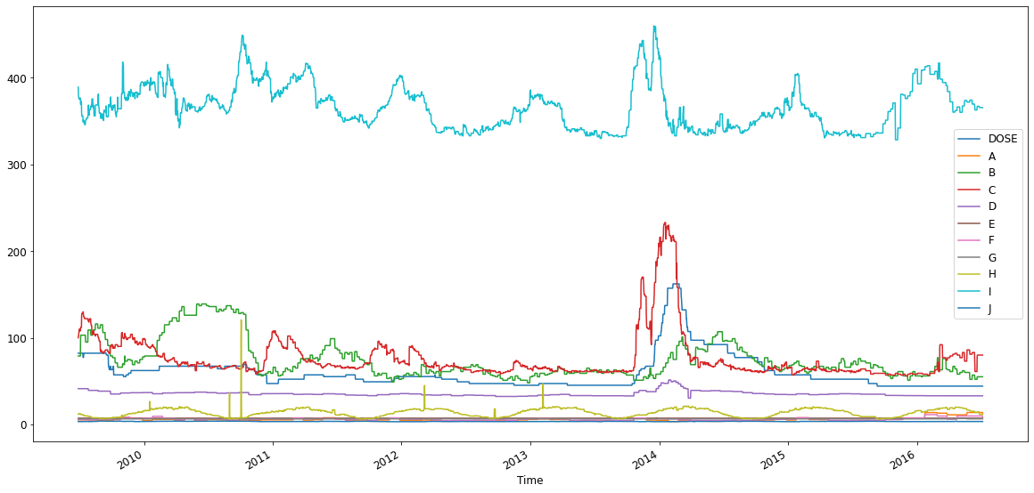
Combined plot of all variables for P05 station

Slide 10
Methods of outlier detection and other data cleaning steps
Current dataset has #VALUE! Text. Need to replace them.
For invalid entries such as above and zero values, they are usually replaced with mean value of the columns, or the average between the t-1 and t+1 values.
But for time series, for single data replacement, they are replaced with either value from last season (week, month or year) or, average between t-1 and t+1 within the current period.
For outlier values, they are usually some recording issues but still stand as valid with high readings, they can be replaced with values from the high or low percentiles.
For non-numeric qualitative data, we can do substitution or encode with numeric values representation.
data values and format needs to be standardized in the exact day-mon-year hh24:min:ss format. (eg. 5th june ‘97 2:20pm → 05/06/1997 14:40:00)
Values need to be converted to acceptable standard measurement and scale (lb → kg, 1000mcg = 0.001g)

Slide 11
Model selection and validation process
Apart from the standard answers that we tend to find on the internet, there are several other aspects that need to be considered especially within a specific categories of models. I start with the current setting;
We need to determine the nature of the problem that the model need to solve;
is it supervised or unsupervised. Do we have labelled data?
Is it classification, regression (for supervised)? Or a clustering, optimization challenge?
Is there sufficient dataset to support the model? Do we need semi-supervised if there is no A-prior dataset?
Will it be a single model or ensembled with multiple models?
What are the hyperparameters that need to be considered and tuned?
If it is time series, is the data univariate or multivariate? We can use models such as ARIMA, Holt-Winters, TBATS or LSTM to perform the forecast. For more discussion on this, please refer to my paper (https://link.springer.com/chapter/10.1007/978-3-319-76081-0_42)
For validation purposes,
The amount of data that need to be split for training and testing. Will it be 80:20 or 70:30 with some randomness sometime, a higher volume will cause the model to overfit. Then there are paths to prevent over-fitting.
If it is time series based, the data used can be 80:20 ratio split but they cannot be random. The forecasted values is compared against the remaining future 20% of the data and measure the difference. A good model will produce a lower error rate.
Then there are other question;
What is the cost function? How can the stochastic gradient descent perform?
For optimization model selection process, is it an NP-hard problem? Is there a time limit to find the near-global maxima for it?

Slide 12
Selection of accuracy metric(s) and prediction accuracy achieved
There are measurements that can determine the accuracy of the model such as MASE, MAPE, MAE. Some are scale-based and others are ratio based.
chi-square error, F1 score, confusion matrix that measure the precision, accuracy of the model.
AUROC curve to determine the progress of how the model performed and can it converge
The model’s objective is to reduce the cost function.
Result of using VAR model for the forecast, squared mean errors between actual test vs predicted values.
Model accuracy
rmse value for DOSE is : 14.624162402810088
rmse value for A is : 4.622550666225494
rmse value for B is : 12.15248108903856
rmse value for C is : 18.398468881219543
rmse value for D is : 1.9447780130132521
rmse value for E is : 0.02098554189931045
rmse value for F is : 2.4736884023547523
rmse value for G is : 0.0967005202649553
rmse value for H is : 4.434472952208541
rmse value for I is : 29.87592316272347
rmse value for J is : 0.13838833850901003

Slide 13
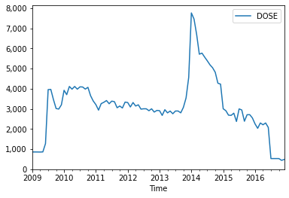
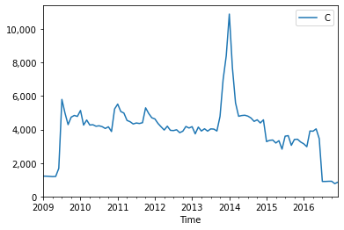
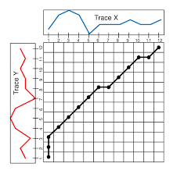
Explanation of variables that are most important to predicting dose rates
From the visual inspections, column B tend to have a more significant effect on the dose as compared to the others.
we can also use dimensionality reduction techniques to determine which variables are more significant that the rest. Models such as PCA, t-SNE or UMAP are some examples.
We can use Dynamic time warping to measure the Euclidean distances among the variables which can determine the similarities, which can be equated to their correlation.

Slide 14
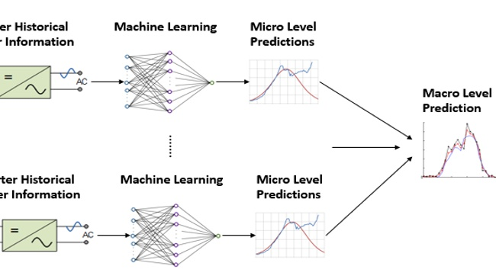
Description of how such a dosing model can be implemented, monitored and utilized
Currently I used the vector autoregression (VAR) model to do this.
The dosage is dependent on the variables A – J, so we need to gain the knowledge of how variables A-J will become in the future. Perhaps, it will be an implementation of hierarchical forecasting where forecasting are performed on the variables for the short-term, then use them to predict the dosage.
Another method is to forecast the variables A-J but use regression model to determine the dosage values.
The model can be served up as a Restful API via a docker container. So intelligent dosing equipment can be programmed to issue an API call with the variables A-J as input and then get the recommended dosage.

Slide 15
Proposal of any other methods that can be pursued
We can use LSTM to introduce the use of deep learning for forecasting. it is well known that deep learning’s forecasting outperform the traditional statistical methods.
The dosage is based on past research and rules. But we can use heuristic optimization to find the best dosage.
There should be a feedback loop if this model is in production. So that we know how well the dosage perform. If the predicted dosage is insufficient, then the feedback loop will inform us that the model in underperforming, and vice versa.
That is why we need reinforcement learning model on top of the forecasting + regression & optimization models’ combination to be more adaptive to the dynamism of the environment and correct the model’s hyperparameters or change the error terms to improve it. (paper:Adaptive Data Replication Optimization Based on Reinforcement Learning, https://ieeexplore.ieee.org/document/9308306)
I proposed the use of cloud services (AWS, Google or Azure) where the time series dataset can be stored in data lakes and load into data warehouses such as Synapse or Snowflake. Then use stored procedures/packages to do the data cleansing processes more efficiently.
New data can be loaded in via ELT tools (either with python or 3rd party tools).
Data warehousing architecture to segregate the role of ODS, data mart, change data control etc.
Cloud service can run Apache’s Spark/Databrick to improve the model training time.
Cloud’s Web app services to serve the model up as API or web portal, in place of kubernetes.

Slide 16
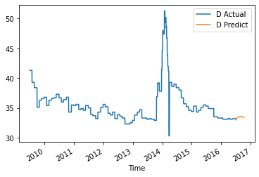
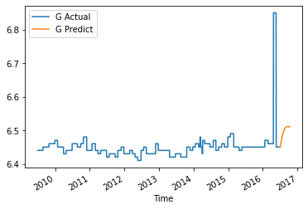
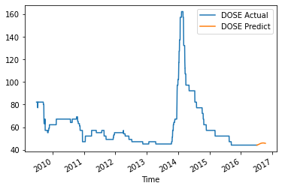
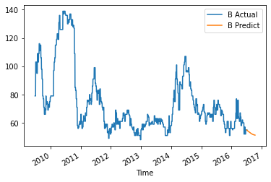
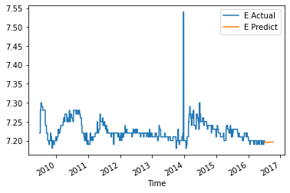
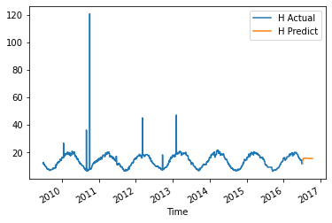
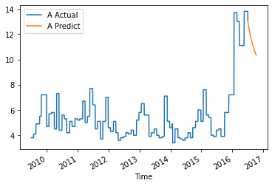
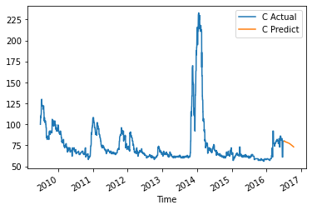


Forecasting on all columns using VAR trained model for 200 future intervals

