Slide 1
CUS1166 – Software Engineering Technology Presentation
Flask-Mail
Calvin Kwong
March 25, 2019

Slide 2
Overview
Many applications will require sending e-mails to users.
Flask-mail allows you to set up an SMTP server connection with your Flask application.
You can use the module in order to send emails to users of your website or service.
Notes:
Provide any information need to orient the audience what topic you are about to present.

Slide 3
Purpose/Goal of Technology
Flask-mail makes it easy to send emails containing text or html from views and functional code.
Much easier to setup than smtplib or comparable modules if you already have a Flask application
Streamlines the process of connecting to an external SMTP server from an email provider
Allows you to send html, attachments, or bulk email
Notes:
Motivate. what problem does this technology tries to solve; What is its purpose

Slide 4
Use Cases/Examples/ Applications
E-mail authentication upon account creation
Forgot my password functionality
Sending confirmation emails about significant actions
Providing users notifications about occurring events (notifications, messages, sales, etc.)
Automation of bulk emails such as a letter to an entire department
Notes:
Identify possible use cases, examples, problems someone could consider using this technology.

Slide 5
Background – Key Concepts
SMTP (Simple Mail Transfer Protocol)
Protocol used to send emails over the internet
Used to send emails between servers that are retrieved using an e-mail client
Other python e-mail modules will use SMTP as well
Flask-mail creates a connection to an SMTP server, which locates the recipient’s SMPT server and transfers the email according to the protocol
Notes:
Introduce any background, key concepts and terminology needed for the audience to understand the technology your are presenting.

Slide 6

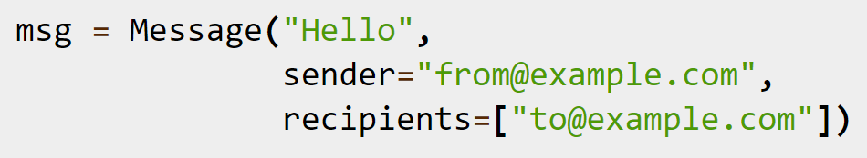

Getting Started Tutorial
Configure the application parameters.
Create a Mail object.
Create a Message object.
Use the Mail object’s send(Message) method
Notes:
Present a getting tutorial; this should cover the basic activities for someone to start using the technology and solving a basic problem using this technology (This might need more that one slides)

Slide 7
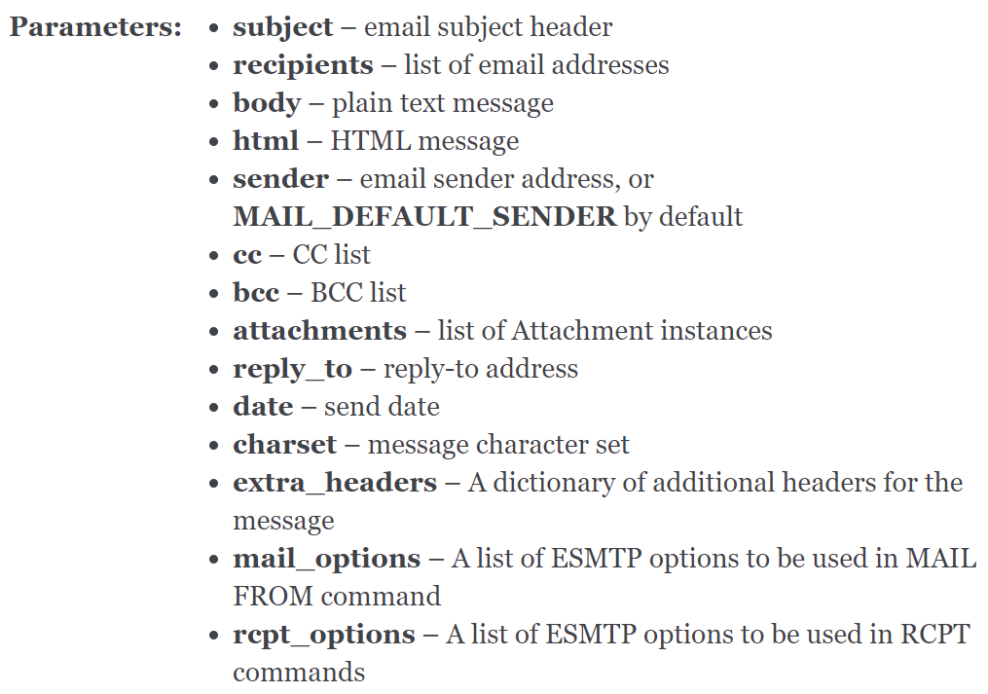
Non-Trivial Application
Message class
Notes:
Demonstrate a non-trivial use case/application of the technology that you coded/prepared. This should be a custom example you coded yourself. Possibly this can be an example demonstrating how you could use this technology in your team’s project. You might need more that one slide for this section.

Slide 8
Resources
https://github.com/mattupstate/flask-mail
https://pythonhosted.org/Flask-Mail/
https://pythonprogramming.net/flask-email-tutorial/
https://github.com/ckwong1601/CUS1166-FlaskMail.git
Notes:
Resources for further reading. Provide a list of resources to help your classmates to learn more about this technolgy.

Slide 9
Q&A
Any questions?
Notes:
Open the floor for your classmates and the instructor to ask question about your presentaiton.

Slide 10
Thank you!!!

