Slide 1
Interrupts
Extending the OS

Slide 2
Two kinds of computer systems
Batch System – Jobs are submitted to a queue. The system monitors the queue periodically for submitted jobs. Typical for Mainframe systems and servers where the maximum utilization of the computer resources such as processors memory and I/O are the most important.
Interactive System – Jobs are submitted by interrupting a running process. Typical of desktop systems where the users are of primary importance. It is also where the interactions(interaction) are considered to be least frequent.

Slide 3
Interrupts
Interrupt forms the basis for the implementation of a system
There are two ways to trigger the execution of a task
Polling or busy waiting
Interrupt

Slide 4
1. By polling - which is by watching the value of some state variable
Do While(X > 0 )
{
Do something
}

Slide 5
Interrupts
By enabling some I/O events to be associated with the task
Example
Hardware event
Timer – generates a signal periodically
Keyboard – when the user press a key
Error - when the printer encounters an error such as out of paper
Network device– when a data is received by the network device
Software event
Division by Zero
Privilege Fault – A program attempting to access memory it does not own
Page fault - A program tries to access a memory page that is not yet loaded in the memory.

Slide 6
Device Interrupts

Slide 7
Controller Basic
Is connected to the Device that it is controlling
Is connected to the CPU data, address and control buses
Is assigned an address
Contains
Data Registers
Status Register
Control Register

Slide 8
Controller

Slide 9
Interrupt Use Case
Keyboard Controller detects key is pressed
The scan code of the key is stored on the keyboard controller data register
The Controller asserts the Interrupt Line connected to the Interrupt controller
The Interrupt controller sets its data register to the value of the IRQ line number and asserts the Interrupt line connected to the CPU

Slide 10
CPU reaction
The CPU upon receiving the Interrupt signal is executing an instruction.
Upon completing the execution of the instruction,
Pushes the value of the Flag register on the stack
Pushes the value of the code segment register CS on the stack
Pushes the value of Instruction pointer register IP on the stack
Copies the first two bytes of the first entry from the Interrupt table to the IP register
Copies the next two bytes of the first entry from the Interrupt table to the CS register

Slide 11
Interrupt Routine Execution
Copying the address at entry 0 from the interrupt table causes the execution of the routine whose address is found in entry 0.
This routine is responsible for reading the value from the Interrupt controller data register which is the IRQ number of the device that caused the event.
If the value is 8 then it means the interrupt is caused by the timer
This routine executes INT 8 instruction to execute the routine whose address is found in entry number 8 of the Interrupt table which is otherwise called the Timer interrupt handler.

Slide 12
Timer Interrupt
The timer interrupt enables the system to become time aware.
The timer serves the following important purposes
In CPU Scheduling it is responsible for triggering the event that will execute a routine to assign the CPU to another process, there by enabling multi tasking - the creation of an illusion that there is more than one process running at the same time.
It is responsible for the periodic synchronization of the system clock
The timer generate an interrupt 18 times every second.

Slide 13
Well Behave Interrupt Routine Rules
Because it can interrupt any running program
It should ensure the values of the registers which represents the state of the interrupted process are preserved. This is done by pushing the register values on the stack and popping them before returning.
The values of the registers are those set by the interrupted process. The only definite value is that of the CS and IP values which is the address of the interrupt routine.

Slide 14
How applications perform I/O
All applications perform Input or Output using the ROM BIOS routine.
Each 64-bit applications include a virtual copy of the ROM BIOS in their image
An application running in 64 bit mode needs to call a system function (System API) to perform an I/O
The system function will switch to 16-bit mode to perform I/O with 16-bit controllers of the PC.

Slide 15
Processor Modes
The x86 processor has 3 modes available
16-bit real mode – When the PC is started it begins with this mode
32-bit virtual mode AX register EAX register Memory is limited to 4 GB 2^32
64 bit virtual mode AX register EAX register Memory is limited to 4 GB 2 ^ 64

Slide 16
16-bit x86 mode
In Real mode
16-bit data or two bytes can be transferred per CPU cycle
20-bit address or a maximuM of 1MB physical addressable memory
Uses 16 bit segment and 16-bit offset address
Has no protection each programs can access any memory location.

Slide 17
32-bit x86 Mode
Uses 32-bit address with a maximum of 4 GB memory
Has protection built into the hardware
Support Virtual memory mode by enabling multiple processes to run whose total memory exceeds the total size physical memory
Support mechanisms to load only into memory the part (or page) of the program code data that is being used currently
Generates faults or interrupts to prevent programs from accessing memory it does not own or has no permissions.
Support for 32 bit register and buses that transfers 4 bytes of data per CPU cycle.

Slide 18
64-bit x86 Mode
Mostly the same as the 32-bit except that it is 64-bit
Transfers 64-bits or 8 bytes of data or register allowing for larger numbers to be processd at a time
In contrast with 32-bit mode, can make use of memory beyond 4 GB.
64-bit addressable space limited only by the amount of address decoder circuit and available physical RAM.
Generally used in Virtualization or Virtual machines specially on cloud servers.

Slide 19
Writing Interrupt Routines
Routines should be limited only to 1 segment
The only segment should contain the PSP
Is consist of
Data
Interrupt routine
Interrupt Installer
The installer will run when the resulting program is executed
The Interrupt routine will be triggered by
a hardware event such as a timer event or
a software invocation from another program

Slide 20
Terminate and Stay Resident program
Interrupt Data
Interrupt Function
Interrupt Installer

Slide 21
Interrupt Data
Address of the overridden interrupt
Trigger data
Output data

Slide 22
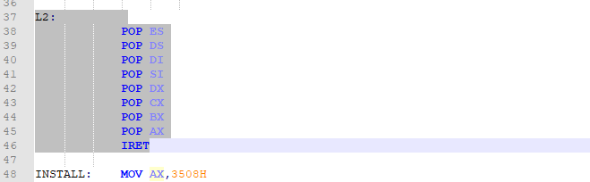
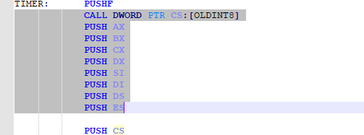
The Prologue and the Epilogue
The steps to take before doing the real task
Call the old routine
Save the state of the interrupted process
Restore the state of the interrupted process
Return to the interrupted process

Slide 23
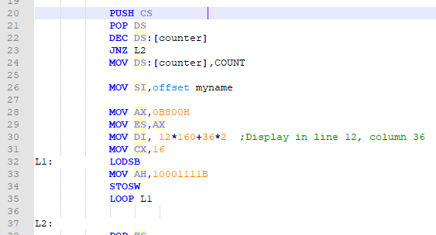
The interrupt function or routine
Decide whether to execute the routine or skip
The actual interrupt routine
Decide which subroutine to execute based on the parameters

Slide 24
The Installer
Gets the address of the interrupt to be overridden from the interrupt table and save this in routines data
Sets the address of this interrupt routine in the Interrupt table
Compute the size of the memory of the program that will remain resident once the program is terminated.
Terminates the program but leave a part of it resident.

