Slide 1
An AI system for Visual Creativity Task
Dec 12, 2016
Chuilian Kong
CS 8395 Project 2
Subtitle or catch phrase for the presentation
Notes:
Hello, Here’s my presentation for project2 An AI system for Visual Creativity Task

Slide 2
Problem statement
Design a AI system for visual creativity task:
generate different drawings using some simple shapes as the starting point.
Notes:
My AI system is designed for the visual creativity task: generate different drawings using some simple shapes as the starting point. For example, if I give a circle and a triangle to the system as input, the system should return some creative drawings that only using circles and triangles as basic elements. However, the size and number of those circles and triangles could be different in order to form a meaningful image.

Slide 3
The way a human may solve the task
Imagination based on memory
find something in my memory that looks like a starting shape
use those things to construct a meaningful image
use several starting shapes to replace them.
Notes:
I think people usually solve this kind of visual creativity task using their imagination, and we are not doing imagination by wandering without limitation, instead I think imagination is based on our experience or memory. When I were given a set of starting shapes and were told to create meaningful drawings using those starting shapes, the first thing I would do is to find something in my memory that looks like a starting shape and use those things to construct a meaningful image and use several starting shapes to replace them. In this way, I created an image that both has a meaningful sense and contains only starting shapes.

Slide 4
General idea
Imagination based on images in imagery space
Break images in imagery space into pieces according to their colors
For each of those small pieces, the system will use one or more starting shapes to fit them
pick the best fit pattern to be the representation of the piece.
Combine them all to be the representation of the image
Pick top three picture that have better fitting performance
Notes:
I believe the AI system I designed should have the same thinking pattern as I do. So the general idea of my system is to give my system an imagery space, which is a set of simple pictures that describe simple concept such as a cat, a face or an apple. This imagery space is considered like the background knowledge as we human do, and the system could do its own imagination based on the those knowledge.
Then the system will break those pictures into pieces according to their colors. For each of those small pieces, the system will use one or more starting shapes to fit them,
And then pick the best fitting pattern to be the representation of the piece. Then the system will combine those representations into one picture according to their spatial relationship in original picture. After get the representation of all of the images in imagery space, the system will output first three pictures that have better overall fitting performance.

Slide 5
System Design
Learning
load sample pictures into imagery space and break them down into different pieces according to their colors.
Fitting
analyze each piece of every image in the imagery space and use the most appropriate starting shape to fit the piece. Then generate a best fitting drawing for each image
Picking
select the image that have better overall fitting performance as the output of the system.
Notes:
Based on this idea, I designed my AI system as three parts.
My AI system can be divided into three part. The first part is called learning, in the learning process the system will load sample pictures into imagery space and break them down into different pieces according to their colors.
The second part is called fitting, in the fitting process the system will analyze each piece of every image in the imagery space and use the most appropriate starting shape to fit the piece. Then generate a best fitting drawing for each image.
The last part is called picking, in the picking process the system will select the image that have better overall fitting performance as the output of the system.

Slide 6
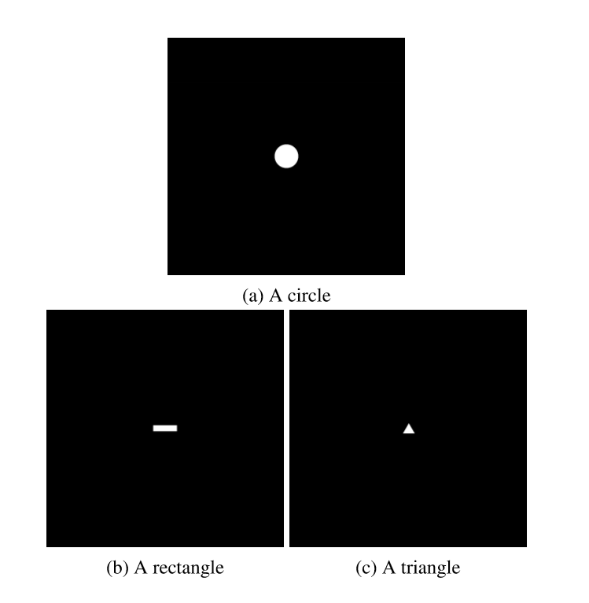
Starting Shapes
A circle
A rectangle
A triangle
Notes:
Let see an example to help you better understand how system works.
In our example, we give the system three starting shapes: a circle, a rectangle and a triangle. Since my system is not capable of recognizing triangle by now and there are no special fitting algorithm for triangle either, the triangle is supposed to be treated as a known-category shape. The specification of these three input elements are shown in the picture

Slide 7
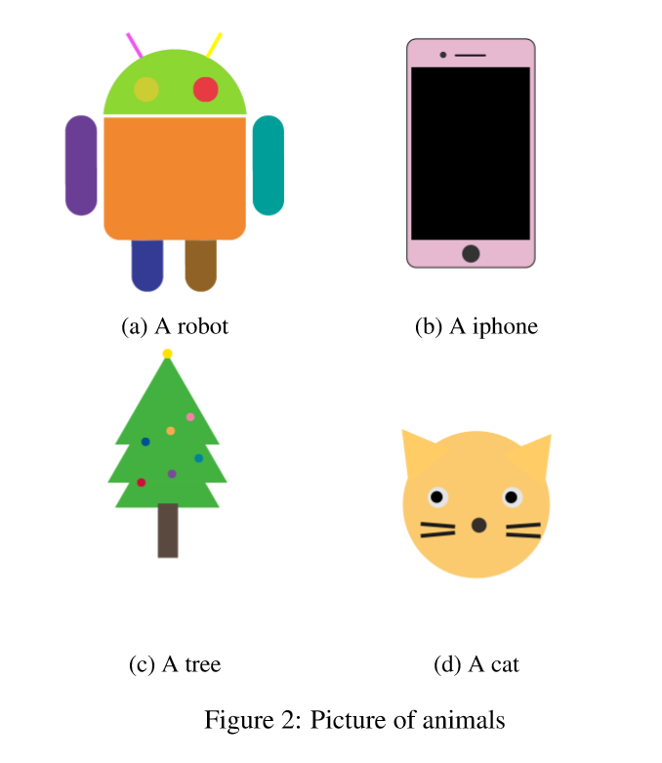
Imagery Space
A robot
A iphone
A tree
A cat
Notes:
This is the imagery space of my system.
The imagery space of my current system is relatively small, but functioning well. The imagery space contains four images as shown in the picture. In the learning process, the system will load all images into the working memory and break them into colors according to the colors and analyze the properties of each piece, then record them in the memory. Note the imagery space is considered as a part of the AI system just as the memory we have in our brain, thus these four images are not considered as the input of the system.

Slide 8
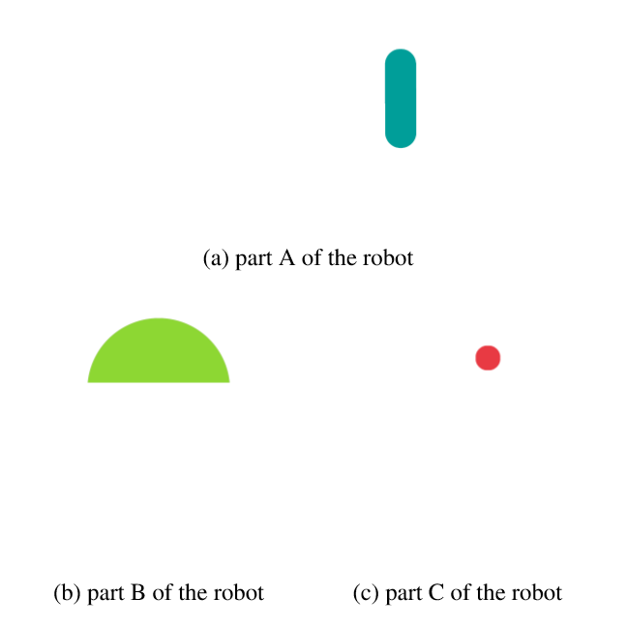
Parts of the Robot
Notes:
After learning, the system get four concept along with a list of shapes that consist of each concept. The system then try to use starting shapes to fit them. Lets take the robot as the example. The robot has been divided into 10 parts according to its color, we show 3 of them here in Figure picture. Then for each of these 10 parts, we use the circle, the rectangle and the triangle in the starting point set to fit them, respectively.

Slide 9
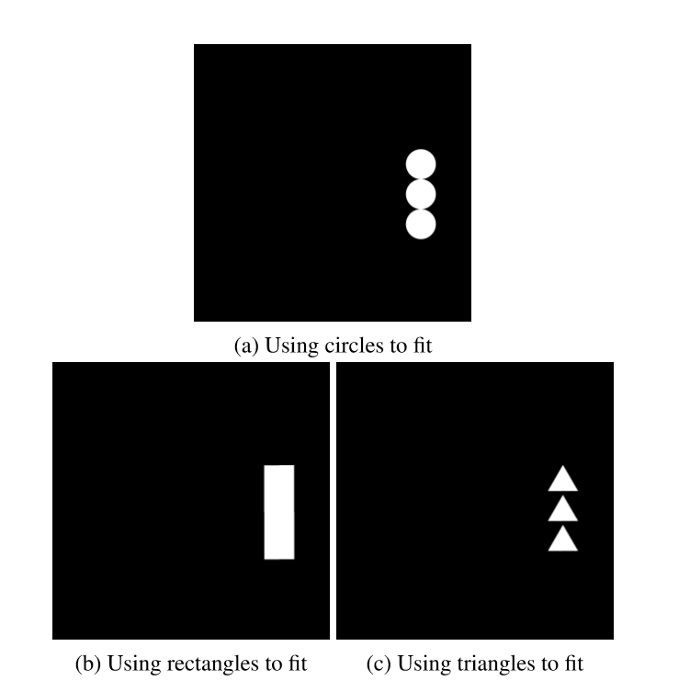
Fitting result for part A of robot
Notes:
The fitting results for the part A as an example are shown in the picture. The algorithm then picks the best fitting solution, the rectangle fitting solution in this example, to be the fitting result for part A, where we use the picking method as we discussed above. Then the algorithm will find the best fitting solution for every part of the robot. Then combine them into one shape as the best fitting solution for the image robot. After the algorithm find all best fitting solutions for every image in the imagery space, it enters into the final picking process.

Slide 10
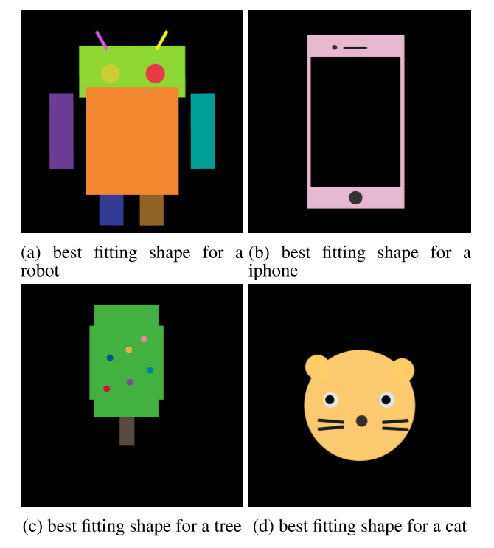
Best fitting shapes for every image
Notes:
Before entering the final picking process, the system has already find the best fitting solution for every images in the imagery space. So in the picking process, the system will simply calculate the measurement for fitting performance we discussed before, then pick top three best fitting shapes to be the output of the system. The four best fitting shapes for the example input are shown in picture .And the system finally picked the robot, the iphone and the tree as the output.

Slide 11
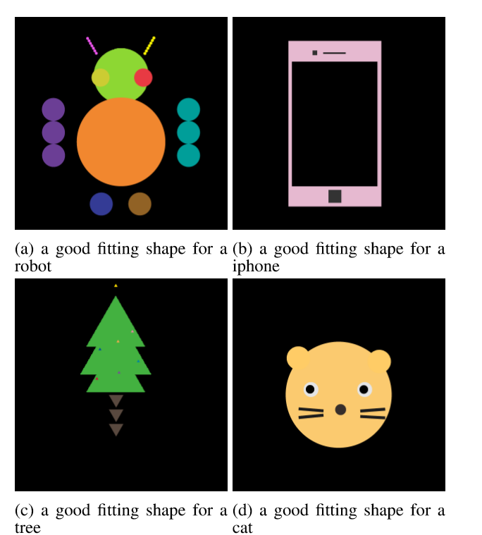
Some good results
Fit a robot only use circle
Fit an iphone only use rectangle
Fit a tree only use triangle
Fit a cate use triangle and rectangle
Notes:
Figure \ref{fig:goodre} shows the four good fitting results that can be recognized the concept of the shape by human. Figure \ref{fig:robot_cir} shows a fitting shape of using only circle to fit all the part of robot, it's not easy but we can recognize the robot from the shape. Figure \ref{fig:iphone_rec} shows a fitting shape of using only rectangles to fit an iphone, we can easily get the concept of an iphone by looking at the shape. Figure \ref{fig:tree_tri} shows a fitting shape of using only triangles to fit a tree, although there might be some imperfection on the fitting of the trunk, that won't effect our understanding of the concept of the shape. And the last Figure\ref{fig:cat_cir_rec} shows a fitting shape of using circles and rectangles to fit a cat, the shape is recognizable and cute.

Slide 12
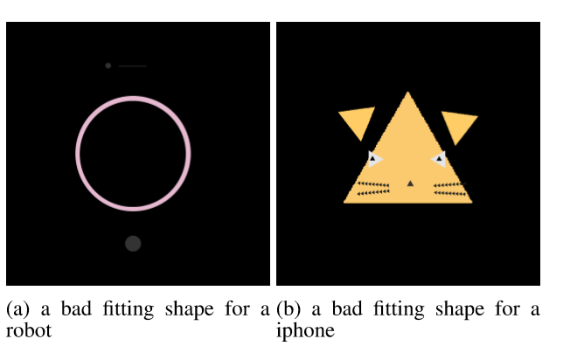
And bad ones
Fit a iphone
only use circle
Fit a cat
only use triangle
Notes:
Figure \ref{fig:badre} shows the two bad fitting results. The first bad fitting example is try to use only circles to fit a iphone, which is hard obviously since the base shape of an iphone is a rectangle and the fitting algorithm for using circle to fit a rectangle is to draw a series of same size circle to cover the rectangle. The diameter of the circles should be the smaller side of rectangle. And apparently there is no room for more circles after drawing one.
The second bad fitting example is try to use only triangles to fit a cat. It's actually better than the first example because at least we can recognize the cat, but the looking of the cat is not that good and the reason is similar to the first example.

Slide 13
Questions & Discussion

